Slide 1
ENCODE enhancers
12/13/2013
Yao Fu
Gerstein lab

Slide 2
‘Supervised’ enhancer prediction
Identifying Potential Enhancer-like Elements from Discriminative Model
Use peaks as examples to learn chromatin features of binding active regions
Human genome in 100bp bins
DNase I
...
Positive examples
...
Positive:
Overlapping with TF peaks
FAIRE
...
Negative examples
...
H3K4me3
...
...
Machine learning
Features
Prediction
...
Gencode genes
...
Filtering
Predicted genes
...
...
Strong H3K4me1
& H3K27ac signal
Get enhancer list away to genes
Yip et al., Genome Biology (2012)

Slide 3
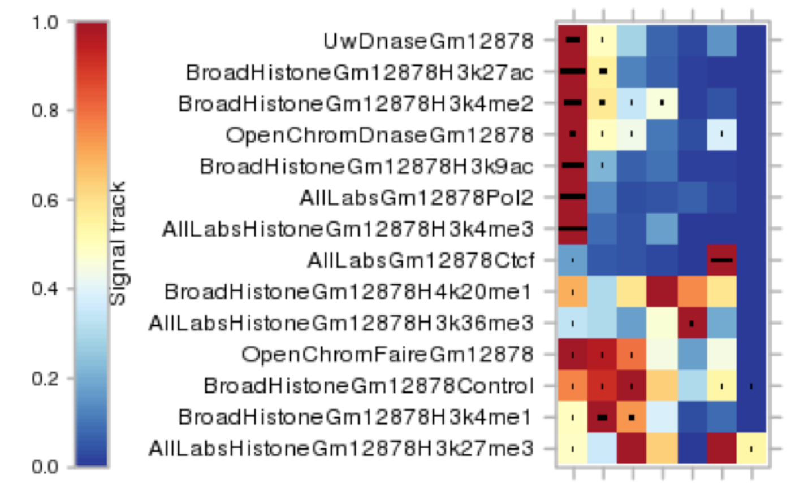
“Unsupervised” Segway/chromHMM
Enhancer “states” from unsupervised segmentations (Hoffman et al. & Ernst et al.)
PF
TSS
E
WE
T
CTCF
R
enhancer / weak enhancer
ENCODE combined segmentation from Segway and chromHMM

Slide 4
Combine with Segway/chromHMM
~130K enhancer-like elements from Yip et al.
~ 291K “enhancer state” elements from segmentation.
Intersection : ~71K
http://info.gersteinlab.org/Encode-enhancers

Slide 5
Associate enhancers with target genes
Idea: Histone modifications to predict gene expression.
Another direction is to use whole-genome DNA long-range interaction data
Form distal regulatory networks (~20k distal edges in ENCODE rollout; we extend to edges with ~17k genes)
HM signals
Expression levels
H3K4me1
H3K27ac
...
Gene 1
Gene 2
Gene 3
...
Scale
GM12878
Strong
Cell lines
H1-hESC
HeLa-S3
Hep-G2
K562
...
Weak
TF
1. Find correlated enhancer-target pairs
Enhancer
2. Find TFs binding enhancers in cell lines with strong HMs
3. Draw distal edges from TFs to targets
Gene
Yip et al., Genome Biology (2012)

Slide 6
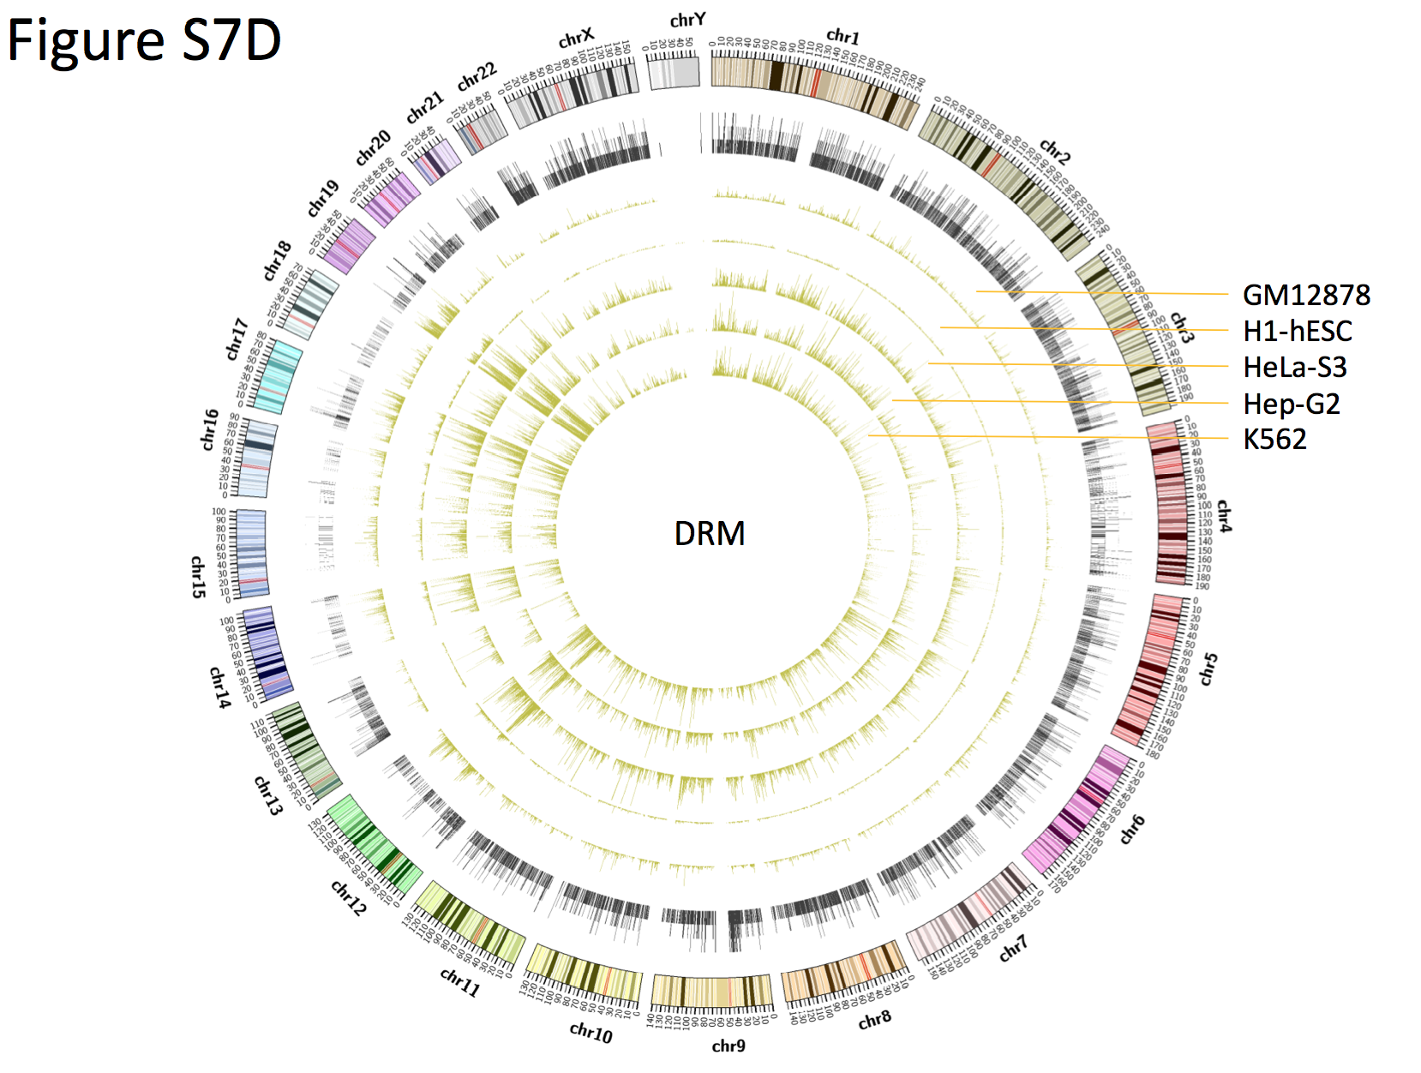
Cell-line specific enhancers
Enhancer

Slide 7
ENCODE Work Products (beyond standardized DCC pipelines)
Examples of element lists:
Enhancers
DNAse HS sites
broad vs cell-type tissue specific sites
TF targets
proximal and distal
regulatory networks
Allelic genes (ASE) and TF binding sites (ASB)
Fusion (chimeric) transcripts
Non-coding transcription (contigs or transcripts)
classification (e.g. eRNAs)
High-occupancy (HOT) regions
Regions of active chromatin
Chromatin states (e.g. segmentation)
TF motifs (PWMs & sites)

