Slide 1
Computational analysis on genomic variation: Detecting and characterizing structural variants in the human genome
Hugo Y. K. Lam
Computational Biology & Bioinformatics, Yale University
May 20, 2010
Advisor: Prof. Mark B. Gerstein
Committee Members:
Prof. Hongyu Zhao & Prof. Kei-Hoi Cheung

Slide 2
Overview
Aim
enhance the understanding of the mechanism and impact of genomic variation
develop an efficient computational approach to identify and characterize SVs
Introduction
SV, event type, formation mechanism, and more
Main Chapters
Clustering pseudogenes into families
Correlating CNV, SD and other genomic features
Nucleotide-resolution analysis of SVs
Conclusion and future directions
Notes:
An overview of this presentation:
The aim…
First, I will give a brief introduction on SV. What are the types of SVs? How do they arise? How do people identify SVs using the current technologies?
Then I will talk about the main chapters, with a focus on the details about how we used a breakpoint library of SVs to analyze their formation characteristics and to identify SVs in personal genomes
Finally I will conclude the presentation and talk about some future directions

Slide 3
Introduction
Chapter One

Slide 4
Genomic Variation
Alu
Gene
Non-allelic homologous recombination (NAHR)
Ancestral State
Alu
Gene
Alu
Gene
The Genome Remodeling Process
Segmental Duplication (SD)
Gene
Dup. Gene
Ortholog
SD/Copy Number Variation (CNV)
Structural Variation (SV)
Insertion
Insertion
Gene
Dup. Gene
VNTR
Pssd. ψgene
Paralog
duplicate
Deletion
Insertion
Gene
Dup. Gene
Dup. ψgene
VNTR
Active L1
family
Retro-elements
Deletion
Inversion
Gene
Dup. Gene
VNTR
Pssd. ψgene
Retro-transpose

Slide 5
Structural Variation
Variants (usually >= 1kb) include
Copy number variants
Deletions
Insertions/duplications
Inversions
Translocations
Important contribution to human diversity and disease susceptibility
Feuk et al. Nature Reviews Genetics 7, 85-97
Notes:
SVs are stretches of DNA that are structurally different among individuals. By convention, they are different from small ndels and are defined as 1k bases.
SVs could be copy number variants such as deletions and insertions, but could also be balanced rearrangements such as inversions and translocation.
Since they might affect the copy number of genes, they do affect the phenotypes of the individuals, including a range of diseases such as schizophrenia or down syndrome.

Slide 6
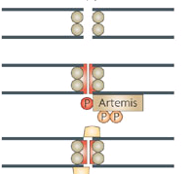
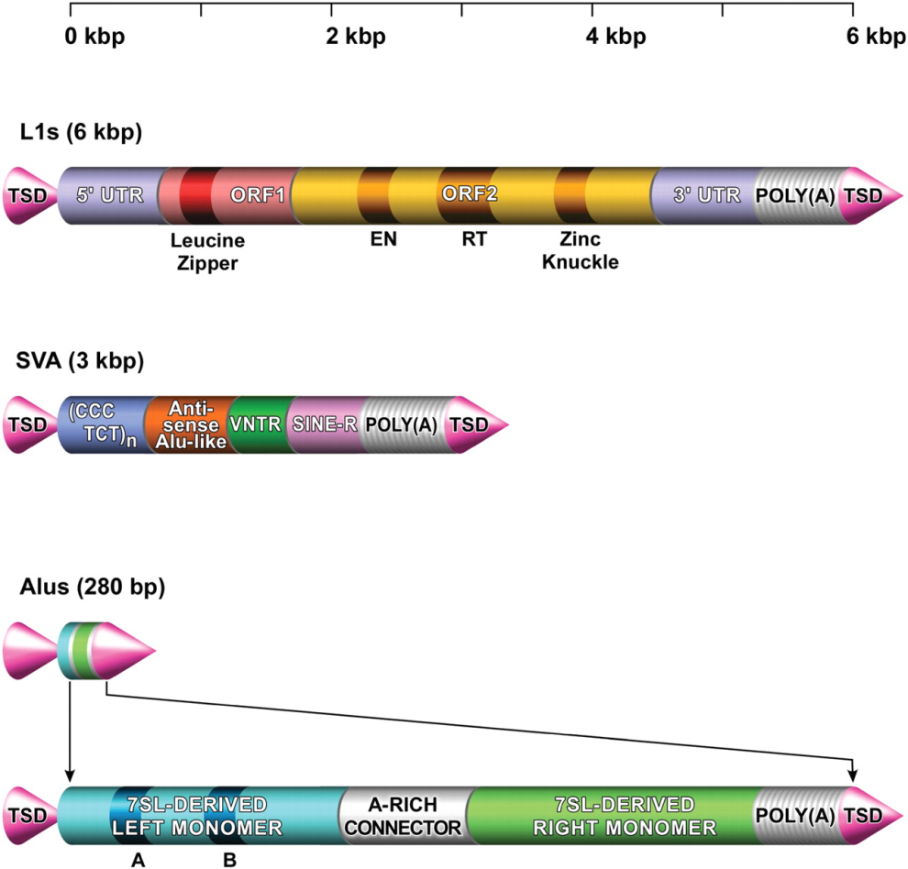
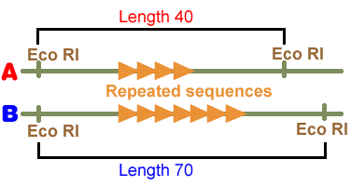
SV Formation Mechanism
NAHR (Non-allelic homologous recombination)
Flanking repeat (e.g. Alu, LINE…)
NHEJ (Non-homologous-end-joining)
No (flanking) repeats. In some cases <4bp microhomologies
TEI
(Transposable element insertion)
L1, SVA, Alus
VNTR
(Variable Number Tandem Repeats)
Number of repeats varies between different people
Notes:
So how did they arise? There are couple proposed mechanisms.
NAHR is one of the major mechanisms which involves non-allelic homologous recombination between highly identical sequences.

Slide 7
Read-depth & CGH Approaches
Image: Snyder et al. Genes Dev. 2010 Mar 1;24(5):423-31.
Ref: Yoon et al. Genome Res. 2009 September; 19(9): 1586–1592.
Image: http://www.implen.de/
Ref: Urban et al. Proc Natl Acad Sci USA 103, 4534{9 (2006).

Slide 8
Paired-End Sequencing & Mapping
Breakpoint
Breakpoint
Breakpoint
Breakpoint
Breakpoint
Reference
Deletion
Inversion
Target
Insertion
Inversion
Paired-End Sequencing and Mapping
Reference
Span << expected
Span >> expected
Altered end orientation
Korbel et al. Science 19 October 2007: Vol. 318. no. 5849, pp. 420 - 426
Notes:
PEM is similar to fosmid PES but it uses a linker to build the vector instead of using a fosmid.

Slide 9
Split-read Analysis
Breakpoint
Breakpoint
Reference
Deletion
Read
Target Genome
Breakpoint
Reference
Read
Target Genome
Insertion
Zhang et al. Submitted
More: Breakpoint Assembly
Alt: BreakSeq
Notes:
This schematic shows you the idea of a split-read analysis. Its simple but powerful enough to identify nucleotide-resolution SVs. Before we talk about how it works, we should know that by convention, when say it’s a deletion, it’s a deletion relative to the reference genome. In other words, the affected sequence actually exists in the reference genome, but is deleted in the query genome. Similar idea for insertion. So a split-read analysis is straight-forward.

Slide 10
Clustering Pseudogenes into families
Chapter Two
Lam HY, Khurana E, Fang G, Cayting P, Carriero N, Cheung KH, Gerstein MB. Pseudofam: the pseudogene families database. Nucleic Acids Res. 2009 37(Database issue):D738-D743.

Slide 11
Motivation
No study had analyzed eukaryotic pseudogenes in a family approach
No resource was annotating pseudogene families
Clustering pseudogenes in families may lead to a better understanding of the evolutionary constraints on pseudogenes, and reveal the formational bias of pseudogenes

Slide 12
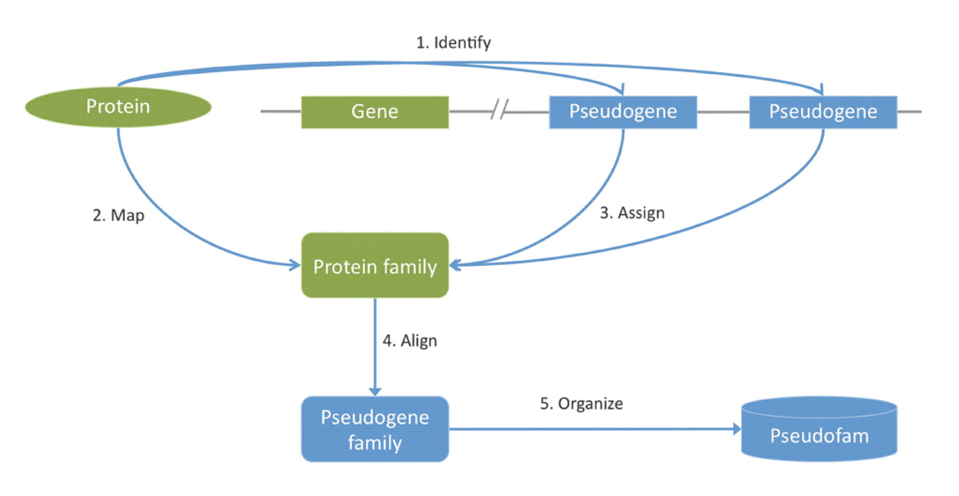
Methodology

Slide 13
Results
Developed a large-scale database of eukaryotic pseudogene families
PSEUDOFAM
Protein family size has an obviously stronger correlation among species than pseudogene family size
Correlation of pseudogene family size decreases when the evolutionary distance increases between the species
Housekeeping families, such as GAPDH and ribosomal, tend to be enriched with a large number of pseudogenes

Slide 14
Correlating CNV, SD and other genomic features
Chapter Three
Kim PM*, Lam HY*, Urban AE, Korbel JO, Affourtit J, Grubert F, Chen X, Weissman S, Snyder M, Gerstein MB. Analysis of copy number variants and segmental duplications in the human genome: Evidence for a change in the process of formation in recent evolutionary history. Genome Res. 2008 Dec;18(12):1865-74.

Slide 15
Motivation
NAHR during meiosis was thought to lead to the formation of larger deletions and duplications
However, not much was known about how other mechanisms are involved, and not many sequences of breakpoints are available
Calculate enrichment of specific genomic features around the breakpoints may reveal different formation signatures for SDs and CNVs

Slide 16
Methodology
1
Survey a range of genomic features
2
Count the number of features in each genomic bin (100kb)
Calculate correlations using robust stats
3
If exact CNV breakpoints are known, we can calculate the enrichment of repeat elements relative to the genome or relative to the local environment
…ATCAAGG CCGGAA…
Exact match
Repeat
Local environment

Slide 17
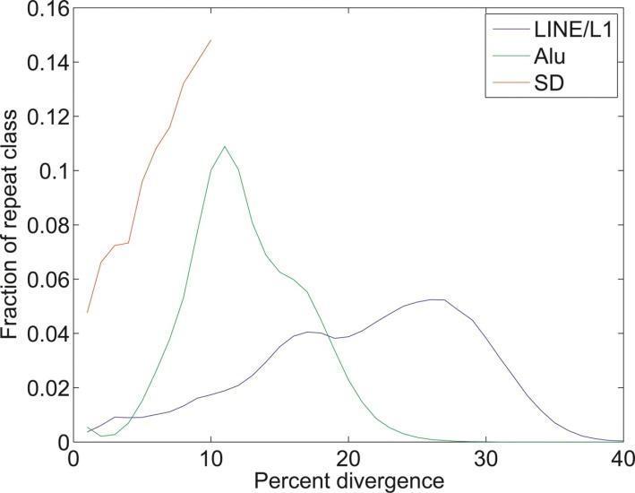
Results
NAHR
Alu
SD
AFTER THE ALU BURST, THE IMPORTANCE OF ALU ELEMENTS FOR GENOME REARRANGEMENT DECLINED RAPIDLY
LINE
Microsatellite
NHEJ
Subtelomeres
Fragile sites
About 40 million years ago there was a burst in retrotransposon activity
The majority of Alu elements stem from that time
This, in turn, led to rapid genome rearrangement via NAHR
The resulting SDs, could create more SDs, but with Alu activity decaying, their creation slowed
CNVs/Young
High seq-ID (%)
SDs
Old
Low seq-ID (%)
Fixation/Aging
Alu Burst (40 MYA)

Slide 18
Nucleotide-resolution Analysis of SV
Chapter Four
Lam HY*, Mu XJ*, Stütz AM, Tanzer A, Cayting PD, Snyder M, Kim PM, Korbel JO*, Gerstein MB. “Nucleotide-resolution analysis of structural variants using BreakSeq and a breakpoint library”. Nature Biotechnology 2010 Jan;28(1):47-55.
Notes:
I am going to talk about how we used a breakpoint library of structural variants to carry out a nucleotide-resolution analysis to study their formation characteristics and to develop an efficient computational method to identify these SVs in personal genomes that are sequenced with short-reads.

Slide 19
Aims
Leverage the nucleotide-level information of the available SV Breakpoints
Enable rapid detection of SVs
short-read sequences
personal genomes
Analyze the breakpoint junctions
Deduce the formation mechanism
Infer ancestral states of events
Examine physical features for formation biases
Notes:
Therefore, we decided to carry out a detailed analysis of SVs by compiling a comprehensive library of breakpoint-level SVs from different studies. Our approach aimed to enable rapid identification of SVs in personal genomes that are usually sequenced with short-reads such as the solexa sequencing. We also aimed to analyze the breakpoint junctions to deduce their formation mechanisms, to infer their ancestral states, and to examine physical features for any formation biases.

Slide 20
Methodology
Breakpoints collection and standardization
SV Detection
SV Characterization
Formation Mechanism
Junction Library Creation
Ancestral State
Physical Feature
Short-read alignment
Notes:
To compile the library, we went through a set of literatures and identified 8 studies that can provide SVs at breakpoint resolution.
Then, we extracted the junctions of each SV to build an SV junction library for subsequent analyses.
By using the junction library, we developed a computational approach to efficiently identify SVs based on short-read alignment and also to systematic characterize them.

Slide 21
SVs with sequenced breakpoints
1KG Project
>20,000
Published BreakSeq Library
Notes:
This figure gives you a sense of how many SVs have been identified with breakpoint information in the past 5 years. By 2009, there were about 2000 such SVs, which were included in our breakpoint library. By 2010, we anticipate that there should be at least 10 fold of such SVs, given the effort of those collaborative efforts, such as the 1kg project.

Slide 22
SV Breakpoint Library
Library of SV breakpoint junctions
Notes:
Our breakpoint library is basically composed of breakpoint-level SVs from 8 different studies, which involve more than 10 individuals from different origins. These studies for example include the Watson genome (454) and the Venter genome (sanger, wgss).

Slide 23
SV Detection and Genotyping
“BreakSeq” leverages the junction library to detect previously known SVs at nucleotide-level from short-read sequenced genome, which can hardly be achieved by methods such as split-read
Library of SV breakpoint junctions
Map reads
onto
Junctions can be put on a chip
Alternative Junctions of an Insertion
Alternative Junction of a Deletion
Notes:
Since the junctions actually represent the exact locations of the formation events, we reasoned that our library can be used to identify SVs by mapping reads directly onto the junctions.
For example, if there was an SV identified as a deletion relative to the reference genome, and the SV also exists in our query genome, we should be able to map the query reads to the alternative junction (junction C). Similarly, if there is an insertion in the query genome, we should be able to map the query reads to the alternative junctions which are junction A and junction B, because it should not have the reference sequence which is junction C.

Slide 24
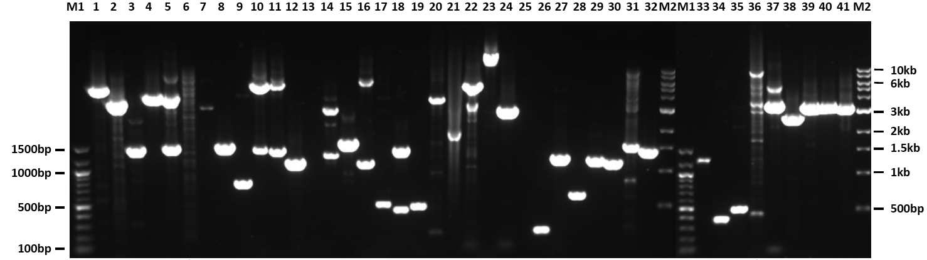
Validation for Detected SVs
Personal genome (ID) | Ancestry | High support hits (>4 supporting hits) | Total hits (incl. low support)
NA18507* | Yoruba | 105 | 179
YH* | East Asian | 81 | 158
NA12891 [1000 Genomes Project, CEU trio] | European | 113 | 219
48 positive outcomes out of 49 PCRs that were scored in NA12891:
98% PCR validation rate (for low and high-support events)
12 amplicons sequenced in NA12891: all breakpoints confirmed
Notes:
To validate our predicted results, we designed primers flanking the predicted SVs and amplified the SV region using PCR.
Overall, ~85% of our prediction was validated as successful and 98% of the validation was positive.
We also looked at couple SVs in nine individuals and we did observe that some of which are present polymorphically.

Slide 25
SV Ancestral State Analysis
Inferring Insertion according to Ancestral State
Inferring Deletion according to Ancestral State
Region in Reference Genome inferring Deletion State
Region in Reference Genome inferring Insertion State
1000 bp
SV Junction Library
1000 bp
1000 bp
Junction A
Junction C
Junction B
Junction A
Junction C
Junction B
Syntenic Primate Region inferring Insertion State
Syntenic Primate Region inferring Deletion State
Ref: Genome Remodeling Process

Slide 26
SV Ancestral State Analysis
Insertion
Deletion

Slide 27
SV Mechanism Classification
Breakpoint
Breakpoint
Non-Allelic Homologous Recombination (NAHR)
SV
Highly similar with minor offset
SV
Single Transposable Element Insertion (STEI)
Repeat Element
Multiple Transposable Element Insertion (MTEI)
RE1
RE2
Breakpoint
Breakpoint

Slide 28
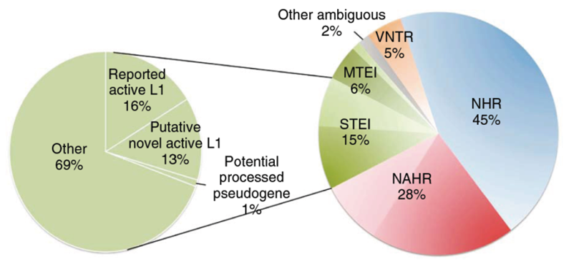
SV Mechanism Classification
Notes:
To understand the formation mechanisms of SVs, we have developed a systematic way to classify SVs into NHR, NAHR, VNTR, and TEI.

Slide 29
SV Insertion Traces
NHR- and
RT-based insertions are mostly inter-chromosomal
NAHR-based insertions involve nearby
sequences

Slide 30
Example of a Rectified SV
Rectified SV
(Deletion -> Insertion)
Mech: STEI
Ancestral Genomes
Putative Active L1
L1 Repeat Element
147 L1s, are still implicated in recent retrotransposition activity (Mill et al., 2007)
Our results suggest the possible recent activity in the human population of at least 84 complete L1 elements
38 of these putative active mobile elements not overlap with the 147
Notes:
This figure is an example of a rectified SV. It shows a deletion event that was rectified as an insertion relative to the ancestral genomes. This kind of rectification, together with our STEI classification, also provides a clue for identifying potential active transposable element.

Slide 31
Breakpoint Features Analysis
SVs vs. Telomeres
Breakpoints
Notes:
At last, we examined the physical properties of the SV breakpoint junctions to see if features such as DNA flexibility, helix stability, or GC content would provide further insight into the SV formation bias.
We observed that, on average, NHR has a lower stability and higher flexibility, which makes them more fragile and prone to have DSBs. On the contrary, NAHR has a lower fragility; however, a higher-GC content and recombination hotspot association (not shown on this figure), which implies DSB is not the main driver of their creation and a different mechanism depending on homologous sequences is required.

Slide 32
An Automated Pipeline
The BreakSeq Pipeline
SV Dataset
Sequence Reads
Data Conversion
The Annotation Pipeline
The Identification Pipeline
Junction Library
Annotating SVs with different features
Rapid SV identification for short-read genomes
SV Calls
Annotated and Standardized SVs
Standardized SVs

Slide 33
Computational Performance
Module | SVs | Processing Time | CPU*
Annotation | 1,889 | 4.1hrs | 1
Standardization |  | <1 min
Mechanism |  | 1.7 hrs
Ancestral State |  | 2.4 hrs
Feature Analysis |  | ~2 mins
Annotation | 20K | 1.7 days | 1
Annotation | 20K | <1 day | 2
Annotation | 3M | ~3 days | 80 (20 nodes)
SV Detection | 1,889 | 8 hrs (40x) | 1
SV Detection | 1,889 | ~1 week (1000 × 40x) | 192 (48 nodes)
* 3GHz CPU, 16GB ram (1 node = 4CPUs)

Slide 34
Conclusion and Future Directions
Chapter Five

Slide 35
Conclusion
Performed analysis on a large-scale study of nucleotide-resolution SVs to pinpoint the effects of SV and to characterize them
Developed a novel approach to rapidly scan for and characterize SVs in a newly sequenced personal genome
revealed the formational biases underlying SV formation
NAHR is driven by recombination between repeat sequences
NHR is likely driven by DNA repair and replication errors
TEI mostly involves transposons or alike
by applying on a large scale, we envisage that it could be used for genotyping and determining SV allele frequencies

Slide 36
Future Directions
Look into transposons that contribute a substantial part of the SVs in the human genome
~45% of the human genome are occupied by transposons or alike
~ 0.05% are still active
About 35-50 subfamilies of Alu, L1, and SVA elements remain actively mobile
produce genetic diversity
cause diseases by gene disruption

Slide 37
Future Directions
No systematic and efficient way to identify active mobile elements and their variation among individuals
Aim to identify active mobile elements in a genome-wide fashion
For example, a microarray with probes that represent both ends of known L1 elements can be used to capture candidates for paired-end sequencing and subsequent alignment analyses to deduce which are still active.

Slide 38
Acknowledgement
Yale University
Mark Gerstein
Hongyu Zhao
Kei-Hoi Cheung
Joel Rozowsky
Nitin Bhardwaj
Tara Gianoulis
Jasmine Mu (Breakseq)
Zhengdong (Split-read)
Jiang Du (Split-read)
Ekta Khurana (Pseudogene)
Suganthi (Pseudogene)
Zhi Lu (Worm TF)
Chong Shou (Network rewiring)
Alex Urban (Transposons)
Annote-assemates (Alex, Roger, Gang, Becky, Lucas…)
Gerstein Lab
Yale University
Nicholas Carriero (ITS)
Robert Bjornson (ITS)
Mihali Felipe (Sys admin)
Anne Nicotra (Admin)
University of Toronto
Philip Kim (Breakseq, SDCNV)
EMBL
Jan Korbel (Breakseq)
Adrian Stuetz (Breakseq)
University of Vienna
Andrea Tanzer (Breakseq)
Stanford University
Philip Cayting (Breakseq, Pseudogene)
Maeve O'Huallachain (Transposons)
Michael Snyder

Slide 39
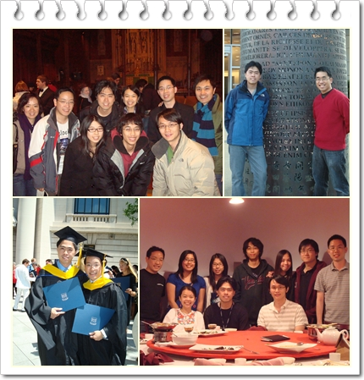
Acknowledgement

Slide 40
Breakpoint Assembly
Quinlan et al. Genome Res. 2010 May;20(5):623-35.
Goto: Split-read

