Slide 1
Thoughts related to integration of genomic information with clinical phenotypes & issues related to data privacy
Mark Gerstein, Yale

Slide 2
Thoughts related to integration of genomic information with clinical phenotypes & issues related to data privacy
Charge: For NHGRI Computational Genomics & Data Science Workshop
Challenges in enabling new clinical insights
Helping NHGRI with planning for extramural computational and data science portfolio
Overall recommendation
For future genomics, we need to be able to do data sharing to enable large-scale data mining but still maintain individual privacy
We need to develop enabling technologies to allow this

Slide 3
Background: The Conundrum of Genomic Privacy
The Genome is very fundamental data, potentially very revealing about one’s identity & characteristics
Identification Risk: Find that someone participated in a study [Craig, Erlich]
Characterization Risk: Finding that you have a particular trait from studying your identified genome [eg Watson ApoE status]
Genetics has a problematic ethical history & might need to be particularly careful to keep public trust
A single bad event (eg HELA like) could cause great damage to genomics research
Sharing helps research
Large-scale mining of this information is essential for medical research
For statistical association, 1M is better than 1K
Privacy is cumbersome, particularly for big data
Sharing is important for reproducible research
Data sharing & doing research on identifiable individuals is useful for education
More interesting to study the genome of someone you know
[Yale Law Roundtable (‘10). Comp. in Sci. & Eng. 12:8; D Greenbaum & M Gerstein (‘09). Am. J. Bioethics; D Greenbaum & M Gerstein (‘10). SF Chronicle, May 2, Page E-4; Greenbaum et al. PLOS CB (‘11)]
[Klitzman & Sweeney ('11), J Genet Couns 20:98l; Greenbaum & Gerstein ('09), New Sci. (Sep 23) ]

Slide 4
Genomics has similar "Big Data" Privacy Issues in the Rest of Society… or does it ?
Sharing & "peer-production" central to success of many new ventures, with the similar risks as in genomics
EG web search: Large-scale mining essential, but we confront privacy risks every day we access the internet
Or is the genome exceptional?
We can’t change it
The individual (harmed?) v the collective (benefits)
(Do sick patients care about their privacy?)
Different cultures of genomics (open-data) & clinical medicine (private data)
Genome is inherited so privacy risk is multi-generational
What you can mine from a genome now is not clear, but what about in 20 years
[Seringhaus & Gerstein ('09), Hart. Courant (Jun 5); Greenbaum & Gerstein ('11), NY Times (6 Oct)]

Slide 5
Current Social & Technical Solutions
Notion of Consent
“Protected” distribution of data (dbGAP)
Local computes on secure computer
Practical Issues
Non-uniformity of consents & paperwork
Different international norms, leading to confusion
Encryption & computer security creates burdensome requirements on data sharing & large scale analysis
Many schemes get “hacked”
[Greenbuam et al ('04), Nat. Biotech; Greenbaum & Gerstein ('13), The Scientist]

Slide 6
How to Surmount the Dilemma
One approach is just using open data
Maybe we need a few "test pilots” (ala PGP)?
Sports stars & celebrities?
Some public data & data donation is helpful but is this a realistic solution for an unbiased sample of ~1M
Hybrid Social & Tech Solution (a strawman)
Fundamentally, researchers have to keep genetic secrets
Legal framework for this (not charge of this group)
Genetic licensure & training for individuals (similar to medical license, drivers license)
Barriers shouldn't create a incentive for “hacking”
Enabling Technologies
We should develop technologies for Quantifying Leakage & allowing a small amounts of it
We should develop technologies for the careful separation & coupling of private & public data
[D Greenbaum, M Gerstein (‘11). Am J Bioeth 11:39. Greenbaum & Gerstein, The Scientist ('13)]

Slide 7
More on Enabling Technologies
Making secure cloud computing easier
Standard & open workflow systems cloud computing & enclaves (eg solution of Genomics England)
Homomorphic encryption, Differential privacy
We should develop technologies for quantifying privacy
What is acceptable risk? What is acceptable data leakage? Can we quantify leakage?
Ex: photos of eye color
Cost Benefit Analysis: how helpful is identifiable data in genomic research v. potential harm from a breach?
Separating but Linking Public & Private Data
Lightweight, freely accessible secondary datasets coupled to underlying variants (eg gene expression quantifications)
Selection of stub & "test pilot" datasets for benchmarking
Developing standards for developing code on public stubs on your laptop; then move programs to the cloud for private production runs

Slide 8
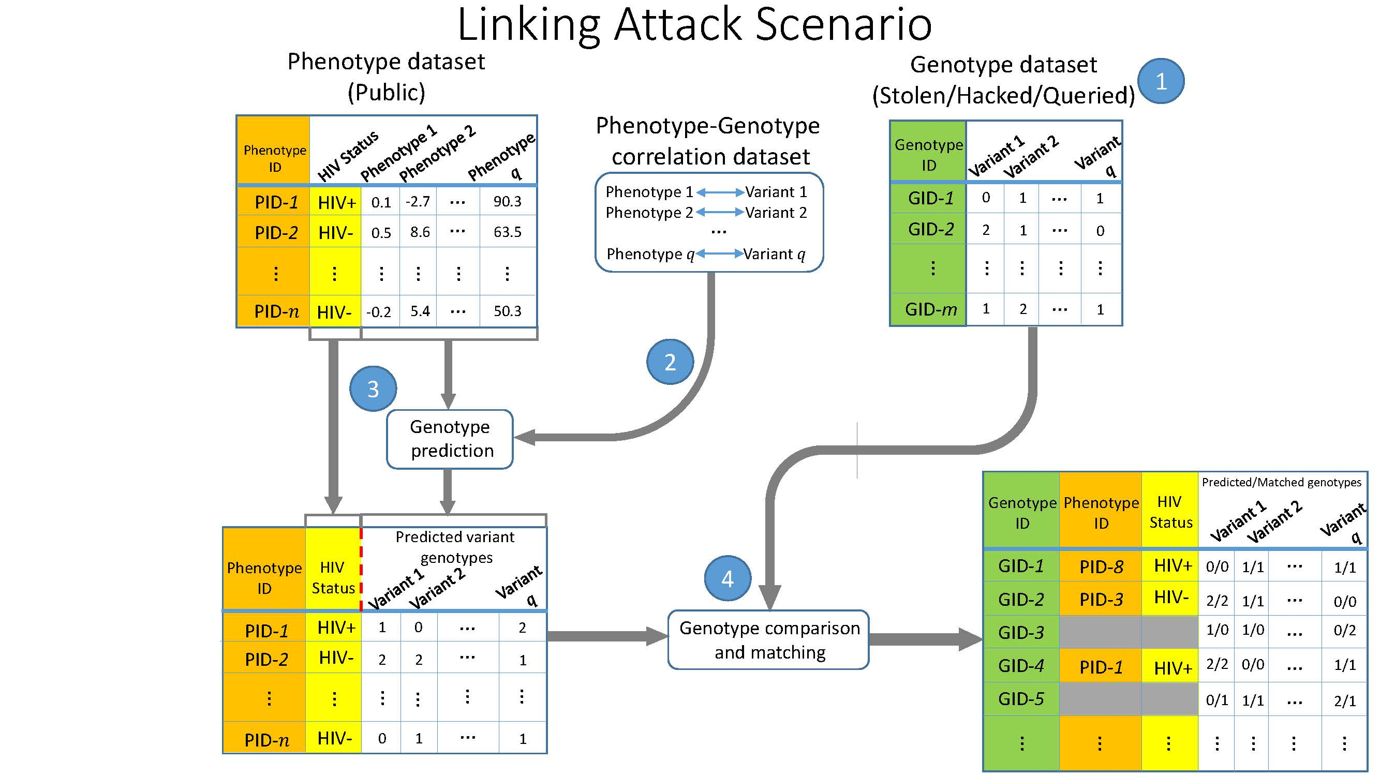
Example: Quantifying Information Leakage in RNA-seq Data & Providing guidelines on anonymizing public DBs
Quantifying the information from a rare SNP (eg log[1/freq]) and information-theoretic predictability of an eQTL
Showing how a small but defined amount of leakage allows the genomic equivalent of the NETFLIX linking attack
A small but defined number of strong eQTLs have enough information to statistically link a few SNPs (eg from a wine glass) to a record in an anonymized public gene expression database and then onto a private phenotype (eg HIV+)
[Harmanci & Gerstein, Nat. Meth. (‘16)]

Slide 9
Further Thoughts on presenting genomic data to clinicians & more mainstream audience
We need to simplify genomic data
We need to make NHGRI products easier to use for a larger public
Particularly for noncoding regions of the genome
Need to more clearly integrate human data with relevant data from model organisms

