Slide 1
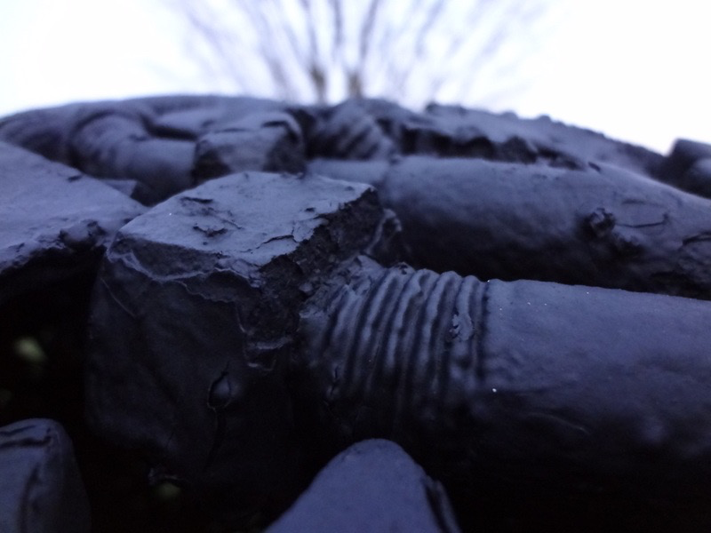
Large-scale Transcriptome Mining:
Building Integrative Regulatory Models, while Protecting Individual Privacy
1 (c) Mark Gerstein, 2002, Yale, bioinfo.mbb.yale.edu
Slides freely
downloadable from Lectures.GersteinLab.org
& “tweetable”
(via @markgerstein).
See last slide for more info.
Mark Gerstein
Yale
Notes:
1

Slide 2
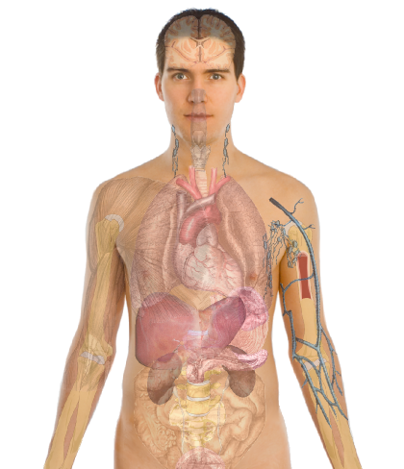
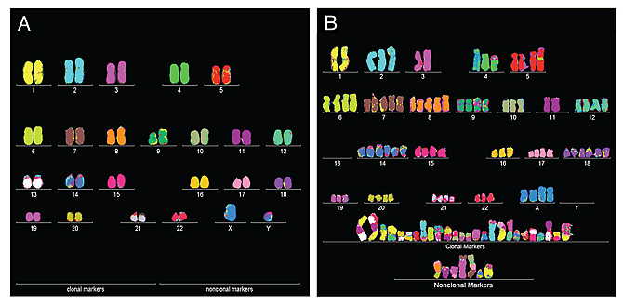
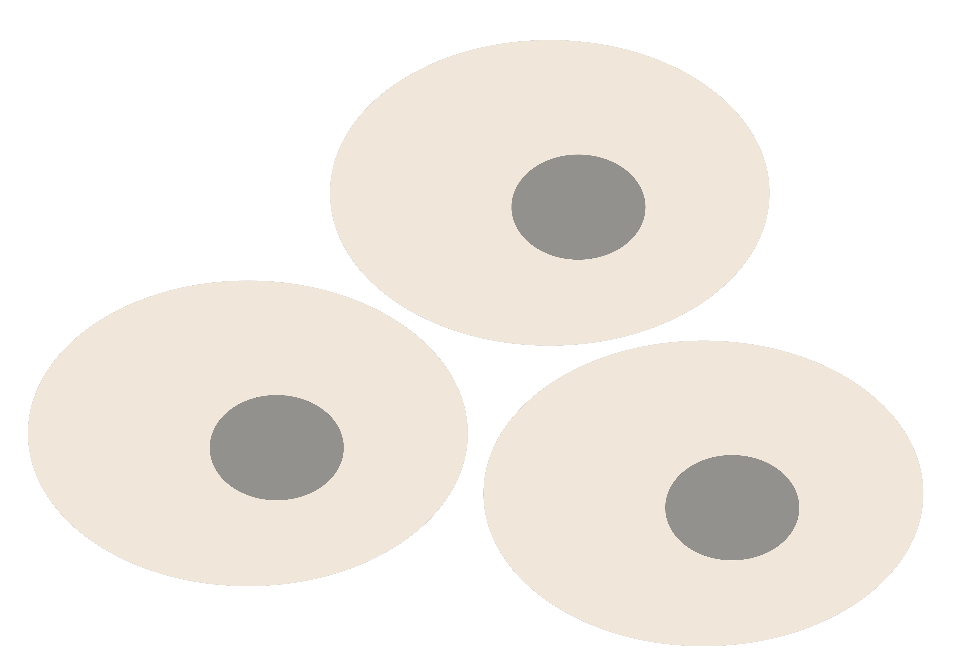
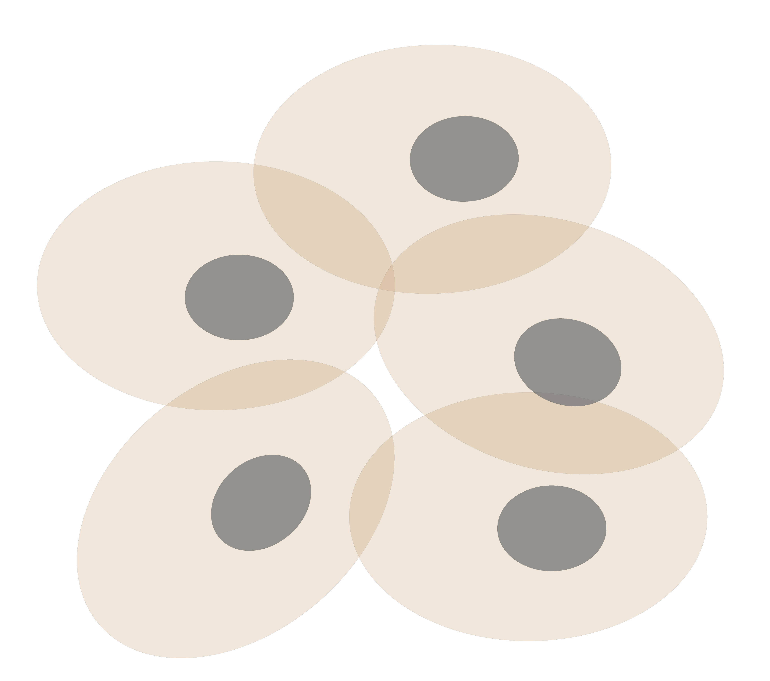
Personal Genomics & Transcriptomics
as a Gateway into Biology
Personal genomes (& Transcriptomes) soon will become a commonplace part of medical research & eventually treatment (esp. for cancer).
They will provide a primary connection for biological science to the general public.
normal
tumor

Slide 3

Placing the individual into the context of the population
&
using the population to build a interpretative model

Slide 4
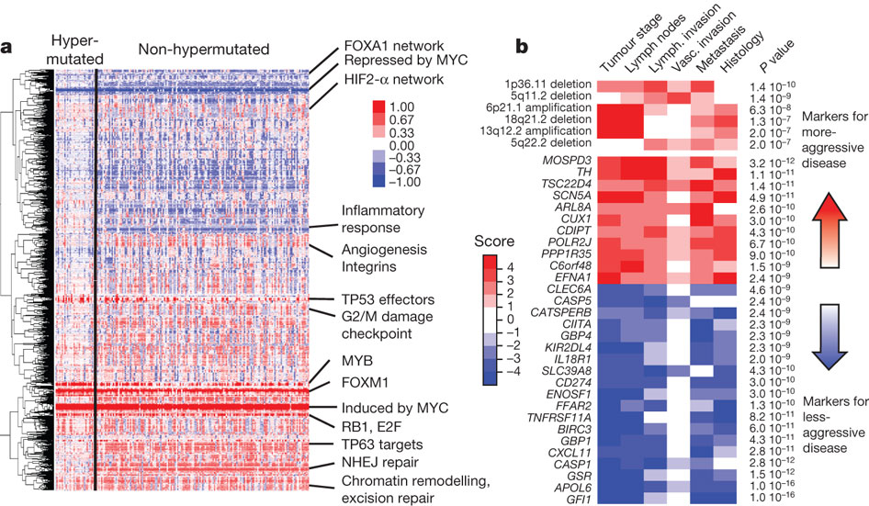
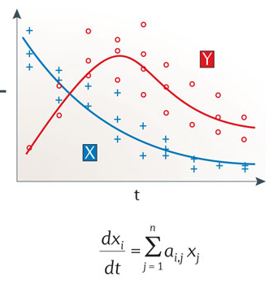
Modeling for RNA-seq data across many samples & individuals… while still protecting individual privacy
Logical model
Continuous model
Probabilistic model
Population
Gene
Over expressed
Under expressed
Gene Regulatory Mechanisms
The Cancer Genome Atlas Network Nature 487, 330-337 (2012) doi:10.1038/nature11252
Istrail & Davidson, PNAS, ‘04
Nicolas Le Novère, Nature Reviews Genetics, ‘15

Slide 5
Large-scale Transcriptome Mining:
Building Interpretative, Regulatory Models, while Protecting Individual Privacy
The Dilemma of Genomic Privacy
  Fundamental, inherited info that’s very private v need for large-scale mining for med. research
  Issues w/ current social & tech approaches: inconsistencies, burdensome security, various "hacks”
  Strawman Hybrid Soc-Tech Proposal (Cloud Enclaves. Quantifying Leaks & Closely Coupled priv.-public datasets)
RNA-seq: How to Publicly Share Some of it
  Removing SNVs in reads w/ MRF
  Quantifying & removing variant info from expression levels + eQTLs using ICI & predictability
  Instantiating a practical linking attack using extreme expression levels
Modeling of RNA-seq in terms of Logical Gates
  Preponderance of OR gates in cancer v. cell-cycle (esp. for myc)
Using State Space Models to Decompose RNA-seq Dynamics
  Using dimensionality reduction to determine drivers and internal & external canonical dynamic patterns (iPDPs & ePDPs)
  In cell cycle, only conserved genes have iPDP w/ matching periodicity
  For worm-fly example, conserved genes have similar canonical patterns in both organisms v. species specific ones
  (eg ribosomal v signaling genes)

Slide 6
Large-scale Transcriptome Mining:
Building Interpretative, Regulatory Models, while Protecting Individual Privacy
The Dilemma of Genomic Privacy
  Fundamental, inherited info that’s very private v need for large-scale mining for med. research
  Issues w/ current social & tech approaches: inconsistencies, burdensome security, various "hacks”
  Strawman Hybrid Soc-Tech Proposal (Cloud Enclaves. Quantifying Leaks & Closely Coupled priv.-public datasets)
RNA-seq: How to Publicly Share Some of it
  Removing SNVs in reads w/ MRF
  Quantifying & removing variant info from expression levels + eQTLs using ICI & predictability
  Instantiating a practical linking attack using extreme expression levels
Modeling of RNA-seq in terms of Logical Gates
  Preponderance of OR gates in cancer v. cell-cycle (esp. for myc)
Using State Space Models to Decompose RNA-seq Dynamics
  Using dimensionality reduction to determine drivers and internal & external canonical dynamic patterns (iPDPs & ePDPs)
  In cell cycle, only conserved genes have iPDP w/ matching periodicity
  For worm-fly example, conserved genes have similar canonical patterns in both organisms v. species specific ones
  (eg ribosomal v signaling genes)

Slide 7


The Conundrum of Genomic Privacy: Is it a Problem?
Yes
Genetic Exceptionalism :
genome is potentially very revealing about one’s identity & characteristics
Most discussion of Identification Risk but what about Characterization Risk?
  Finding you were in study X vs identifying that you have trait Y from studying your identified genome
No
Shifting societal foci
No one really cares
about your genes
You might not care
[Klitzman & Sweeney ('11), J Genet Couns 20:98l; Greenbaum & Gerstein ('09), New Sci. (Sep 23) ]

Slide 8












Genomics has similar "Big Data" Dilemma in the Rest of Society
Sharing & "peer-production" is central to success of many new ventures, with the same risks as in genomics
We confront privacy risks every day we access the internet
(...or is the genome more exceptional & fundamental?)
[Seringhaus & Gerstein ('09), Hart. Courant (Jun 5); Greenbaum & Gerstein ('11), NY Times (6 Oct)]

Slide 9

Tricky Privacy Considerations in Personal Genomics
Personal Genomic info. essentially meaningless currently but will it be in 20 yrs? 50 yrs?
  Genomic sequence very revealing about one’s children. Is true consent possible?
  Once put on the web it can’t be taken back
Culture Clash: Genomics historically has been a proponent of “open data” but not clear personal genomics fits this
Ethically challenged history of genetics
Ownership of the data & what consent means (Hela)
  Could your genetic data give rise to a product line?
[D Greenbaum & M Gerstein (’08). Am J. Bioethics; D Greenbaum & M Gerstein, Hartford Courant, 10 Jul. '08 ; SF Chronicle, 2 Nov. '08;
Greenbaum et al. PLOS CB (‘11) ; Greenbaum & Gerstein ('13), The Scientist; Photo from NY Times]

Slide 10

The Other Side of the Coin:
Why we should share
Sharing helps speed research
  Large-scale mining of this information is important for medical research
  Privacy is cumbersome, particularly for big data
Sharing is important for reproducible research
Sharing is useful for education
[Yale Law Roundtable (‘10). Comp. in Sci. & Eng. 12:8; D Greenbaum & M Gerstein (‘09). Am. J. Bioethics; D Greenbaum & M Gerstein (‘10). SF Chronicle, May 2, Page E-4;
Greenbaum et al. PLOS CB (‘11)]

Slide 11

The Dilemma
[Economist, 15 Aug ‘15]
The individual (harmed?) v the collective (benefits)
  But do sick patients care about their privacy?
Quantification
  What is acceptable risk? What is acceptable data leakage? Can we quantify leakage?
    Ex: photos of eye color
  Cost Benefit Analysis: how helpful is identifiable data in genomic research v. potential harm from a breach?
Maybe a we need a few "test pilots” (ala PGP)?
  Sports stars & celebrities?

Slide 12
Current Social & Technical Solutions
Consents
“Protected” distribution of data (dbGAP)
Local computes on secure computer
Issues
  Non-uniformity of consents & paperwork
    Different international norms, leading to confusion
  Encryption & computer security creates burdensome requirements on data sharing & large scale analysis
  Many schemes get “hacked”
[Greenbuam et al ('04), Nat. Biotech; Greenbaum & Gerstein ('13), The Scientist]

Slide 13
Genomic Privacy Hacks,
Mostly Focusing on Identification
Early genomic studies were based on small cohorts
  Individuals give consent to participate but request anonymity
    HAPMAP, PGP, 1000 Genomes…
  Focus on hiding the participation of individuals
  Attacks aimed at detecting whether an individual with known genotypes participated a study
    “Detection of genomes in a mixture” (Homer et al 2008, Im et al 2012)
As more people are genotyped, more individuals are in large private genomic databases
  Detection of an individual is irrelevant, as their participation is already known
    Current EX: “An individual’s genomic/phenotypic data is most certainly stored in their hospital”
    Future: >1M people’s health information is part of a NIH/PMI or NHS databases
Identification attacks now focus on pinpointing individuals by cross-referencing large seemingly independent datasets
  Illustrates that a leaked/hacker/stolen dataset, even when anonymized, can leak information
  Sweeney et al 2013, Gymrek et al 2013
Gymrek et al, “Identifying Personal Genomes by Surname Inference” (2013)
Homer et al, “Resolving individuals contributing trace amounts of DNA to highly complex mixtures using high-density SNP genotyping microarrays.” (2008)
Im et al, “On Sharing Quantitative Trait GWAS Results in an Era of Multiple-omics Data and the Limits of Genomic Privacy” (2012)
Sweeney et al, “Identifying Participants in the Personal Genome Project by Name” (2013)

Slide 14


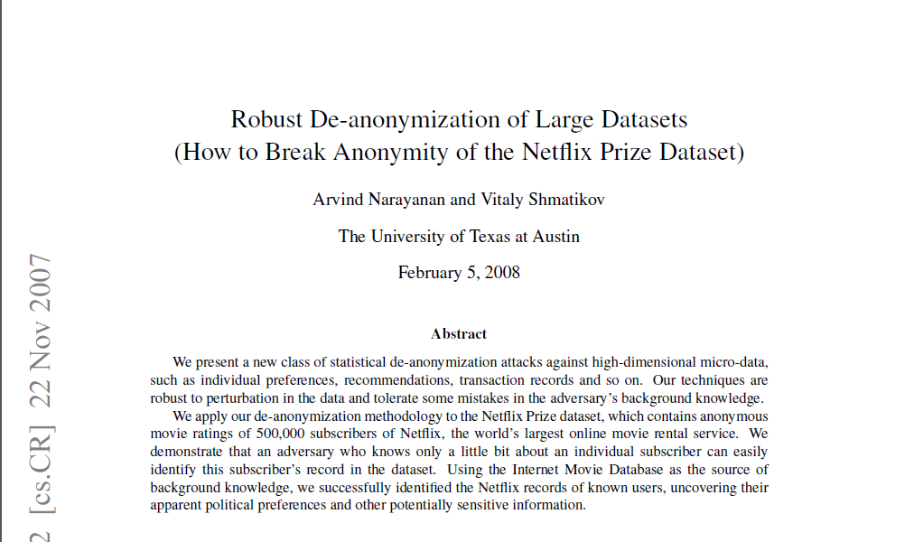
NetFlix challenge as an example of a “Linking Attack”,
characterizing already identified individuals in IMDB,
with their (previously hidden) movie viewing habits
Cross correlated small set of identifiable IMDB rating records with large set of “anonymized” Netflix customer ratings, which were being used for a Machine Learning competition

Slide 15
Strawman Hybrid Social & Tech Proposed Solution?
Fundamentally, researchers have to keep genetic secrets
  Genetic Licensure & training for individuals
  (similar to medical license, drivers license)
Technology to make things easier
  Cloud computing & enclaves (eg solution of Genomics England)
Technological barriers shouldn't create a social incentive for “hacking”
Quantifying Leakage & allowing a small amounts of it
Careful separation & coupling of private & public data
  Lightweight, freely accessible secondary datasets coupled to underlying variants
  Selection of stub & "test pilot" datasets for benchmarking
  Develop programs on public stubs on your laptop, then move the program to the cloud for private production run
[D Greenbaum, M Gerstein (‘11). Am J Bioeth 11:39. Greenbaum & Gerstein, The Scientist ('13)]

Slide 16
Large-scale Transcriptome Mining:
Building Interpretative, Regulatory Models, while Protecting Individual Privacy
The Dilemma of Genomic Privacy
  Fundamental, inherited info that’s very private v need for large-scale mining for med. research
  Issues w/ current social & tech approaches: inconsistencies, burdensome security, various "hacks”
  Strawman Hybrid Soc-Tech Proposal (Cloud Enclaves. Quantifying Leaks & Closely Coupled priv.-public datasets)
RNA-seq: How to Publicly Share Some of it
  Removing SNVs in reads w/ MRF
  Quantifying & removing variant info from expression levels + eQTLs using ICI & predictability
  Instantiating a practical linking attack using extreme expression levels
Modeling of RNA-seq in terms of Logical Gates
  Preponderance of OR gates in cancer v. cell-cycle (esp. for myc)
Using State Space Models to Decompose RNA-seq Dynamics
  Using dimensionality reduction to determine drivers and internal & external canonical dynamic patterns (iPDPs & ePDPs)
  In cell cycle, only conserved genes have iPDP w/ matching periodicity
  For worm-fly example, conserved genes have similar canonical patterns in both organisms v. species specific ones
  (eg ribosomal v signaling genes)

Slide 17

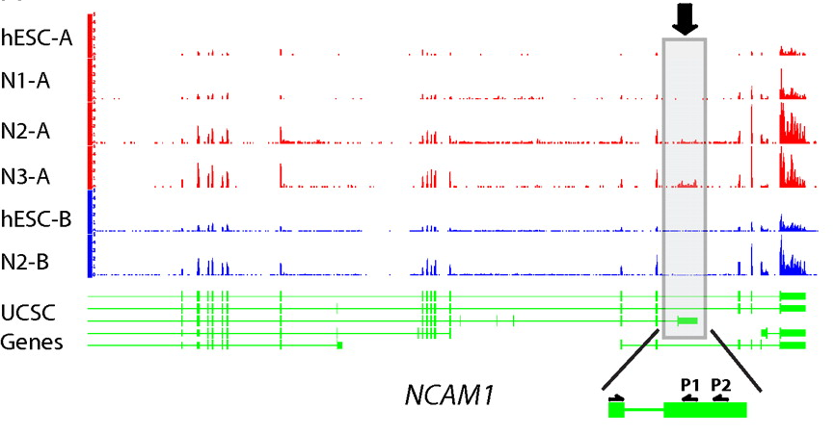
RNA-seq
RNA-seq uses next-generation sequencing technologies to reveal RNA presence and quantity within a biological sample.
ATACAAGCAAGTATAAGTTCGTATGCCGTCTT
GGAGGCTGGAGTTGGGGACGTATGCGGCATAG
TACCGATCGAGTCGACTGTAAACGTAGGCATA
ATTCTGACTGGTGTCATGCTGATGTACTTAAA
Reads (fasta)
－ Quality scores (fastq)
－ Mapping (BAM)
－ Contain variant information in transcribed regions
Quantitative information from RNA-seq signal: average signals at exon level (RPKMs)
Reads => Signal
[PLOS CB 4:e1000158; PNAS 4:107: 5254 ; IJC 123:569 ]

Slide 18
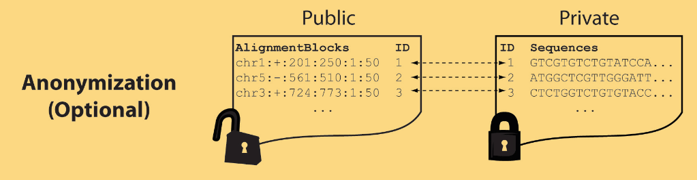
Light-weight formats
Some lightweight format clearly separate public & private info., aiding exchange
Files become much smaller
Distinction between formats to compute on and those to archive with – become sharper with big data
Reads
(linked via ID,
10X larger than
mapping coord.)
Mapping coordinates without variants (MRF)
[Bioinformatics 27: 281]

Slide 19
MRF Examples
chr2:+:601:630:1:30,chr2:+:921:940:31:50
TS
TE
TS
TE
Reference
AlignmentBlock 1
AlignmentBlock 2
Reference based compression
(ie CRAM)
is similar but it stores actual variant beyond just position of alignment block
Splice junction Read
QS
QE/QS
QE
Legend: TS = TargetStart, TE = TargetEnd, QS = QueryStart, QE = QueryEnd
chr9:+:431:480:1:50|chr9:+:945:994:1:50
TS
TE
TS
TE
Reference
AlignmentBlock 1
AlignmentBlock 2
Paired-end Read
QS
QE
QS
QE
Legend: TS = TargetStart, TE = TargetEnd, QS = QueryStart, QE = QueryEnd
[Habegger et al., Bioinformatics (‘11)]

Slide 20
Large-scale Transcriptome Mining:
Building Interpretative, Regulatory Models, while Protecting Individual Privacy
The Dilemma of Genomic Privacy
  Fundamental, inherited info that’s very private v need for large-scale mining for med. research
  Issues w/ current social & tech approaches: inconsistencies, burdensome security, various "hacks”
  Strawman Hybrid Soc-Tech Proposal (Cloud Enclaves. Quantifying Leaks & Closely Coupled priv.-public datasets)
RNA-seq: How to Publicly Share Some of it
  Removing SNVs in reads w/ MRF
  Quantifying & removing variant info from expression levels + eQTLs using ICI & predictability
  Instantiating a practical linking attack using extreme expression levels
Modeling of RNA-seq in terms of Logical Gates
  Preponderance of OR gates in cancer v. cell-cycle (esp. for myc)
Using State Space Models to Decompose RNA-seq Dynamics
  Using dimensionality reduction to determine drivers and internal & external canonical dynamic patterns (iPDPs & ePDPs)
  In cell cycle, only conserved genes have iPDP w/ matching periodicity
  For worm-fly example, conserved genes have similar canonical patterns in both organisms v. species specific ones
  (eg ribosomal v signaling genes)

Slide 21


eQTL Mapping Using RNA-Seq Data
eQTLs are genomic loci that contribute to variation in mRNA expression levels
eQTLs provide insights on transcription regulation, and the molecular basis of phenotypic outcomes
eQTL mapping can be done with RNA-Seq data
[Biometrics 68(1) 1–11]
Notes:
A diagram to illustrate the RNA‐seq count variation of one gene due to an cis‐eQTL. (a) RNA‐seq measurements of a hypothetic gene with two exons in three diploid individuals. The target SNP which we test for association has the genotype CT, CC, and TT for the three individuals. There is an SNP on the first exon, which has genotype AT, AT, and AA for the three individuals. ASE can be measured by those sequence reads that overlap with a heterozygous exonic SNP. Therefore we can measure ASE for individuals (i) and (ii). However, association testing by ASE is only possible if the target SNP is heterozygous, thus only individual (i) can be used to test for eQTL by ASE (b) ASE measurements for individual (i). (c) TReC measured for the three individuals across the two exons of this gene.
© IF THIS IMAGE HAS BEEN PROVIDED BY OR IS OWNED BY A THIRD PARTY, AS INDICATED IN THE CAPTION LINE, THEN FURTHER PERMISSION MAY BE NEEDED BEFORE ANY FURTHER USE. PLEASE CONTACT WILEY'S PERMISSIONS DEPARTMENT ON PERMISSIONS@WILEY.COM OR USE THE RIGHTSLINK SERVICE BY CLICKING ON THE 'REQUEST PERMISSION' LINK ACCOMPANYING THIS ARTICLE. WILEY OR AUTHOR OWNED IMAGES MAY BE USED FOR NON-COMMERCIAL PURPOSES, SUBJECT TO PROPER CITATION OF THE ARTICLE, AUTHOR, AND PUBLISHER.

Slide 22
Information Content and Predictability
[Harmanciet al. Nat. Meth. (in revision)]

Slide 23


Representative Expression, Genotype, eQTL Datasets
Genotypes are available from the 1000 Genomes Project
mRNA sequencing for 462 individuals
  Publicly available quantification for protein coding genes
Approximately 3,000 cis-eQTL (FDR<0.05)

Slide 24

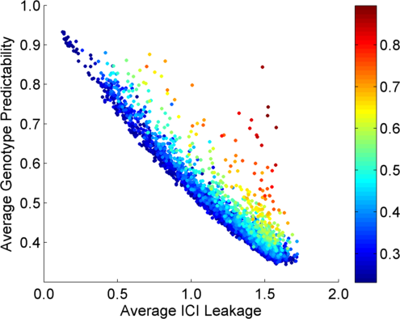
Per eQTL and ICI Cumulative Leakage versus Genotype Predictability
Colors by absolute correlation
Absolute Correlation
[Harmanciet al. Nat. Meth. (in revision)]

Slide 25
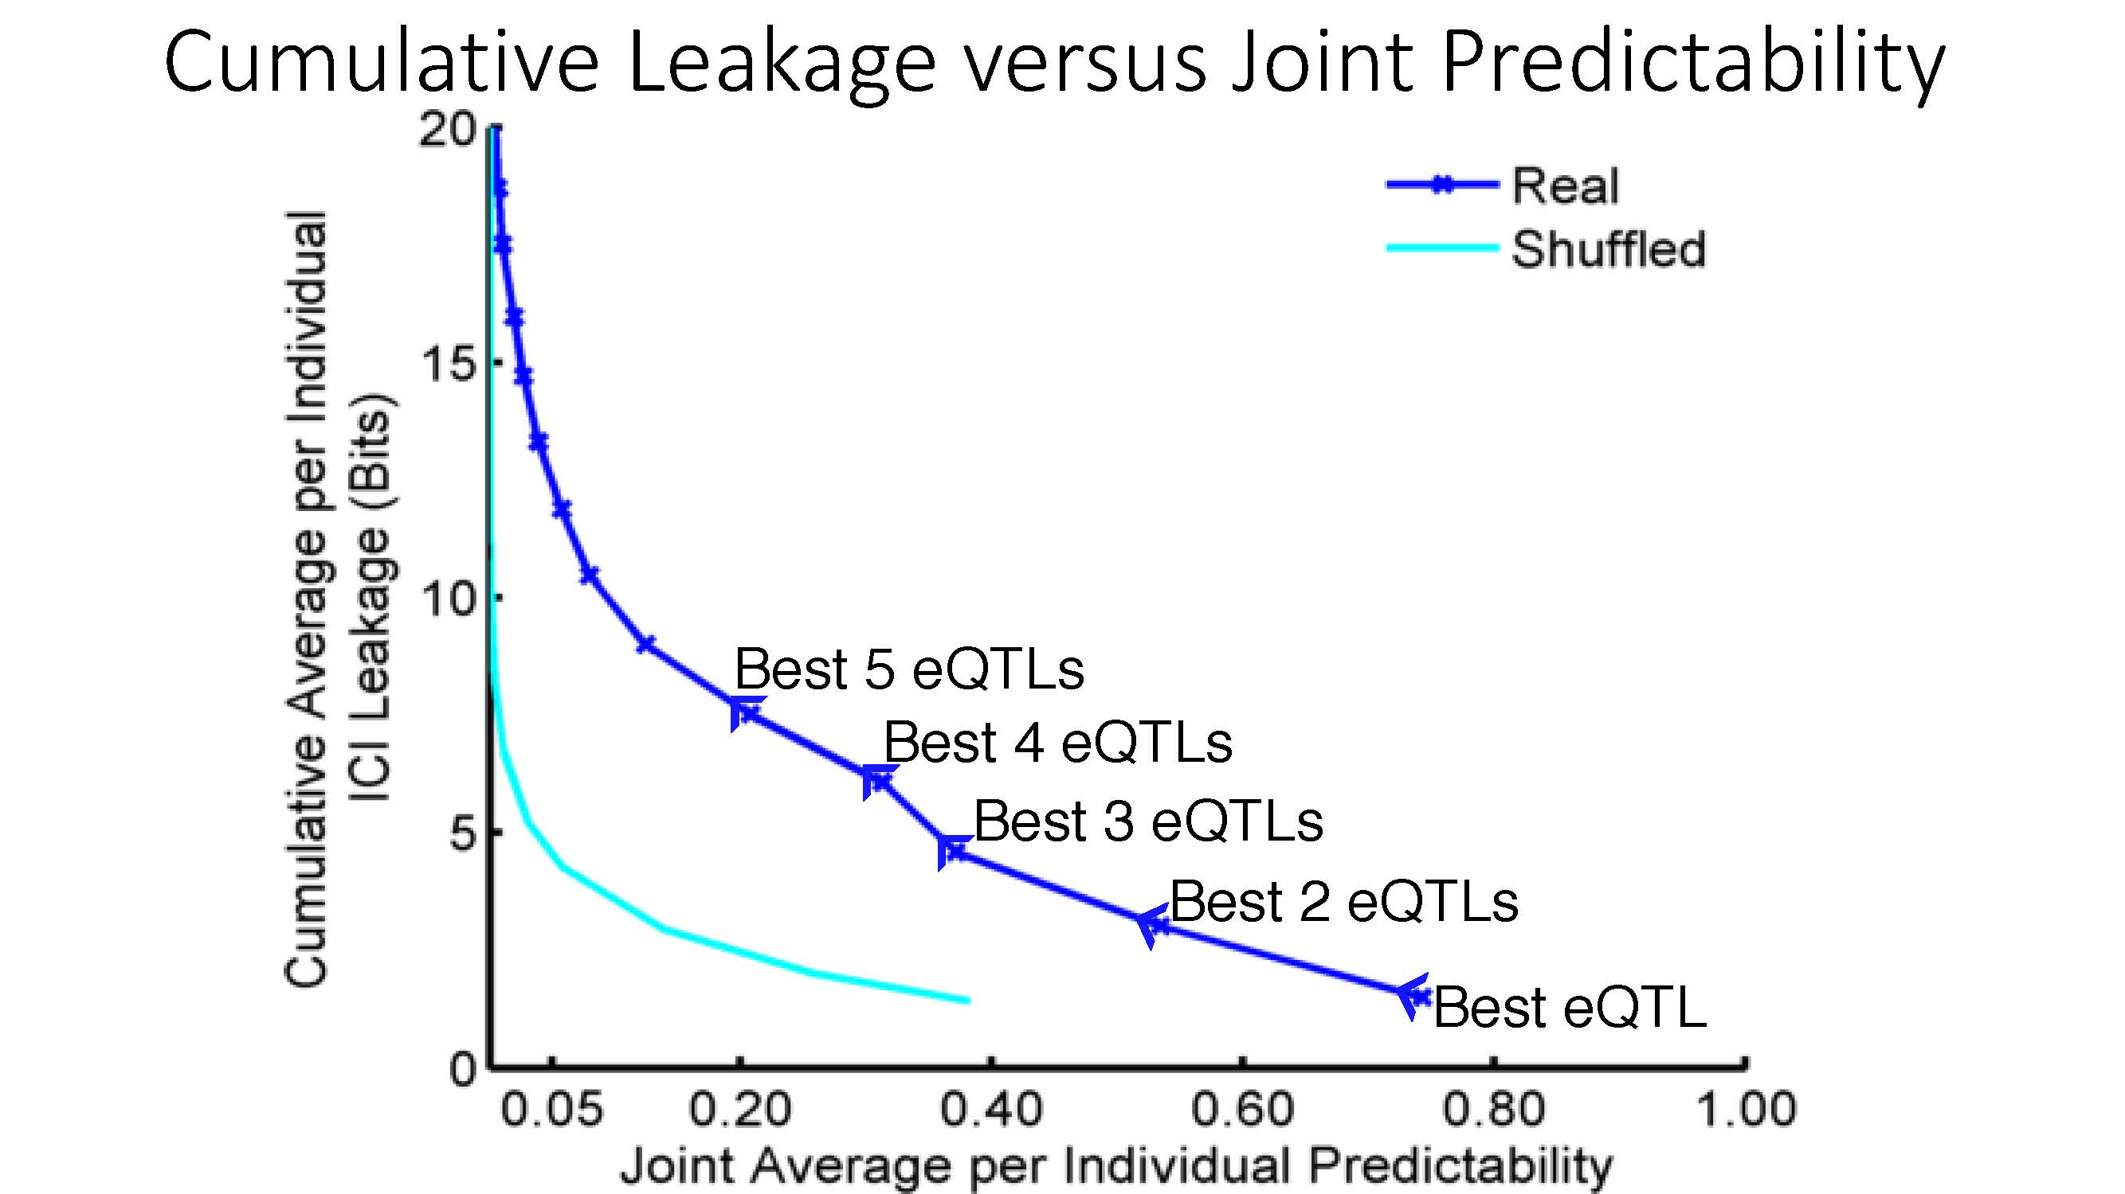
Cumulative Leakage versus Joint Predictability
[Harmanciet al. Nat. Meth. (in revision)]

Slide 26

Linking Attack Scenario
[Harmanciet al. Nat. Meth. (in revision)]

Slide 27
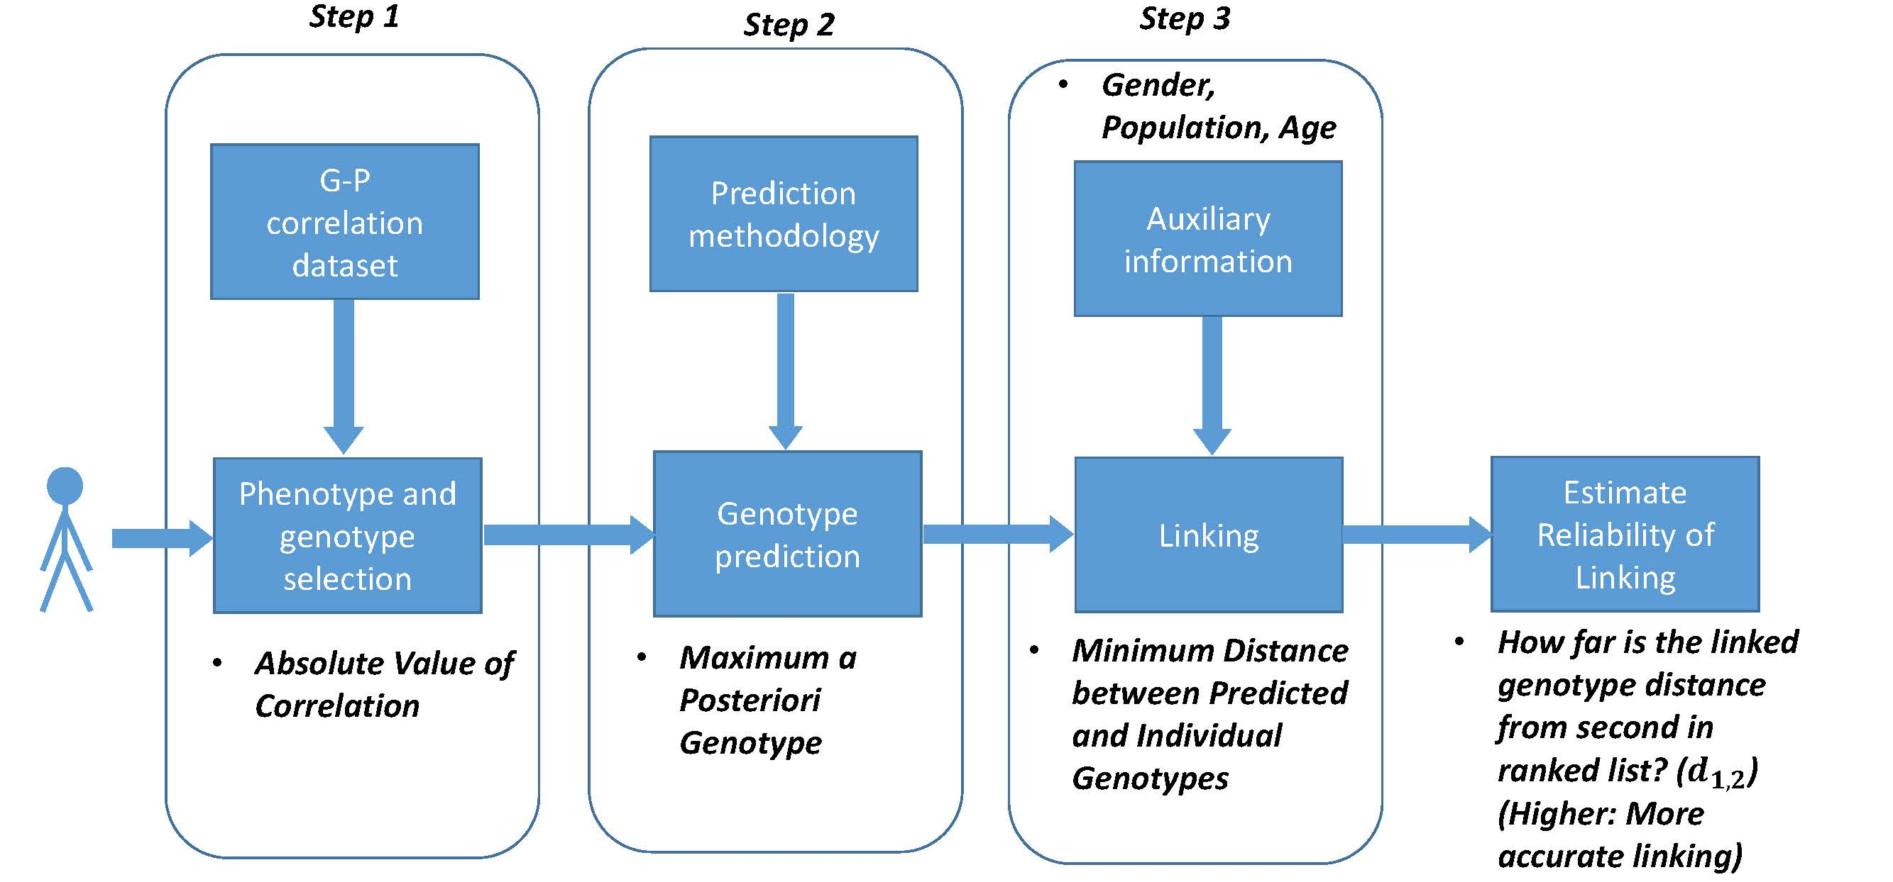
Steps in Instantiation of a (Mock) Linking Attack
[Harmanciet al. Nat. Meth. (in revision)]

Slide 28
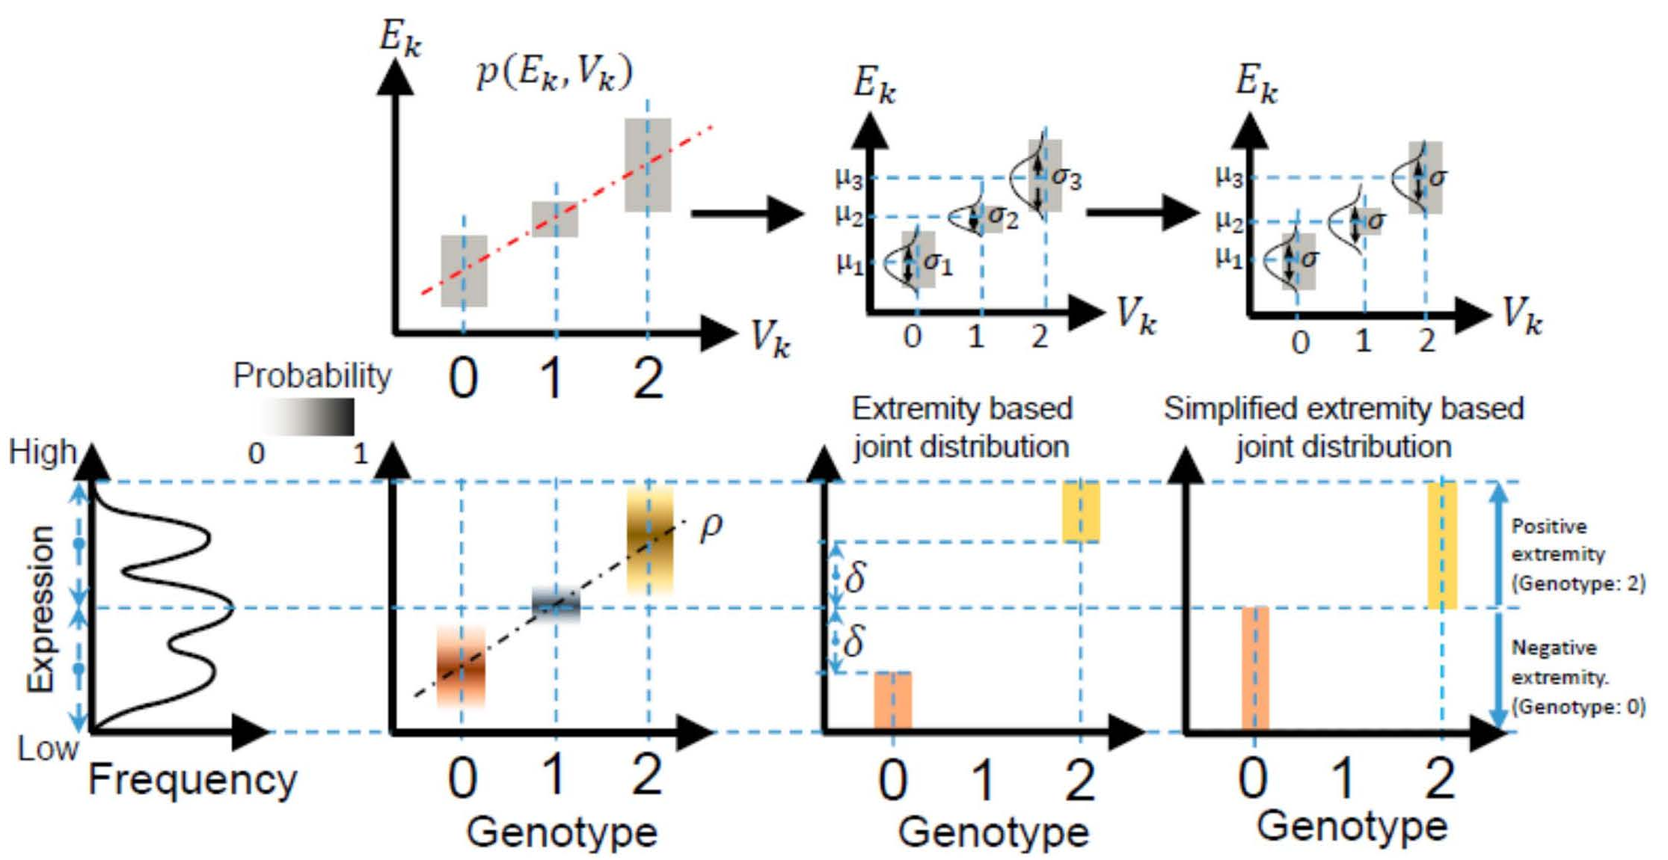
Levels of Expression-Genotype Model Simplifications
[Harmanciet al. Nat. Meth. (in revision)]

Slide 29
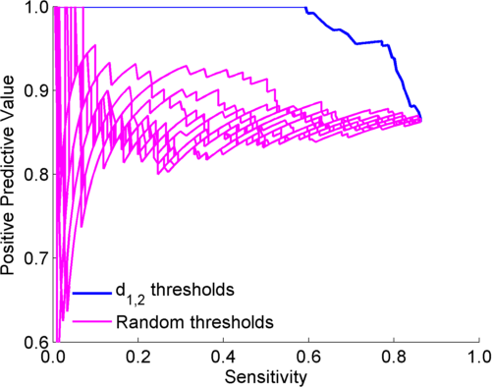
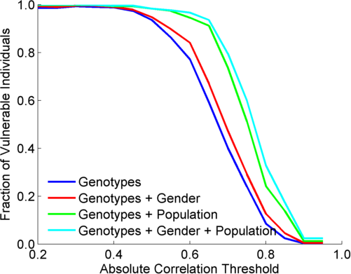
Extremity based linking with
homozygous genotypes
Attacker can estimate the
reliability of linkings
Sensitivity: Fraction of correctly linked
Individuals among all individuals
PPV: Fraction of correctly linked individuals
among selected individuals
[Harmanciet al. Nat. Meth. (in revision)]

Slide 30
Large-scale Transcriptome Mining:
Building Interpretative, Regulatory Models, while Protecting Individual Privacy
The Dilemma of Genomic Privacy
  Fundamental, inherited info that’s very private v need for large-scale mining for med. research
  Issues w/ current social & tech approaches: inconsistencies, burdensome security, various "hacks”
  Strawman Hybrid Soc-Tech Proposal (Cloud Enclaves. Quantifying Leaks & Closely Coupled priv.-public datasets)
RNA-seq: How to Publicly Share Some of it
  Removing SNVs in reads w/ MRF
  Quantifying & removing variant info from expression levels + eQTLs using ICI & predictability
  Instantiating a practical linking attack using extreme expression levels
Modeling of RNA-seq in terms of Logical Gates
  Preponderance of OR gates in cancer v. cell-cycle (esp. for myc)
Using State Space Models to Decompose RNA-seq Dynamics
  Using dimensionality reduction to determine drivers and internal & external canonical dynamic patterns (iPDPs & ePDPs)
  In cell cycle, only conserved genes have iPDP w/ matching periodicity
  For worm-fly example, conserved genes have similar canonical patterns in both organisms v. species specific ones
  (eg ribosomal v signaling genes)

Slide 31
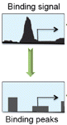
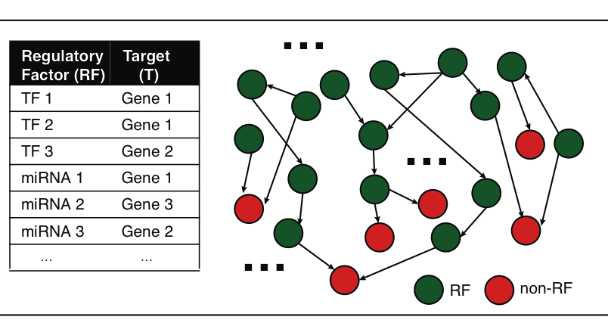
A gene can be regulated by multiple gene regulatory factors
Next generation sequencing techniques (e.g., ChIP-seq, CLIP-seq) predict gene regulatory factors (RFs) and their target genes
transcription factors (TFs)
micro-RNAs
…
Gene regulatory network
Peak calling
Many genes are regulated by multiple RFs.
How RFs coordinate to regulate target gene expression?
cooperative?
competitive?
independent?
…
Notes:
besides gene expression data, next generation sequencing technologies such as ChIP-seq and CLIP-seq can identify the target genes of gene regulatory factors. the regulatory factors include TF, mirnas and so on like TF1 and TF2 regulate Gene 1. Then, we can create a gene regulatory network. it is very likely that a target gene can be regulated by two or more RFs. e.g., we can get a lot of regulatory triplets where RF1 and RF2 regulate a common target gene T. Then, we would ask how two RFs coordinate to regulate T? are they really cooperative, or competitive, or independent? Is there a way to describe their cooperativity?

Slide 32
Modeling cooperativity between RFs to target gene using logic gates
A regulatory triplet
2-input-1-output logic gate
10110101…
10110101…
RF1
RF1
?
T
00110101…
T
00110101…
10110101…
01110111…
RF2
RF2
0 – gene off
1 – gene on
after binarizing gene expression data*
Input type (RF1, RF2) | RF1 | 0 | 0 | 1 | 1
 | RF2 | 0 | 1 | 0 | 1
Output | T | X | X | X | X
Binarized expression
X can be 0 or 1, so there are 2⁴=16 possible output combinations, each of which corresponds to a unique 2-input-1-output logic gate
…
*BoolNet, R package
Notes:
let’s look at a particular triplet, TF1 and TF2 regulate Gene 1. At logical level, gene expression has two states, gene is on or off, i.e., 1 represents gene is expressed or 0 represents gene is not expressed. So, then we can look at the triplet as 2-input-1-output system. TF1 and TF2 are inputs, and Gene 1 are output, and then use a 2-input-1-output logic gate to model this triplet. As shown in a truth table, there are 4 different types of input of TF1 and TF2, 00, 01, 10, 11, and for each input type, there are 2 possible output types, 1 or 0. so in total, we have 2^4 = 16 possible logic gates that can be used to describe the triplet.

Slide 33
An example: selection of the best-matched logic gate
Laplace’s rule of succession
s=(# of selected output state for the input type + 1)
/(# of input type + 2)
Consistency score:
6/7*5/7*6/7*5/7=0.37
Wang, et al., PLoS Computational Biology, 2015
Notes:
*********************************************
This toy example demonstrates that how we choose the best matched logic gates. first, for each input type of TF1, TF2 like 01, green, we count numbers of 0 and 1 output from Gene 1 data. and select the most state as output of this input type. e.g., we have 4 zeros and 1 one, then 0 is considered as output of input type 01. we also calculate the output’s succession prob using laplace’s rule of succession derived from Bayes' theorem, like 5/7. after we go thru all four input types, we get a truth table. Here, it’s the table for the AND gate. Also, we define production of four output succession probs as consistency score to the matched logic gate. e.g. the consistency score is 0.37 for AND gate.

Slide 34
Application 1 – transcription factor cooperativity in Yeast cell cycle
Target gene | 2464
TF | 176
Triplet | 39,011
Time point | 59
AND-like gates
Wang, et al., PLoS Computational Biology, 2015
Notes:
First, we apply Loregic to characterize TF cooperativity during yeast cell cycle, and found AND gate matches the most triplets, which implies that yeast TFs need to cooperate during cell cycle. we were able to distinguish three categories for this triplet group: 1) “homogenous” gate-consistent triplets – matching the same logic gate across all targets (e.g., top table); 2) “inhomogeneous” gate-consistent triplets – matching different logic gates across all targets (e.g., middle table); and 3) non-gate-consistent triplets, i.e. triplets inconsistent with all logic gates across all targets (e.g., bottom table).

Slide 35
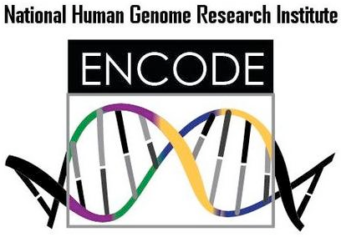

Application 2 – transcription factor cooperativity in Acute Myeloid Leukemia (AML)
Target gene | 1824 | ENCODE Data (K562, ChIP-seq) http://encodenets.gersteinlab.org/
TF | 70
Regulatory triplet | 50,865 | TCGA Data (AML, level 3, RNA-seq) https://tcga-data.nci.nih.gov/tcga/tcgaDownload.jsp
Patient sample | 197
Wang, et al., PLoS Computational Biology, 2015
Notes:
Then, we apply Loregic to the human cancer data. e.g., we characterized the TF cooperativity in leukemia cancer using 70 TF chip-seq data in ENCODE and gene expression data across 200 patients in TCGA. it is interesting to find that OR gate matches the most triplets, which implies that TF may not cooperate with each other in human cancer.

Slide 36
Application 2 – transcription factor cooperativity in Acute Myeloid Leukemia (AML)
OR-like gates
number of logic-gate consistent triplets
Wang, et al., PLoS Computational Biology, 2015
Notes:
Then, we apply Loregic to the human cancer data. e.g., we characterized the TF cooperativity in leukemia cancer using 70 TF chip-seq data in ENCODE and gene expression data across 200 patients in TCGA. it is interesting to find that OR gate matches the most triplets, which implies that TF may not cooperate with each other in human cancer.

Slide 37

Cancer-related TF, MYC universally amplifies target expression
2,153 (RF1=MYC, RF2=other TFs, T=all common targets) triplets
RF1
OR(RF1, RF2)
OR(RF1, NOT RF2)
number of logic-gate consistent triplets
High expression of MYC is sufficient for high target gene expression
Wang, et al., PLoS Computational Biology, 2015
Notes:
So, we then look at triplets with cancer-related TFs, e.g., MYC. biologists found that MYC universally amplifies target gene expressions in lymphocytes. we checked 2000 MYC associated triplets where MYC is 1st RF, and found the most MYC associated triplets are consistent with three logic gates, RF1, RF1+RF2 and RF1+~RF2 with significant enrichments. all three logic gates mean that high expression of MYC is sufficient for high target gene expression, which supports that MYC is a universal amplifier.
then use MYC to slince targe gene expresison in cancer

Slide 38
Large-scale Transcriptome Mining:
Building Interpretative, Regulatory Models, while Protecting Individual Privacy
The Dilemma of Genomic Privacy
  Fundamental, inherited info that’s very private v need for large-scale mining for med. research
  Issues w/ current social & tech approaches: inconsistencies, burdensome security, various "hacks”
  Strawman Hybrid Soc-Tech Proposal (Cloud Enclaves. Quantifying Leaks & Closely Coupled priv.-public datasets)
RNA-seq: How to Publicly Share Some of it
  Removing SNVs in reads w/ MRF
  Quantifying & removing variant info from expression levels + eQTLs using ICI & predictability
  Instantiating a practical linking attack using extreme expression levels
Modeling of RNA-seq in terms of Logical Gates
  Preponderance of OR gates in cancer v. cell-cycle (esp. for myc)
Using State Space Models to Decompose RNA-seq Dynamics
  Using dimensionality reduction to determine drivers and internal & external canonical dynamic patterns (iPDPs & ePDPs)
  In cell cycle, only conserved genes have iPDP w/ matching periodicity
  For worm-fly example, conserved genes have similar canonical patterns in both organisms v. species specific ones
  (eg ribosomal v signaling genes)

Slide 39
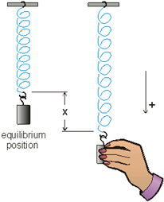
Internal and external gene regulatory networks
Internal Group
External Group
How to identify gene expression dynamics driven by internal/external regulation?
Internal regulation
External regulation
Interested system | Internal regulatory network | External regulatory network
Cross-species conserved genes | Conserved transcriptional factors (TFs) | Non-conserved TFs
Protein-coding genes | TFs | micro-RNAs
Individual’s protein coding genes | Wild-type TFs | Somatic mutated TFs
Protein-coding genes in brain | Commonly expressed TFs | Brain-specific expressed TFs
Protein-coding genes in development | House-keeping TFs | Developmental TFs
External force
[Wang et al. PLOS CB (in revision, ‘15)]
Notes:
connect loregic to here too! to see regulatory mechanisms similar too

Slide 40
State-space model for internal and external gene regulatory networks
Internal Group
External Group
How to identify gene expression dynamics driven by internal/external regulation?
Internal regulation
External regulation
Control: Gene expression vector of external factors at time t
State space model
X_{t+1}
A
X_{t}
B
U_{t}
B_{kl} captures temporal casual influence from external factor k to Gene l in internal group
State: Gene expression vector of Group X at time t+1
A_{ij} captures temporal casual influence from Gene i to Gene j in internal group
State: Gene expression vector of internal group at time t
[Wang et al. PLOS CB (in revision, ‘15)]
Notes:
connect loregic to here too! to see regulatory mechanisms similar too

Slide 41
Effective state space model for meta-genes
Not enough data to estimate state space model for genes
(e.g., 25 time points per gene to estimate 4 million elements of A or B for 2000 genes)
Dimensionality reduction from genes to meta-genes (e.g., SVD)
Effective state space model for meta-genes
(e.g., 250 time points to estimate 50 matrix elements if 5 meta-genes)
[Wang et al. PLOS CB (in revision, ‘15)]

Slide 42
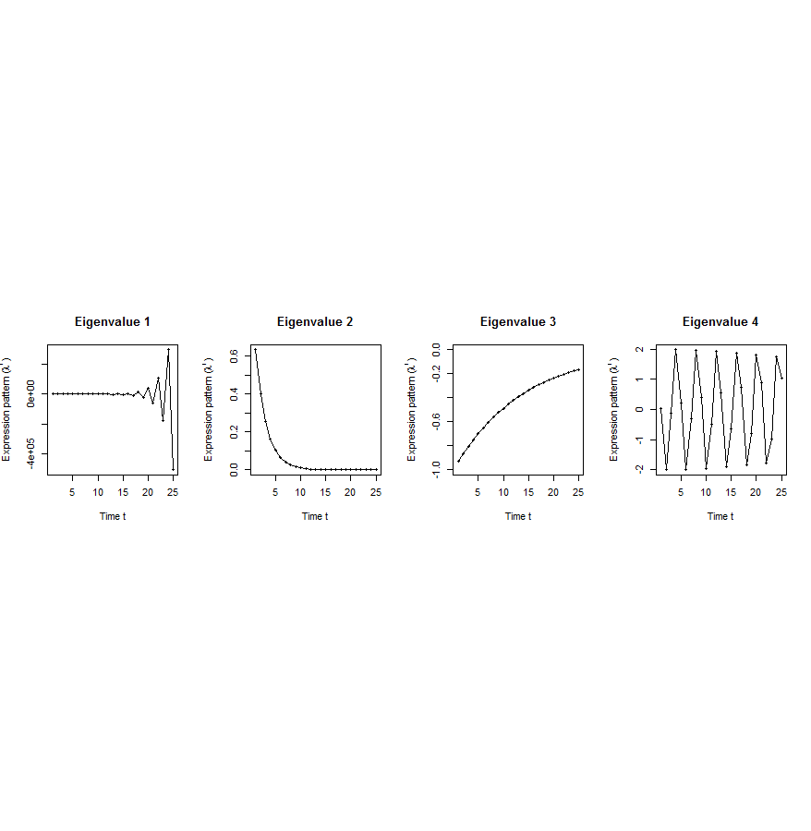
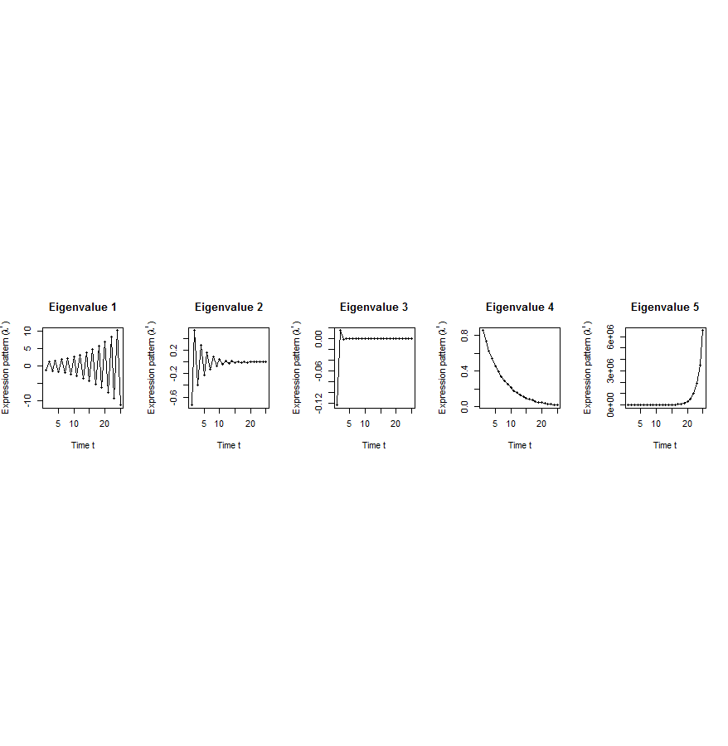
Canonical temporal expression trajectories from effective state space model
Internal driven dynamics
Externally driven dynamics
p^{th} internal principal dynamic pattern (iPDP): [λ_{p}¹, λ_{p}², …, λ_{p}^{T}],
where λ_{p} is p^{th} eigenvalue of Ã.
q^{th} external principal dynamic pattern (ePDP): [σ_{q}¹, σ_{q}², …, σ_{q}^{T}],
where σ_{q} is q^{th} eigenvalue of .
Canonical temporal expression trajectories
(e.g., degradation, growth, damped oscillation, etc.)
iPDP expression
ePDP expression
time
time
[Wang et al. PLOS CB (in revision, ‘15)]
Notes:
if we look at A tilde, it controls the dynamic trajectory of expression part internally driven by meta-genes of X. according to the analytic solution, the internally driven expression part Xtilde I can be linear combinations of A tilde’s eigenvalue’s exponentials across time, which are defined by us as internal principal dynamic pattern (iPDP). B tilde controls the dynamic trajectory of X’s metagene expression part externally driven by U. similarly, we can find external principal dynamic pattern (ePDP) based on B tilde’s eigenvalue exponentials across time. Actually, those patterns are canonical temporal expression trajectories, which are as simple as degradation, growth, damped oscillation temporal processes). In short, from metagene effective model, we are able to identify internal and external driven canonical temporal expression trajectories.

Slide 43
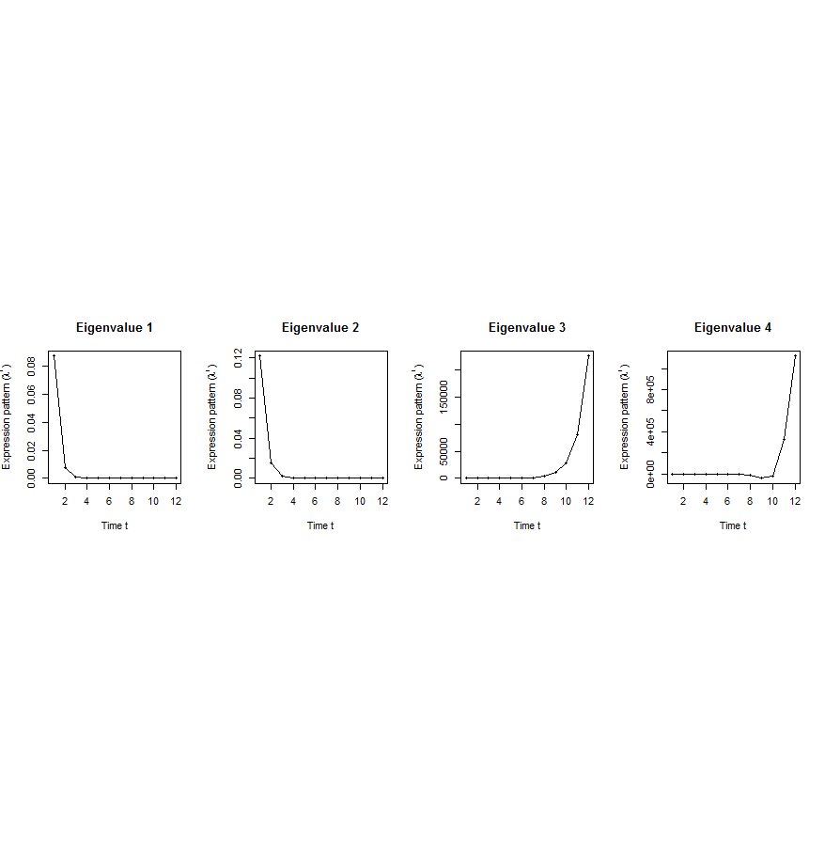
Flowchart
[Wang et al. PLOS CB (in revision, ‘15)]
A. Gene state-space model
C. Meta-gene state-space model
B. Dimensionality Reduction
X_{t+1}=AX_{t}+BU_{t}
Genes of X
Meta-genes of X
time
E. Gene’s internal (INT) and external (EXT) driven expression dynamics composed of PDPs
D. Internal/External Principal Dynamic Patterns (PDPs)
time
[λ_{p}¹, λ_{p}², …, λ_{p}^{T}] [σ_{q}¹, σ_{q}², …, σ_{q}^{T}]
x^{INT}=c₁ +c₂
+c₃ +c₄
Genes of U
Meta-genes of U
time
time
…
x^{EXT}=d₁ +d₂
+d₃ +d₄
/
Internal regulation among genes/meta-genes Group X by A/Ã
/
External regulation from genes/meta-genes in Group U
to genes/meta-genes in Group X by B/
/
Genes/Meta-genes in Group X
/
Genes/Meta-genes in Group U

Slide 44
Breast cancer cell cycle (under hormonal stimulation):
Conserved genes & TFs have dynamic pattern matching cell-cycle period; Non-conserved ones, do not
Dataset | Group X (internal) | Group U (external) | Time samples of a full cell cycle
Human breast cancer cell cycle under hormonal stimulation | 1132 metazoan conserved genes incl. 150 orthologous TFs | 1870 non-conserved metazoan transcription factors | T=12 time points: 0, 4, 6, 8, 12, …, 28, 32 hours
Oscillated iPDP by conserved TFs
a full cell cycle
Oscillated ePDP by non-conserved TFs
faster cycle due to hormone
[Wang et al. PLOS CB (in revision, ‘15)]

Slide 45
Are gene regulations among orthologs conserved across species?
Are gene regulatory networks among orthologs conserved across species?
Species A
Species B
orthologs
co-expressed
Regulation among orthologs (internal)
Regulation from species-specific factors (external)
Orthologous genes (orthologs)
Species-specific transcription factors
To what degree can’t ortholog expression levels be predicted due to species-specific regulation
[Wang et al. PLOS CB (in revision, ‘15)]
Notes:
connect loregic to here too! to see regulatory mechanisms similar too

Slide 46
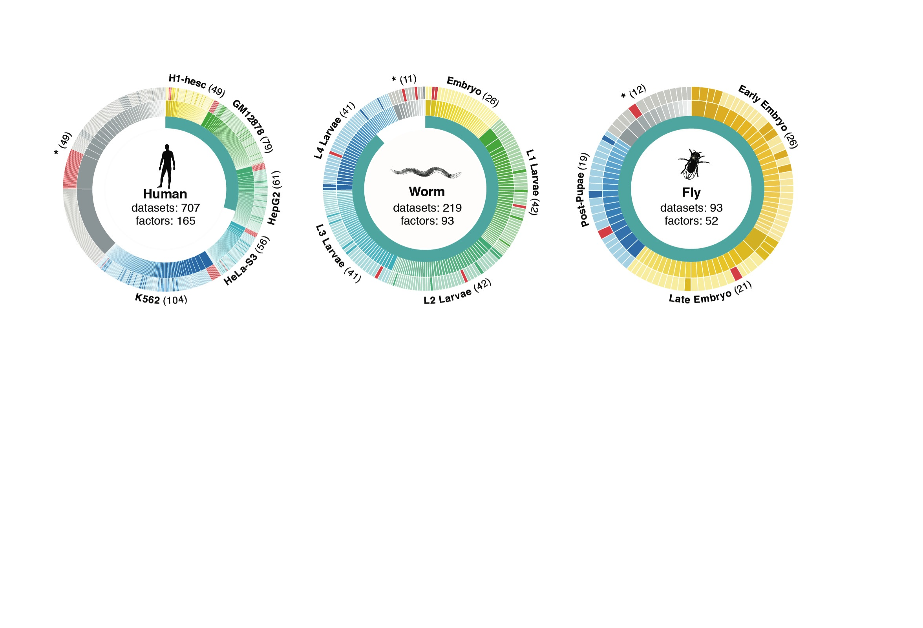
Time-course gene expression data of worm & fly development, from modENCODE
[Nature 512:445 ('14); doi: 10.1038/nature13424]
Organism | Major developmental stages
worm (C. elegans) | 33 stages: 0, 0.5, 1, …, 12 hours, L1, L2, L3, L4, …, Young Adults, Adults
fly (D. mel.) | 30 stages: 0, 2, 4, 6, 8,…, 20, 22 hours, L1-L4, Pupaes, Adults

Slide 47
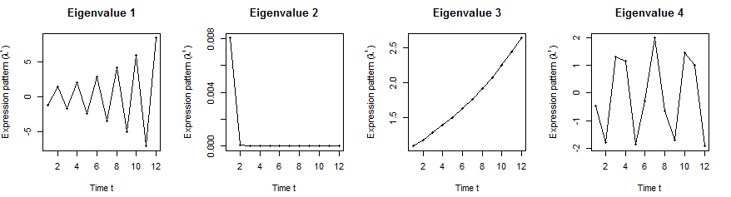
Orthologs have similar internal but different external dynamic patterns during embryonic development
Worm’s effective state space model
iPDPs: time exponentials of Ã eigenvalues in worm
ePDPs: time exponentials of eigenvalues in worm
1st iPDP
2nd iPDP
3rd iPDP
4th iPDP
1st ePDP
2nd ePDP
3rd ePDP
4th ePDP
Expression
Expression
Similar iPDP canonical trajectories
Different ePDP canonical trajectories
1st iPDP
2nd iPDP
3rd iPDP
4th iPDP
1st ePDP
2nd ePDP
3rd ePDP
4th ePDP
Expression
Expression
iPDPs: time exponentials of Ã eigenvalues in fly
ePDPs: time exponentials of eigenvalues in fly
Fly’s effective state space model
[Wang et al. PLOS CB (in revision, ‘15)]

Slide 48
Orthologs have correlated iPDP coefficients
1st iPDP
2nd iPDP
r=+0.33
r=+0.66
Coefficients of orthologs on fly iPDPs
3rd iPDP
4th iPDP
r=+0.67
r=+0.73
Coefficients of orthologs on worm iPDPs
[Wang et al. PLOS CB (in revision, ‘15)]

Slide 49
Evolutionarily conserved and younger genes exhibit the opposite internal and external PDP coefficients
iPDP coeffs > ePDP coeffs | Worm | Fly
Ribosomal genes | p<0.001 | p<2.2e-16
Ribosomal genes have significantly larger coefficients for the internal than external PDPs, but signaling genes exhibit the opposite trend
Coefficients of ribosomal related genes (absolute)
iPDPs ePDPs
iPDP coeffs < ePDP coeffs | Worm | Fly
Signaling genes | p<7e-4 | p<6e-4
* p-values from KS-test
[Wang et al. PLOS CB (in revision, ‘15)]
Notes:
Ribosomal related genes: coefficients over conserved (iPDP) and specific (ePDP) meta-patterns

Slide 50
Large-scale Transcriptome Mining:
Building Interpretative, Regulatory Models, while Protecting Individual Privacy
The Dilemma of Genomic Privacy
  Fundamental, inherited info that’s very private v need for large-scale mining for med. research
  Issues w/ current social & tech approaches: inconsistencies, burdensome security, various "hacks”
  Strawman Hybrid Soc-Tech Proposal (Cloud Enclaves. Quantifying Leaks & Closely Coupled priv.-public datasets)
RNA-seq: How to Publicly Share Some of it
  Removing SNVs in reads w/ MRF
  Quantifying & removing variant info from expression levels + eQTLs using ICI & predictability
  Instantiating a practical linking attack using extreme expression levels
Modeling of RNA-seq in terms of Logical Gates
  Preponderance of OR gates in cancer v. cell-cycle (esp. for myc)
Using State Space Models to Decompose RNA-seq Dynamics
  Using dimensionality reduction to determine drivers and internal & external canonical dynamic patterns (iPDPs & ePDPs)
  In cell cycle, only conserved genes have iPDP w/ matching periodicity
  For worm-fly example, conserved genes have similar canonical patterns in both organisms v. species specific ones
  (eg ribosomal v signaling genes)

Slide 51
Large-scale Transcriptome Mining:
Building Interpretative, Regulatory Models, while Protecting Individual Privacy
The Dilemma of Genomic Privacy
  Fundamental, inherited info that’s very private v need for large-scale mining for med. research
  Issues w/ current social & tech approaches: inconsistencies, burdensome security, various "hacks”
  Strawman Hybrid Soc-Tech Proposal (Cloud Enclaves. Quantifying Leaks & Closely Coupled priv.-public datasets)
RNA-seq: How to Publicly Share Some of it
  Removing SNVs in reads w/ MRF
  Quantifying & removing variant info from expression levels + eQTLs using ICI & predictability
  Instantiating a practical linking attack using extreme expression levels
Modeling of RNA-seq in terms of Logical Gates
  Preponderance of OR gates in cancer v. cell-cycle (esp. for myc)
Using State Space Models to Decompose RNA-seq Dynamics
  Using dimensionality reduction to determine drivers and internal & external canonical dynamic patterns (iPDPs & ePDPs)
  In cell cycle, only conserved genes have iPDP w/ matching periodicity
  For worm-fly example, conserved genes have similar canonical patterns in both organisms v. species specific ones
  (eg ribosomal v signaling genes)

Slide 52
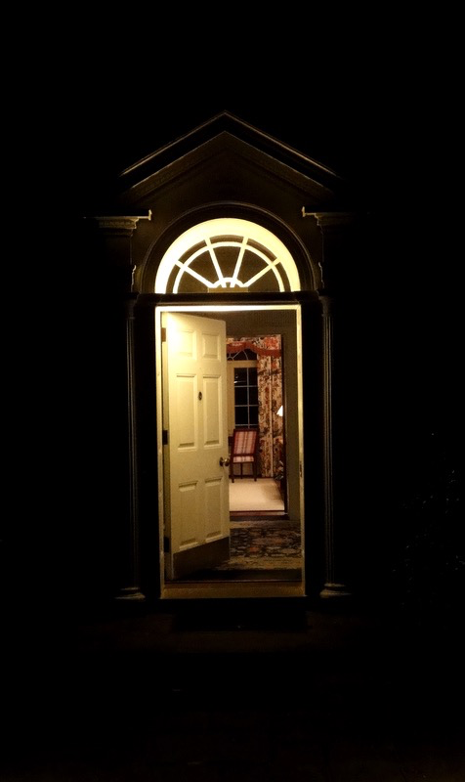
Acknowledgements
papers.gersteinlab.org/subject/privacy
D Greenbaum
PrivaSeq.gersteinlab.org
A Harmanci
RSEQtools.gersteinlab.org [MRF]
L Habegger, A Sboner,
TA Gianoulis, J Rozowsky, A Agarwal, M Snyder
Loregic.gersteinlab.org [github]
D Wang,
KK Yan, C Sisu, C Cheng, J Rozowsky, W Meyerson
DREISS.gersteinlab.org [github]
D Wang, F He, S Maslov
Hiring Postdocs. See gersteinlab.org/jobs !

Slide 53
Default Theme
Default Outline Level 1
  Level 2

Slide 54
More Information on this Talk
SUBJECT: Networks
DESCRIPTION:
NOTES:
This PPT should work on mac & PC. Paper references in the talk were mostly from Papers.GersteinLab.org.
PERMISSIONS: This Presentation is copyright Mark Gerstein, Yale University, 2010. Please read permissions statement at http://www.gersteinlab.org/misc/permissions.html . Feel free to use images in the talk with PROPER acknowledgement (via citation to relevant papers or link to gersteinlab.org).
PHOTOS & IMAGES. For thoughts on the source and permissions of many of the photos and clipped images in this presentation see http://streams.gerstein.info . In particular, many of the images have particular EXIF tags, such as kwpotppt , that can be easily queried from flickr, viz: http://www.flickr.com/photos/mbgmbg/tags/kwpotppt .
Notes:
54

