Slide 1


(Human Genome Analysis)
Large-scale Transcriptome Mining:
Building Interpretative Models while Protecting Individual Privacy
1 (c) Mark Gerstein, 2002, Yale, bioinfo.mbb.yale.edu
Mark Gerstein, Yale
Slides freely downloadable from Lectures.GersteinLab.org & “tweetable” (via @markgerstein). See last slide for more info.
Notes:
1

Slide 2
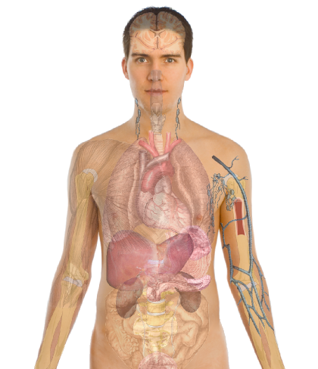
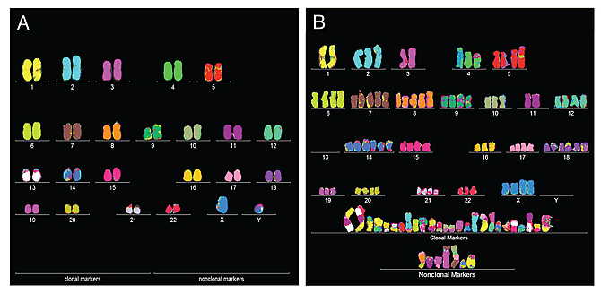
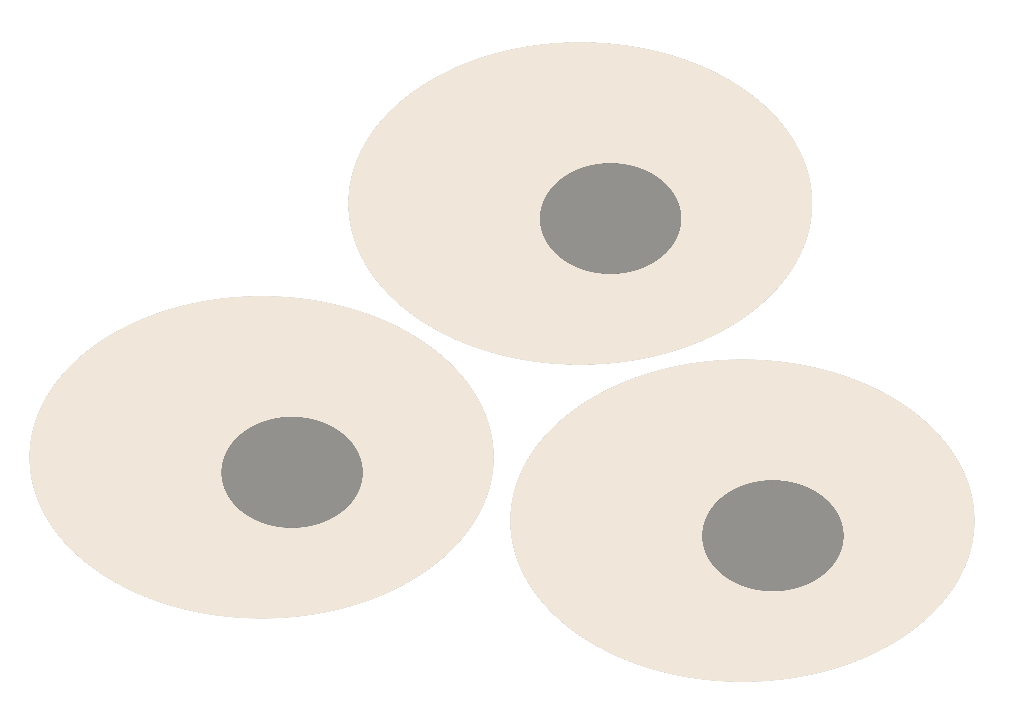
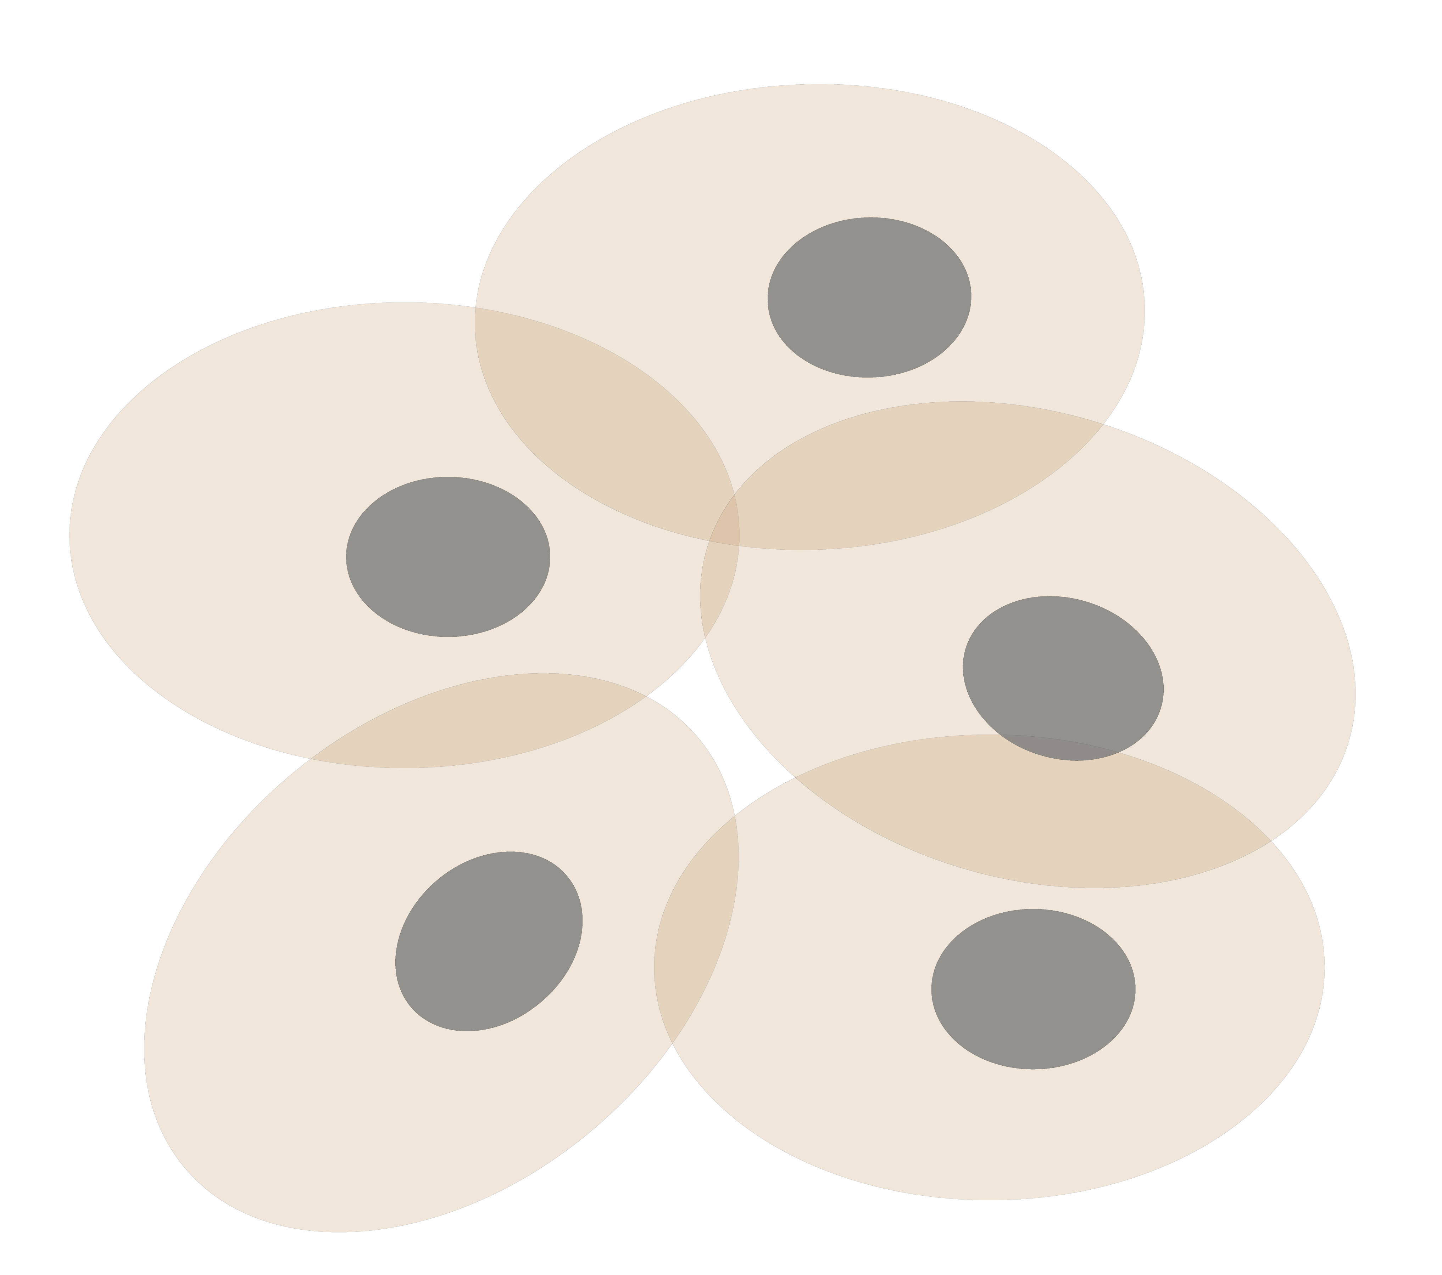
Personal Genomics
as a Gateway into Biology
Personal genomes soon will become a commonplace part of medical research & eventually treatment (esp. for cancer). They will provide a primary connection for biological science to the general public.
normal
tumor

Slide 3
Personal Genomics
as a Gateway into Biology
Personal genomes soon will become a commonplace part of medical research & eventually treatment (esp. for cancer). They will provide a primary connection for biological science to the general public.

Slide 4


Slide 5
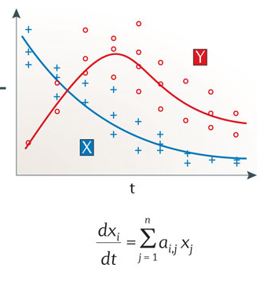
Building Regulatory Models from Large-scale RNA-seq Data
Continuous model
Boolean logical model
Istrail & Davidson, PNAS, ‘04
Nicolas Le Novère, Nature Reviews Genetics, ‘15

Slide 6
Privacy Aspects of Large-scale
RNA-seq Analysis
Large magnitude of RNA-seq data generated
  ENCODE, modENCODE, TCGA, GTEx, Roadmap, psychENCODE, etc.
Mostly the data is about the phenotype (e.g., cancer gene expression), but the individual information often comes along as collateral
  Maybe we can separate private info but couple it with the public presentation?

Slide 7
Large-scale Transcriptome Mining: Building Interpretative Models while Protecting Individual Privacy
The Dilemma of Genomic Privacy
  Fundamental, inherited info that’s very private vs the need for large-scale data-sharing to enable med. research
  Current Social & Tech Approaches
    Issues: burdensome security, inconsistencies + ways the solutions have been partially "hacked”
    Strawman Hybrid Soc-Tech Proposal (Cloud Enclaves. Quantifying Leaks, & Closely Coupled priv.-public data)
RNA-seq: How to Publicly Share Some of it
  Removing SNVs in reads using MRF
  Quantifying & removing variant info from expression levels + eQTLs
  Linking Attack using extreme expression levels
Large-scale Mining of RNA-seq to Determine State Space Models
  Using dimensionality reduction to help determine internal & external drivers
  Decoupling expression changes into those driven by worm-fly conserved genes vs species-specific ones. Also, Conserved genes have similar canonical patterns (iPDPs) in contrast to species specific ones (Ex of ribosomal v signaling genes)
  In human cell cycle, only conserved genes show matching periodic pattern

Slide 8


The Conundrum of Genomic Privacy: Is it a Problem?
Yes
Genetic Exceptionalism :
genome is potentially very revealing about one’s identity & characteristics
Most discussion of Identification Risk but what about Characterization Risk?
  Finding you were in study X vs identifying that you have trait Y from studying your identified genome
No
Shifting societal foci
No one really cares
about your genes
You might not care
[Klitzman & Sweeney ('11), J Genet Couns 20:98l; Greenbaum & Gerstein ('09), New Sci. (Sep 23) ]

Slide 9

Tricky Privacy Considerations in Personal Genomics
Personal Genomic info. essentially meaningless currently but will it be in 20 yrs? 50 yrs?
  Genomic sequence very revealing about one’s children. Is true consent possible?
  Once put on the web it can’t be taken back
Culture Clash: Genomics historically has been a proponent of “open data” but not clear personal genomics fits this
Ethically challenged history of genetics
Ownership of the data & what consent means (Hela)
  Could your genetic data give rise to a product line?
[D Greenbaum & M Gerstein (’08). Am J. Bioethics; D Greenbaum & M Gerstein, Hartford Courant, 10 Jul. '08 ; SF Chronicle, 2 Nov. '08;
Greenbaum et al. PLOS CB (‘11) ; Greenbaum & Gerstein ('13), The Scientist; Photo from NY Times]

Slide 10

The Other Side of the Coin:
Why we should share
Sharing helps speed research
  Large-scale mining of this information is important for medical research
  Privacy is cumbersome, particularly for big data
  Sharing is important for reproducible research
Sharing is useful for education
[Yale Law Roundtable (‘10). Comp. in Sci. & Eng. 12:8; D Greenbaum & M Gerstein (‘09). Am. J. Bioethics; D Greenbaum & M Gerstein (‘10). SF Chronicle, May 2, Page E-4;
Greenbaum et al. PLOS CB (‘11)]

Slide 11

The Dilemma
[Economist, 15 Aug ‘15]
What is acceptable risk? What is acceptable data leakage? Can we quantify leakage?
Cost Benefit Analysis: how helpful is identifiable data in genomic research v. potential harm from a breach?
The individual (harmed?) v the collective (benefits)
  But do sick patients care about their privacy?
Maybe a we need a few "test pilots” (ala PGP)?
  Sports stars & celebrities?

Slide 12












Genomics has similar "Big Data" Dilemma in the Rest of Society
Sharing & "peer-production" is central to success of many new ventures, with the same risks as in genomics
We confront privacy risks every day we access the internet
(...or is the genome more exceptional & fundamental?)
[Seringhaus & Gerstein ('09), Hart. Courant (Jun 5); Greenbaum & Gerstein ('11), NY Times (6 Oct)]

Slide 13
Current Social & Technical Solutions
Consents
“Protected” distribution of data (dbGAP)
Local computes on secure computer
Issues
  Non-uniformity of consents & paperwork
    Different international norms, leading to confusion
  Encryption & computer security creates burdensome requirements on data sharing & large scale analysis
  Many schemes get “hacked”
[Greenbuam et al ('04), Nat. Biotech; Greenbaum & Gerstein ('13), The Scientist]

Slide 14
Privacy Hacks
Personalized genomic data generation is booming
“Detection of genome in a mixture”
  Individuals give consent to participate but request anonymity
    HAPMAP, Personal genome project, 1000 Genomes…
Larger and more datasets leads to more realistic risks of linking attacks, that may be much more damaging than detection of genome in a mixture attacks
Main focus is on protecting variants

Slide 15


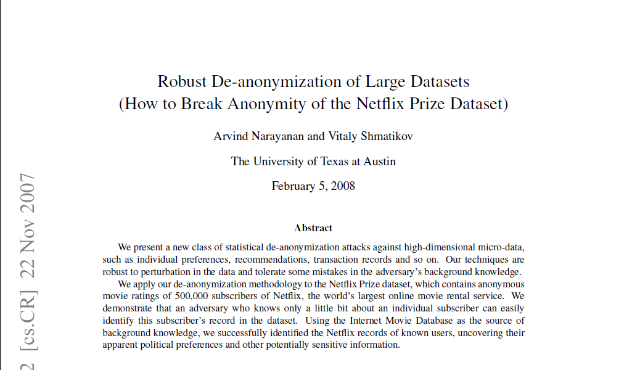
Cross correlated small set of identifiable IMDB movie database rating
records with large set of “anonymized” Netflix customer ratings

Slide 16
Strawman Hybrid Social & Tech Proposed Solution?
Fundamentally, researchers have to keep genetic secrets
  Genetic Licensure & training for individuals
  (similar to medical license, drivers license)
Technology to make things easier
  Cloud computing & enclaves (eg solution of Genomics England)
Technological barriers shouldn't create a social incentive for “hacking”
Quantifying Leakage & allowing a small amounts of it (eg photos of eye color)
Careful separation & coupling of private & public data
  Lightweight, freely accessible secondary datasets coupled to underlying variants
  Selection of stub & "test pilot" datasets for benchmarking
  Develop programs on public stubs on your laptop, then move the program to the cloud for private production run
[D Greenbaum, M Gerstein (‘11). Am J Bioeth 11:39. Greenbaum & Gerstein, The Scientist ('13)]

Slide 17
Large-scale Transcriptome Mining: Building Interpretative Models while Protecting Individual Privacy
The Dilemma of Genomic Privacy
  Fundamental, inherited info that’s very private vs the need for large-scale data-sharing to enable med. research
  Current Social & Tech Approaches
    Issues: burdensome security, inconsistencies + ways the solutions have been partially "hacked”
    Strawman Hybrid Soc-Tech Proposal (Cloud Enclaves. Quantifying Leaks, & Closely Coupled priv.-public data)
RNA-seq: How to Publicly Share Some of it
  Removing SNVs in reads using MRF
  Quantifying & removing variant info from expression levels + eQTLs
  Linking Attack using extreme expression levels
Large-scale Mining of RNA-seq to Determine State Space Models
  Using dimensionality reduction to help determine internal & external drivers
  Decoupling expression changes into those driven by worm-fly conserved genes vs species-specific ones. Also, Conserved genes have similar canonical patterns (iPDPs) in contrast to species specific ones (Ex of ribosomal v signaling genes)
  In human cell cycle, only conserved genes show matching periodic pattern

Slide 18

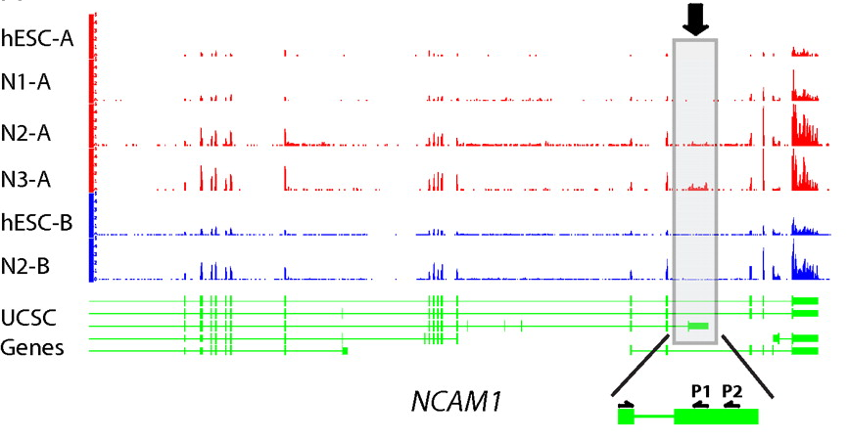
RNA-seq
RNA-seq uses next-generation sequencing technologies to reveal RNA presence and quantity within a biological sample.
ATACAAGCAAGTATAAGTTCGTATGCCGTCTT
GGAGGCTGGAGTTGGGGACGTATGCGGCATAG
TACCGATCGAGTCGACTGTAAACGTAGGCATA
ATTCTGACTGGTGTCATGCTGATGTACTTAAA
Reads (fasta)
－ Quality scores (fastq)
－ Mapping (BAM)
－ Contain variant information in transcribed regions
Quantitative information from RNA-seq signal: average signals at exon level (RPKMs)
Reads => Signal
[PLOS CB 4:e1000158; PNAS 4:107: 5254 ; IJC 123:569 ]

Slide 19
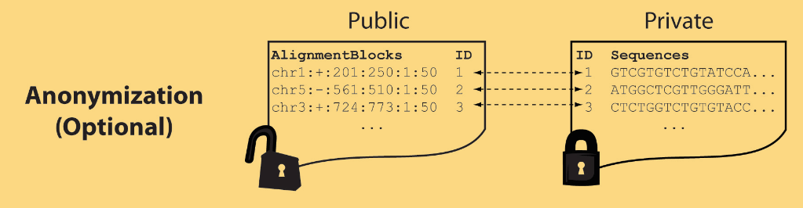
Light-weight formats
Some lightweight format clearly separate public & private info., aiding exchange
Files become much smaller
Distinction between formats to compute on and those to archive with – become sharper with big data
Reads
(linked via ID,
10X larger than
mapping coord.)
Mapping coordinates without variants (MRF)
[Bioinformatics 27: 281]

Slide 20
MRF Examples
chr2:+:601:630:1:30,chr2:+:921:940:31:50
TS
TE
TS
TE
Reference
AlignmentBlock 1
AlignmentBlock 2
10X Compression Ex.
Raw ELAND export file has uncompressed file size: ∼4 GB; total number of reads: ∼20 million; number of mapped reads: ∼12 million .
MRF file is significantly smaller (∼400 MB uncompressed, ∼130 MB compressed with gzip).
BAM file
has a size of ∼1.2 GB.
Splice junction Read
QS
QE/QS
QE
Legend: TS = TargetStart, TE = TargetEnd, QS = QueryStart, QE = QueryEnd
chr9:+:431:480:1:50|chr9:+:945:994:1:50
TS
TE
TS
TE
Reference
AlignmentBlock 1
AlignmentBlock 2
Reference based compression (ie CRAM) is similar but it stores actual variant beyond just position of alignment block
Paired-end Read
QS
QE
QS
QE
Legend: TS = TargetStart, TE = TargetEnd, QS = QueryStart, QE = QueryEnd
[Habegger et al., Bioinformatics (‘11)]

Slide 21
Large-scale Transcriptome Mining: Building Interpretative Models while Protecting Individual Privacy
The Dilemma of Genomic Privacy
  Fundamental, inherited info that’s very private vs the need for large-scale data-sharing to enable med. research
  Current Social & Tech Approaches
    Issues: burdensome security, inconsistencies + ways the solutions have been partially "hacked”
    Strawman Hybrid Soc-Tech Proposal (Cloud Enclaves. Quantifying Leaks, & Closely Coupled priv.-public data)
RNA-seq: How to Publicly Share Some of it
  Removing SNVs in reads using MRF
  Quantifying & removing variant info from expression levels + eQTLs
  Linking Attack using extreme expression levels
Large-scale Mining of RNA-seq to Determine State Space Models
  Using dimensionality reduction to help determine internal & external drivers
  Decoupling expression changes into those driven by worm-fly conserved genes vs species-specific ones. Also, Conserved genes have similar canonical patterns (iPDPs) in contrast to species specific ones (Ex of ribosomal v signaling genes)
  In human cell cycle, only conserved genes show matching periodic pattern

Slide 22


eQTL Mapping Using RNA-Seq Data
eQTLs are genomic loci that contribute to variation in mRNA expression levels
eQTLs provide insights on transcription regulation, and the molecular basis of phenotypic outcomes
eQTL mapping can be done with RNA-Seq data
[Biometrics 68(1) 1–11]
Notes:
A diagram to illustrate the RNA‐seq count variation of one gene due to an cis‐eQTL. (a) RNA‐seq measurements of a hypothetic gene with two exons in three diploid individuals. The target SNP which we test for association has the genotype CT, CC, and TT for the three individuals. There is an SNP on the first exon, which has genotype AT, AT, and AA for the three individuals. ASE can be measured by those sequence reads that overlap with a heterozygous exonic SNP. Therefore we can measure ASE for individuals (i) and (ii). However, association testing by ASE is only possible if the target SNP is heterozygous, thus only individual (i) can be used to test for eQTL by ASE (b) ASE measurements for individual (i). (c) TReC measured for the three individuals across the two exons of this gene.
© IF THIS IMAGE HAS BEEN PROVIDED BY OR IS OWNED BY A THIRD PARTY, AS INDICATED IN THE CAPTION LINE, THEN FURTHER PERMISSION MAY BE NEEDED BEFORE ANY FURTHER USE. PLEASE CONTACT WILEY'S PERMISSIONS DEPARTMENT ON PERMISSIONS@WILEY.COM OR USE THE RIGHTSLINK SERVICE BY CLICKING ON THE 'REQUEST PERMISSION' LINK ACCOMPANYING THIS ARTICLE. WILEY OR AUTHOR OWNED IMAGES MAY BE USED FOR NON-COMMERCIAL PURPOSES, SUBJECT TO PROPER CITATION OF THE ARTICLE, AUTHOR, AND PUBLISHER.

Slide 23
Information Content and Predictability
[Harmanciet al. Nat. Meth. (in revision)]

Slide 24

Representative Expression, Genotype, eQTL Datasets
mRNA sequencing for 462 individuals
  Publicly availableQuantification for protein
  coding genes
Approximately 3,000 cis-eQTL (FDR<0.05)
Genotypes are available from the 1000 Genomes Project

Slide 25

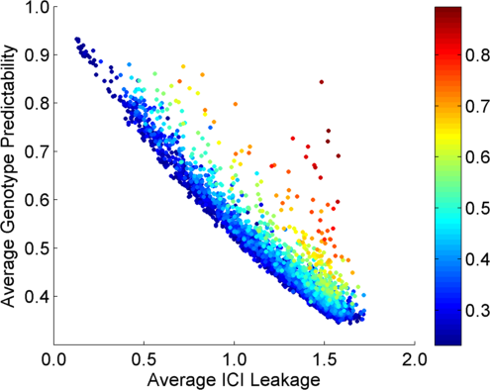
Per eQTL and ICI Cumulative Leakage versus Genotype Predictability
Colors by absolute correlation
Absolute Correlation
[Harmanciet al. Nat. Meth. (in revision)]

Slide 26
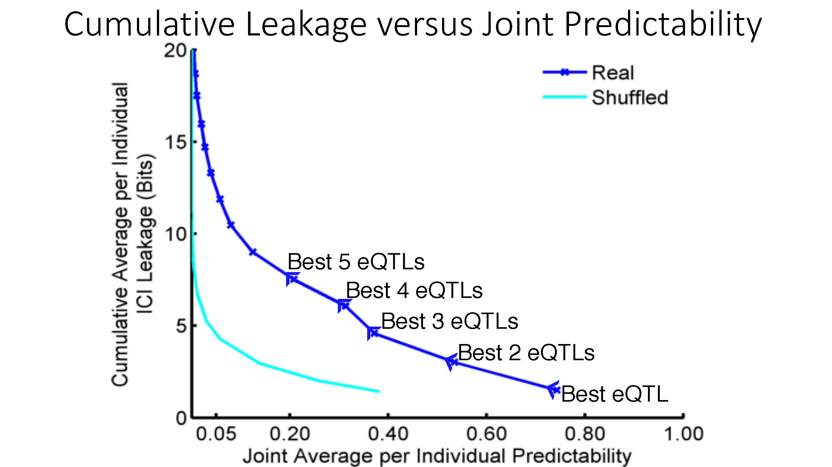
Cumulative Leakage versus Joint Predictability
[Harmanciet al. Nat. Meth. (in revision)]

Slide 27

Linking Attack Scenario
[Harmanciet al. Nat. Meth. (in revision)]

Slide 28
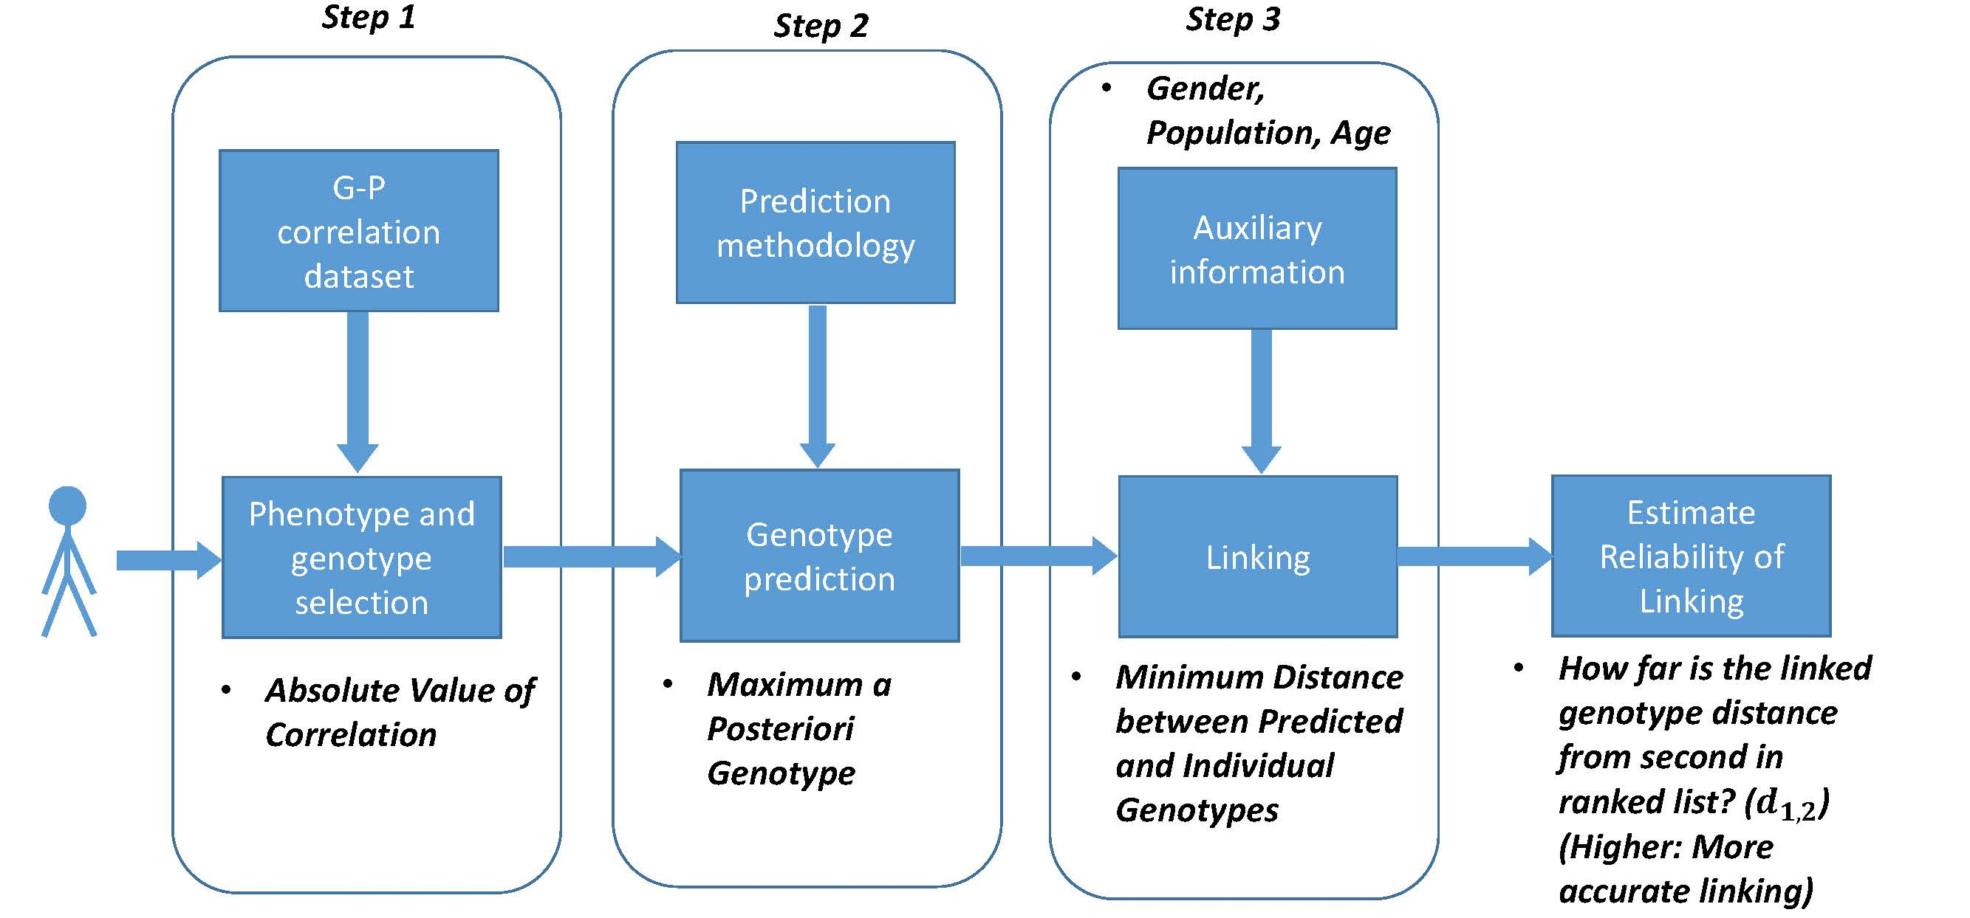
Steps in Instantiation of a (Mock) Linking Attack
[Harmanciet al. Nat. Meth. (in revision)]

Slide 29
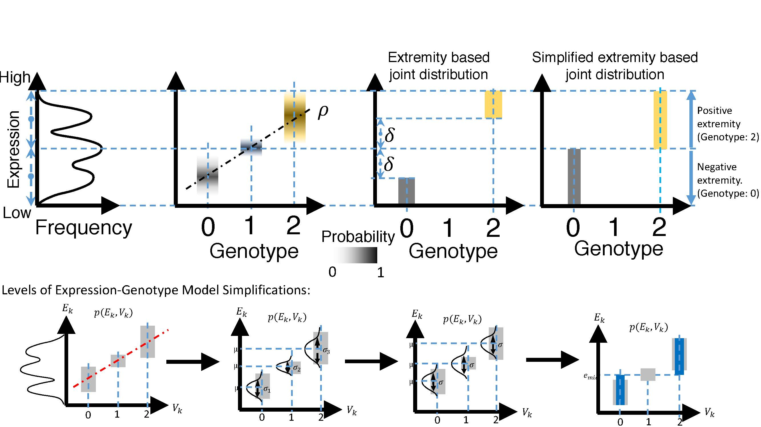
[Harmanciet al. Nat. Meth. (in revision)]

Slide 30
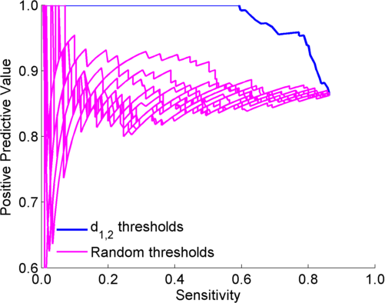
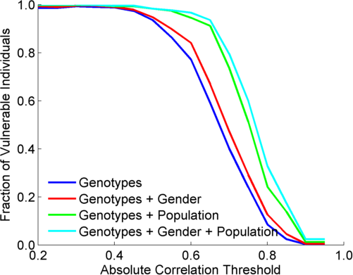
Extremity based linking with
homozygous genotypes
Attacker can estimate the
reliability of linkings
Sensitivity: Fraction of correctly linked
Individuals among all individuals
PPV: Fraction of correctly linked individuals
among selected individuals
[Harmanciet al. Nat. Meth. (in revision)]

Slide 31
Large-scale Transcriptome Mining: Building Interpretative Models while Protecting Individual Privacy
The Dilemma of Genomic Privacy
  Fundamental, inherited info that’s very private vs the need for large-scale data-sharing to enable med. research
  Current Social & Tech Approaches
    Issues: burdensome security, inconsistencies + ways the solutions have been partially "hacked”
    Strawman Hybrid Soc-Tech Proposal (Cloud Enclaves. Quantifying Leaks, & Closely Coupled priv.-public data)
RNA-seq: How to Publicly Share Some of it
  Removing SNVs in reads using MRF
  Quantifying & removing variant info from expression levels + eQTLs
  Linking Attack using extreme expression levels
Large-scale Mining of RNA-seq to Determine State Space Models
  Using dimensionality reduction to help determine internal & external drivers
  Decoupling expression changes into those driven by worm-fly conserved genes vs species-specific ones. Also, Conserved genes have similar canonical patterns (iPDPs) in contrast to species specific ones (Ex of ribosomal v signaling genes)
  In human cell cycle, only conserved genes show matching periodic pattern

Slide 32
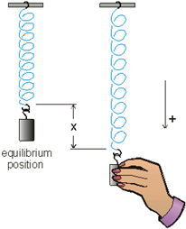
Internal and external gene regulatory networks
Internal Group
External Group
How to identify gene expression dynamics driven by internal/external regulation?
Internal regulation
External regulation
Interested system | Internal regulatory network | External regulatory network
Cross-species conserved genes | Conserved transcriptional factors (TFs) | Non-conserved TFs
Protein-coding genes | TFs | micro-RNAs
Individual’s protein coding genes | Wild-type TFs | Somatic mutated TFs
Protein-coding genes in brain | Commonly expressed TFs | Brain-specific expressed TFs
Protein-coding genes in development | House-keeping TFs | Developmental TFs
External force
[Wang et al. PLOS CB (in revision, ‘15)]
Notes:
connect loregic to here too! to see regulatory mechanisms similar too

Slide 33
State-space model for internal and external gene regulatory networks
Internal Group
External Group
How to identify gene expression dynamics driven by internal/external regulation?
Internal regulation
External regulation
Control: Gene expression vector of external factors at time t
State space model
X_{t+1}
A
X_{t}
B
U_{t}
B_{kl} captures temporal casual influence from external factor k to Gene l in internal group
State: Gene expression vector of Group X at time t+1
A_{ij} captures temporal casual influence from Gene i to Gene j in internal group
State: Gene expression vector of internal group at time t
[Wang et al. PLOS CB (in revision, ‘15)]
Notes:
connect loregic to here too! to see regulatory mechanisms similar too

Slide 34
Effective state space model for meta-genes
Not enough data to estimate state space model for genes
(e.g., 25 time points per gene to estimate 4 million elements of A or B for 2000 genes)
Dimensionality reduction from genes to meta-genes (e.g., SVD)
Effective state space model for meta-genes
(e.g., 250 time points to estimate 50 matrix elements if 5 meta-genes)
[Wang et al. PLOS CB (in revision, ‘15)]

Slide 35
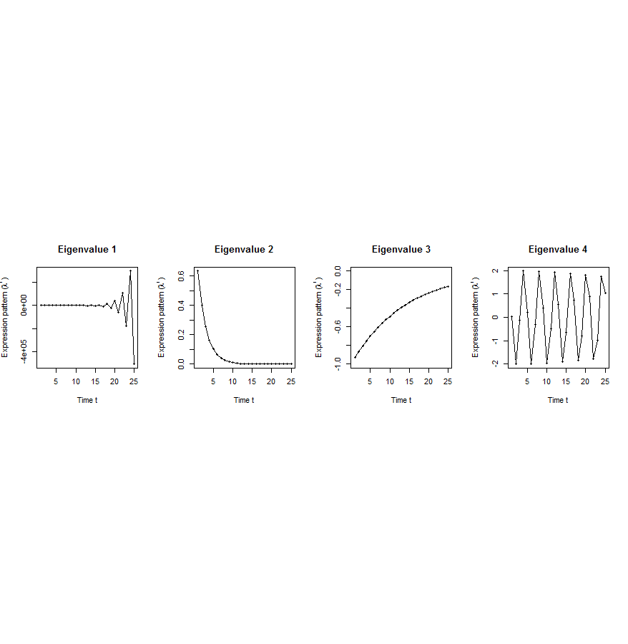
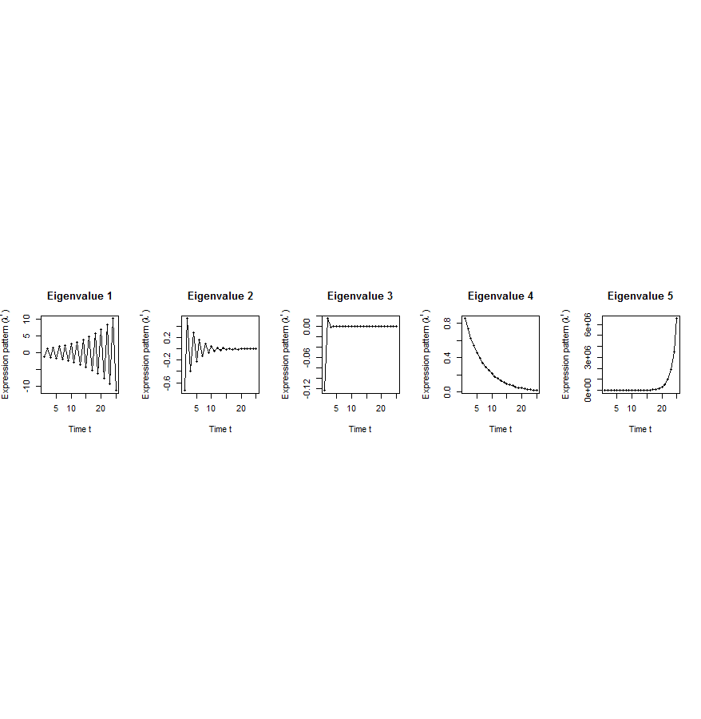
Canonical temporal expression trajectories from effective state space model
Internal driven dynamics
Externally driven dynamics
p^{th} internal principal dynamic pattern (iPDP): [λ_{p}¹, λ_{p}², …, λ_{p}^{T}],
where λ_{p} is p^{th} eigenvalue of Ã.
q^{th} external principal dynamic pattern (ePDP): [σ_{q}¹, σ_{q}², …, σ_{q}^{T}],
where σ_{q} is q^{th} eigenvalue of .
Canonical temporal expression trajectories
(e.g., degradation, growth, damped oscillation, etc.)
iPDP expression
ePDP expression
time
time
[Wang et al. PLOS CB (in revision, ‘15)]
Notes:
if we look at A tilde, it controls the dynamic trajectory of expression part internally driven by meta-genes of X. according to the analytic solution, the internally driven expression part Xtilde I can be linear combinations of A tilde’s eigenvalue’s exponentials across time, which are defined by us as internal principal dynamic pattern (iPDP). B tilde controls the dynamic trajectory of X’s metagene expression part externally driven by U. similarly, we can find external principal dynamic pattern (ePDP) based on B tilde’s eigenvalue exponentials across time. Actually, those patterns are canonical temporal expression trajectories, which are as simple as degradation, growth, damped oscillation temporal processes). In short, from metagene effective model, we are able to identify internal and external driven canonical temporal expression trajectories.

Slide 36
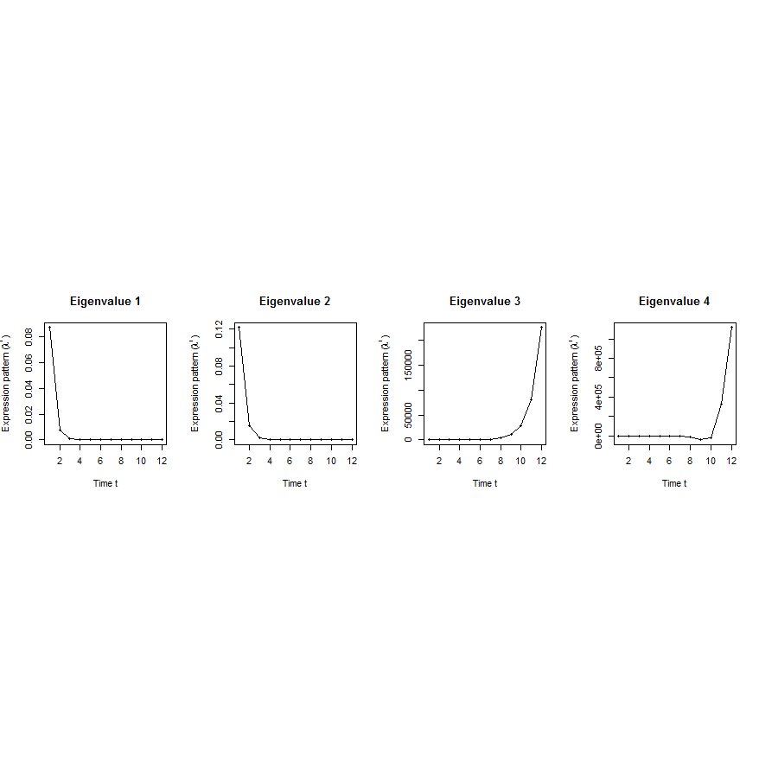
Flowchart
[Wang et al. PLOS CB (in revision, ‘15)]
A. Gene state-space model
C. Meta-gene state-space model
B. Dimensionality Reduction
X_{t+1}=AX_{t}+BU_{t}
Genes of X
Meta-genes of X
time
E. Gene’s internal (INT) and external (EXT) driven expression dynamics composed of PDPs
D. Internal/External Principal Dynamic Patterns (PDPs)
time
[λ_{p}¹, λ_{p}², …, λ_{p}^{T}] [σ_{q}¹, σ_{q}², …, σ_{q}^{T}]
x^{INT}=c₁ +c₂
+c₃ +c₄
Genes of U
Meta-genes of U
time
time
…
x^{EXT}=d₁ +d₂
+d₃ +d₄
/
Internal regulation among genes/meta-genes Group X by A/Ã
/
External regulation from genes/meta-genes in Group U
to genes/meta-genes in Group X by B/
/
Genes/Meta-genes in Group X
/
Genes/Meta-genes in Group U

Slide 37
Are gene regulations among orthologs conserved across species?
Are gene regulatory networks among orthologs conserved across species?
Species A
Species B
orthologs
co-expressed
Regulation among orthologs (internal)
Regulation from species-specific factors (external)
Orthologous genes (orthologs)
Species-specific transcription factors
To what degree can’t ortholog expression levels be predicted due to species-specific regulation
[Wang et al. PLOS CB (in revision, ‘15)]
Notes:
connect loregic to here too! to see regulatory mechanisms similar too

Slide 38
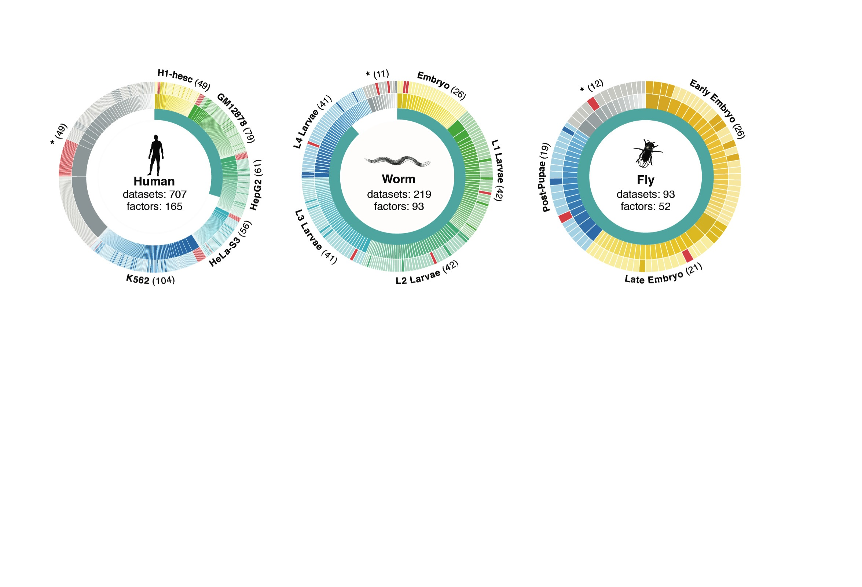
Time-course gene expression data of worm & fly development
[Nature 512:445 ('14); doi: 10.1038/nature13424]
Organism | Major developmental stages
worm (C. elegans) | 33 stages: 0, 0.5, 1, …, 12 hours, L1, L2, L3, L4, …, Young Adults, Adults
fly (D. mel.) | 30 stages: 0, 2, 4, 6, 8,…, 20, 22 hours, L1-L4, Pupaes, Adults

Slide 39
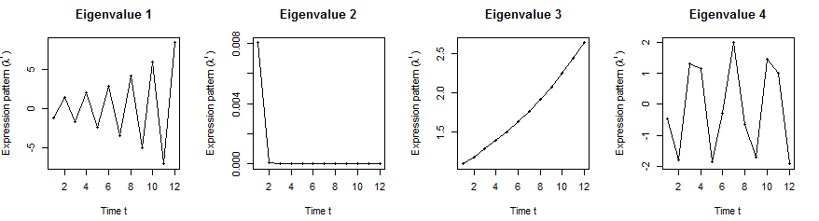
Orthologs have similar internal but different external dynamic patterns during embryonic development
Worm’s effective state space model
iPDPs: time exponentials of Ã eigenvalues in worm
ePDPs: time exponentials of eigenvalues in worm
1st iPDP
2nd iPDP
3rd iPDP
4th iPDP
1st ePDP
2nd ePDP
3rd ePDP
4th ePDP
Expression
Expression
Similar iPDP canonical trajectories
Different ePDP canonical trajectories
1st iPDP
2nd iPDP
3rd iPDP
4th iPDP
1st ePDP
2nd ePDP
3rd ePDP
4th ePDP
Expression
Expression
iPDPs: time exponentials of Ã eigenvalues in fly
ePDPs: time exponentials of eigenvalues in fly
Fly’s effective state space model
[Wang et al. PLOS CB (in revision, ‘15)]

Slide 40
Orthologs have correlated iPDP coefficients
1st iPDP
2nd iPDP
r=+0.33
r=+0.66
Coefficients of orthologs on fly iPDPs
3rd iPDP
4th iPDP
r=+0.67
r=+0.73
Coefficients of orthologs on worm iPDPs
[Wang et al. PLOS CB (in revision, ‘15)]

Slide 41
Evolutionarily conserved and younger genes exhibit the opposite internal and external PDP coefficients
iPDP coeffs > ePDP coeffs | Worm | Fly
Ribosomal genes | p<0.001 | p<2.2e-16
Ribosomal genes have significantly larger coefficients for the internal than external PDPs, but signaling genes exhibit the opposite trend
Coefficients of ribosomal related genes (absolute)
iPDPs ePDPs
iPDP coeffs < ePDP coeffs | Worm | Fly
Signaling genes | p<7e-4 | p<6e-4
* p-values from KS-test
[Wang et al. PLOS CB (in revision, ‘15)]
Notes:
Ribosomal related genes: coefficients over conserved (iPDP) and specific (ePDP) meta-patterns

Slide 42
Breast cancer cell cycle under hormonal stimulation
Dataset | Group X (internal) | Group U (external) | Time samples of a full cell cycle
Human breast cancer cell cycle under hormonal stimulation | 1132 metazoan conserved genes incl. 150 orthologous TFs | 1870 non-conserved metazoan transcription factors | T=12 time points: 0, 4, 6, 8, 12, …, 28, 32 hours
Oscillated iPDP by conserved TFs
a full cell cycle
Oscillated ePDP by non-conserved TFs
faster cycle due to hormone
[Wang et al. PLOS CB (in revision, ‘15)]

Slide 43
Large-scale Transcriptome Mining: Building Interpretative Models while Protecting Individual Privacy
The Dilemma of Genomic Privacy
  Fundamental, inherited info that’s very private vs the need for large-scale data-sharing to enable med. research
  Current Social & Tech Approaches
    Issues: burdensome security, inconsistencies + ways the solutions have been partially "hacked”
    Strawman Hybrid Soc-Tech Proposal (Cloud Enclaves. Quantifying Leaks, & Closely Coupled priv.-public data)
RNA-seq: How to Publicly Share Some of it
  Removing SNVs in reads using MRF
  Quantifying & removing variant info from expression levels + eQTLs
  Linking Attack using extreme expression levels
Large-scale Mining of RNA-seq to Determine State Space Models
  Using dimensionality reduction to help determine internal & external drivers
  Decoupling expression changes into those driven by worm-fly conserved genes vs species-specific ones. Also, Conserved genes have similar canonical patterns (iPDPs) in contrast to species specific ones (Ex of ribosomal v signaling genes)
  In human cell cycle, only conserved genes show matching periodic pattern

Slide 44

Acknowledgements
DREISS.gersteinlab.org
D Wang, F He, S Maslov
papers.gersteinlab.org/subject/privacy
D Greenbaum
PrivaSeq.gersteinlab.org
A Harmanci
RSEQtools.gersteinlab.org
L Habegger, A Sboner, TA Gianoulis, J Rozowsky, A Agarwal, M Snyder
Hiring Postdocs. See gersteinlab.org/jobs !

Slide 45
Default Theme
Default Outline Level 1
  Level 2

Slide 46
More Information on this Talk
SUBJECT: Networks
DESCRIPTION:
NOTES:
This PPT should work on mac & PC. Paper references in the talk were mostly from Papers.GersteinLab.org.
PERMISSIONS: This Presentation is copyright Mark Gerstein, Yale University, 2010. Please read permissions statement at http://www.gersteinlab.org/misc/permissions.html . Feel free to use images in the talk with PROPER acknowledgement (via citation to relevant papers or link to gersteinlab.org).
PHOTOS & IMAGES. For thoughts on the source and permissions of many of the photos and clipped images in this presentation see http://streams.gerstein.info . In particular, many of the images have particular EXIF tags, such as kwpotppt , that can be easily queried from flickr, viz: http://www.flickr.com/photos/mbgmbg/tags/kwpotppt .
Notes:
46

