Slide 1


Activities in SVs, focusing on breakpoint characterization
Mark Gerstein, Yale

Slide 2
Our Activities Related to SVs
SV calling (eg Retroduplications)
Functional enrichment
Breakpoints/Mechanism study

Slide 3
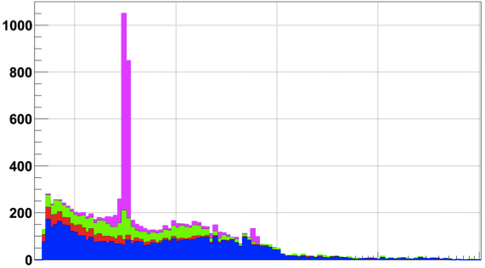
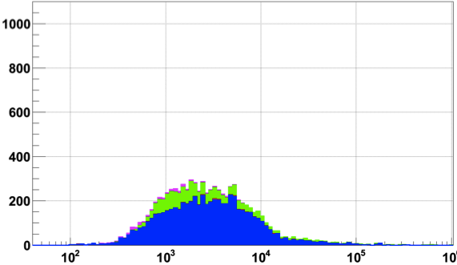
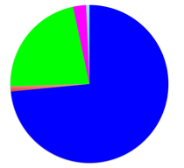
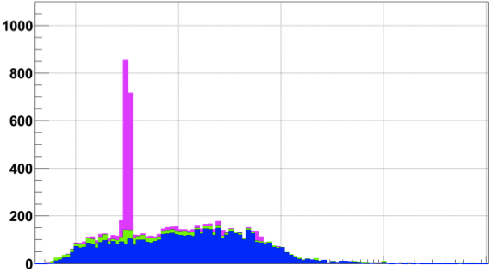
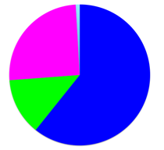
Breakpoint characterization in 1000G
Breakseq #1 w/ ~2000 breakpoints [Lam et al. Nat. Biotech. (‘10)]
Pilot
Phase 1 “Integrated” &
Phase 1 refined
Phase 3
Pilot set
Integrated set
TEI
NAHR
NH
VNTR
2,839
(2,644)
6,104
(6,299)
23,850
(23,655)
Phase 1
Count of deletions
Refined
Phase 1
Phase 3
Exact match
Number in parentheses: >50% reciprocal match
Notes:
2839 unique Phase 1 events were b/c Phase 3 did assembly of only large events

Slide 4
8,943 Deletion Breakpoints
(Phase I Refined)
FDR from IRS, PCR, and high-coverage trios
  ~7% for site existence
  13% for site existence + sequence precision
Data for 1,092 samples
Multiple CNV callers
Call merging
Breakpoint assembly
Mapping to junctions

Slide 5
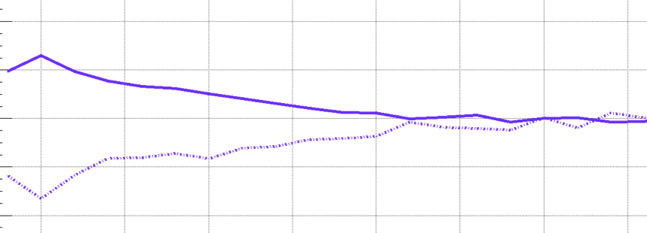
Higher SNP Density and Relaxed Selection at NH Breakpoints
+4%
NH
SNP density
-4%
Conservation score
0
700 Kbps
Notes:
SNP density at NAHR bkpts is driven by excessive C>T
A consequence of high CpG%

Slide 6
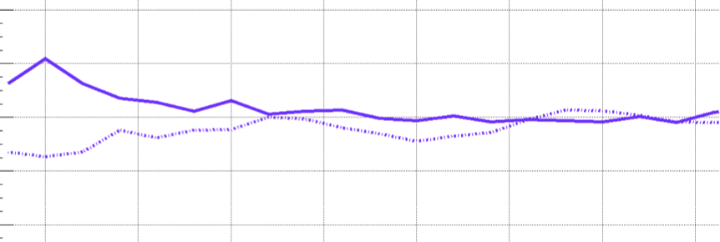
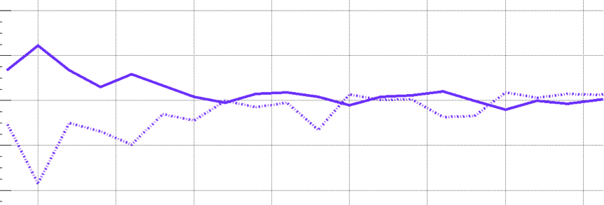
Higher SNP Density and Relaxed Selection at all Breakpoints
+4%
NH
SNP density
-4%
Conservation score
+4%
TEI
-4%
+4%
NAHR
-4%
0
700 Kbps
Notes:
SNP density at NAHR bkpts is driven by excessive C>T
A consequence of high CpG%

Slide 7
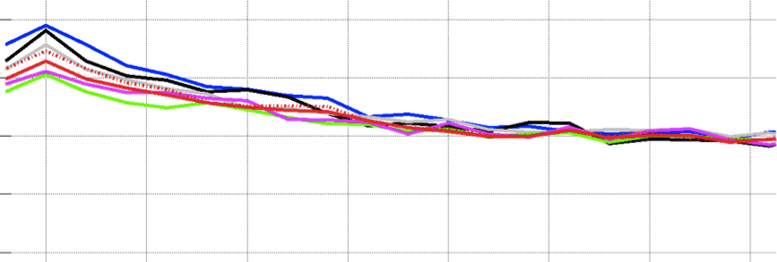
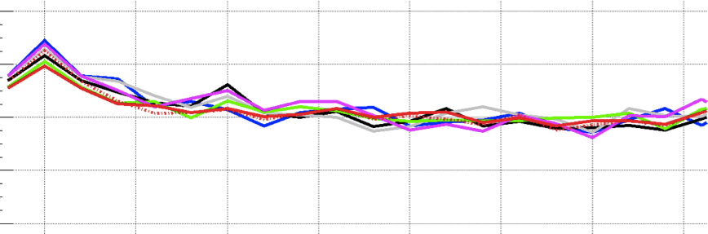
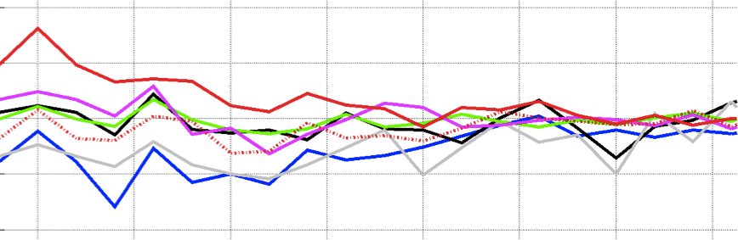
SNP Density at NAHR is Driven by High C>T
C>A C>G C>T
T>A T>C T>G
C>T outside CpG
+4%
NH
SNP density
-4%
Conservation score
+4%
TEI
-4%
+4%
NAHR
-4%
0
700 Kbps
Notes:
SNP density at NAHR bkpts is driven by excessive C>T
A consequence of high CpG%

Slide 8
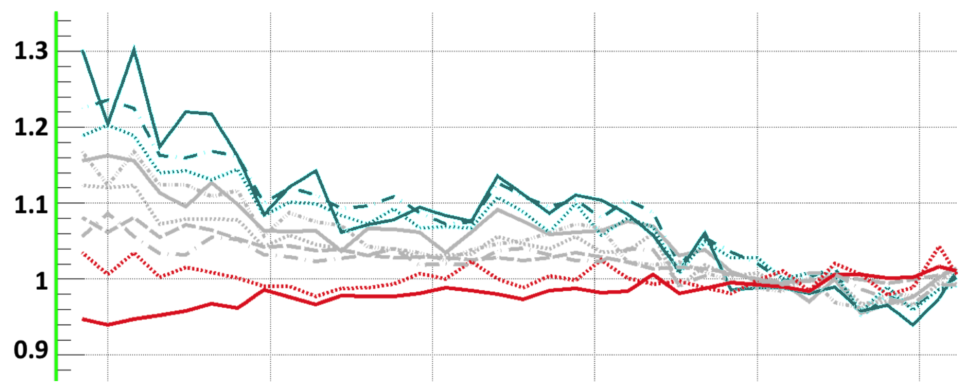

NAHR breakpoint are associated with open chromatin environment
TEI
NAHR
NH
Supported by Hi-C and
Histone modification
Hypothesis: Some NAHR
deletions occur w/o cell
Replication
* H1 & GM12878 cells
Closed
Open
0 ±0.5 ±1 ±1.5 ±2 ±2.5
Distance from breakpoints, Mbps
Abyzov et al. 2015

Slide 9
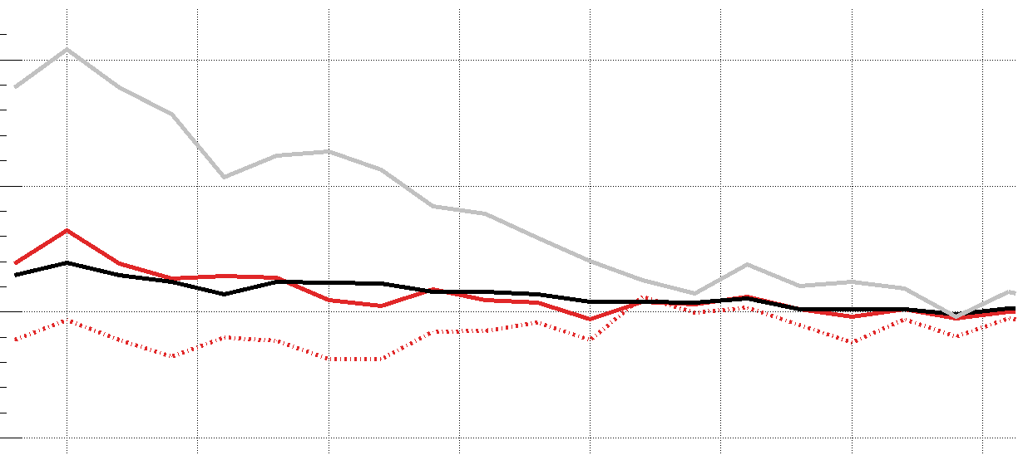
Methylation pattern associated with breakpoints mechanisms
Lower C>T in CpG around NAHR breakpoints
  indicates lower methylation level in germline & embryonic cells
Confirmed in male gamete
TEI
NAHR
NH
+10%
6
1
CpG%
NAHR
C>T(all)
Hypomethylated regions in sperm
GC%
C>T(CpG)
-5%
0
700 Kbps
-10 0 10
Distance from breakpoints, Kbps

Slide 10
Micro-homologies
Identified around Breakpoints
Breakpoints have
Micro-homologous sequences
with the template sites.

Slide 11
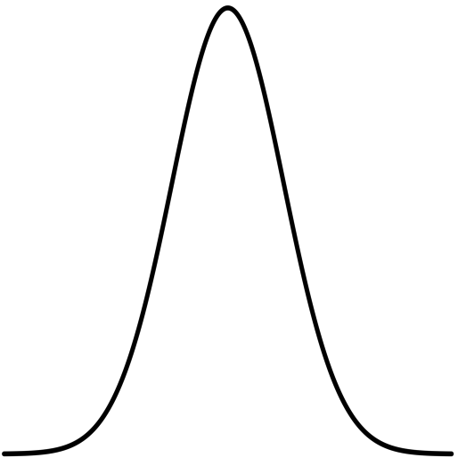
NH deletions are often coupled with micro-insertions
Templates located at 2 characteristic distances from breakpoints, which tend to replicate late
Suggests spatial & temporal configuration of DNA during template switching

Slide 12
More about breakpoints/mechanisms
See shadow

Slide 13
More Functional Characterization of SVs
See shadow

Slide 14
More SV calling & retrodups
See shadow

Slide 15
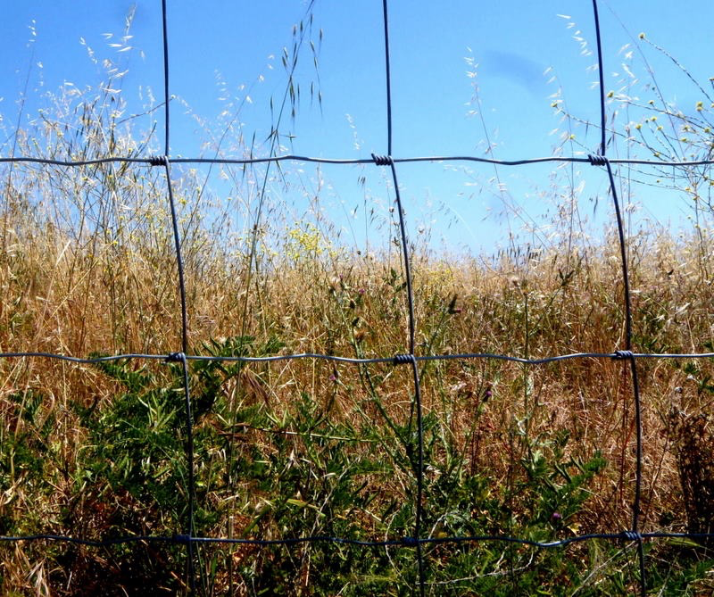

Acknowledgements
Refined Phase 1 Breakpoints Analysis
Alexej Abyzov,
Shantao Li,
Daniel Rhee Kim, Marghoob Mohiyuddin, Adrian Stuetz, Nicholas F. Parrish, Xinmeng Jasmine Mu, Wyatt Clark, Ken Chen, Matthew Hurles, Jan Korbel, Hugo Y.K. Lam, Charles Lee
Other SV participants
  Y Zhang, J Zhang,
  F Navarro, S Kumar

Slide 16
Info about content in this slide pack
Breakpoints analysis was from Abyzov et al. Nat. Comm. (’15, in press)
General PERMISSIONS
  This Presentation is copyright Mark Gerstein,
  Yale University, 2015.
  Please read permissions statement at
  http://www.gersteinlab.org/misc/permissions.html .
  Feel free to use slides & images in the talk with PROPER acknowledgement
  (via citation to relevant papers or link to gersteinlab.org).
  Paper references in the talk were mostly from Papers.GersteinLab.org.
For SeqUniverse slide, please contact Heidi Sofia, NHGRI
PHOTOS & IMAGES. For thoughts on the source and permissions of many of the photos and clipped images in this presentation see http://streams.gerstein.info .
  In particular, many of the images have particular EXIF tags, such as kwpotppt , that can be easily queried from flickr, viz: http://www.flickr.com/photos/mbgmbg/tags/kwpotppt

