Slide 1

Analysis of Protein Networks:
Using 3D-structure into interpret networks & deep-sequencing data
Slides freely downloadable from
Lectures.GersteinLab.org
& “tweetable” (via @markgerstein)
See Last Slide for References & More Info.
Mark B Gerstein
Yale

Slide 2
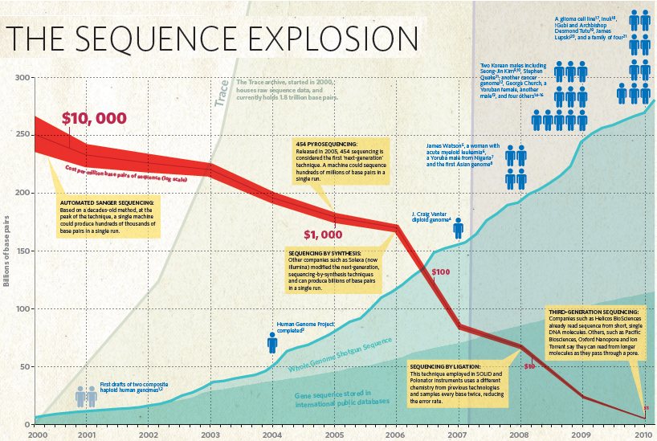
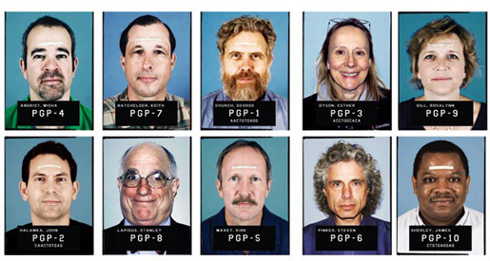


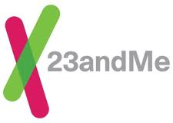




Nature (2010)

Slide 3
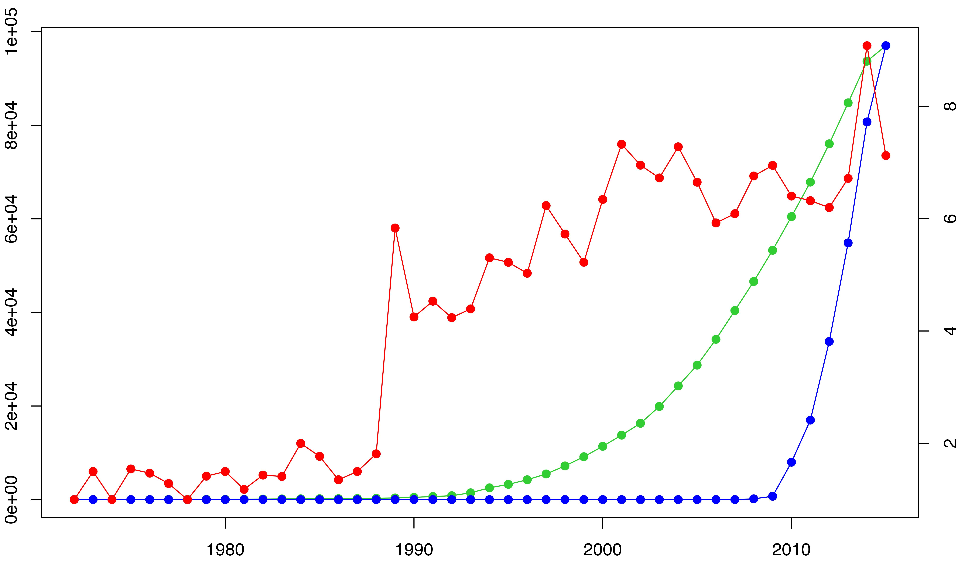
Trends in data generation point to growing opportunities for leveraging sequence variants to study structure (and vice versa)
The volume of sequenced exomes is outpacing that of structures, while solved structures have become more complex in nature.
Cumulative # of X-ray structures and # exomes
Avg # chains per PDB (top 10% for each year)
Year
Exome data hosted on NCBI Sequence Read Archive (SRA)

Slide 4
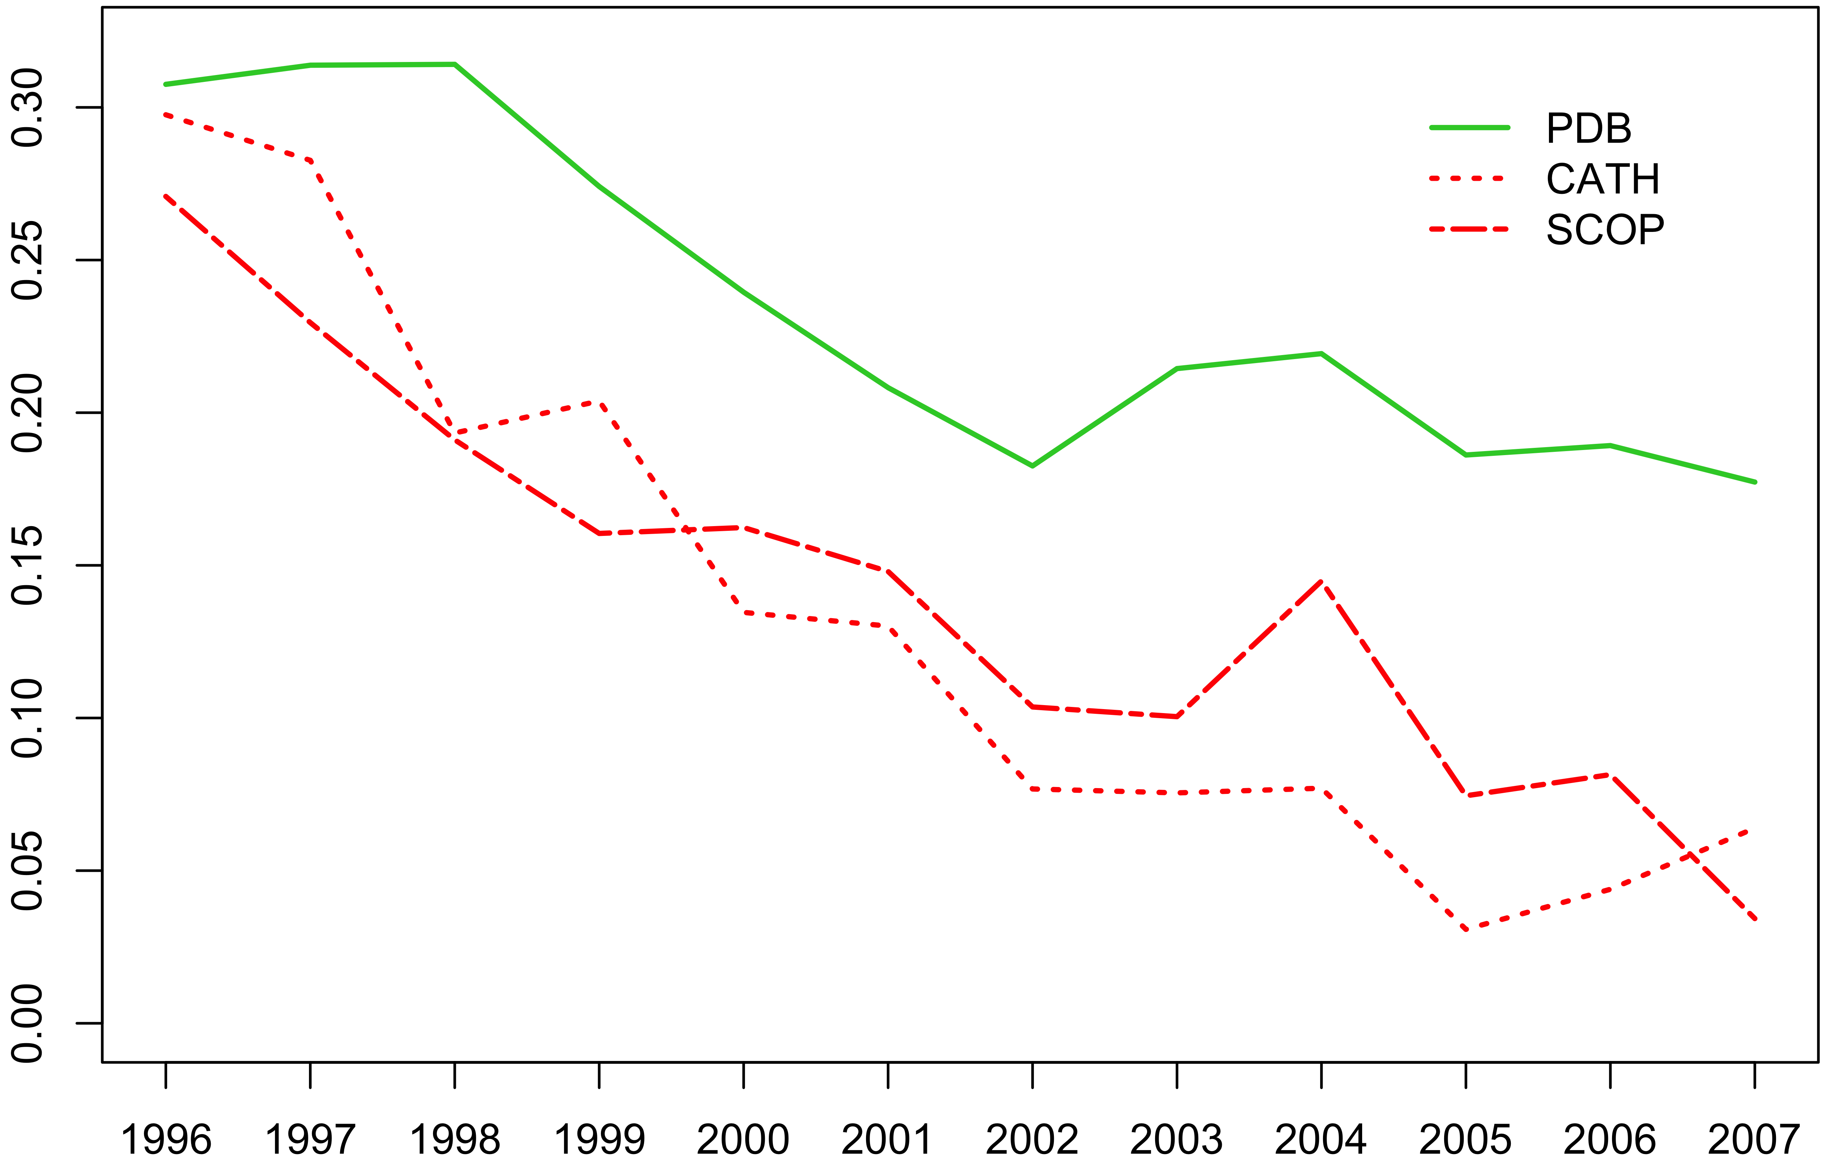
Growing sequence redundancy in the PDB (as evidenced by a reduced pace of novel fold discovery) offers a more comprehensive view of how such sequences occupy conformational landscapes
% Increase
Year
PDB: Berman HM, et al. NAR. (2000)
CATH: Sillitoe I, et al. NAR. (2015)
SCOP: Fox NK et al. NAR. (2014)

Slide 5
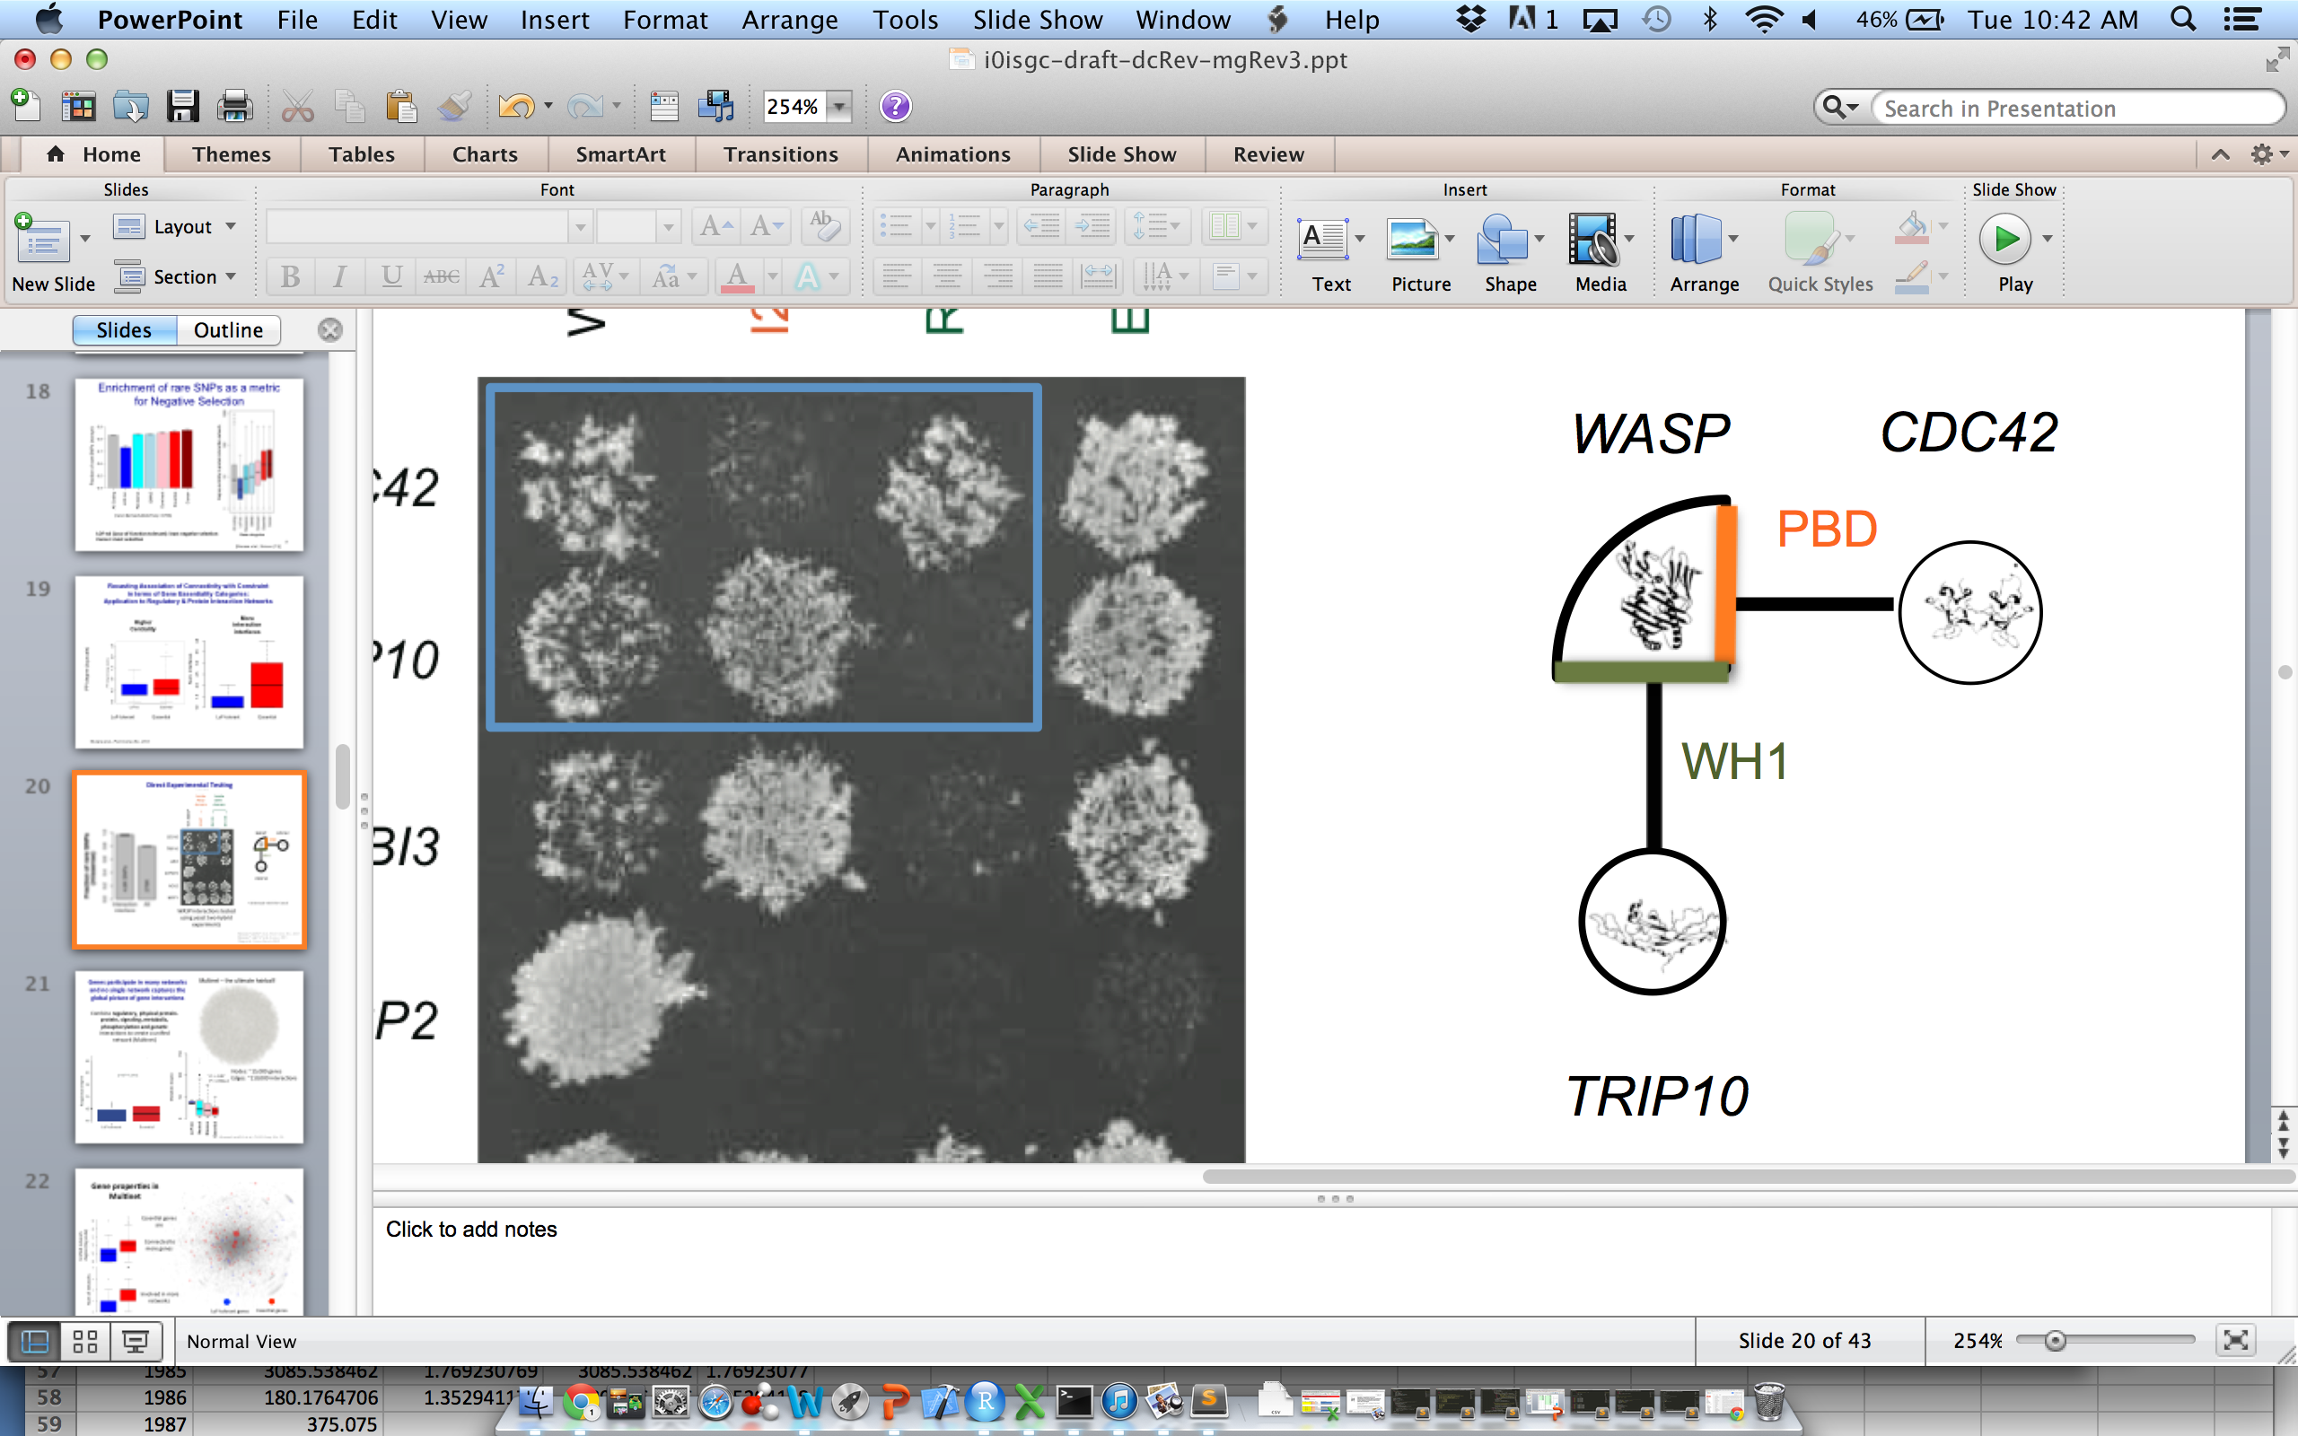
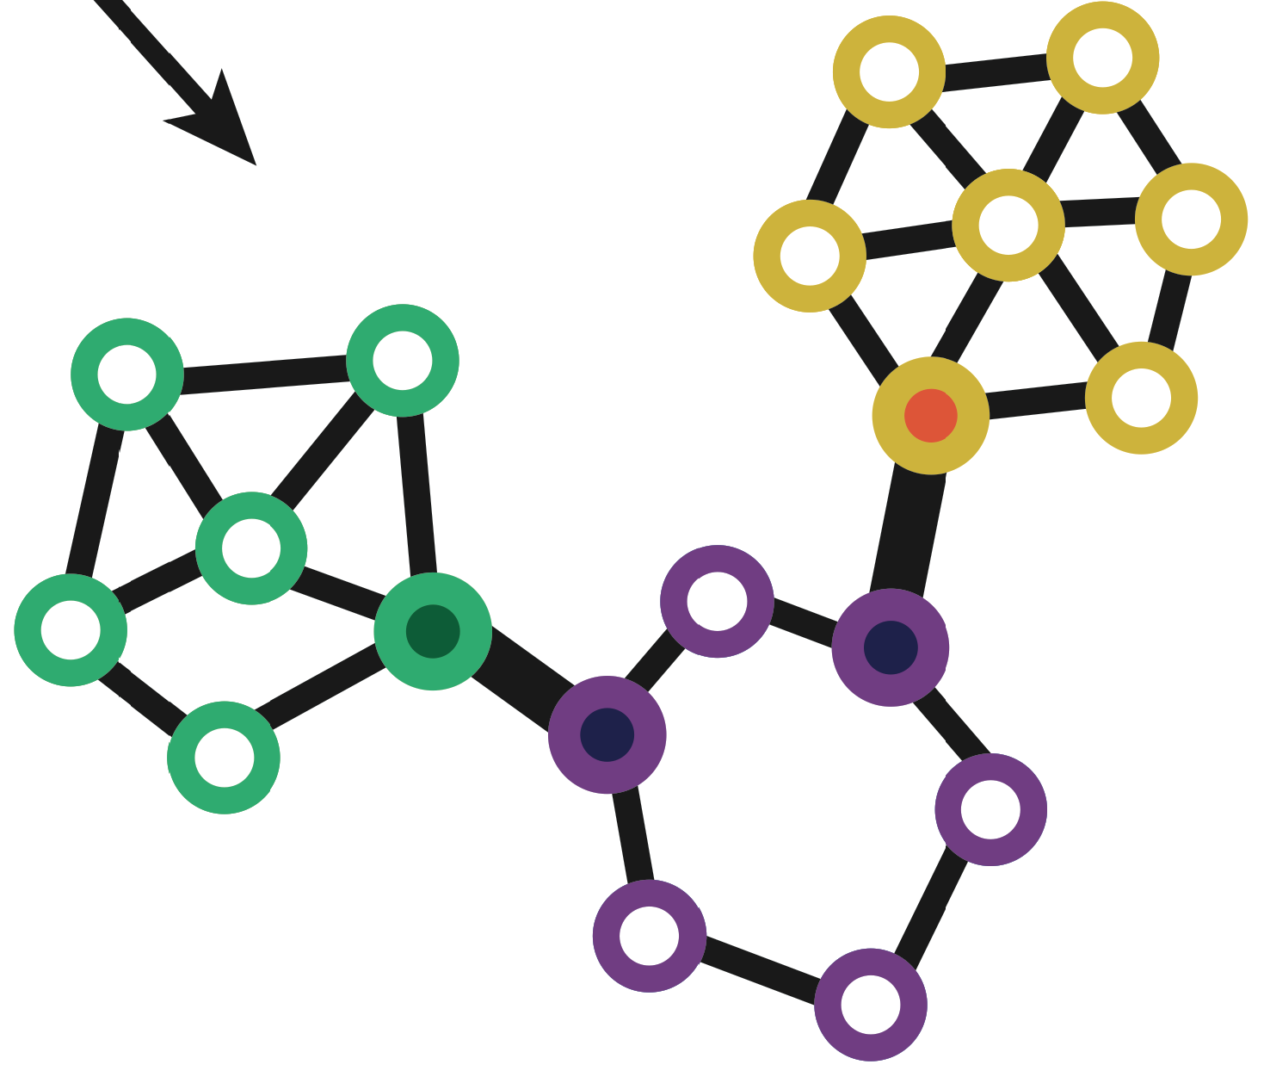
Using 3D-structure into interpret networks & deep-sequencing data
Structural Interaction Network & Protein Motions (DynaSIN)
  Multi-interface permanent hubs have more motion than single-interface transient ones
  Also have more conflicting motions
LOF variants & Categories of Essential & Disease-sensitive Genes
Variation at Protein Interfaces in the context of Network Connectivity & its use for Disease-gene Predictions
  Highly connected parts of PPI under stronger selection but signal weak
  Stronger signal in SIN & even stronger in multiNet (integration of many networks)
  Signal strong enough to build predictor
Rationalizing Deleterious Variants in terms of Potential Allosteric Sites
  Identifying potential allosteric residues on surface & inside
  These are under stronger selection & may explain some HGMD SNPs

Slide 6
Using 3D-structure into interpret networks & deep-sequencing data
Structural Interaction Network & Protein Motions (DynaSIN)
  Multi-interface permanent hubs have more motion than single-interface transient ones
  Also have more conflicting motions
LOF variants & Categories of Essential & Disease-sensitive Genes
Variation at Protein Interfaces in the context of Network Connectivity & its use for Disease-gene Predictions
  Highly connected parts of PPI under stronger selection but signal weak
  Stronger signal in SIN & even stronger in multiNet (integration of many networks)
  Signal strong enough to build predictor
Rationalizing Deleterious Variants in terms of Potential Allosteric Sites
  Identifying potential allosteric residues on surface & inside
  These are under stronger selection & may explain some HGMD SNPs

Slide 7
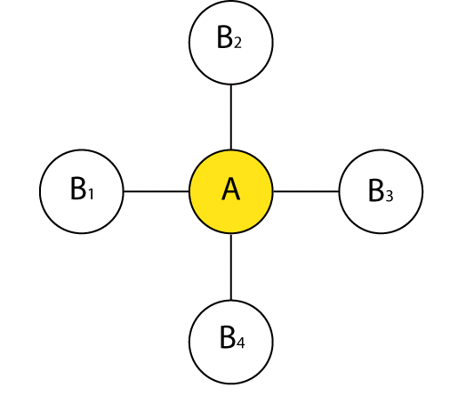
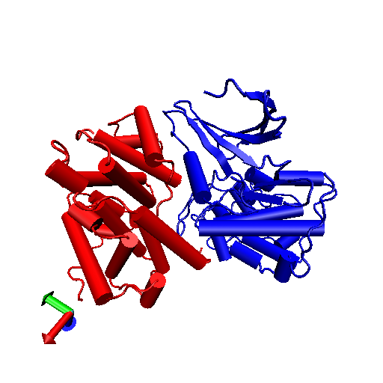
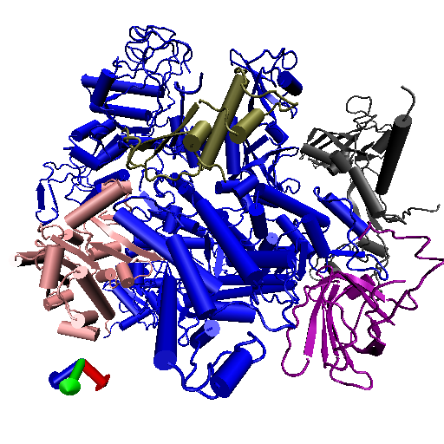
Network perspective:
=
There remains a rich source
of knowledge unmined by network
theorists!
Structural biology perspective:
B4
B1-4
A
B3
≠
B1
A
B2
Cdk/cyclin complex
Part of the RNA-pol complex
Source: Kim et al. Science (2006)

Slide 8
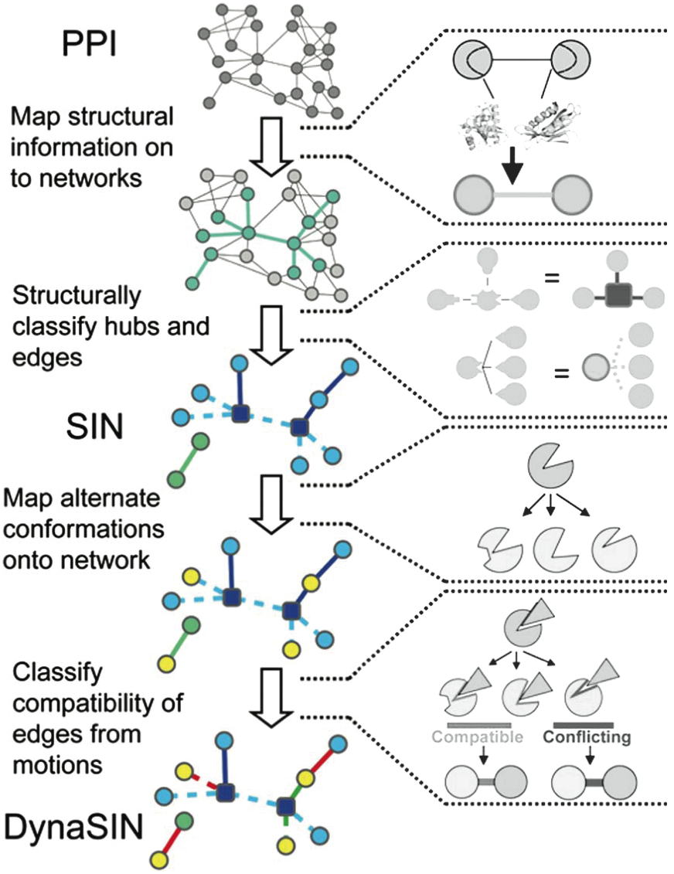
Overview of DynaSIN
Construction
DynaSIN.MolMovDB.org
[Bhardwaj et al. (’11) Prot Sci]
Notes:
Flip red and green

Slide 9
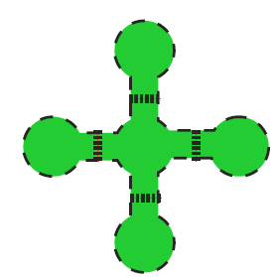
Overview of DynaSIN
Construction
“Permanent”
Interactions in Multi-Interface Hub
“Transient”
Interactions in Single-interface Hub
[Bhardwaj et al. (’11) Prot Sci]
Notes:
add trans

Slide 10
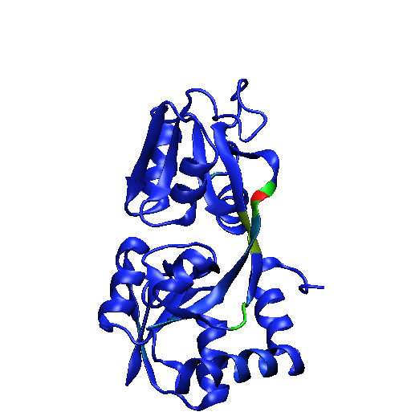
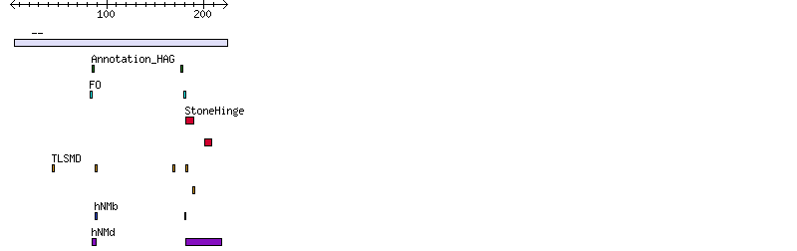
EX: Glutamine Binding Protein
MolMovDB.org :
Analysis of a single motion to characterize with it standard stats (eg rot. Angle) & find key residues (eg hinges) using a variety of tools
[Flores et al. Proteins ('08)]

Slide 11
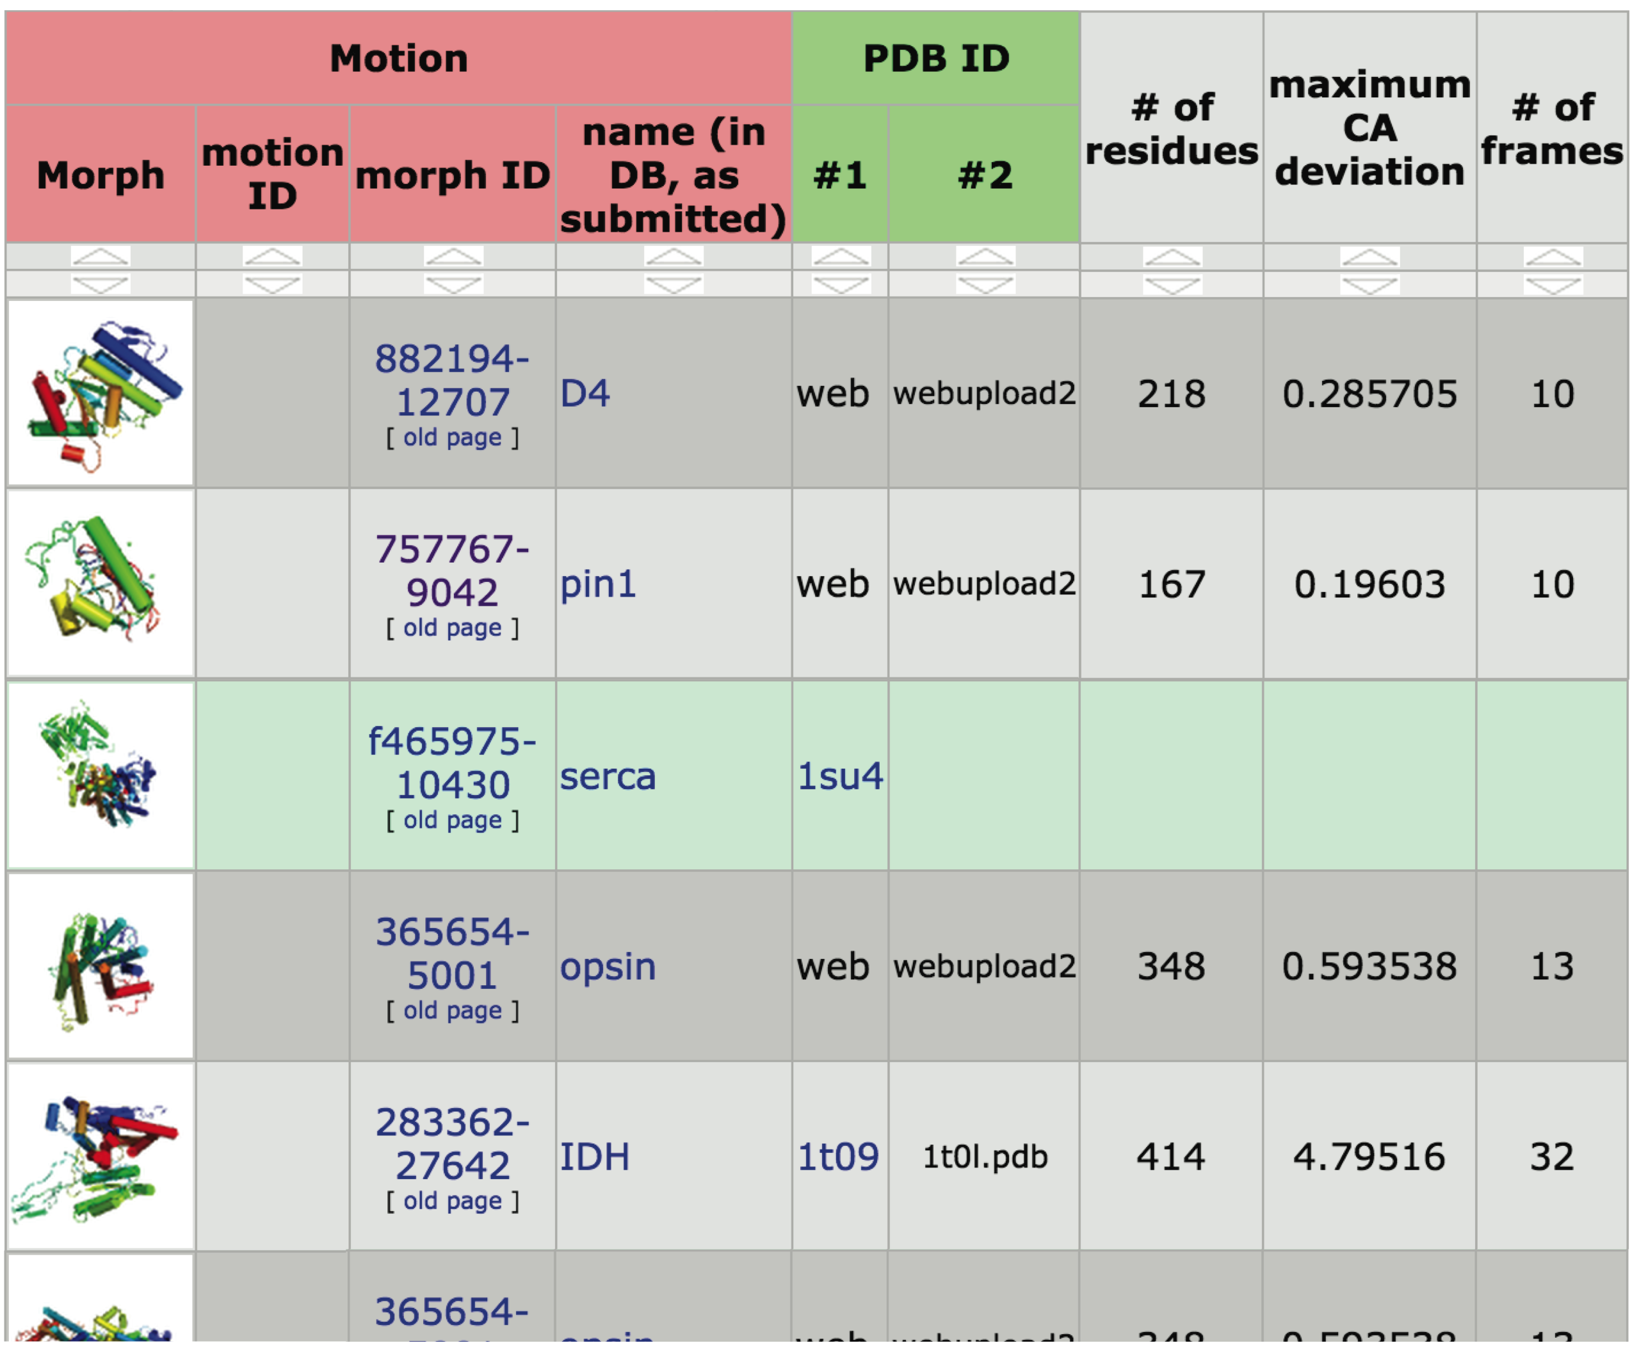
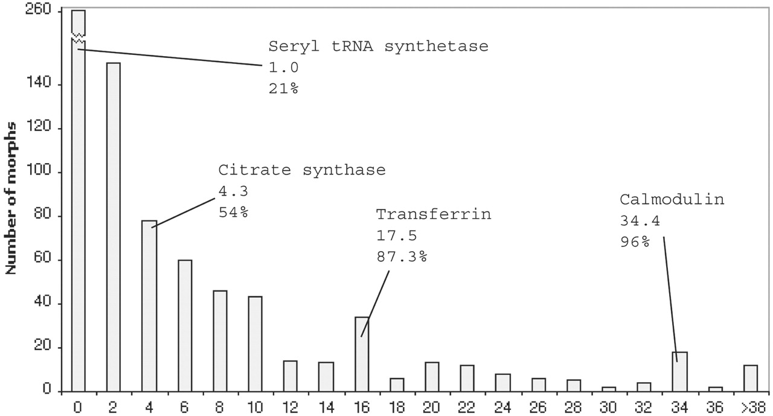
MolMovDB: determining population statistics on protein motions
Distribution across user-submitted morphs
[Echols et al. (‘02) NAR 31:478]
Average Displacement of Moving Core

Slide 12
Overview of DynaSIN
Construction
DynaSIN.MolMovDB.org
[Bhardwaj et al. (’11) Prot Sci]
Notes:
Flip red and green

Slide 13
Overview of DynaSIN
Construction
‘Compatible’
motions
‘Conflicting’
motion
DynaSIN.MolMovDB.org
[Bhardwaj et al. (’11) Prot Sci]
Notes:
Flip red and green

Slide 14
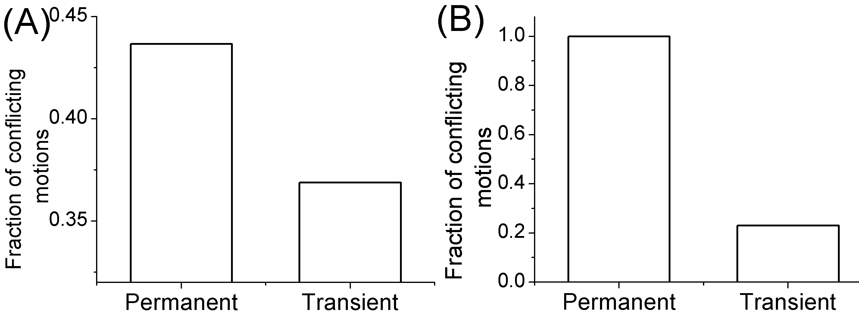
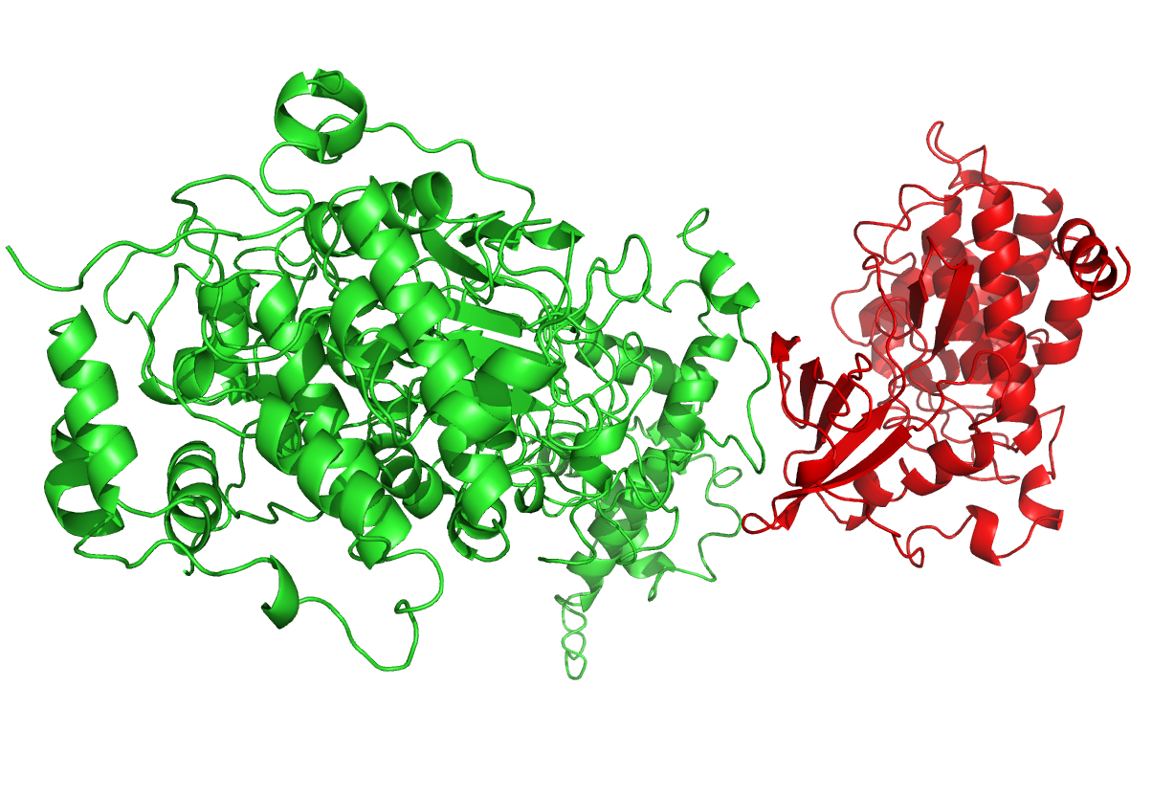
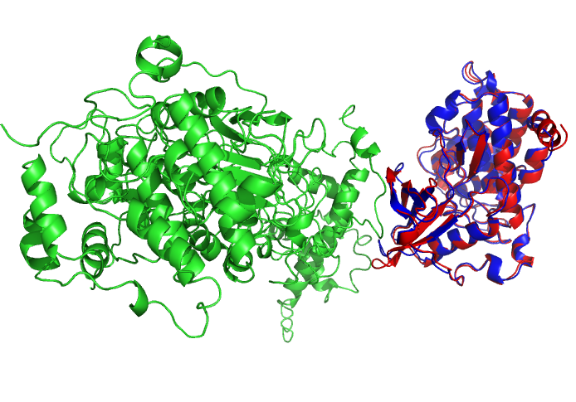
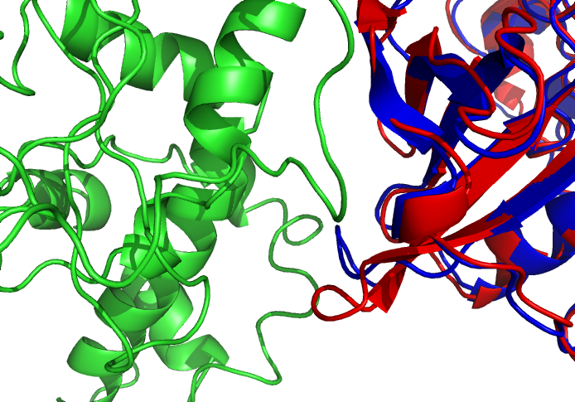
Conflicting and compatible interactions
Protein Kinase CK2 β
Protein Kinase CK2 α
“Permanent” “Transient”
Blue: alternate conformation
[Bhardwaj et al. (’11) Prot Sci] dynasin.gersteinlab.org
Notes:
Supplement figure: real example.

Slide 15
The degree of conformational change correlates with hub properties
hubs >
non-hubs
multi-interface >
singlish-interface
many-interface proteins >
few-interface proteins
non-hubs
hubs
singlish-
interface
multi-
interface
3 5 7 9 11
Num. Interfaces
* Note: All p-values < 4E-3
[Bhardwaj et al. (’11) Prot Sci] dynasin.gersteinlab.org
Notes:
Human only

Slide 16
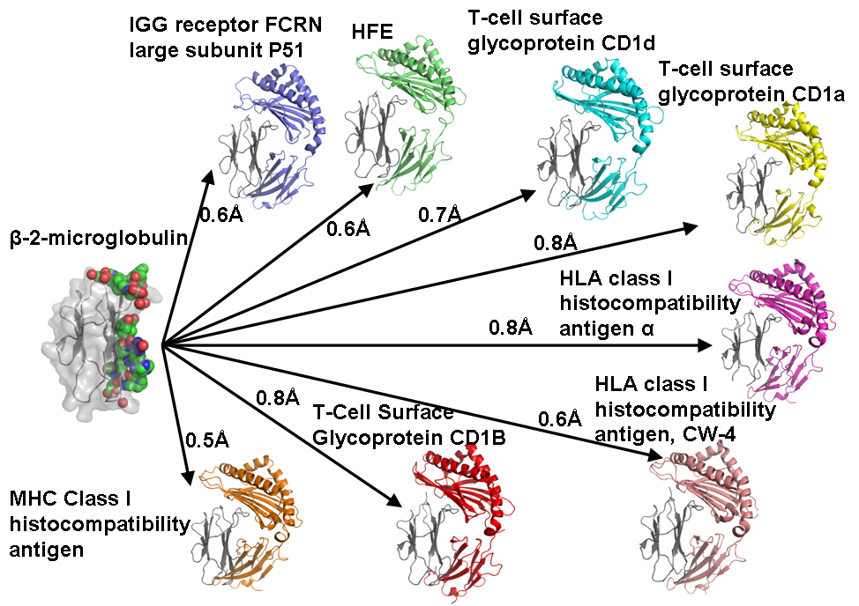
Examples: Single Interface Hubs
[Bhardwaj et al. (’11) Prot Sci] dynasin.gersteinlab.org

Slide 17
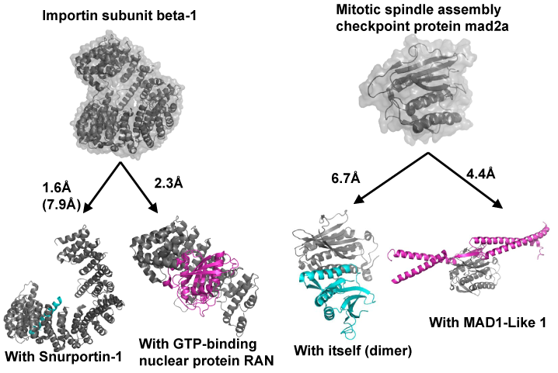
Examples: Multi-interface hubs Hubs
[Bhardwaj et al. (’11) Prot Sci] dynasin.gersteinlab.org

Slide 18
Rationalization: “Permanent” vs “Transient” Interactions
Single-interface hub
interactions
→Less interface modification
(lower energy barrier) for
frequently-changing
interactions
Multi-interface hub
interactions
→Only need to pay high
energetic costs for larger
changes infrequently
[Bhardwaj et al. (’11) Prot Sci] dynasin.gersteinlab.org

Slide 19
Using 3D-structure into interpret networks & deep-sequencing data
Structural Interaction Network & Protein Motions (DynaSIN)
  Multi-interface permanent hubs have more motion than single-interface transient ones
  Also have more conflicting motions
LOF variants & Categories of Essential & Disease-sensitive Genes
Variation at Protein Interfaces in the context of Network Connectivity & its use for Disease-gene Predictions
  Highly connected parts of PPI under stronger selection but signal weak
  Stronger signal in SIN & even stronger in multiNet (integration of many networks)
  Signal strong enough to build predictor
Rationalizing Deleterious Variants in terms of Potential Allosteric Sites
  Identifying potential allosteric residues on surface & inside
  These are under stronger selection & may explain some HGMD SNPs

Slide 20
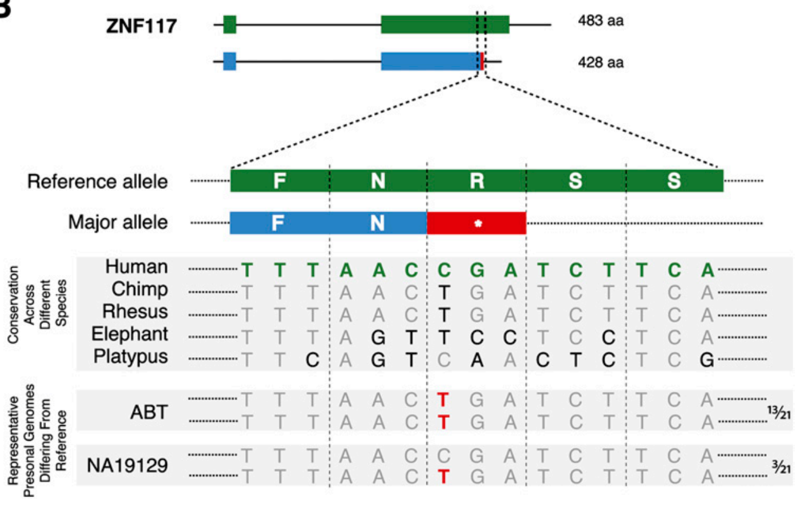
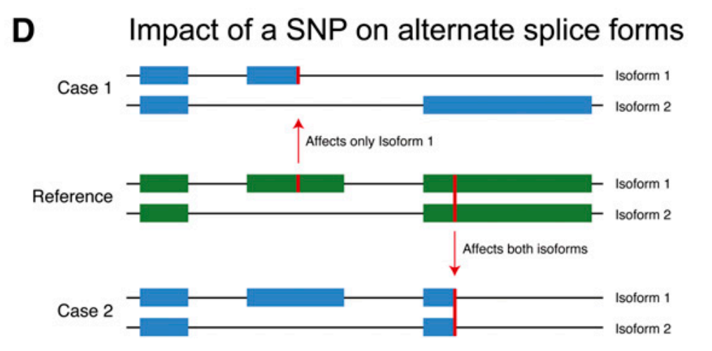
LOF variants
[Balasubramanian et al., Genes Dev., ’11]

Slide 21
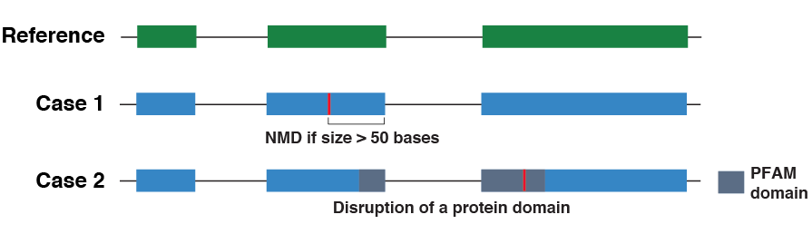
Making Sense Of Nonsense
Tricky to find true LOFs
Use VAT tool
Some further complexities beyond alt. splicing
Future: use more structural & protein knowledge
Balasubramanian S., et al. Genes Dev 25: 1-10, 2011
Notes:
Here the reference allele is indicated in green. When a nonsense SNP is found in a protein, it can either lead to gene inactivation either by NMD or disruption of a functional domain.

Slide 22
Number Of LoF Variants In An Individual
Initial estimate of 250-300
LoF variants.
Enriched for sequencing,
annotation artifacts.
Each of us probably carry
~ 100 genuine LoF variants.
Majority of the LoF variants
are rare.
Each individual has ~ 20
homozygous LoF variants
Phase 1 Update:
~150 LOF/individual
but only 10-20 of these rare
[MacArthur, Balasubramanian, et al., Science (’12);
1000 Genomes Consortium, Nature (’12)]
5
Notes:
25% are due to STOP codons. But several in splice also. We have some estimates for healthy cohort. Background/natural LoF variation

Slide 23
Gene Categories with known phenotypic effects
Decreasing tolerance to mutation
LoF-tol
Neutral
GWAS
HGMD
Essential
(common
disease-assoc.
variants)
(rare
disease-causing
variants)
Homozygous inactivation in at least one healthy 1000 Genomes individual
Weak selection constraints
Homozygous inactivation leads to clinical features of death before puberty or infertility
Very strong selection constraints
From MacArthur et al, Science, 2012
From Liao et al, PNAS, 2008
Notes:
Introduce the pink & cyan
Goal is to predict disease
We’ll start training/testing on the extremes
Lof
Essen -
Hgmd – rarer mendelian variants
Gwas – “common” variants
Neutral

Slide 24



Quantifying Selection inter- and intra-species approaches
‘Conservation’
Typically defined by comparison across species
dN/dS in coding regions
GERP noncoding
1
2
3
4
Metrics for selection within population
  SNP density (confounded by mutation rate)
Depletion of common polymorphisms for regions under selection (also an enrichment of rare variants)
Notes:
Baseline within human pop: 99.9% of the elements should be conserved

Slide 25
Selection vs Gene Categories:
Signal there but weak
dN/dS (log scale)
(rare=derived allele freq < 0.5%)
LOF-tol (Loss-of-function tolerant): least negative selection
Cancer: most selection
[Khurana et al., Science (‘13)]

Slide 26
Using 3D-structure into interpret networks & deep-sequencing data
Structural Interaction Network & Protein Motions (DynaSIN)
  Multi-interface permanent hubs have more motion than single-interface transient ones
  Also have more conflicting motions
LOF variants & Categories of Essential & Disease-sensitive Genes
Variation at Protein Interfaces in the context of Network Connectivity & its use for Disease-gene Predictions
  Highly connected parts of PPI under stronger selection but signal weak
  Stronger signal in SIN & even stronger in multiNet (integration of many networks)
  Signal strong enough to build predictor
Rationalizing Deleterious Variants in terms of Potential Allosteric Sites
  Identifying potential allosteric residues on surface & inside
  These are under stronger selection & may explain some HGMD SNPs

Slide 27
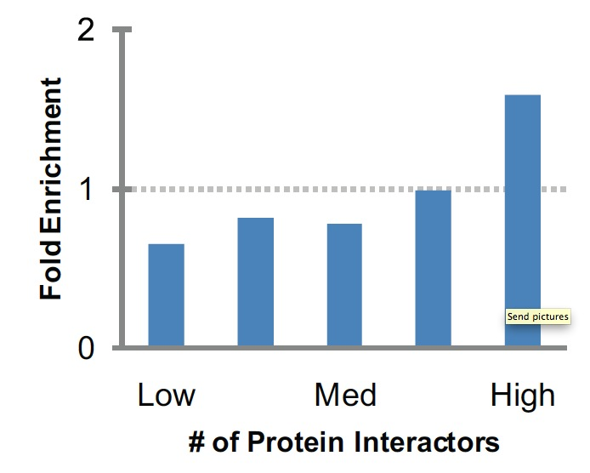
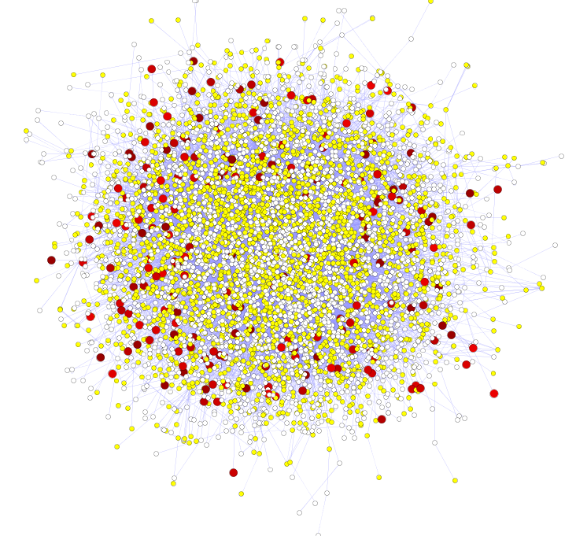
More Connectivity, More Constraint : A theme borne out in many studies
Result for Yeast PPI
[Xia et al. PLOS CB ('09)]
Seq. Conservation
High likelihood of positive selection
Not under positive selection
Lower likelihood of positive selection
No data about positive selection
Genes & proteins that have a more central position in the network tend to evolve more slowly and are more likely to be essential.
This phenomenon is observed in
many organisms & different kinds of networks
  yeast PPI - Fraser et al ('02) Science,
  ('03) BMC Evo. Bio.
  Ecoli PPI - Butland et al ('04) Nature
  Worm/fly PPI - Hahn et al ('05) MBE
  Human RegNet - Gerstein et al. (’12) Nature
  miRNA net - Cheng et al ('09) BMC Genomics
[Nielsen et al. PLoS Biol. (2005), HPRD, Kim et al. PNAS (2007)]

Slide 28
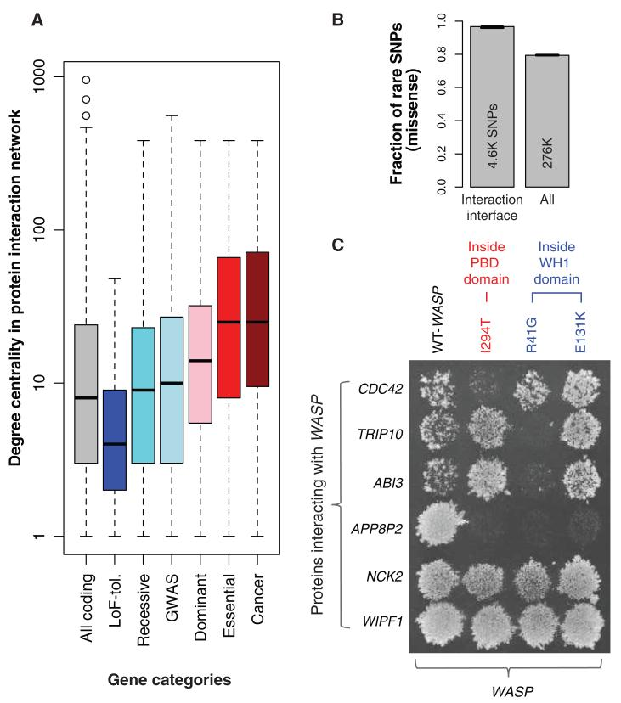
Categories vs Centrality in Human Genome, using 1000G Phase 1 Data: Signal there but weak
Degree centrality in protein interaction network
[Khurana et al., Science (‘13)]
Gene categories

Slide 29
Stronger signal in the SIN than the Human PPI
Higher
Centrality
More interaction interfaces
PPI degree (log scale)
Num. interfaces
LoF-tolerant
Essential
LoF-tolerant
Essential
Khurana et al., PLoS Comp. Bio., 2013

Slide 30
Recasting selection in SIN in terms of rare SNPs & direct experimental testing of such putative deleterious variants
WASP interactions tested using yeast two-hybrid experiments
Collaboration with H Yu Cornell
Khurana* and Fu* et al., PLoS Comp. Bio., 2013
Khurana* and Fu* et al, Science, 2013
Wang et al, Nature Biotech, 2012

Slide 31
Genes participate in many networks (no single network captures the global picture of gene interactions)
Multinet – the ultimate hairball!
Combine regulatory, physical protein-protein, signaling, metabolic, phosphorylation and genetic interactions to create a unified network (Multinet)
Nodes: ~15,000 genes
Edges: ~110,000 interactions
Khurana* and Fu* et al., PLOS Comp. Bio. ’13
Notes:
Explain better: may be show just the hairball and then show nodes on it

Slide 32
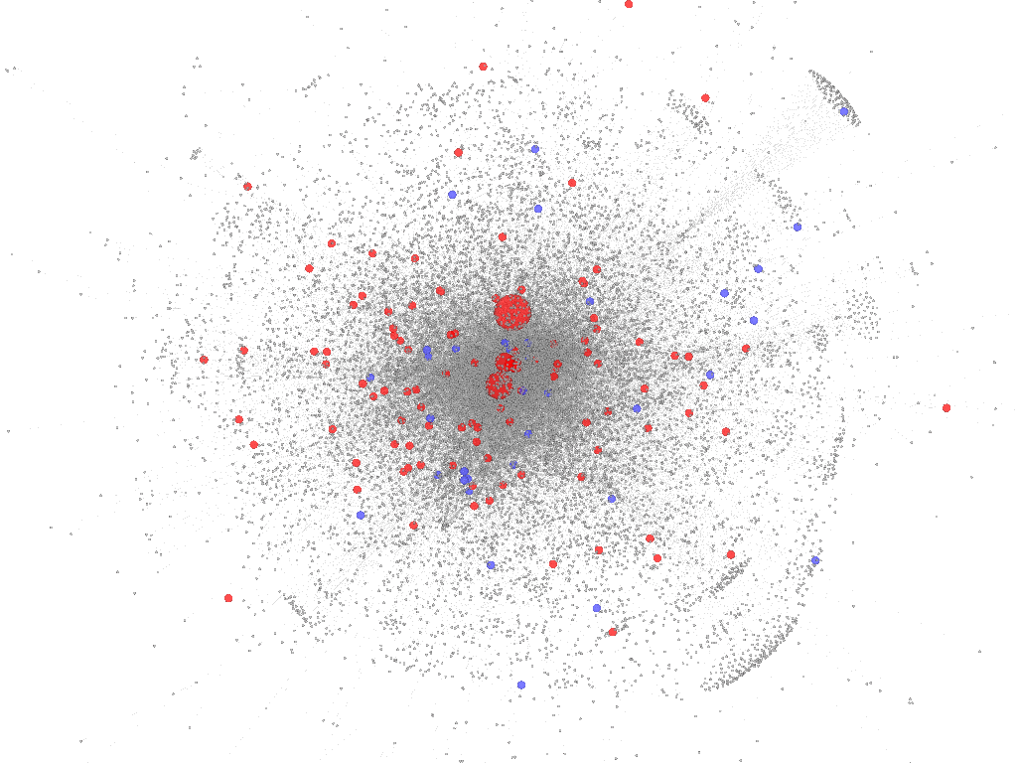
Even Stronger Signal of Connectivity v Constraint in MultiNet
Essential genes are
Unified network
degree (log scale)
Connected to more genes
Num of networks
Involved in more networks
LoF-tolerant genes
Essential genes
LoF-tolerant
Essential
Z Gumus
iCAVE movie
Size of nodes scaled by total degree
[Khurana et al., PLOS Comp. Bio. ’13]

Slide 33
Integration of network & other properties
to predict systems-level effects of deleterious mutations
Train logistic regression model using network and evolutionary properties
Can distinguish between LoF-tolerant and Essential genes with high accuracy
Application of the model on all genes
AUC=0.91
True positive rate
Predicted score
False positive rate
[Khurana et al., PLOS Comp. Bio. ’13]

Slide 34
Using 3D-structure into interpret networks & deep-sequencing data
Structural Interaction Network & Protein Motions (DynaSIN)
  Multi-interface permanent hubs have more motion than single-interface transient ones
  Also have more conflicting motions
LOF variants & Categories of Essential & Disease-sensitive Genes
Variation at Protein Interfaces in the context of Network Connectivity & its use for Disease-gene Predictions
  Highly connected parts of PPI under stronger selection but signal weak
  Stronger signal in SIN & even stronger in multiNet (integration of many networks)
  Signal strong enough to build predictor
Rationalizing Deleterious Variants in terms of Potential Allosteric Sites
  Identifying potential allosteric residues on surface & inside
  These are under stronger selection & may explain some HGMD SNPs

Slide 35
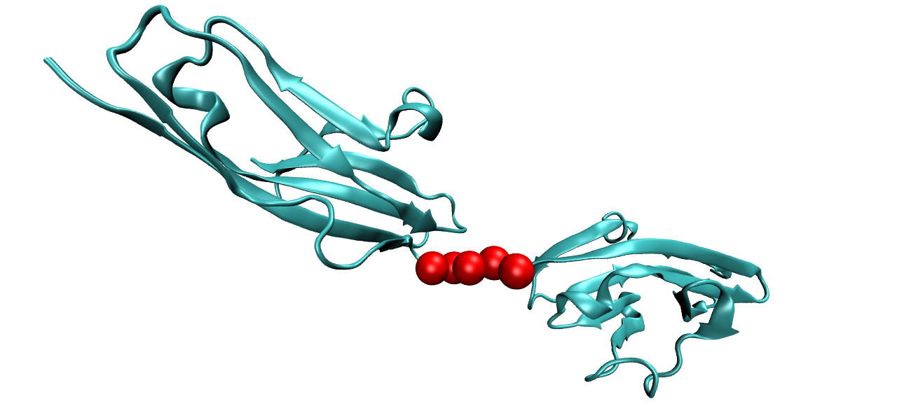
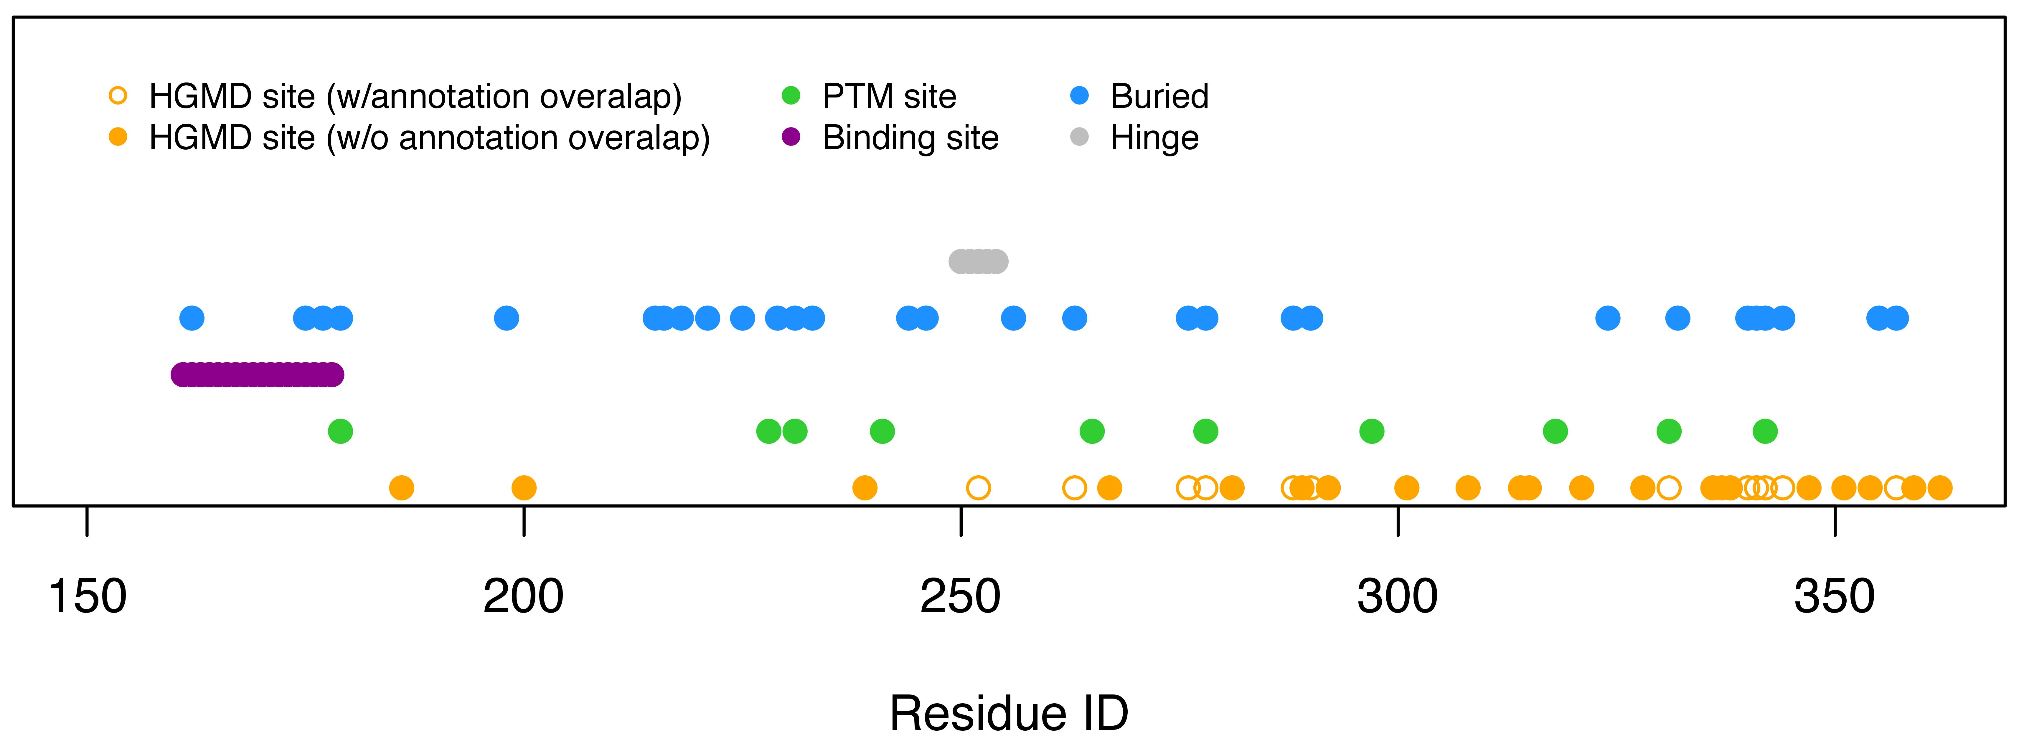
Interpreting Disease Variants in terms of aspects of Protein Structure
Fibroblast growth factor receptor (pdb 1IIL)
“STRESS” pipeline
to tackle unaccounted for variants, in terms of potential allosteric sites

Slide 36
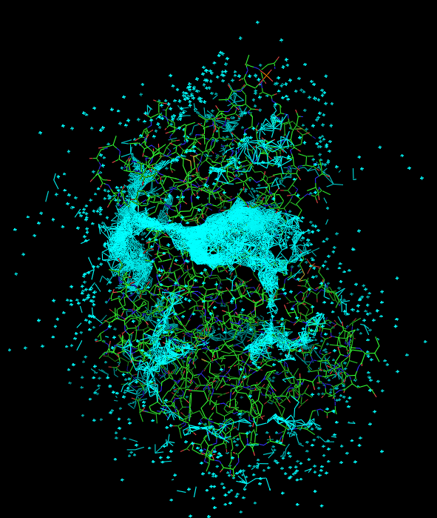
Modified Binding Leverage Framework for Predicting Allosterically-Important Surface Residues
Use Monte Carlo simulations
to generate 1000s of
candidate sites
Apply normal modes to score each
candidate site by the degree to
which it perturbs large-scale motions
Prioritize & threshold list to
identify final set of high
confidence-sites
pdb 1J3H
Ranked List
of Sites
Prioritized List
of Sites
Site Z
Site X
Site Y
.
.
.
Site Z
Site X
Adapted from
Mitternacht S, et al. (2011)
Surface region with high
density of candidate sites
Surface region with low density of candidate sites
Notes:
III. Binding leverage

Slide 37
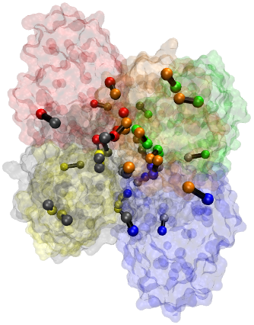
Identifying Potential Allosteric Residues in the Protein Interior
Edge ‘distance’ between residues i & j is:
Wij = -ln(|Cij|)
Cij is the correlation between the motions of residues i & j.
A large ‘distance’ (i.e., low correlated motion) increases the shortest path lengths between such residues.
Freeman LC (1977) Set of measures of centrality based on betweenness. Sociometry 40: 35–41.
Girvan & Newman (2002) PNAS 99: 7821.

Slide 38
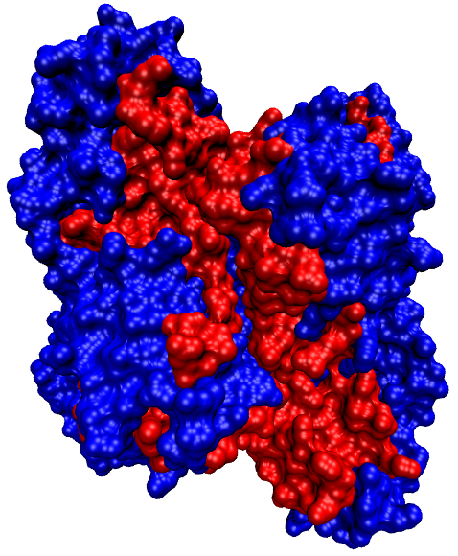
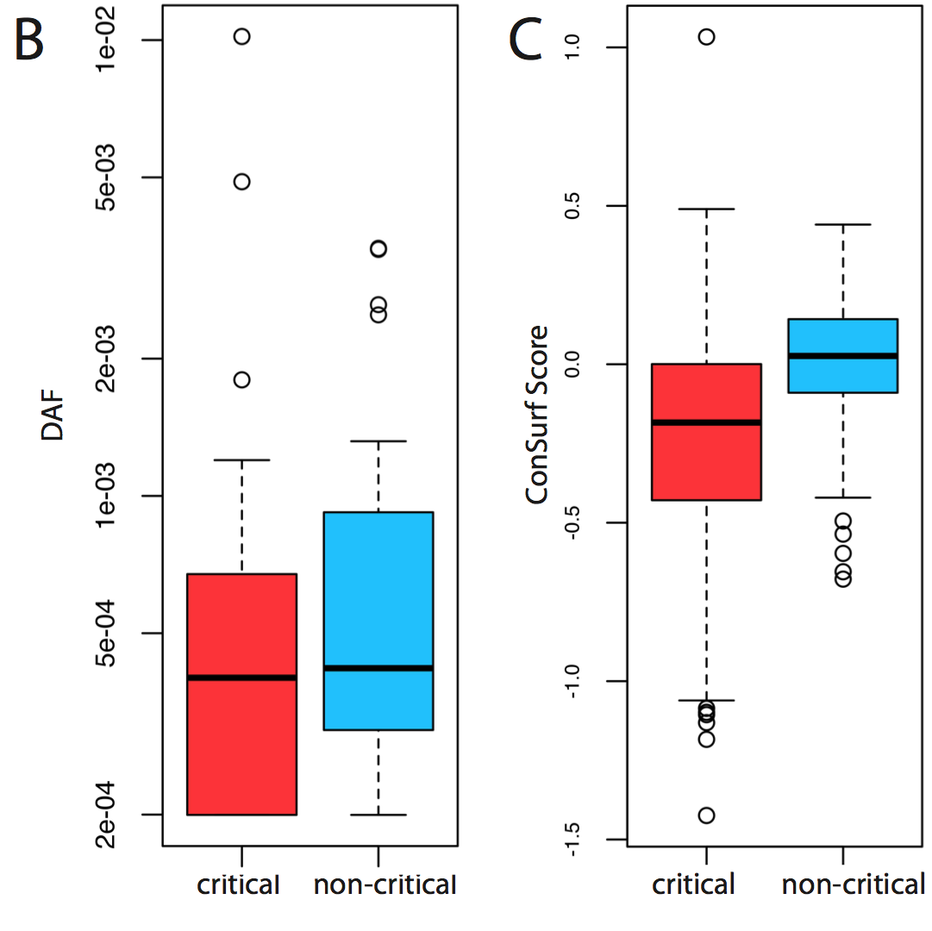
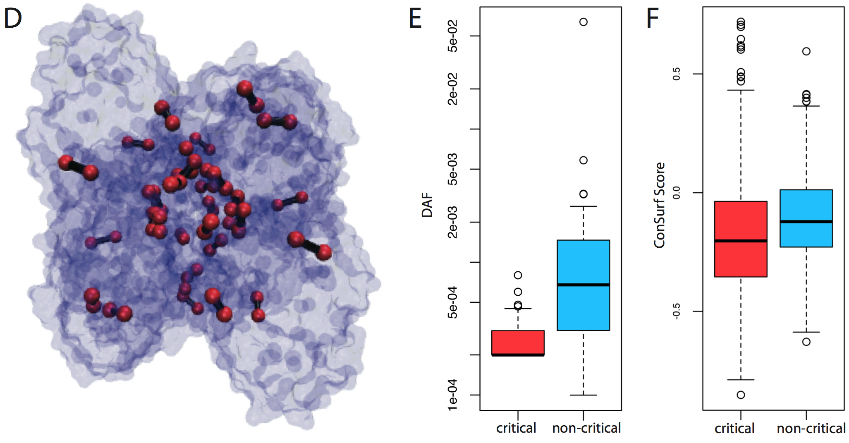
Conservation of network-identified residues implicated in allosteric signal transmission

Slide 39
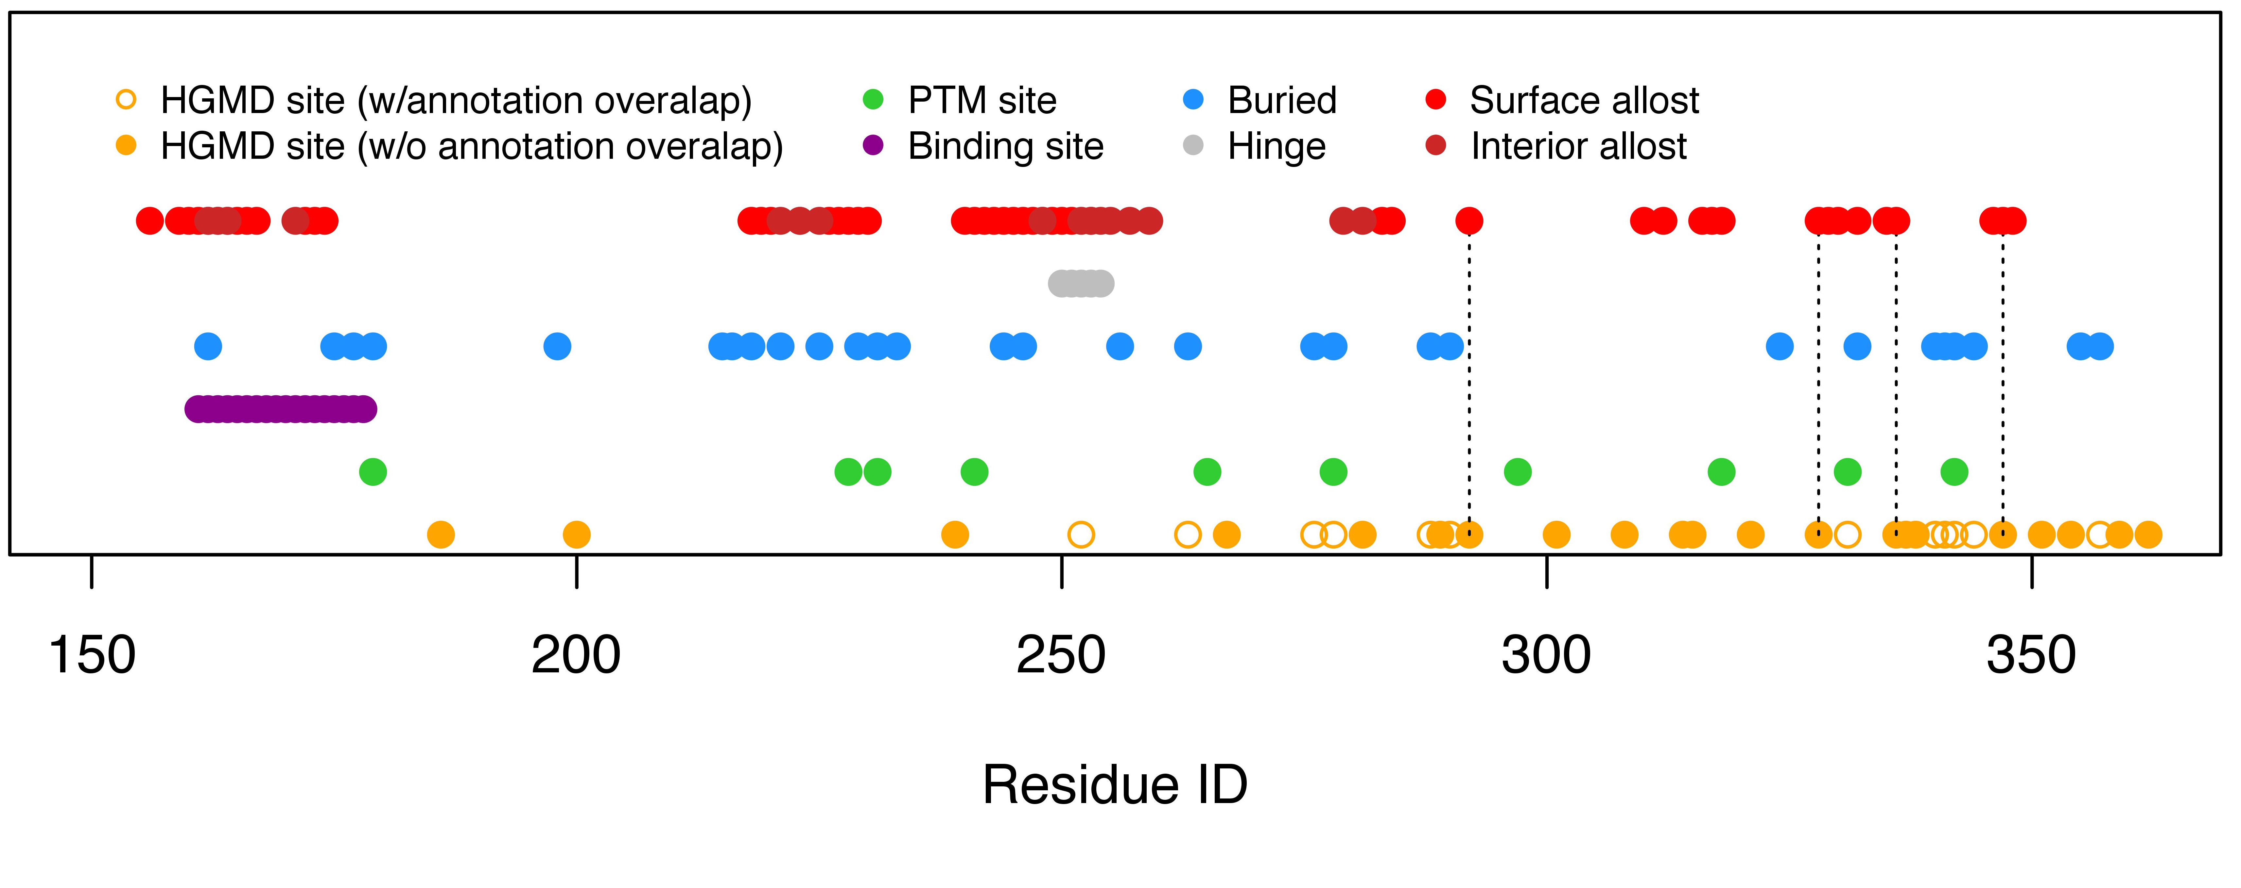
Conservation, allosteric hotspots, and disease variants in sequence space
Fibroblast growth factor receptor (pdb 1IIL)
Dotted lines designate HGMD sites without clear biophysical mechanisms of pathogenicity, but which are nevertheless captured by our pipeline.

Slide 40
Using 3D-structure into interpret networks & deep-sequencing data
Structural Interaction Network & Protein Motions (DynaSIN)
  Multi-interface permanent hubs have more motion than single-interface transient ones
  Also have more conflicting motions
LOF variants & Categories of Essential & Disease-sensitive Genes
Variation at Protein Interfaces in the context of Network Connectivity & its use for Disease-gene Predictions
  Highly connected parts of PPI under stronger selection but signal weak
  Stronger signal in SIN & even stronger in multiNet (integration of many networks)
  Signal strong enough to build predictor
Rationalizing Deleterious Variants in terms of Potential Allosteric Sites
  Identifying potential allosteric residues on surface & inside
  These are under stronger selection & may explain some HGMD SNPs

Slide 41
Using 3D-structure into interpret networks & deep-sequencing data
Structural Interaction Network & Protein Motions (DynaSIN)
  Multi-interface permanent hubs have more motion than single-interface transient ones
  Also have more conflicting motions
LOF variants & Categories of Essential & Disease-sensitive Genes
Variation at Protein Interfaces in the context of Network Connectivity & its use for Disease-gene Predictions
  Highly connected parts of PPI under stronger selection but signal weak
  Stronger signal in SIN & even stronger in multiNet (integration of many networks)
  Signal strong enough to build predictor
Rationalizing Deleterious Variants in terms of Potential Allosteric Sites
  Identifying potential allosteric residues on surface & inside
  These are under stronger selection & may explain some HGMD SNPs

Slide 42
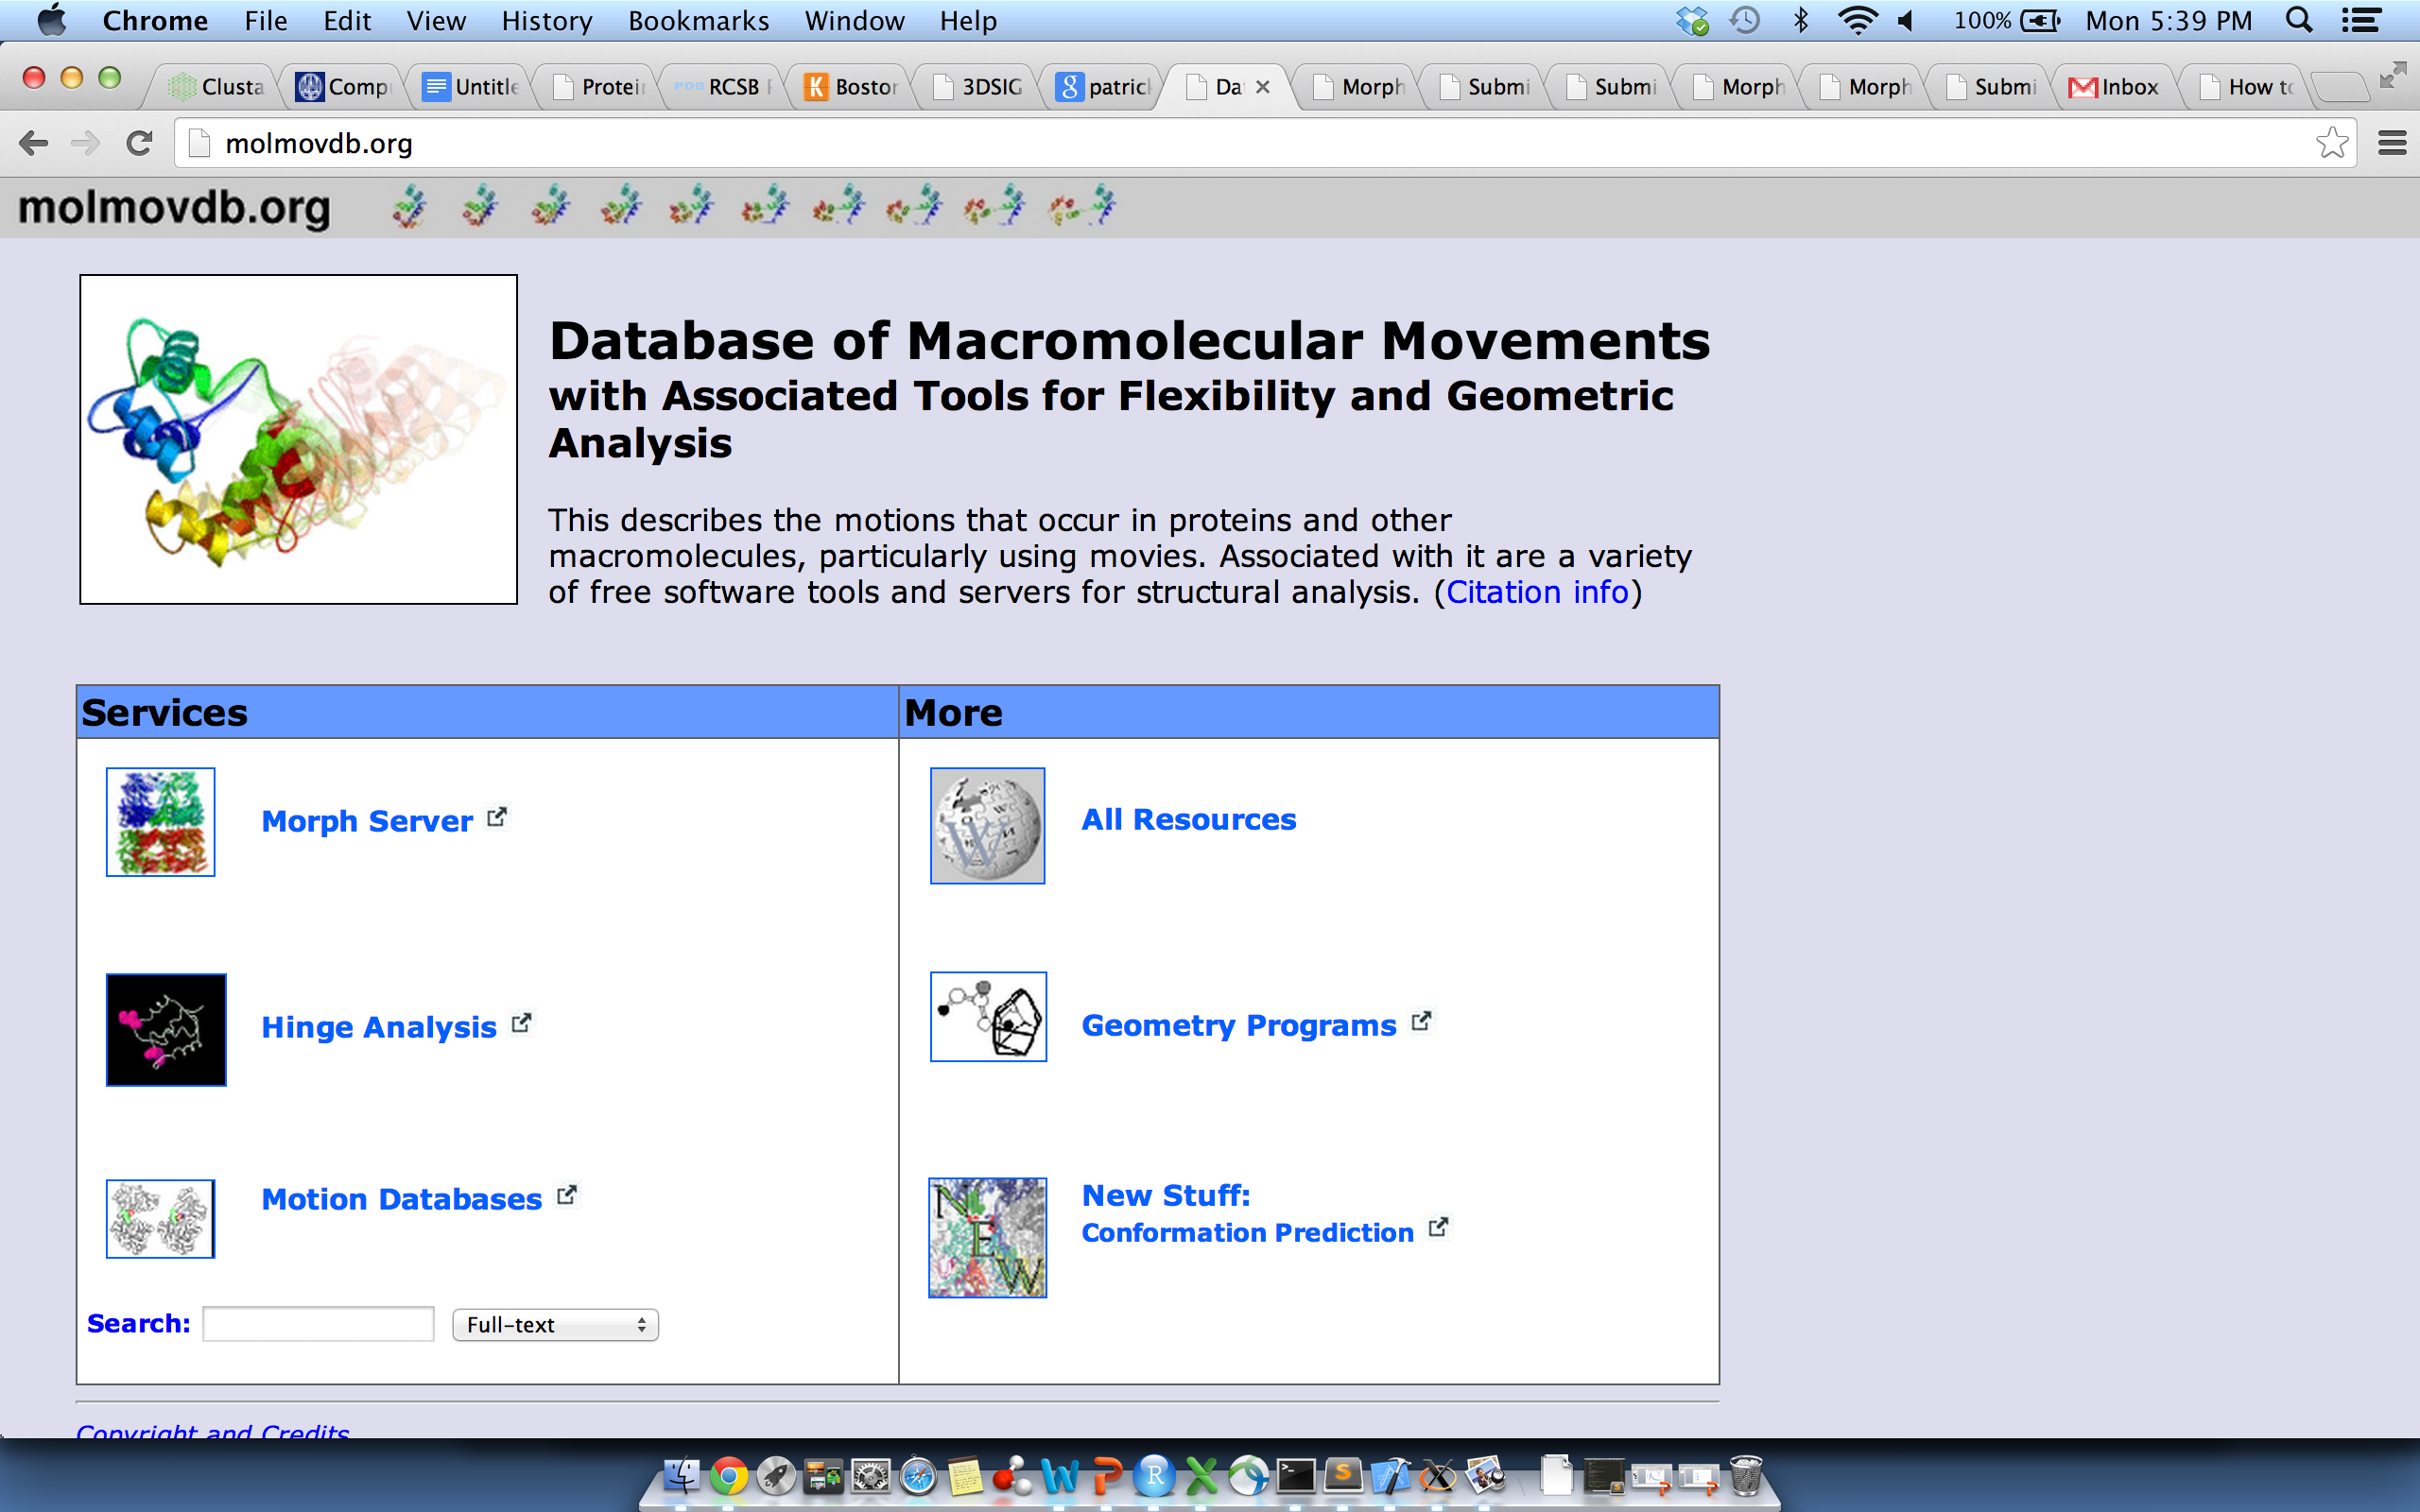
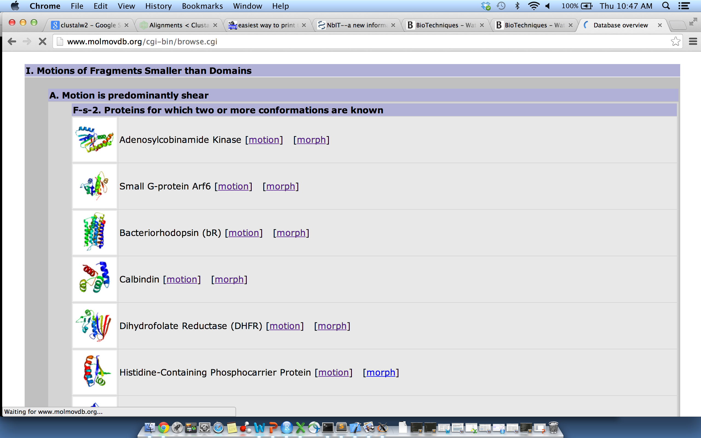
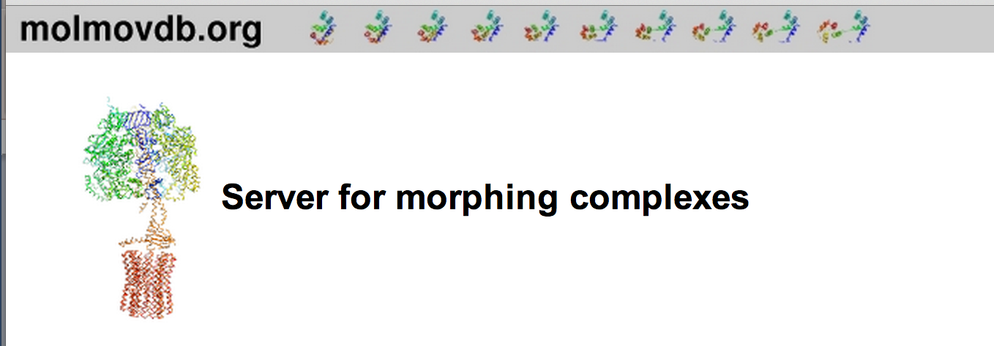
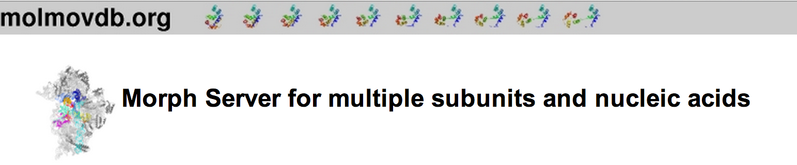

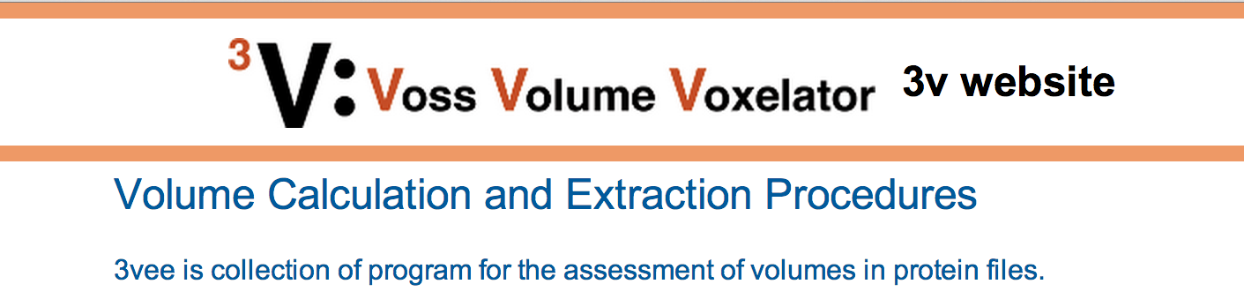
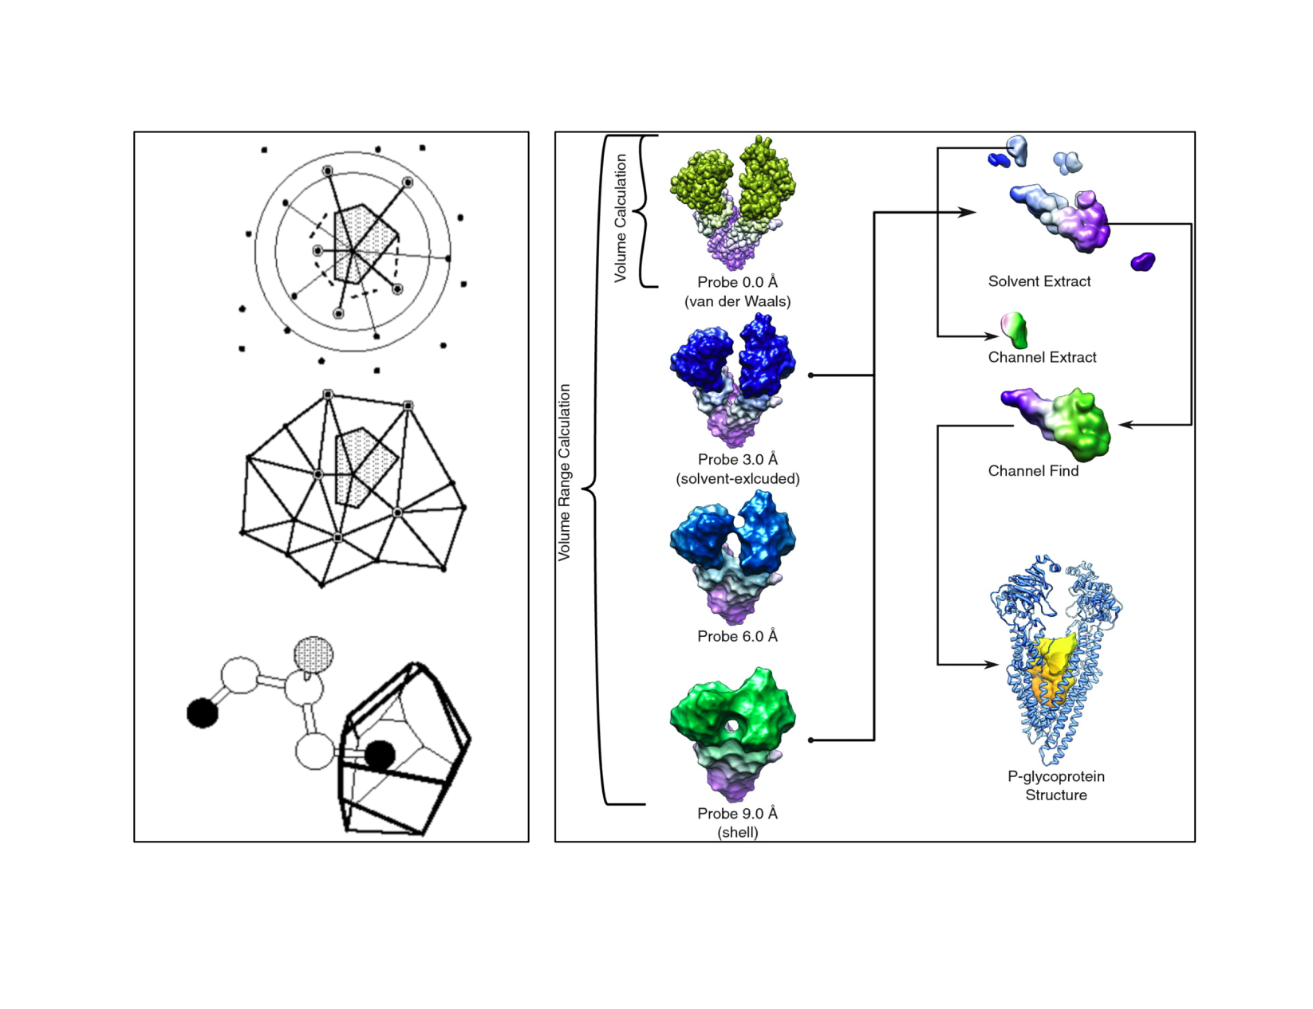
Movies of Conformational Changes
Database of Alternative Conformations
Quantifying Internal Packing of Residues
Identification of Protein Cavities

Slide 43
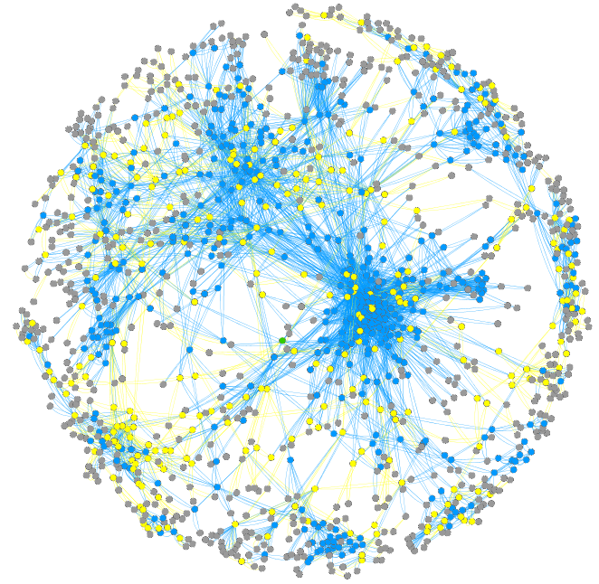
Structural Interaction Network
(v2.0, ‘11, available for yeast, human, E coli)
Non-hub
Multi-interface hub
Singlish-interface hub
Simultaneously possible
interaction: “Permanent”
Mutually exclusive
interaction: “Transient”
~8.5K Human & ~1.5K yeast edges
[Bhardwaj et al. (’11) Prot Sci]
dynasin.molmovdb.org
sin.gersteinlab.org
Notes:
supplement:

Slide 44
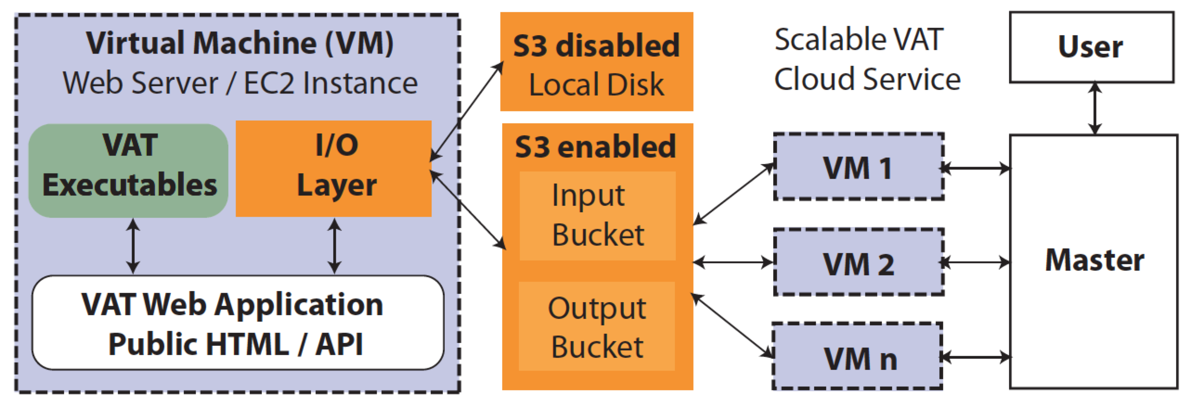
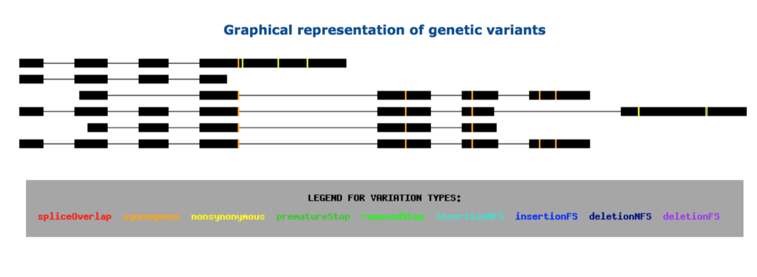
VAT.gersteinlab.org
Variant Annotation Tool (VAT)
All our annotation
from this pipeline
Input
  Uses GENCODE (with option of CCDS & other annotations)
  Overlaps with 1000G
  SNPs, MNPs, indels & SVs
  (other input VCFs possible)
Output
  Annotated VCFs
  Graphical representations of
  functional impact on transcripts
Access
  Source freely available
  Webserver
  AWS cloud
  instance
CLOUD APPLICATION
Habegger L.*, Balasubramanian S.*, et al. Bioinformatics, 2012
Notes:
44
Big data challenge, graphical interface is important

Slide 45

Acknowledgments
DynaSIN.molmovdb.org
N Bhardwaj, A Abyzov, D Clarke, C Shou
VAT.gersteinlab.org + LOF
L Habegger, S Balasubramanian, DZ Chen, E Khurana, A Sboner, A Harmanci, J Rozowsky, D Clarke, M Snyder
S Balasubramanian, L Habegger, A Frankish, DG MacArthur, R Harte, C Tyler-Smith, J Harrow,
archive.gersteinlab.org/proj/NetSNP
FunSEQ.gersteinlab.org
E Khurana, Y Fu, V Colonna, XJ Mu, HM Kang, T Lappalainen, A Sboner, L Lochovsky, J Chen, A Harmanci, J Das, A Abyzov, S Balasubramanian, K Beal, D Chakravarty, D Challis, Y Chen, D Clarke, L Clarke, F Cunningham, US Evani, P Flicek, R Fragoza, E Garrison, R Gibbs, ZH Gumus, J Herrero, N Kitabayashi, Y Kong, K Lage, V Liluashvili, SM Lipkin, DG MacArthur, G Marth, D Muzny, TH Pers, GR Ritchie, JA Rosenfeld, C Sisu, X Wei, M Wilson, Y Xue, F Yu, 1000 Genomes Project Consortium, ET Dermitzakis, H Yu, MA Rubin, C Tyler-Smith
STRESS
A Sethi, D Clarke, S Kumar, S Li, R Chang, KK Yan, J Chen
Hiring Postdocs. See gersteinlab.org/jobs

Slide 46
Default Theme
Default Outline Level 1
  Level 2

Slide 47
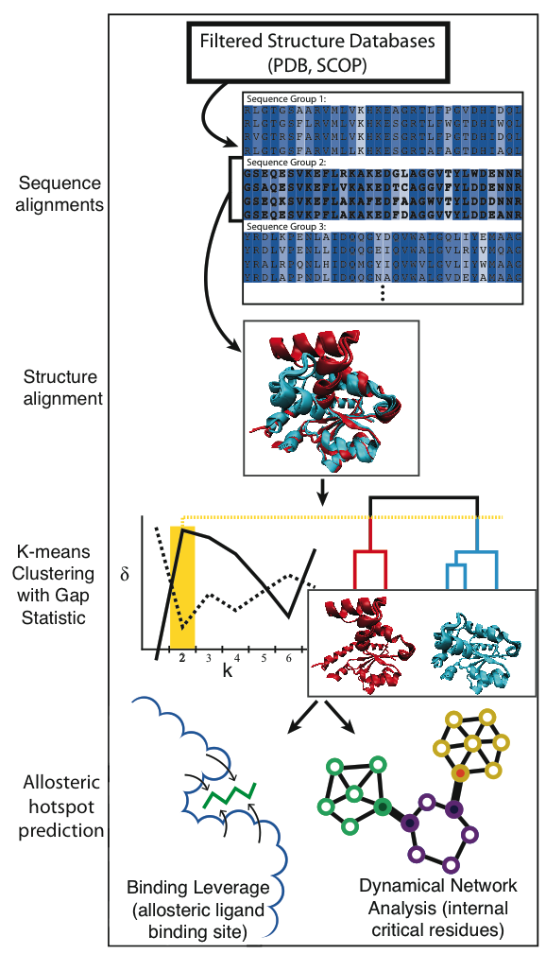
Pipeline (“STRESS”)
for culling alternative
conformations and predicting
allosterically important residues

Slide 48
Conformational changes associated with “transient” interactions
Conformational changes associated with “permanent” interactions
[Bhardwaj et al. (’11) Prot Sci] dynasin.gersteinlab.org

Slide 49
Objective: Using 3D-structure into interpret PPI networks & mutations from deep-sequencing data
Growing numbers of complex structures with many interfaces allow structure to be related to networks
Growing proportion of structures with same fold allow probing conformational plasticity & motions
Vast increase exome data provides new ways to think about coding mutations – eg in terms of selection & allele freq. In turn, structure & networks provide interpreting these data
Sites associated with allosteric motions provide a way interpreting disease mutations, not accounted for otherwise

Slide 50
More Information on this Talk
SUBJECT: Networks
DESCRIPTION:
NOTES:
This PPT should work on mac & PC. Paper references in the talk were mostly from Papers.GersteinLab.org.
PERMISSIONS: This Presentation is copyright Mark Gerstein, Yale University, 2010. Please read permissions statement at http://www.gersteinlab.org/misc/permissions.html . Feel free to use images in the talk with PROPER acknowledgement (via citation to relevant papers or link to gersteinlab.org).
PHOTOS & IMAGES. For thoughts on the source and permissions of many of the photos and clipped images in this presentation see http://streams.gerstein.info . In particular, many of the images have particular EXIF tags, such as kwpotppt , that can be easily queried from flickr, viz: http://www.flickr.com/photos/mbgmbg/tags/kwpotppt .
Notes:
50

