Slide 1
ENCODE Elements
Credits? Team ENCODE ?

Slide 2
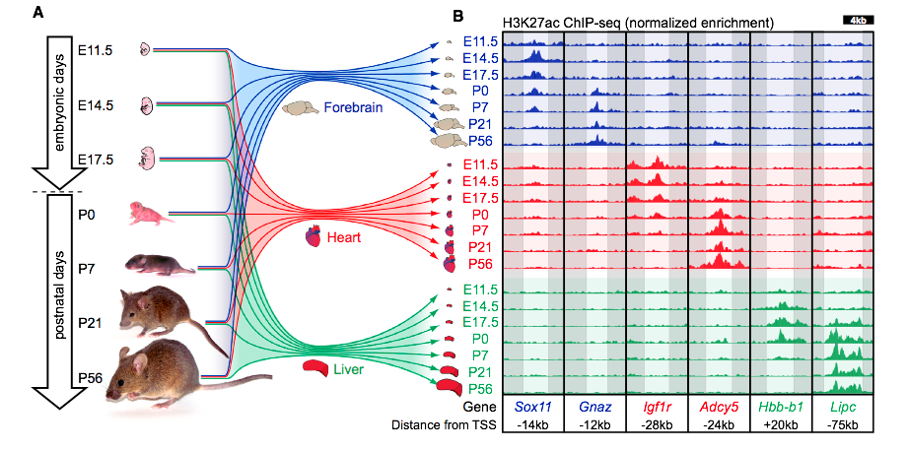
H3K27ac is an important mechanism to regulate the activity of enhancers in different developmental stages
Epigenetically, H3K27ac marks are present near active enhancers.
Nord, et al., Cell, 2013

Slide 3
Simplified **subset** of the annotation
Candidate enhancers based on DNase hypersensitivity and H3K27ac and annotated with TF-ChIP peaks.
  Prototype: http://genome.ucsc.edu/cgi-bin/hgTracks?db=hg19&position=chr9%3A73026585-73041684&hgsid=391401755_RFMac79u2wdtXNRu4KCBPmq8eoeP
    A master list of DNase peaks annotated with H3K27ac (percentile) in a cell-type-specific manner.
    A master list of DNase peaks annotated with individual TF-ChIP peaks in a cell-type-specific manner.
Candidate promoters annotated with TF-ChIP peaks. (see prototype in the previous link)

Slide 4
More Detail on Simplified Annotation
Gene expression matrix over ENCODE2 cell lines (~60 cell lines in total) in GENCODE 19
  http://genome.crg.es/~sdjebali/Gencode/version19/GeneExpression/gencodev19_genes_with_RPKM_and_npIDR_oct2014.txt.gz
GENCODE v19 TSS list stratified by Fantom5 CAGE data:
  http://genome.crg.es/~sdjebali/Gencode/version19/Fantom5_CAGE
“Tissue type” facet for the cell lines (DCC).
  Ontology for the cell lines from the DCC. (http://genome.ucsc.edu/ENCODE/cellTypes.html)

Slide 5
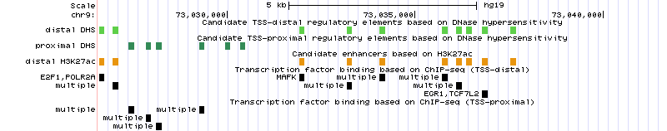

Slide 6
