Slide 1
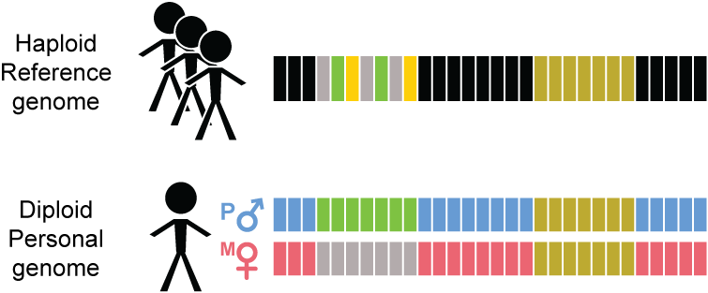
Transitioning from Reference Genome (RG) to Personal Genome (PG)

Slide 2
Personal genome construction using vcf2diploid
(fasta; reference)
(vcf, variants phased or unphased)
(fasta; for each haplotype)
Rozowsky et al. Mol Syst Biol (2011)

