Slide 1
Comprehensive functional genomic resource and integrative model for the human brain
Daifeng Wang
ASHG 2018

Slide 2
Functional genomics reveal molecular mechanisms between genotype and phenotype in brain disorders
Disease | Heritability*
Schizophrenia | 81%
Bipolar disorder | 70%
Blood pressure | 30%
Breast cancer | 25-56%
Heart disease | 34-53%
Colon cancer | 13%
Lung cancer | 8%
Leukemia | 1%
Phenotype
SCZ
BPD
AGE
…
Higher-order groupings
(e.g., pathways, circuits)
Cell types
https://www.genome.gov/imagegallery/
Modules
Co-expression modules
Cell fractions
Regulatory elements
Genes
Enhancers
Gene expression
Loci
Genotype
SNPs
Regulation
QTL
*https://www.snpedia.com/index.php/Heritability

Slide 3
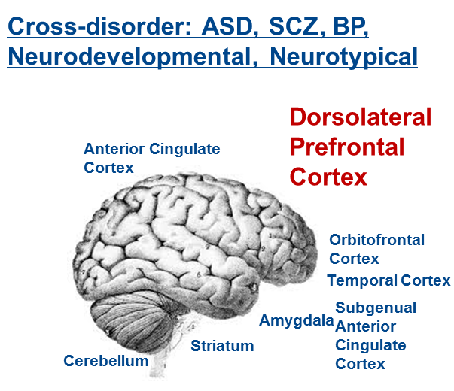
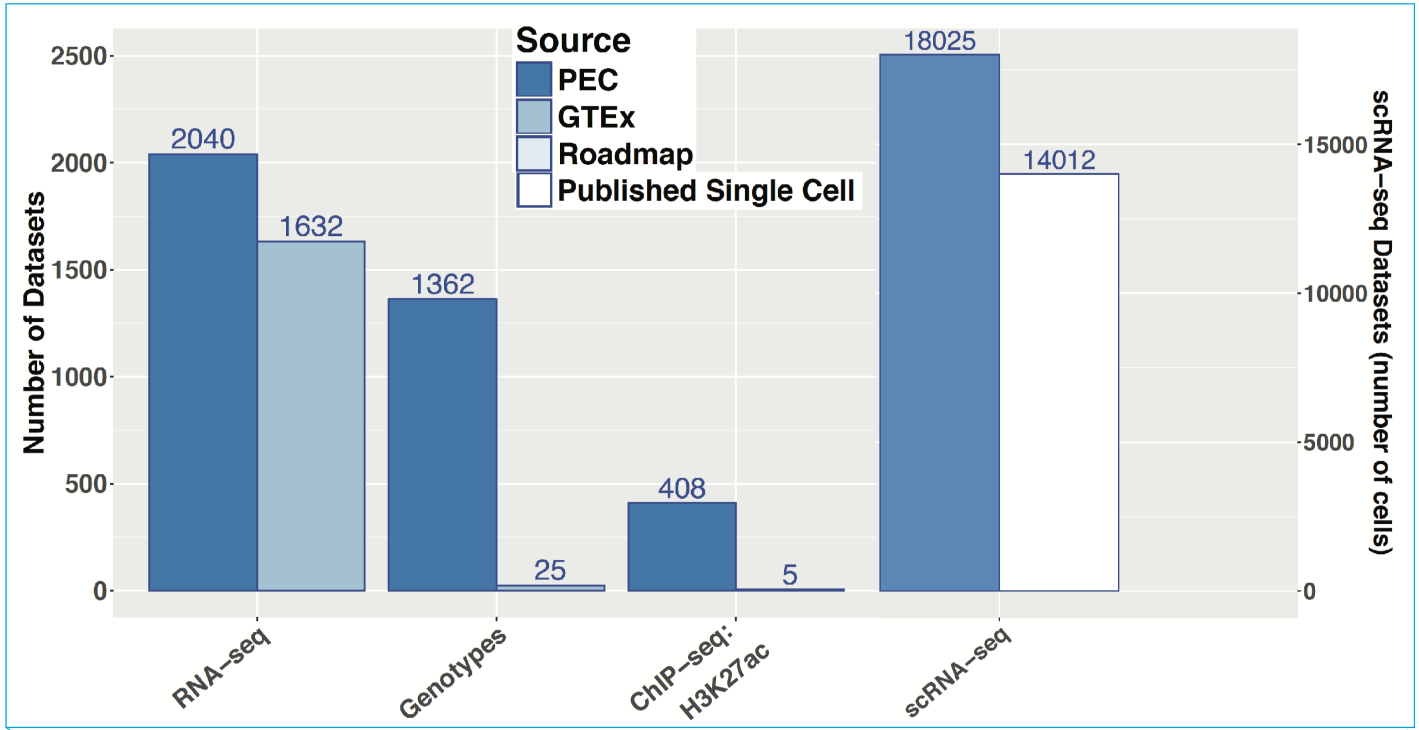
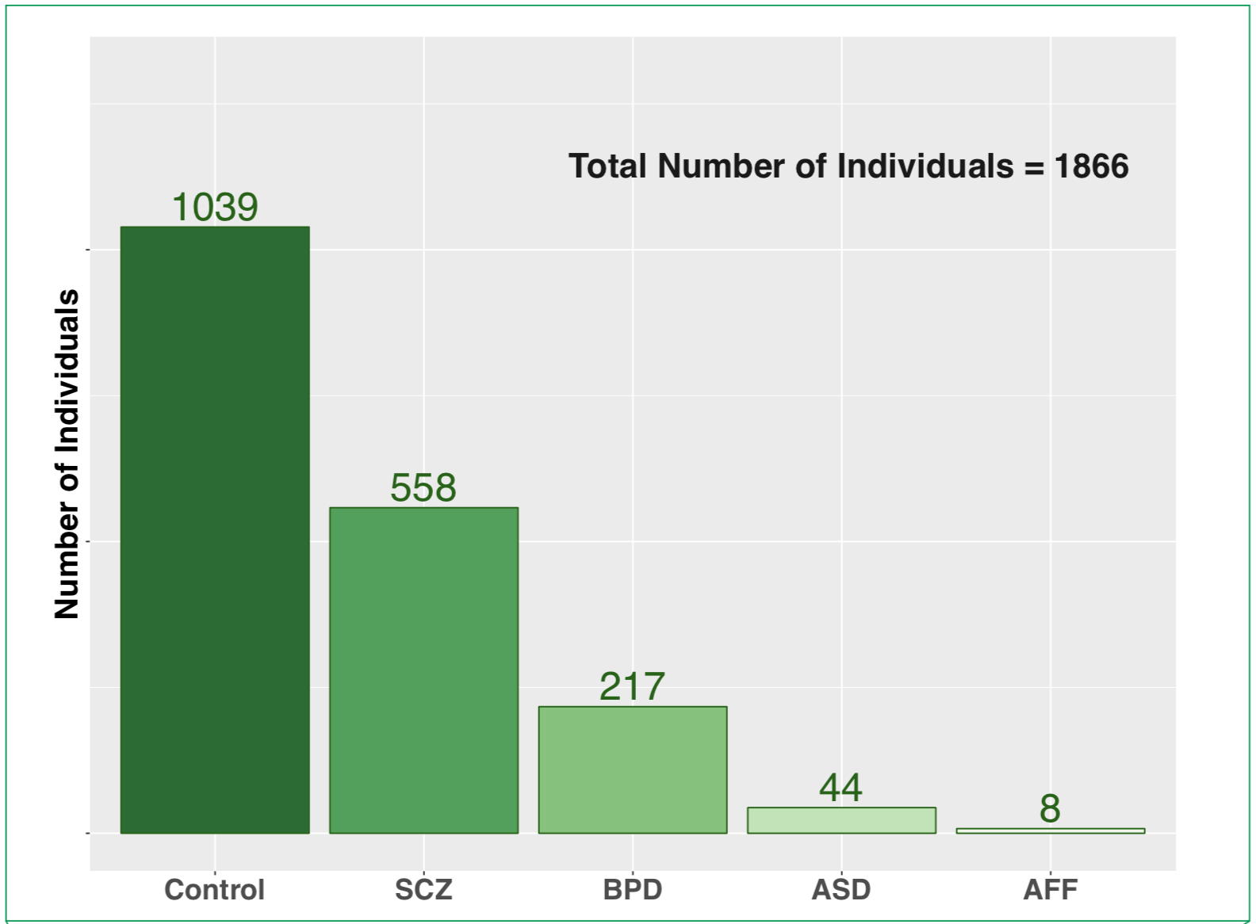
Brain multi-omics of PsychENCODE & other consortia
Brain specific transcriptome and epigenome
Single cell deconvolution
Quantitative Trait Locus (QTL)
Gene regulatory network
Deep Neural Network for predicting disorders
1866 brains
Control
Schizophrenia (SCZ)
Bipolar Disorder (BPD)
Autism Spectrum Disorder (ASD)

Slide 4
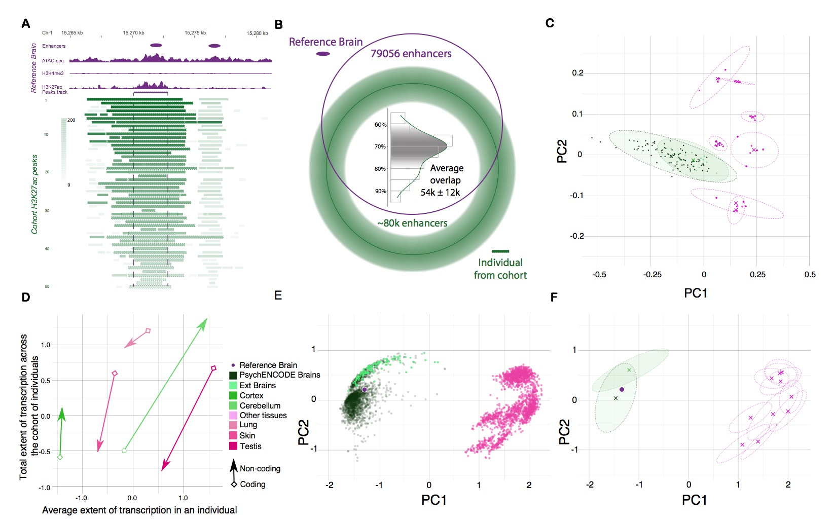
Brain specific transcriptome and epigenome from comparative analysis
Transcriptome
Epigenome
(~79,000 brain enhancers)
Notes:
GTEX frontal cortex N=138

Slide 5
Single cell deconvolution
Step 1: unsupervised learning to see cell types
1866 individuals
25 top components
1866 individuals
Unsupervised
decomposition
(NMF)
Bulk
expression
(B)
NMF
comp
(V)
NMF comp fractions
(H)
All genes
25 top components
All genes (∼20K)
≈
×
~14,000 cells (Lake et al., Science, 2016&2018)
Single cell signatures
~400 cells (Darmanis et al., PNAS, 2015)
~18,000 cells (PsychENCODE, submitted)

Slide 6
24 selected cell types
(Neuronal, NonNeuronal, Developmental)
Single cell deconvolution
Step 2: supervised learning to estimate cell fractions
1866 individuals
1866 individuals
Bulk
expression
(B)
Deconvolution
All genes
24 selected cell types
All genes (∼20K)
≈
×
Cell fractions (W)
Single cell expression (C)
88%±4%
Individual and cross-population reconstruction accuracy via deconvolution
Experimental validation

Slide 7
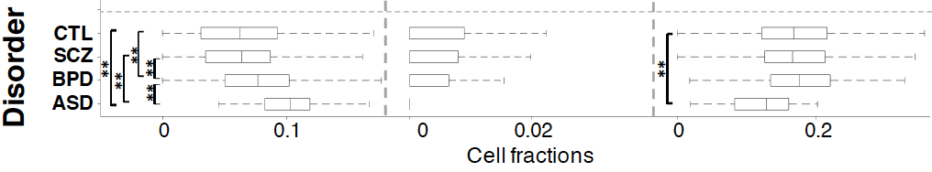
Neuronal and glial cell fractions across disorders
Ex5
In6
Oligodendrocytes
Excitatory to Inhibitory imbalance at neuronal subtype level for ASD*
* Rubenstein et al., Model of autism: increased ratio of excitation/inhibition in key neural systems, Genes Brain Behav. 2003
Notes:
* Rubenstein et al., Model of autism: increased ratio of excitation/inhibition in key neural systems, Genes Brain Behav. 2003
** Gandal et al., Shared molecular neuropathology across major psychiatric disorders parallels polygenic overlap, Science 2018

Slide 8
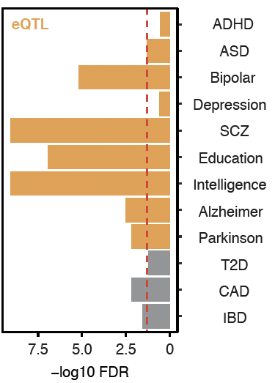
Larger Brain eQTL sets than previous studies
GWAS enrichment
2,542,908 eQTLs (FDR< 0.05)
Notes:
Brain eQTLs
32944(75%) eGenes
2,542,908 eQTLs (3% out of 66,441,766 total pairs)
1,341,182 unique cis-eSNP (~20%) (~238K independent SNPs after linkage-disequilibrium (LD) pruning)

Slide 9
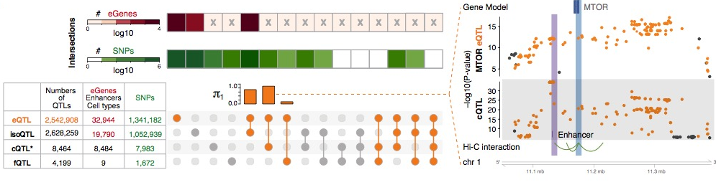
multi-QTLs
eQTLs for mammalian target of rapamycin (mTOR) potentially mediated by cQTLs
eQTLs and cQTLs significantly overlap
1391 SNPs (multi-QTLs) in at least three types among eQTLs, isoQTLs, cQTLs, fQTLs
Notes:
*top SNPs for each enhancer
To evaluate this precisely, we calculated π₁ statistics and found that the eQTL overlap with cQTLs was the most significant while that with fQTLs was lowest (0.89 vs 0.11). Moreover, eQTL-cQTL overlaps often suggested that the expression-modulating function of an eQTL derived from chromatin changes (e.g. for MTOR, Fig. 4F). Finally, 119 SNPs, which we dubbed multi-QTLs, functioned as QTLs in more than 3 different capacities (e.g. as eQTLs, cQTLs and isoQTLs).
https://www.nature.com/articles/nrn3068

Slide 10
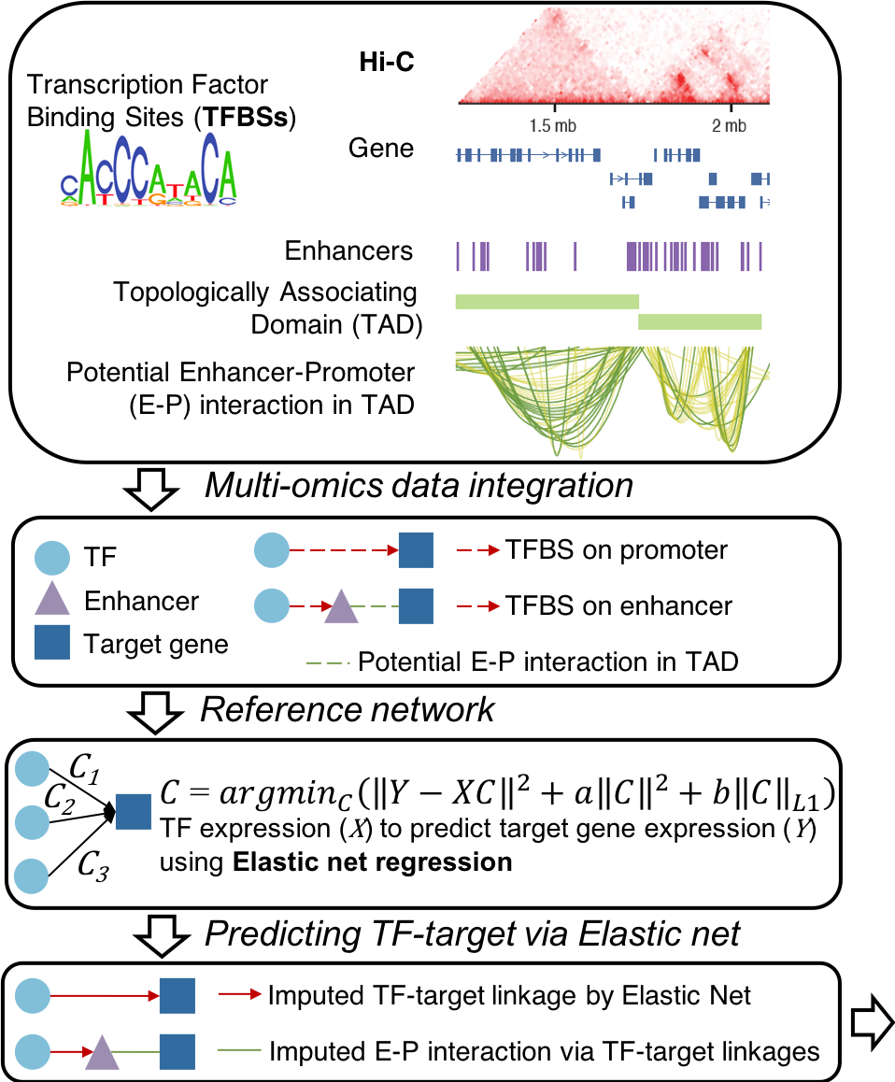
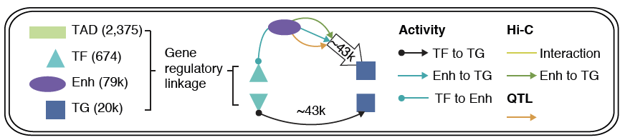

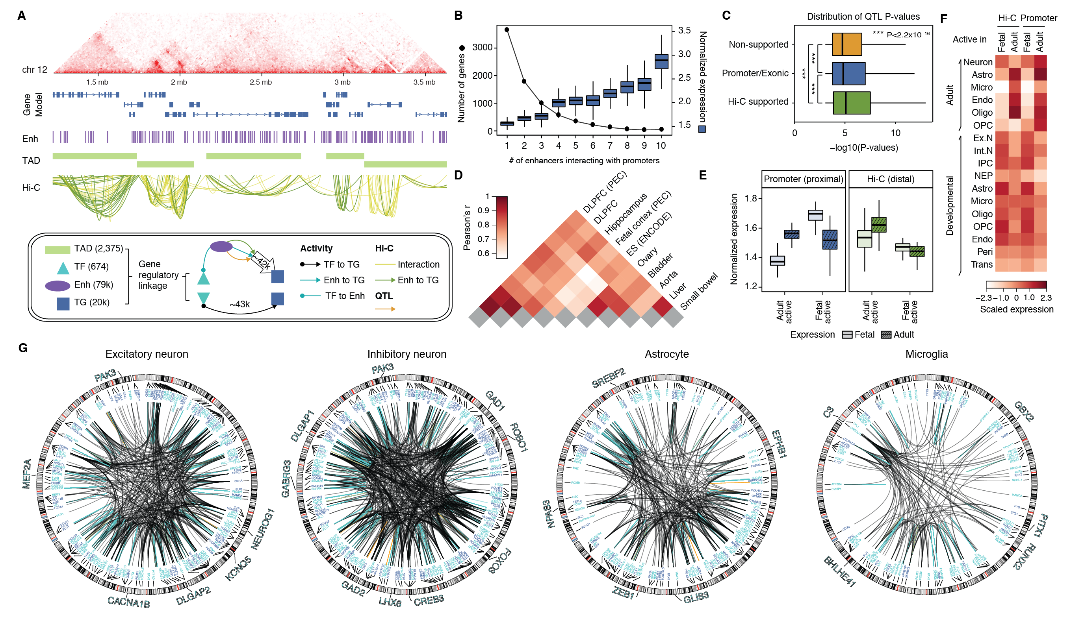

Gene regulatory network inference
Imputed gene regulatory network linking TFs, enhancers and genes plus QTLs
e.g., subnetworks targeting single cell marker genes

Slide 11
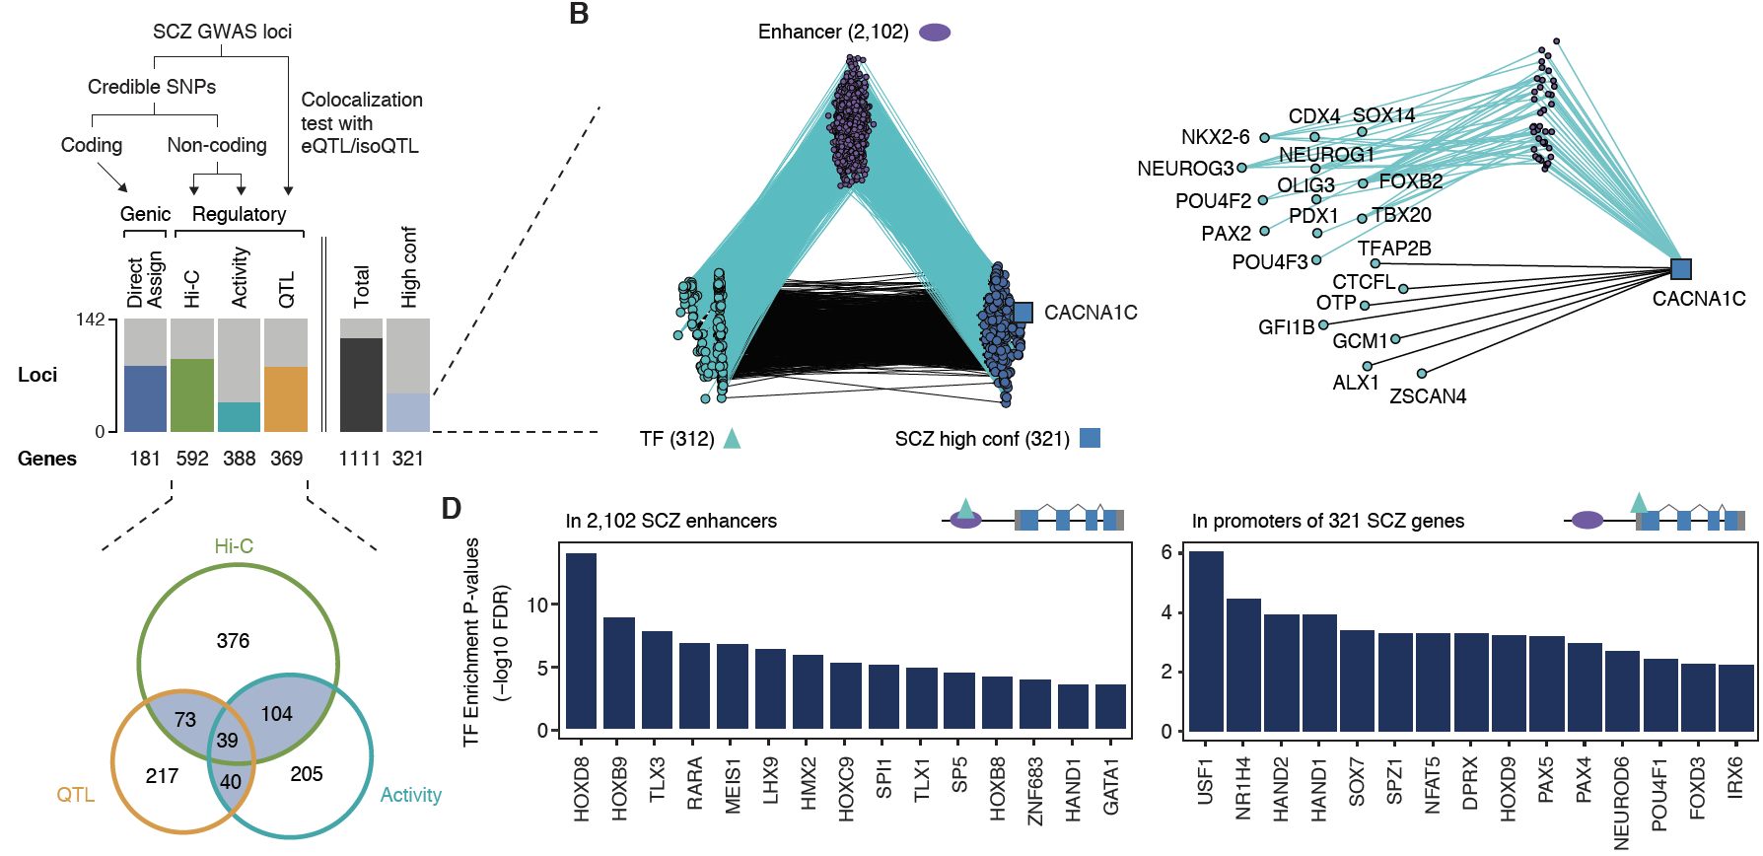
Linking GWAS SNPs to new disease genes using gene regulatory network
142
321 high-confident SCZ genes
early cortical specification
promote neuronal apoptosis
Notes:
* A. F. Pardinas et al., Common schizophrenia alleles are enriched in mutation-intolerant genes and in regions under strong background selection. Nat Genet 50, 381-389 (2018)
For example, we found a set of TFs having enriched binding sites (TFBSs) on the promoters of SCZ genes, revealing potential cis-regulatory mechanisms of TFs to SCZ gene expression (Fig. 6D). Also, we found additional TFs that have enriched binding sites on the enhancers that overlap with SCZ credible SNPs (Fig. 6D), suggesting potential distal regulatory mechanisms of SCZ credible SNPs via affecting TFBSs on enhancers. In particular, these TFs include REST, a transcriptional repressor for neuronal genes \cite{16150588}, and SOX7, a TF that promotes neuronal apoptosis \cite{25847511}.

Slide 12
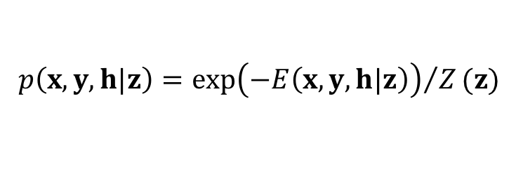
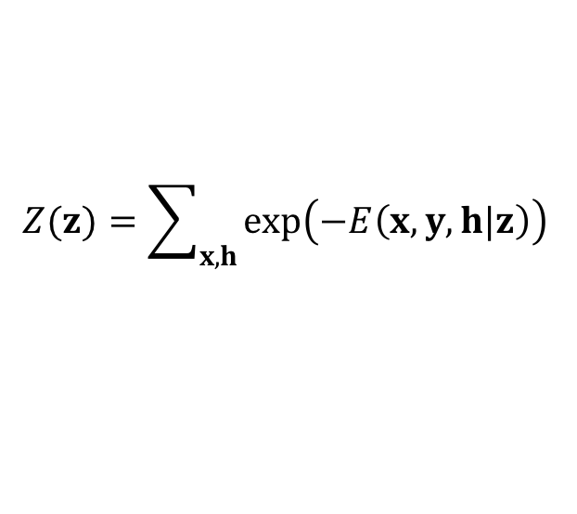
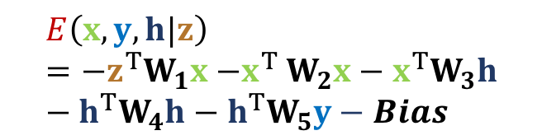
Deep Structured Phenotype Network (DSPN)
Boltzmann machine
y: phenotypes
  h: hidden units (e.g., circuits)
  x: intermediate phenotypes (e.g., genes, enhancers)
  z: genotypes (e.g. SNPs)
  W: weights (e.g., regulatory network)
$$p\left(x,y,h|z\right)={\exp\left(−E\left(x,y, h|z\right)\right)}/Z(z)$$
$$Z(z)=\sum_{x,h}{\exp\left(−E\left(x,y, h|z\right)\right)}$$
Gene regulatory network builds DSPN skeleton for biological interpretability
$$E\left(x,y, h|z\right)={−z}^{T}W_{1}x{−x}^{T}W_{2}x−x^{T}W_{3}h−h^{T}W_{4}h−h^{T}W_{5}y−Bias$$

Slide 13
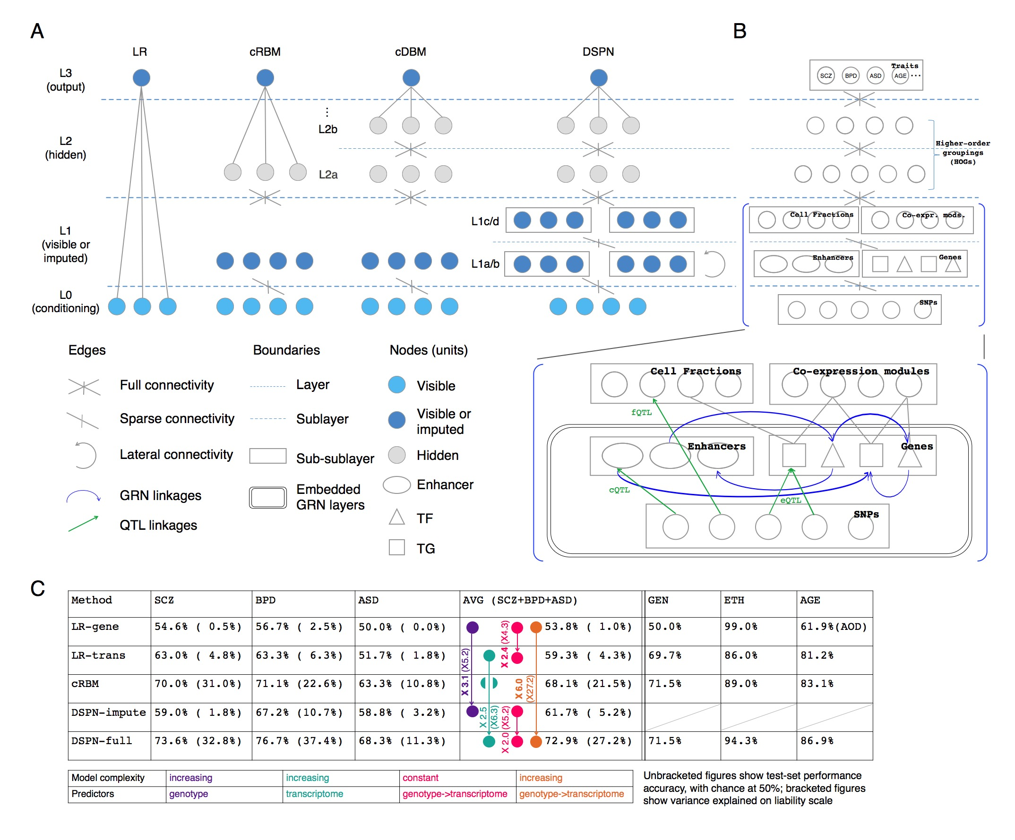
DSPN improves brain disease prediction by adding deep layers
Method | LR-genotype | LR-transcriptome | cRBM | DSPN-imputation | DSPN-full
Schizophrenia | 54.6% | 63.0% | 70.0% | 59.0% | 73.6%
Bipolar Disorder | 56.7% | 63.3% | 71.1% | 67.2% | 76.7%
Autism Spectrum Disorder | 50.0% | 51.7% | 67.2% | 62.5% | 68.3%
Accuracy = chance to correctly predict disease/health

Slide 14
DSPN improves brain disease prediction by adding deep layers
Method | LR-genotype | LR-transcriptome | cRBM | DSPN-imputation | DSPN-full
Schizophrenia | 54.6% | 63.0% | 70.0% | 59.0% | 73.6%
Bipolar Disorder | 56.7% | 63.3% | 71.1% | 67.2% | 76.7%
Autism Spectrum Disorder | 50.0% | 51.7% | 67.2% | 62.5% | 68.3%
Accuracy = chance to correctly predict disease/health

Slide 15
DSPN improves brain disease prediction by adding deep layers
Method | LR-genotype | LR-transcriptome | cRBM | DSPN-imputation | DSPN-full
Schizophrenia | 54.6% | 63.0% | 70.0% | 59.0% | 73.6%
Bipolar Disorder | 56.7% | 63.3% | 71.1% | 67.2% | 76.7%
Autism Spectrum Disorder | 50.0% | 51.7% | 67.2% | 62.5% | 68.3%
Accuracy = chance to correctly predict disease/health

Slide 16
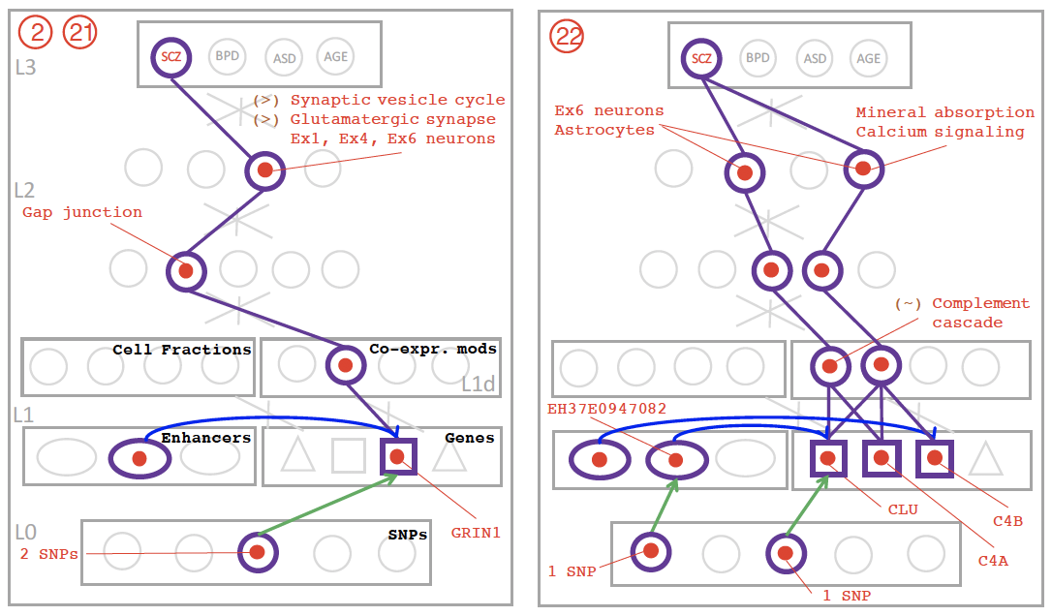
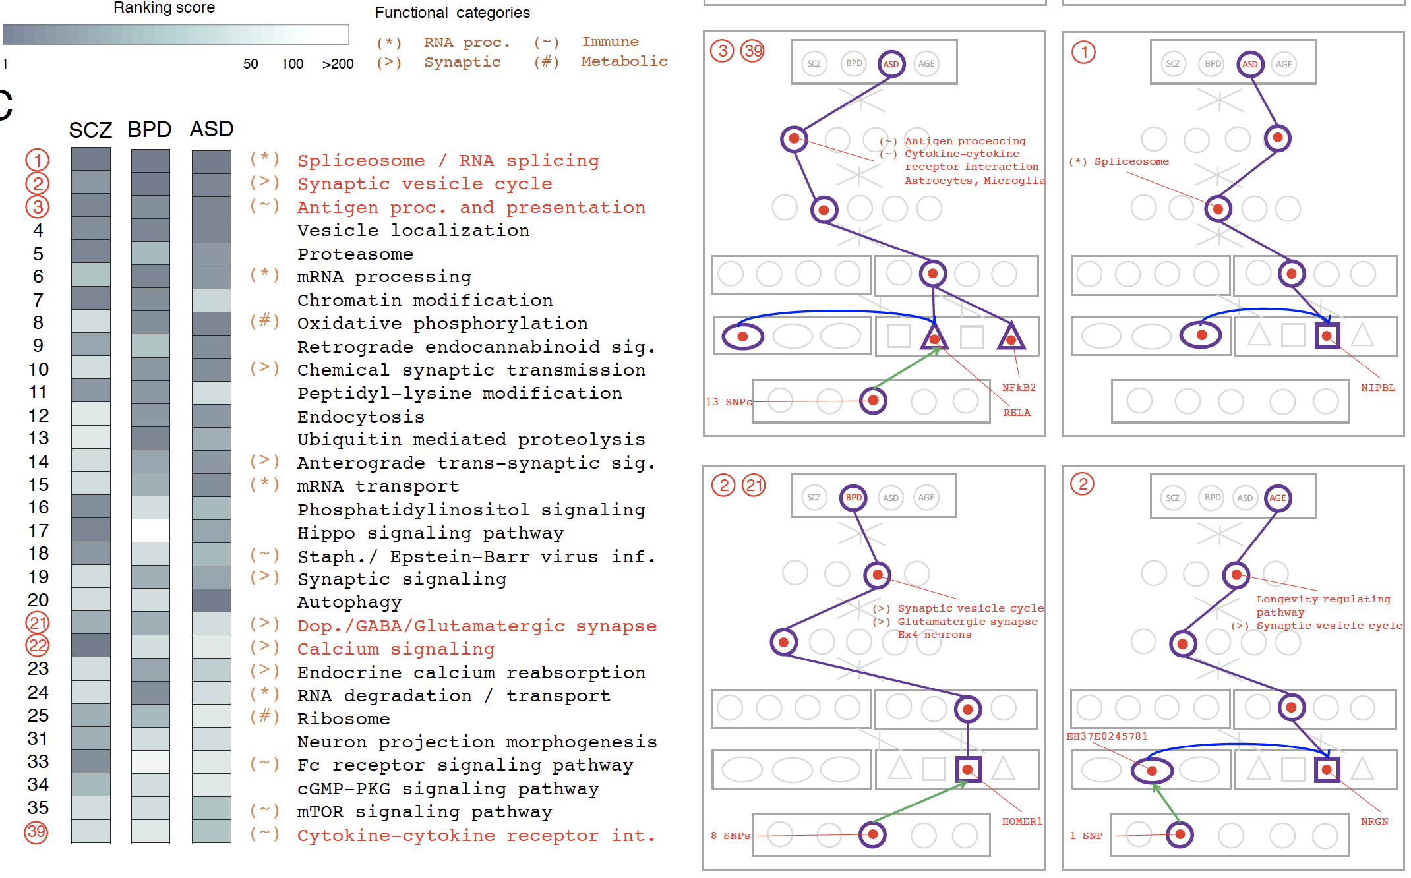
DSPN discovers molecular pathways from genotype to phenotype

Slide 17
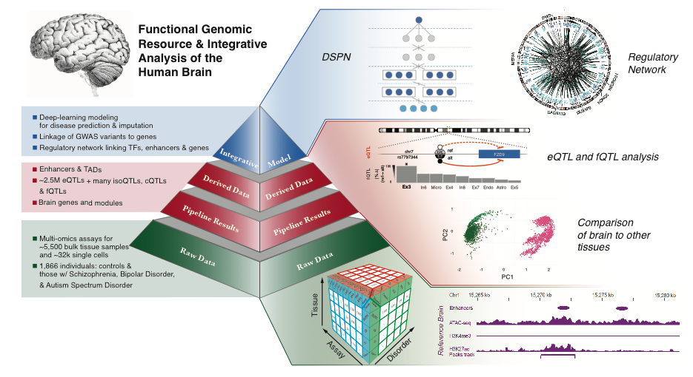
Comprehensive functional genomic resource for the human brain
Brain specific transcriptome and epigenome
Single cell deconvolution
  Single cell contributions to brain tissues
  Cell fraction changes across observed phenotypes (e.g., disorders, sex, age)
Quantitative Trait Locus (QTL) analysis
  Expression, chromatin, splicing, cell fraction
  Functional genomic variants
Gene regulatory network analysis
  TFs, enhancers, QTLs and target genes
  New disease genes to GWAS variants
  Single cell biomarker genes
Deep Structured Phenotype Network (DSPN)
  Improved disease prediction by deep learning
  Molecular pathways from genotype to phenotype
  Transcriptome imputation
http://resource.psychencode.org/

Slide 18
PsychENCODE Acknowledgment
“Adult Capstone” Team – 1 of 3 capstones
Shuang Liu, Jonathan Warrell, Hyejung Won, Xu Shi, Fabio Navarro, Declan Clarke, Mengting Gu, Prashant Emani, Yucheng T. Yang, Min Xu, Michael Gandal, Shaoke Lou, Jing Zhang, Jonathan J. Park, Chengfei Yan, Suhn Kyong Rhie, Kasidet Manakongtreecheep, Holly Zhou, Aparna Nathan, Mette Peters, Eugenio Mattei, Dominic Fitzgerald, Tonya Brunetti, Jill Moore, Yan Jiang, Kiran Girdhar, Gabriel Hoffman, Selim Kalayci, Zeynep Hulya Gumus, Greg Crawford,
PsychENCODE Consortium,
Panos Roussos, Schahram Akbarian, Andrew E. Jaffe, Kevin White, Zhiping Weng, Nenad Sestan,
Daniel H. Geschwind, James A. Knowles, Mark Gerstein
Dedicated to Pamela Sklar
Geetha Senthil
Lora Bingaman
David Panchision
Alexander Arguello
Thomas Lehner
The PsychENCODE Consortium: Allison E Ashley-Koch, Duke University; Gregory E Crawford, Duke University; Melanie E Garrett, Duke University; Lingyun Song, Duke University; Alexias Safi, Duke University; Graham D Johnson, Duke University; Gregory A Wray, Duke University; Timothy E Reddy, Duke University; Fernando S Goes, Johns Hopkins University; Peter Zandi, Johns Hopkins University; Julien Bryois, Karolinska Institutet; Andrew E Jaffe, Lieber Institute for Brain Development; Amanda J Price, Lieber Institute for Brain Development; Nikolay A Ivanov, Lieber Institute for Brain Development; Leonardo Collado-Torres, Lieber Institute for Brain Development; Thomas M Hyde, Lieber Institute for Brain Development; Emily E Burke, Lieber Institute for Brain Development; Joel E Kleiman, Lieber Institute for Brain Development; Ran Tao, Lieber Institute for Brain Development; Joo Heon Shin, Lieber Institute for Brain Development; Schahram Akbarian, Icahn School of Medicine at Mount Sinai; Kiran Girdhar, Icahn School of Medicine at Mount Sinai; Yan Jiang, Icahn School of Medicine at Mount Sinai; Marija Kundakovic, Icahn School of Medicine at Mount Sinai; Leanne Brown, Icahn School of Medicine at Mount Sinai; Bibi S Kassim, Icahn School of Medicine at Mount Sinai; Royce B Park, Icahn School of Medicine at Mount Sinai; Jennifer R Wiseman, Icahn School of Medicine at Mount Sinai; Elizabeth Zharovsky, Icahn School of Medicine at Mount Sinai; Rivka Jacobov, Icahn School of Medicine at Mount Sinai; Olivia Devillers, Icahn School of Medicine at Mount Sinai; Elie Flatow, Icahn School of Medicine at Mount Sinai; Gabriel E Hoffman, Icahn School of Medicine at Mount Sinai; Barbara K Lipska, Human Brain Collection Core, National Institutes of Health, Bethesda, MD; David A Lewis, University of Pittsburgh; Vahram Haroutunian, Icahn School of Medicine at Mount Sinai and James J Peters VA Medical Center; Chang-Gyu Hahn, University of Pennsylvania; Alexander W Charney, Mount Sinai; Stella Dracheva, Mount Sinai; Alexey Kozlenkov, Mount Sinai; Judson Belmont, Icahn School of Medicine at Mount Sinai; Diane DelValle, Icahn School of Medicine at Mount Sinai; Nancy Francoeur, Icahn School of Medicine at Mount Sinai; Evi Hadjimichael, Icahn School of Medicine at Mount Sinai; Dalila Pinto, Icahn School of Medicine at Mount Sinai; Harm van Bakel, Icahn School of Medicine at Mount Sinai; Panos Roussos, Mount Sinai; John F Fullard, Mount Sinai; Jaroslav Bendl, Mount Sinai; Mads E Hauberg, Mount Sinai; Lara M Mangravite, Sage Bionetworks; Mette A Peters, Sage Bionetworks; Yooree Chae, Sage Bionetworks; Junmin Peng, St. Jude Children's Hospital; Mingming Niu, St. Jude Children's Hospital; Xusheng Wang, St. Jude Children's Hospital; Maree J Webster, Stanley Medical Research Institute; Thomas G Beach, Banner Sun Health Research Institute; Chao Chen, Central South University; Yi Jiang, Central South University; Rujia Dai, Central South University; Annie W Shieh, SUNY Upstate Medical University; Chunyu Liu, SUNY Upstate Medical University; Kay S. Grennan, SUNY Upstate Medical University; Yan Xia, SUNY Upstate Medical University/Central South University; Ramu Vadukapuram, SUNY Upstate Medical University; Yongjun Wang, Central South University; Dominic Fitzgerald, The University of Chicago; Lijun Cheng, The University of Chicago; Miguel Brown, The University of Chicago; Mimi Brown, The University of Chicago; Tonya Brunetti, The University of Chicago; Thomas Goodman, The University of Chicago; Majd Alsayed, The University of Chicago; Michael J Gandal, University of California, Los Angeles; Daniel H Geschwind, University of California, Los Angeles; Hyejung Won, University of California, Los Angeles; Damon Polioudakis, University of California, Los Angeles; Brie Wamsley, University of California, Los Angeles; Jiani Yin, University of California, Los Angeles; Tarik Hadzic, University of California, Los Angeles; Luis De La Torre Ubieta, UCLA; Vivek Swarup, University of California, Los Angeles; Stephan J Sanders, University of California, San Francisco; Matthew W State, University of California, San Francisco; Donna M Werling, University of California, San Francisco; Joon-Yong An, University of California, San Francisco; Brooke Sheppard, University of California, San Francisco; A Jeremy Willsey, University of California, San Francisco; Kevin P White, The University of Chicago; Mohana Ray, The University of Chicago; Gina Giase, SUNY Upstate Medical University; Amira Kefi, University of Illinois at Chicago; Eugenio Mattei, University of Massachusetts Medical School; Michael Purcaro, University of Massachusetts Medical School; Zhiping Weng, University of Massachusetts Medical School; Jill Moore, University of Massachusetts Medical School; Henry Pratt, University of Massachusetts Medical School; Jack Huey, University of Massachusetts Medical School; Tyler Borrman, University of Massachusetts Medical School; Patrick F Sullivan, University of North Carolina - Chapel Hill; Paola Giusti-Rodriguez, University of North Carolina - Chapel Hill; Yunjung Kim, University of North Carolina - Chapel Hill; Patrick Sullivan, University of North Carolina - Chapel Hill; Jin Szatkiewicz, University of North Carolina - Chapel Hill; Suhn Kyong Rhie, University of Southern California; Christoper Armoskus, University of Southern California; Adrian Camarena, University of Southern California; Peggy J Farnham, University of Southern California; Valeria N Spitsyna, University of Southern California; Heather Witt, University of Southern California; Shannon Schreiner, University of Southern California; Oleg V Evgrafov, SUNY Downstate Medical Center; James A Knowles, SUNY Downstate Medical Center; Mark Gerstein, Yale University; Shuang Liu, Yale University; Daifeng Wang, Stony Brook University; Fabio C. P. Navarro, Yale University; Jonathan Warrell, Yale University; Declan Clarke, Yale University; Prashant S. Emani, Yale University; Mengting Gu, Yale University; Xu Shi, Yale University; Min Xu, Yale University; Yucheng T. Yang, Yale University; Robert R. Kitchen, Yale University; Gamze Gürsoy, Yale University; Jing Zhang, Yale University; Becky C Carlyle, Yale University; Angus C Nairn, Yale University; Mingfeng Li, Yale University; Sirisha Pochareddy, Yale University; Nenad Sestan, Yale University; Mario Skarica, Yale University; Zhen Li, Yale University; Andre M.M. Sousa, Yale University; Gabriel Santpere, Yale University; Jinmyung Choi, Yale University; Ying Zhu, Yale University; Tianliuyun Gao, Yale University; Daniel J Miller, Yale University; Adriana Cherskov, Yale University; Mo Yang, Yale University; Anahita Amiri, Yale University; Gianfilippo Coppola, Yale University; Jessica Mariani, Yale University; Soraya Scuderi, Yale University; Anna Szekely, Yale University; Flora M Vaccarino, Yale University; Feinan Wu, Yale University; Sherman Weissman, Yale University; Tanmoy Roychowdhury, Mayo Clinic Rochester; Alexej Abyzov, Mayo Clinic Rochester;.

Slide 19
DSPN improves brain disease prediction
Accuracy = chance to correctly predict disease/health
Notes:
We transformed our results to the liability scale for comparison with narrow-sense heritability estimates (Fig. 7C; 15). Prior studies have estimated that common SNPs explain 25.6%, 20.5%, and 19% of the genetic variance for SCZ, BPD and ASD, respectively \cite{29930110}. These may be taken as upper bounds for additive models, given unlimited common-variant data. By contrast, non-linear predictors can exceed these limits. Our best liability scores (from just the genotype at QTL-associated variants) are substantially below these bounds, implying that additional data would be beneficial. In contrast, the variance explained by the full DSPN model exceeds that explained by common SNPs (32.8%, 37.4%, and 14.4%, respectively), possibly reflecting the influence of rare variants and epistatic interactions. Note, however, these estimates may be confounded though by trait-associated variation which is environmental in origin (Fig. [[Potential_causal_relationships]]).

