Slide 1
A2CPS – U54 Acute to Chronic Pain Signatures Program DIRC Data Integration and Resource Center Writing Starter’s Gunshot
Kim C. Worley, Ph.D.
Department of Molecular and Human Genetics
Baylor College of Medicine
Writing Meeting October 1, 2018

Slide 2
Outline For Today’s Call
Introductions
Organization of the group
Brief logistics for sharing
Proposal Preparation Plan and Logistics
Short timeframe, critical path
Who is doing what
Parts that are needed
Timeline for proposal preparation
To Do List for 10/3
Detailed logistics for sharing for your reference

Slide 3
People, Expertise
Name | email | Institution | DIRC Group
Anticevic, Alan | alan.anticevic@yale.edu | Yale
DeBenedet-Murgo, Andrea | andrea.debenedet@yale.edu | Yale
Fisch, Kathleen (Katie) | kfisch@ucsd.edu | UCSD | DCC
Gelernter, Joel | joel.gelernter@yale.edu | Yale | SOC
Gerstein, Mark | mark@gersteinlab.org | Yale | DIAC
Jackson, Andrew R | andrewj@bcm.edu | BCM | DCC, CORE
Laurent, Louise | louise.laurent@gmail.com | UCSD
Milosavljevic, Aleksandar | amilosav@bcm.edu | BCM | DCC, CORE
Pico, Alex | alex.pico@gladstone.ucsf.edu | UCSF | SOC
Polimanti, Renato | renato.polimanti@yale.edu | Yale | SOC
Quehenberger, Oswald (Ossie) | oquehenberger@ucsd.edu | UCSD | DCC
Roth, Matt | mattr@bcm.edu | BCM | DCC, CORE
Rozowsky, Joel | joel.rozowsky@yale.edu | Yale | DIAC
Subramanian, Sai Lakshmi | SaiLakshmi.Subramanian@bcm.edu | BCM | DCC, CORE
Worley, Kim C. | kworley@bcm.edu | BCM | DCC, CORE

Slide 4
Contributors
Research Sections | Contributors | BCM Coord
DIRC – Overall | Aleks Milosavljevic | Aleks M.
SOC | Joel Gelernter Renato Poimanti Alan Anticevic Alex Pico | Kim Worley
DIAC | Mark Gerstein Joel Rozowsky | Kim Worley
DCC | Aleks Milosavljevic Katie Fisch Ossie Quehenberger | Kim Worley
Admin Core | Aleks Milosavljevic | Matt Roth

Slide 5
BCM Coordinators
Elke Norwig-Eastaugh – admin
elken@bcm.edu
Collecting administrative contacts
Communicating required forms
Kim Worley – research sections
kworley@bcm.edu
Collecting biosketches / descriptions

Slide 6
Logistics
Genboree A2CPS Project
Instructions
Google Docs
Concurrent editing, quick revisions
Then MSWord
Allows references, need to check out & return
Include references as <PMID>
Figures don’t work well in Google Docs
Upload Figures individually to High Quality Figure
Name with section, figure letter, version (SOC figure A version 2, DCC figure C version 1)

Slide 7
Organization
See Participants and Roles
List of people, emails, and brief descriptions
Add administrative contacts for each group
Edit descriptions of yourself
NIH Biosketches
Upload yours here by 10/3
See Proposal writing telcons for this document

Slide 8
A2CPS Genboree Forums
NIH Biosketches
Google Doc Links
DIRC – Overall
DIRC – DCC
DIRC – SOC
DIRC – DIAC
DIRC – Admin Core
High Quality Figures

Slide 9
Proposal Discussion
Working through DIRC – Overall document to discuss coordination
https://docs.google.com/document/d/1d2NUxacjYle0Pu8gmxFwtXkDrx0E4E-f6hf25HUzKVY/edit
Aleks (DIRC – Overall, SOC, DCC, CORE)
Joel R. (DIAC)

Slide 10
Google doc for DIRC-Overall
Title: Data Integration and Resource Center (DIRC) for the Acute to Chronic Pain Signatures (A2CPS) Program
SIGNIFICANCE
Problem to be addressed by A2CPS program
Opioid addiction epidemic. Connection to chronic pain. Candide univariate biomarkers combined into biosignatures of A2CP transition (A2CPS) susceptibility or resilience as a starting point toward (1) development of candidate actionable biomarkers (univariate or multivariate signatures); (2) understanding mechanisms; (3) identifying targets for the development of personal prevention strategies. A2CPS.
A2CPS program and DIRC’s role within it
Figure: Interactions of DIRC with other A2CPS components
Scientific Premise for association studies and integrative analyses
Genetic and epigenetic biosignatures
Omics biosignatures (tissue, blood) considered independently and jointly with genetic/epigenetic markers.
Phenotypes and brain imaging
Integrative analyses (possibly in the context of EHR, questionnaire, and other data and external data) in network/pathway context to combine individual biomarkers into mutivariate signatures
Selection of candidate biomarkers for validation? (Not explicitly stated requirement for DIRC, but may help?
Justify selection of candidate biosignatures to supplement “ome-wide” association studies:
prior studies, hypotheses (surgical, musculo-skeletal injury)
clinical utility (surgical, musculo-skeletal injury)
Summary table (two sections: surgical, musculo-skeletal injury): Rows: layers of information (SNPs, epigenetics, omics, imaging, phenotypes; Columns: 1:information type; 2: biomarkers selected for validation; 3: rationale for each selected biomarker
What will be accomplished if goals achieved
Biosignatures of A2CP transition (A2CPS) susceptibility or resilience
Leads toward understanding mechanisms of susceptibility to chronic pain

Slide 11
3. Candidate targets for the development of personal prevention strategies
INNOVATION
Highlights of SOC, DCC, DIAC innovations from individual sections and how they will work together to achieve A2CPS aims.
RESEARCH STRATEGY
DIRC organization
Figure: DIRC organization, key personnel Qualifications of key personnel.
How will key personnel interact to achieve the overall aims? Record of prior collaboration and consortium participation.
SOC Aim
SOC 12 pages compressed with emphasis on interactions within DIRC and A2CPS toward accomplishing project goals
DCC Aim
DCC 12 pages compressed with emphasis on interactions within DIRC and A2CPS toward accomplishing project goals
DIAC Aim
DIAC 12 pages compressed with emphasis on interactions within DIRC and A2CPS toward accomplishing project goals
Admin Aim
Admin 6 pages compressed with emphasis on interactions within DIRC and A2CPS toward accomplishing project goals
Milestones and Timeline
Notes: From this: https://grants.nih.gov/grants/guide/rfa-files/RFA-RM-18-031.html
Will need to coordinate with other parts

Slide 12
SOC:
Develop A2CPS Program Portal
A community-wide nexus for protocols, assay and data standards, raw and processed data, data pipelines, and other resources generated by the A2CPS consortium.
UCSD - Katie.
Data Analysis Outreach to Scientific Community
Demonstrate utility of the data by performing analyses, developing use-cases, discovering biosignatures etc. using uconsortium data, robust tools that empower both naïve and experienced investigators to query, integrate, analyze, and model the data.
Yale - Joel G, Renato P.
Develop Workshops and Community Outreach Strategy
Develop workshops with the Admin Core and implement a community outreach strategy to inform the research community of the accomplishments of the program and disseminate information about the community resources and data generated by the program.
Kim, Matt, with input from Joel G, Renato.

Slide 13
DCC
Ensure A2CPS-generated data and metadata have standardized formats and associated quality metrics (both raw and processed data)
Ensure A2CPS-generated data and metadata have standardized formats and associated quality metrics. Metadata types - metabolomics lipidomics, proteomics, imaging.
EHR data types.
Quality metrics - refer to DIAC.
Implement data flow, data portal and deploy web-accessible tools for reproducible analyses
Provide data portal infrastructure.
Use case (data flow, tools aligned with integrative analyses - DIAC) - aligned with scientific premise
-from Yale
Make A2CPS data available to community using resources obtained through NIH Data Commons to ensure data will be FAIR and accessible via cloud-based data storage and computing and archive raw and processed datasets generated by A2CPS Consortium
Dockerization - Katie.
Tools - metabolomics, lipidomics, proteomics, imaging, exRNA-seq. Archive raw and processed datasets generated by the A2CPS Consortium.
Facilitate data use: provide user-friendly access to consortium data, identify or generate robust tools to enable both naïve and experienced investigators to query, integrate, analyze, and model the data.
Make the A2CPS data available to the community using resources obtained through the NIH Data Commons (https://commonfund.nih.gov/commons) to ensure the data will be FAIR (Findable, Accessible, Interoperable, and Reusable) and accessible via cloud based data storage and computing.
DIAC
1. Work with A2CPS consortium PIs to analyze the data generated
Work with A2CPS consortium PD(s)/PI(s) to analyze the data generated.

Slide 14
DIAC
1. Work with A2CPS consortium PIs to analyze the data generated
Work with A2CPS consortium PD(s)/PI(s) to analyze the data generated.
2. Develop analysis strategies to integrate the A2CPS datasets in synergistic ways with other relevant datasets
Work with A2CPS consortium PD(s)/PI(s) to develop analysis strategies to integrate the A2CPS datasets in synergistic ways with other relevant datasets.
3. Share useful information and insights about these data with the broader biomedical research community
Facilitate data use: provide user-friendly access to consortium data, identify or generate robust tools to enable both naïve and experienced investigators to query, integrate, analyze, and model the data.
Work with A2CPS consortium PD(s)/PI(s) to share useful information and insights about these data with the broader biomedical research community.
Admin CORE
1. Facilitate communication across the A2CPS consortium and among the DIRC components
Coordinate A2CPS consortium activities by organizing steering committee meetings, workgroup meetings, and other awardee meetings.
2. Organize steering committee meetings, workgroup meetings and other awardee meetings
3. Provide quarterly updates to the NIH staff

Slide 15
Timeline for Proposal Prep
Finalized Budget
NIH Biosketches
Proposed Figures list & illustrated ideas
Call Noon CDT
Subcontracts DUE
Budgets
Institutional Signatures
Biosketches
Budget justification
Facilities and Resources
Timelines
Assurances
Letters of Support
DUE
Refined Figures
Call Noon CDT
Call Noon CDT
Final Text & Figures DUE
Research sections
Figures
References
Timelines

Slide 16
To Do List – Due 10/3 or 10/4
NIH Biosketch modified for this proposal
Administrative contacts
Elke will send list of required forms by email
Budgets
Proposed Figures (list, drafts)
Text and figure contribution
Short personal description and PMIDs for relevant previous work and roles

Slide 18
Genboree A2CPS Project
Getting access
Get an account at: http://www.genboree.org/java-bin/login.jsp
After you have an account, sign in (with the login and password you created) to Genboree Commons at http://genboree.org/theCommons/login
Note the different address
This makes it possible to add you to a project, but we still need to know you have access so:
Email Matt (mattr@bcm.edu) or Kim (kworley@bcm.edu) to be added to the A2CPS project
Tabs and Use
Overview – who is on the list
Documents – share referenced documents
Forums – this is where to share discuss and share documents for the proposal preparation

Slide 19
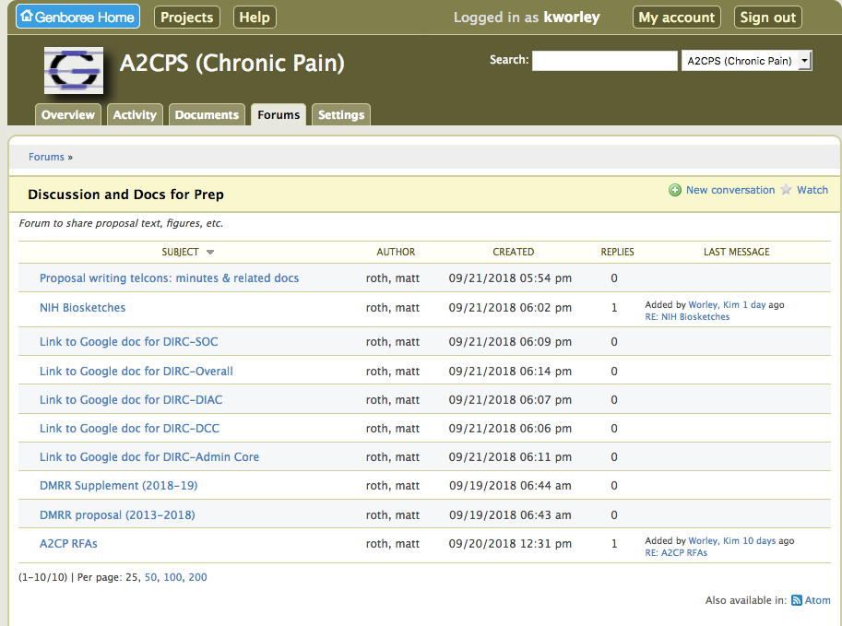
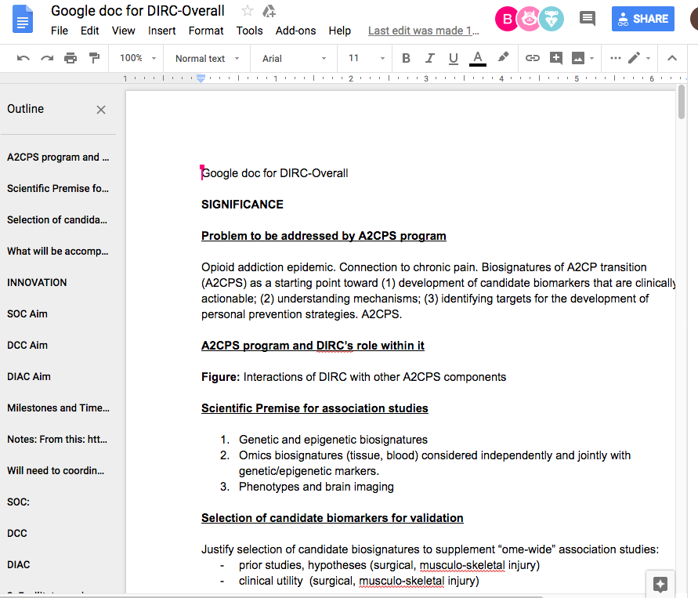
Forum for Docs & Discussion

Slide 20
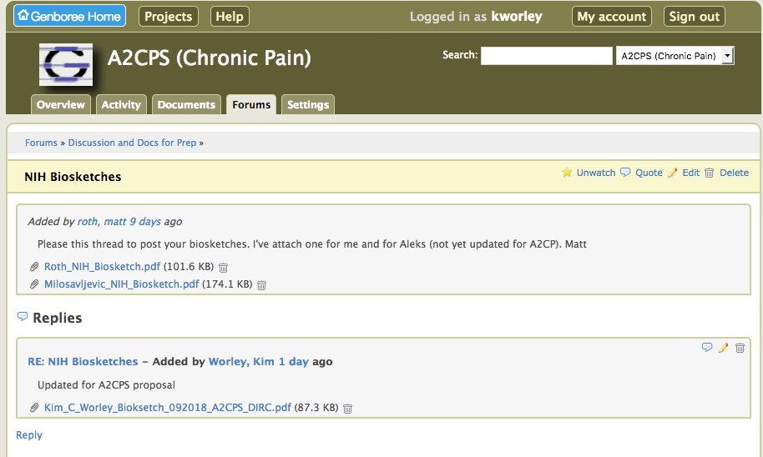
Edit NIH Biosketch Thread To Post Your Biosketch
Use Edit, and no email notification is sent.
Use Reply, and Genboree sends an email notification

Slide 21
Google Document Sharing
Start from an existing document, click new to create, edit the title.
Click share in upper right corner, and copy the link to the document
Paste that document link
Into the Forum comments
Or into a different google doc to cross reference Figures

