Slide 1
Genomic Informatics a.k.a Where’s Waldo’s Genotype?
Prashant Emani
Group meeting
May 30th, the year of your Lord 2018.

Slide 2
Outline
Motivation: Information content of a collection of SNPs
Definitions and Assumptions
“Genotype Tree” method for individual within database
“De novo” individual identification using HMMs

Slide 3
Motivation for studying genomic information
Known issue of information leakage through queries of SNP “beacons” ^{1,2,3}, genotype and allele frequencies^{4,5} and functional genomics data^{6,7}
However, there is an interest in quantifying the degree to which single SNPs or collections of SNPs can pinpoint an individual or determine the membership of that individual to a population subgroup
Specifically, what is the information content of a single or a group of common SNPs?
  Knowing this beforehand could aid in attacks through beacon queries of low entropy regions of the genome
  As will be shown later, can be used to categorize sparsely genotyped samples
¹Shringarpure & Bustamante Am. J. Hum. Gen. 2015, 97 (5): 631-646; ²Raisaro et al. J. Am. Med. Inform. Assoc. 2017, 24 (4): 799-805;
³von Thenen et al. biorxiv 2017, doi: https://doi.org/10.1101/200147; ⁴Homer et al. PLoS Gen. 2008, 4 (8): e1000167; ⁵Visscher & Hill PLoS Gen. 2009, 5 (10): e1000628; ⁶Harmanci & Gerstein, Nat. Meth. 2016, 13 (3): 251-256; Gürsoy et al., submitted to Nat. Biotech.

Slide 4
Definitions and assumptions
Query Individual Membership assumption: Do you assume that a given individual is a part of a database or not?
  Will treat both cases in this work
SNP Membership assumption: Has the SNP being queried been genotyped in the hacked database, or in a reference database, or in neither?
  Will treat the cases where the queried SNP has been genotyped in the hacked database or in a reference database
  Can extend eventually to case where you have a completely “de novo” SNP

Slide 5
The “Genotype Tree”
Idea: For the genotyped individuals within a database, identification is relative to other members of the database
  i.e. with no assumptions about ancestry or relatedness, an individual can be picked out purely based on the set of “discriminating” SNPs
“Discriminating” SNPs: those that are responsible for the branching out of two groups of genotyped individuals
Construct a tree where nodes are associated with sets of discriminating SNPs

Slide 6
Conceptual visualization
Advantages:
Pairs of SNPs in LD, if they are genotyped, should automatically be grouped together
No assumptions are made about the LD structure of the genotyped SNPs
Can calculate the informational entropy of a single SNP
Quickly ID individual with minimal set of SNPs
Disadvantages:
No guarantee of existence and uniqueness of such a tree
{rs706218, rs3422449, …}_{1,2→3,4,5,6}
{rs14253207, …}_{3,4→5,6}
{rs24881919,…}_{1→2}
5
6
1
2
3
4

Slide 7
Protocol
Downsample 1kG genotypes
[This is to make the problem
more tractable]
Build pairwise distance scores
[An approximate method to
separate the sample branching
and SNP placement problems]
Build hierarchical clustering tree
Assign SNPs to nodes
Top-down assignment
Bottom-up assignment

Slide 8
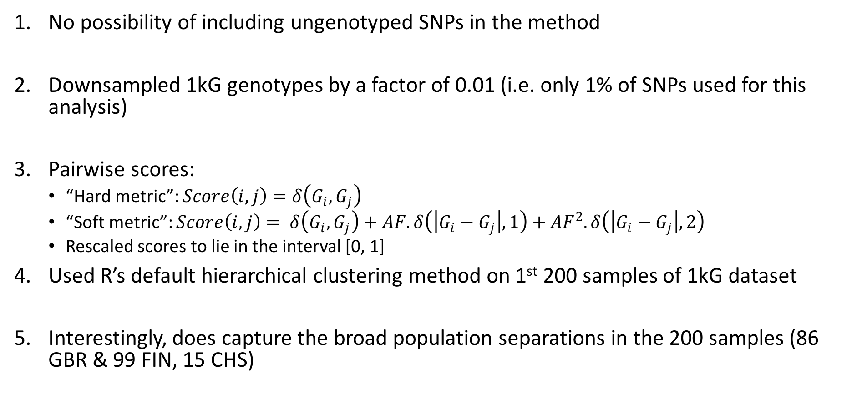
Specifics of the method
No possibility of including ungenotyped SNPs in the method
Downsampled 1kG genotypes by a factor of 0.01 (i.e. only 1% of SNPs used for this analysis)
Pairwise scores:
  “Hard metric”: $Score\left(i,j\right)=δ\left(G_{i},G_{j}\right)$
  “Soft metric”: $Score\left(i,j\right)= δ\left(G_{i},G_{j}\right)+AF.δ\left(\left|G_{i}−G_{j}\right|,1\right)+{AF}^{2}.δ\left(\left|G_{i}−G_{j}\right|,2\right)$
  Rescaled scores to lie in the interval [0, 1]
Used R’s default hierarchical clustering method on 1st 200 samples of 1kG dataset
Interestingly, does capture the broad population separations in the 200 samples (86 GBR & 99 FIN, 15 CHS)

Slide 9
SNP assignment approaches
Bottom-up approach:
  Start with the terminal nodes
  Find discriminating SNPs with different genotypes in the different leaves
  Remove those SNPs from that lineage and repeat process in higher nodes, until the top.
Top-down approach:
  Start at topmost node
  Find discriminating SNPs that are shared by 80% of members in each branch and that are different between branches
  Remove those SNPs from the lineage and continue down
  Place all leftover SNPs in terminal leaves

Slide 10
Results from Top-down approach
chr10_72539085_rs35312461_A:G;1 HG00236
chr10_72539085_rs35312461_A:G;1 HG00123
chr10_72539085_rs35312461_A:G;1 HG00443
chr10_72539085_rs35312461_A:G;1 HG00267 HG00188
chr10_72539085_rs35312461_A:G;1 HG00266
chr10_72539085_rs35312461_A:G;1 HG00173
chr17_9015439_rs11078786_T:C;2 HG00421 HG00442
chr17_9015439_rs11078786_T:C;2 HG00139 HG00130
chr17_9015439_rs11078786_T:C;2 HG00358_HG00375_HG00183_HG00278
chr17_9015439_rs11078786_T:C;2 HG00325 HG00338
chr17_9015439_rs11078786_T:C;2 HG00282_HG00323
chr17_9015439_rs11078786_T:C;2 HG00171
chr17_9015439_rs11078786_T:C;2 HG00178
chr17_9015439_rs11078786_T:C;2 HG00238_HG00240_HG00100_HG00099_HG00102
chr17_9015439_rs11078786_T:C;2 HG00177 HG00173
chr17_9015439_rs11078786_T:C;2 HG00263
chr17_9015439_rs11078786_T:C;2 HG00259
chr5_2539835_rs2121585_G:C;2 HG00122
chr5_2539835_rs2121585_G:C;2 HG00137
chr5_2539835_rs2121585_G:C;2 HG00251
chr5_2539835_rs2121585_G:C;2 HG00330
chr5_2539835_rs2121585_G:C;2 HG00236_HG00264
chr5_2539835_rs2121585_G:C;2 HG00325
chr5_2539835_rs2121585_G:C;2 HG00178
chr5_2539835_rs2121585_G:C;2 HG00290_HG00342_HG00328_HG00319_HG00357
chr5_2539835_rs2121585_G:C;2 HG00360
chr5_2539835_rs2121585_G:C;2 HG00313
Randomly picked a single individual
Sampled 5 SNPs at random
Placed them according to Genotype Tree
Found that most SNPs fell in the terminal leaves, i.e. most SNPs were not “discriminating”
Can find the entropy, but no advantage over brute force searches

Slide 11
Conclusions
Either
  Most SNPs are genuinely lacking in discriminative power and are randomly strewn about
OR
  Need to find a better method that simultaneously differentiates between individuals and assigns SNPs to branches
Such a tree would maximally use the information from individual SNPs
Could be used to attack with SNP beacons
Could be used to identify certain genomic regions as highly informative in privacy attacks
¹Shringarpure and Bustamante Am. J. Hum. Gen. 2015, 97 (5): 631-646; ²Raisaro et al. J. Am. Med. Inform. Assoc. 2017, 24 (4): 799-805;
³von Thenen et al. biorxiv 2017, doi: https://doi.org/10.1101/200147

Slide 12
Identification of individuals using Genotype Hidden Markov Models (HMMs)
Use the framework set up by Li and Stephens¹ for modeling LD, and Marchini, Donnelly and co-workers² for the IMPUTE programs (for genotypic imputation) for individual identification
Construct an HMM that where the hidden states are the unknown haplotypes of a sample and the observations are the sample genotypes
Modify the algorithm to output best sequence of states (Viterbi algorithm), rather than the maximum likelihood (as done in IMPUTE)
Can identify both individuals within databases, as well as mosaics of reference haplotypes
¹Li and Stephens, Genetics 2003, 165: 2213 – 2233; ²Marchini et al., Nat. Gen. 2007, 39 (7): 906 - 913

Slide 13








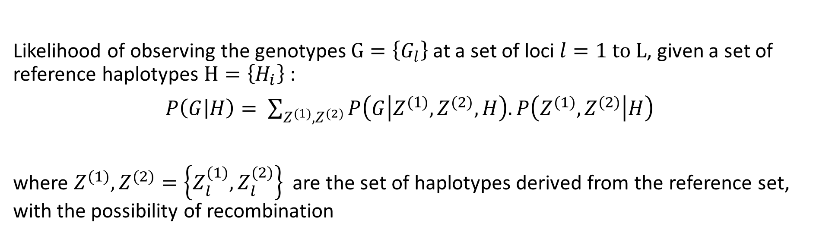
Details of the HMM
$$l=1$$
$$l=2$$
$$l=3$$
$$l=L−1$$
$$l=L$$
Observed
Genotype
2
0
1
0
1
Visible Layer
$$G_{l}$$
…
Chromosome 1
Haplotype
$$Z_{l}^{\left(1\right)}$$
1
0
0
1
0
Hidden Layer
Recombination possible
Chromosome 2
Haplotype
…
$$Z_{l}^{\left(2\right)}$$
1
1
0
0
0
Likelihood of observing the genotypes $G=\left\{G_{l}\right\}$ at a set of loci $l=1 to L$, given a set of reference haplotypes $H=\left\{H_{i}\right\}$ :
$P\left(G | H\right)= \sum_{Z^{(1)},Z^{(2)}}{P\left(G | Z^{(1)},Z^{(2)},H\right).}P\left(Z^{(1)},Z^{(2)} | H\right)$
where $Z^{(1)},Z^{(2)}=\left\{Z_{l}^{(1)},Z_{l}^{(2)}\right\}$ are the set of haplotypes derived from the reference set, with the possibility of recombination

Slide 14
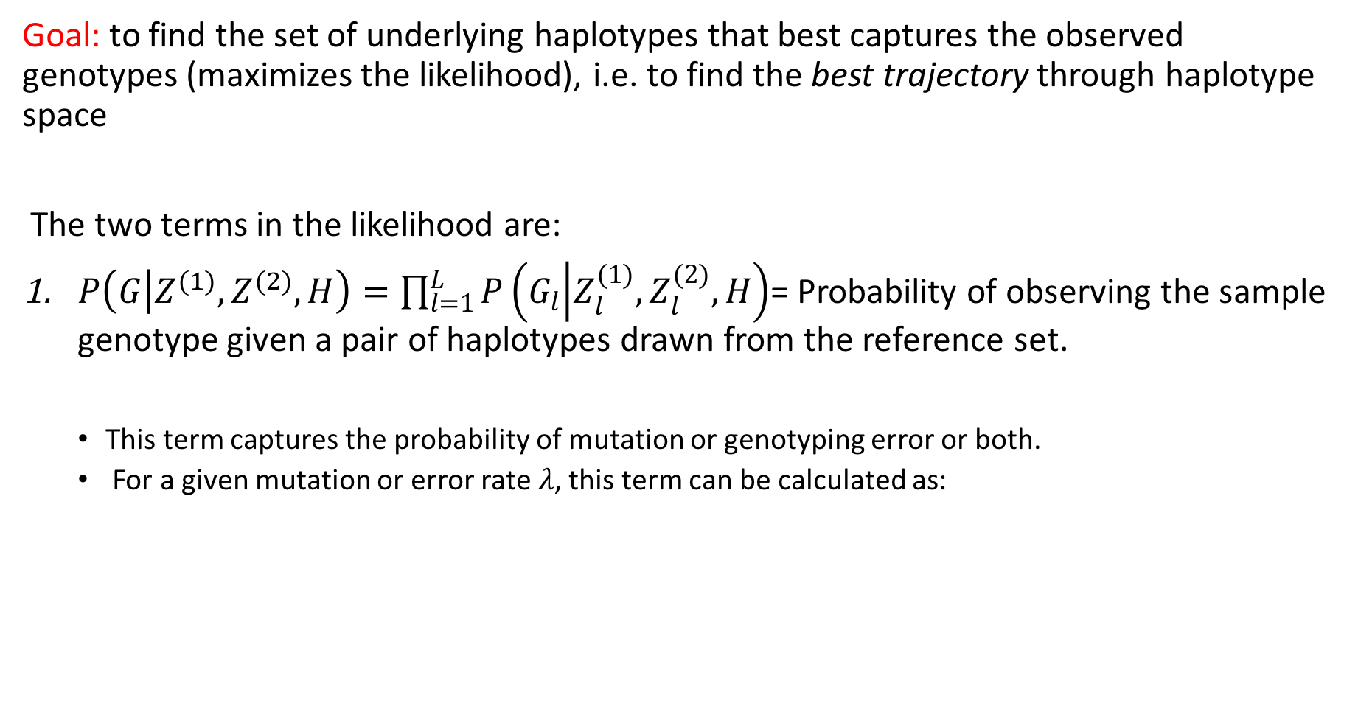
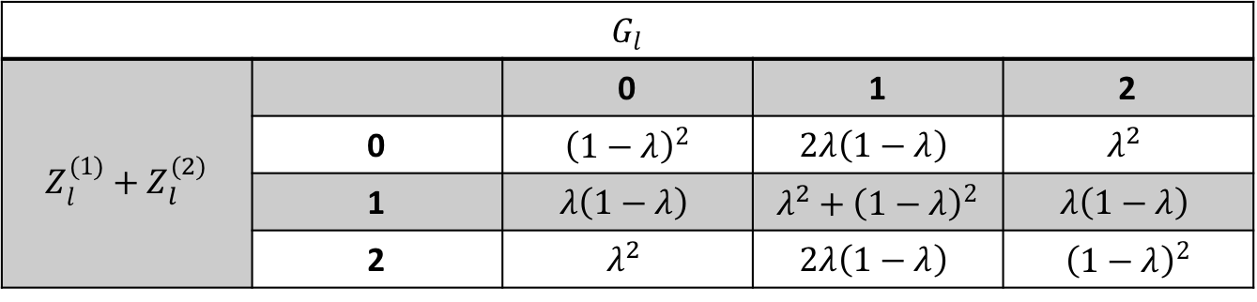
Goal: to find the set of underlying haplotypes that best captures the observed genotypes (maximizes the likelihood), i.e. to find the best trajectory through haplotype space
The two terms in the likelihood are:
$P\left(G | Z^{(1)},Z^{(2)},H\right)=\prod_{l=1}^{L}{P\left(G_{l} | Z_{l}^{(1)},Z_{l}^{(2)},H\right)}$= Probability of observing the sample genotype given a pair of haplotypes drawn from the reference set.
  This term captures the probability of mutation or genotyping error or both.
  For a given mutation or error rate $λ$, this term can be calculated as:
$G_{l}$
$$Z_{l}^{(1)}+Z_{l}^{(2)}$$ |  | 0 | 1 | 2
 | 0 | ${\left(1−λ\right)}^{2}$ | $$2λ\left(1−λ\right)$$ | $$λ^{2}$$
 | 1 | $$λ\left(1−λ\right)$$ | $λ^{2}+{\left(1−λ\right)}^{2}$ | $$λ\left(1−λ\right)$$
 | 2 | $$λ^{2}$$ | $$2λ\left(1−λ\right)$$ | ${\left(1−λ\right)}^{2}$

Slide 15
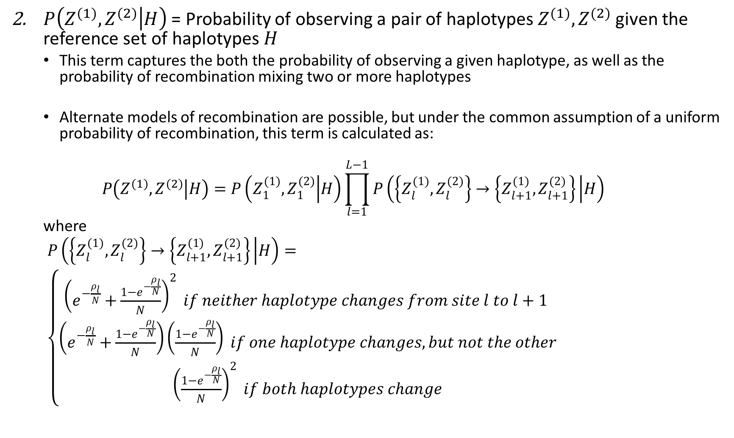
$P\left(Z^{(1)},Z^{(2)} | H\right)$ = Probability of observing a pair of haplotypes $Z^{(1)},Z^{(2)}$ given the reference set of haplotypes $H$
  This term captures the both the probability of observing a given haplotype, as well as the probability of recombination mixing two or more haplotypes
  Alternate models of recombination are possible, but under the common assumption of a uniform probability of recombination, this term is calculated as:
  $$P\left(Z^{(1)},Z^{(2)} | H\right)=P\left(Z_{1}^{(1)},Z_{1}^{(2)} | H\right)\prod_{l=1}^{L−1}{P\left(\left\{Z_{l}^{(1)},Z_{l}^{(2)}\right\}→\left\{Z_{l+1}^{(1)},Z_{l+1}^{(2)}\right\} | H\right)}$$
  where
  $P\left(\left\{Z_{l}^{(1)},Z_{l}^{(2)}\right\}→\left\{Z_{l+1}^{(1)},Z_{l+1}^{(2)}\right\} | H\right)=$
  $\left\{\begin{matrix}{\left(e^{−\frac{ρ_{l}}{N}}+\frac{1−e^{−\frac{ρ_{l}}{N}}}{N}\right)}^{2} if neither haplotype changes from site l to l+1 \\ \left(e^{−\frac{ρ_{l}}{N}}+\frac{1−e^{−\frac{ρ_{l}}{N}}}{N}\right)\left(\frac{1−e^{−\frac{ρ_{l}}{N}}}{N}\right) if one haplotype changes, but not the other \\ {\left(\frac{1−e^{−\frac{ρ_{l}}{N}}}{N}\right)}^{2} if both haplotypes change\end{matrix}\right.$

Slide 16
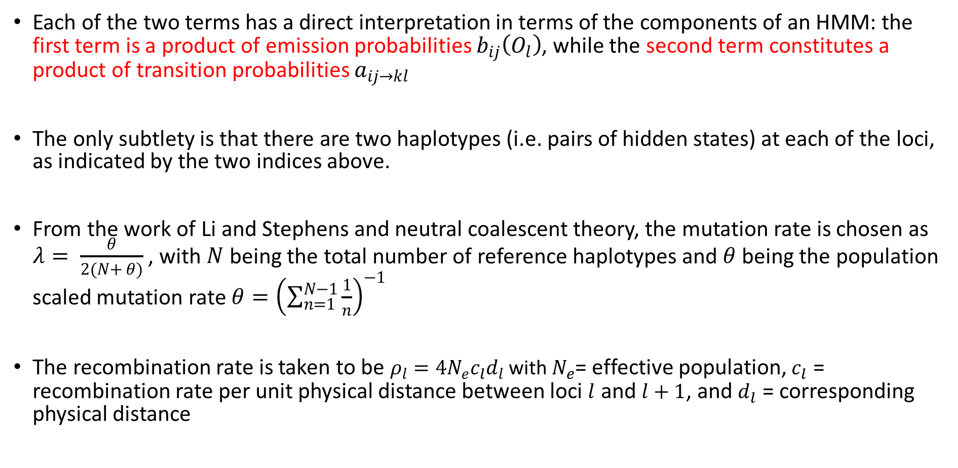
Translation to an HMM and parameter values
Each of the two terms has a direct interpretation in terms of the components of an HMM: the first term is a product of emission probabilities $b_{ij}\left(O_{l}\right)$, while the second term constitutes a product of transition probabilities $a_{ij→kl}$
The only subtlety is that there are two haplotypes (i.e. pairs of hidden states) at each of the loci, as indicated by the two indices above.
From the work of Li and Stephens and neutral coalescent theory, the mutation rate is chosen as $λ= \frac{θ}{2\left(N+ θ\right)}$ , with $N$ being the total number of reference haplotypes and $θ$ being the population scaled mutation rate $θ={\left(\sum_{n=1}^{N−1}{\frac{1}{n}}\right)}^{−1}$
The recombination rate is taken to be $ρ_{l}=4N_{e}c_{l}d_{l}$ with $N_{e}$= effective population, $c_{l}$ = recombination rate per unit physical distance between loci $l$ and $l+1$, and $d_{l}$ = corresponding physical distance

Slide 17
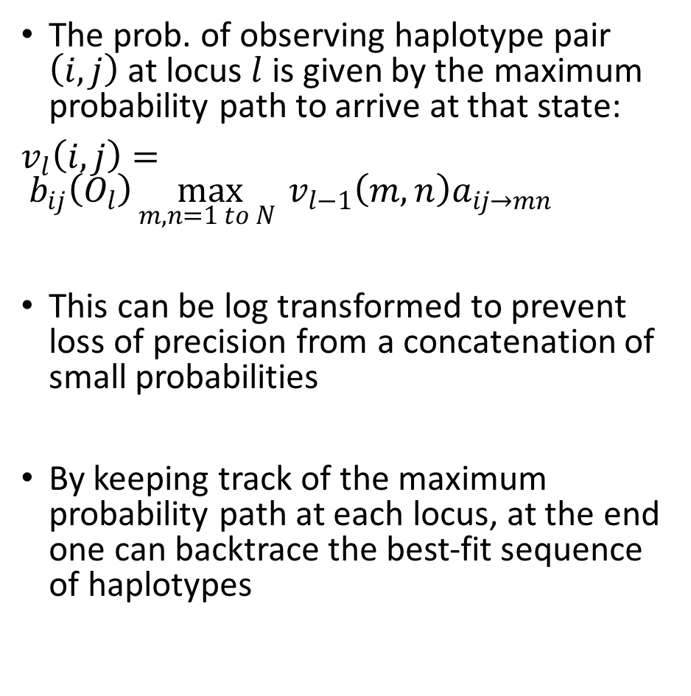
Logarithmic Viterbi algorithm
The prob. of observing haplotype pair $\left(i,j\right)$ at locus $l$ is given by the maximum probability path to arrive at that state:
$v_{l}\left(i,j\right)= b_{ij}\left(O_{l}\right)\max_{m,n=1 to N }{v_{l−1}\left(m,n\right)a_{ij→mn}}$
This can be log transformed to prevent loss of precision from a concatenation of small probabilities
By keeping track of the maximum probability path at each locus, at the end one can backtrace the best-fit sequence of haplotypes
Image from: Jurafsky and Martin, Speech and Language Processing 2017

Slide 18
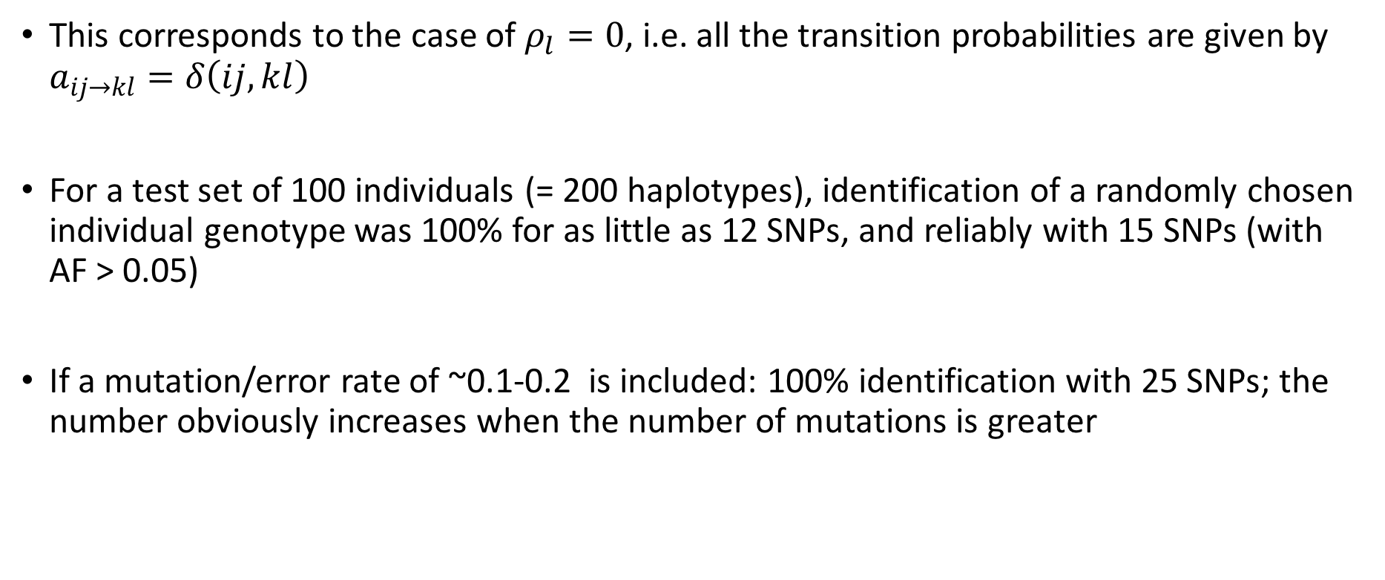
Results
Case 1: Identifying an individual known to be within a database
This corresponds to the case of $ρ_{l}=0$, i.e. all the transition probabilities are given by $a_{ij→kl}=δ\left(ij,kl\right)$
For a test set of 100 individuals (= 200 haplotypes), identification of a randomly chosen individual genotype was 100% for as little as 12 SNPs, and reliably with 15 SNPs (with AF > 0.05)
If a mutation/error rate of ~0.1-0.2 is included: 100% identification with 25 SNPs; the number obviously increases when the number of mutations is greater

Slide 19
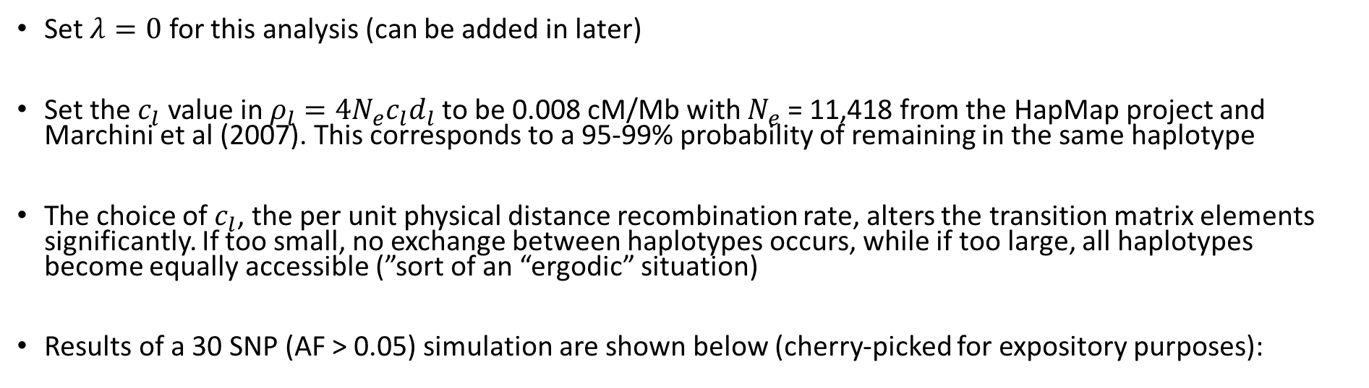
Case 2: Identifying an individual not in the database, but related to the ancestries represented therein
Set $λ=0$ for this analysis (can be added in later)
Set the $c_{l}$ value in $ρ_{l}=4N_{e}c_{l}d_{l}$ to be 0.008 cM/Mb with $N_{e}$ = 11,418 from the HapMap project and Marchini et al (2007). This corresponds to a 95-99% probability of remaining in the same haplotype
The choice of $c_{l}$, the per unit physical distance recombination rate, alters the transition matrix elements significantly. If too small, no exchange between haplotypes occurs, while if too large, all haplotypes become equally accessible (”sort of an “ergodic” situation)
Results of a 30 SNP (AF > 0.05) simulation are shown below (cherry-picked for expository purposes):
HG00233: 16 SNPs
HG00111: 14 SNPs
Input Sample:
…
…
rs2737118
G₁ = 1
rs7208257
G₂ = 2
rs8074079
G₁₆ = 2
rs6504069
G₁₇ = 1
rs9303031
G₃₀ = 2
HG00233_A
HG00233_A
HG00111_B
HG00111_A
HG00111_A
…
…
Best sequence:
HG00233_B
HG00233_B
HG00233_A or HG00233_B
HG00111_B
HG00111_B

Slide 20
As an example of an under-determined result, consider the following case with 25 SNPs, and a slightly higher recombination rate of 0.01 cM/Mb:
HG00233: 13 SNPs
HG00142: 12 SNPs
Input Sample:
…
…
rs112430143
G₁ = 1
rs7208257
G₂ = 2
rs11657433
G₁₃ = 2
rs7208291
G₁₄ = 2
rs55992714
G₂₅ = 2
HG0096_A
HG0096_A
HG00176_B
…
HG00176_B
HG00233_A
HG00233_A
HG00142_A
HG00142_A
Best sequence:
HG00233_B
HG00233_B
HG00142_B
…
HG00142_B
HG00137_A
HG00137_A
HG00233_A
HG00233_A

Slide 21
Conclusions
Method successfully identifies individuals and “genomic mosaics” within a window of reasonable recombination and mutation rates
Can be used to characterize the informational entropy of a given set of variants, calculated using the number of equally likely best-fit trajectories
Can identify from a sparse set of SNP information, including the single queries from genotype “beacons”

Slide 22
Future Directions
Identifying unknown samples through association with different population subgroups (can compare maximum likelihood of belonging to different ancestries/phenotypic groups)
“Kinship” analysis (suggested by GG)
Expansion to larger populations (requires further improvements in computational efficiency)
Adding in more realistic recombination models, including fine-scale models,^{1,2} that could include (anti)correlations with regulatory importance³, gene conversion models, etc.
Alternate expressions for the transition matrix (for eg. biasing transitions within populations) and including “finite sites” analysis
¹McVean et al. Science 2004, 304: 581-584; ²Myers et al. Science 2005, 310: 321-324 ³Liu et al. Genome Bio. 2017, 18: 193

Slide 23
Acknowledgments
Mark Gerstein
Gamze Gürsoy
Fabio Navarro
Xu Shi
Yucheng Yang
Jonathan Warrell
Min Xu
Shuang Liu
Daifeng Wang
Mengting Gu
Declan Clarke
Jinrui Xu
Bo Wang
Timur Galeev
Xiangmeng Kang
Chengfei Yan
Patrick McGillivray
Joel Rozowsky
Molly Green
Xiaotong Li
Donghoon Lee
Sushant Kumar
Jing Zhang
Will Meyerson
Lori Iannicelli
Michael R. Schoenberg
Shantao Li
Mihali Felipe
Hussein Mohsen
Lucas Lochovsky
Dan Spakowicz
Shaoke Lou
Jason Liu
Paul Muir
Leonidas Salichos
Kasidet Manakongtreecheep
Flynn Chen
23

