Slide 1
Enrichment of rare variants in compact annotations

Slide 2
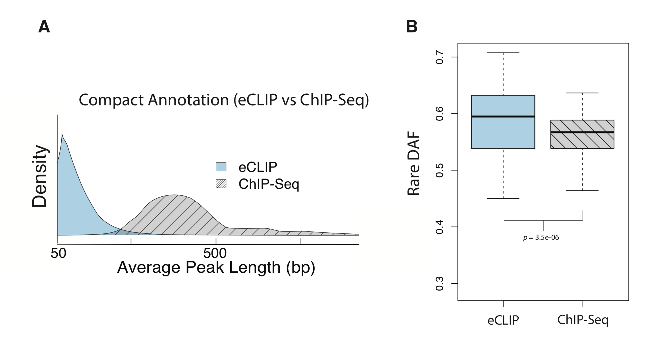

Slide 3
Method Name | Rare DAF | Average Length | Total Coverage
ESCAPE_peakcalls_GM12878 | .576 | 1159.552 | 193902668
ESCAPE_peakcalls_K562 | .573 | 2176.562 | 587358295
EC-003-CRE.CASPERxESCAPE_GM12878.bed | 0.557 | 2072.323 | 34124938
EC-003-CRE.CASPERxESCAPE_K562.bed | 0.550 | 1774.779 | 54558481
CASPER_merged_GM12878 | .569 | 1358.389 | 29345283
CASPER_merged_K562 | .536 | 1329.098 | 29241498
CASPER_ESCAPE_JEME_target_filtered_merged_GM12878 | .560 | 1648.710 | 5556154
CASPER_ESCAPE_JEME_target_filtered_merged_K562 | .558 | 1542.859 | 6035666
EC-003-CRE.CASPERxESCAPExJEME-targetGene_FitHiC-filtered_GM12878.bed | 0.560 | 2413.636 | 49211630
EC-003-CRE.CASPERxESCAPExJEME-targetGene_FitHiC-filtered_K562.bed | 0.559 | 2198.941 | 38257172
CASPER_ESCAPE_JEME_cRE_target_filtered_merged_trimmed_GM12878 | .507 | 258.678 | 2227735
CASPER_ESCAPE_JEME_cRE_target_filtered_merged_trimmed_K562 | .510 | 282.419 | 4862419
ccRE_aggregate_ELS_GM12878.bed | 0.606 | 481.1171 | 13345707
ccRE_aggregate_ELS_K562.bed | 0.607 | 478.2469 | 18168600

Slide 4
Method Name | Rare DAF | Average Binding Length
TF | 0.556 | 416.00
eCLIP | 0.585 | 67.59
PARCLIP | 0.668 | 39.22
iCLIP | 0.610 | 16.92
HITSCLIP | 0.630 | 63.20
CLIPSeq | 0.636 | 57.15

