Slide 1
Using ancient protein reconstruction to study protein evolutionary trajectories
Journal Club
5/29/18

Slide 2
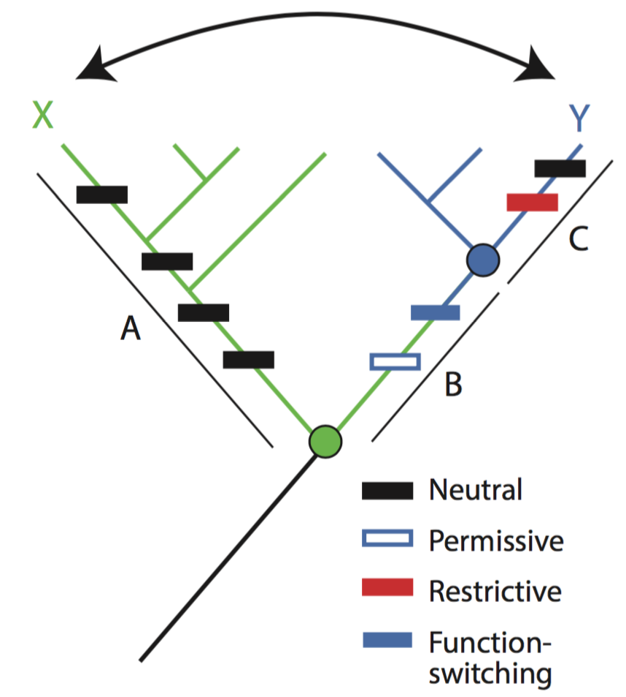
Background: Ancestral protein reconstruction
Provides a ’vertical’ perspective in the analysis of paralogous proteins.
Enables better identification of causal mutations contributing to a switch in function.
Reconstructed proteins are often more evolvable due to fewer restrictive mutations.
Hochberg and Thornton, Annu. Rev. Biophys. 2017

Slide 3
Following Gene Duplication, Paralog Interference Constrains Transcriptional Circuit Evolution
Christopher R. Baker, Victor Hanson-Smith, and Alexander D. Johnson

Slide 4
MADS-box regulators: paralog interference
Baker et al. Science 2013

Slide 5
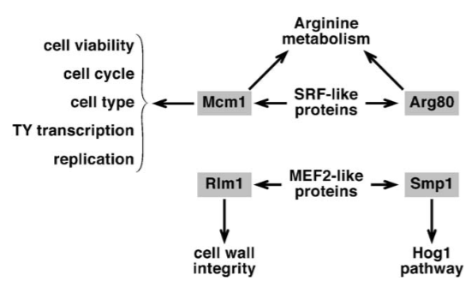
Mcm1 and Arg80 fulfill multiple regulatory roles.
Messenguy and Dubois Gene 2003
Notes:
Mcm1 binds with 7 different cofactor partner transcriptional regulators to regulate a variety of functions.

Slide 6
Reconstruction of ancestral paralogs and pre-duplication ancestor.
Notes:
No growth defect when Mcm1 or Arg80 were deleted and rescued with AncMADS
However,

Slide 7
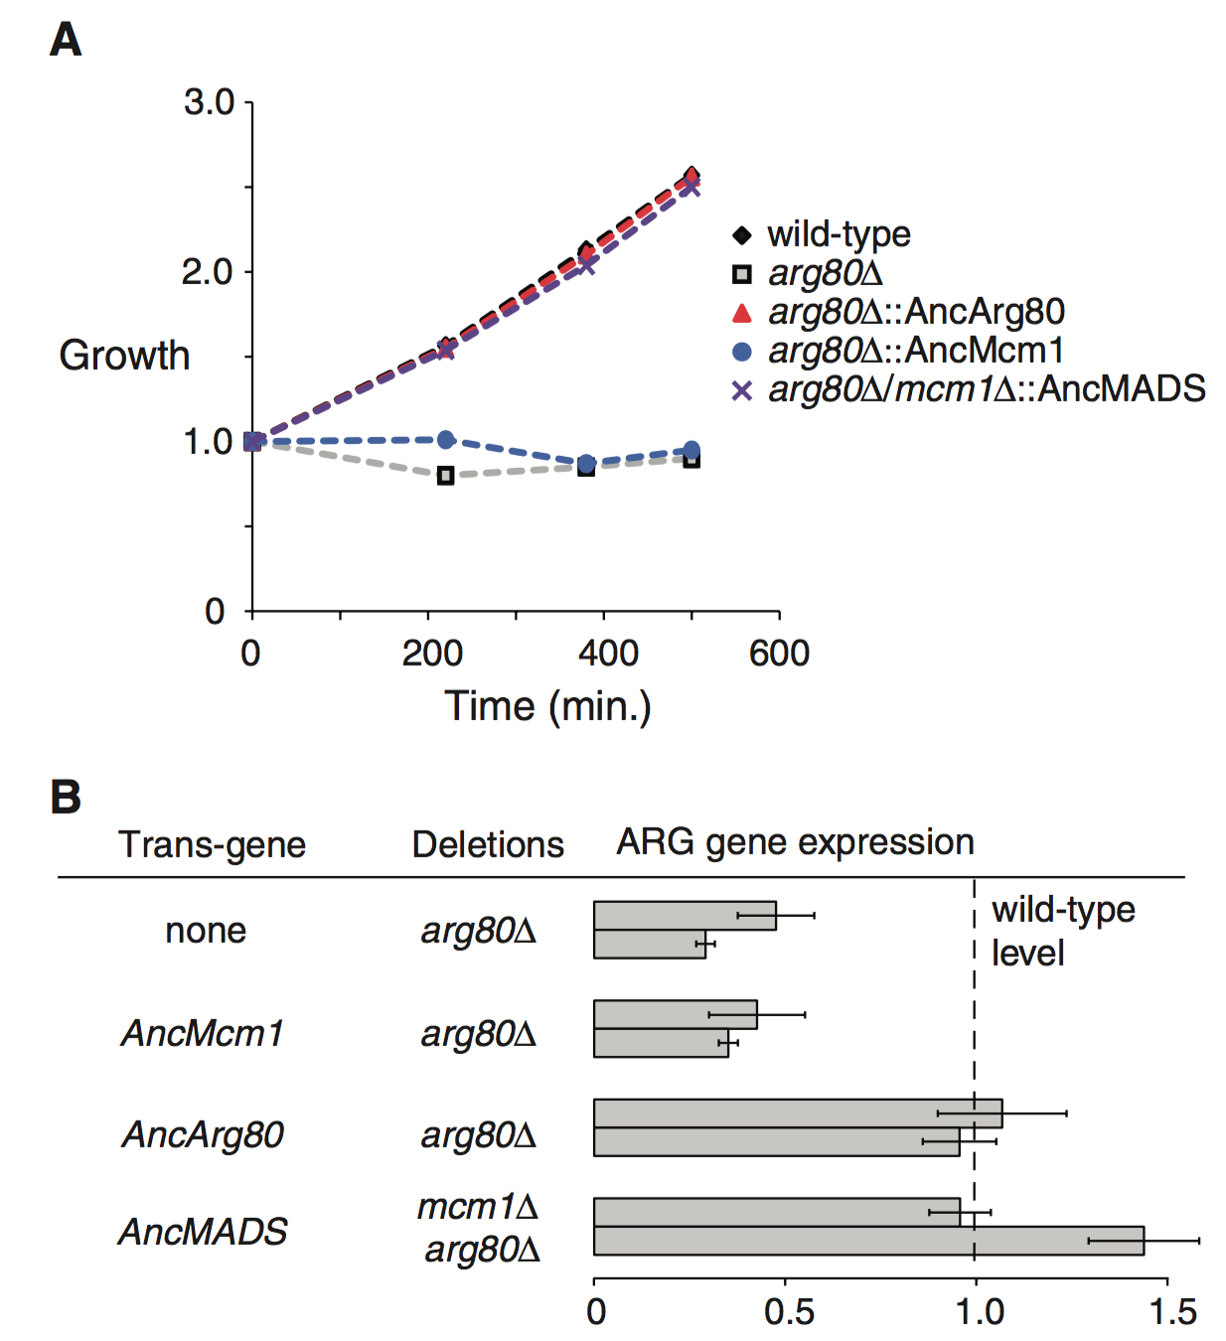
Ancestral pre-duplication MADS protein is able to rescue loss of Mcm1 and Arg80
Mcm1 is an essential gene
Arg80 deletion results in defects in arginine metabolism
Notes:
Growth on ornithine (arginine precursor) needed as sole nitrogen source.

Slide 8
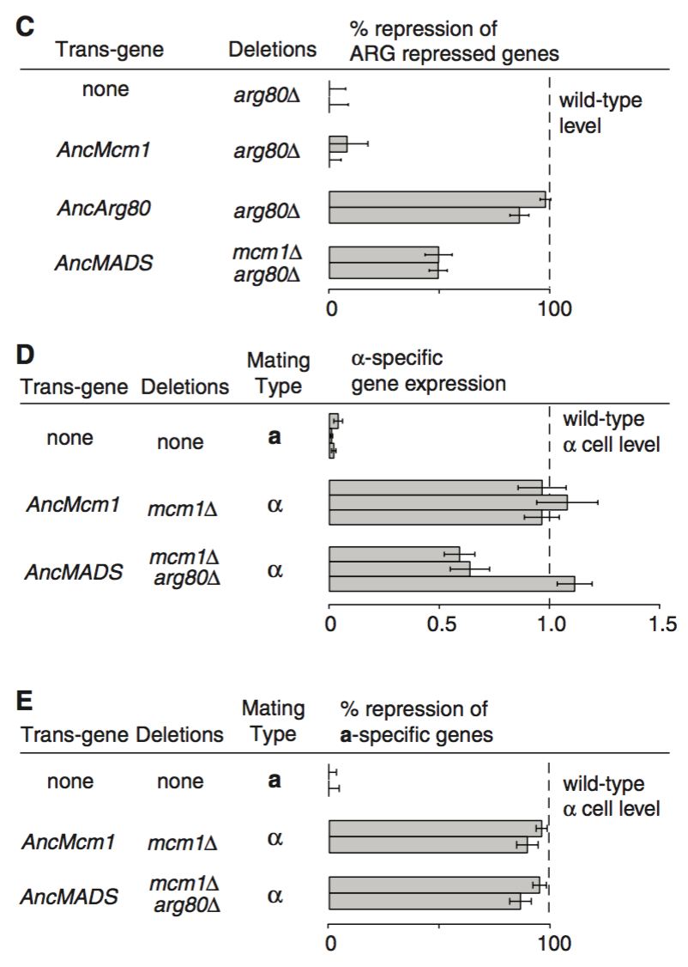
Ancestral pre-duplication MADS protein is able to rescue loss of Mcm1 and Arg80

Slide 9
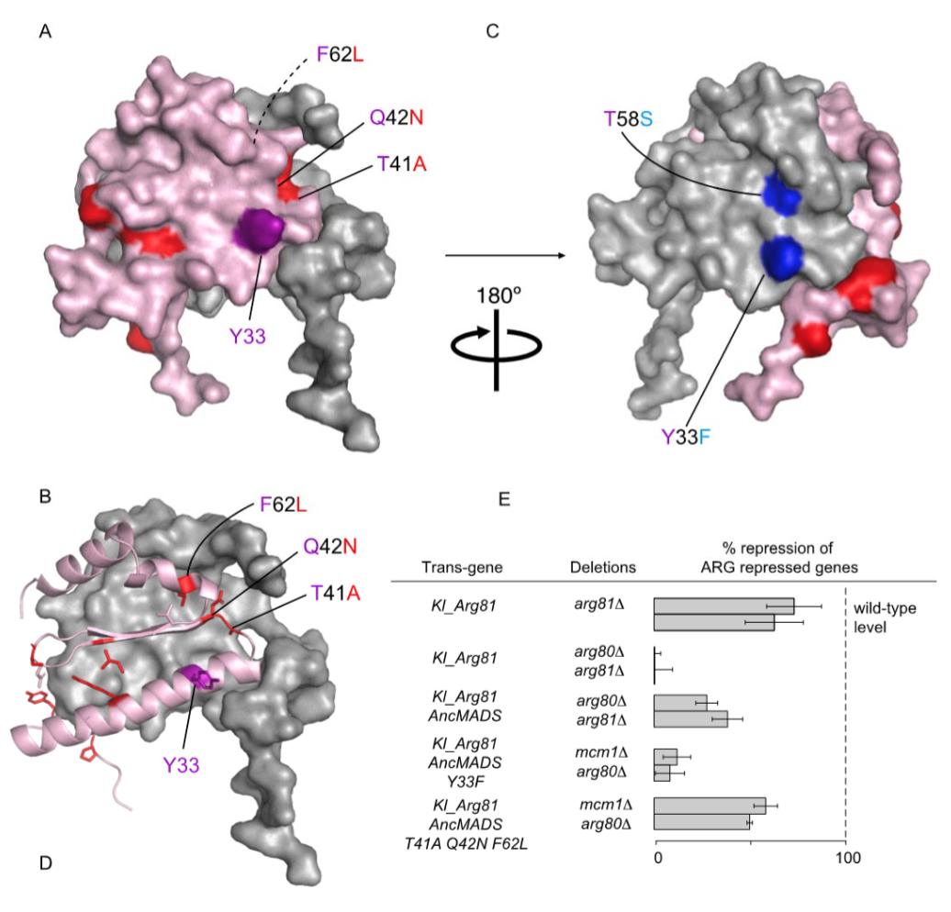
Modelling mutations between AncMcm1 and AncArg80
Surface of AncMcm1 is modeled in grey
Surface AncArg80 is modeled in pink.
Residues that mutated between AncMcm1 and
AncArg80 (relative to AncMADS) are labeled red and blue, respectively.
Notes:
Reconstructed ancient proteins are overlaid onto the structure of S. Cerevisiae Mcm1

Slide 10
Reconstruction of ancestral paralogs and pre-duplication ancestor.
Notes:
Reciprocol loss of of interaction with cofactors in the paralogs
On the lineage from AncMADS to AncMcm1, one substitution occurred in the pocket [Tyr33→Phe33 (Y33F ); Y, Tyr; F, Phe], and it has been conserved in all Mcm1 descendants (Fig. 3A and table S1).
On the lineage from AncMADS to AncArg80, three sequence substitutions occurred within the cofactor binding pocket (T41A, Q42N, F62L; T, Thr; A, Ala, Q, Gln; N, Asn; L, Leu), and each has been strongly conserved in postduplication Arg80 descendant sequences
No change when K. Lactis Matalpha1 and Arg81 were used

Slide 11
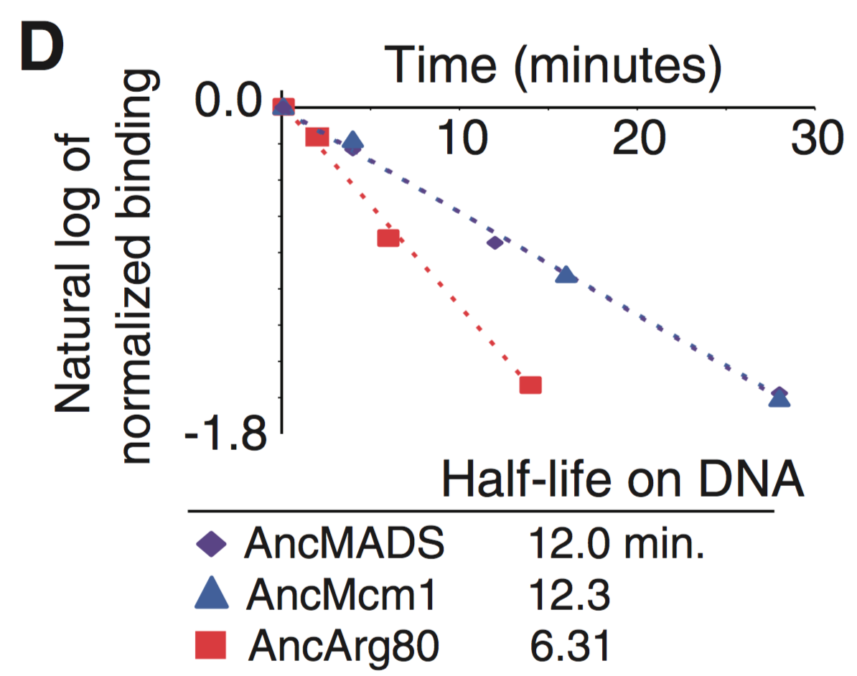
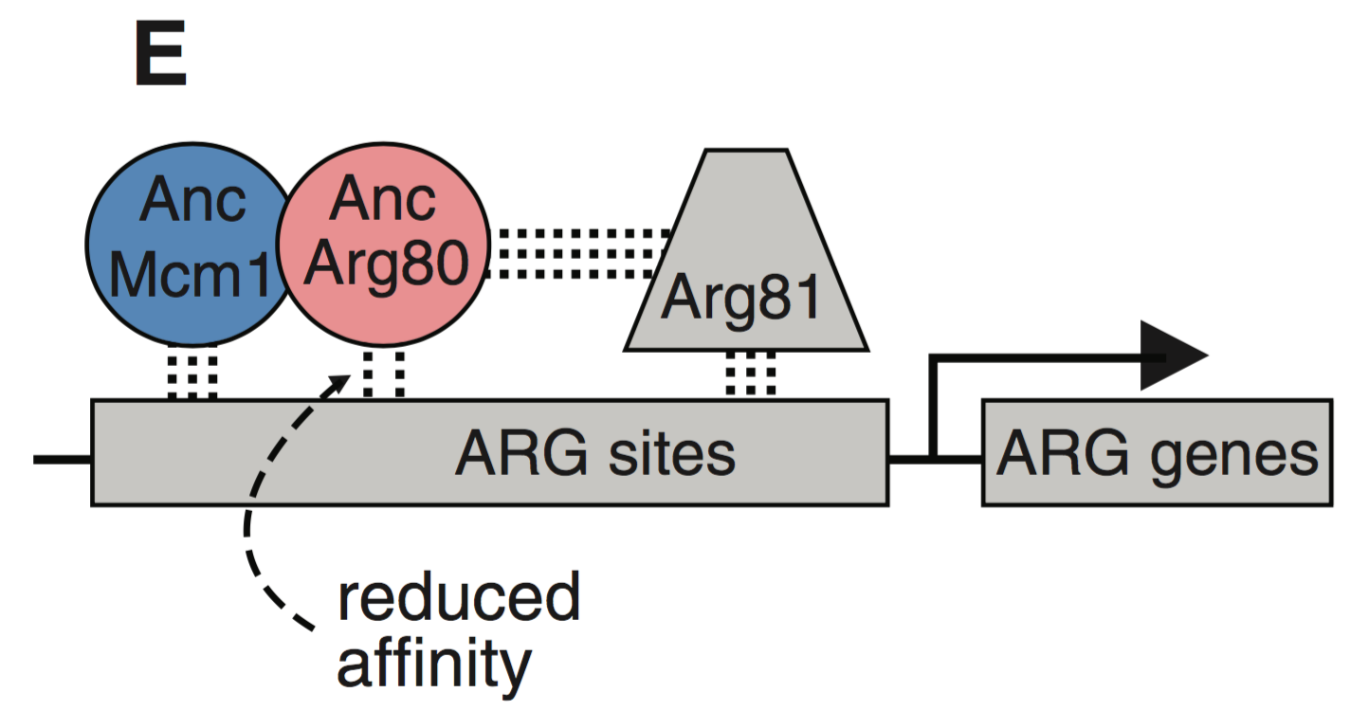
Mutations in AncArg80 reduce DNA binding affinity
Notes:
Both Mcm1 and Arg80 have similar binding motifs
Half life of AncArg80 on DNA is lower than that of AncMcm1 or AncMADS
Decrease in DNA affinity occurred shortly after duplication

Slide 12
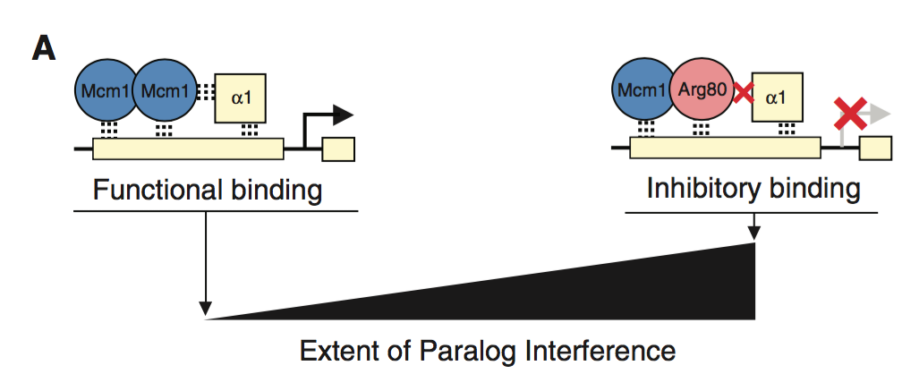
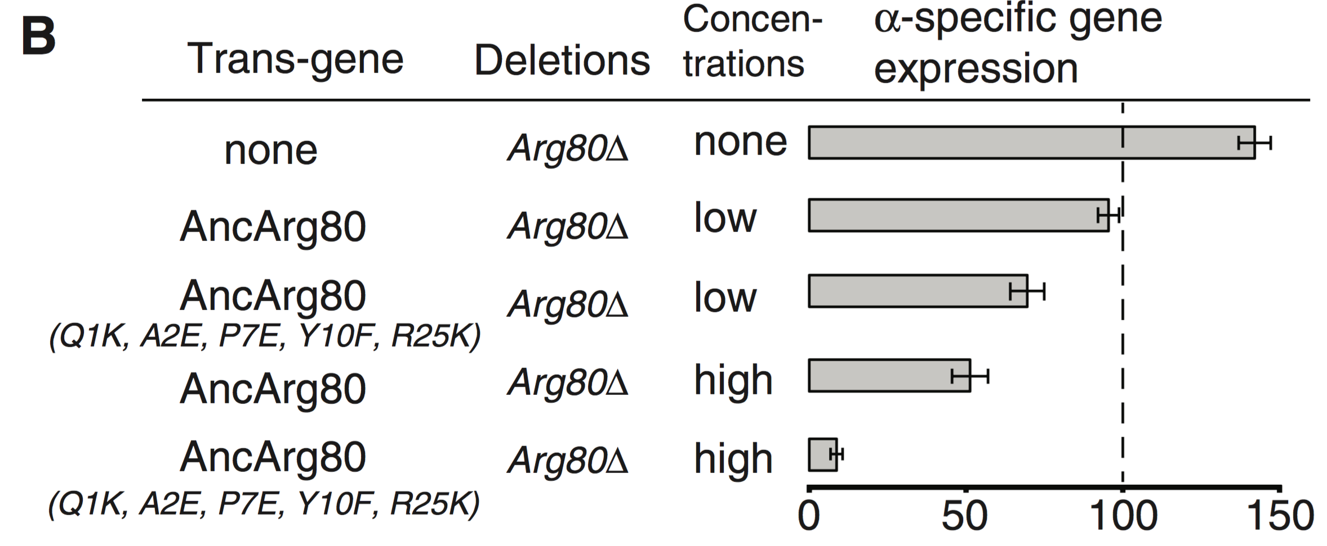
DNA binding affinity changes are responsible for a reduction of paralog interference.
Notes:
Paralog interference due to dominant negative impact of an Mcm1-Arg80 dimer binding at Alpha related gene regulatory sites
Reintroduced DNA biding affinity to test impact on alpha gene regulation

Slide 13
MADS-box regulators: paralog interference
Divergence of paralogs in larger complexes can lead to dominant negative interactions.
This violates the assumption that ancestral functions of a gene are independent.
Baker et al. Science 2013
Notes:
DNA binding affinity may explain Mcm1-Arg80 heterodimer rather than an Arg80-Arg80 homodimer

Slide 14
Alternative evolutionary histories in the sequence space of an ancient protein
Tyler N. Starr, Lora K. Picton & Joseph W. Thornton

Slide 15
Key approaches and questions
Combine ancestral protein reconstruction with deep mutational scanning.
Investigate “whether the outcome of evolution represents an optimal state driven by natural selection or the contingent product of historical events”
Evaluate “how the underlying distribution of functions across sequence space shaped historical evolution”

Slide 16
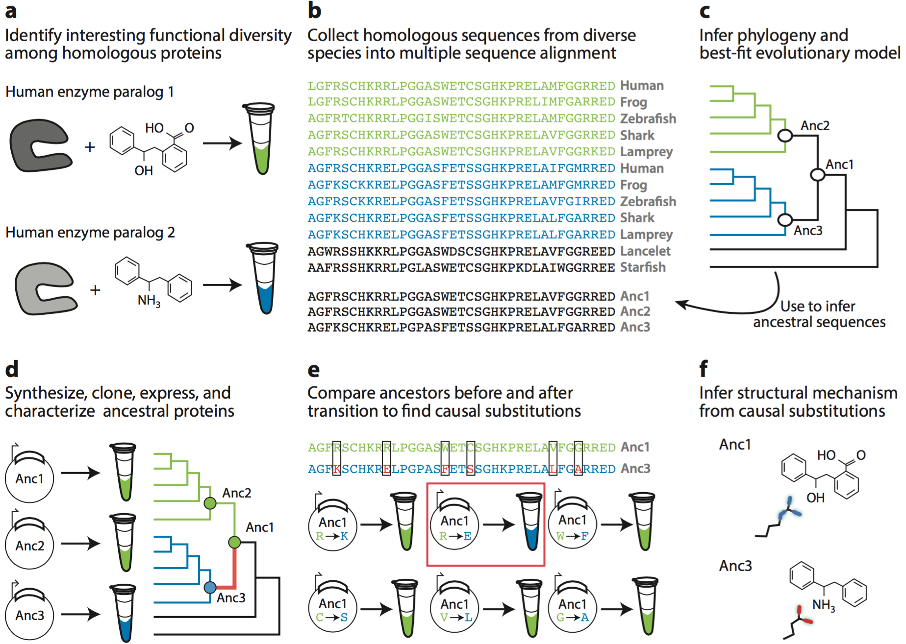
General workflow for ancestral protein recreation and testing.

Slide 17
Background: Steroid response elements
Two major clades:
- Oestrogen receptors (prefers EREs)
- Androgen, progestogen, and
corticosteroid receptors ( prefers SREs)
Ancestral protein (AncSR1) prefers EREs.
3 mutations switch activity from ERE to SRE:
- These mutations reduce affinity for
binding site.
- Need 11 permissive mutations that
improve affinity for both ERE and SRE
(11p mutations)

Slide 18
Experimental workflow
Created a library of AncSR1+11p proteins all amino acid mutations at 4 key sites on the recognition helix (160,000 variants).
Created reporter yeast strains with GFP driven by either an ERE or SRE motif.
Transformed library into both reporter strains, FACS sorted into four bins, and deep sequenced the bins.

Slide 19
Investigating variants that switch activity from ERE to SRE
828 new variants that preferentially bind to SRE.
The new variants discriminate between SRE and ERE using different physical contacts.
- The historical outcome (GSKV) binds SRE in
part by polar contacts from Lys28 to
nucleotides A1 and G2.
- The alternative outcome KAAI makes no polar
contacts using residue 28, instead hydrogen
bonding from Lys25 to A1, G2, and the
opposite-strand nucleotide T-3.
Historical outcome not biochemically or genetically unique….but was it uniquely accessible from the ancestral sequence?
historical
Notes:
-These alternative SRE-specific genotypes use amino acids with diverse biochemical characteristics (Fig. 1d), and they discriminate between SRE and ERE using different physical contacts (Fig. 1e, f and Extended Data Fig. 4).
-For example, the historical outcome (RH sequence GSKV) binds SRE in part by polar contacts from Lys28 to nucleotides A1 and G2, but the alternative outcome KAAI makes no polar contacts using residue 28, instead hydrogen bonding from Lys25 to A1, G2, and the opposite-strand nucleotide T-3 (Fig. 1e).
-It also exhibits novel mechanisms of ERE-exclusion: whereas GSKV leaves the hydrogen bonding potential of C-3 unsatisfied, KAAI also leaves G2 and T4 unpaired, because Ala28—unlike Lys28 of GSKV— cannot bond to G2, and Ile29 interferes with a hydrogen bond to T4 made by the conserved Arg33 residue (Fig. 1f and Extended Data Fig. 4c).

Slide 20
Visualizing the relationships between functional variants
Created a graph illustrating the paths between all functional variants.
- Each node is a functional variant (1,351).
- Edges connect nodes separated by one
nonsynonymous mutation.
Almost all functional variants form a single connected network.
- Can travel between functional variants
without visiting a nonfunctional variant.
- Clusters of similar variants are distinguishable.
Notes:
-ERE-specific, SRE-specific, and promiscuous variants are distributed throughout the network. This allows for many paths to switch between functions.

Slide 21
How likely is the historical sequence given the network of functional variants?
The ancestral (EGKA) and derived variants (GSKV) are separated by a path of length 3.
64 other SRE-specific variants are 3 or fewer steps from the ancestral sequence without passing through nonfunctional variants.
Difference evolutionary models still produce similar outcomes.
- Only allow a small range of binding affinities.
- Only allow mutations that increase SRE affinity, as
expected during positive selection.
Historical path not the only or the shortest path to switch in activity.
Notes:
-The longest path is 13.
-Some alternative SRE responsive elements are 1 or 2 steps away
-Difference evolutionary models still produce similar outcomes. If select against binding that is too strong or too weak then you still have hundreds of paths for switching specificity.
-Or if only trajectories with ever increasing SRE specificity (as expected under positive selection) are considered switching paths are still readily available.

Slide 22
Is the SRE-specific genotype obtained contingent upon the starting ERE-specific genotype?
b. You can reach an SRE variant with 3 steps for ~90% ERE nodes.
c. About a third of SRE nodes are inaccessible within 3 steps from any ERE node.
d. Most pairs of ERE-specific variants have entirely non-overlapping sets of accessible SRE-specific variants.
While SRE-specific variants are easily accessible, the specific variant depends on the starting genotype.
Notes:
All but 2 ERE specific variants can access SRE specificity without passing through a nonfunctional intermediate.
90% can do so by paths no longer than the historical trajectory
What SRE genotype evolved is dependent on where in the network of ERE-specific variants the starting point is located.
b, Distribution of ERE-specific nodes (starting points) by number of SRE-specific nodes (outcomes) reached in three or fewer steps.
c, Distribution of outcomes by number of starting points that reach it in three or fewer steps.
Black, outcomes reached from zero starting points because of epistasis; white, because all starting points are more than three non-synonymous mutations away.
d, Distribution of pairs of starting points by the fraction of outcomes within three or fewer steps that are shared.

Slide 23
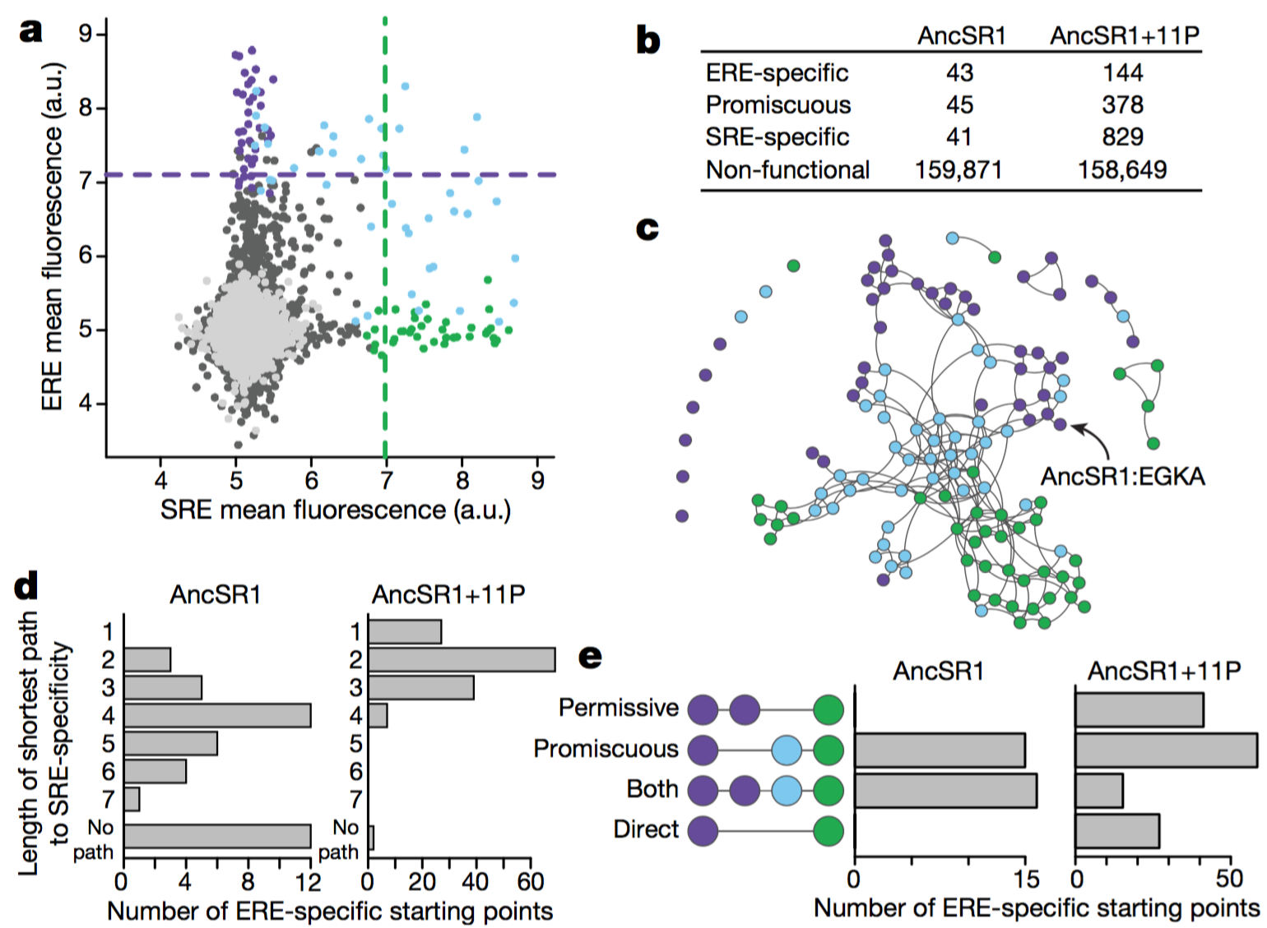
How have the 11 permissive mutations influenced the evolutionary landscape?
Repeat of FACS-seq experiment – with a mutant library of AncSR1 proteins without the 11 permissive mutations.
Far fewer functional variants.
Lower connectivity in the evolutionary network.
Many genotypes can’t be reached without passing through nonfunctional variants.

Slide 24
How have the 11 permissive mutations influenced the evolutionary landscape?
The historical (GSKV) variant requires the 11 permissive mutations.
>25% of ERE-specific variants no longer have a path to an SRE-specific variant.
Average path to SRE-specificity is longer.
No longer any direct paths from ERE to SRE specificity
Historical permissive substitutions enhanced evolvability of SRE specificity.
Notes:
Shortest path is now 5 steps compared to just 1 in AncSR1+ 11p
All paths require going through a states through permissive steps that don’t increase SRE specificity.
All paths require going through a promiscuous intermediate

Slide 25
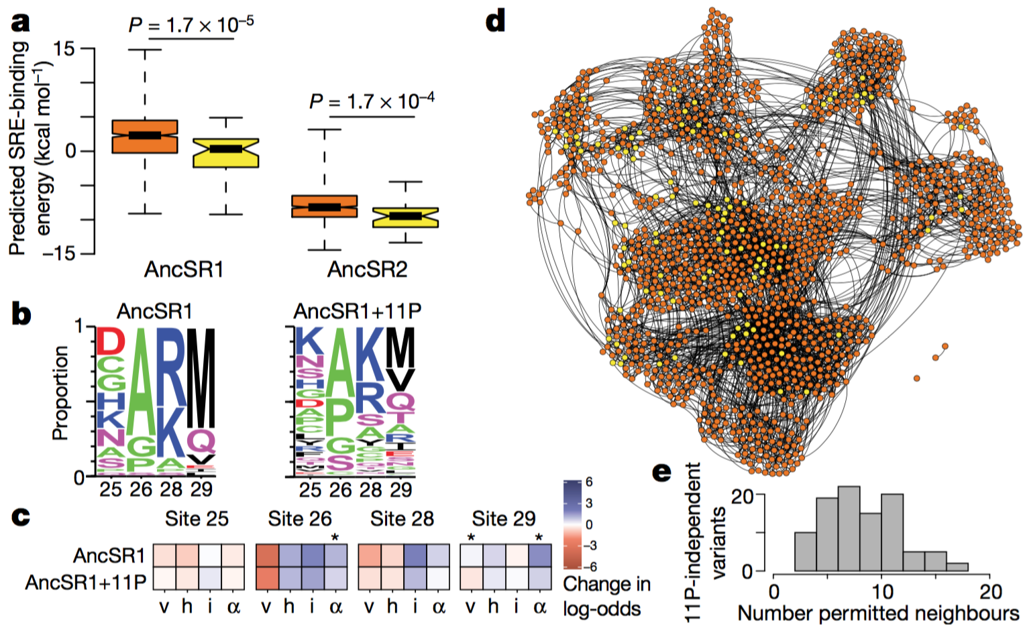
What mechanism underlies the improvement provided by the 11 permissive mutations?
11p mutations don’t increase stability of AncSR1 (previous work).
Hypothesis: 11p mutations nonspecifically increase affinity for both ERE and SRE.
Binding affinity of variants that don’t need 11p should be higher than that of those that do.
11p mutations shouldn’t impact the response element motif preference.
11p mutations shouldn't change biochemical mechanisms of specificity determination.
New variants enabled by 11p should be distributed across the sequence space.
v, volume; h hydrophobicity; i isoelectric point; α, α-helix propensity
Notes:
Non specific nature of 11p mutation enhanced activity means that the network is better connected. - Not necessarily the case if the enhanced activity was specific
Orange – require 11p
Yellow – don’t require 11p

Slide 26
Chance vs. determinism in evolution
Two types of chance in evolution:
- Historical contingency
- Stochasticity
The ERE to SRE switch is contingent upon permissive mutations.
After acquisition of permissive mutations the path to a derived function appears stochastic (but contingent upon starting sequence).
“History leaves no trace of the many roads it did not take, or of the possibility that evolution turned out as it did for no good reason at all.”
Notes:
- Authors find contingency and stochasticity under different selection conditions
They only look at 4 sites (space too vast) but contingency and stochasticity is likely important for larger regions. Unless a single mutation elsewhere is able to switch specificity (unlikely).
Importance of starting point could increase if genetically dissimilar paths are found.
The historical genotype is highly conserved. Is this due to some other selection on the site not captured in the assay? The result of restrictive mutations accumulated later?

Slide 27
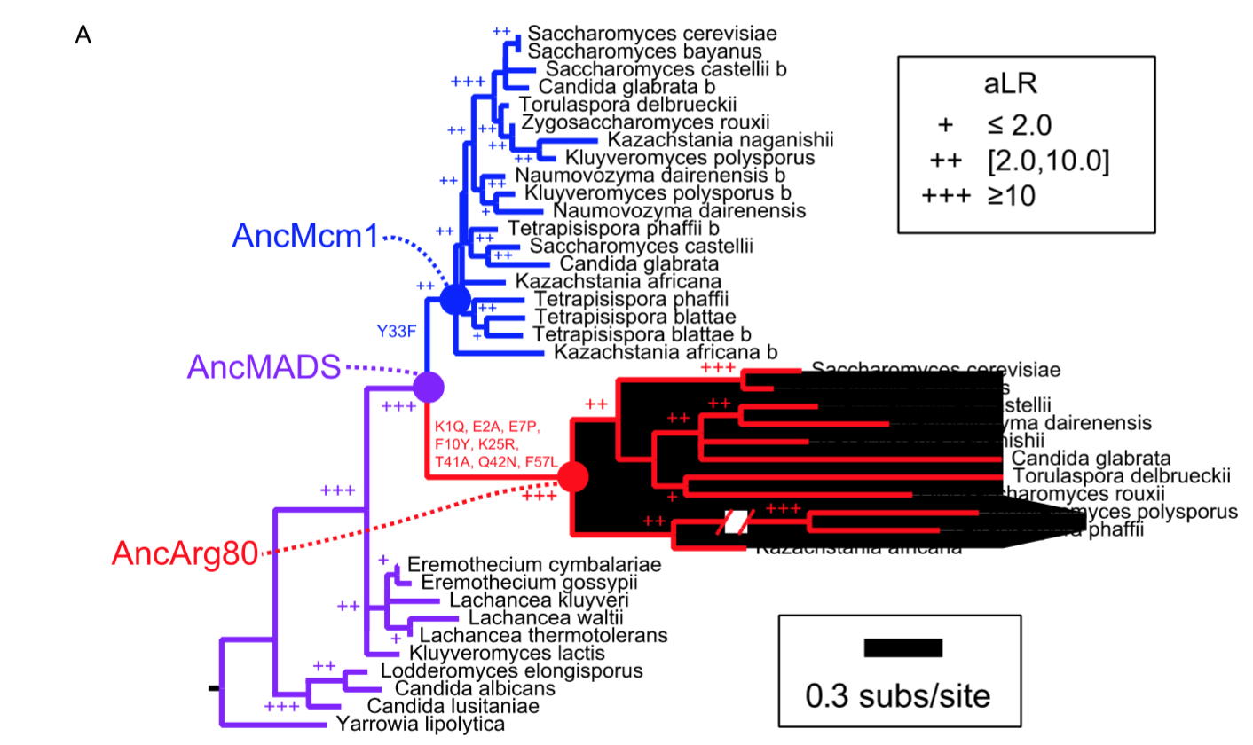
Phylogenetic tree for yeast MADS-box proteins

Slide 28
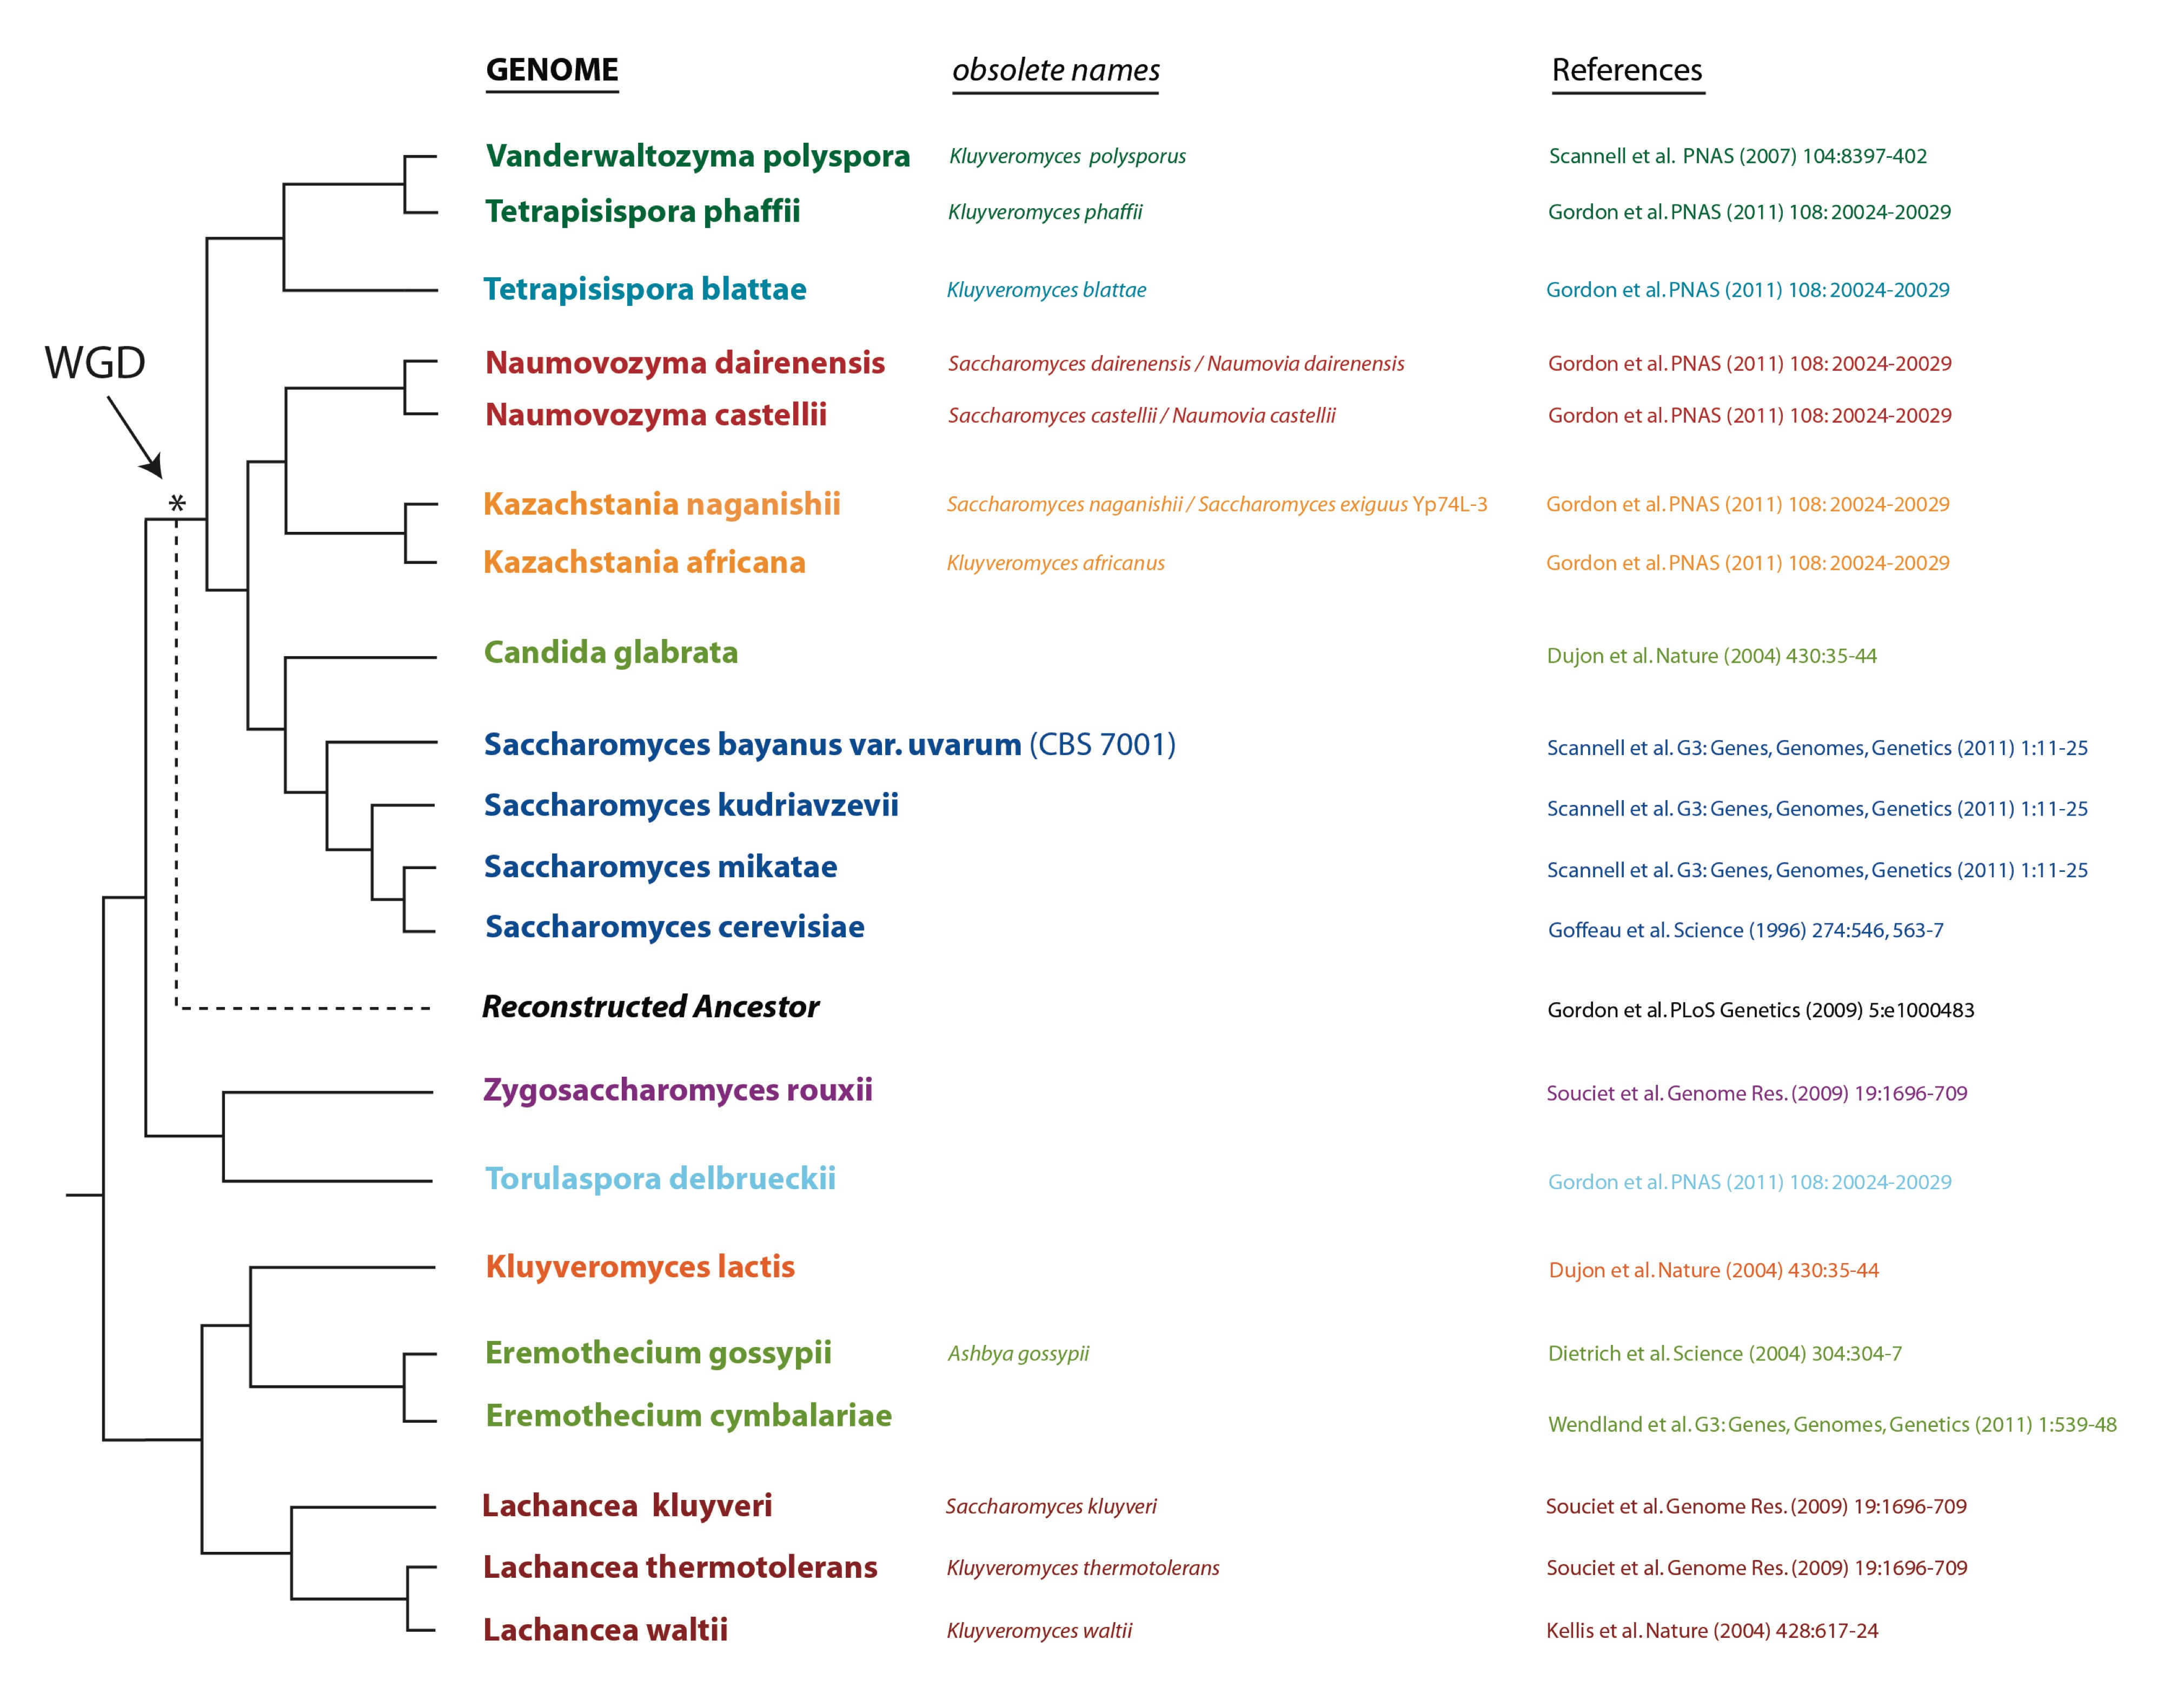
S. cerevisiae is an ideal system to study duplication and divergence
547 ohnologs in S. cerevisiae
~20% of genes in S. cerevisiae member of an ohnolog pair
80 pairs with accelerated evolution
37 transcription factor ohnolog pairs with motif information
http://ygob.ucd.ie/

Slide 29
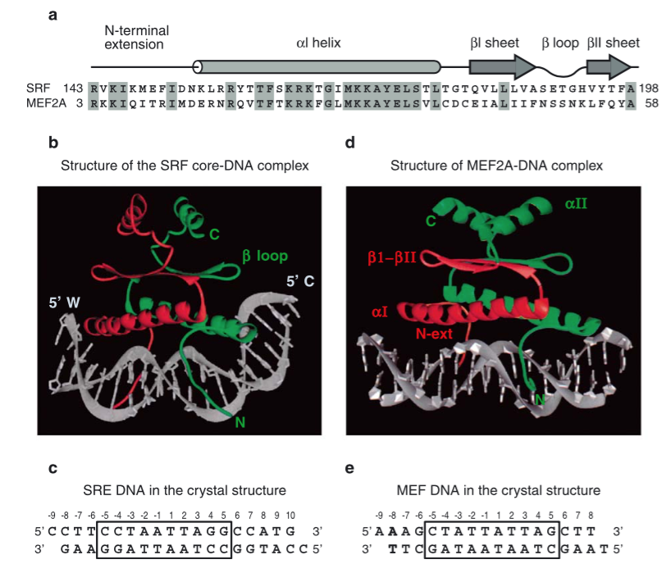
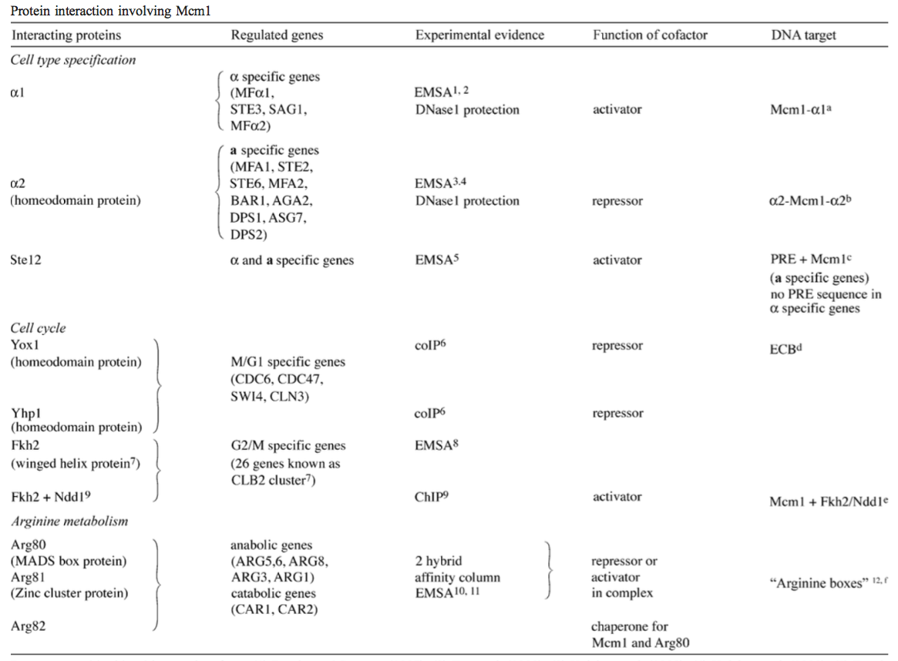
Interaction of MADS box proteins with DNA and cofactors is well characterized.
Cofactors determine the activity of Mcm1
Messenguy and Dubois Gene 2003

Slide 30
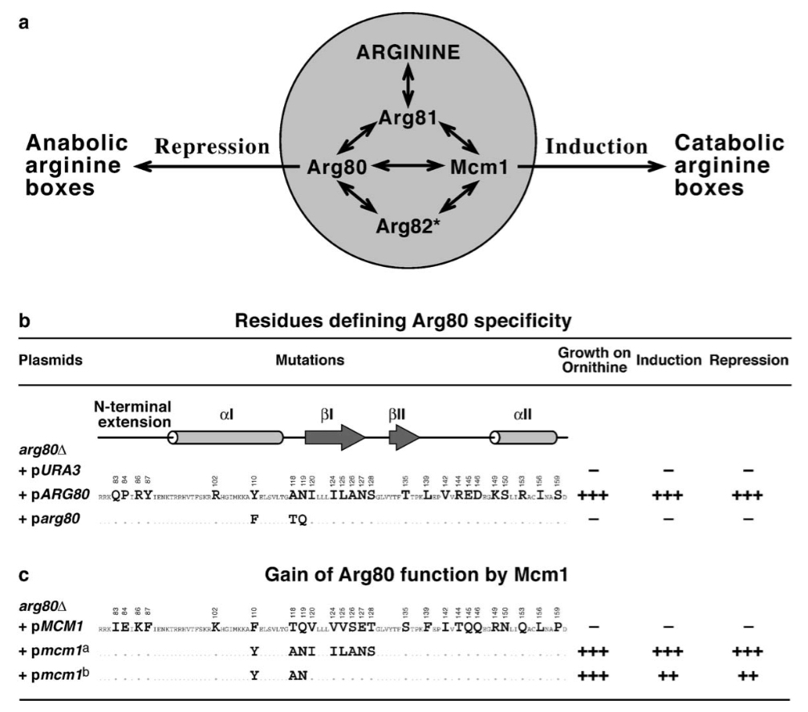
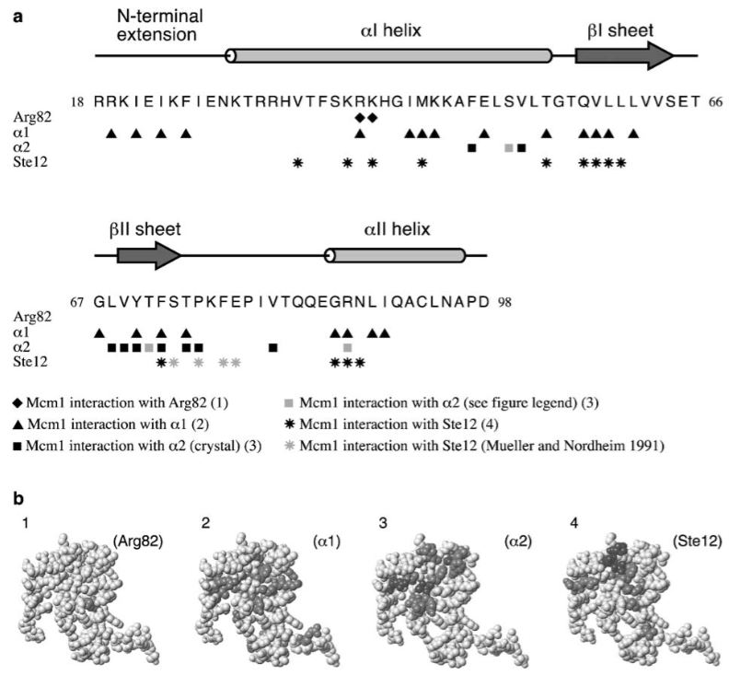
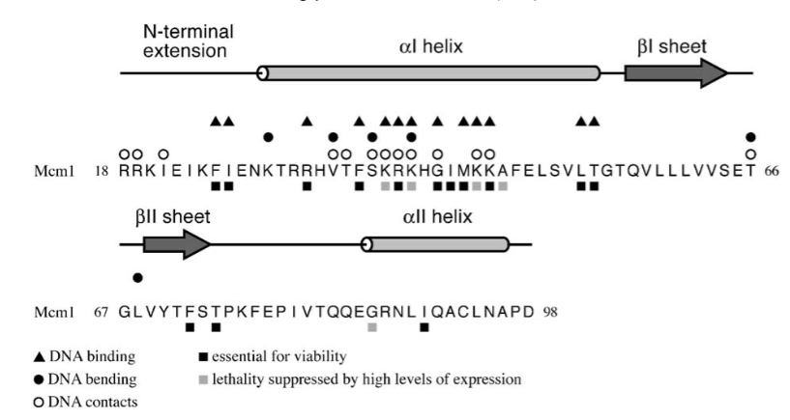
Many of the key residues mediating Mcm1 and Arg80 activities are known.
Key residues involved in Arg80 regulation of arginine biosynthesis.
Key residues mediating Mcm1 interactions with various cofactors.
Messenguy and Dubois Gene 2003

Slide 31
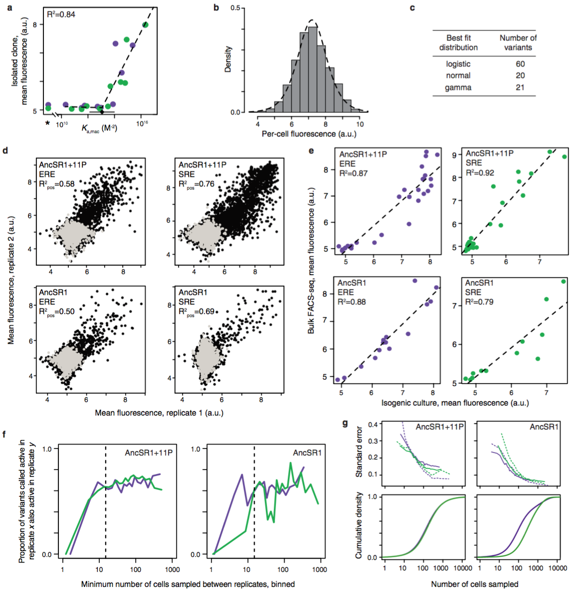
Determining mean fluorescence of a variant
Determined the logistic distribution was the best fit for a series of isogenic cultures.
Used this to determine the maximum likelihood mean fluorescence for each variant given the distribution of counts across bins.

Slide 32
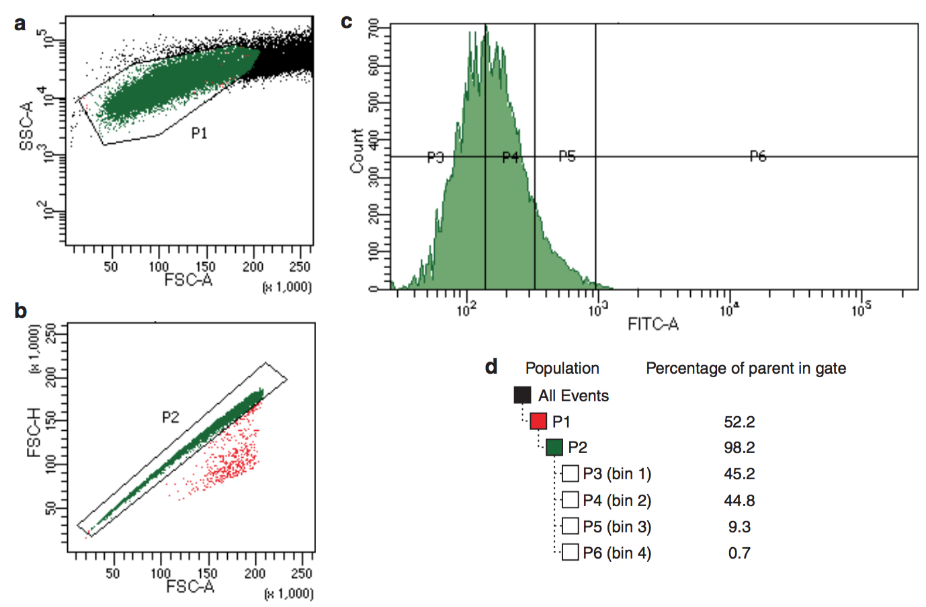

Slide 33
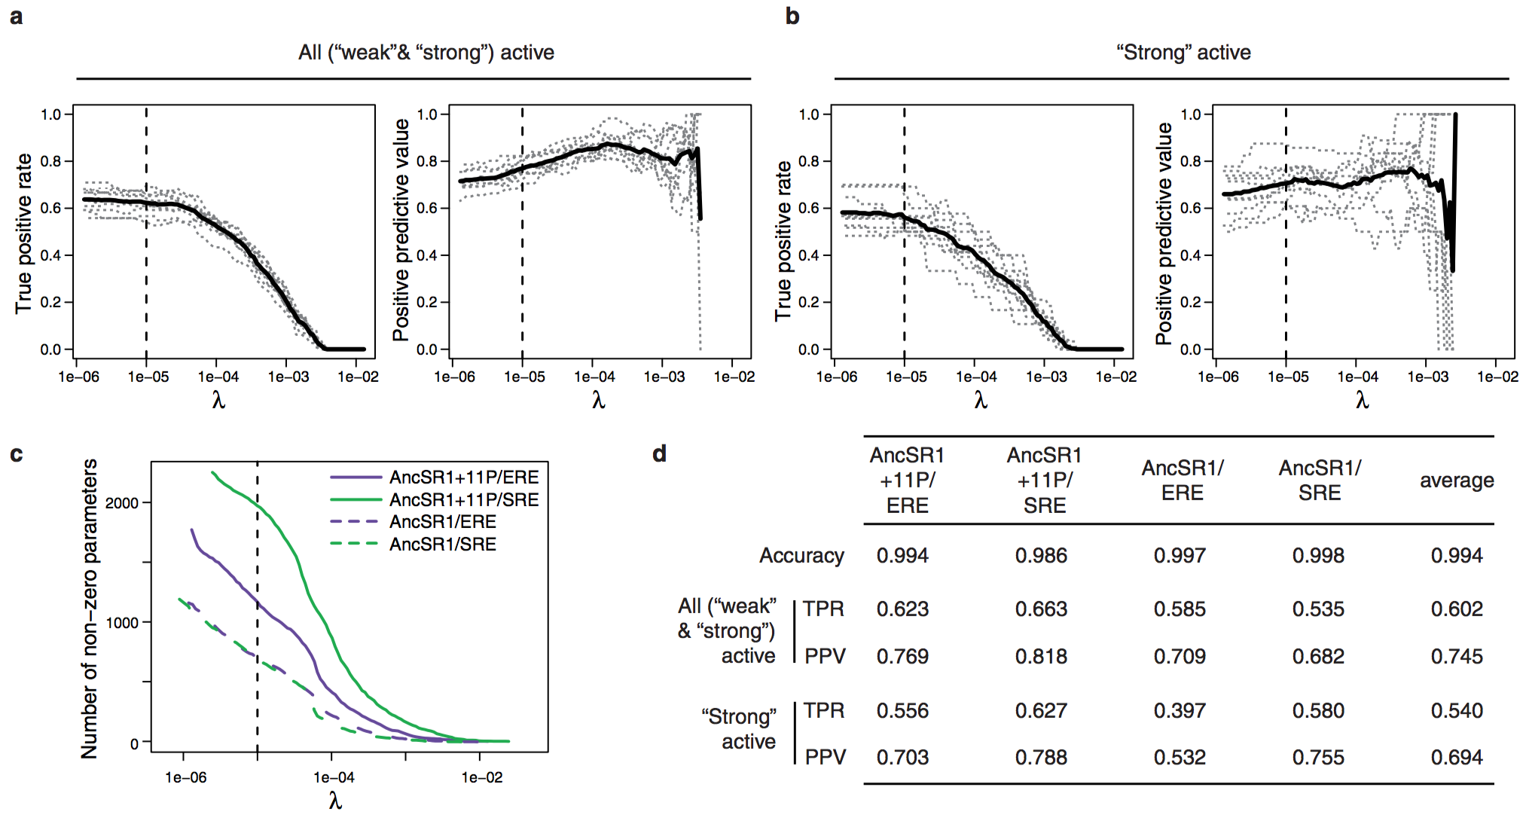

Slide 34
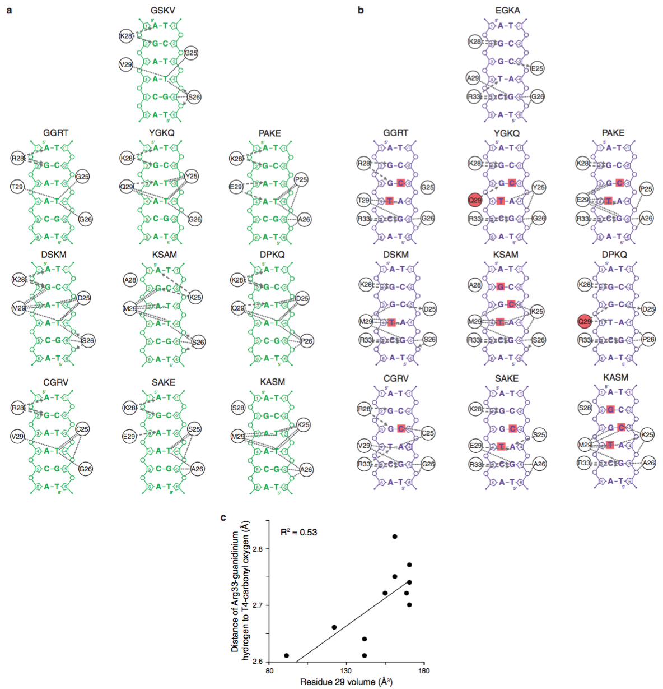

Slide 35
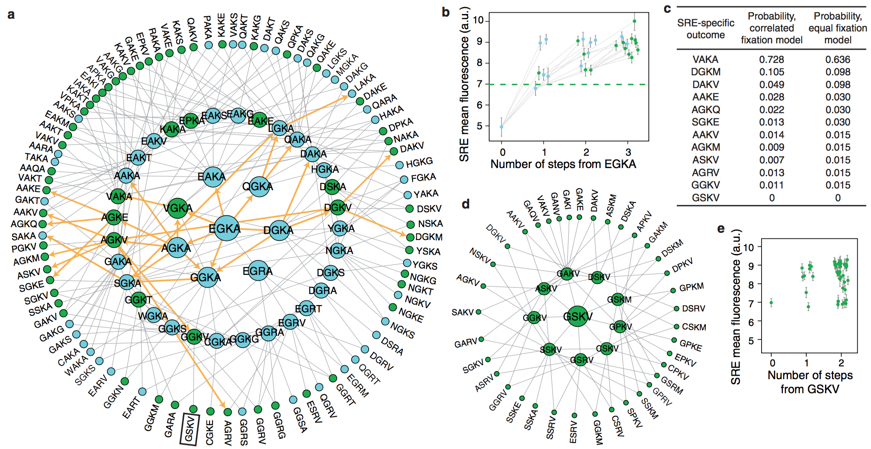

Slide 36
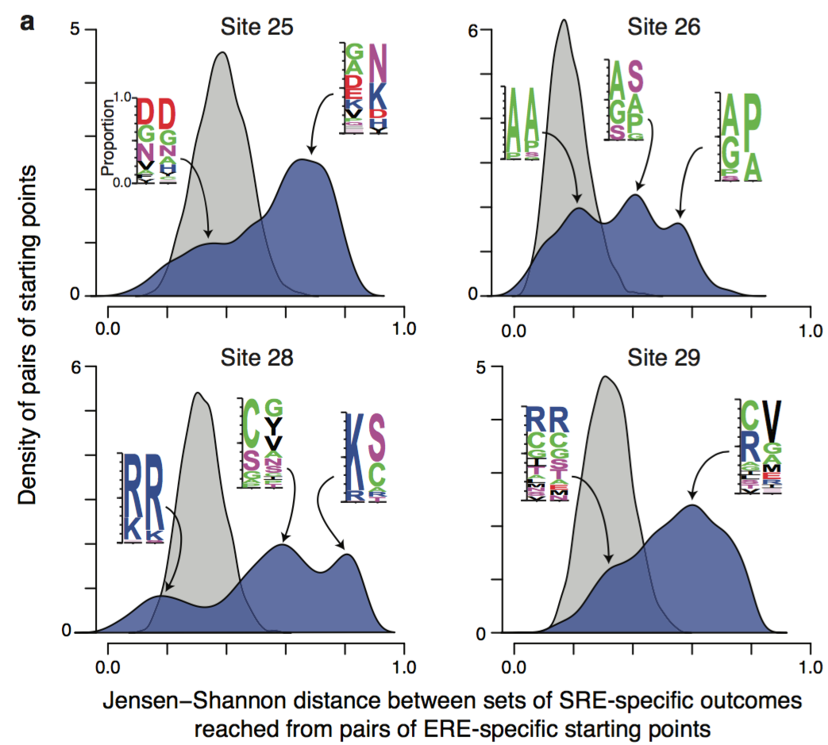

Slide 37
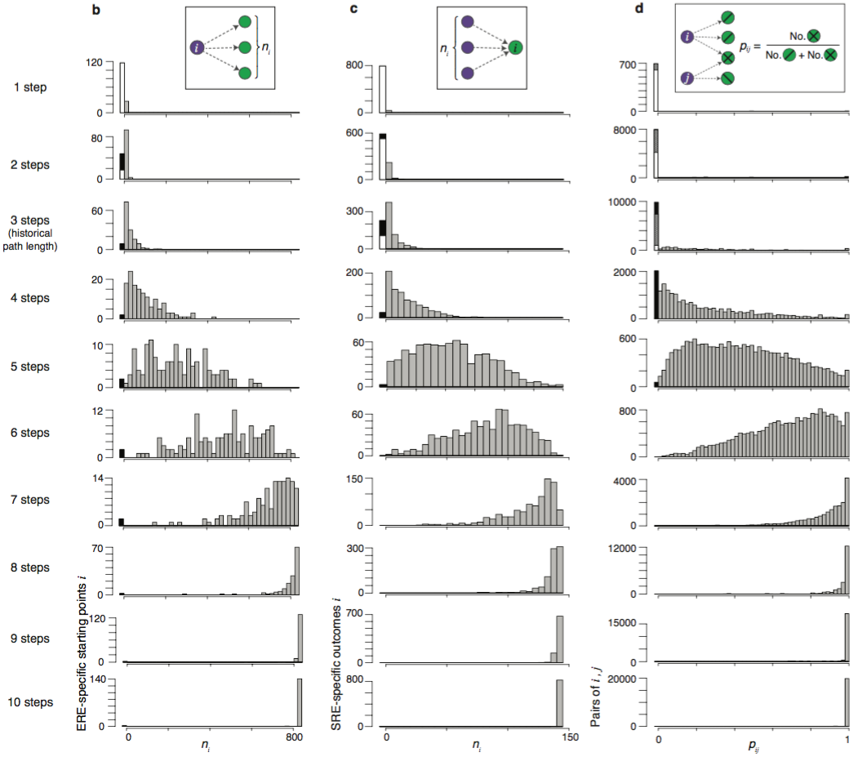

Slide 38
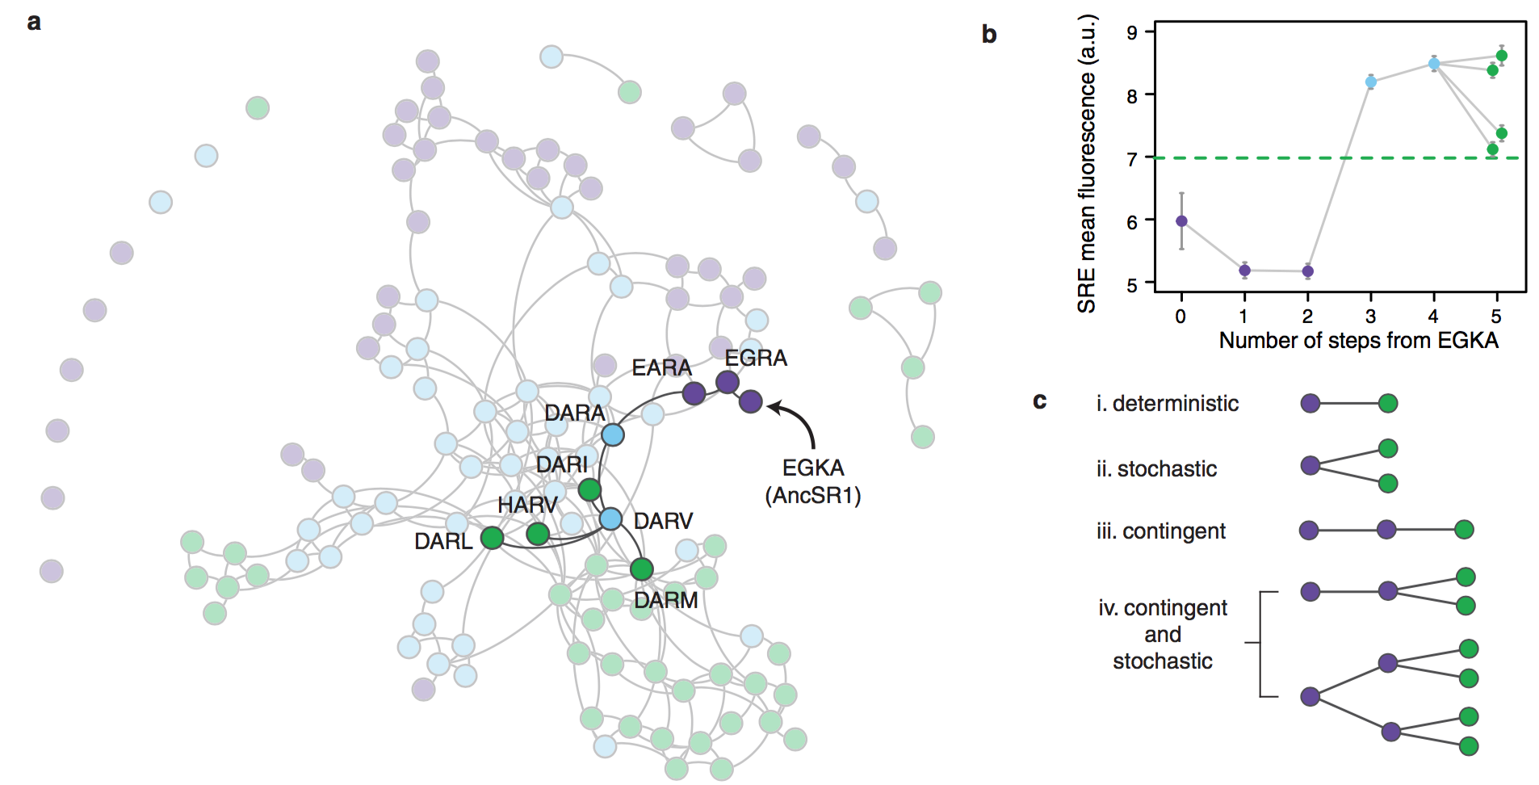

Slide 39
