Slide 1
ATAC-seq vs DNase-seq: split peaks
Min Xu

Slide 2
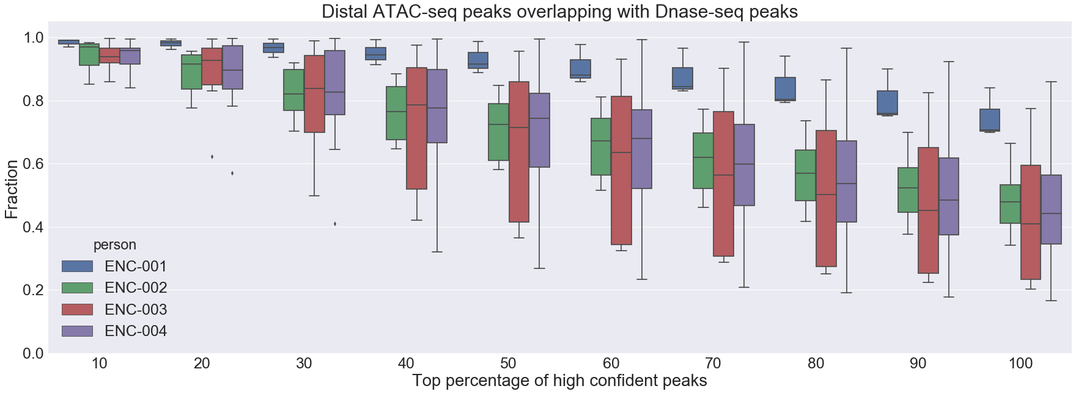
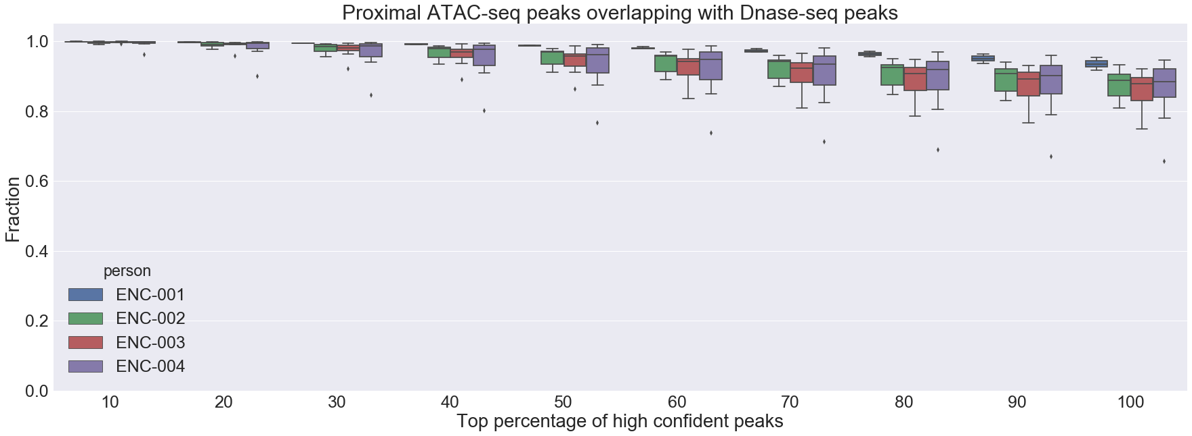
Split the ATAC-seq and DNase-seq peaks respectively using distance to TSS:
Threshold: 1000 bp
Number of intersection tissue samples:
ENC-001: 3
ENC-002: 6
ENC-003: 8
ENC-004: 11

Slide 3
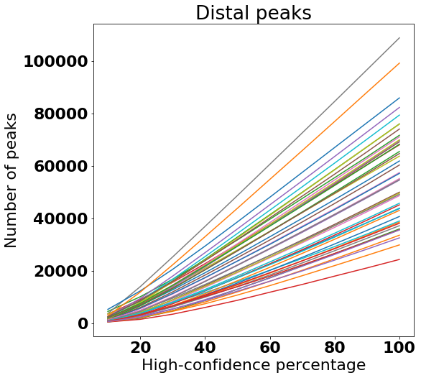
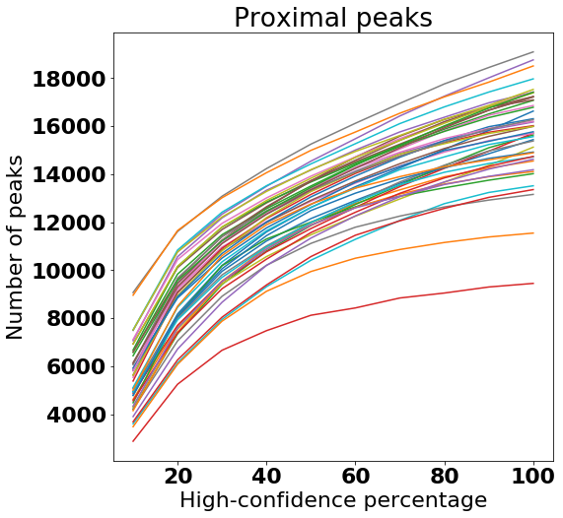

Slide 4
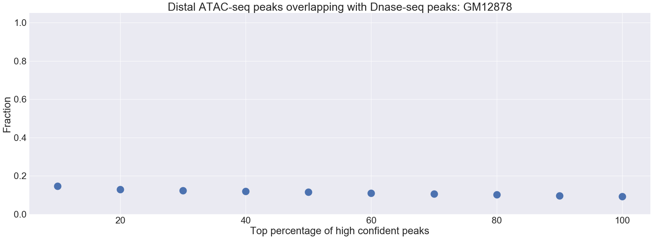
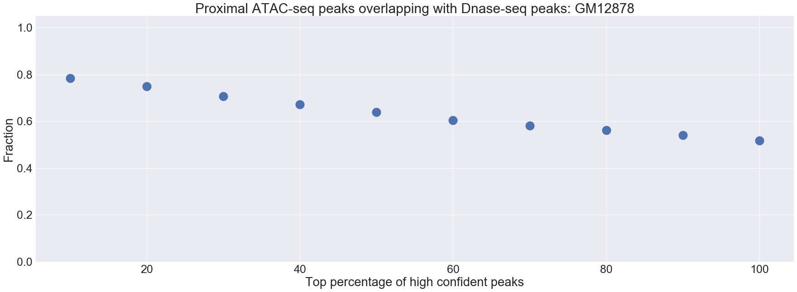
ATAC-seq: from GEO
DNase-seq: from ENCODE

