Slide 1
Encodec SUB1 and MYC
Jason Liu

Slide 2
Percentage of MYC and JUND target genes overlapping SUB1
Cell-Type | A549 | GM12878 | H1-hESC | HeLa | K562
MYC | 0.3291629 | 0.3858505 | 0.3214575 | 0.3658798 | 0.3894009
JUND | 0.3012680 | 0.2870627 | 0.2029390 | 0.2509866 | 0.2834125

Slide 3
Checking the KD of SUB1 and MYC
We intersected the top 10% genes with the most negative log FC after KD of MYC with the top 10% genes with the most negative log FC expression after SUB1 KD in HepG2 and K562.
We noticed that of the target genes you gave us in your list, our list of the most significant changing genes in both MYC and SUB1 share 13 of these genes.

Slide 4
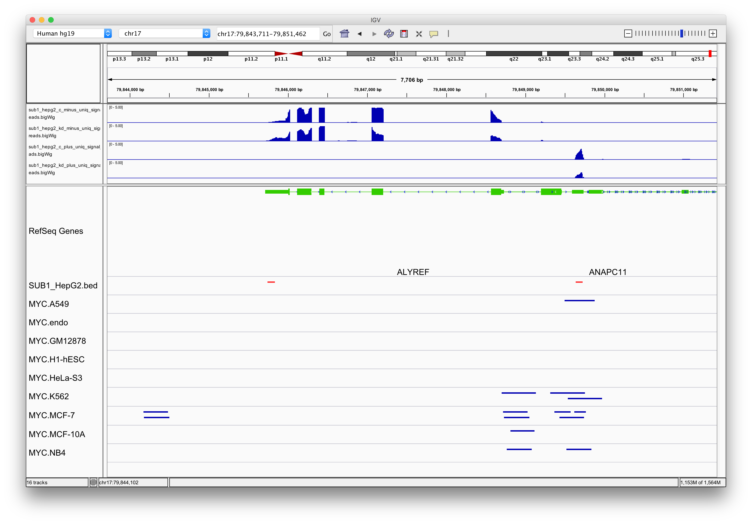
ALYREF

Slide 5
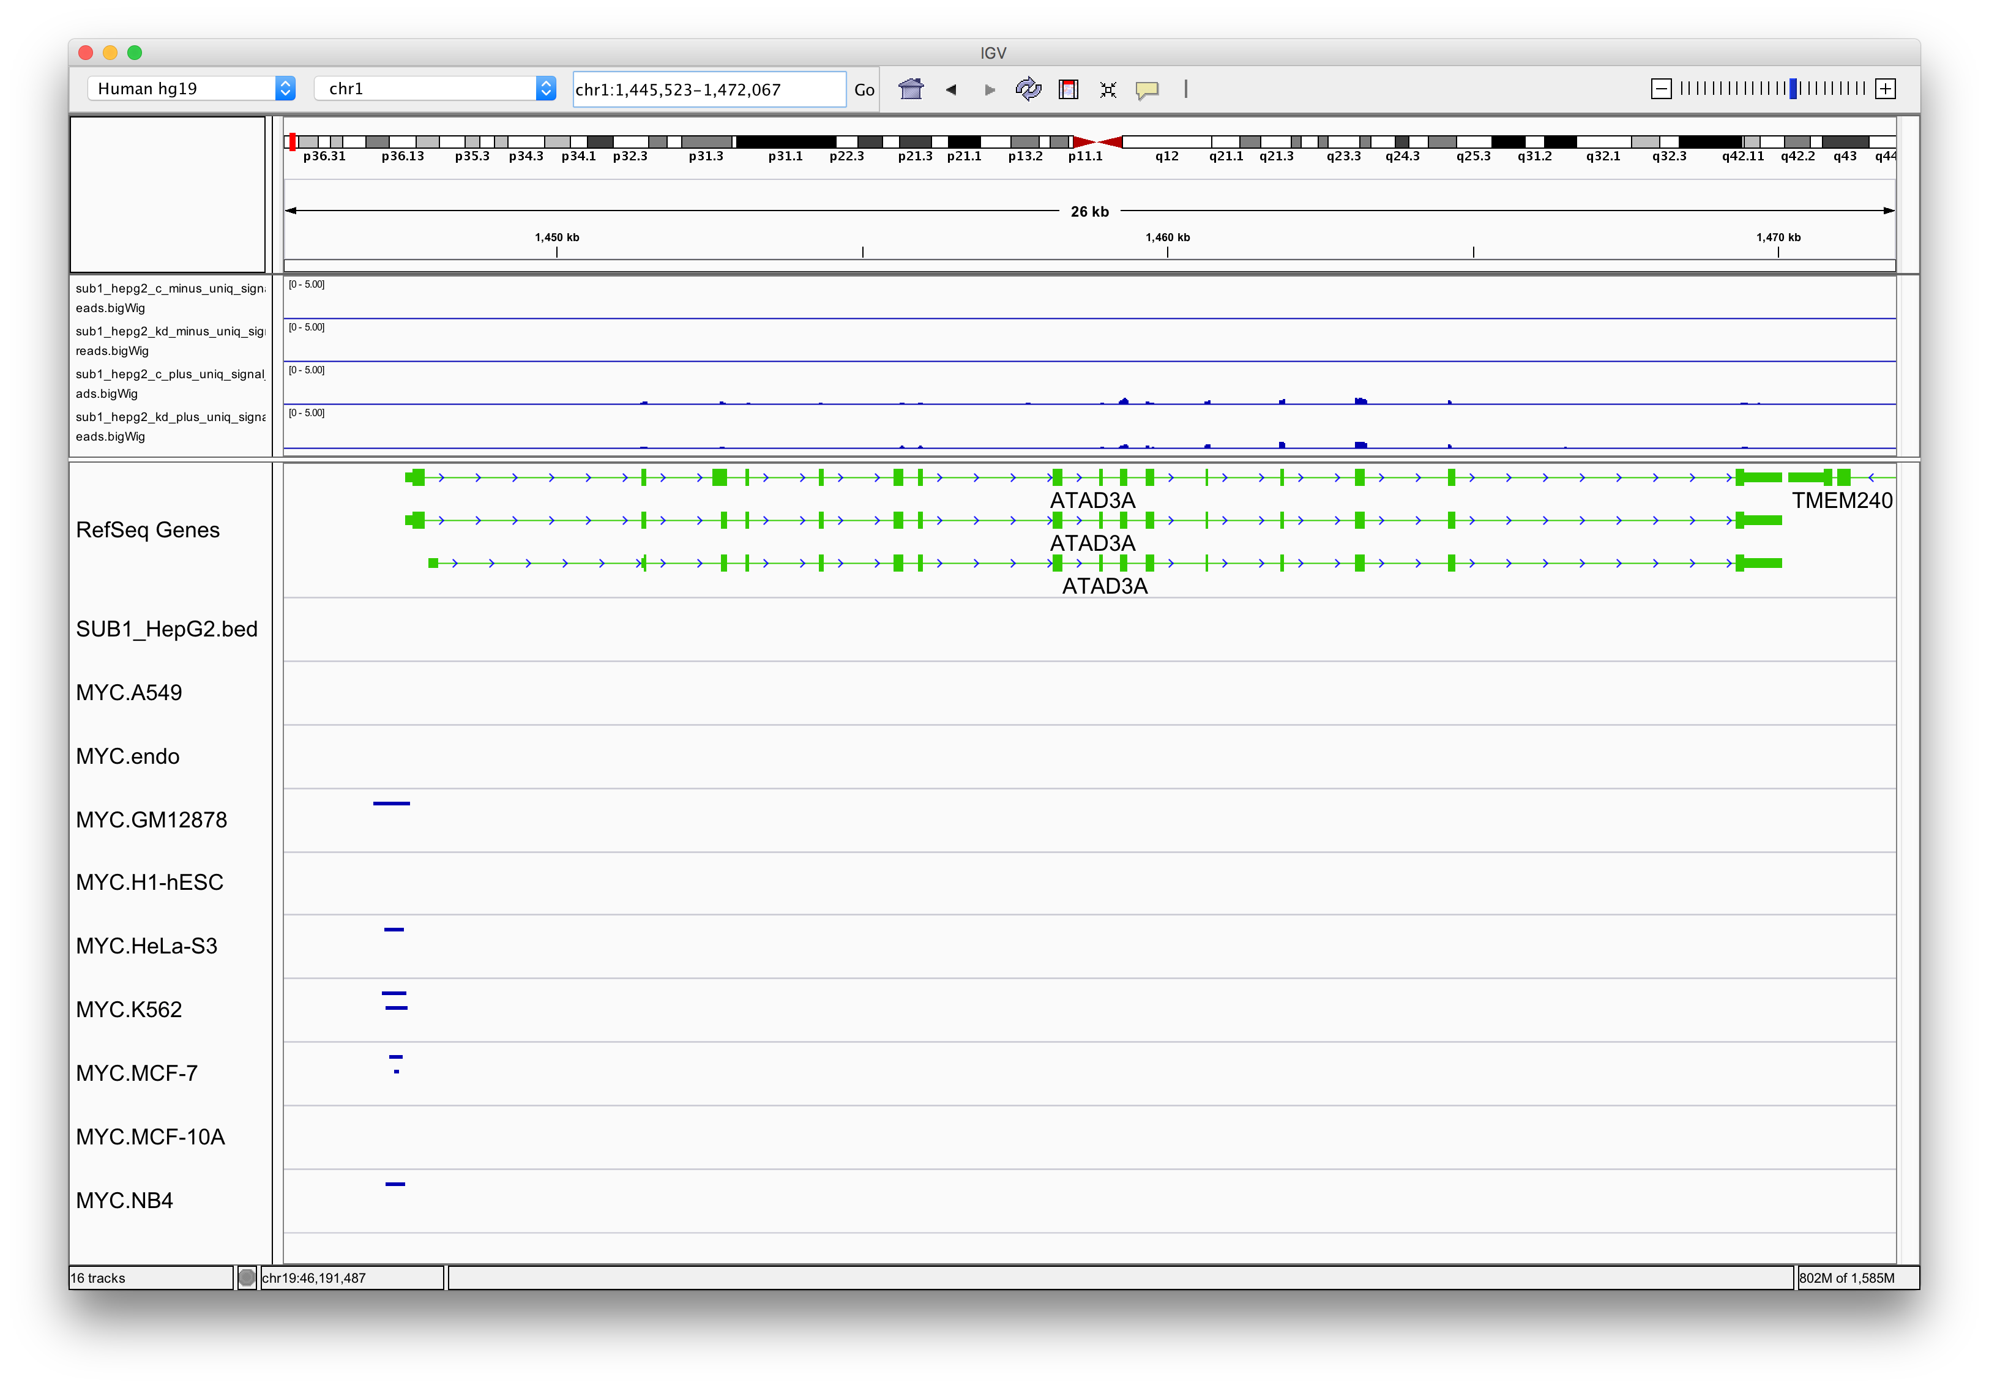
ATAD3A

Slide 6
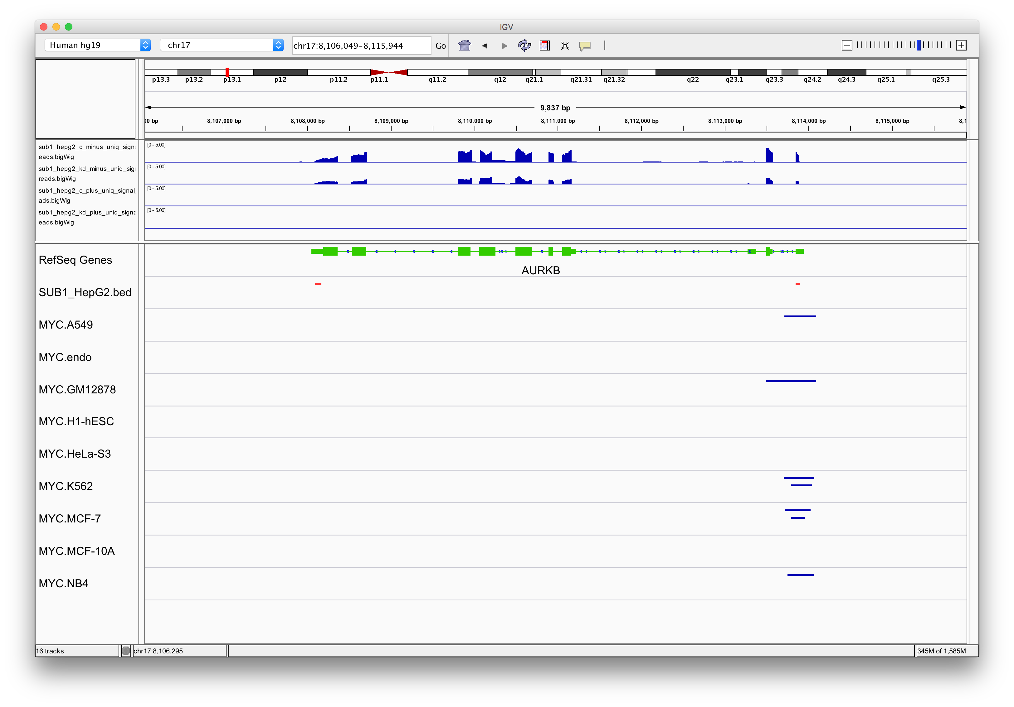
AURKB
Notes:
The difference in sub1 signals are nice here and sub1 and myc have good interaction with the gene.

Slide 7
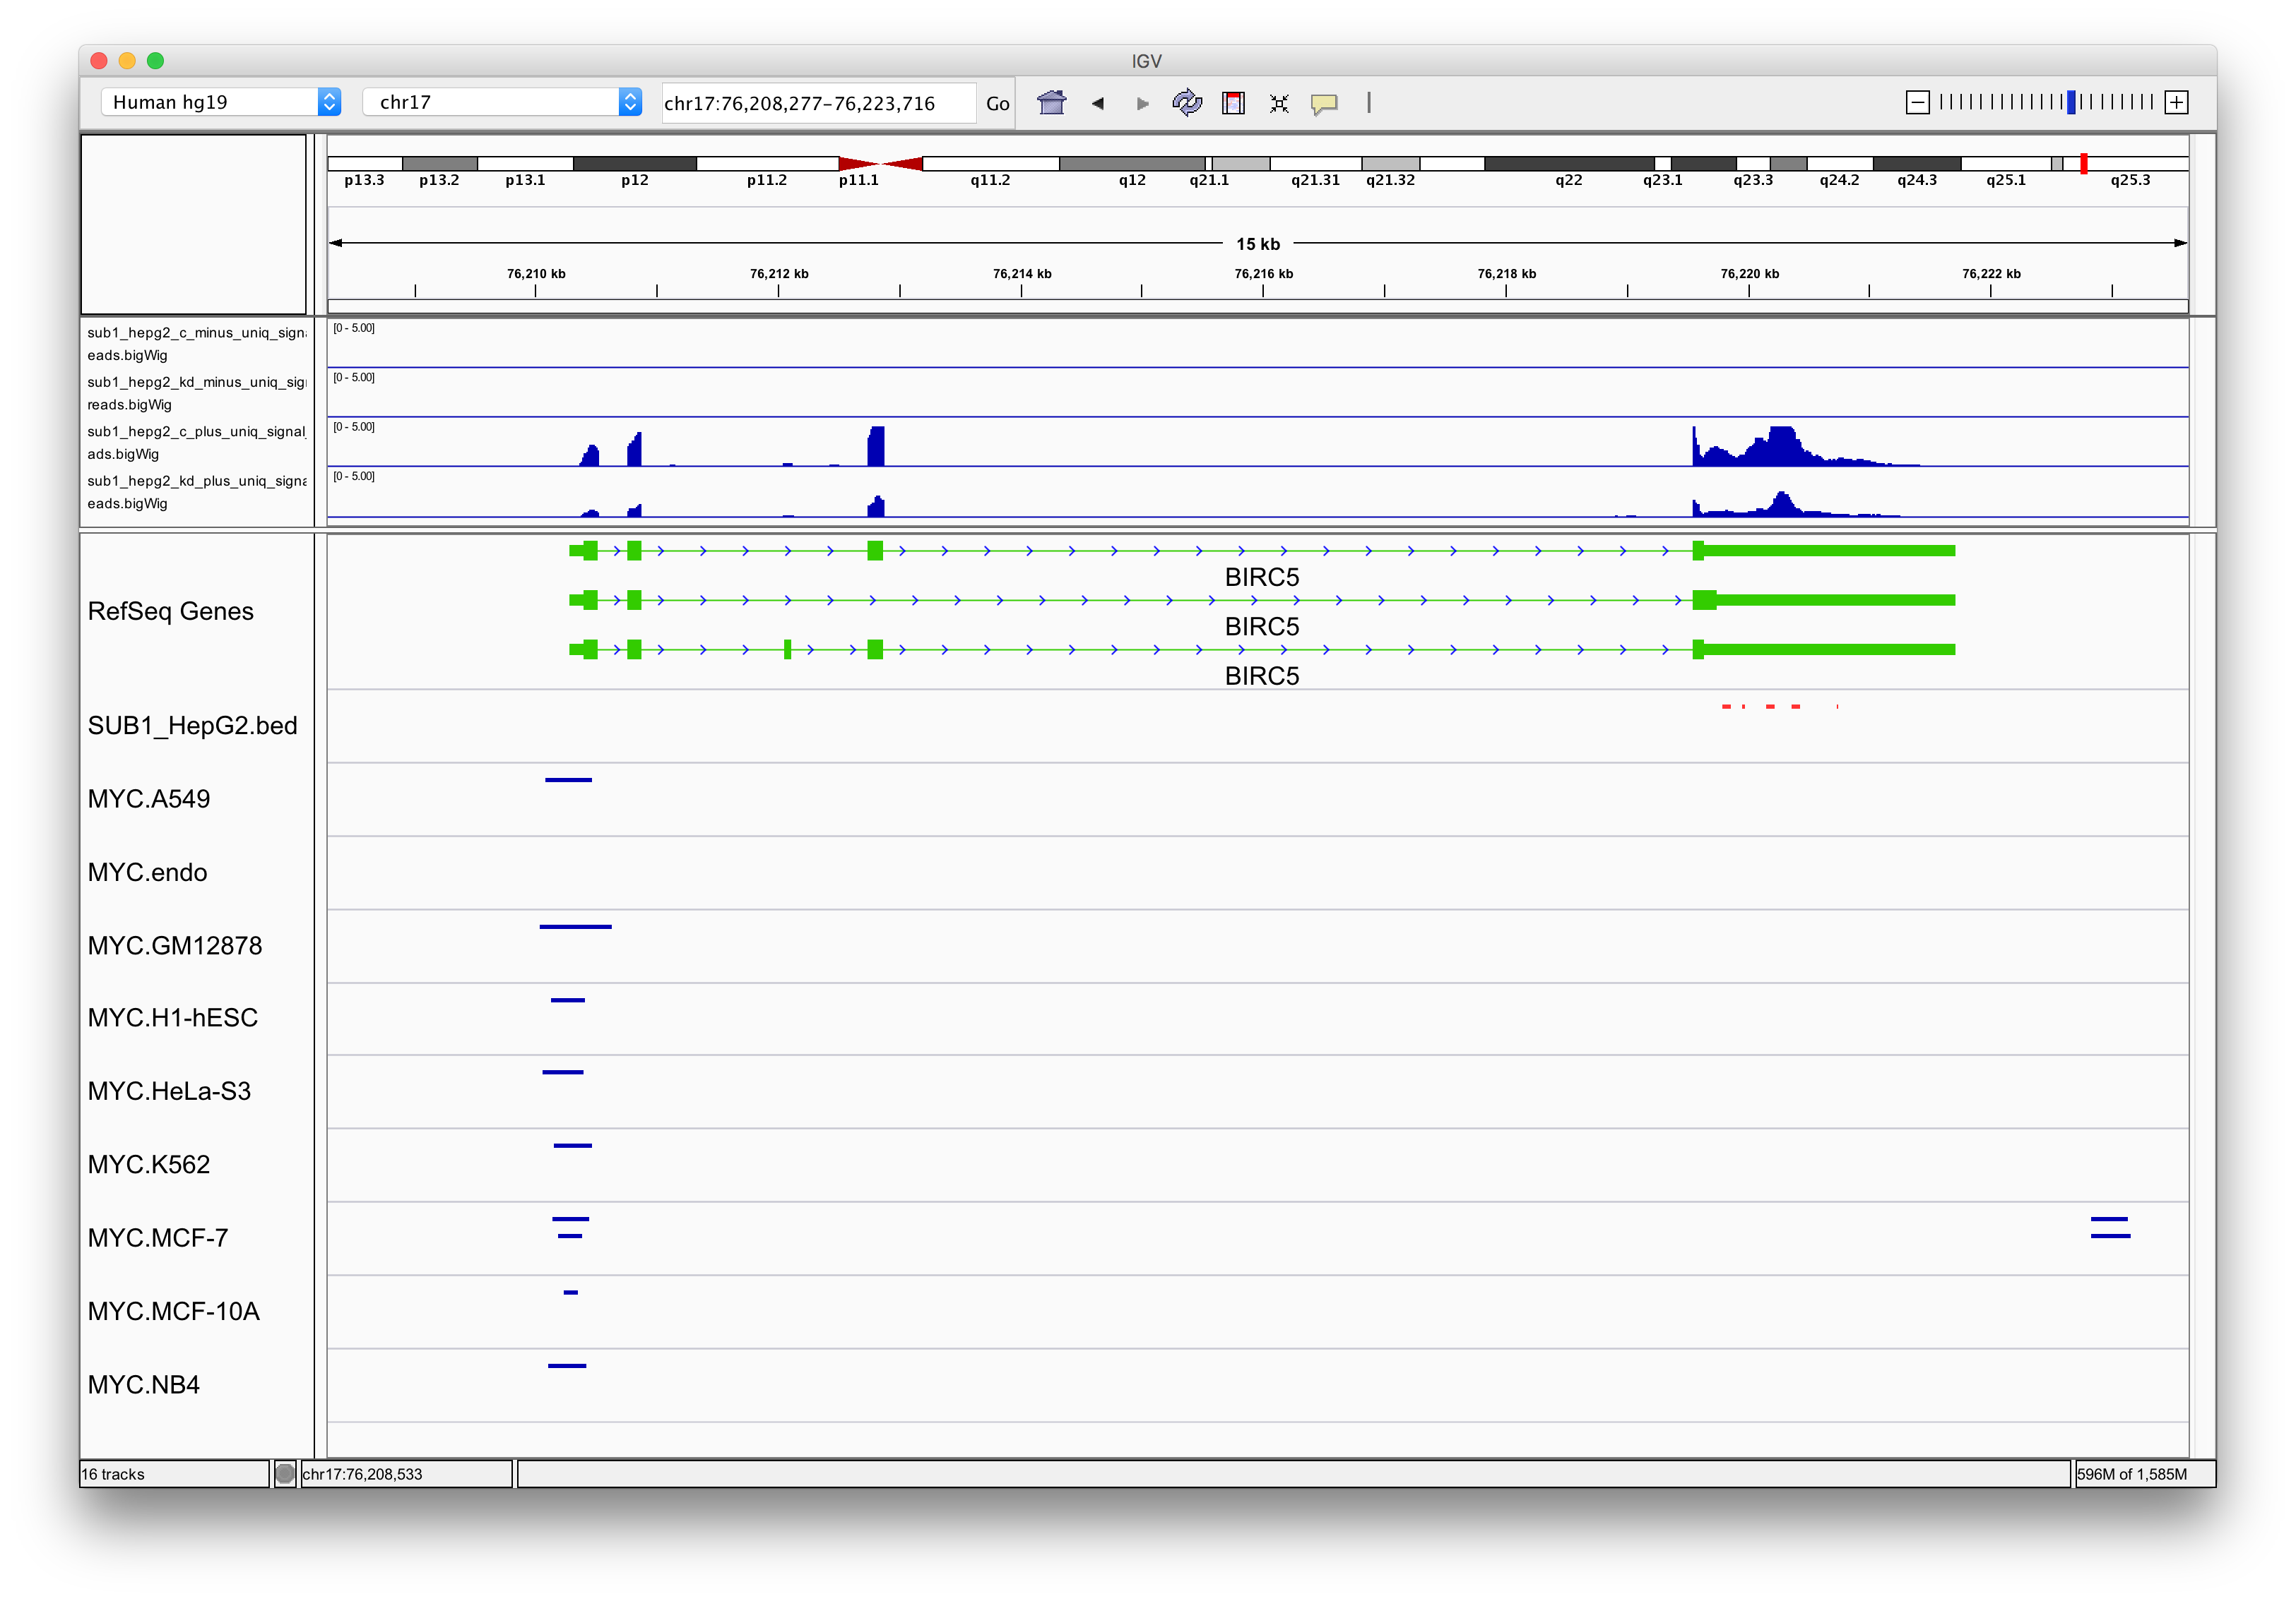
BIRC5
Notes:
Peaks are okay, interaction of Sub1 and MYC are pretty good

Slide 8
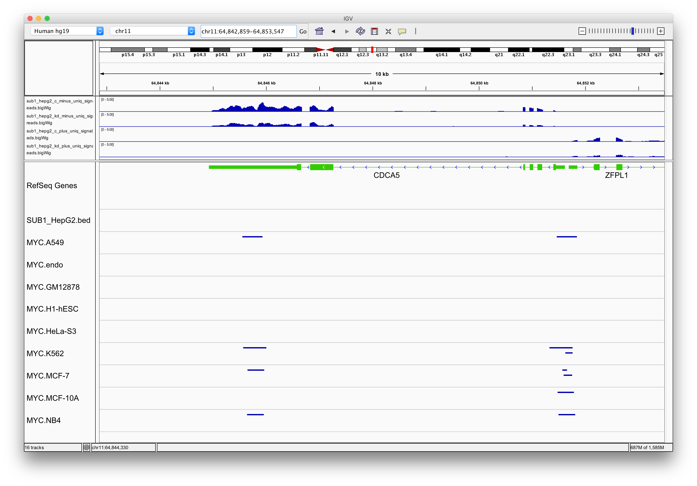
CDCA5
Notes:
Reduction of interaction is pretty good

Slide 9
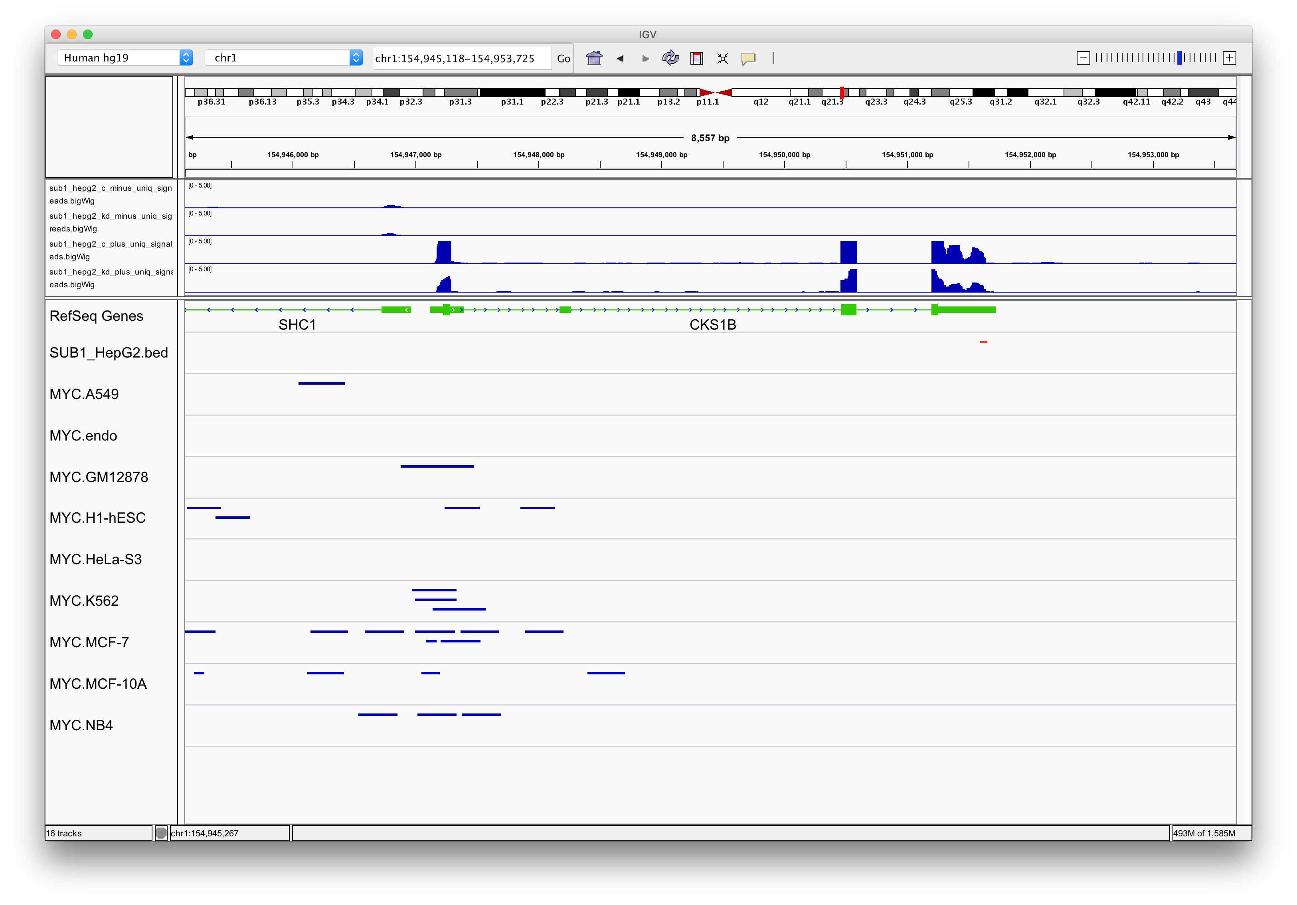
CKS1B
Notes:
This is a little messy – MYC-wise

Slide 10
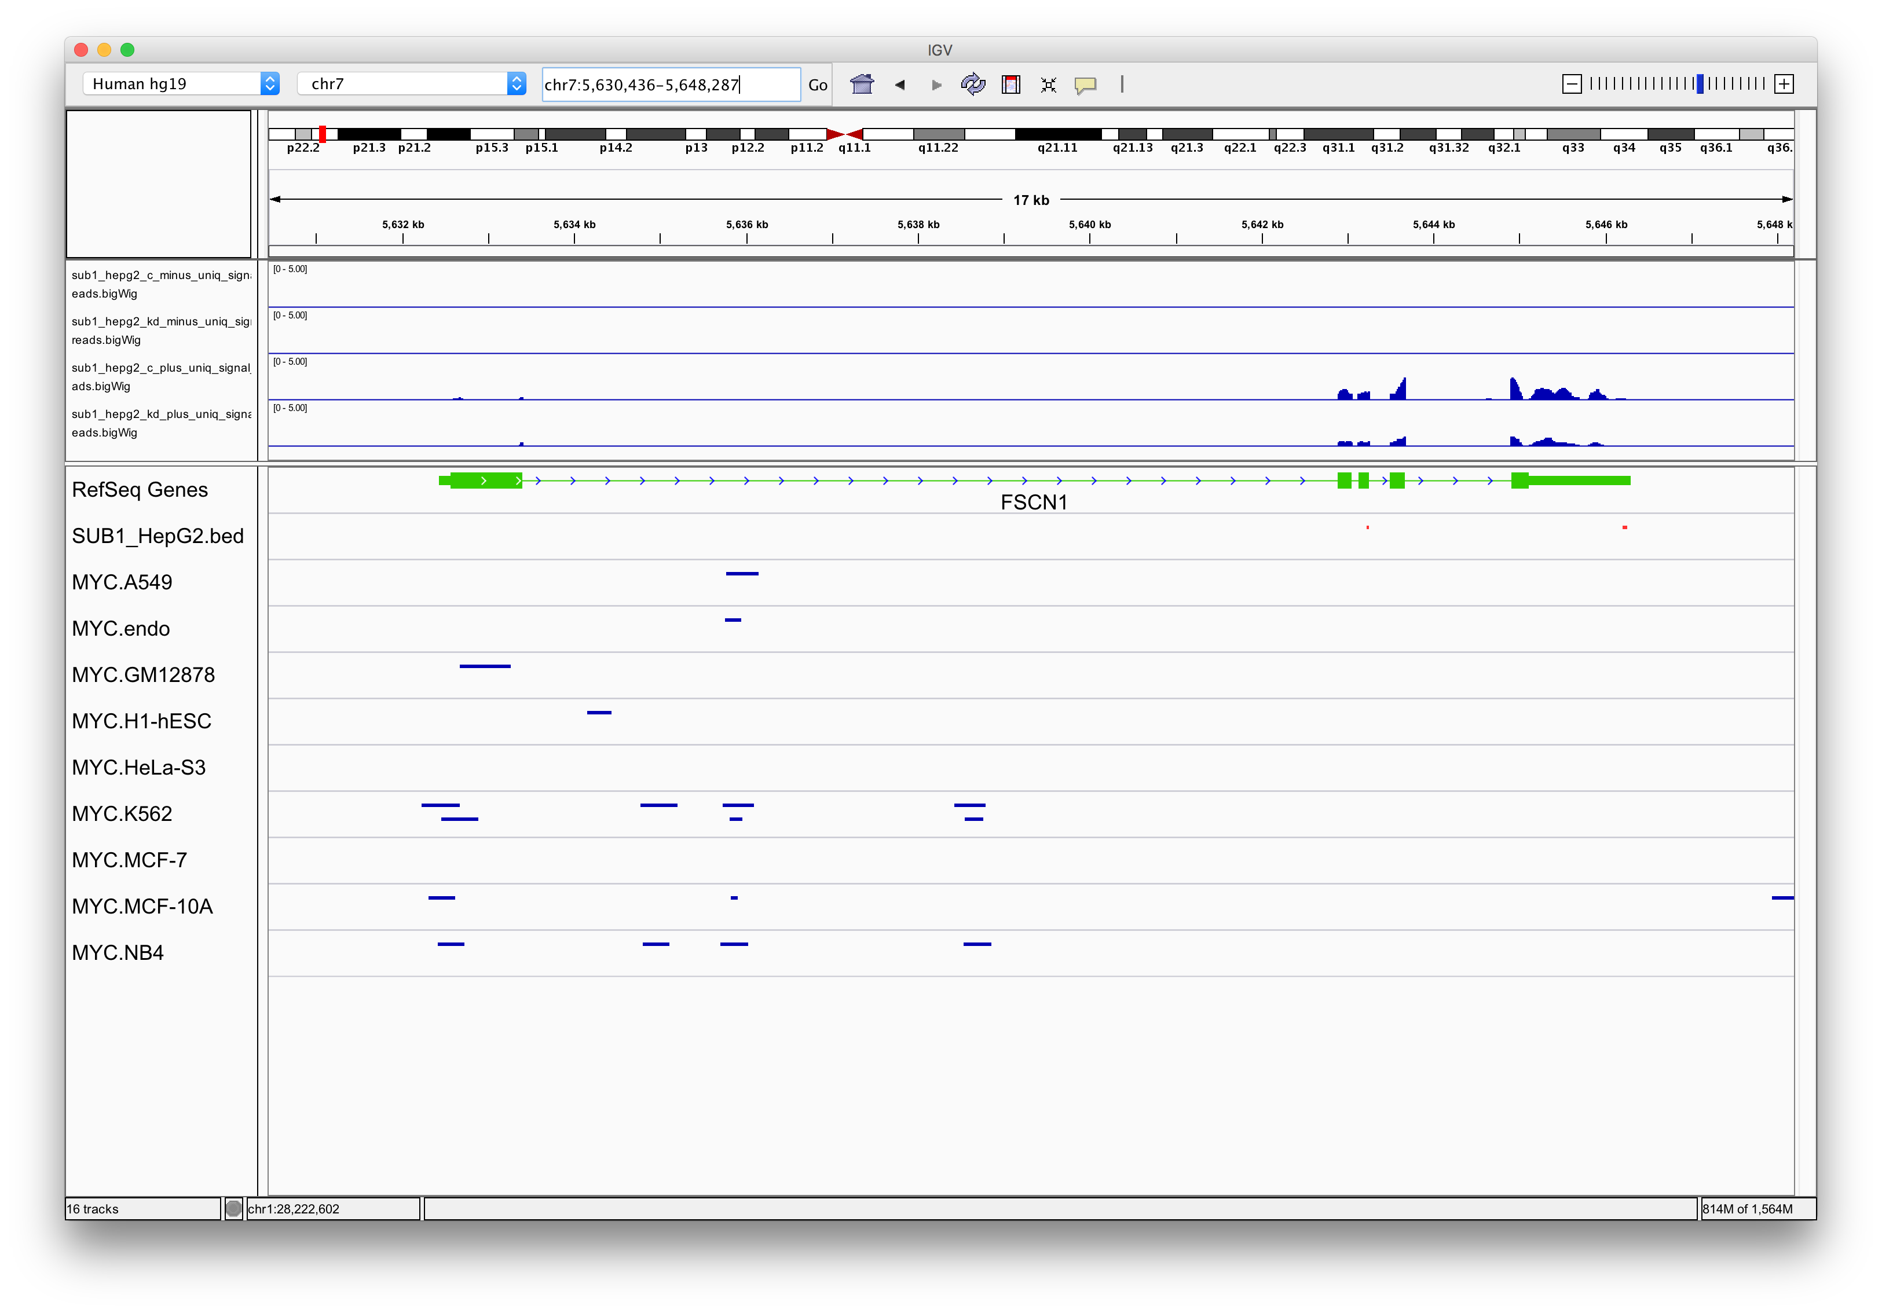
FSCN1
Notes:
Good peaks

Slide 11
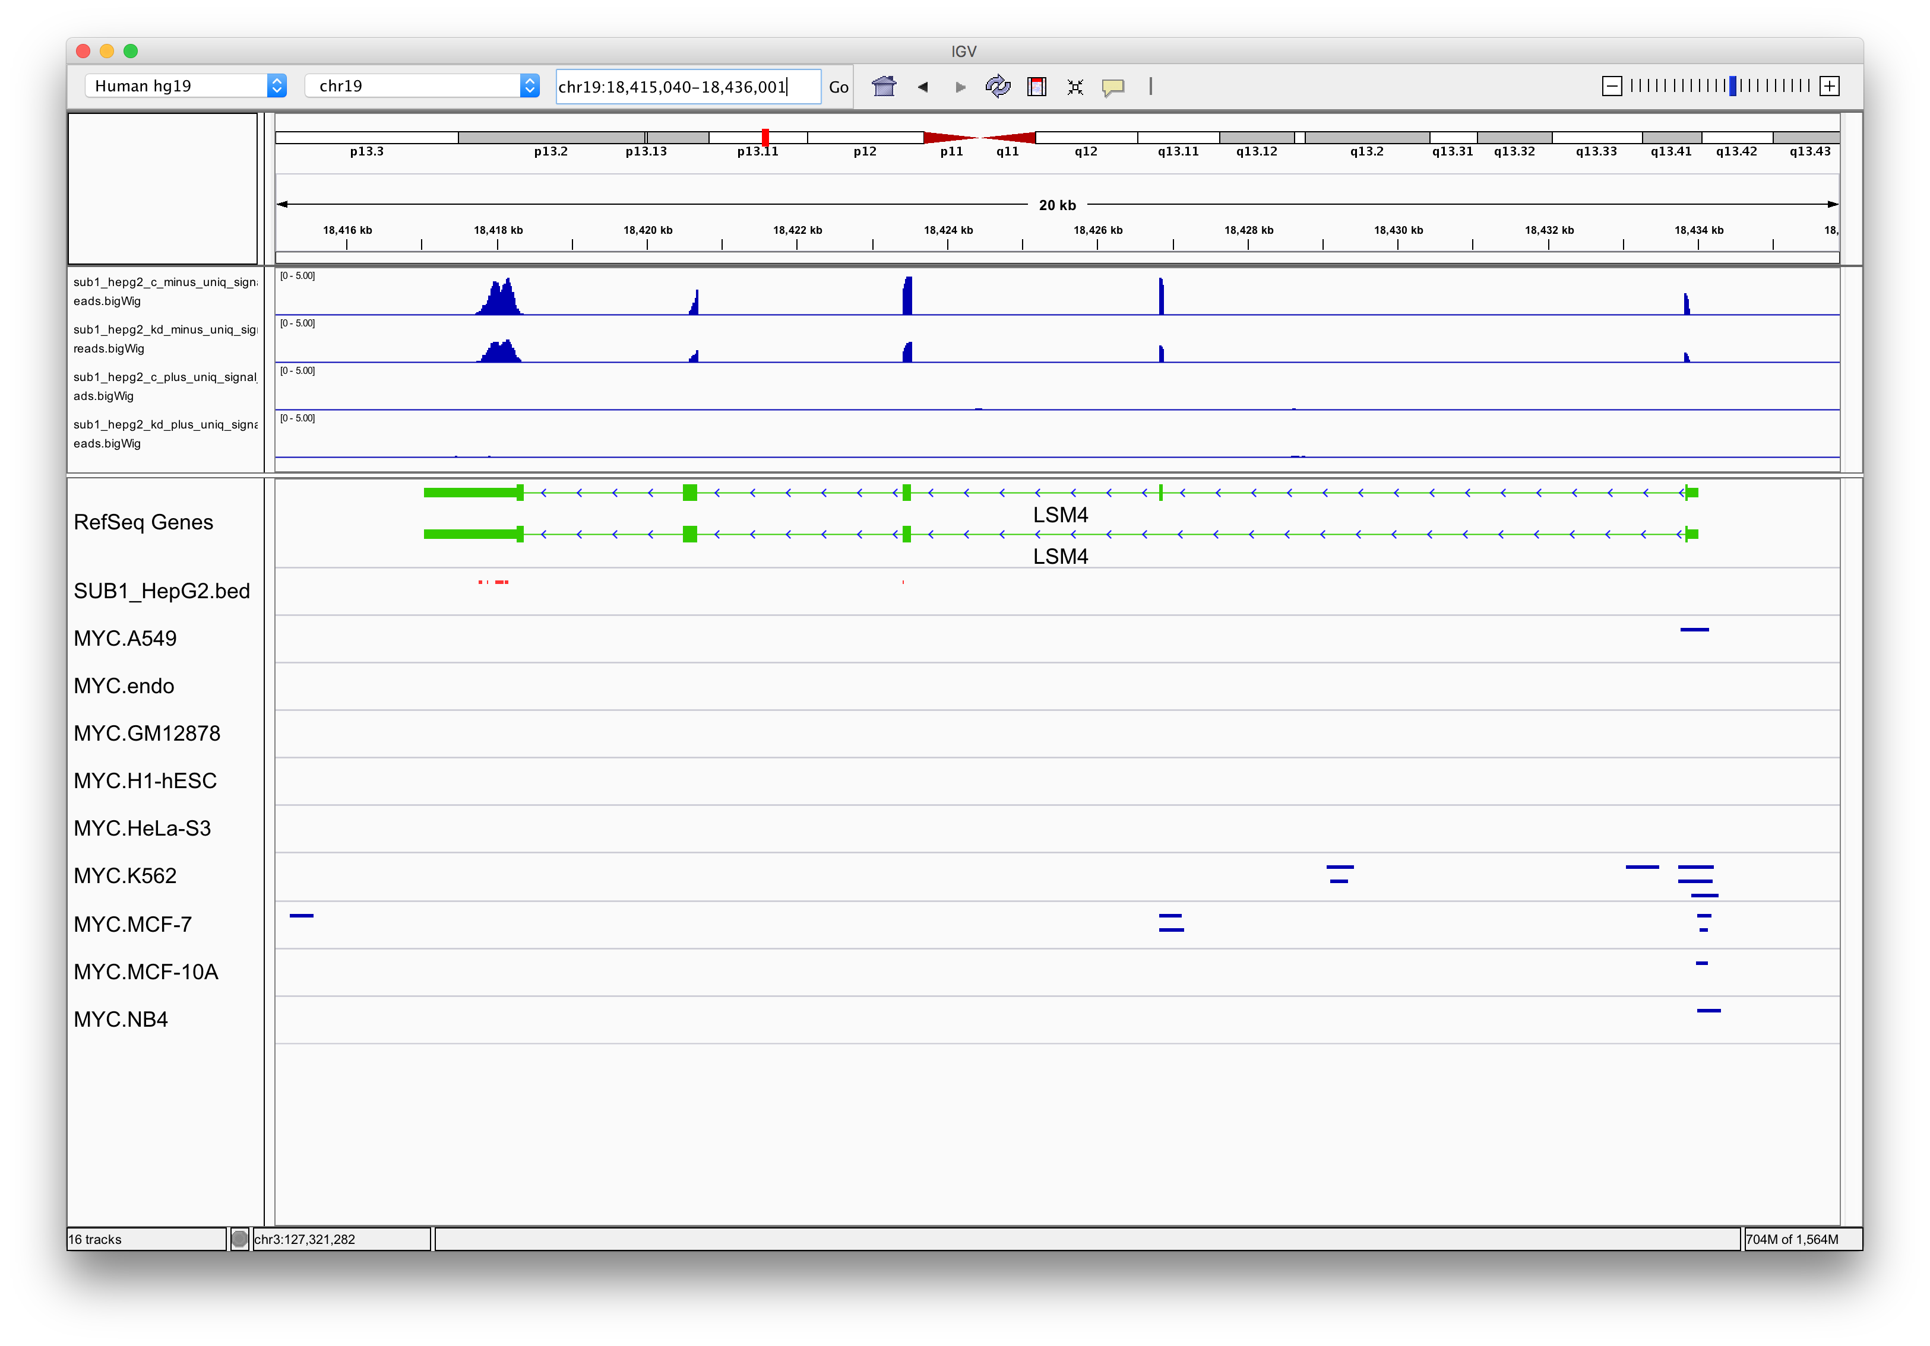
LSM4

Slide 12
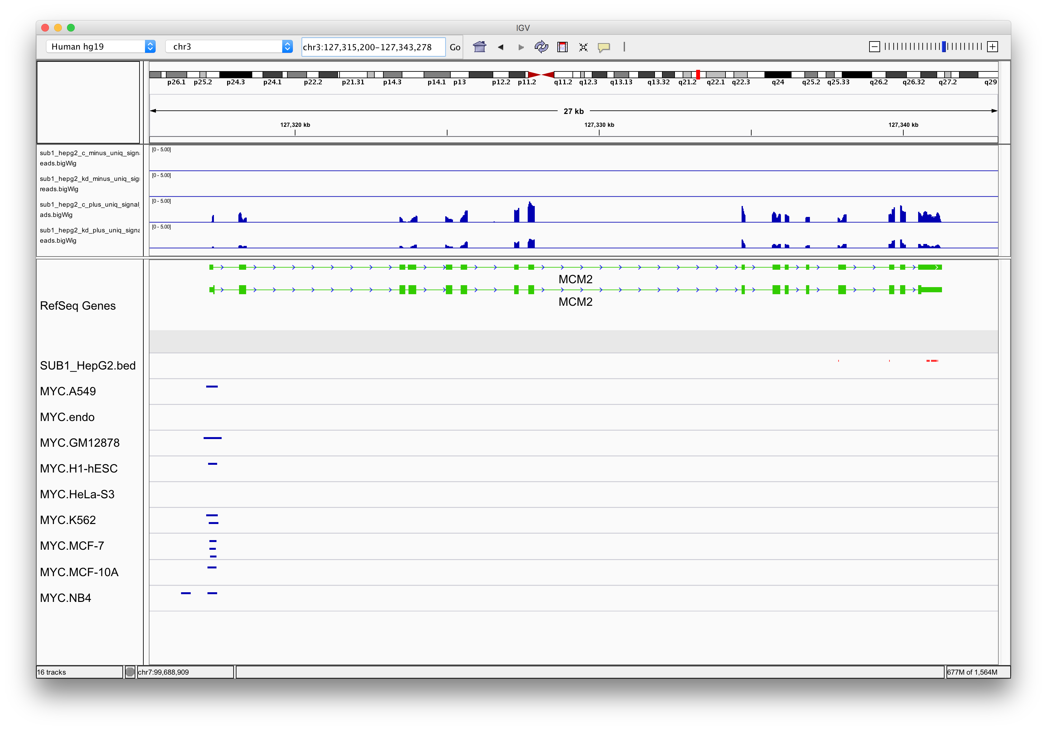
MCM2
Notes:
Good peaks

Slide 13
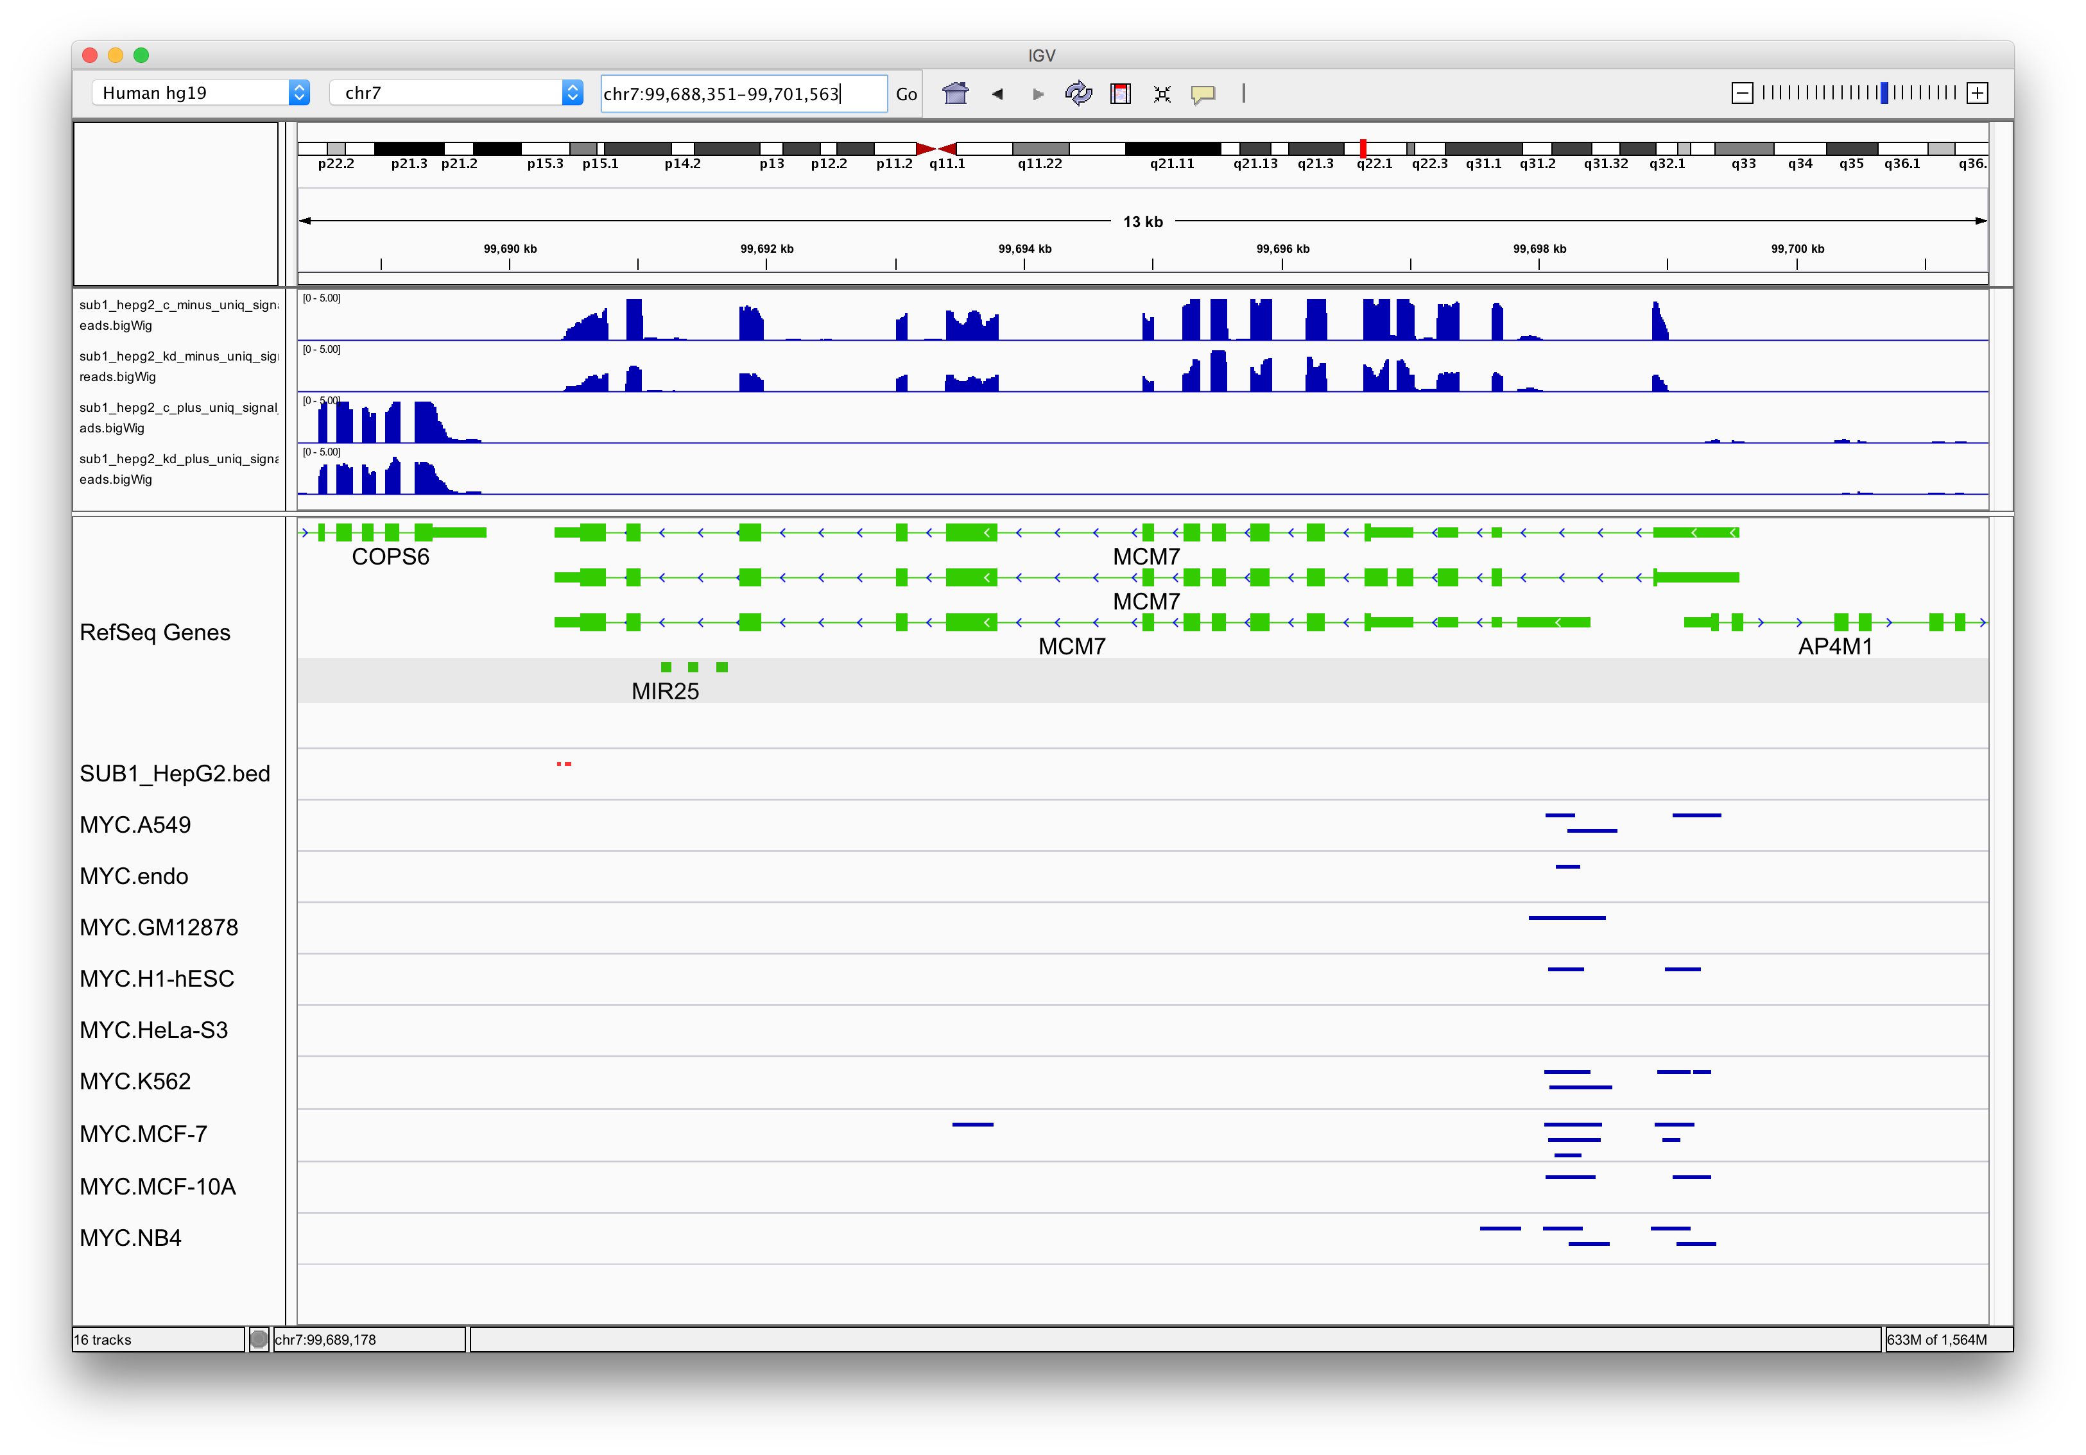
MCM7

Slide 14
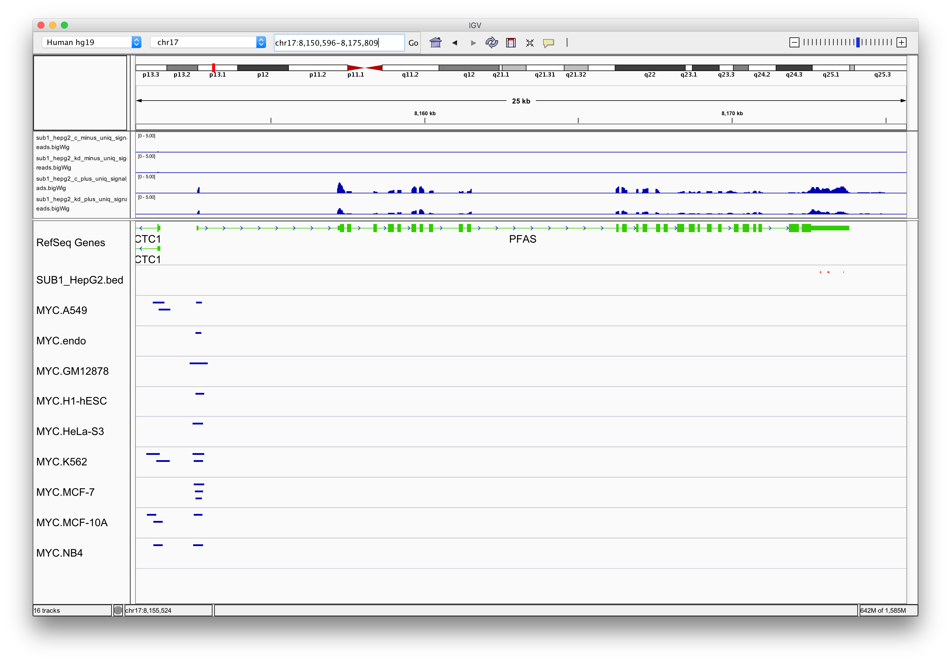
PFAS

Slide 15
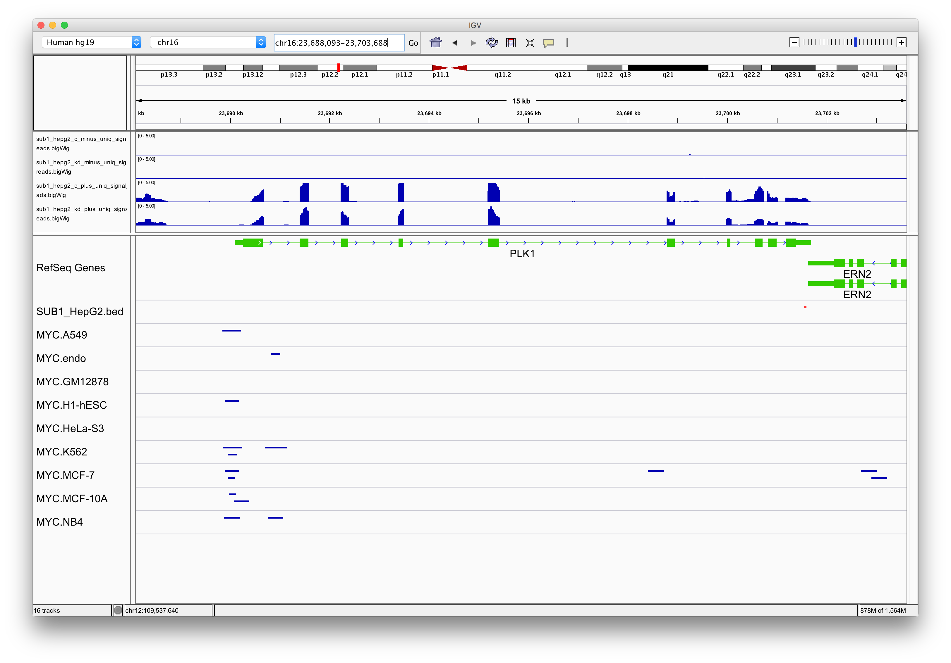
PLK1

Slide 16
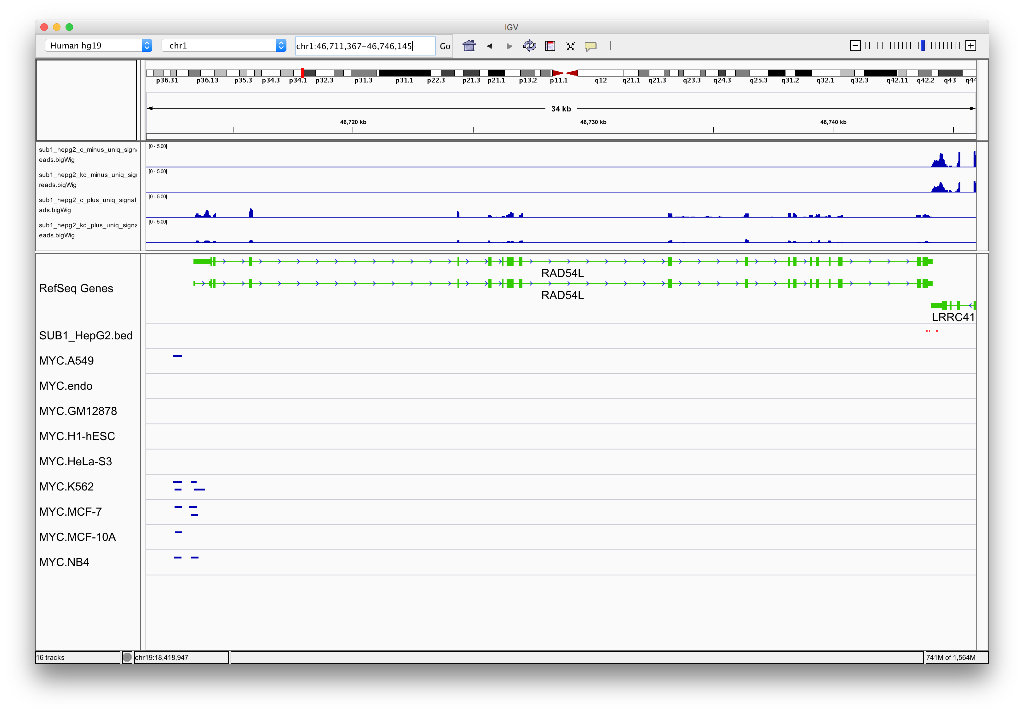
RAD54L

Slide 17
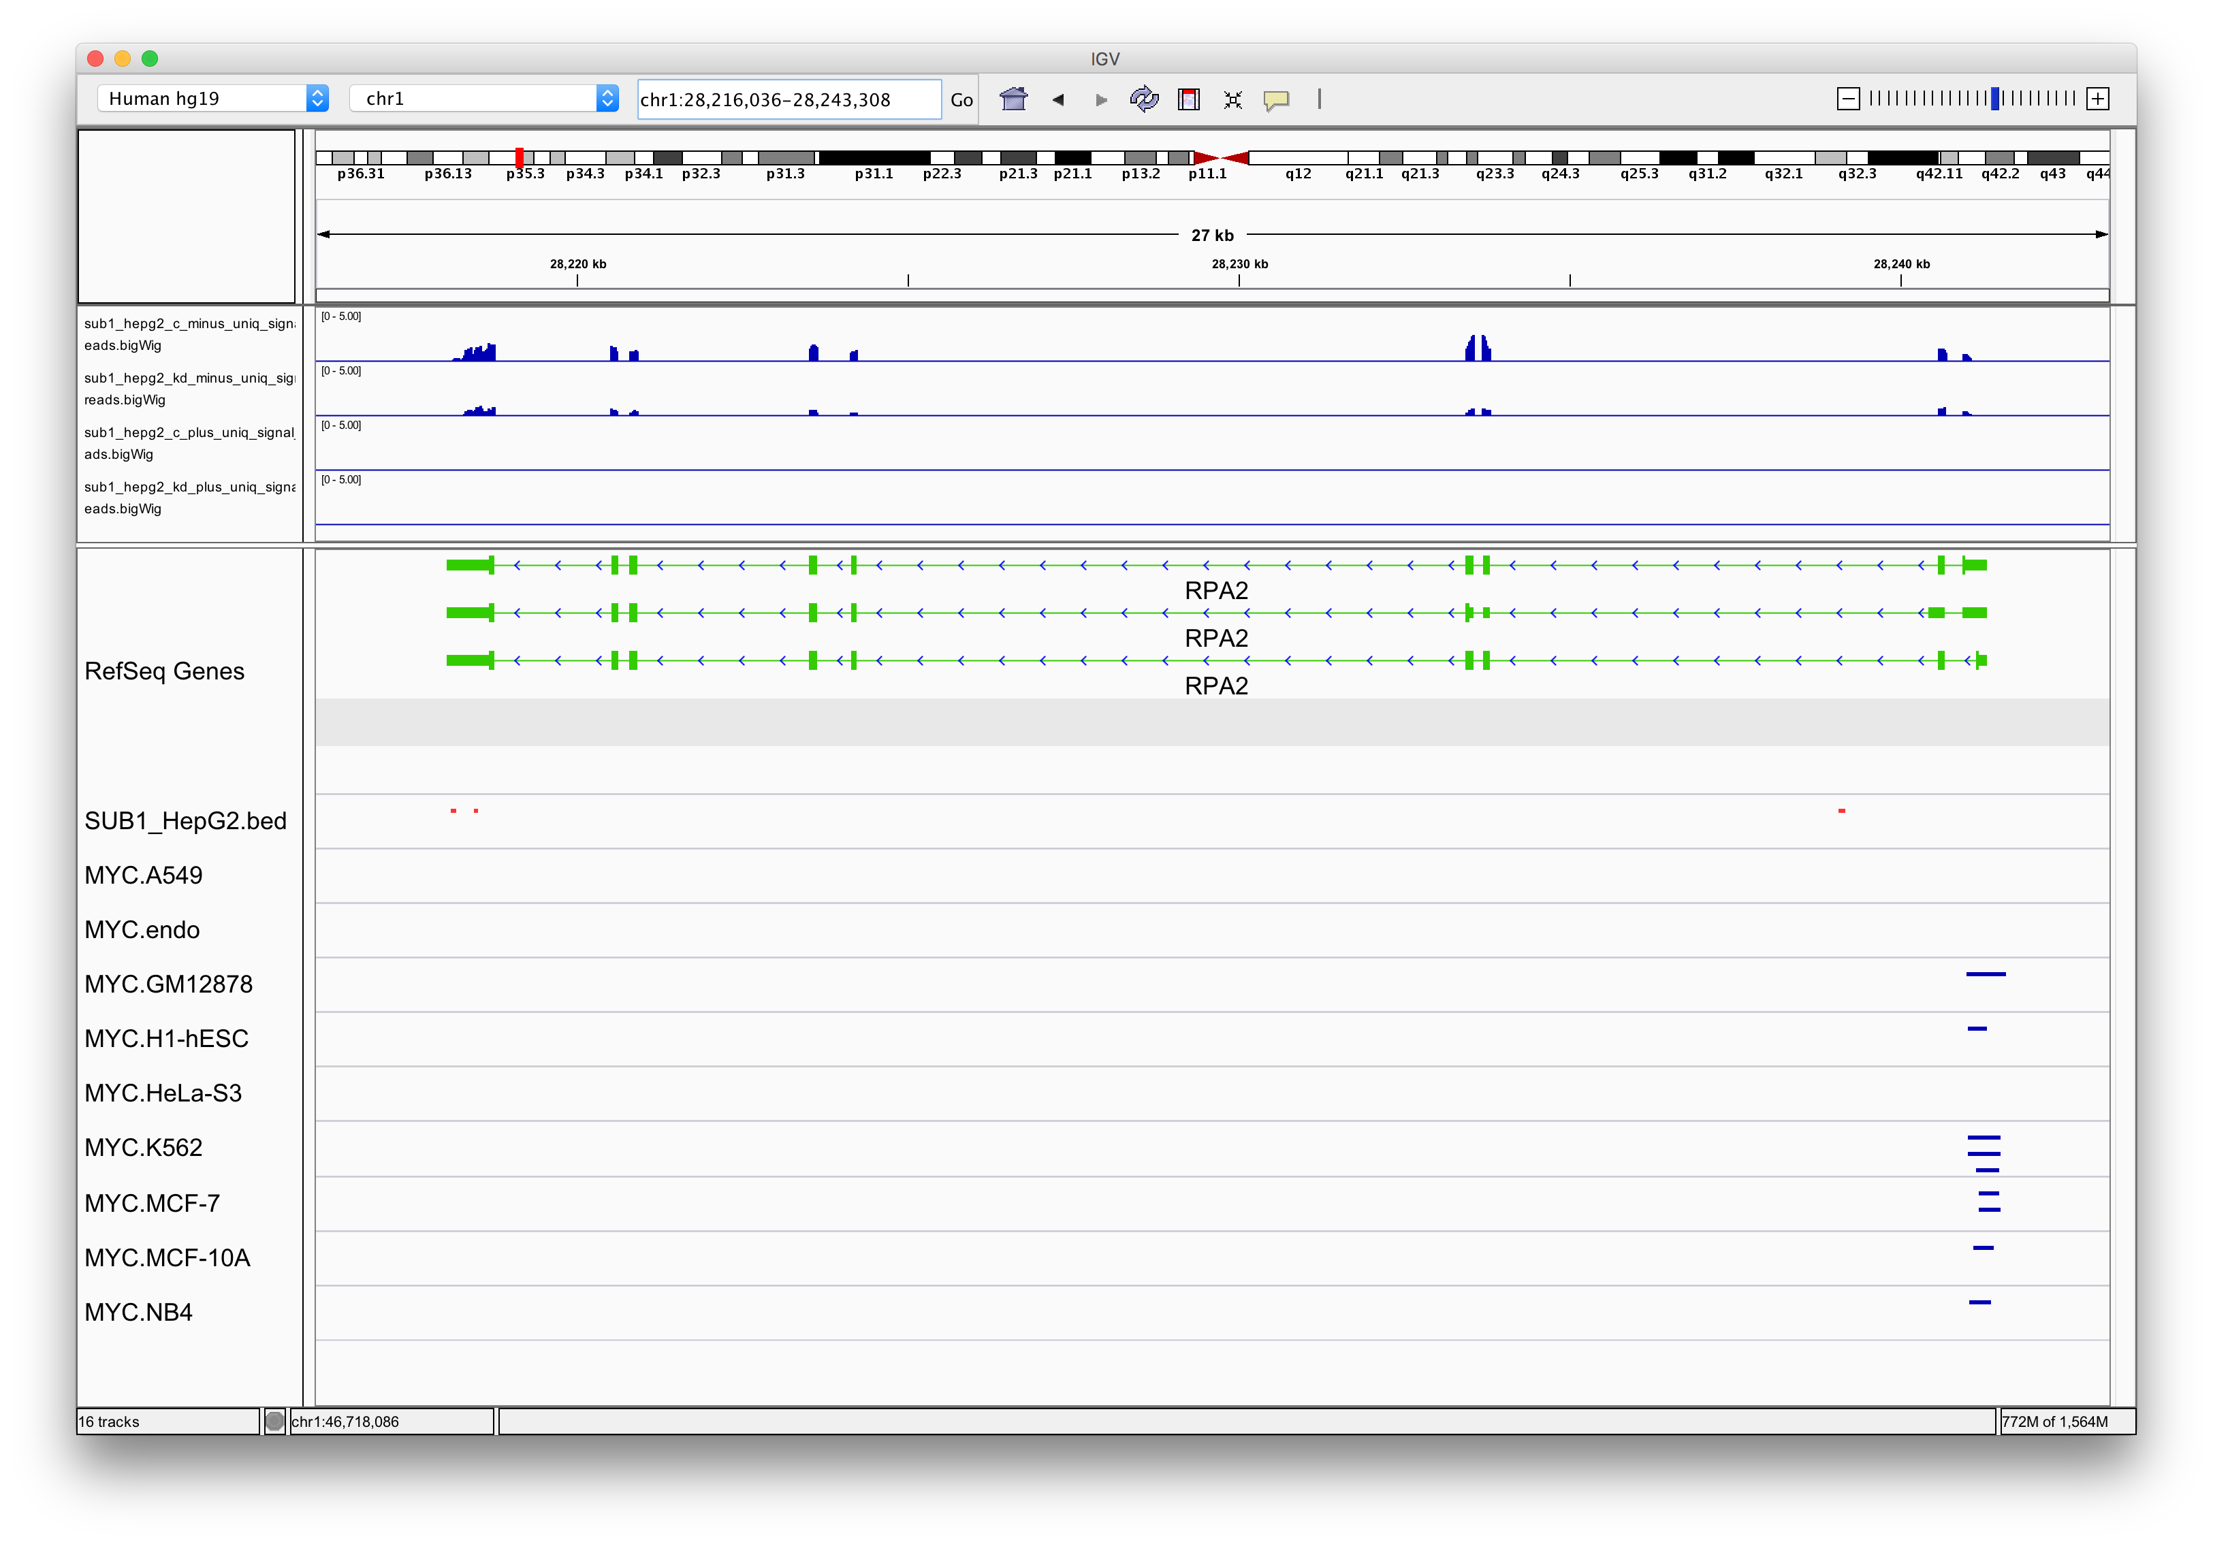
RPA2

Slide 18
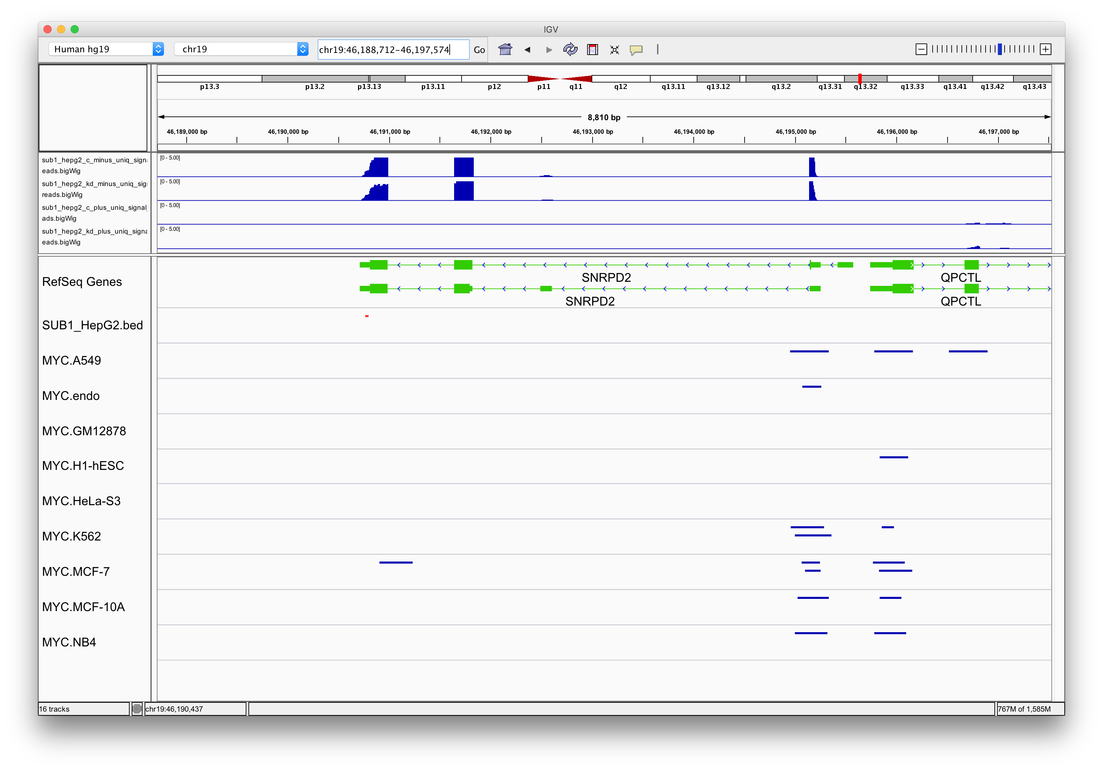
SNRPD2

Slide 19
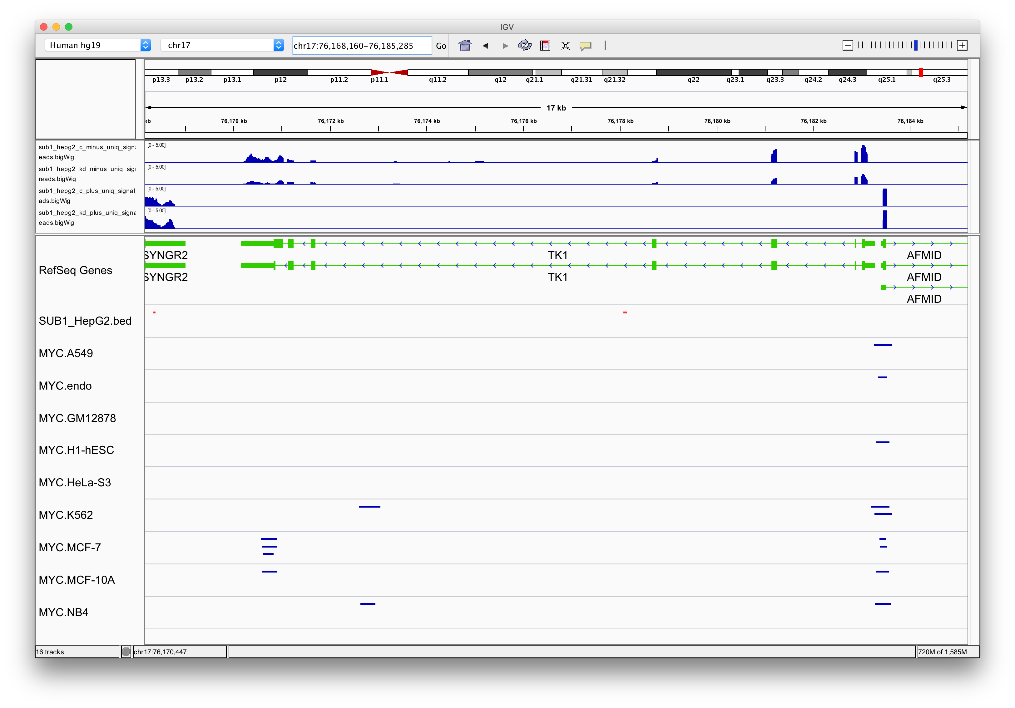
TK1

Slide 20
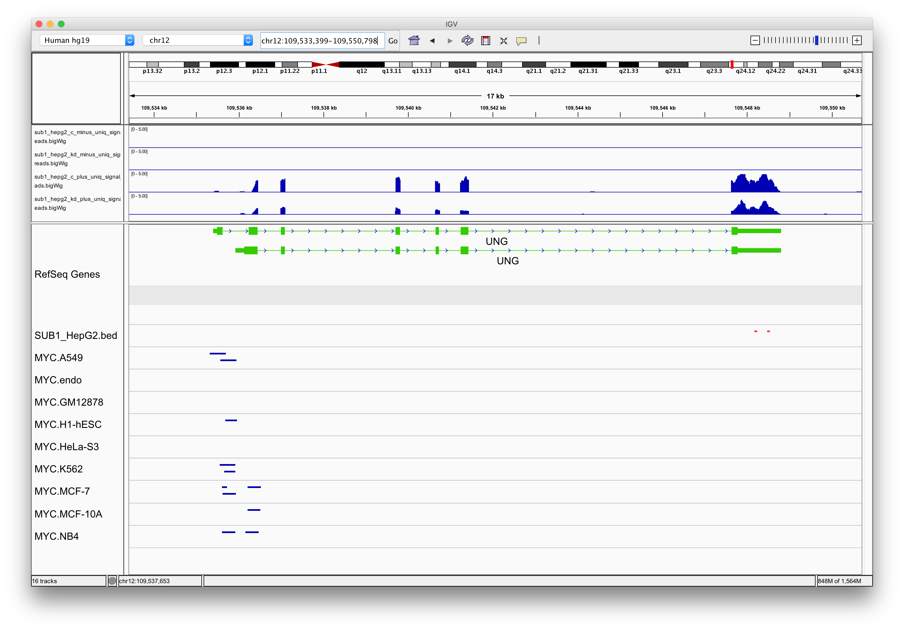
UNG
Notes:
Good peaks and sub1 and myc interactions

