Slide 1
Gerstein Lab slides

Slide 2
Overview
1 Past lab work on SVs as context
Functional characterization
Breakpoints
2 Relevance to future large-scale short read sequencing
3 Current work on rapid breakpoint identifier
4 Current work on SV functional characterization score

Slide 3
Methods for finding breakpoints
BreakSeq [add 2vref]
Fast SV detection by alignment against a breakpoint library
AGE
Optimal alignment over breakpoints
SRiC
Split read alignment, parameterized by simulation
Retrodup
Finding of retroduplications & variable processed pseudogenes via alignment to a junction library

Slide 4
SV Junction and Identification
[Lam et al. Nat. Biotech. ('10)]

Slide 5
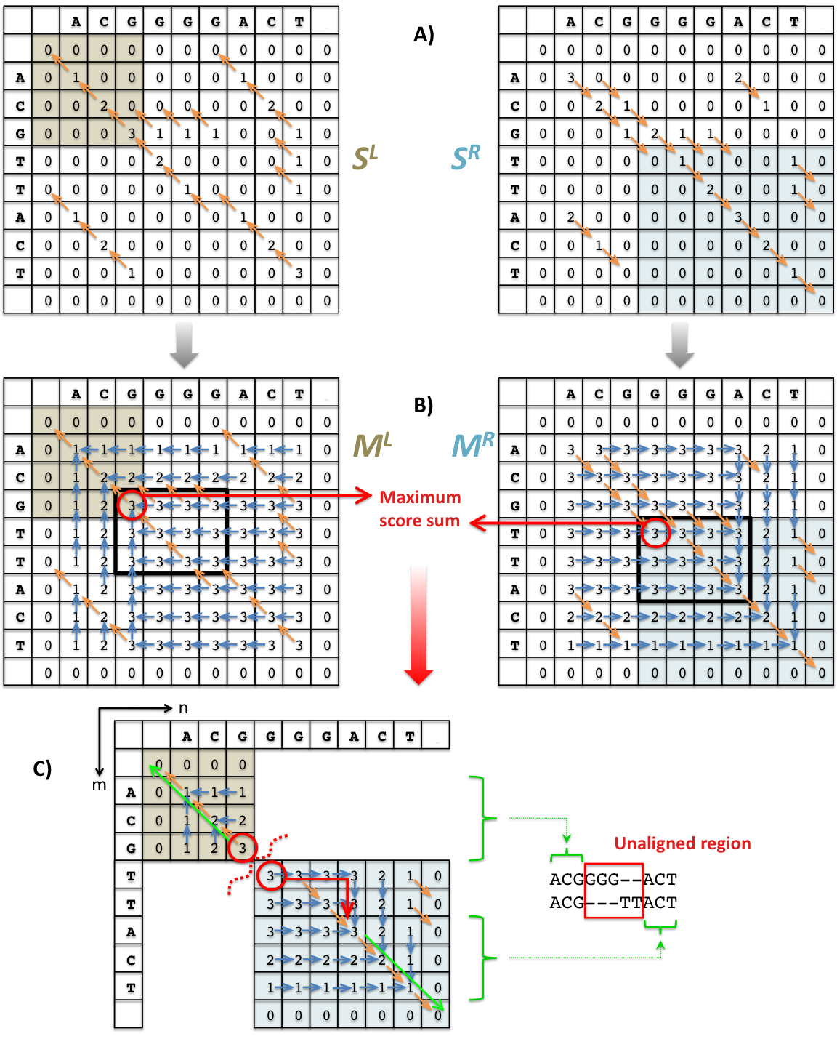
AGE
Alignment with Gap Excision
Given scoring scheme (match, mismatch, gap open, gap extend) find an optimal alignment of two sequences (i.e. with highest score) where ONE gap is NOT penalized
[Abyzov & Gerstein (’11) Bioinfo.]

Slide 6
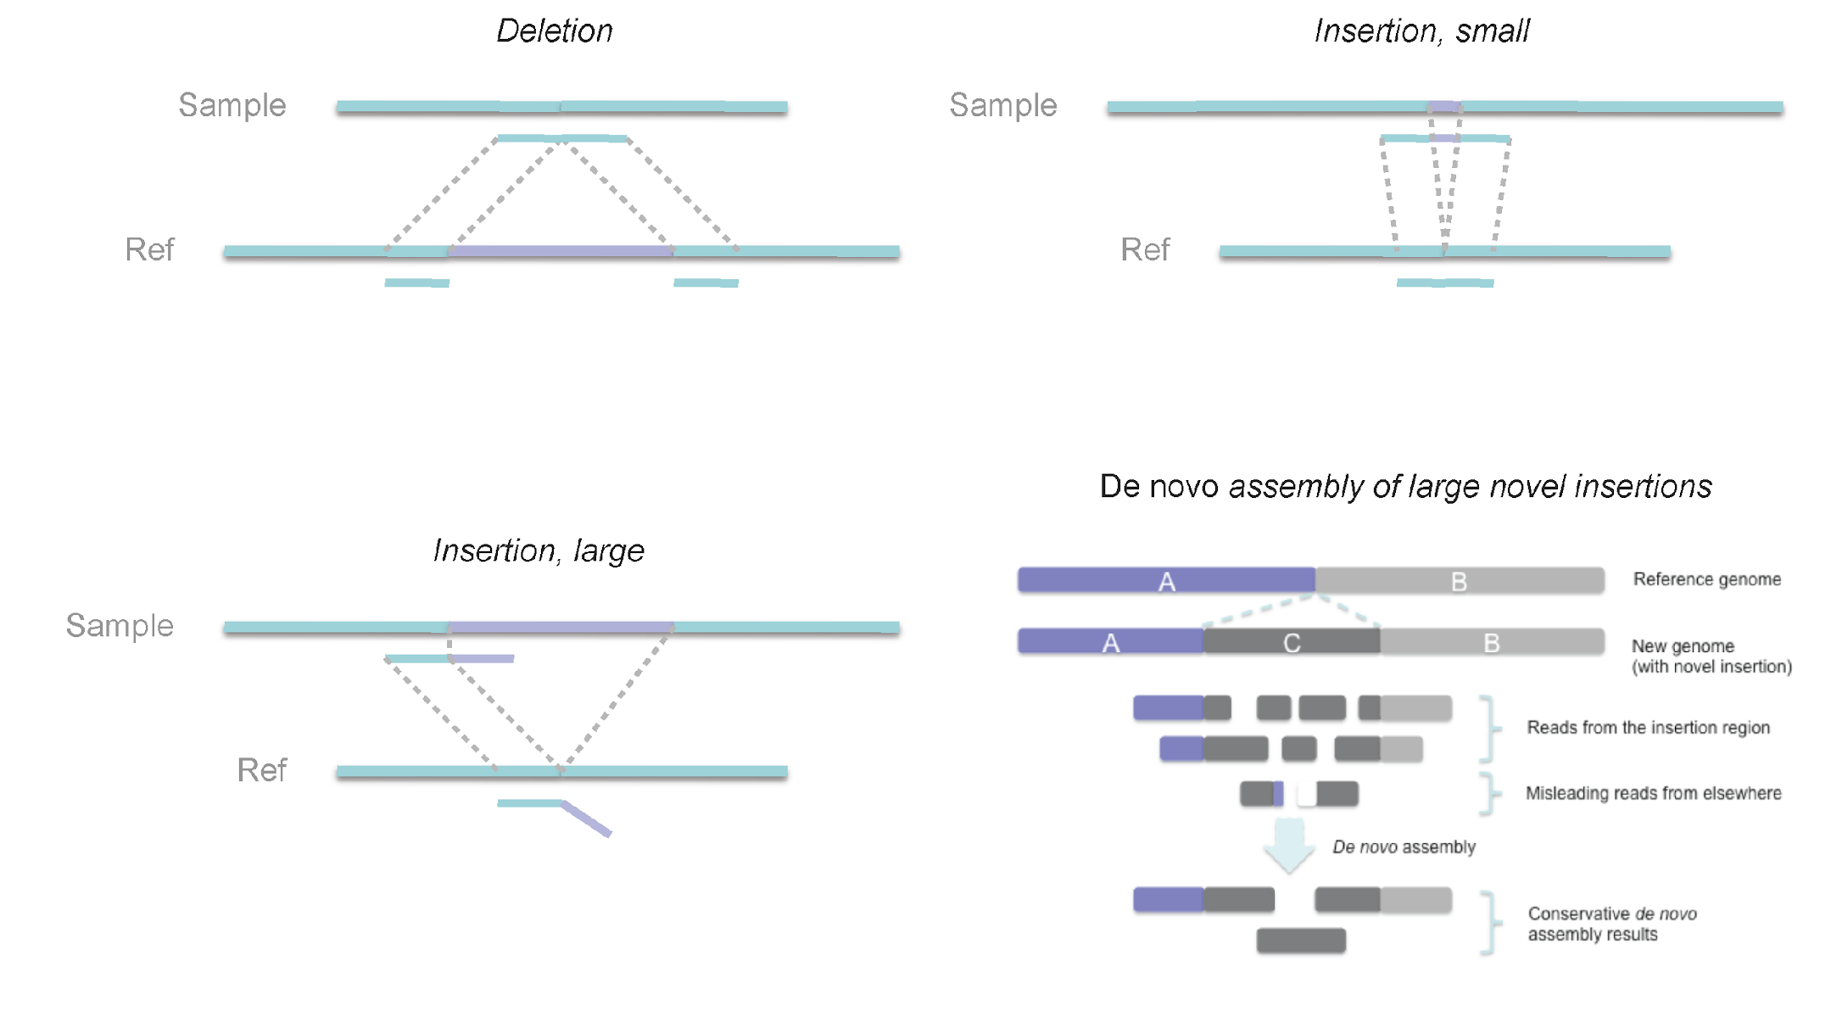
Using Simulation to Parameterize SRiC: Deletions Easier than Insertions
SRiC: Split Read Pipeline
[Zhang et al. ('11) BMC Genomics]

Slide 7
Gene
Novel retroduplication
Read pairs
1 2 3 4
…
…
Reference
Alignment to
the reference
…
3
1
Evidence
from alignment
Unaligned reads
Aligned
reads
Splice-junction library
…
2
4
Evidence
from cluster
1
[Abyzov et al. Gen. Res. ('13) ]
…
3
2 3 4
Evidence from
read depth
1
Pipeline to identify novel retro-dups. from 3 evidence sources
Zero level

Slide 8
Approaches for functional characterization of SVs
Overlaps enrichment of SVs [refs]
against functional annotations (CDS, TFBS, &c)
using an appropriate null
Mechanism classification of SV breakpoints
NAHR, NHR, &c
Patterns of epigenetic marks at SV breakpoints

Slide 9
Indels and larger SVs show largely consistent patterns to SNPs

Slide 10
SV Mechanism Classification
[Lam et al. Nat. Biotech. ('10)]

Slide 11
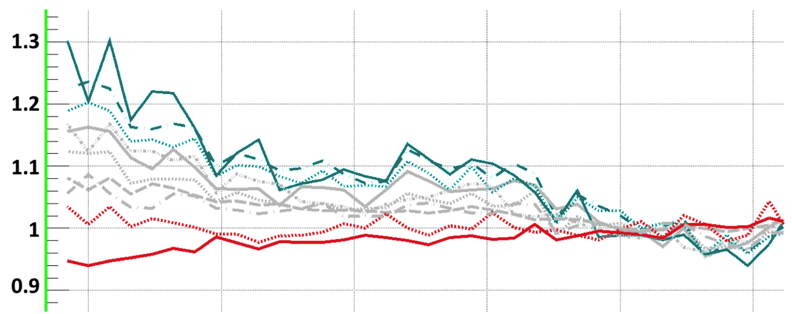
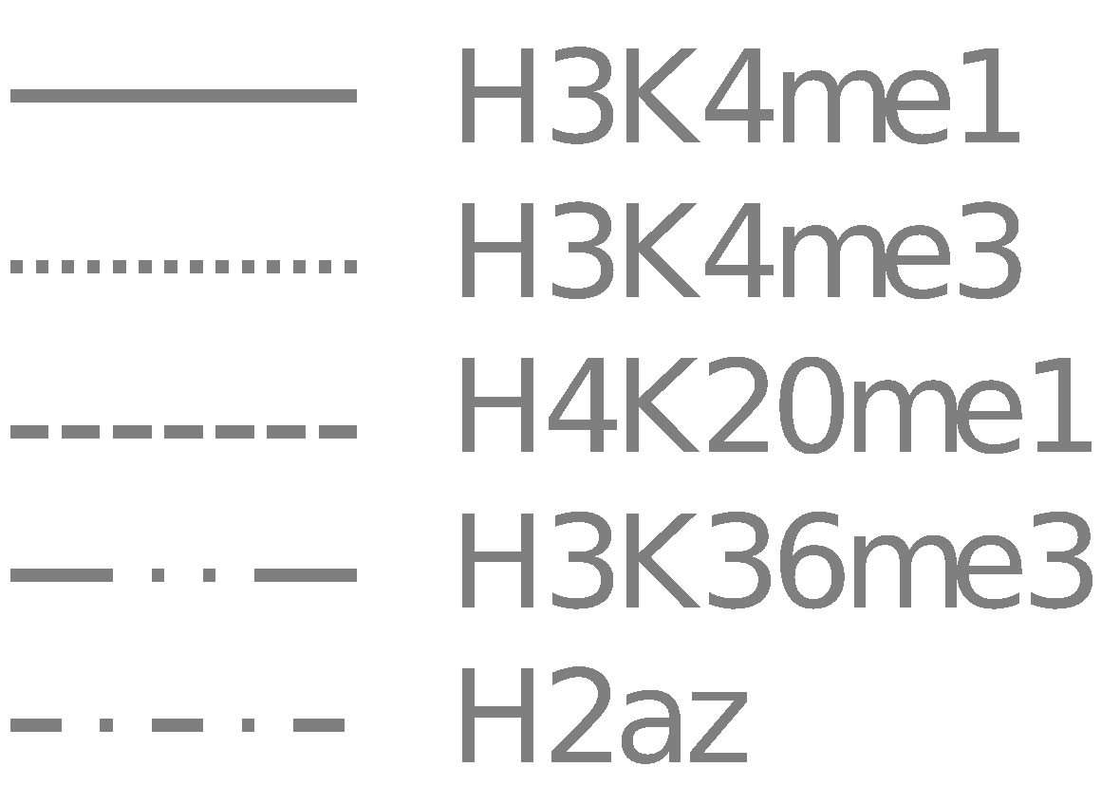
NAHR breakpoint are associated with open chromatin
TEI
NAHR
NH
Supported by Hi-C and
Histone modification
Hypothesis: Some NAHR
deletions occur w/o cell
Replication
* H1 & GM12878 cells
Closed
Open
0 ±0.5 ±1 ±1.5 ±2 ±2.5
Distance from breakpoints, Mbps
[Abyzov et al. (‘15) Nature Comm.]

Slide 12
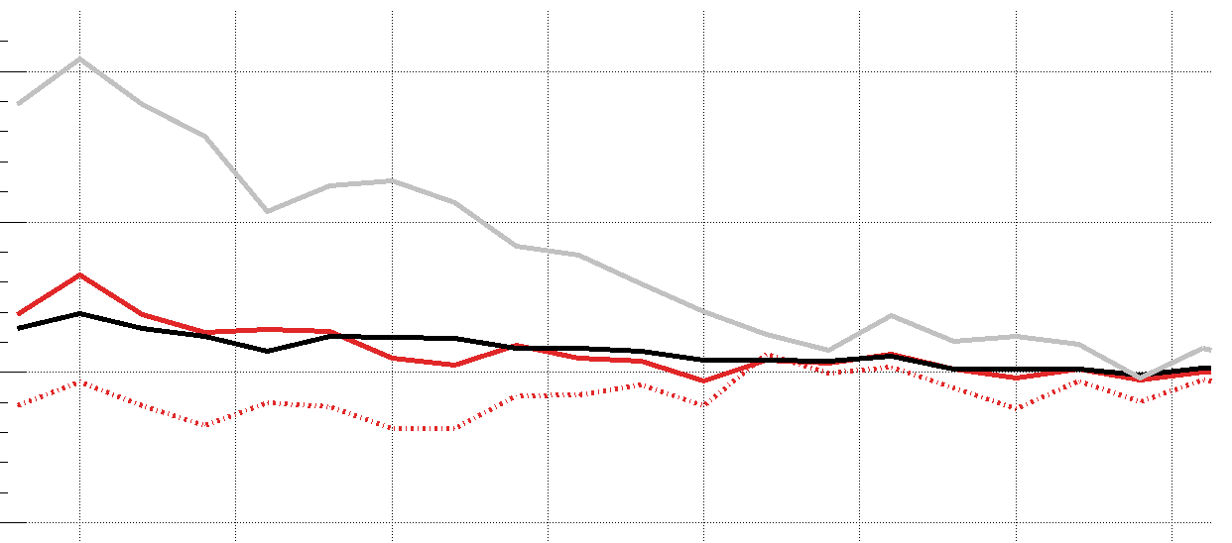
Methylation pattern associated with breakpoints mechanisms
Lower C>T in CpG around NAHR breakpoints
indicates lower methylation level in germline & embryonic cells
Confirmed in male gamete
+10%
6
1
TEI
NAHR
NH
CpG%
NAHR
C>T(all)
Hypomethylated regions in sperm
GC%
C>T(CpG)
-5%
0
700 Kbps
-10 0 10
Distance from breakpoints, Kbps
[Abyzov et al. (‘15) Nature Comm.]

Slide 13
Relevance to large-scale short read sequencing
US GSP (CCDG+CMG) & TopMed will sequence 1000s of genomes w. short reads
Useful to run these against a developed breakpoint library to find more SVs
Useful to characterize the SVs in terms of functional impact to find those most important to disease
particularly for CMG

Slide 14
AIM A - Fast identification of Breakpoints in Large Datasets
1
2
3
4
5
Build BP Library
Expand BP Library (EBPL)
Index EBPL
Efficiently Map reads to iEBPL
Call/Genotype SVs
Construction Phase
Execution Phase

Slide 15
AIM A - Fast identification of Breakpoints in Large Datasets
Indexing BPs and EBPs and "Fish" reads from FASTq pool
Extract BP and EBPs sequences
Exhaustively index the human genome and BP/EBPs sequences
Compare and exclude BP/EBPs indexes represented in the Ref Genome.
Hash from unique BP/EBPs sequences
Alternatively, we could create k-mers from sequences
It would be great if we could create an incremental index, so you can fish for different versions of the index
Release1 (20,000BP); Release2 (+5,000BP)
So one could run the pipeline efficiently for each release.
Pool FastQ files and quickly run through the BP hash
Selecting only reads that are evidence for SVs

Slide 16
AIM A - Fast identification of Breakpoints in Large Datasets
Break point Library / Extended Break Point Library
Create an integrated library of Break Points in the Human Genome
Sources of Break Points
BreakSeq
Population-wise calls (i.e. 1000G Phase1-3)
Break points based on Long Reads
HGSVC (3 Trios)
PacBio
Nanopore
GiaB
NA12878 + Family
Mobile Element Polymorphisms (MEI)
Processed Pseudogenes
NumT
Machine Learning to detect Breakpoint (abnormal reads)
Extend known Breakpoints to allow uncataloged gaps near known BPs

Slide 17
AIM A - Fast identification of Breakpoints in Large Datasets
Indexing BPs and EBPs and "Fish" reads from FASTq pool
At scale / Fast
Able to quickly genotype/call SVs from thousands of individuals
Cloud Aware (Spark, Hive)
Biased (sensitive) calling in fragile(?) regions of the genome
Make up breakpoints
Homolog regions prone to recomb
TEs facilitating recomb

Slide 18
Prioritizing SV by functional impact

Slide 19
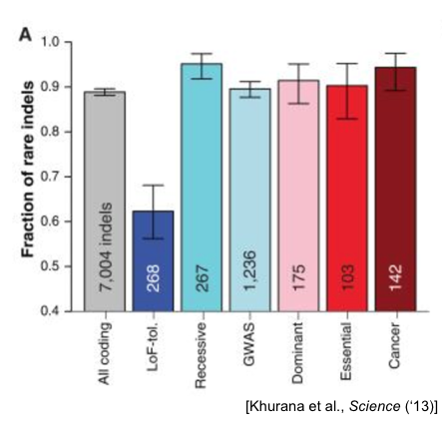
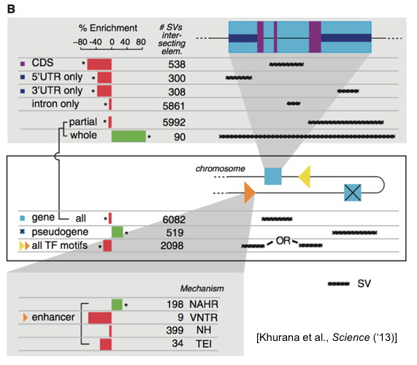
Indels and larger SVs show consistent patterns to SNPs
Functional annotations of indels and SVs. (A) Fraction of rare indels in coding-gene categories. Total number of indels shown. (B) Enrichment of SVs affecting functional annotations. Middle box shows genes, pseudogenes, and TF motifs; upper blow-out shows gene parts in different modes, and bottom blow-out shows enhancers with differ- ent formation mechanisms, i.e., NAHR, NH (nonhomol- ogous), TEI (transposable element insertion), and VNTR (variable number of tandem repeats). Asterisks indicate significant enrichment (green) or depletion (red) after multiple hypothesis correction. SVs intersecting various functional categories in different modes (e.g., whole/partial) are shown in the right-hand schematics.

Slide 20
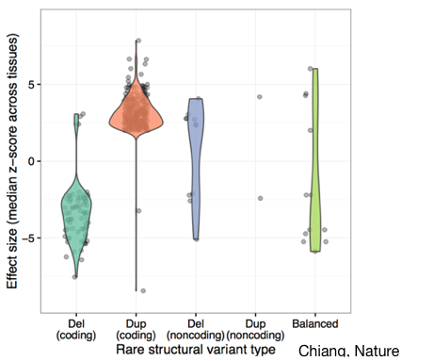
Tool for SV prioritization
Use personal genome to better quantify the impact of SV on gene expression
Integrate SV with SNP impact information measurements in the region (e.g. PolyPhen, SIFT), SV forming mechanism, as well as functional annotation, to help predict SV impact
Build machine learning algorithm to train on know data for SV impact score
Tool is potentially useful for CMG unsolved cases

Slide 22
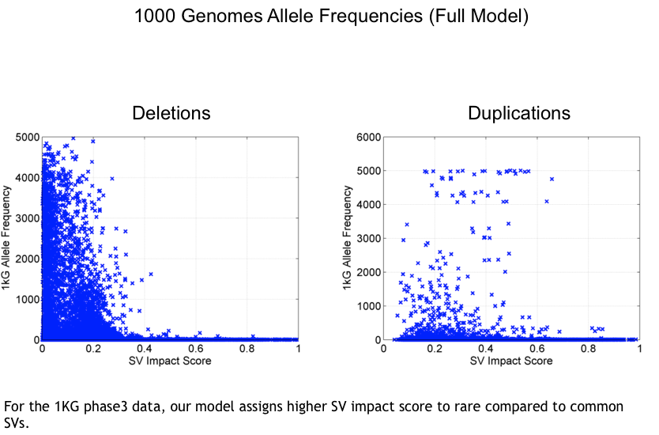

Slide 23
Uber SV slides
(HGSVC)

Slide 24
Integrative Annotation of Variants from 1092 Humans: Application to Cancer Genomics
Finding ultra-sensitive non-coding regions & disruptive mutations (eg motif breakers)
Using 1000G & ENCODE to characterize natural patterns of SNPs in regulatory elements
Finding similar but not identical patterns for indels & SVs
Also, annotation based on network connectivity
Prioritize hubs
Building a practical workflow & software tool for cancer genomes
Identifying drivers as somatic variants breaking natural patterns

Slide 25
Gene categories with known phenotypic effects
Decreasing tolerance to mutation
LoF-tol
Neutral
GWAS
HGMD
Essential
(common
disease-assoc.
variants)
(rare
disease-causing
variants)
Homozygous inactivation in at least one healthy 1000 Genomes individual
Weak selection constraints
Homozygous inactivation leads to clinical features of death before puberty or infertility
Very strong selection constraints
From MacArthur et al, Science, 2012
From Liao et al, PNAS, 2008
‹#›

Slide 26
Metrics for selection
Evolutionary conservation (GERP)
SNP density (confounded by mutation rate)
Depletion of common polymorphisms for regions under selection
Alternatively, negative selection restricts the allele frequency of deleterious mutations.
1
2
3
4
‘Conservation’
Typically defined by comparison across species
How do we define ‘sensitivity’ within human population?
a depletion of common variants/an enrichment of rare variants
‹#›

Slide 27
Enrichment of rare SNPs as a metric for Negative Selection
(rare=derived allele freq < 0.5%)
LOF-tol (Loss-of-function tolerant): least negative selection
Cancer: most selection
‹#›
[Khurana et al., Science (‘13)]

Slide 28
Negative selection in non-coding elements
Broad categories of regulatory regions under negative selection
Consistent with previous studies
ENCODE, Nature, 2012
Mu et al, NAR, 2011
(Non-coding RNA)
(DNase I hypersensitive sites)
(TFSS: Sequence-specific TFs)
(Transcription factor binding sites)
‹#›
[Khurana et al., Science (‘13)]

Slide 29
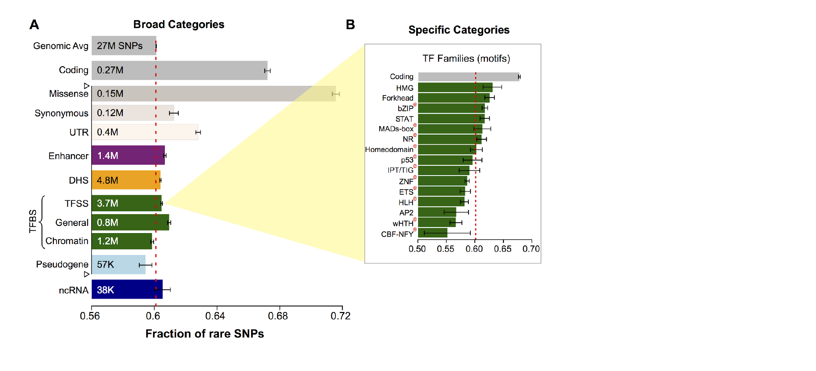
Differential selective constraints among sub-categories
[Khurana et al., Science (‘13)]

Slide 30
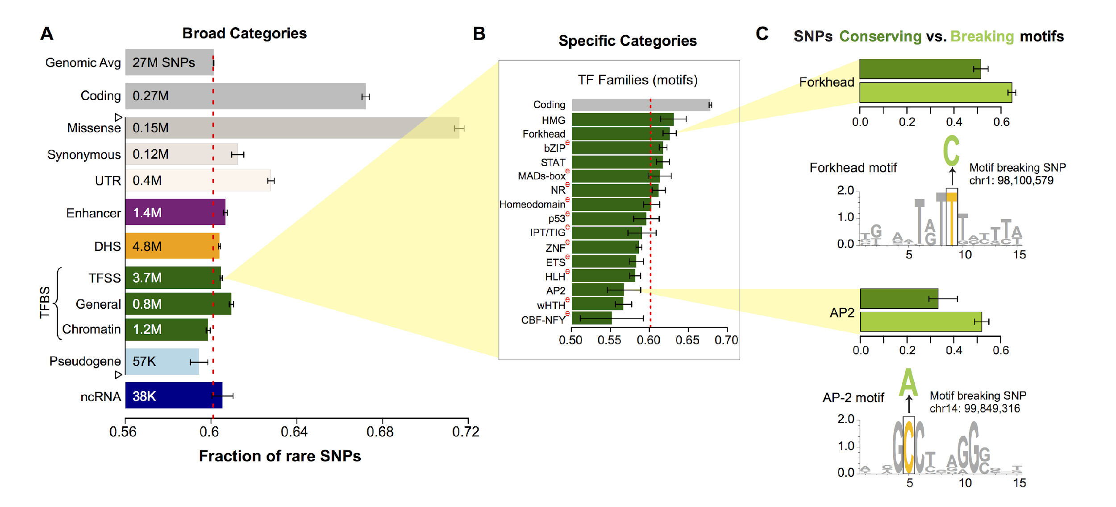
SNPs which break TF motifs are under stronger selection
[Khurana et al., Science (‘13)]

Slide 31
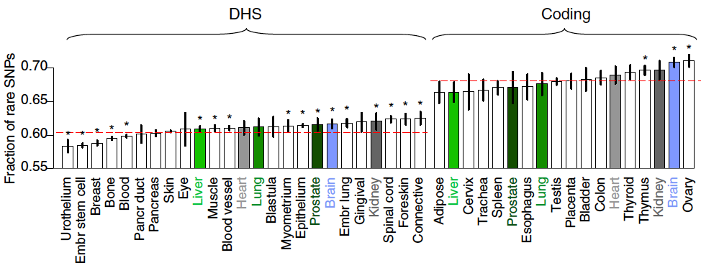
Negative selection and tissue-specificity of coding and non-coding regions
Ubiquitously expressed genes and bound regions show stronger selection
Differences in constraints amongst tissues
Constraints in coding genes and regulatory genes are correlated across tissues
‹#›
[Khurana et al., Science (‘13)]

Slide 32
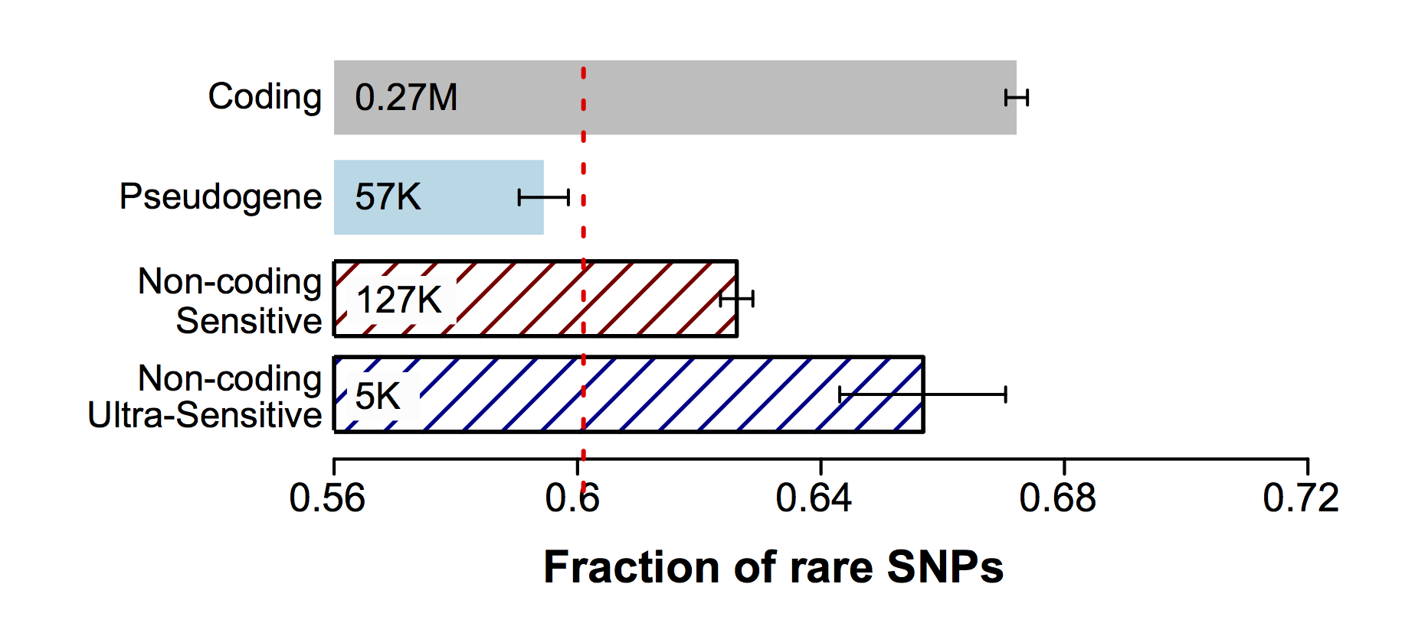
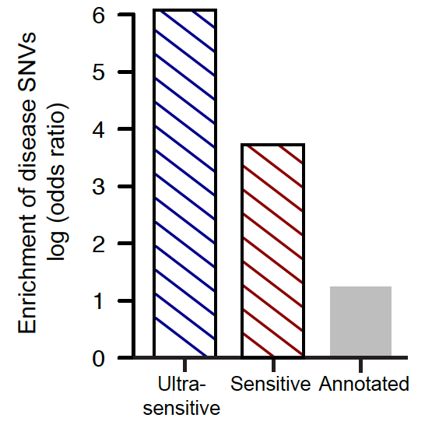
Can we identify which non-coding elements are under very strong “coding-like” selection ?
~0.4% genomic coverage (~ top 25)
~0.02% genomic coverage (top 5)
Start 677 high-resolution non-coding categories; Rank & find those under strongest selection
Binding peaks of some general TFs (eg FAM48A)
Core motifs of some TF families (eg JUN, GATA)
DHS sites in spinal cord and connective tissue
~400-fold
Enrichment of know disease-causing mutations from Human Gene Mutation database
~40-fold
[Khurana et al., Science (‘13)]

Slide 33
Integrative Annotation of Variants from 1092 Humans: Application to Cancer Genomics
Finding ultra-sensitive non-coding regions & disruptive mutations (eg motif breakers)
Using 1000G & ENCODE to characterize natural patterns of SNPs in regulatory elements
Finding similar but not identical patterns for indels & SVs
Also, annotation based on network connectivity
Prioritize hubs
Building a practical workflow & software tool for cancer genomes
Identifying drivers as somatic variants breaking natural patterns

Slide 34
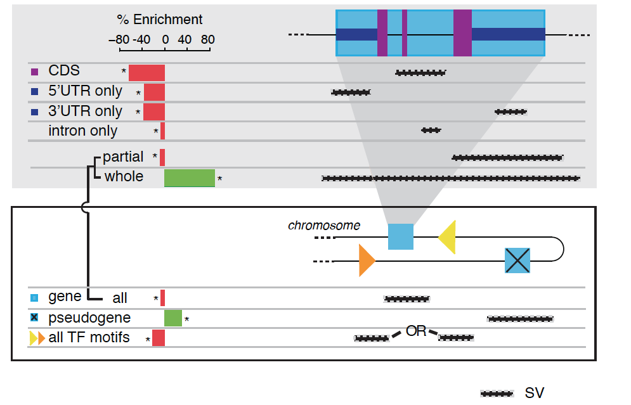
Indels and larger SVs show largely consistent patterns to SNPs
Indels
Structural variants are generally depleted for functional elements
‹#›
[Khurana et al., Science (‘13)]

Slide 35
Indels and larger SVs show largely consistent patterns to SNPs

Slide 36
TF binding sites have a complex relationship with SVs, depending on their mechanisms
NAHR: non-allelic homologous recombination
VNTR: variable number of tandem repeats NH: non-homologous events
TEI: transposable element insertions
TF: transcription factor
‹#›
Khurana et al, Science 2013

Slide 37
Human Genome Analysis – SVs & Pseudogenes, Tricky but Crucial Genomic Features, Targeted by Long-read Sequencing: Current Short-read Results & Future Prospects
SV Breakpoints
~9K deletions with breakpoints & mechanism classification from 1000G
Small subset of tot. deletions, which could be greatly expanded by long reads
More nearby SNPs than genomic average.
From methylation, Hi-C , & his mods, NAHR breakpoints associated with open chromatin (perhaps occurring w/o replication & division)
NHR breakpoints associated w/ sequence microinsertions, templated from later replicating sites, spaced at 2 characteristic distances
Pseudogenes
Fundamentally repetitive elements
Collaborative assignment in results in ~14K
Impact of lineage-specific retro-transpositional burst – ie human v other metazoans is dominated (~80%) by retro-duplication ~40 MYA (Ribo. Proteins).
Intersection of Pseudogenes & SVs
Enrichment of SVs in pseudogenes v genes, particularly for NAHR
Novel Processed Pseudogenes as a Form of SV
Not in reference but in human population – could be improved by long reads
Now found w/ splice junction mapping + clustering of unmapped PEs
~8 per person, often pop. specific
Associated w/ G1/M expressed genes
Many Pseudogenes with Low Levels of Biochemical Activity
Conservative assignment, mis-map issue, could be improved by long reads
~15% transcribed & 80% w/ some activity

Slide 38
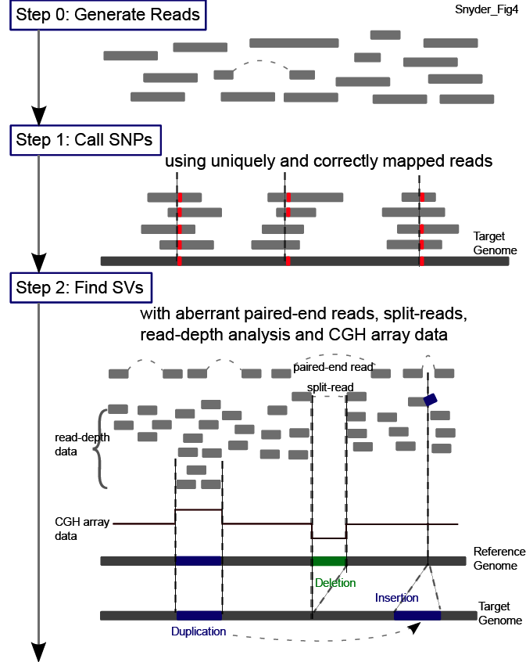
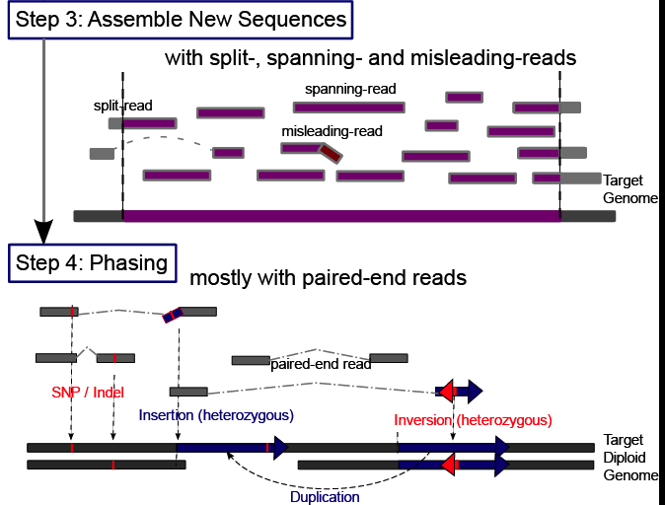
Main Steps in Genome Resequencing
[Snyder et al. Genes & Dev. ('10)]

Slide 39
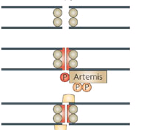
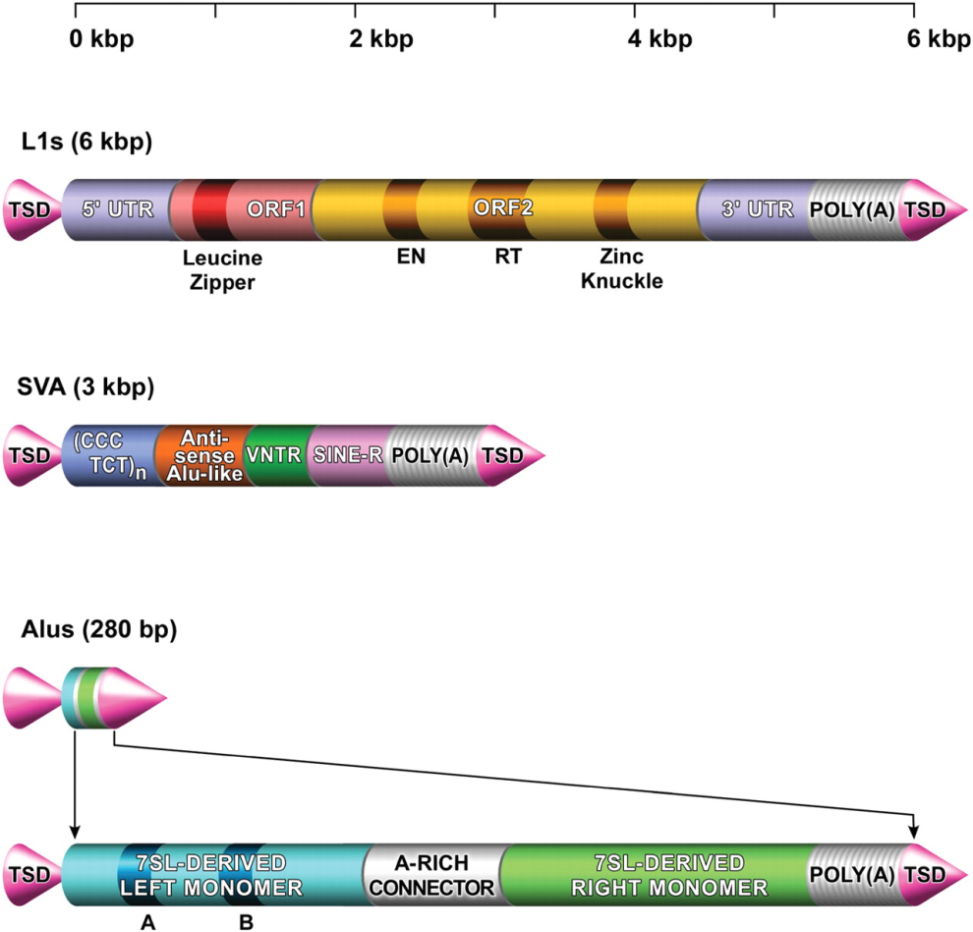
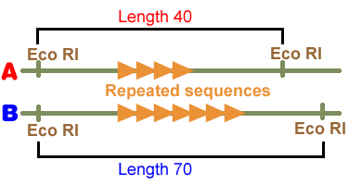
4 mechanisms for SV formation
NAHR (Non-allelic homologous recombination)
Flanking repeat (e.g. Alu, LINE…)
NHEJ (NHR) (Non-homologous-end-joining)
No (flanking) repeats. In some cases <4bp microhomologies
TEI
(Transposable element insertion)
L1, SVA, Alus
VNTR
(Variable Number Tandem Repeats)
Number of repeats varies between different people
Notes:
So how did they arise? There are couple proposed mechanisms.
NAHR is one of the major mechanisms which involves non-allelic homologous recombination between highly identical sequences.

Slide 40
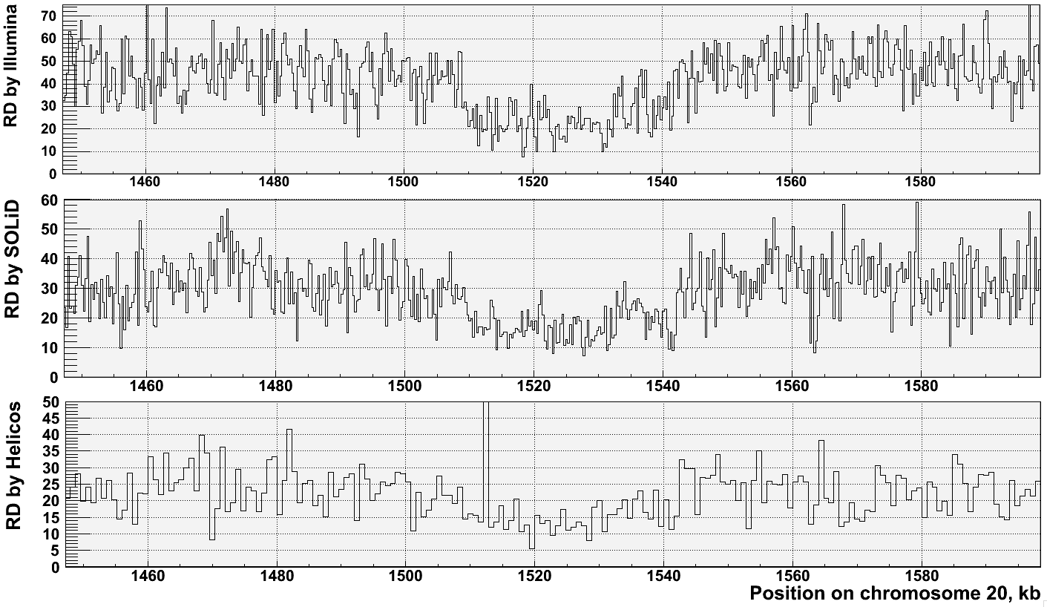
Read-depth works well on a variety of sequencing platforms but provides imprecise breakpoints
[Abyzov et al. Gen. Res. (’11)]
[NA18505]

Slide 41
1000G SV (Pilot, Phase I & III)
Many different callers compared & used
including SRiC & CNVnator but also VariationHunter, Cortex, NovelSeq, PEMer, BreakDancer, Mosaik, Pindel, GenomeSTRiP, mrFast….
Merging
Genotyping (GenomeSTRiP)
Breakpoint assembly (AGE & Tigra_SV)
Mechanism Classification
[1000 Genomes Consortium, Nature (2010, 2012); Mills et al., Nature (2011)]

Slide 42
8,943 Deletion Breakpoints (Phase I Refined)
42K deletions in official Phase 1 release
~20% w/ breakpt
Breakpoint FDR from IRS, PCR, and high-coverage trios
~7% for site existence
13% for site existence + sequence precision
Data for 1,092 samples
Multiple CNV callers
Call merging
Breakpoint assembly
Mapping to junctions

Slide 43
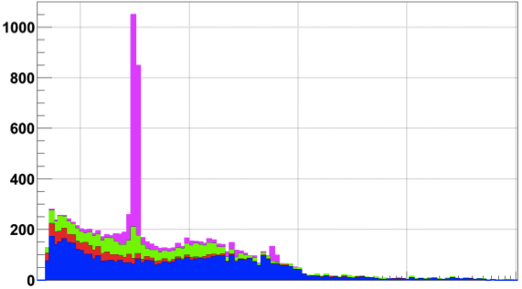
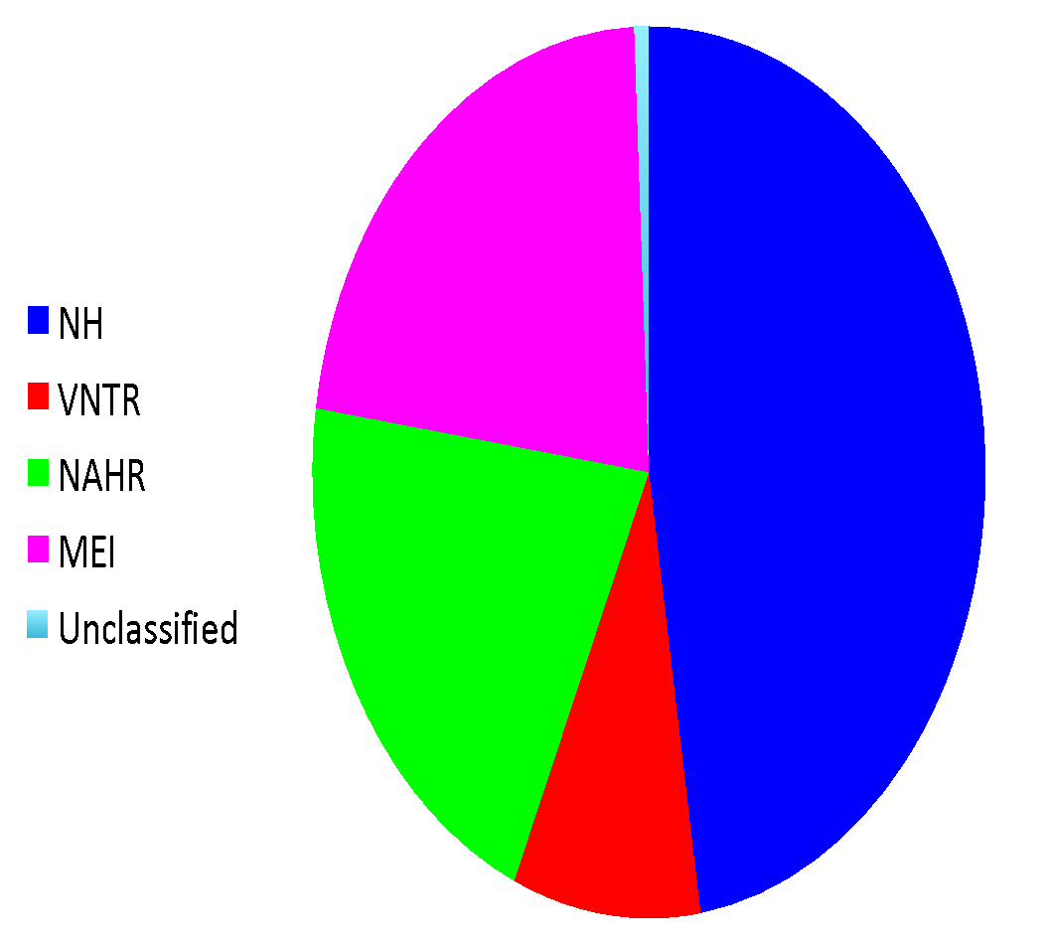
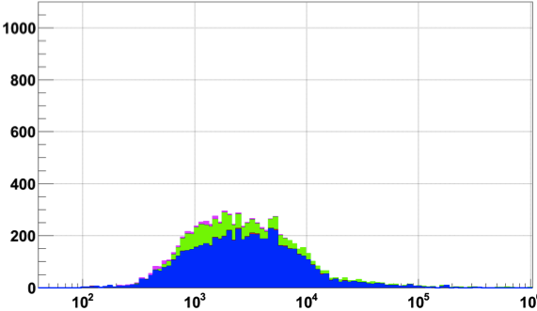
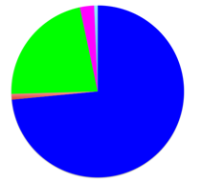
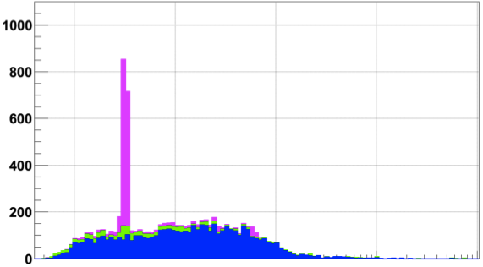
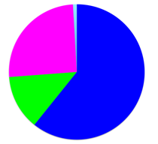
Breakpoint characterization in 1000G
Breakseq #1 w/ ~2000 breakpoints [Lam et al. Nat. Biotech. (‘10)]
Pilot
Phase 1 “Integrated” & Phase 1 refined
Phase 3
Pilot set
Integrated set
TEI
NAHR
NH
VNTR
2,839
(2,644)
6,104
(6,299)
23,850
(23,655)
Phase 1
Count of deletions
Refined
Phase 1
Phase 3
Exact match
Number in parentheses: >50% reciprocal match
[Abyzov et al. (‘15) Nature Comm.]
Notes:
2839 unique Phase 1 events were b/c Phase 3 did assembly of only large events

Slide 44
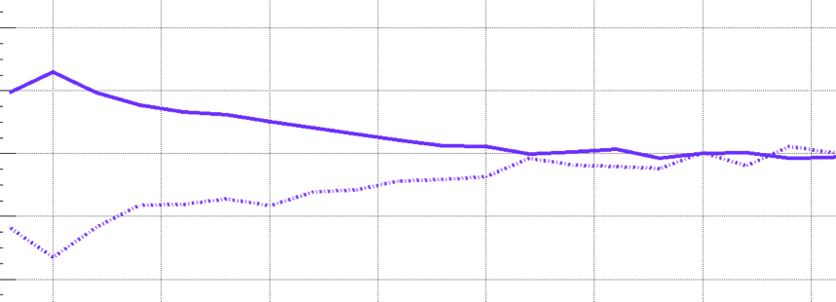
Higher SNP Density and Relaxed Selection at NH Breakpoints
+4%
NH
SNP density
-4%
Conservation score
0
700 Kbps
[Abyzov et al. (‘15) Nature Comm.]
Notes:
SNP density at NAHR bkpts is driven by excessive C>T
A consequence of high CpG%

Slide 45
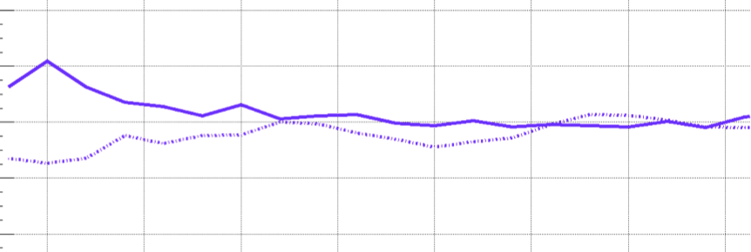
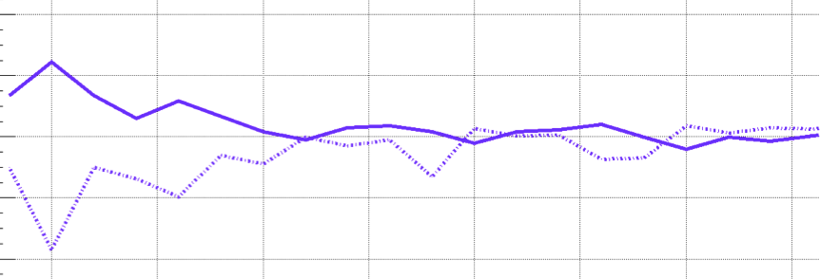
Higher SNP Density and Relaxed Selection at all Breakpoints
+4%
NH
SNP density
-4%
Conservation score
+4%
TEI
-4%
+4%
NAHR
-4%
0
700 Kbps
[Abyzov et al. (‘15) Nature Comm.]
Notes:
SNP density at NAHR bkpts is driven by excessive C>T
A consequence of high CpG%

Slide 46
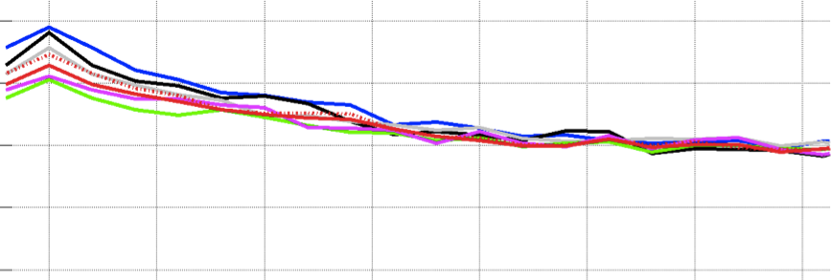
SNP Density at NAHR is Driven by High C>T
C>A C>G C>T
T>A T>C T>G
C>T outside CpG
+4%
NH
SNP density
-4%
Conservation score
+4%
TEI
-4%
+4%
NAHR
-4%
0
700 Kbps
[Abyzov et al. (‘15) Nature Comm.]
Notes:
SNP density at NAHR bkpts is driven by excessive C>T
A consequence of high CpG%

Slide 47
Micro-homologies Identified around NH Breakpoints
Breakpoints have Micro-homologous sequences with the template sites.
[Abyzov et al. (‘15) Nature Comm.]

Slide 48
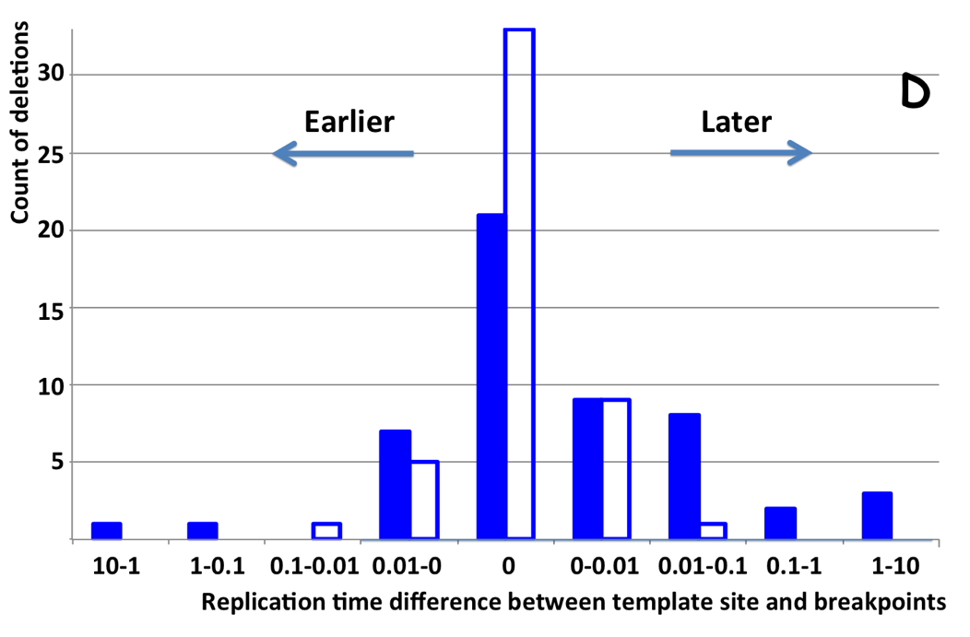
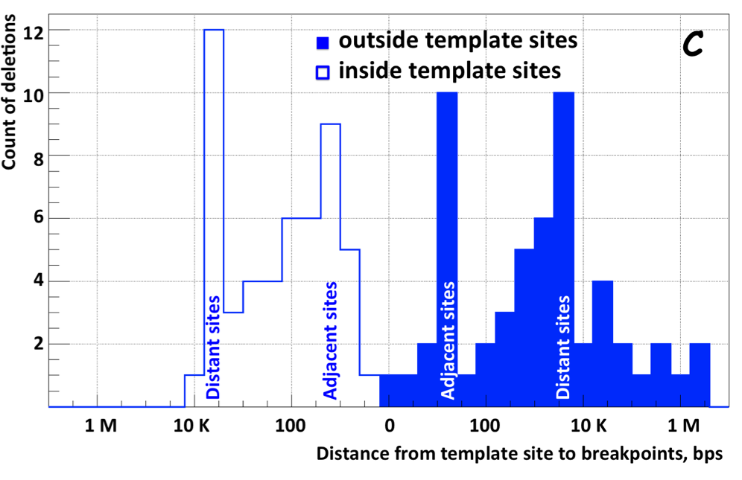
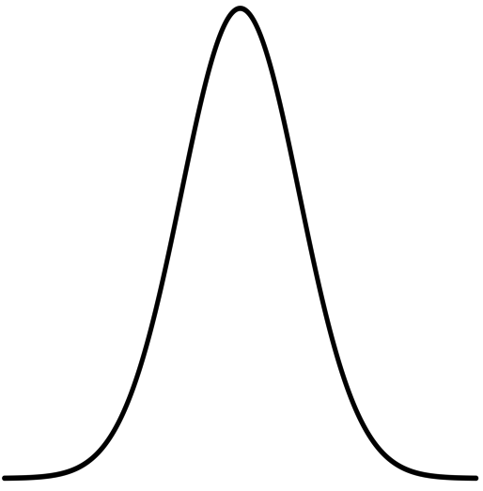
NH deletions are often coupled with micro-insertions
Templates located at 2 characteristic distances from breakpoints, which tend to replicate late
Suggests spatial & temporal configuration of DNA during template switching
[Abyzov et al. (‘15) Nature Comm.]

Slide 49
Trying to Annotate the Genome Comparatively & Functionally, in terms of Variable Blocks & Networks
Annotation via Large-scale Identification of Variable Blocks in the Population
Methods
Read-depth: MSB+CNVnator
Breakpoints & Split Read: SRiC, AGE & BreakSeq
Applications : 1000G & Somatic Variation
A Networks View on Large-scale Organization of Genomic Elements
Understanding the human regulatory network as a hierarchy with information flow bottlenecks
Understanding the impact of variation and constraint on the network
Particularly with network analogies

Slide 50
Main Steps in Genome Resequencing
[Snyder et al. Genes & Dev. ('10)]

Slide 51
Methods to Find SVs
1. Paired ends
Deletion
Reference
Mapping
Genome
Sequenced paired-ends
Reference
2. Split read
3. Read depth (or aCGH)
Deletion
Deletion
Reference
Reference
Genome
Genome
Read
Reads
Mapping
Mapping
Read count
Reference
Zero level
4. Local Reassembly
[Snyder et al. Genes & Dev. ('10)]

Slide 52
Different Approaches Work Differently on Different Events
[Zhang et al. ('11) BMC Genomics]

Slide 53
Trying to Annotate the Genome Comparatively & Functionally, in terms of Variable Blocks & Networks
Annotation via Large-scale Identification of Variable Blocks in the Population
Methods
Read-depth: MSB+CNVnator
Breakpoints & Split Read: SRiC, AGE & BreakSeq
Applications : 1000G & Somatic Variation
A Networks View on Large-scale Organization of Genomic Elements
Understanding the human regulatory network as a hierarchy with information flow bottlenecks
Understanding the impact of variation and constraint on the network
Particularly with network analogies

Slide 54
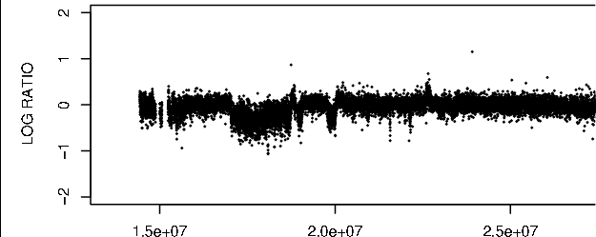
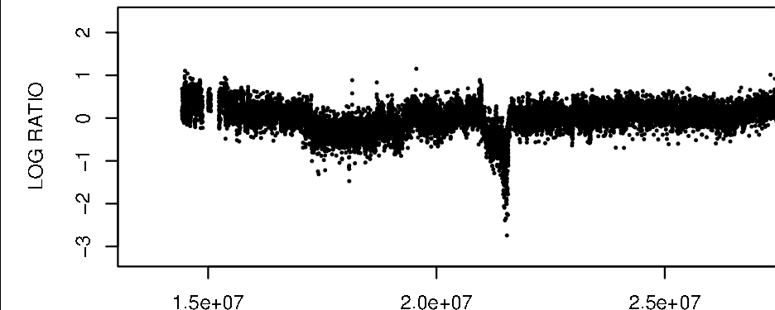
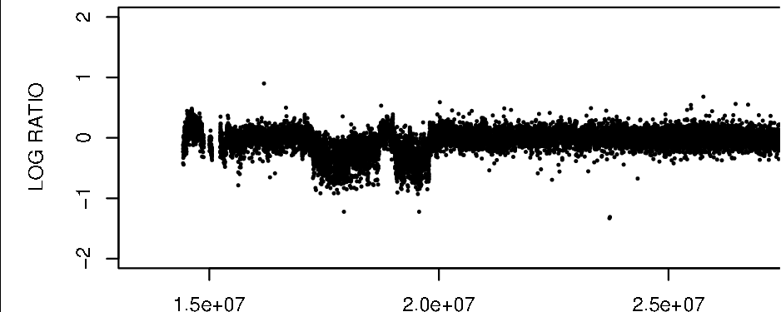
Array Signal Read depth
Patient 98-135
Individual genome
Patient 99-199
Reads
Mapping
Patient 97-237
Reference genome
[Urban et al. ('06) PNAS; Wang et al. Gen. Res. ('09); Abyzov et al. Gen. Res. (’11)]
Counting mapped reads
Read depth signal
LCR A B C D
Zero level

Slide 55
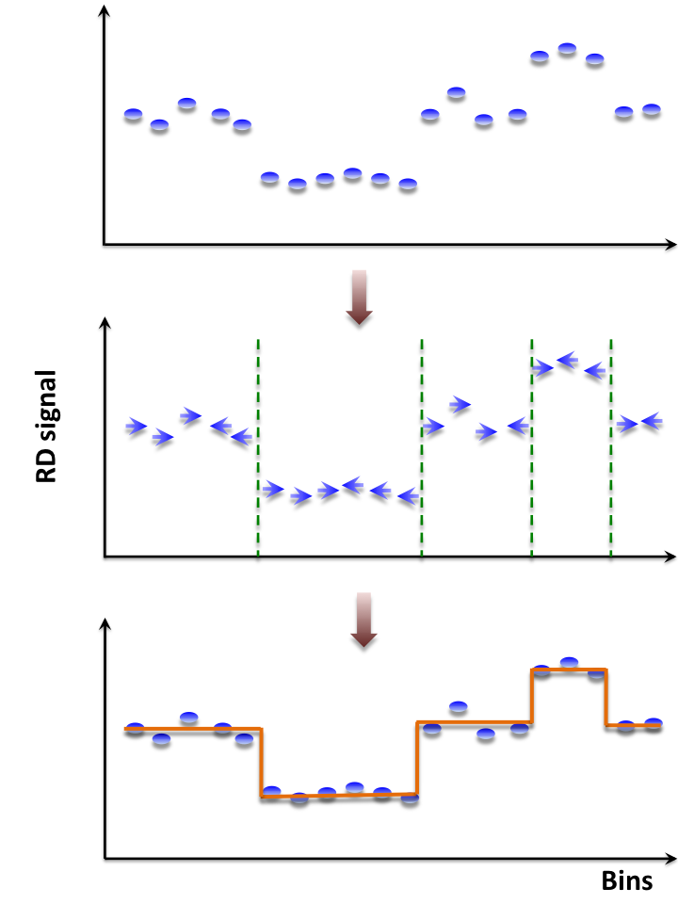
Mean-shift-based (MSB) segmentation: no explicit model
CNVnator
For each bin attraction (mean-shift) vector points in the direction of bins with most similar RD signal
No prior assumptions about number, sizes, haplotype, frequency and density of CNV regions
Not Model-based (e.g. like HMM) with global optimization, distr. assumption & parms. (e.g. num. of segments).
Achieves discontinuity-preserving smoothing
Derived from image-processing applications
[Abyzov et al. Gen. Res. (’11)]

Slide 56
Intuitive Description of MSB
Observed depth of coverage counts as samples from PDF
Kernel-based approach to estimate local gradient of PDF
Iteratively follow grad to determine local modes
Region of
interest
Center of
mass
[ Adapted from S Ullman et al. "Advanced Topics in Computer Vision," www.wisdom.weizmann.ac.il/~vision/courses/2004_2 ]
Mean Shift
vector
Objective : Find the densest region
Distribution of identical billiard balls

Slide 57
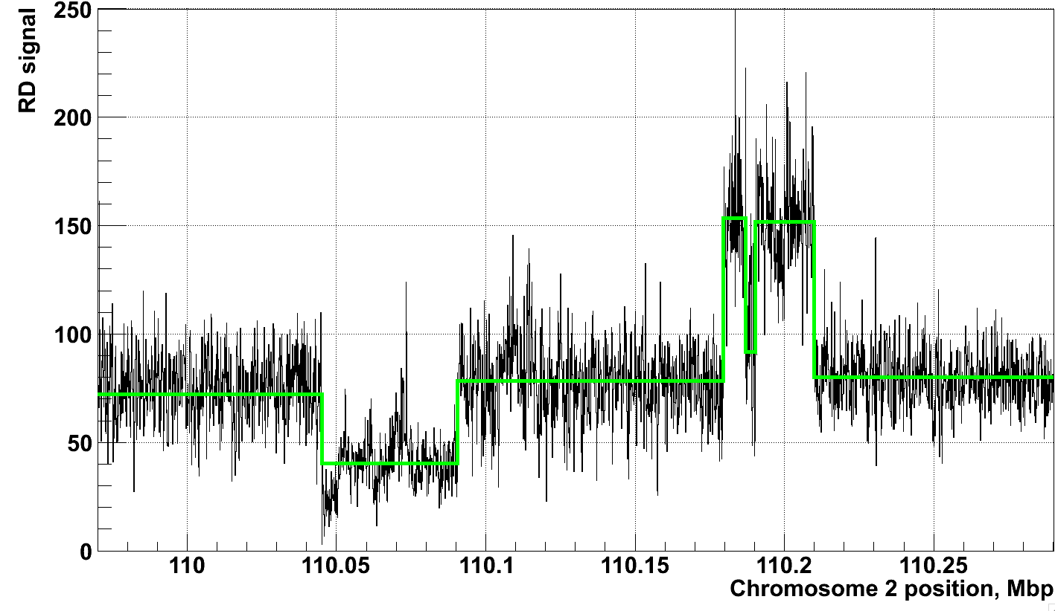
Example of Application of CNVnator to RD data
[Abyzov et al. Gen. Res. (’11)]
NA12878, Solexa 36 bp paired reads, ~30x coverage

Slide 58
Trying to Annotate the Genome Comparatively & Functionally, in terms of Variable Blocks & Networks
Annotation via Large-scale Identification of Variable Blocks in the Population
Methods
Read-depth: MSB+CNVnator
Breakpoints & Split Read: SRiC, AGE & BreakSeq
Applications : 1000G & Somatic Variation
A Networks View on Large-scale Organization of Genomic Elements
Understanding the human regulatory network as a hierarchy with information flow bottlenecks
Understanding the impact of variation and constraint on the network
Particularly with network analogies

Slide 59
1000G Pilot & Phase I
Many different callers compared & used (including SRiC & CNVnator but also VariationHunter, Cortex, NovelSeq,, PEMer, BreakDancer, Mosaik, Pindel, GenomeSTRiP, mrFast….)
AGE (& Tigra_SV) for precise breakpoints on the resulting SVs
BreakSeq Mechanism classification
GenomeSTRiP genotyping
[1000 Genomes Consortium, Nature (2010, 2012); Mills et al., Nature (2011)]

Slide 60
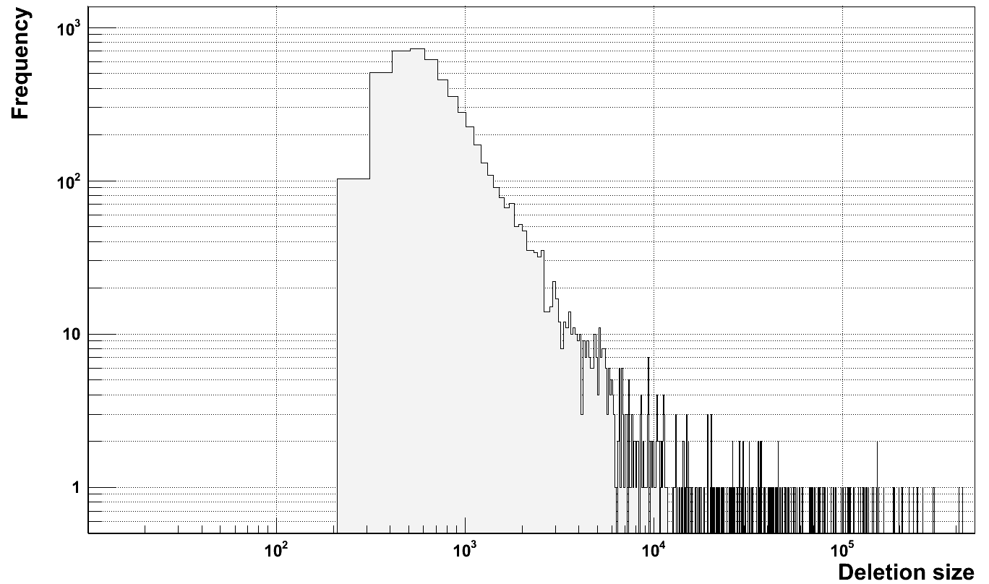
Deletion Size Distribution
NA12878, Solexa 36 bp paired reads, ~30x coverage
[Abyzov et al. Gen. Res. (’11); Mills et al. Nature (2011)]
Uniformly Determined Deletion Size Distribution in a High Coverage Individual vs. Overall Distribution in Pilot 1 (~180 low cov. individuals)

Slide 61
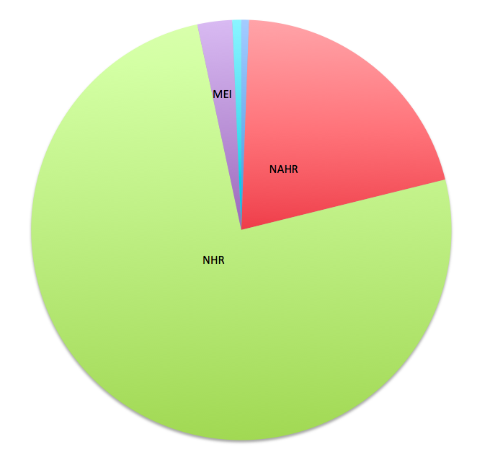
Summary of Mechanism Classification of ~8900 Deletion Breakpoints in 1000G Phase I
[1000 Genomes Consortium, Nature (2012)]

Slide 62
Breakpoint Features Analysis
SVs vs. Telomeres
Breakpoints
[Lam et al., ('10) Nat. Biotech.]

Slide 63
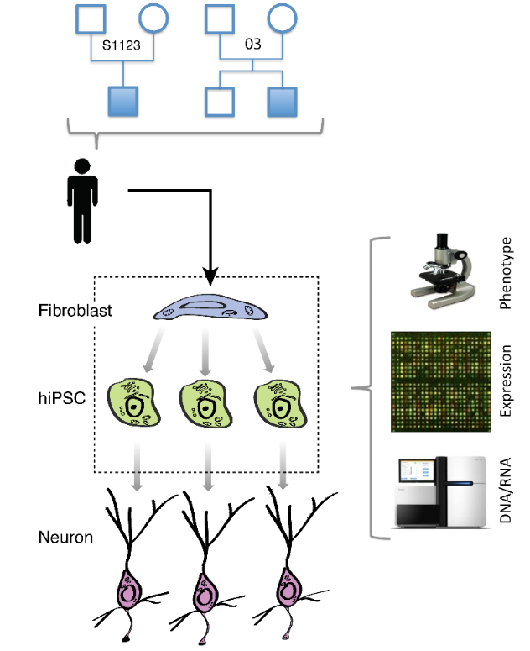
Does reprogramming of human somatic cells into iPSC (hiPSC) cause de novo CNVs?
- autism
7 individuals, 21 hiPSC lines
Few previous studies reported de novo CNVs in hiPSC
Is the hiPSC genome stable during reprogramming?
What is the cause/origin of hiPSC line manifested CNVs (LM-CNVs)?
Data (one HiSeq lane per hiPSC and fibroblast):
Poly-A RNAseq
Whole genome DNAseq
Simons Foundation Partial Funding
Abyzov et al., Nature, Nov 18 (online)
‹#›

Slide 64
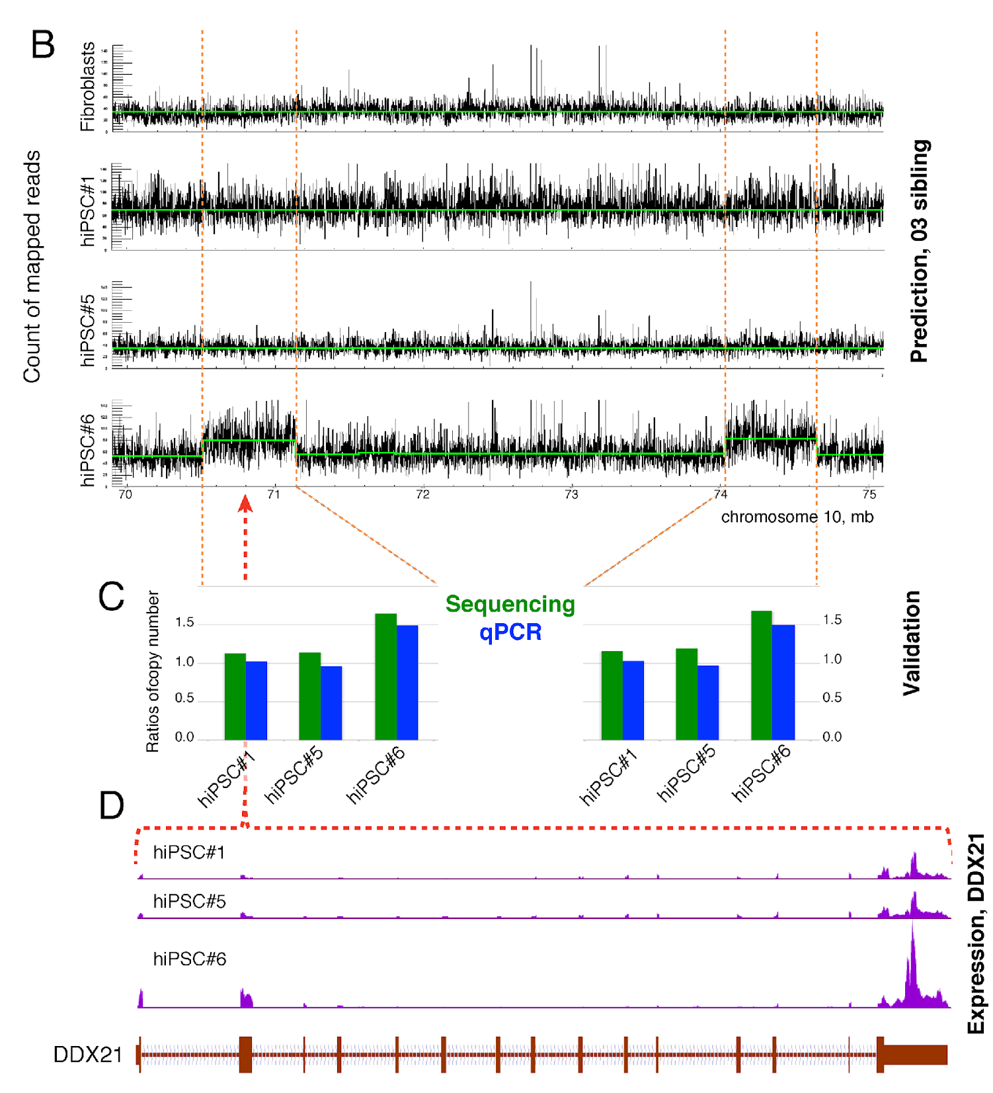
Example of line manifested CNV (LM-CNV)
One lane of genomic DNA sequencing reads by Illumina HiSeq
(2 x 100 nt) at ~10x coverage
Abyzov et al., Nature, Nov 18 (online)
Gene in duplication has increased expression
‹#›

Slide 65
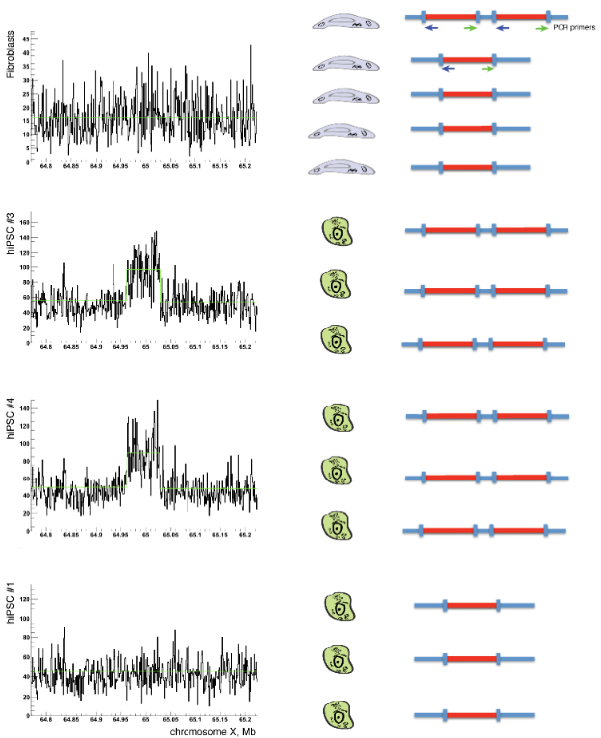
Hypothesis about somatic CNVs
Somatic CNVs present in few fibroblast cells (i.e., at low allele frequency) give rise to hiPSC, as those are derived from a single (or just a few) fibroblast cell
Equal DNA input
hiPSC #3 hiPSC #4 Fibroblast Control
Excess of DNA input from fibroblast
hiPSC #3 hiPSC #4 Fibroblast Control
Abyzov et al., Nature, Nov 18 (online)
‹#›

Slide 66
Previous slides

Slide 67
The BreakSeq Project
Nucleotide-resolution analysis of structural variants using BreakSeq and a breakpoint library
Mark Gerstein

Slide 68
Overview
Introduction
SV, event type, and formation mechanism
The BreakSeq Analysis
Analysis of SVs using a breakpoint library
The BreakSeq Pipeline
The SV Annotation and Identification Pipeline
[Lam et al. Nat. Biotech. ('10)]

Slide 69
SV Event Type
Deletion Event
Reference
Deletion
Query
Breakpoint
Insertion Event
Reference
Query
Insertion

Slide 70
SV formation mechanism
Non-Allelic Homologous Recombination (NAHR)
Non-homologous Recombination(NHR)
Non-homologous end joining (NHEJ)
Fork Stalling and Template Switching (FoSTeS)
Transposable Element Insertion (TEI)
Variable Number of Tandem Repeats (VNTR)

Slide 71
Some Issues
Limited resolution of recent SV surveys (e.g., microarray based)
Prevented from intersecting with exons of genes or analyzing gene fusion events.
Prevented systematic deduction of the SV formation process.
Prevented from inferring the ancestral states of the SV events.
Prevented estimation of the physical properties of the SVs.

Slide 72
THE BREAKSEQ ANALYSIS
Analysis of SVs using a breakpoint library
Lam HY, Mu XJ, Stütz AM, Tanzer A, Cayting PD, Snyder M, Kim PM, Korbel JO, Gerstein MB. “Nucleotide-resolution analysis of structural variants using BreakSeq and a breakpoint library”. Nature Biotechnology 2010 Jan;28(1):47-55.

Slide 73
SV Breakpoint Library
[Lam et al. Nat. Biotech. ('10)]

Slide 74
Mechanism Classification
NAHR
Deletion
Highly similar with minor offset
Deletion
Single RETRO
Repeat Element
Multiple RETRO
RE1
RE2
[Lam et al. Nat. Biotech. ('10)]

Slide 75
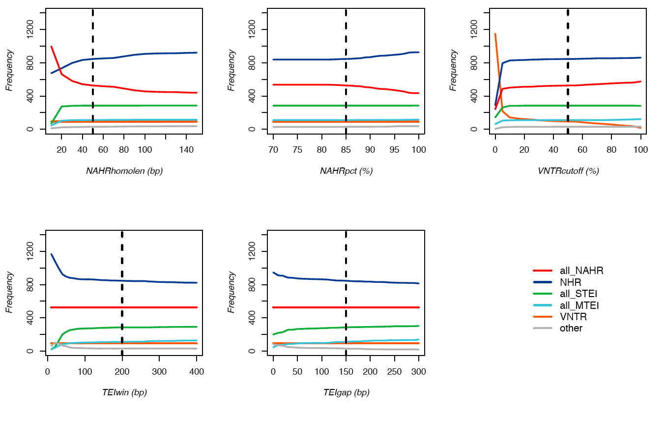
Sensitivity analysis of the classification pipeline
[Lam et al. Nat. Biotech. ('10)]
x-axis is the parameter space. y-axis is the number of SVs of different formation mechanisms classified by the pipeline using corresponding value of the varied parameter and default values of other parameters. Dotted vertical lines indicate the default parameters.
‹#›

Slide 76
SV Formation Analysis
[Lam et al. Nat. Biotech. ('10)]

Slide 77
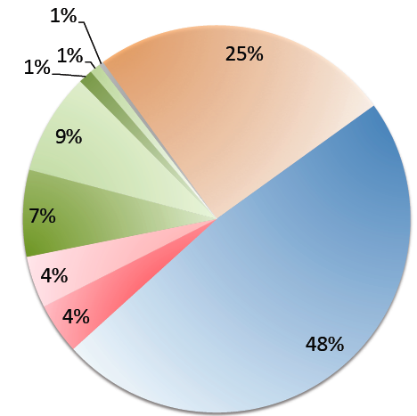
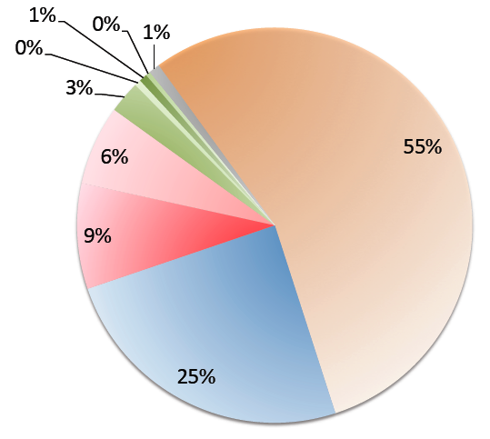
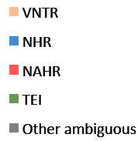
Formation mechanisms of SVs identified in the 1000 genomes project: split reads
(MTEI + STEI)
16128 Yale SR from Zhengdong Zhang, NA12878, Aug 2009 version, >=200bp
4285 Yale SR from Zhengdong Zhang, NA12878, Aug 2009 version, >=1kb

Slide 78
Active L1 Transposition
431 fully rectifiables overlapped with 147 Active L1s by Mills et al. 2007 consolidated from Brouha et al. 2003 and Mills et al. 2006
Chr | Source | Event | Start | End | Size | Mech | Active L1 | Supported
chr1 | Korbel | Insertion | 84290516 | 84297219 | 6703 | Mech "MTEI"; Rectified "2:2:2" | chr1:84290591-84296677['L1HS', 'Ta-1d'] | 2
chr1 | Korbel | Insertion | 245917096 | 245923148 | 6052 | Mech "STEI"; Rectified "2:2:2" | chr1:245917098-245923129['L1HS', 'Ta-0'] | 3
chr10 | Korbel | Insertion | 5277306 | 5283354 | 6048 | Mech "UNSURE"; Rectified "2:2:2" | chr10:5277317-5283348['L1HS', 'Ta-1dn(g)'] | 1
chr11 | Korbel | Insertion | 24306070 | 24312135 | 6065 | Mech "STEI"; Rectified "2:2:2" | chr11:24306073-24312103['L1HS', 'Ta-1d'] | 1
chr11 | Korbel | Deletion | 92791150 | 92800593 | 9443 | Mech "NAHR"; Rectified "1:1:1" | chr11:92793800-92799845['L1HS', 'Ta-1d'] | 1
chr11 | Venter | Insertion | 92793799 | 92799859 | 6060 | Mech "STEI"; Rectified "2:2:2" | chr11:92793800-92799845['L1HS', 'Ta-1d'] | 1
chr11 | Watson | Insertion | 94809017 | 94815068 | 6051 | Mech "UNSURE"; Rectified "2:2:2" | chr11:94809028-94815058['L1HS', 'Ta-1d'] | 1
chr15 | Venter | Insertion | 53005523 | 53011731 | 6208 | Mech "MTEI"; Rectified "2:2:2" | chr15:53005558-53011589['L1HS', 'Ta-0'] | 3
chr15 | Kim | Insertion | 68808908 | 68814562 | 5654 | Mech "MTEI"; Rectified "2:2:2" | chr15:68809138-68814556['L1HS', 'L1HS'] | 2
chr18 | Korbel | Insertion | 46124318 | 46130363 | 6045 | Mech "STEI"; Rectified "2:2:2" | chr18:46124336-46130355['L1HS', 'Pre-Ta (ACG/G)'] | 1
chr2 | Venter | Insertion | 176054929 | 176060981 | 6052 | Mech "STEI"; Rectified "2:2:2" | chr2:176054939-176060968['L1HS', 'Ta-1d'] | 1
chr20 | Venter | Insertion | 7044794 | 7050858 | 6064 | Mech "STEI"; Rectified "2:2:2" | chr20:7044828-7050846['L1HS', 'Ta-0'] | 4
chr4 | Watson | Insertion | 59627149 | 59633191 | 6042 | Mech "UNSURE"; Rectified "2:2:2" | chr4:59627160-59633190['L1HS', 'L1HS'] | 1
chr5 | Venter | Insertion | 57715759 | 57721867 | 6108 | Mech "STEI"; Rectified "2:2:2" | chr5:57715758-57721790['L1HS', 'Ta-0'] | 3
chr5 | Venter | Insertion | 103882188 | 103888239 | 6051 | Mech "STEI"; Rectified "2:2:2" | chr5:103882187-103888216['L1HS', 'Ta-1d'] | 3
chr5 | Watson | Insertion | 108622973 | 108629020 | 6047 | Mech "UNSURE"; Rectified "2:2:2" | chr5:108622987-108629018['L1HS', 'Ta-1d'] | 1
chr6 | Venter | Insertion | 133383514 | 133389578 | 6064 | Mech "STEI"; Rectified "2:2:2" | chr6:133383548-133389578['L1HS', 'Ta-1d'] | 3
chr7 | Venter | Insertion | 113203413 | 113209458 | 6045 | Mech "STEI"; Rectified "2:2:2" | chr7:113203413-113209443['L1HS', 'Ta-1d'] | 4
chr8 | Venter | Insertion | 73950330 | 73956387 | 6057 | Mech "STEI"; Rectified "2:2:2" | chr8:73950346-73956377['L1HS', 'Ta-1d'] | 4
chr8 | Venter | Insertion | 126664312 | 126670324 | 6012 | Mech "STEI"; Rectified "2:2:2" | chr8:126664312-126670315['L1HS', 'Ta-1d'] | 5
chr8 | Korbel | Insertion | 135152107 | 135158208 | 6101 | Mech "STEI"; Rectified "2:2:2" | chr8:135152168-135158198['L1HS', 'L1HS'] | 3
chrX | Venter | Insertion | 11863121 | 11869370 | 6249 | Mech "STEI"; Rectified "2:2:2" | chrX:11863128-11869354['L1HS', 'Ta-1d'] | 2
chrX | Venter | Insertion | 95199436 | 95205519 | 6083 | Mech "STEI"; Rectified "2:2:2" | chrX:95199466-95205497['L1HS', 'Ta-0'] | 1
‹#›
[Lam et al. Nat. Biotech. ('10)]

Slide 79
Active L1 Transposition Example
‹#›

Slide 80
Pseudogene Number Variation
431 fully rectifiables overlapped with 13,453 duplicated and processed pseudogenes identified by PseudoPipe based on Ensembl 48
Chr | Source | Event | Start | End | Size | Mech | Pgene Type
chr10 | Kidd | Deletion | 100678090 | 100692331 | 14241 | Mech "NAHR"; Rectified "1:1:1" | PSSD
chr12 | Venter | Deletion | 22467006 | 22473645 | 6639 | Mech "NAHR"; Rectified "1:1:1" | PSSD
chr17 | Kidd | Deletion | 65603123 | 65859003 | 255880 | Mech "NHR"; Rectified "1:1:1" | PSSD
chr20 | Kidd | Deletion | 1503149 | 1536176 | 33027 | Mech "NAHR"; Rectified "1:1:1" | PSSD
chr3 | Korbel | Deletion | 74230280 | 74237487 | 7207 | Mech "NHR"; Rectified "1:1:1" | PSSD
chr5 | Watson | Deletion | 64538468 | 64548395 | 9927 | Mech "NHR"; Rectified "1:1:1" | DUP
chr5 | Kidd | Insertion | 69544715 | 69817387 | 272672 | Mech "NAHR"; Rectified "2:2:2" | DUP/PSSD
chrX | Kidd | Deletion | 47752047 | 47874915 | 122868 | Mech "NAHR"; Rectified "1:1:1" | PSSD
‹#›

Slide 81
Aligning to Ancestral Genome
Deletion Rectification:
A
C
B
syn
syn
syn
Chimp
Different state
Chimp
Same state
[Lam et al. Nat. Biotech. ('10)]

Slide 82
Aligning to Ancestral Genome
Insertion Rectification:
A
C
B
syn
syn
syn
Chimp
Same state
Chimp
Different state
[Lam et al. Nat. Biotech. ('10)]

Slide 83
SV Ancestral State Analysis
[Lam et al. Nat. Biotech. ('10)]

Slide 84
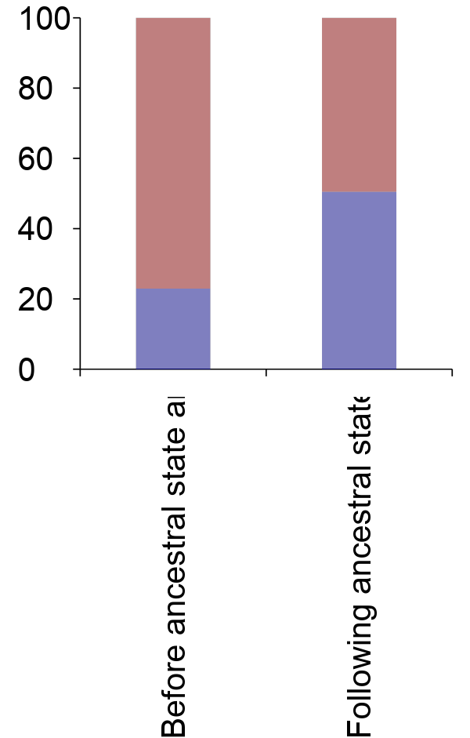
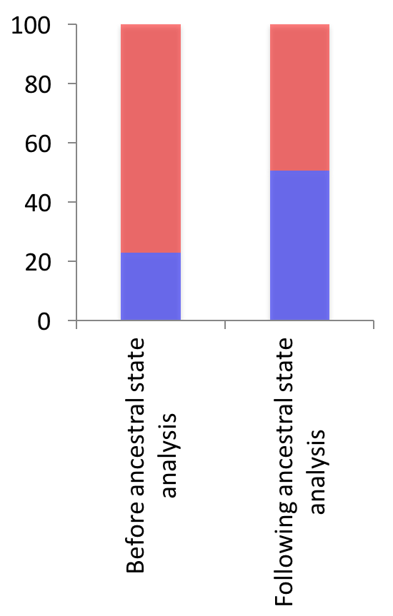
Ancestral state analysis reveals balance of insertions and deletions, and biases in formation mechanisms
208
1409
212
419
Insertion
Deletion
[Lam et al. Nat. Biotech. ('10)]

Slide 85
Tracing the origin of recent human insertions
NHR- / RT-based
insertions are mostly inter- chromosomal
NAHR-based insertions involve nearby
sequences
[Lam et al. Nat. Biotech. ('10)]

Slide 86
Relative location of Inserted Sequence
[Lam et al. Nat. Biotech. ('10)]

Slide 87
Breakpoint Features Analysis
[Lam et al. Nat. Biotech. ('10)]

Slide 88
THE BREAKSEQ PIPELINE
The SV Annotation and Identification Pipeline

Slide 89
The Pipeline Workflow
BreakSeq Workflow
The BreakSeq Pipeline
SV Dataset
Sequence Reads
Data Conversion
The Annotation Pipeline
The Identification Pipeline
Junction Library
Annotating SVs with different features
Rapid SV identification for short-read genomes
SV Calls
Annotated and Standardized SVs
Standardized SVs
[Lam et al. Nat. Biotech. ('10)]

Slide 90
The Pipeline Modules
SV Annotation
SV Identification
[Lam et al. Nat. Biotech. ('10)]

Slide 91
BreakSeq enables detecting SVs in Next-Gen Sequencing data based on breakpoint junctions
Leveraging read data to identify previously known SVs (“Break-Seq”)
Map reads
onto
Library of SV breakpoint junctions
Detection of insertions
Detection of deletions
[Lam et al. Nat. Biotech. ('10)]

Slide 92
Applying BreakSeq to short-read based personal genomes boosts numbers of bp-level SVs by ~50-fold
Personal genome (ID) | Ancestry | High support hits (>4 supporting hits) | Total hits (incl. low support)
NA18507* | Yoruba | 105 | 179
YH* | East Asian | 81 | 158
NA12891 [1000 Genomes Project, CEU trio] | European | 113 | 219
*According to the operational definition we used in our analysis (>1kb
events) less than 5 SVs were previously reported in these genomes …
[Lam et al. Nat. Biotech. ('10)]

Slide 93
PCR validations in NA12891 demonstrate high accuracy of BreakSeq and add 48 validated calls to the CEU trio
48 positive outcomes out of 49 PCRs that were scored in NA12891:
98% PCR validation rate (for low and high-support events)
Adrian Stütz
12 amplicons sequenced in NA12891: all breakpoints confirmed
[Lam et al. Nat. Biotech. ('10)]

Slide 94
Retrodups

Slide 95
A typical individual (NA12878) with 10 validated retrodups (by RD & PCR)
On avg. 6-10 novel Retrodups per person in 1000G dataset. Also, 147 total genes with retrodups
‹#›
[Abyzov et al. Gen. Res. ('13) ]

Slide 96
Frequency of novel retroduplications by populations.
Abyzov A et al. Genome Res. 2013;23:2042-2052

Slide 97
Genomic Variation
Alu
Gene
Non-allelic homologous recombination (NAHR)
Ancestral State
Alu
Gene
Alu
Gene
The Genome Remodeling Process
Segmental Duplication (SD)
Gene
Dup. Gene
Syntenic Ortholog
SD
Insertion
Insertion
Gene
Dup. Gene
VNTR
Pssd. ψgene
Paralog
duplicate
Deletion
Insertion
Gene
Dup. Gene
Dup. Gene
VNTR
L1
family
Retro-elements
Deletion
Inversion
Gene
Dup. ψgene
VNTR
Pssd. ψgene
Retro-transpose
‹#›

Slide 98
Genomic Variation
Alu
Gene
Non-allelic homologous recombination (NAHR)
Ancestral State
Alu
Gene
Alu
Gene
The Genome Remodeling Process
Segmental Duplication (SD)
Gene
Dup. Gene
Syntenic Ortholog
CNV (type of SV)
Insertion
Insertion
Gene
Dup. Gene
VNTR
Pssd. ψgene
duplicate
Deletion
Insertion
Gene
Dup. Gene
Dup. Gene
VNTR
L1
Retro-elements
Deletion
Inversion
Gene
Dup. ψgene
VNTR
Pssd. ψgene
Retro-transpose
"Polymorphic" Genes & Pseudogenes
‹#›

Slide 99
*
‹#›

Slide 100
Local Reassembly of Structural Variants
Idea
Works for long reads
Not proven to be possible for short reads
Maybe small amount of long reads could be used to bootstrap re-assembly process
Simulations
Expensive to test; very computational expensive to simulate
Each round of whole-genome assembly takes >100 CPU hrs; thus, simulation exploring 1K possibilities takes 100K CPU hr
Developed tool box for simulating reconstruction process with different combinations of long, medium & short reads (and arrays)
Find optimal low-cost combination with given parameters

Slide 101
Optimal integration of sequencing technologies: Reconstruction of large novel insertions
Given a fixed budget, what are the sequencing coverage A, B and C that can achieve the maximum reconstruction rate (on average/worst-case)?
Du et al. (2009), PLoS Comp Biol, in press

Slide 102
Optimal integration of sequencing technologies: Efficient Simulation
Focus on the insertion region only
Du et al. (2009), PLoS Comp Biol, in press

Slide 103
Optimal integration of sequencing technologies: Efficient Simulation using Mappability Maps
Du et al. (2009), PLoS Comp Biol, in press

Slide 104
Tremendous Speedup

Slide 105
Optimal integration of sequencing technologies: Simulation shows power of PEs
Simulation results w/ shotgun & paired-end reads on the same ~10Kb insertion
Optimal combination
Source: Du et al. (2009), PLOS Comp Biol, in press

Slide 106
Optimal integration of sequencing technologies: Simulation shows combination better than single technology
Optimal combination of different technologies
Result dependent on specific parameter setting of different sequencing technologies
Simulation results w/ shotgun long, medium and short read sequencing on a ~10Kb novel insertion using a fixed total budget
Du et al. (2009), PLOS Comp Biol, in press

Slide 107
Split-read analysis for SV detection: examples
Source: Zhang et al. (2009)

Slide 108
*
‹#›

Slide 109
Split-read Analysis
Breakpoint
Breakpoint
Reference
Deletion
Read
Target Genome
Breakpoint
Reference
Read
Target Genome
Insertion
[ Zhang et al. BMC Genomics (’11) ]
‹#›

Slide 110
Deletions are the Easiest to Identify
[Zhang et al. ('11) BMC Genomics]

Slide 111
Using Simulation to Parameterize SRiC: Coverage & Read Length
[Zhang et al. ('11) BMC Genomics]

Slide 112
Using BreakSeq with a Breakpoint Library
Library of SV breakpoint junctions
Map reads
onto
Junctions can be put on a chip
Alternative Junctions of an Insertion
Alternative Junction of a Deletion
[Lam et al., ('10) Nat. Biotech.]
‹#›

Slide 113
SV Ancestral State Analysis
Inferring Insertion according to Ancestral State
Inferring Deletion according to Ancestral State
Region in Reference Genome inferring Deletion State
Region in Reference Genome inferring Insertion State
1000 bp
SV Junction Library
1000 bp
1000 bp
Junction A
Junction C
Junction B
Junction A
Junction C
Junction B
Syntenic Primate Region inferring Insertion State
Syntenic Primate Region inferring Deletion State
[Lam et al., ('10) Nat. Biotech.]
‹#›

Slide 114
SV Formation Mechanism
NAHR (Non-allelic homologous recombination)
Flanking repeat (e.g. Alu, LINE…)
NHEJ (Non-homologous-end-joining)
No (flanking) repeats. In some cases <4bp microhomologies
TEI
(Transposable element insertion)
L1, SVA, Alus
VNTR
(Variable Number Tandem Repeats)
Number of repeats varies between different people

Slide 115
SV Mechanism Classification
NAHR
Deletion
Highly similar with minor offset
Deletion
Single RETRO
Repeat Element
Multiple RETRO
RE1
RE2
[Lam et al., ('10) Nat. Biotech.]

Slide 116
SV Mechanism Classification
[Lam et al., ('10) Nat. Biotech.]

Slide 117
Trying to Annotate the Genome Comparatively & Functionally, in terms of Variable Blocks & Networks
Annotation via Large-scale Identification of Variable Blocks in the Population
Methods
Read-depth: MSB+CNVnator
Breakpoints & Split Read: SRiC, AGE & BreakSeq
Applications : 1000G & Somatic Variation
A Networks View on Large-scale Organization of Genomic Elements
Understanding the human regulatory network as a hierarchy with information flow bottlenecks
Understanding the impact of variation and constraint on the network
Particularly with network analogies

Slide 118
PGenome with SVs

Slide 127
SVFX
Arif Harmanci

Slide 128
SVFX: Introduction
We can identify SVs using different tools
Somatator, dRanger, Meerkat, Delly, …
Can we measure the effect of structural variants?
Focus on the somatic structural variants

Slide 129
Prioritization of Somatic CNVs
Somatic Copy Number Variants:
Copy number changes that are specific to a tumor that does not exist in normal tissue
Problem: How do we measure impact of somatic CNVs?
88,407 Deletions and 77,841 Duplications
CNVs lengths vary widely: 10,000 base pairs – 100 megabase pairs
Somatic CNVs
Scoring Method Training and Deployment
Scored Somatic CNVs

Slide 130
Prioritization of Somatic CNVs
How do we prioritize somatic CNVs?
CNVs lengths vary widely: 10,000 base pairs – 100 megabase pairs
Some are as long as chromosome arms
Machine learning based scoring
Functional
Genomics Data
Cancer
Genomics
Conservation
Annotation
ENCODE
PhyloP
GENCODE
COSMIC
Expression
Histone
Modifications
Somatic CNVs
Feature Extraction
Supervised Machine Learning
Scored Somatic CNVs
Germline CNVs
Background
CNV Rates
1kG
CNVs
Kumar, et al, In preparation

Slide 131
How to build model+score SVs at the same time
Divide data into 10 batches
Build 10 models using each batch
We get 10 models
Each SV is scored using the 9 models that were trained using data that did not include them
We use the average of 9 model scores to assign the final score

Slide 132
Distribution of SVIS versus SV length for different classes (Full Model)
Somatic
Germline
1kG
Deletions
Duplications

Slide 133
Cancer census gene-set enrichment (<100kb SVs) (Restricted Model)
Somatic
Germline
1kG
Deletions
Duplications

Slide 134
Conservation (Restricted Model)
Deletions
Duplications

Slide 135
Gene expression data (Cancer Census Only) (Restricted Model)
Somatic
Germline
1kG
Deletions
Duplications
Notes:
Restricted model: No conservation and cancer gene annotation features in the model.

Slide 136
1000 Genomes Allele Frequencies (Full Model)
Deletions
Duplications

Slide 137
Distribution of SVIS among meta-cohorts cancers (Deletions)
All SVs
SVs<100kb

Slide 138
Distribution of SVIS among meta-cohorts cancers (Duplications)
All SVs
SVs<100kb

Slide 139
Confusion Matrix of the Random Forest (Full Model); Not much as expected?
Duplications
Deletions
SV classified as
SV classified as
 | Somatic | Germline | 1kG
Somatic | 566 | 321 | 113
Germline | 318 | 508 | 174
1kG | 243 | 299 | 458
 | Somatic | 1kG
Somatic | 644 | 356
1kG | 350 | 650
SV belongs to
Notes:
Table shows the confusion matrix of the random forest classification model. Each row shows the classification of the 3 classes of 1000 SVs used in training.
0 644 356 0.356
2 350 650 0.350

