Slide 1
BMR related Questions
JZ+JL

Slide 2
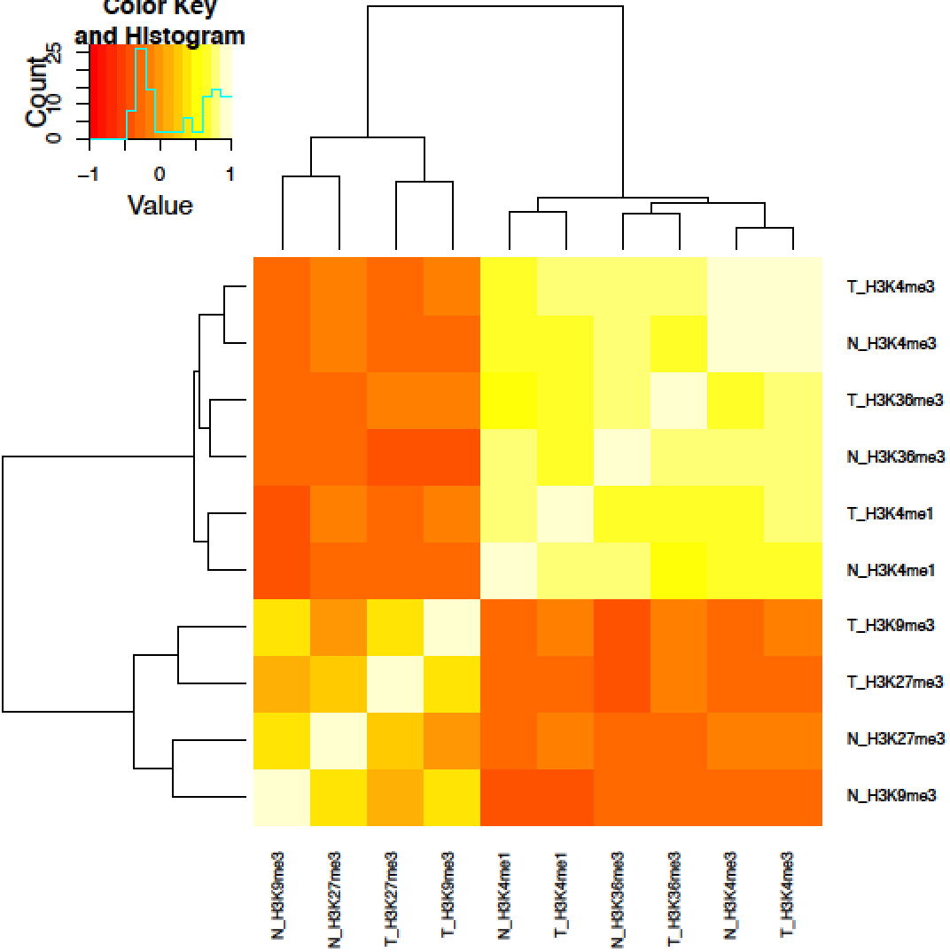
Regarding the usefulness of cell line data
The Roadmap consolidated data. Signal tracks of five histone marks (breast epithelium primary cells)
ENCODE data 5 histone marks from MCF-7
Calculate the average signal within 1mb bins

Slide 3
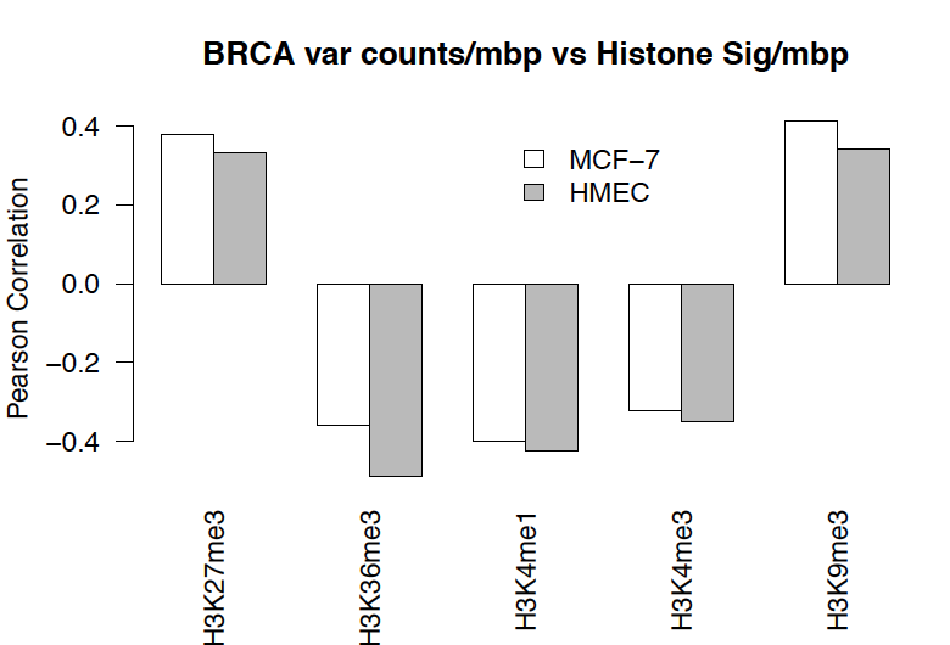
Cell line data is some times even better
Matching to the cell of origin is difficult
Matching to the cell of origin is not always the case (even in the Polak 2015 paper mentioned this case)

Slide 4
Lots of missing data from the tissue, like Prostate case. JL will add a figure here

Slide 5
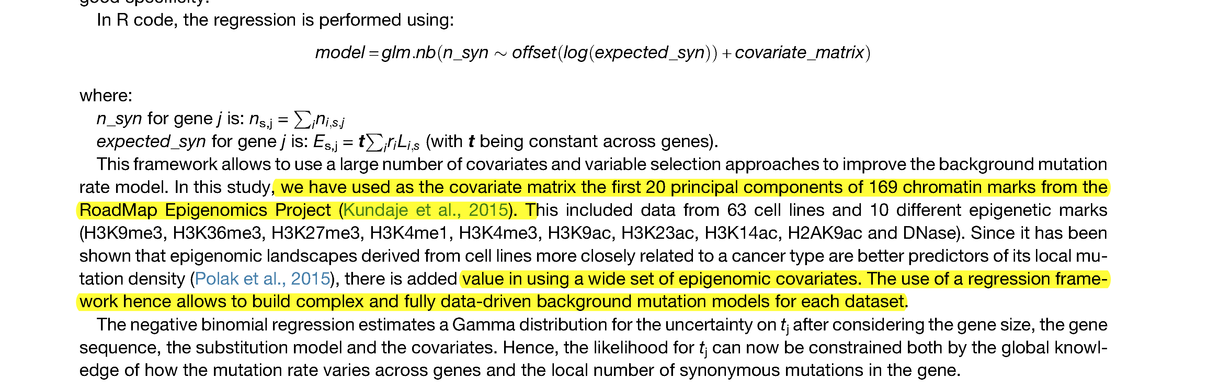

Slide 6
Regarding the improved performance is overfitting or true
Breast cancer:
Full model: all features we collected
Selected model: use forward selection (computation intense)
Nested model: use the top 5 feature from the above feature selection
Use 5 fold cross validation

Slide 7
In the test data set, correlation of predicted vs observed counts using our selected model is much better than the nested model
Different features does capture the heterogeneity nature of cancer samples

Slide 9
We did see the incremental effect when # of covariates increases.
It is OK to use a fixed number of co-variates considering the complexity of model selection
However, the top features are changing and ENCODE provide a wide selection of covariates

Slide 10
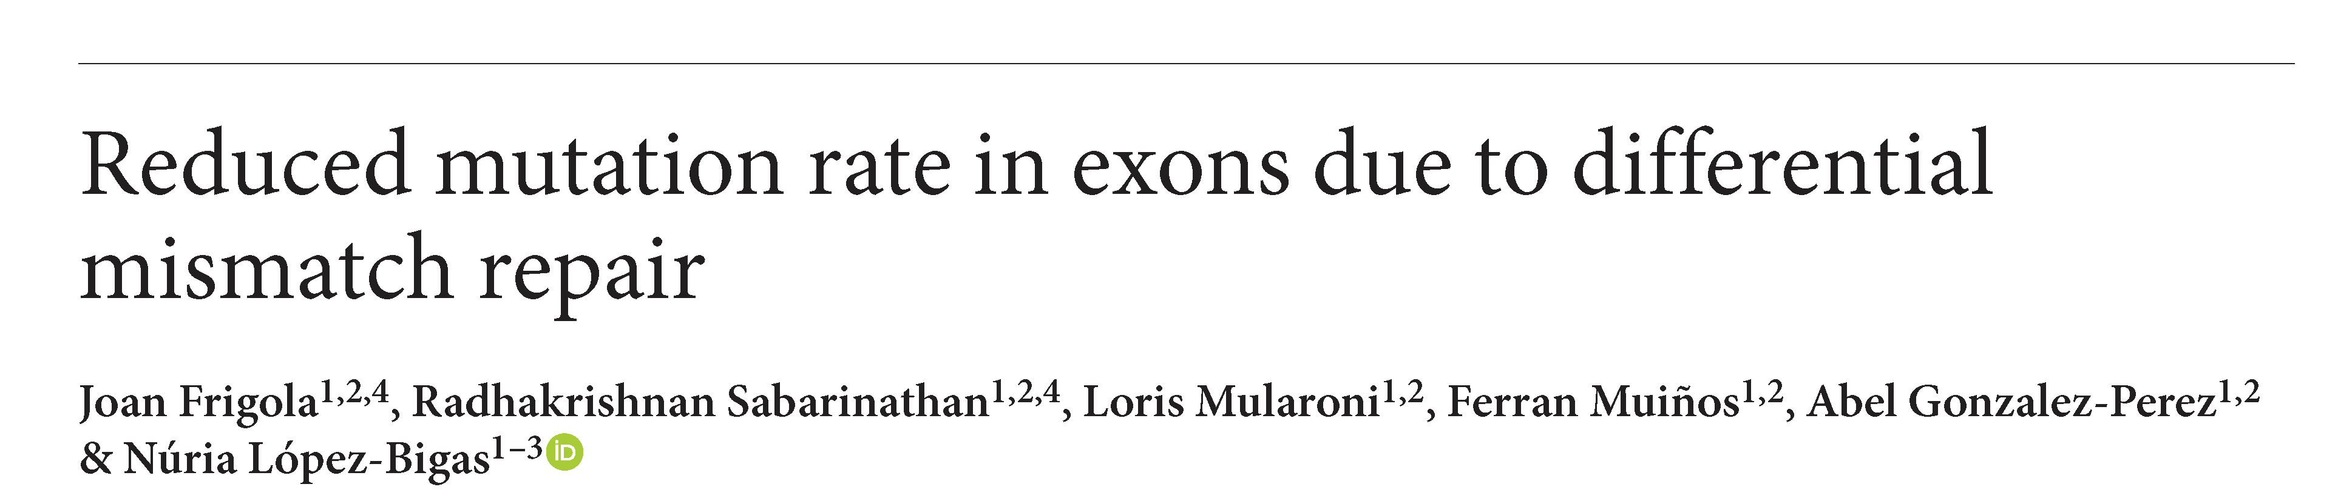
Regarding comparison with Nuria’s paper

Slide 11
1mb bins
Y_rand: generated using the estimated parameters
Then calculate obs(Y-rand, Y_obs)
Repeat 100 times

Slide 12
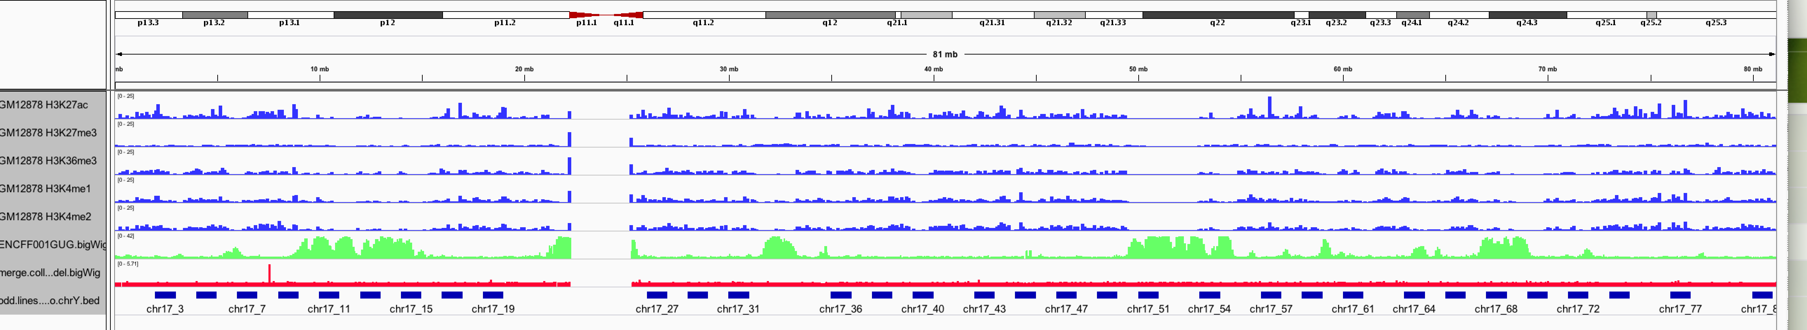
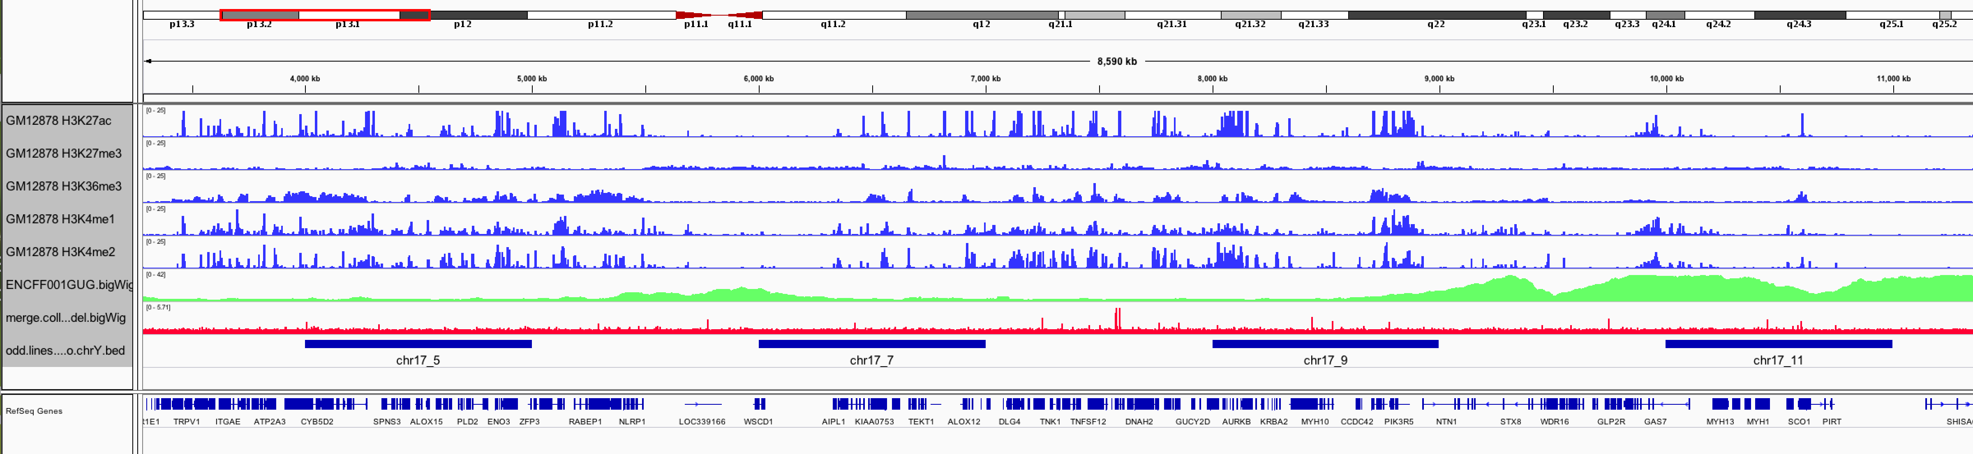

Slide 13
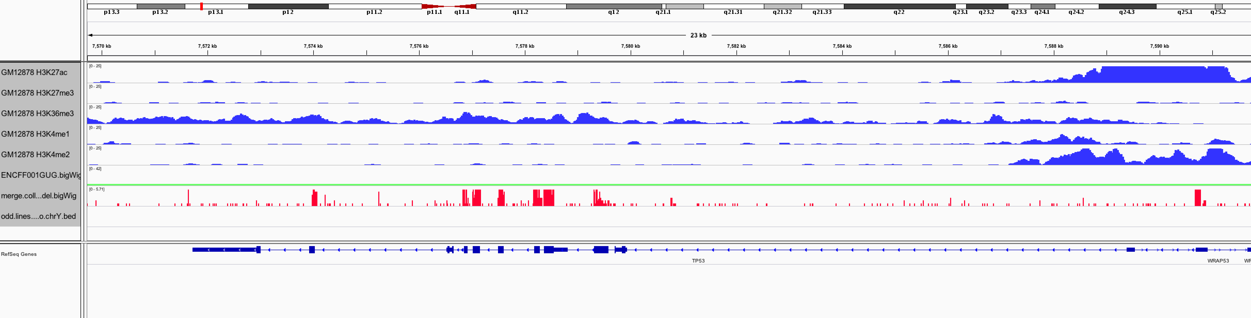

Slide 14
1mb bins
…
Sample 1%
Sample 1%
1mb bins
Y_rand: generated using the estimated parameters
Then calculate obs(Y-rand, Y_obs)
Repeat 100 times

Slide 16
Regarding Rejection of Negative Binomial models
See JL slides

Slide 17
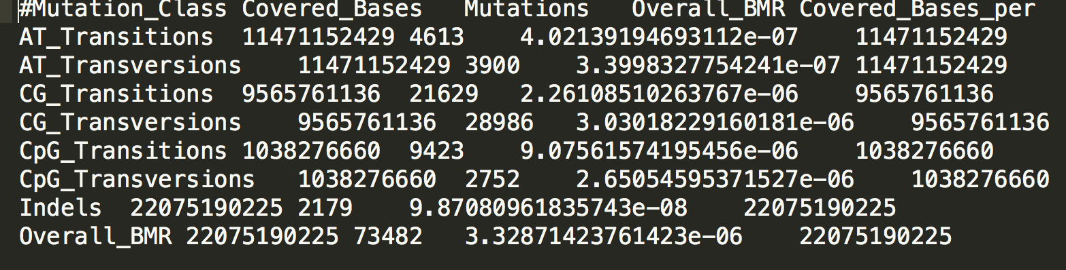
Other BMR Bench mark?

Slide 18
Comparison of Exteneded gene
What did we exactly introduced to the burden test?

Slide 19
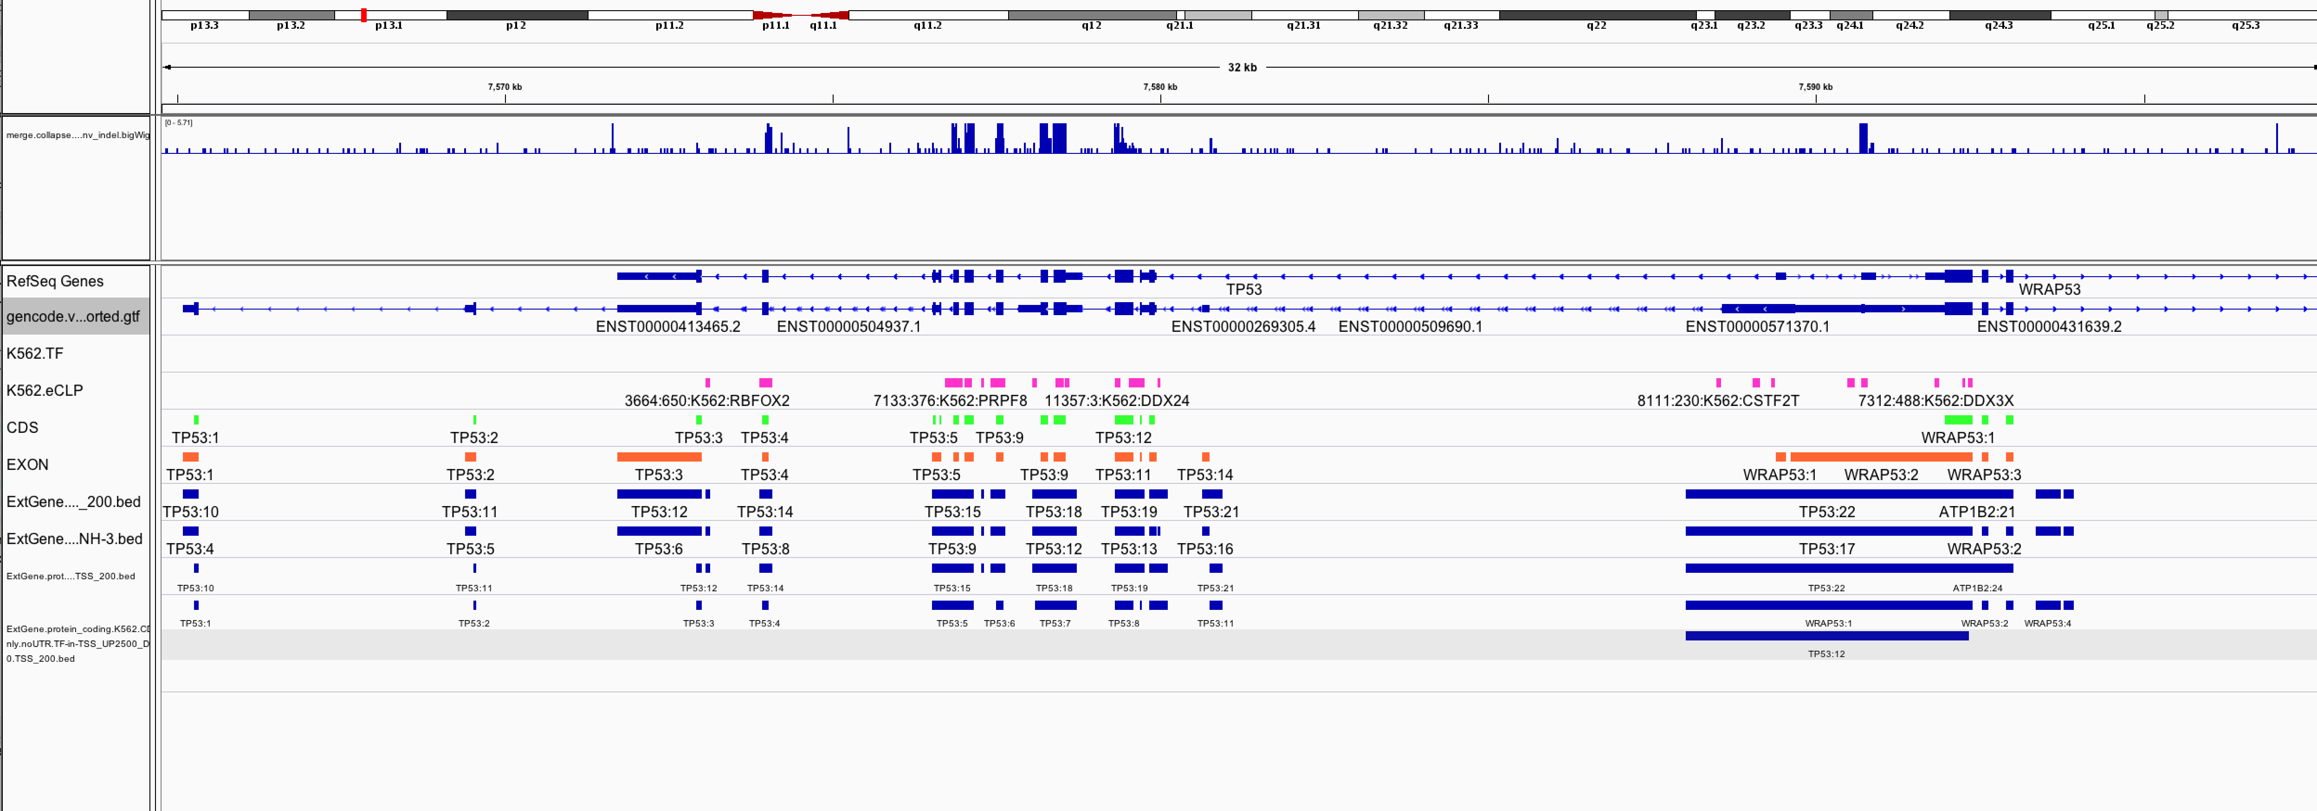

Slide 20
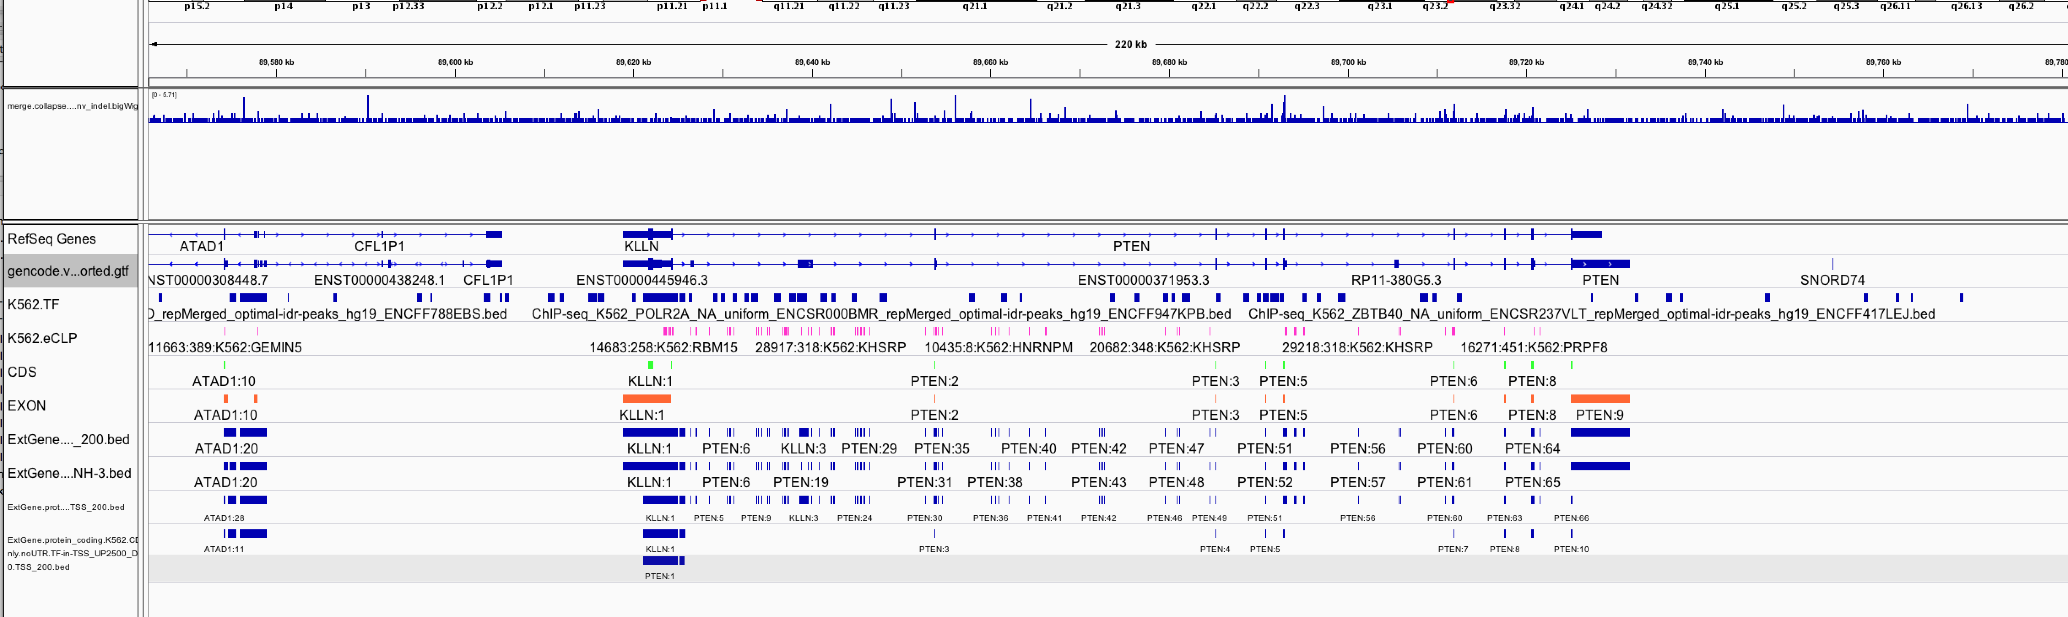

Slide 21
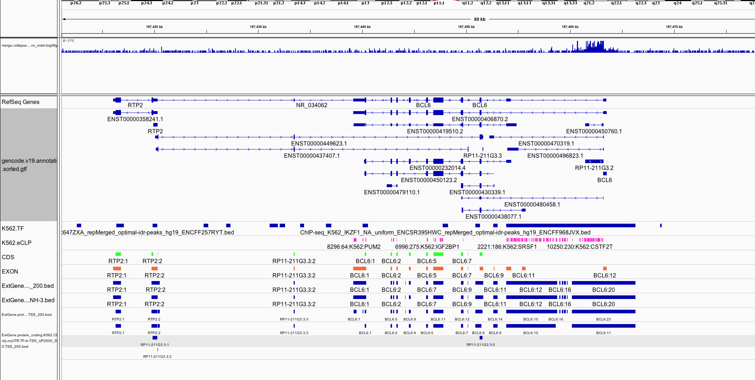

Slide 22
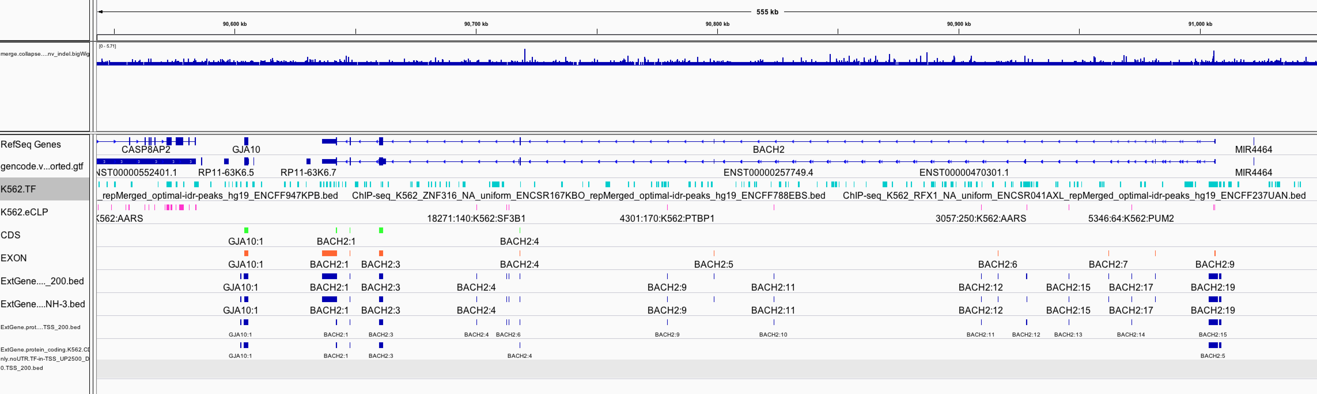

Slide 23
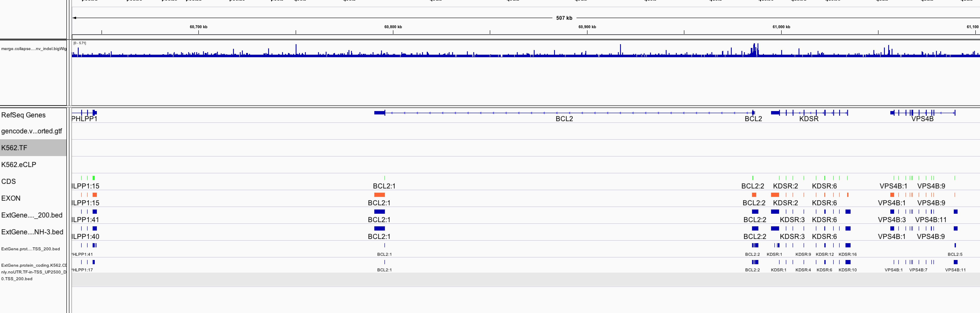

Slide 24
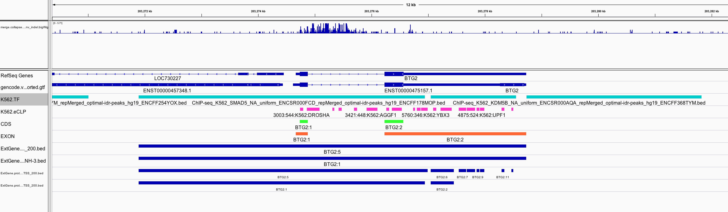

Slide 25
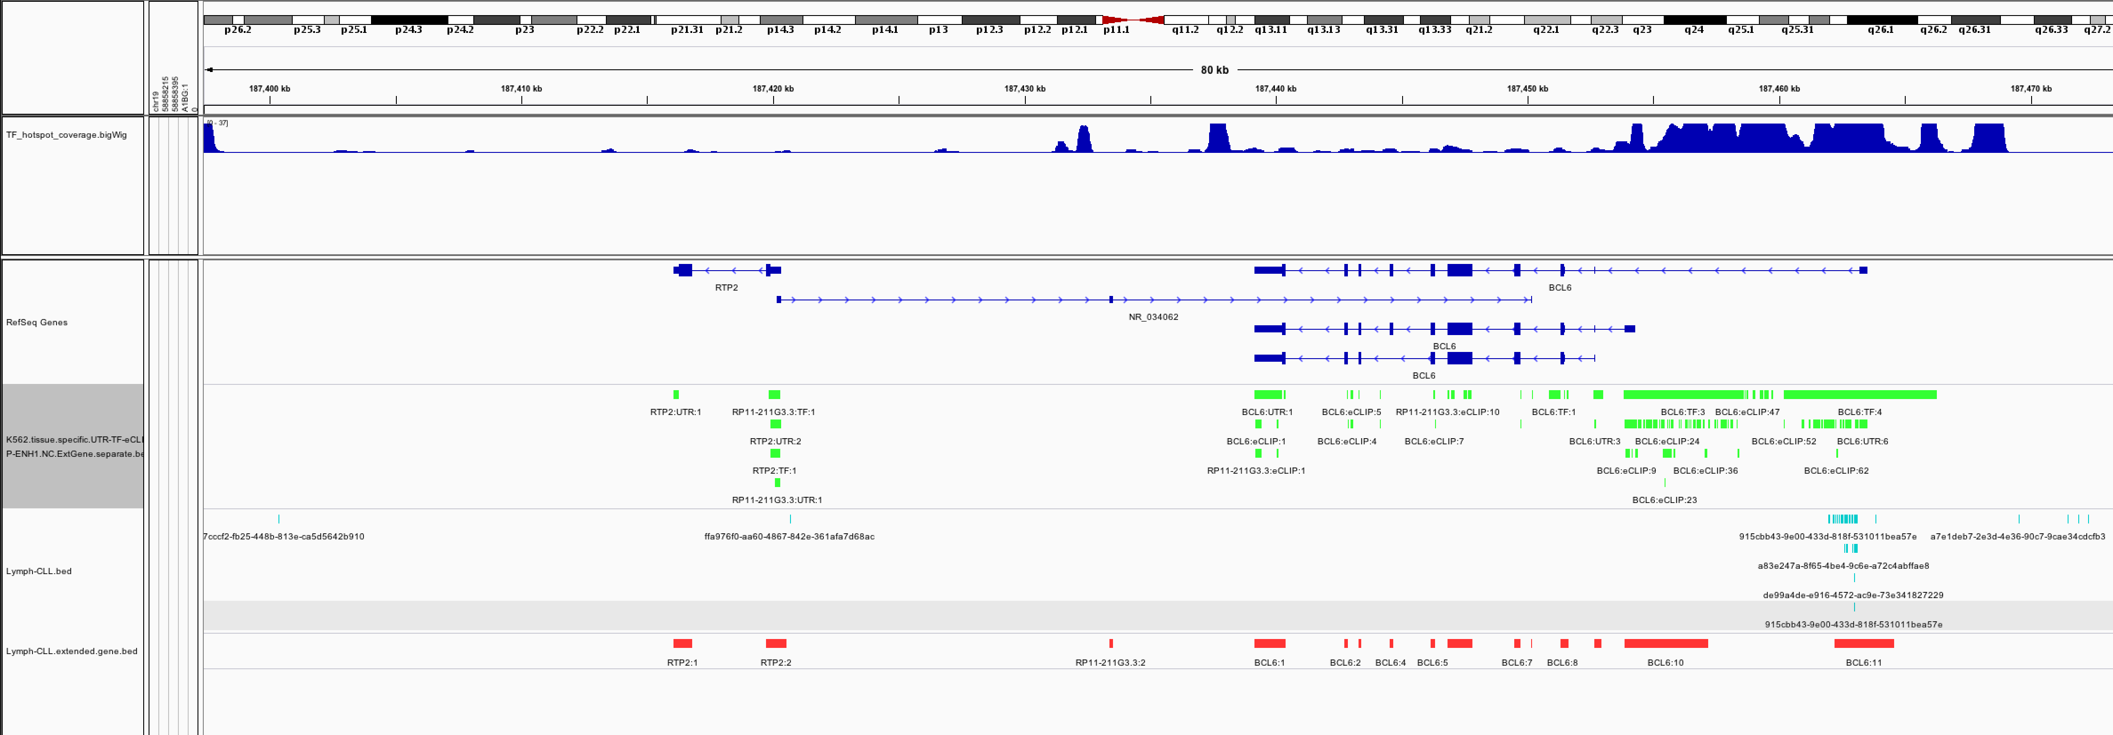

Slide 26
What is extended gene?
200bp
1kb
2.5k
2.5k

Slide 27
200bp
1kb
STEP1
2.5k
2.5k
STEP2
STEP3

Slide 28
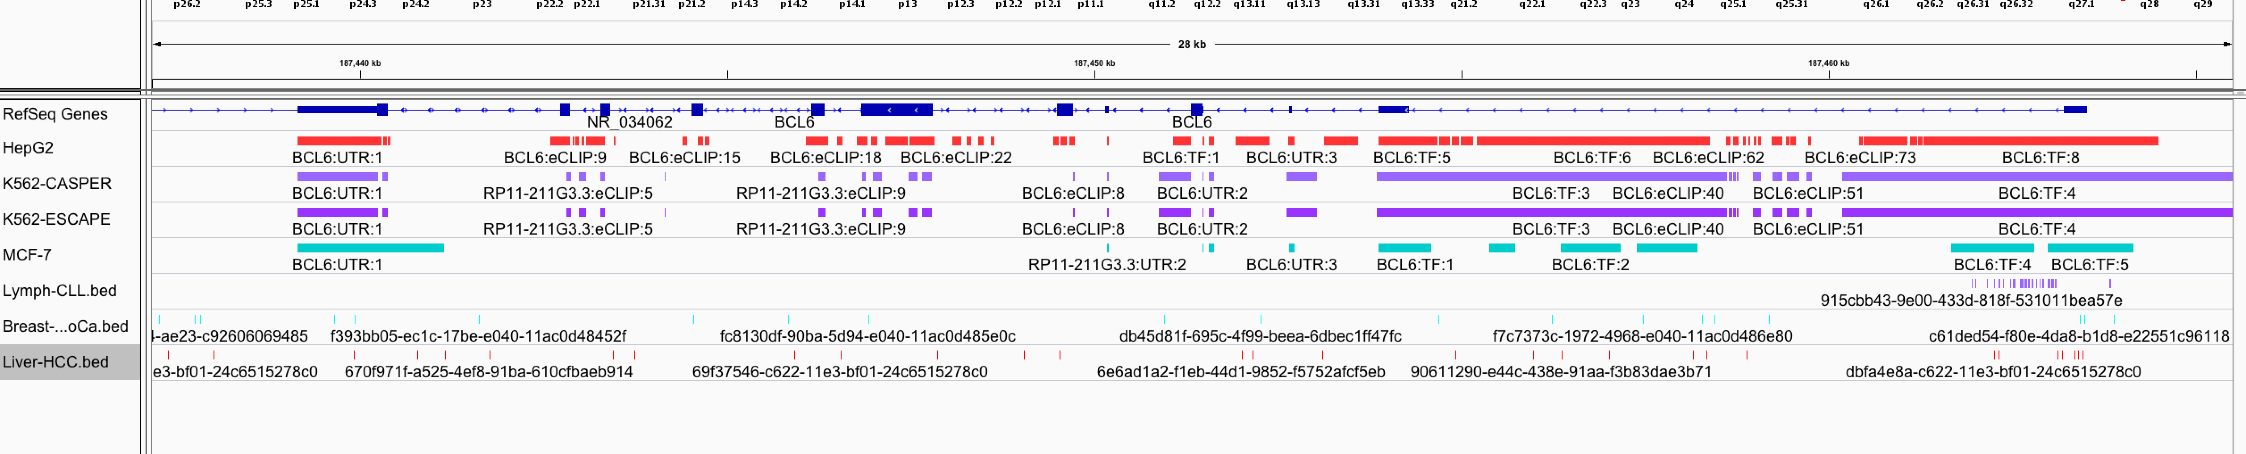

Slide 30
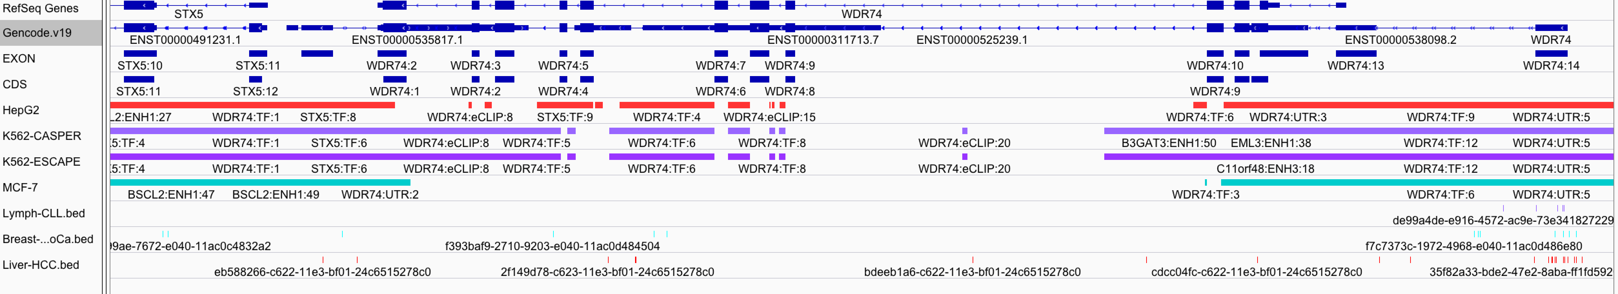

Slide 31
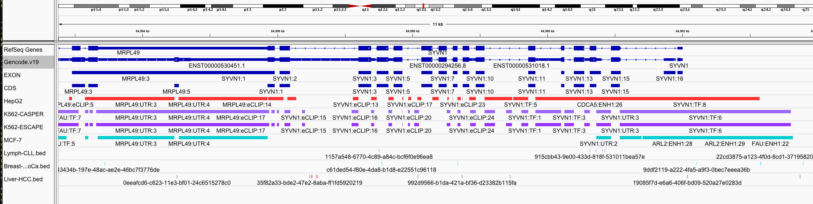

Slide 32
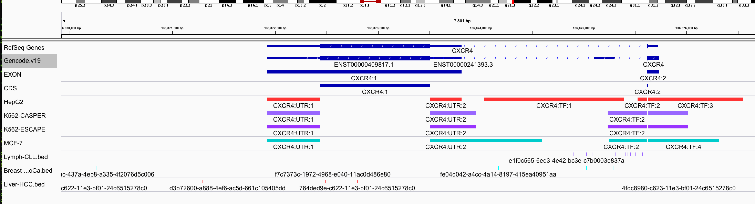

Slide 33
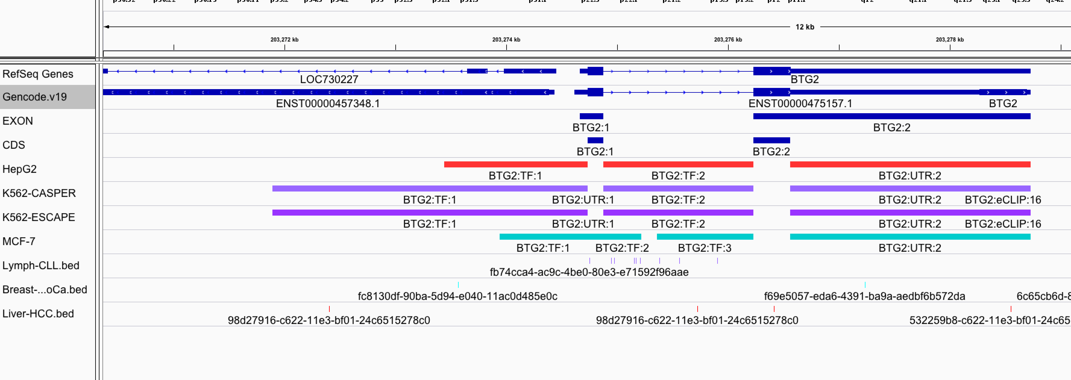

Slide 34
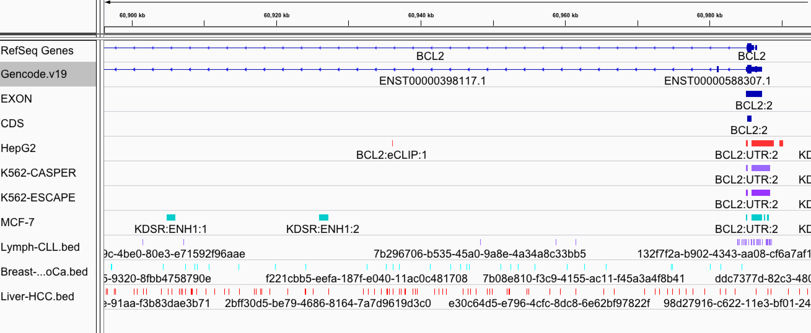

Slide 35
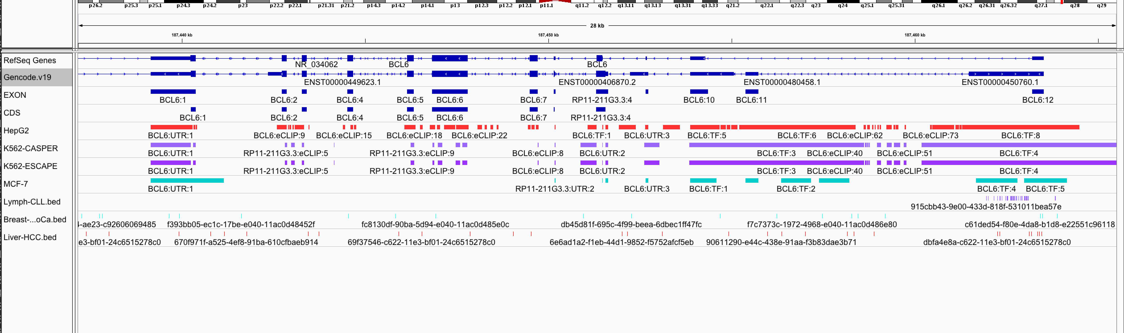

Slide 36
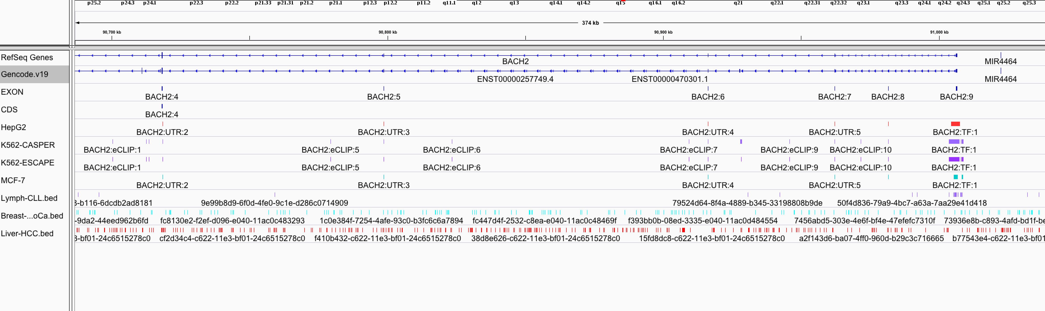

Slide 37
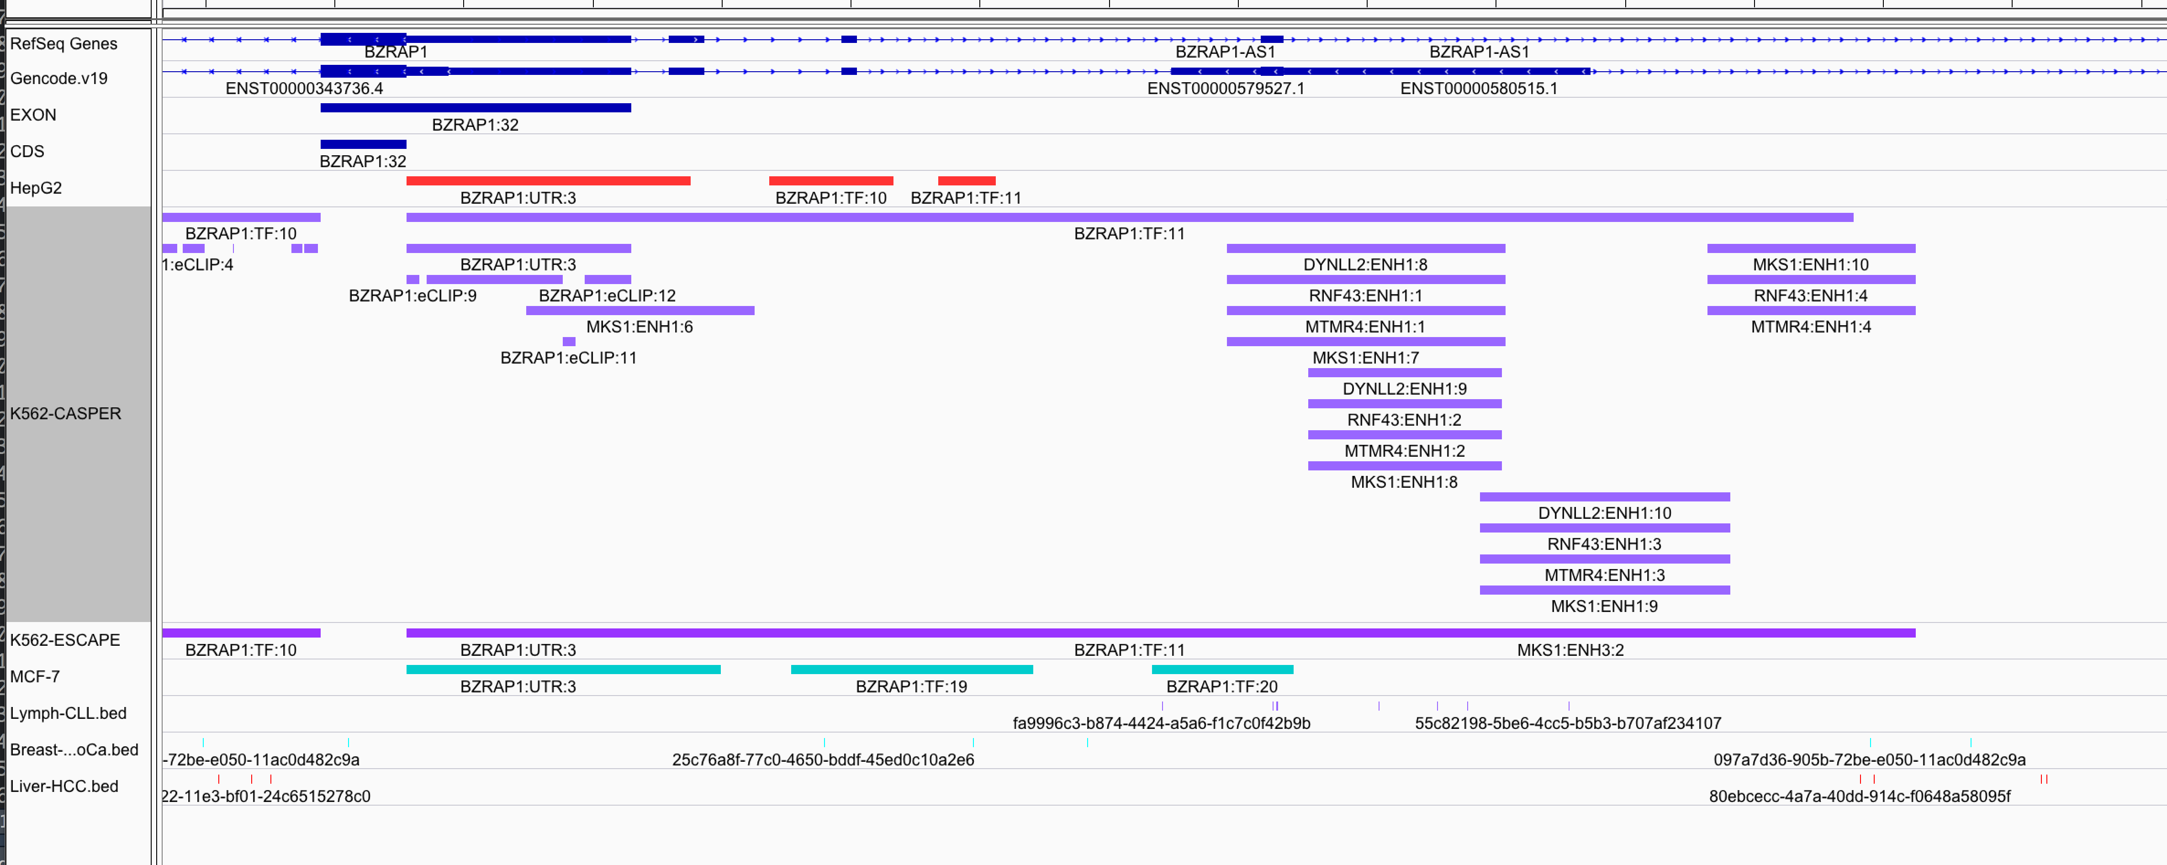
Distal: enhancers

Slide 38
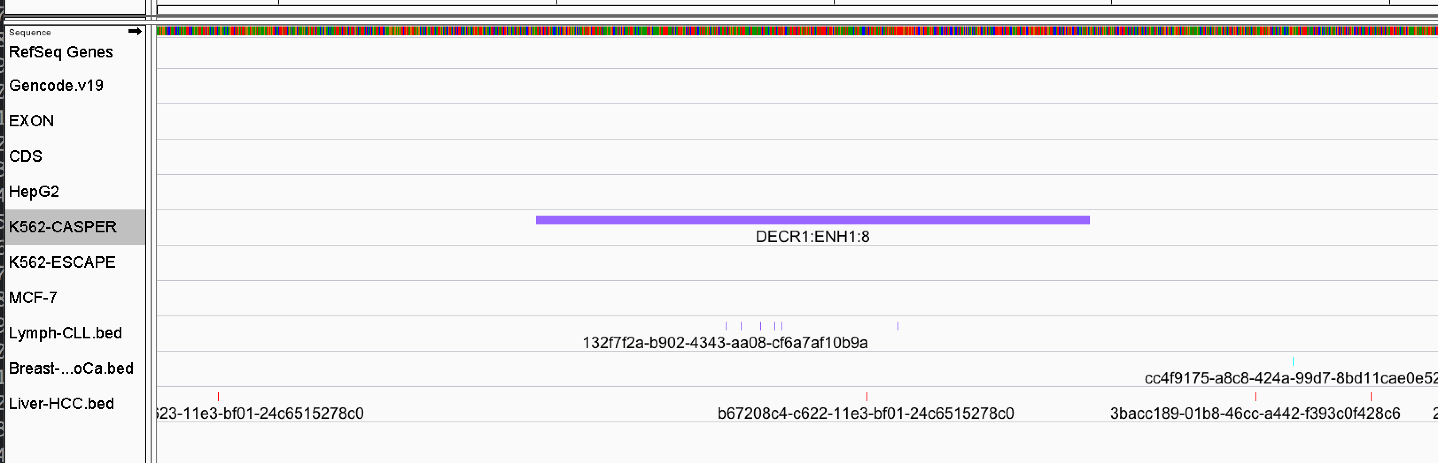

Slide 39
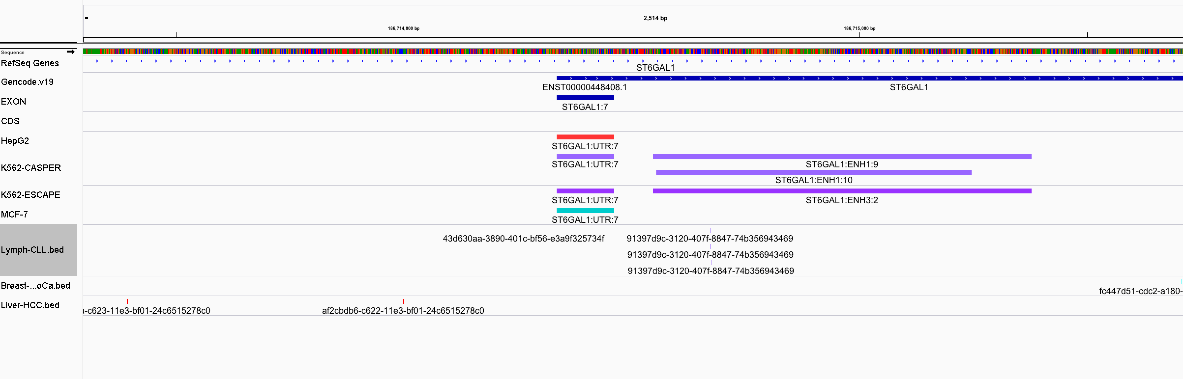
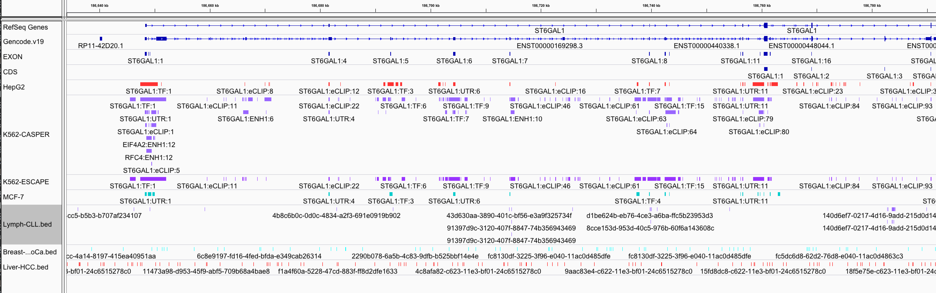

Slide 40
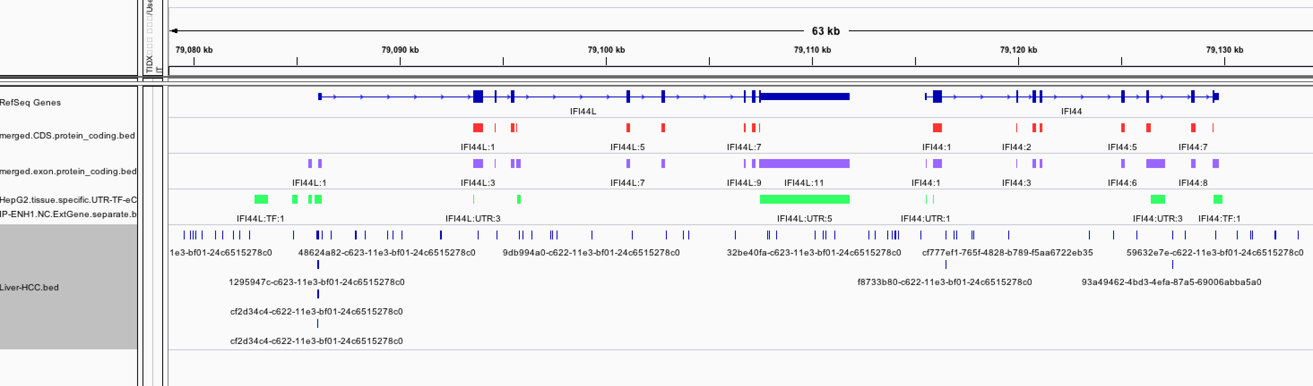
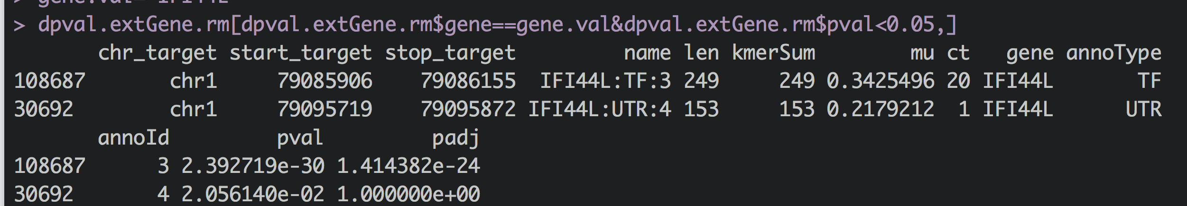

Slide 41
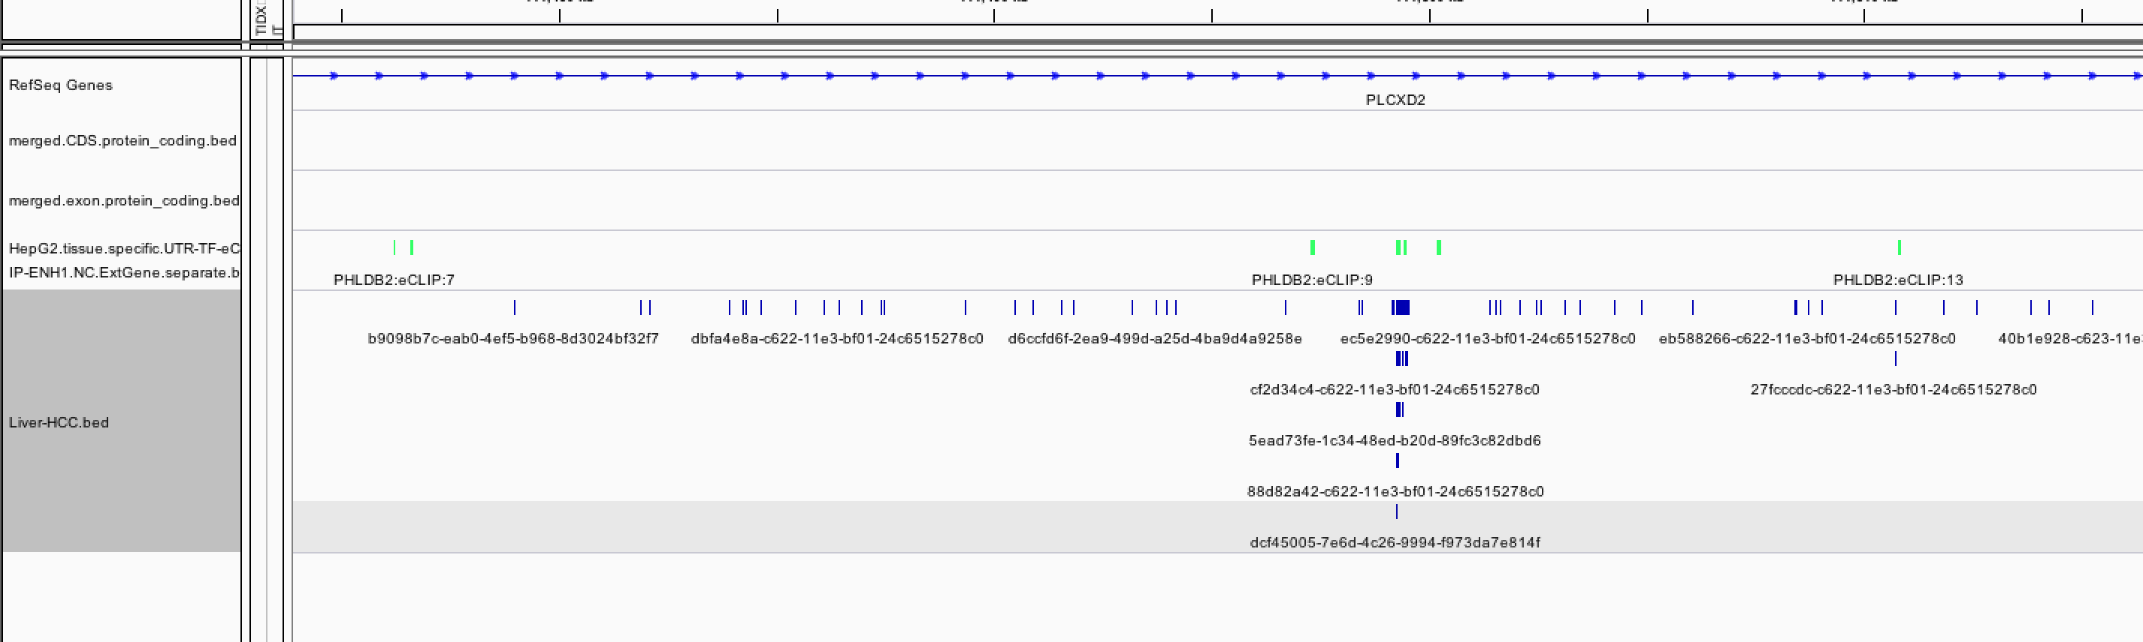
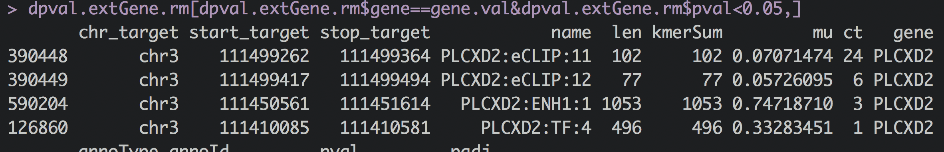

Slide 42
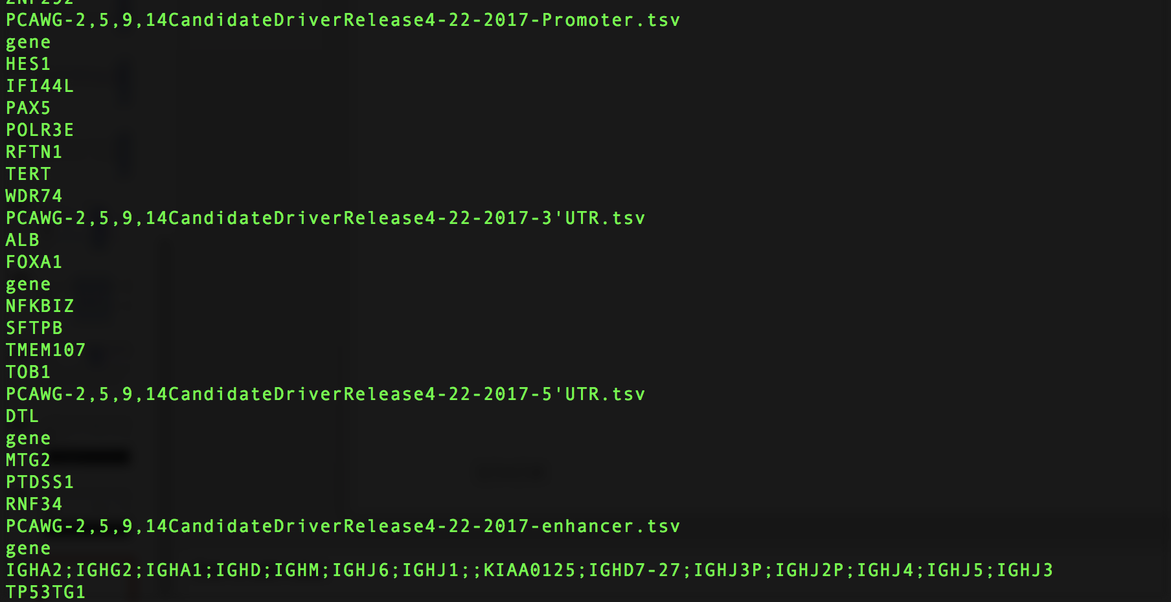

Slide 43
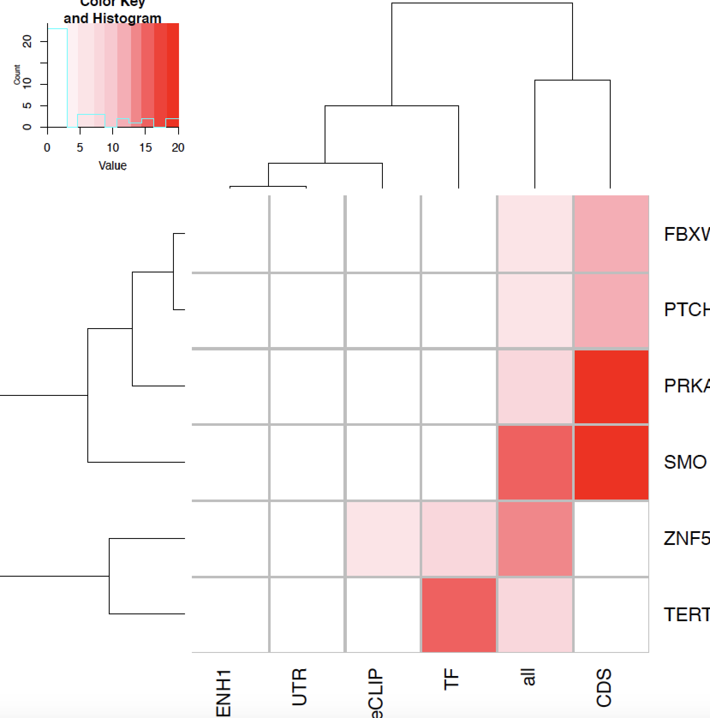

Slide 44
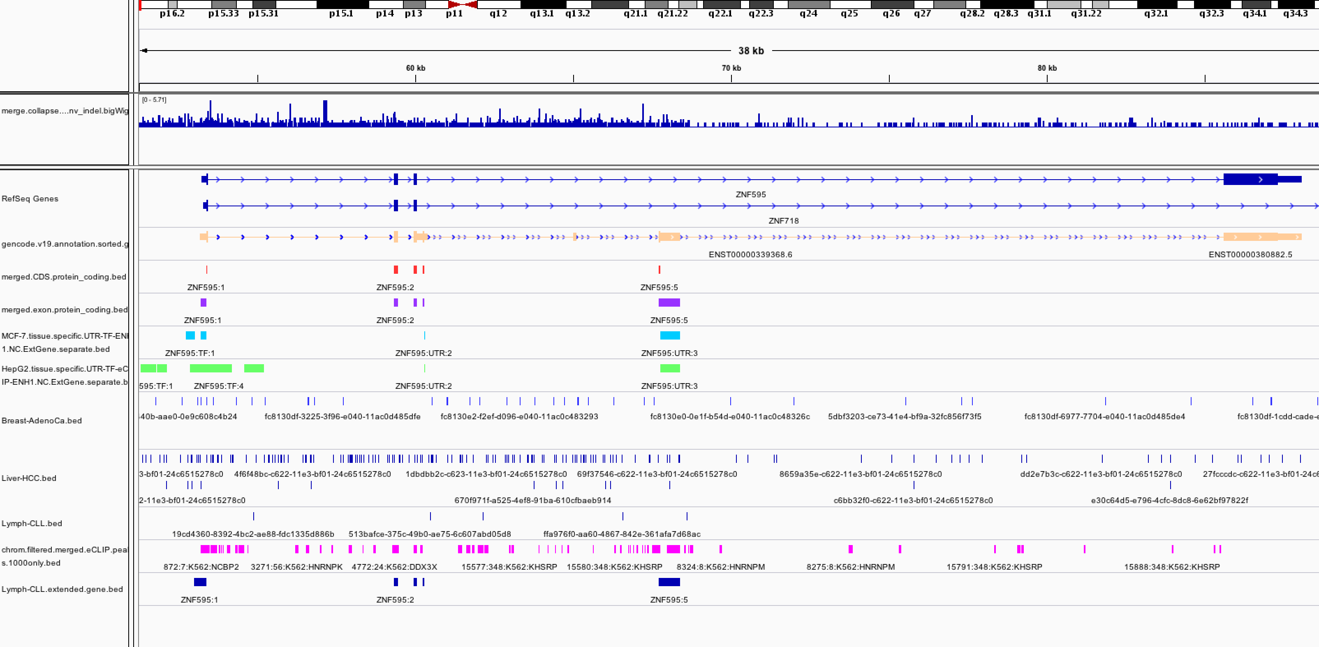

Slide 45
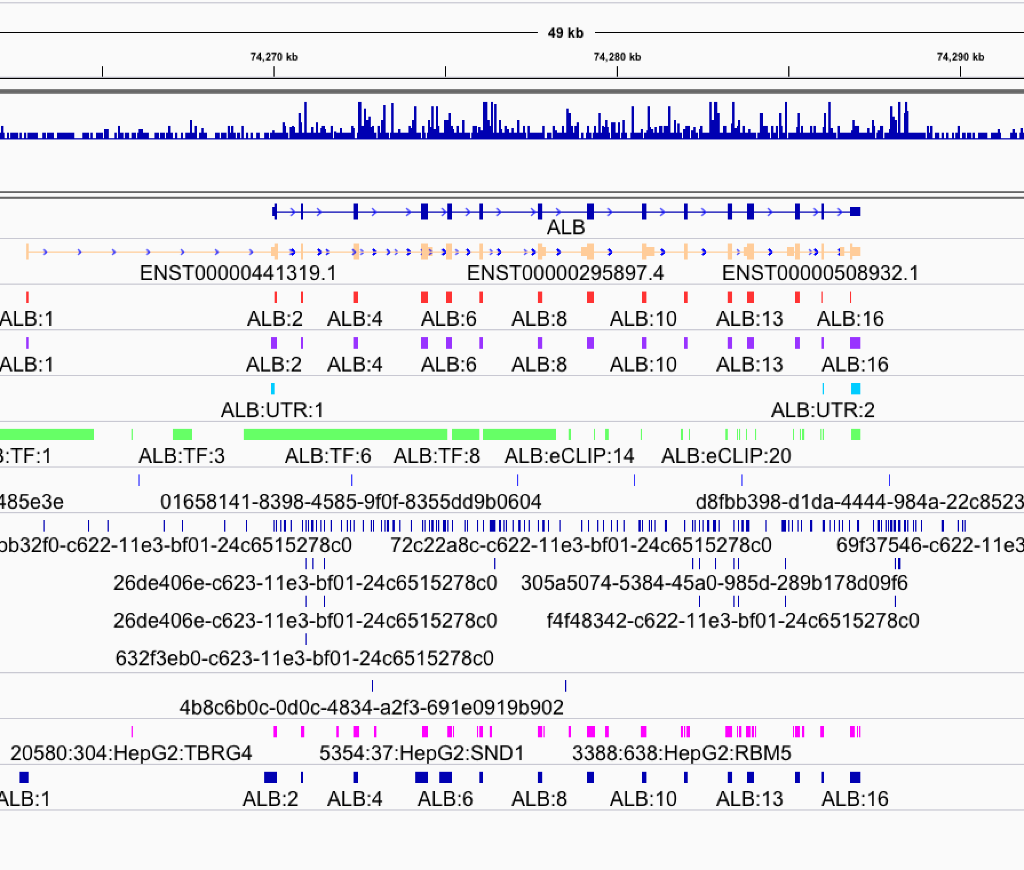

Slide 46
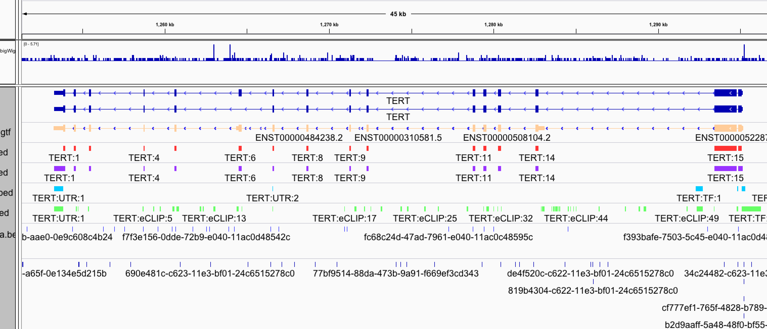

Slide 47
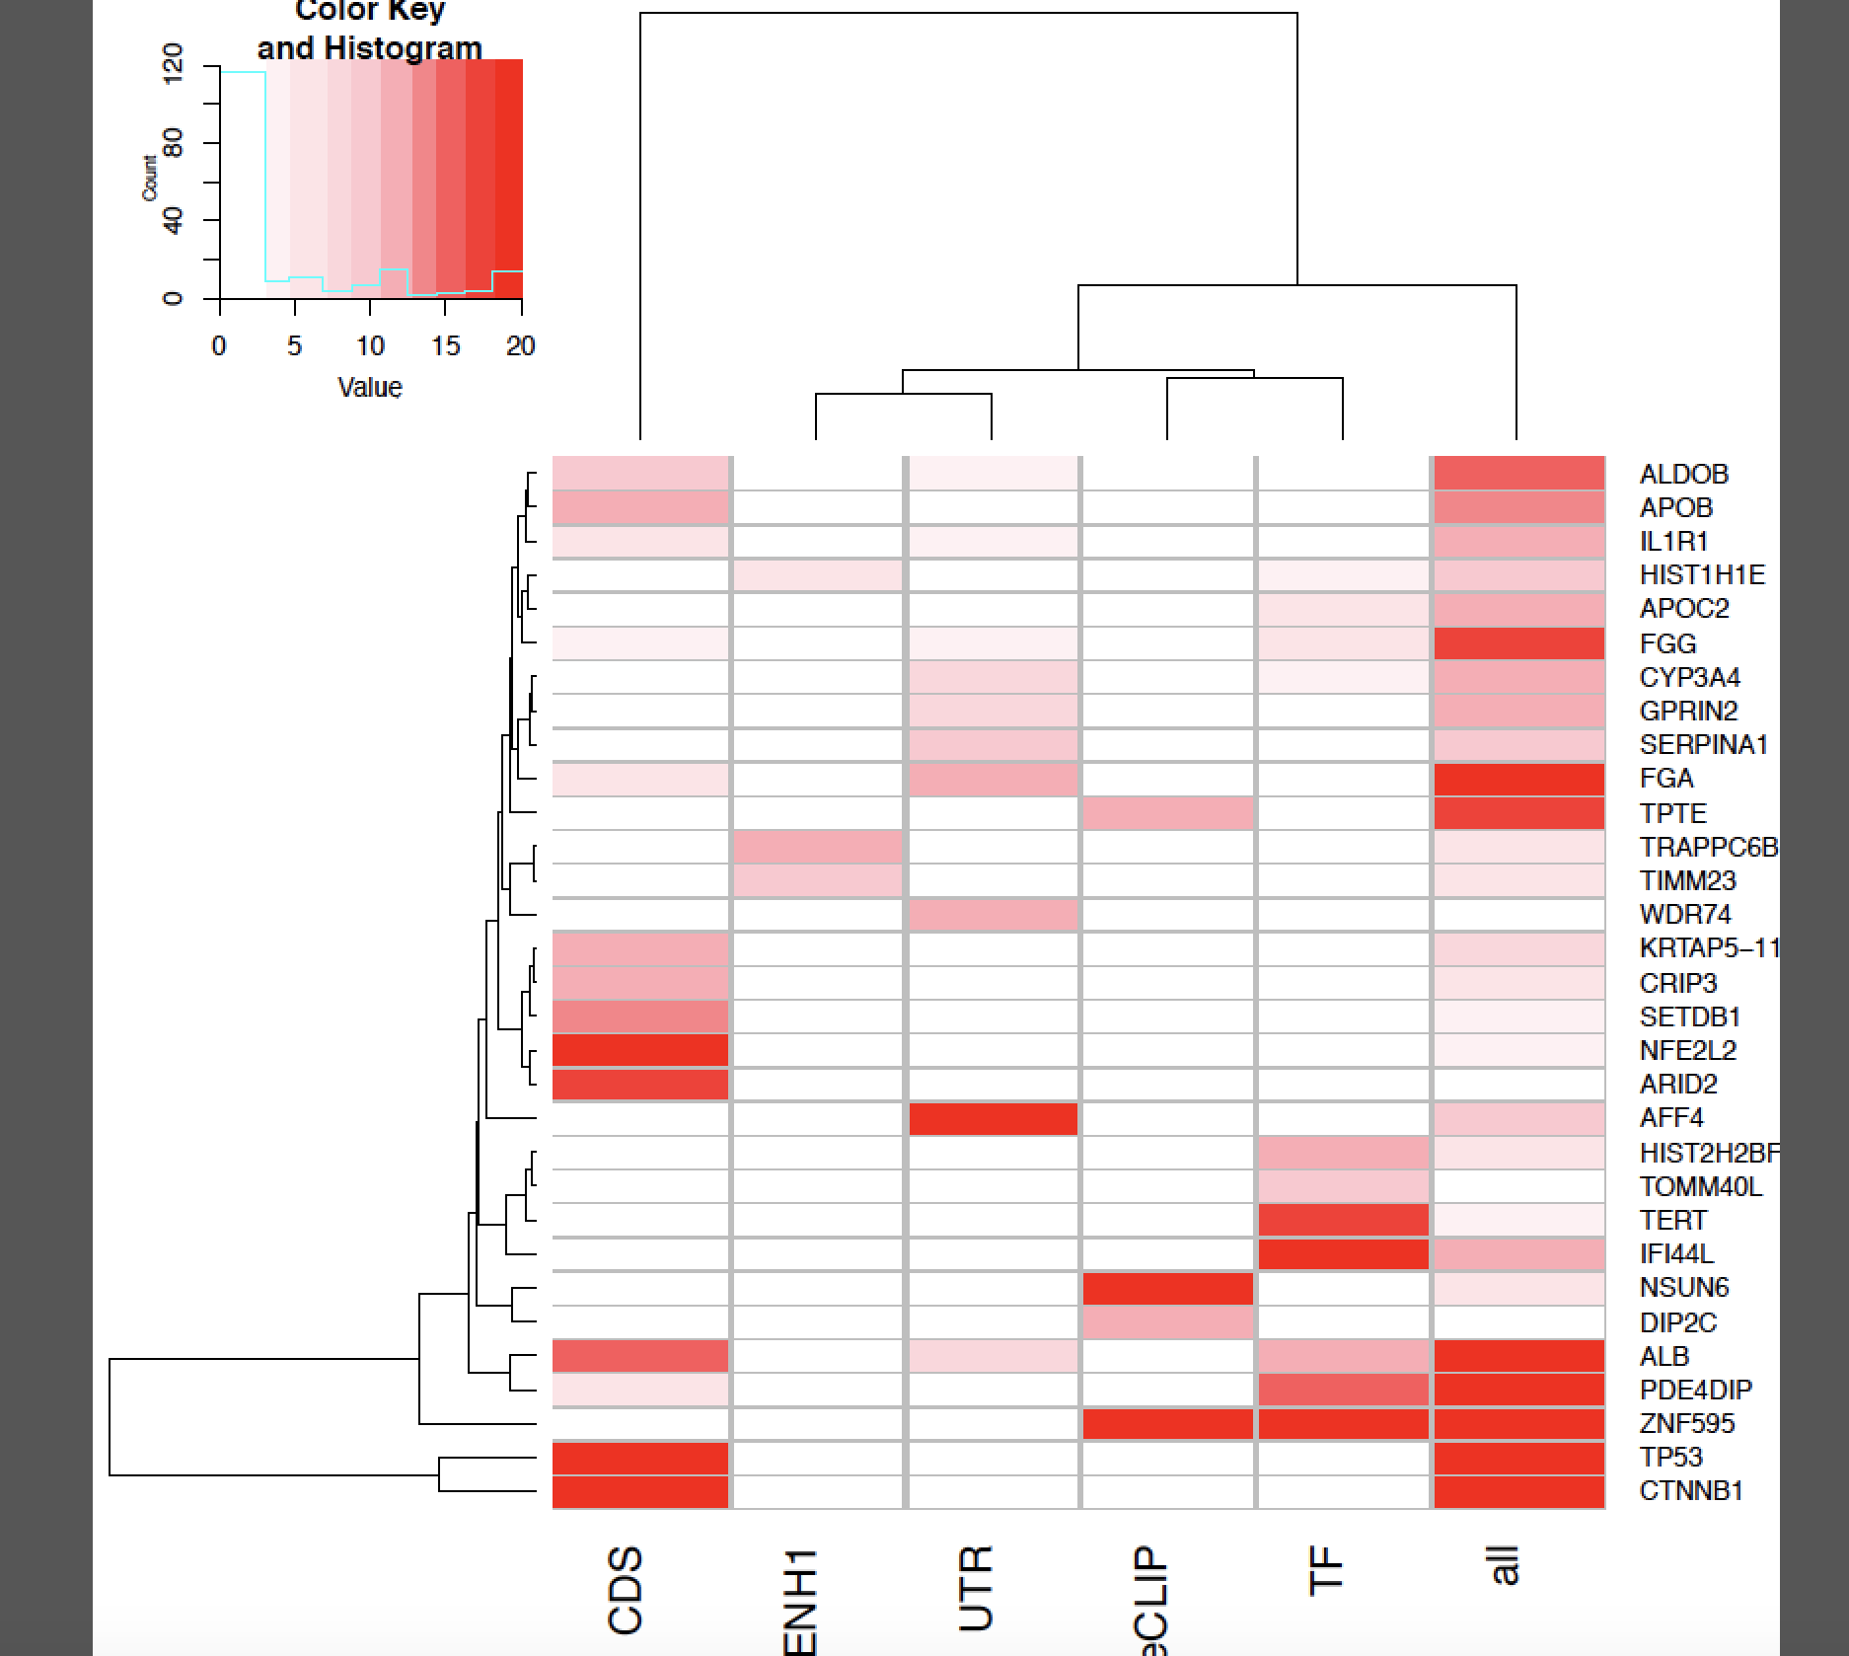

Slide 48
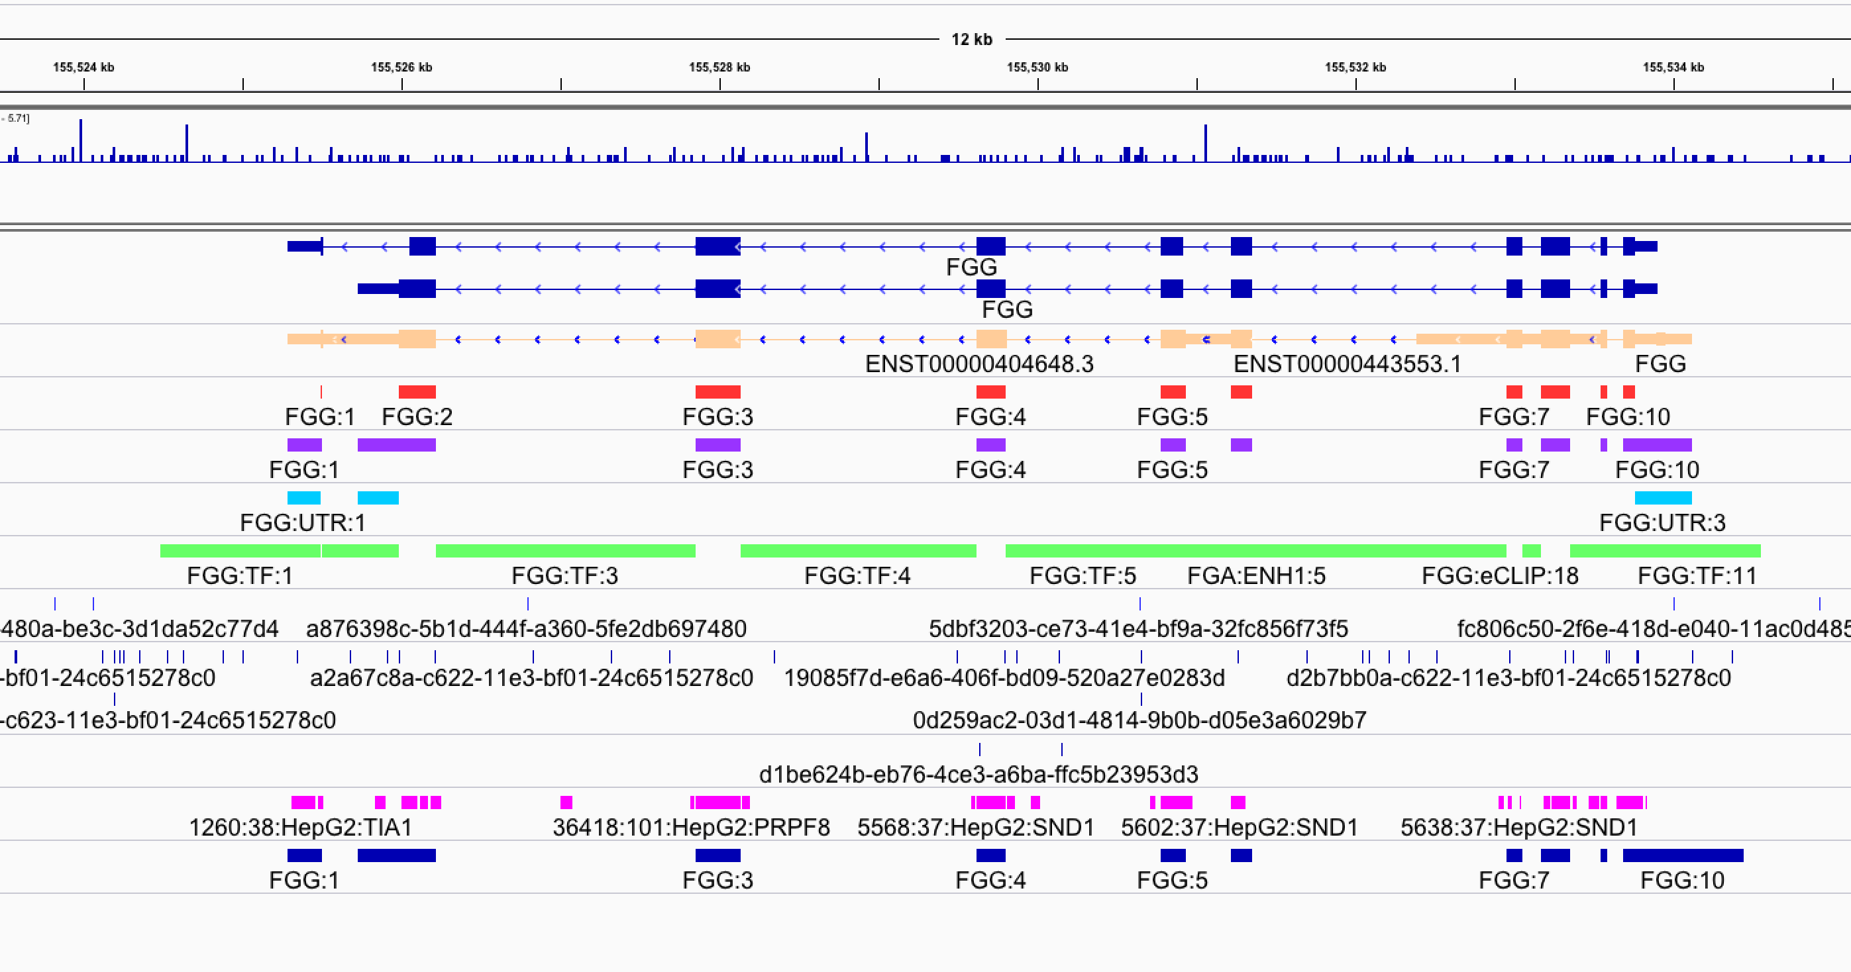

Slide 49
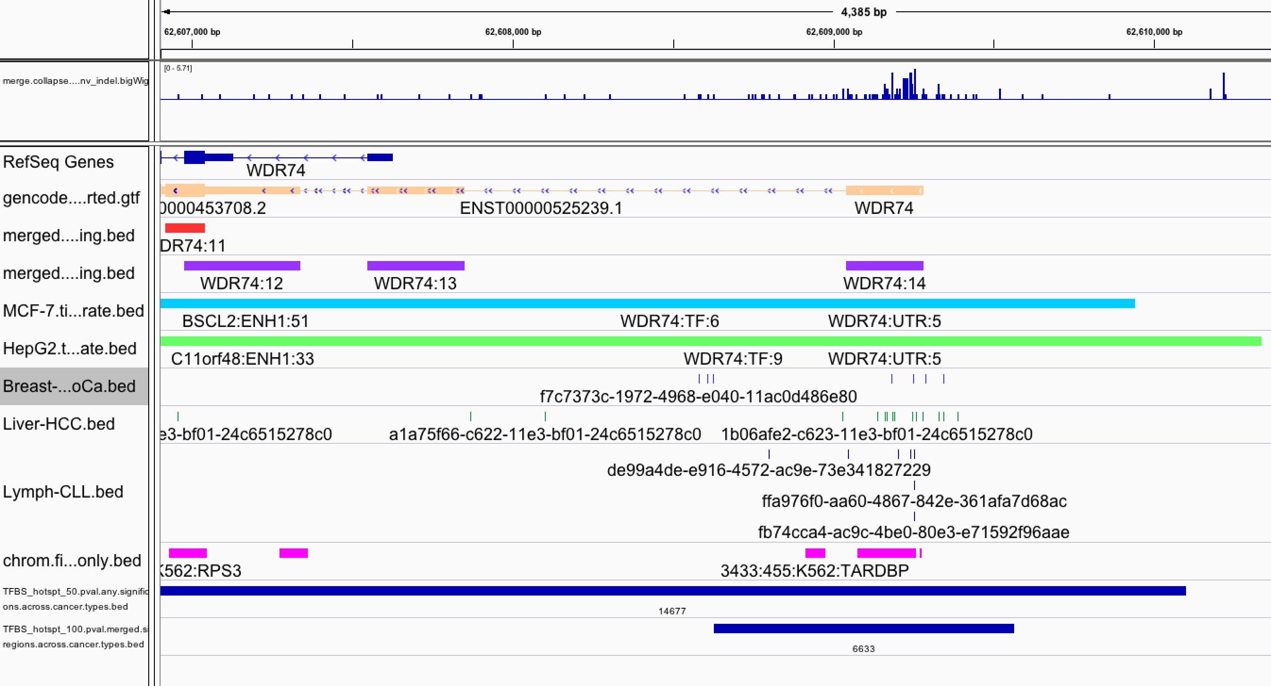
Distal

Slide 50
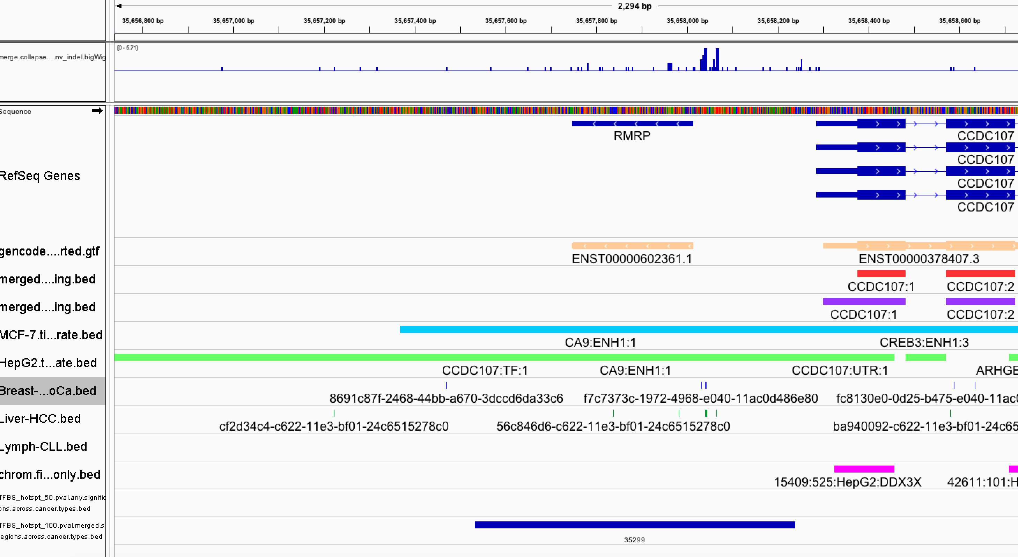

Slide 52
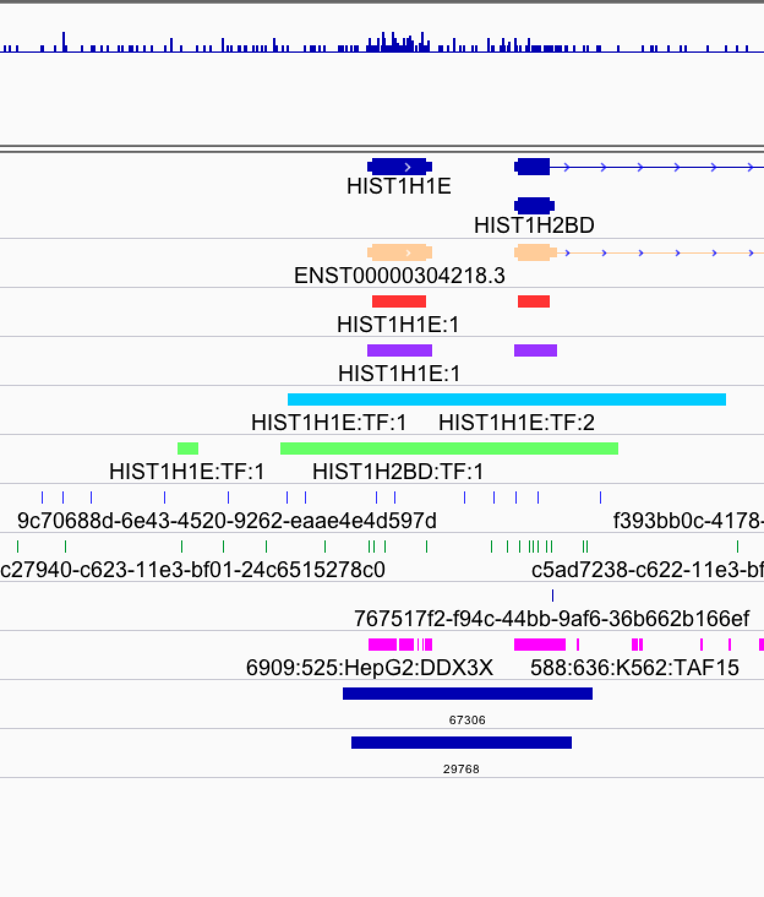

Slide 53
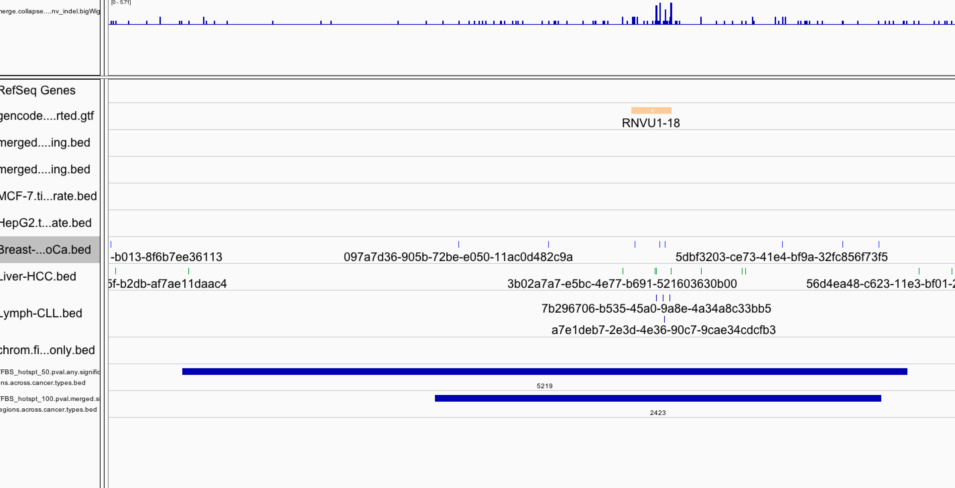

Slide 54
BMR calculation inigo’s paper:
Covariates: run regression on 20k CDS genes

Slide 55
BMR calculation ActiveDriver paper:
50k
Covariates: run regression on whatever test region
50k

Slide 56
BMR calculation our paper:
200k
200k
200k

Slide 58
SV vs.RepliSeq & BMR

Slide 59
Positive values represent early replication and negative values late replication.
Early replicated regions
Late replicated regions

Slide 60
Early replicated regions
Just use the original bin to train, only use K562 histones
Data is weird, there must be some hotspots
Late replicated regions

Slide 61
Early replicated regions
Just bin (extending 20Kb) to train, only use K562 histones
Data is weird, there must be some hotspots
Late replicated regions

Slide 62
Early replicated regions
Just bin (extending 50Kb) to train, only use K562 histones
Data is weird, there must be some hotspots
Late replicated regions

Slide 63
Early replicated regions
Just bin (extending 100Kb) to train, only use K562 histones
Data is weird, there must be some hotspots
Late replicated regions

Slide 64
Orginal bin
20Kb bin
50Kb bin
100Kb bin

Slide 65
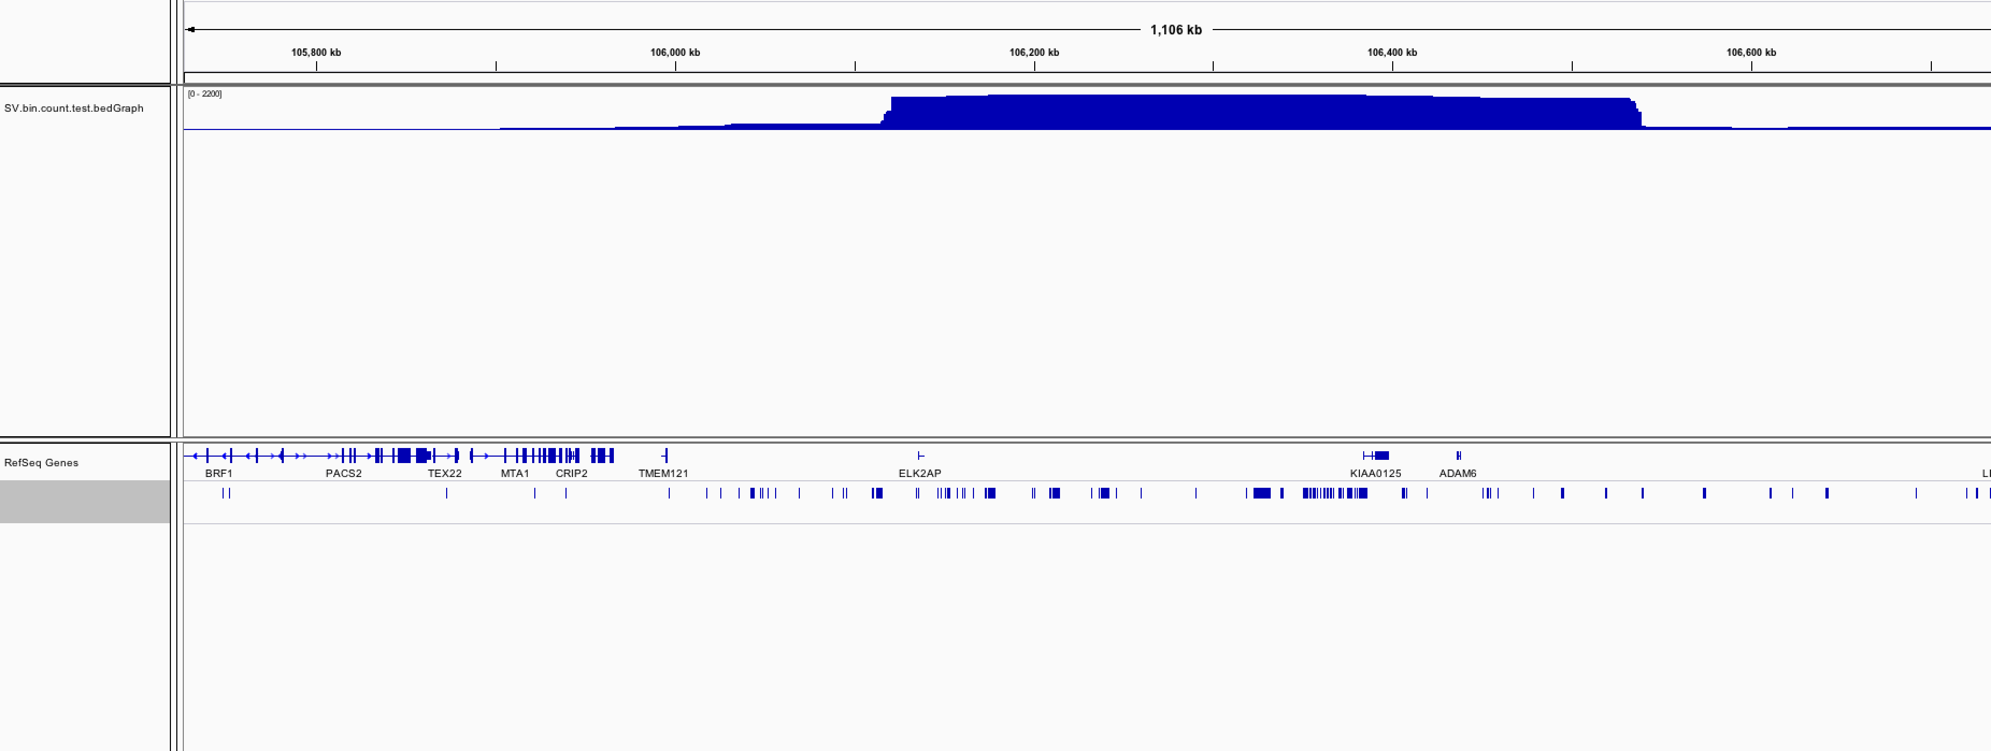
2200 mutations in this bin

Slide 66
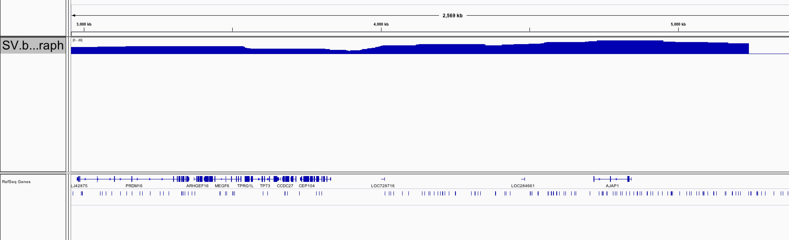
19 mutations

Slide 68
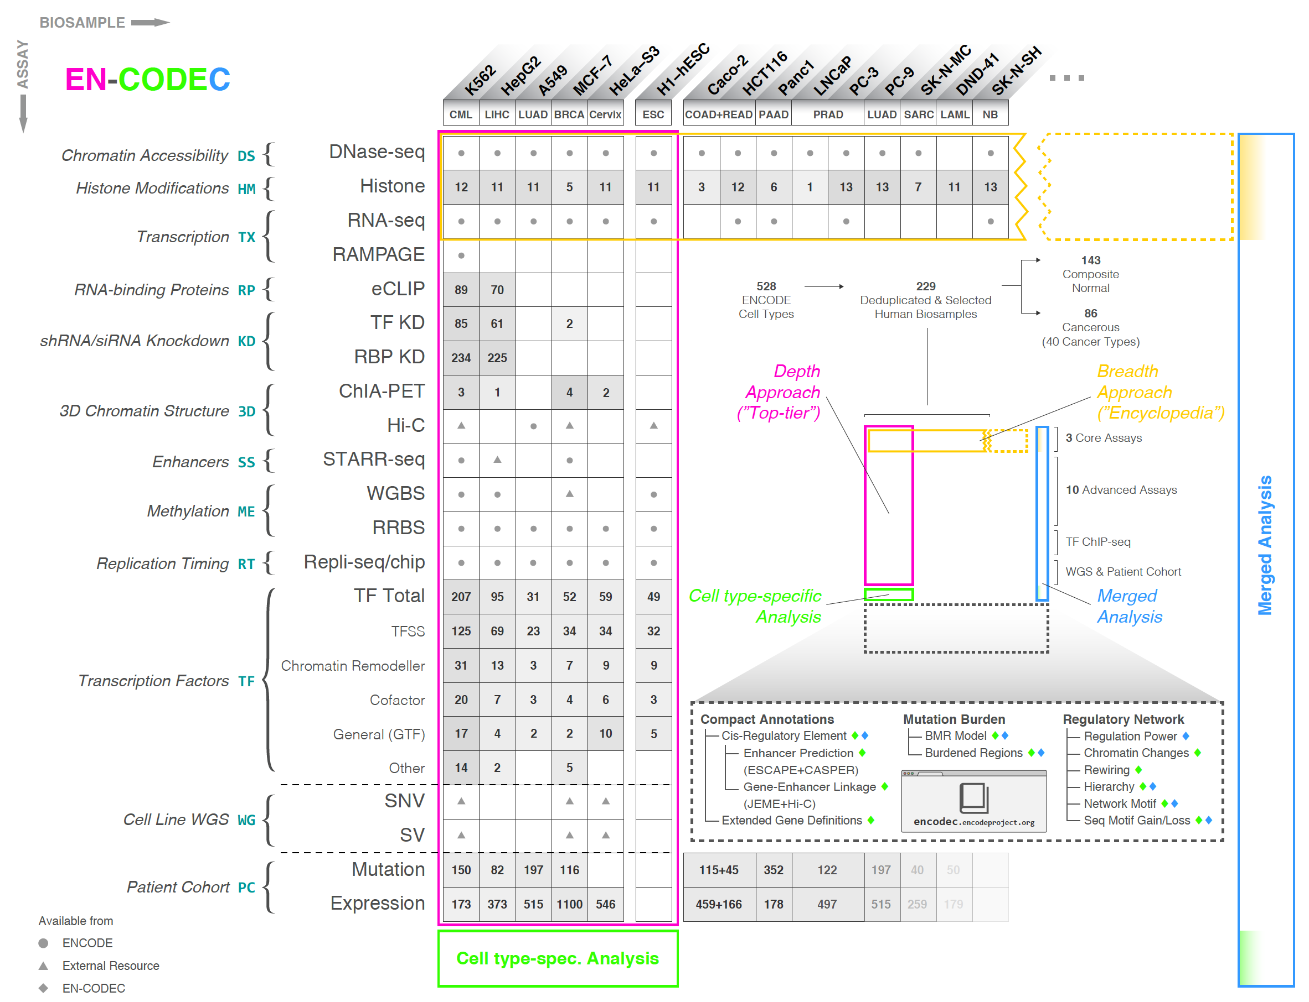
Where is imputation?
Add more network, especially the distal network?

Slide 69
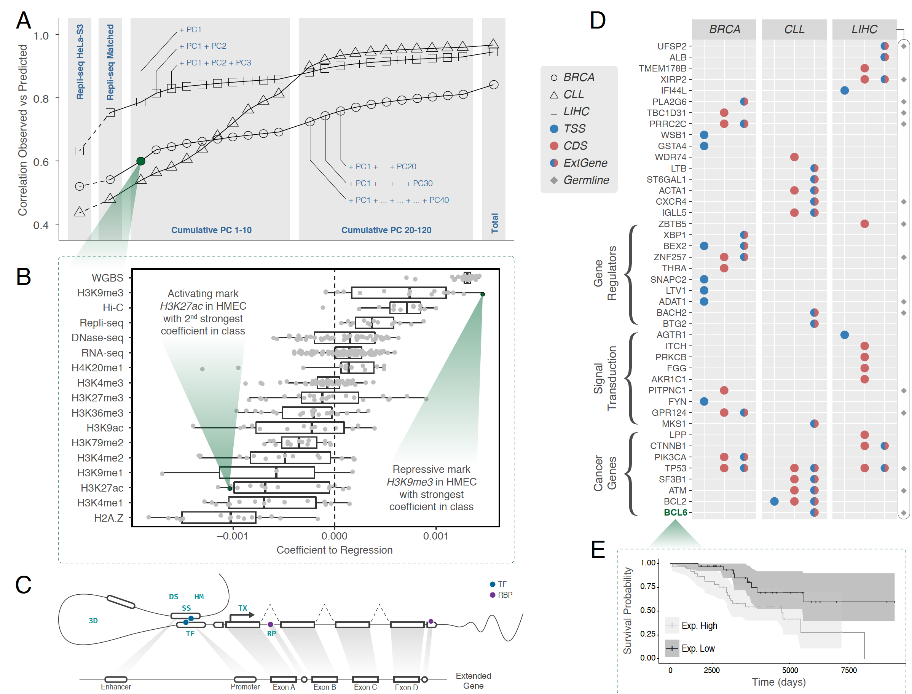
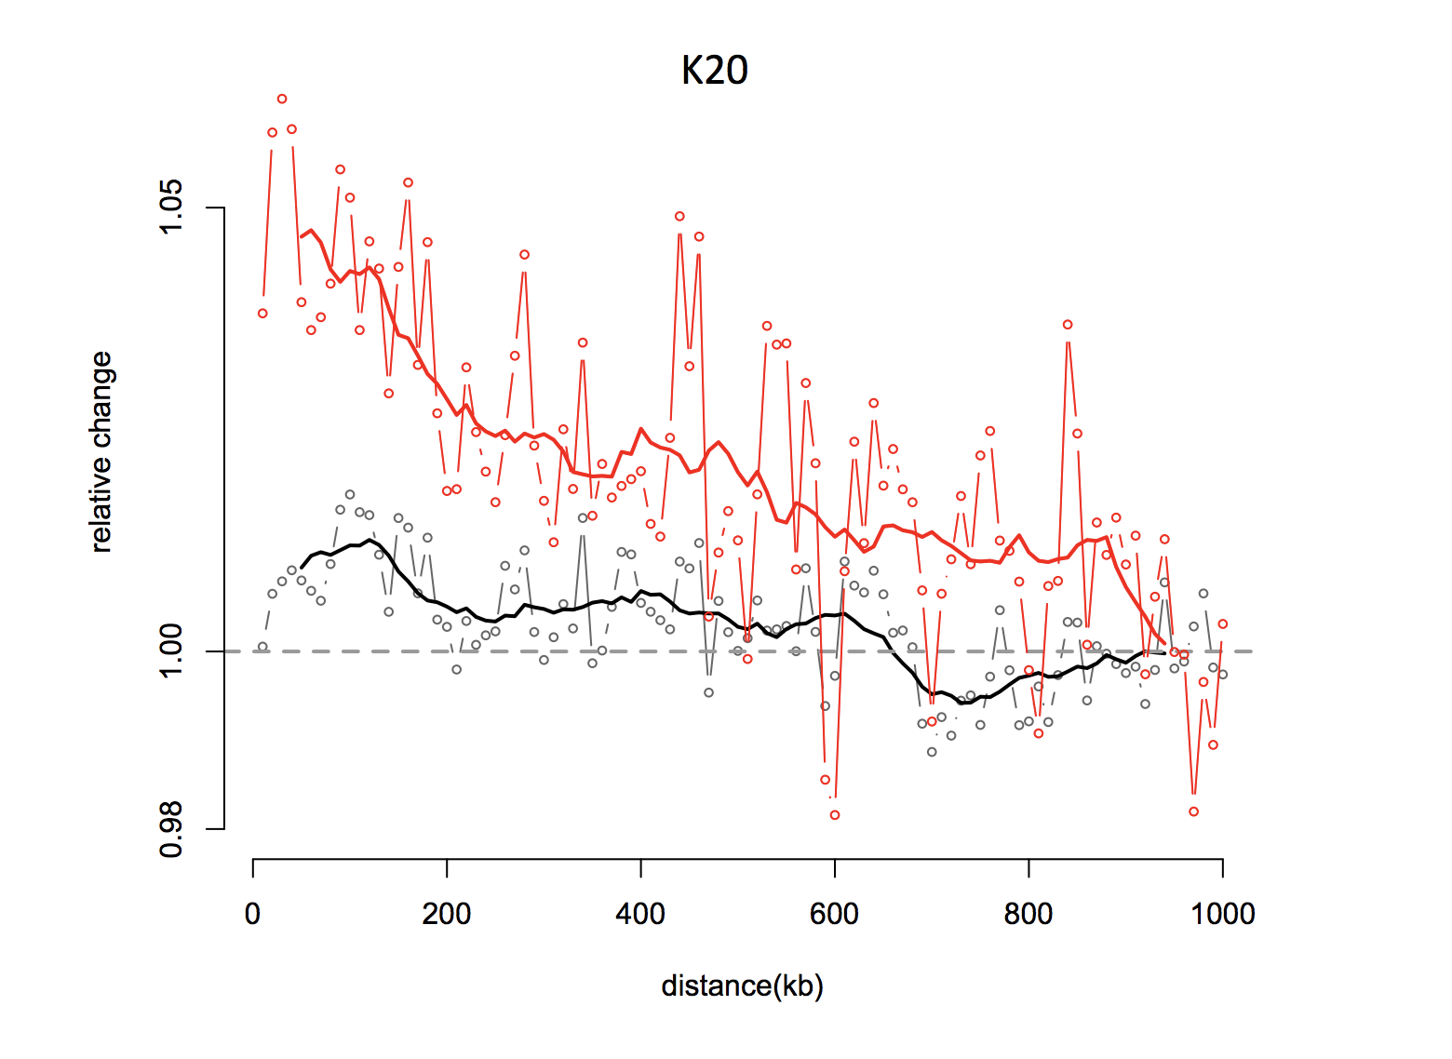
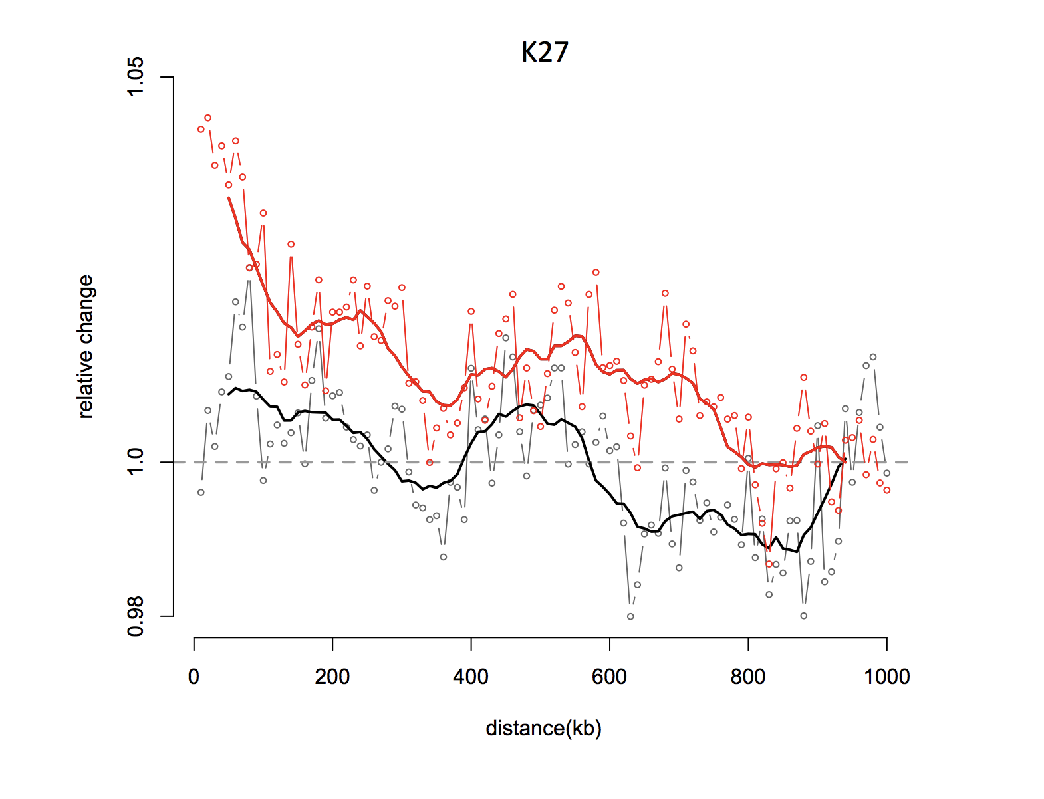
Expression stratification

Slide 70
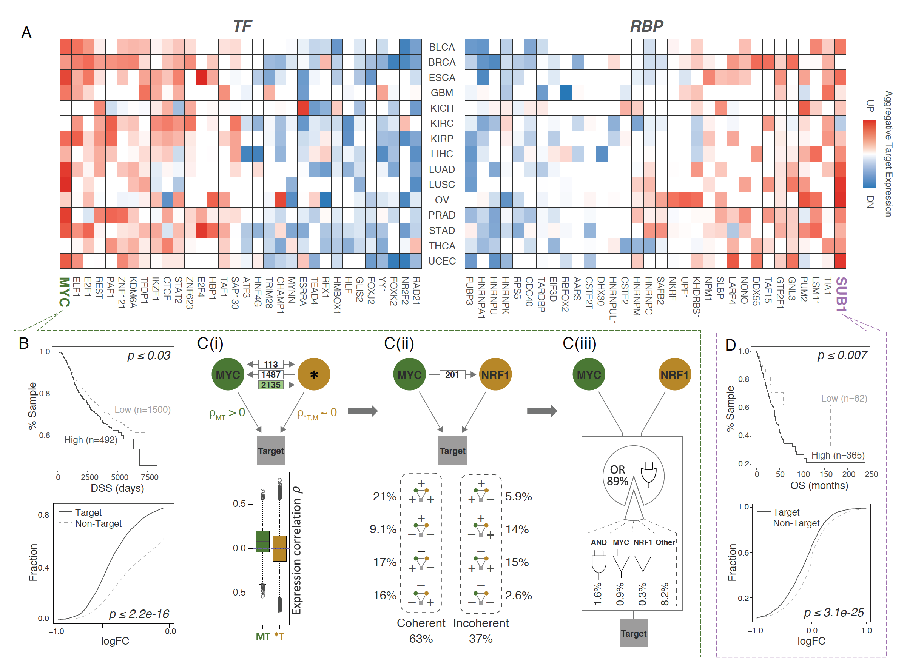
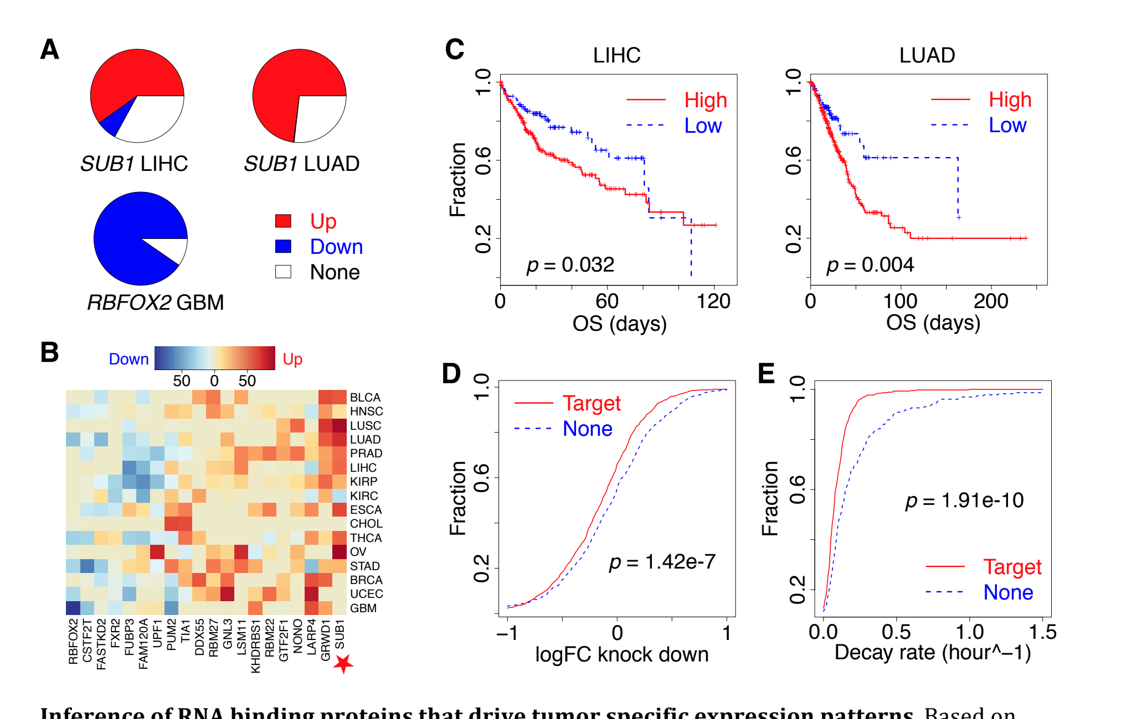

More KD
More Biology

Slide 71

SV burden shuffling results on other cell lines?

Slide 72

KD for some bars in the examples
H1: 1~2 panels
SV added in D

Slide 73


Slide 74


Slide 75


Slide 76
All cancer pooled together
Remove duplicate associations
6293 associations
Remove regions with known issues
Mappable to hg19
With rsID (guarantee that this is a common SNP)
~ 4000 SNPs
Useable to call this is a Tag SNP

Slide 77

All cancer pooled together
1569 associations
Remove duplicate associations
Remove regions with known issues
Mappable to hg19
Select EUR population
With rsID (guarantee that this is a common SNP)
Useable to call this is a Tag SNP
~ 1000 SNPs

Slide 78
How to calculate the LD SNPs
Download the 1kg VCFs
Extract EUR populations (503)
Remove multiple alellic positions
Remove positions with duplicate IDs
929 Tag SNPs has >= 1 LD SNP
21770 (-929) LD SNPs found total
Get a clean SNP file in either VCF or PLINK format
For a given tag SNP, extract all the LD SNP within 500K with R2>0.8

Slide 79

How to select a good background model:
Simple minded way: use all 1kg data that with MAF > 1%
Simple minded way: use all 1kg data that with MAF > 1%
312
36

Slide 80
#(HitSNP)/#(total SNPs)
P=binomial.test(n=total_length, x=totalSNPHit, p=background)

Slide 81


How to select a better background? MAF, distance, matching. Two packages:

Slide 82



LD regression and GWAS enrichment
In GWAS test, you first test for each individual SNP
But in partition heritability, you use all SNPs
Heritability of a set G
Heritability of a category C of set G

Slide 83
LDSC for partitioned heritability
When you do a GWAS, you are testing SNPs one by one. Here Y and X are both vectors
When you think about heritability, you are pooling all SNPs together

Slide 84







A N*M matrix including all the SNPs and all the samples
Heritability of a category C of set G
Marginal effect of SNP j from many samples
Var(y)=1

Slide 85


GOAL of LDSC: estimates an average heritability per SNP in the genome
1KG data
Given
To be estimated
Same for every SNP

Slide 86

Conclusion:
N<5000, LDSC is too noisy
Without summary statistic, can not even try LDSC
Can try, but would not work out well for targeted Chip data

Slide 87


Slide 88


Slide 89

Problem:
Missing sample size, and this is targeted CHIP not GWAS ChIP

Slide 90

100 loci from catalog
Calculate LD SNPsfrom 1kg European population

Slide 93
EXO4
BTG2
EZR
BACH2
RIMS1
EDEM3
ZNF595
BCL6
Distal: ***
Distal: BCL2
BTZGAR1
Distal: KIAA0125
Distal: SCL10A1
BCL7A
BTG1
WDR74
HIST
RMRP
Hist
Distal CBLN3

Slide 94
1 | Cell-of-Origin Patterns Dominate the Molecular Classification of 10,000 Tumors from 33 Types of Cancer | Peter W. Laird22
2 | Oncogenic Signaling Pathways in The Cancer Genome Atlas | Chris Sander, Nikolaus Schultz
3 | Machine Learning Identifies Stemness Features Associated with Oncogenic Dedifferentiation | Joshua M. Stuart, Maciej Wiznerowicz
4 | Pathogenic Germline Variants in 10,389 Adult Cancers | Sharon E. Plon, Feng Chen, Li Ding
5 | Comprehensive Characterization of Cancer Driver Genes and Mutations | Gordon B. Mills, Rachel Karchin, Li Ding
6 | A Pan-Cancer Analysis of Enhancer Expression in Nearly 9000 Patient Samples | Han Liang
7 | An Integrated TCGA Pan-Cancer Clinical Data Resource to Drive High-Quality Survival Outcome Analytics | Hai Hu
8 | Perspective on Oncogenic Processes at the End of the Beginning of Cancer Genomics | Li Ding … Gad Getz

Slide 96
HepG2-Casper
MCF-7-Casper
K562-Casper
MCF-7-Casper-with-JEME-ESCAPE
GM12878-Casper
MCF-7-Casper-with-JEME

Slide 99
Leukemia, 4563 tag + LD SNPs

Slide 101


