Slide 1
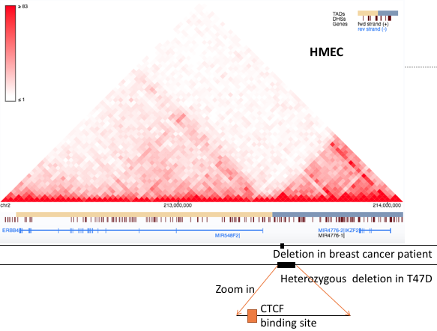
T47D deletion is located within a TAD boundary containing a CTCF binding site
Hi-C map shows T47D deletion is located within a TAD boundary
Only one CTCF binding site is found in this boundary

Slide 2
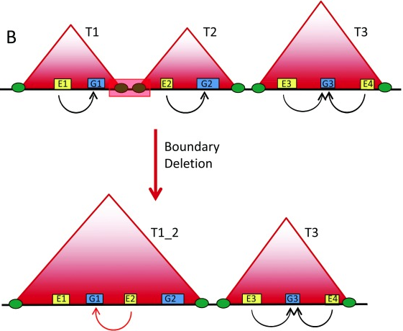
Three TADs in this region
Deletion of boundary resulted in neo-TAD
As a result G1 is up-regulated by
enhancer E2.

Slide 3
CRISPR guide sequence design
T47D, has a wt allele and a mutant allele
Since there is no PAM sequence close to the CTCF binding site, we have to do a double cut.
Knock out a 88bp region containing the CTCF binding site

Slide 4
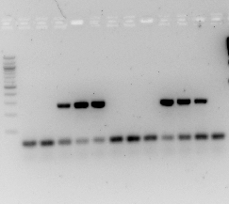
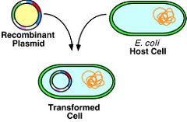
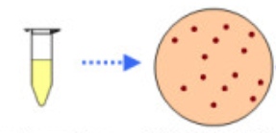
CRISPR knockout plasmid preparation
PCR screening for positive clones
Confirm by Sanger sequencing
Amplify the correct CRIPSR plasmid using Qiagen Midiprep kit

Slide 5
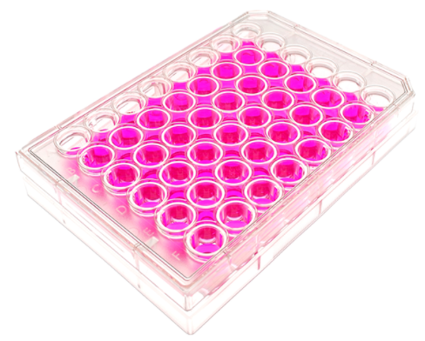
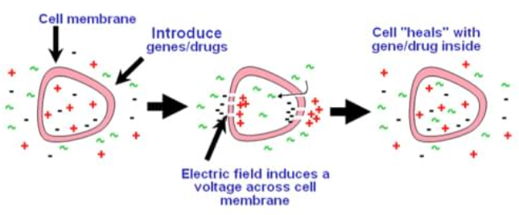
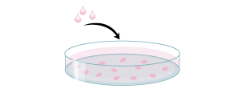
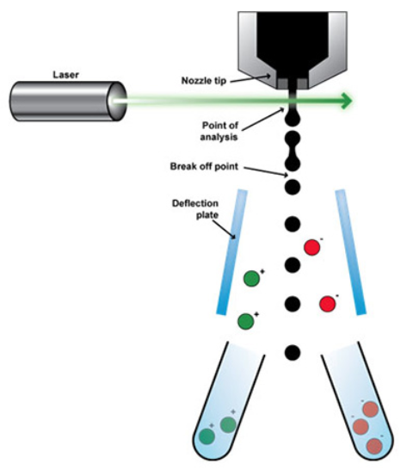
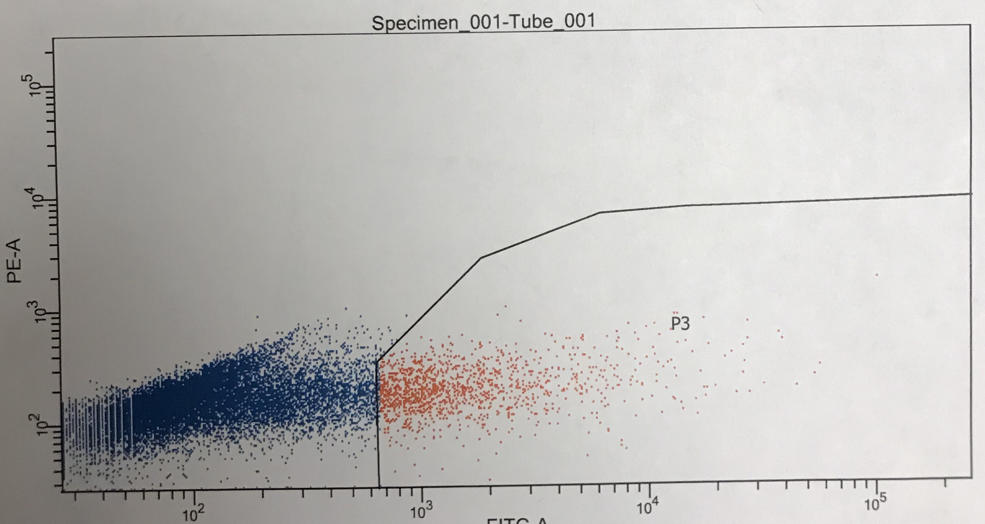
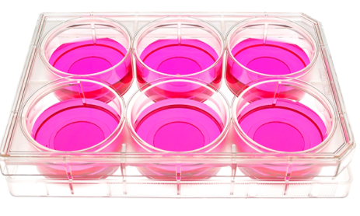
CRISPR Knock out
Pick single cell colonies, and plate them in 48-well plates
Transfect T47D cells with CRISPR plasmid by electroporation
plate GFP+ cells in a 10cm plate to grow single cell colonies, 5000 cells/plate
Culture electroporated cells in a 6-well plate for 2 days
FACS sorting GFP+ cells

Slide 6
Design for PCR screening of CTCF KO clones
310bp
F primer
T47D wt allele
CTCF binding site
R primer
CRISPR cutting site
CRISPR cutting site
88bp
F primer
R primer
222bp

Slide 7
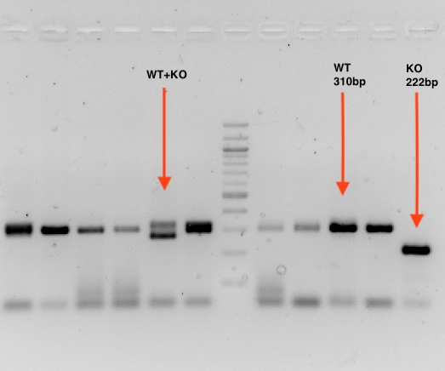
CRISPR PCR validation
T47D wild type allele
310bp
CTCF_Knockout
222bp
Choose CTCF_KO clones and confirm the genotype by sanger sequencing

Slide 8
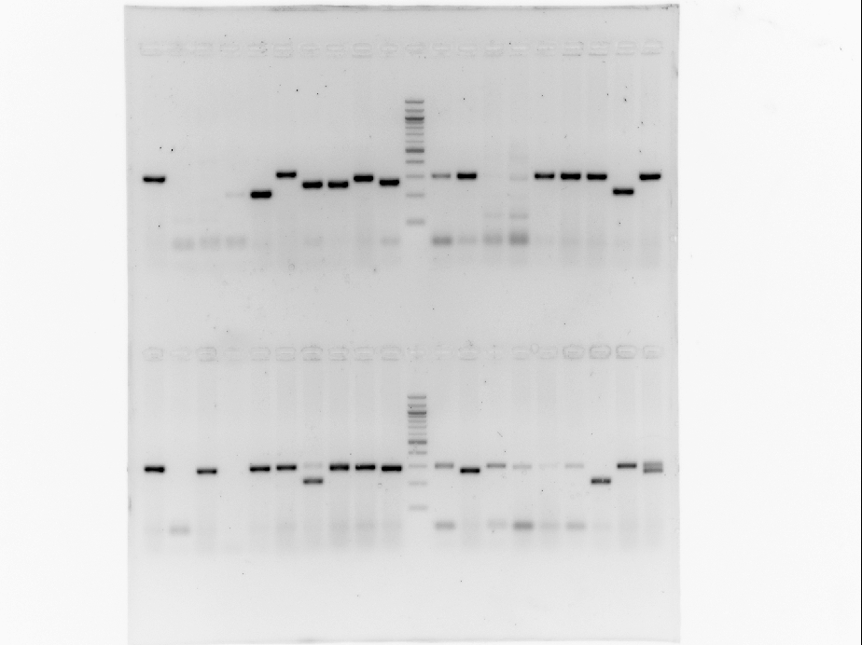
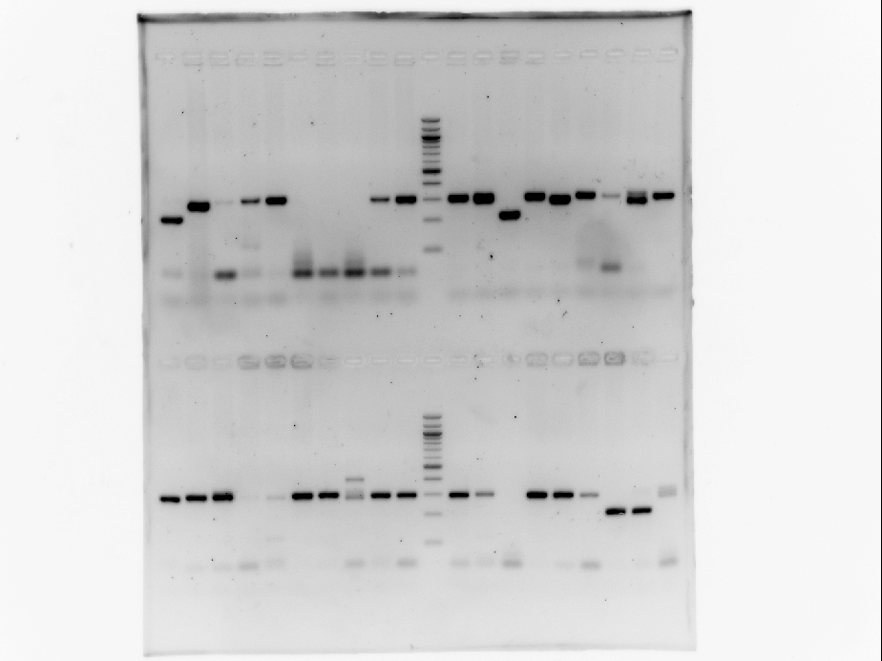
10% CRISPR efficiency, and confirmed by Sanger sequencing

Slide 9
Breast cancer onco-gene is upregulated by 2 fold

