Slide 1
Upstream open reading frames (uORFs) regulate translation and are affected by somatic mutation
uORFs regulate the translation of downstream coding regions.
This regulation may be altered by somatic mutation in cancer.
In Battle et al. 2014 data uORF gain & loss assoc. protein level change.
[McGillivray et al., NAR (‘18)]

Slide 2
The population of functional upstream open reading frames may be significant
[McGillivray et al., NAR (‘18)]
Ribosome profiling experiments have low overlap in identified uORFs.
This suggests a high false-negative rate and more functional uORFs than currently known.
All 1.3 million uORFs scored by predicted functional impact.

Slide 3
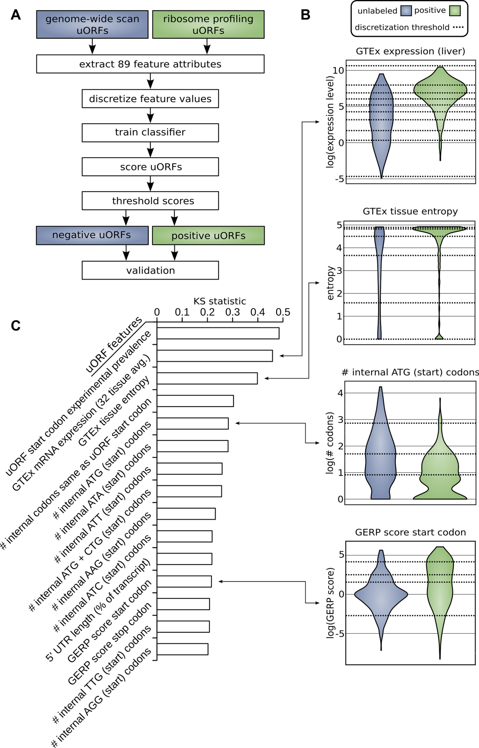
Prediction and validation of functional uORFs using 89 features
All near-cognate start codons predicted.
Cross-validation on independent ribosome profiling datasets and validation using in vivo protein levels and ribosome occupancy in humans (Battle et al. 2014).
[McGillivray et al., NAR (‘18)]

Slide 4
A comprehensive catalog of functional uORFs for use
All 1.3 million scored uORFs available for download.
github.gersteinlab.org/uORFs
Large predicted positive set likely to affect translation (1.8x10⁵).
Predicted functional uORFs may be intersected with disease associated variants.
[McGillivray et al., NAR (‘18)]

Slide 5
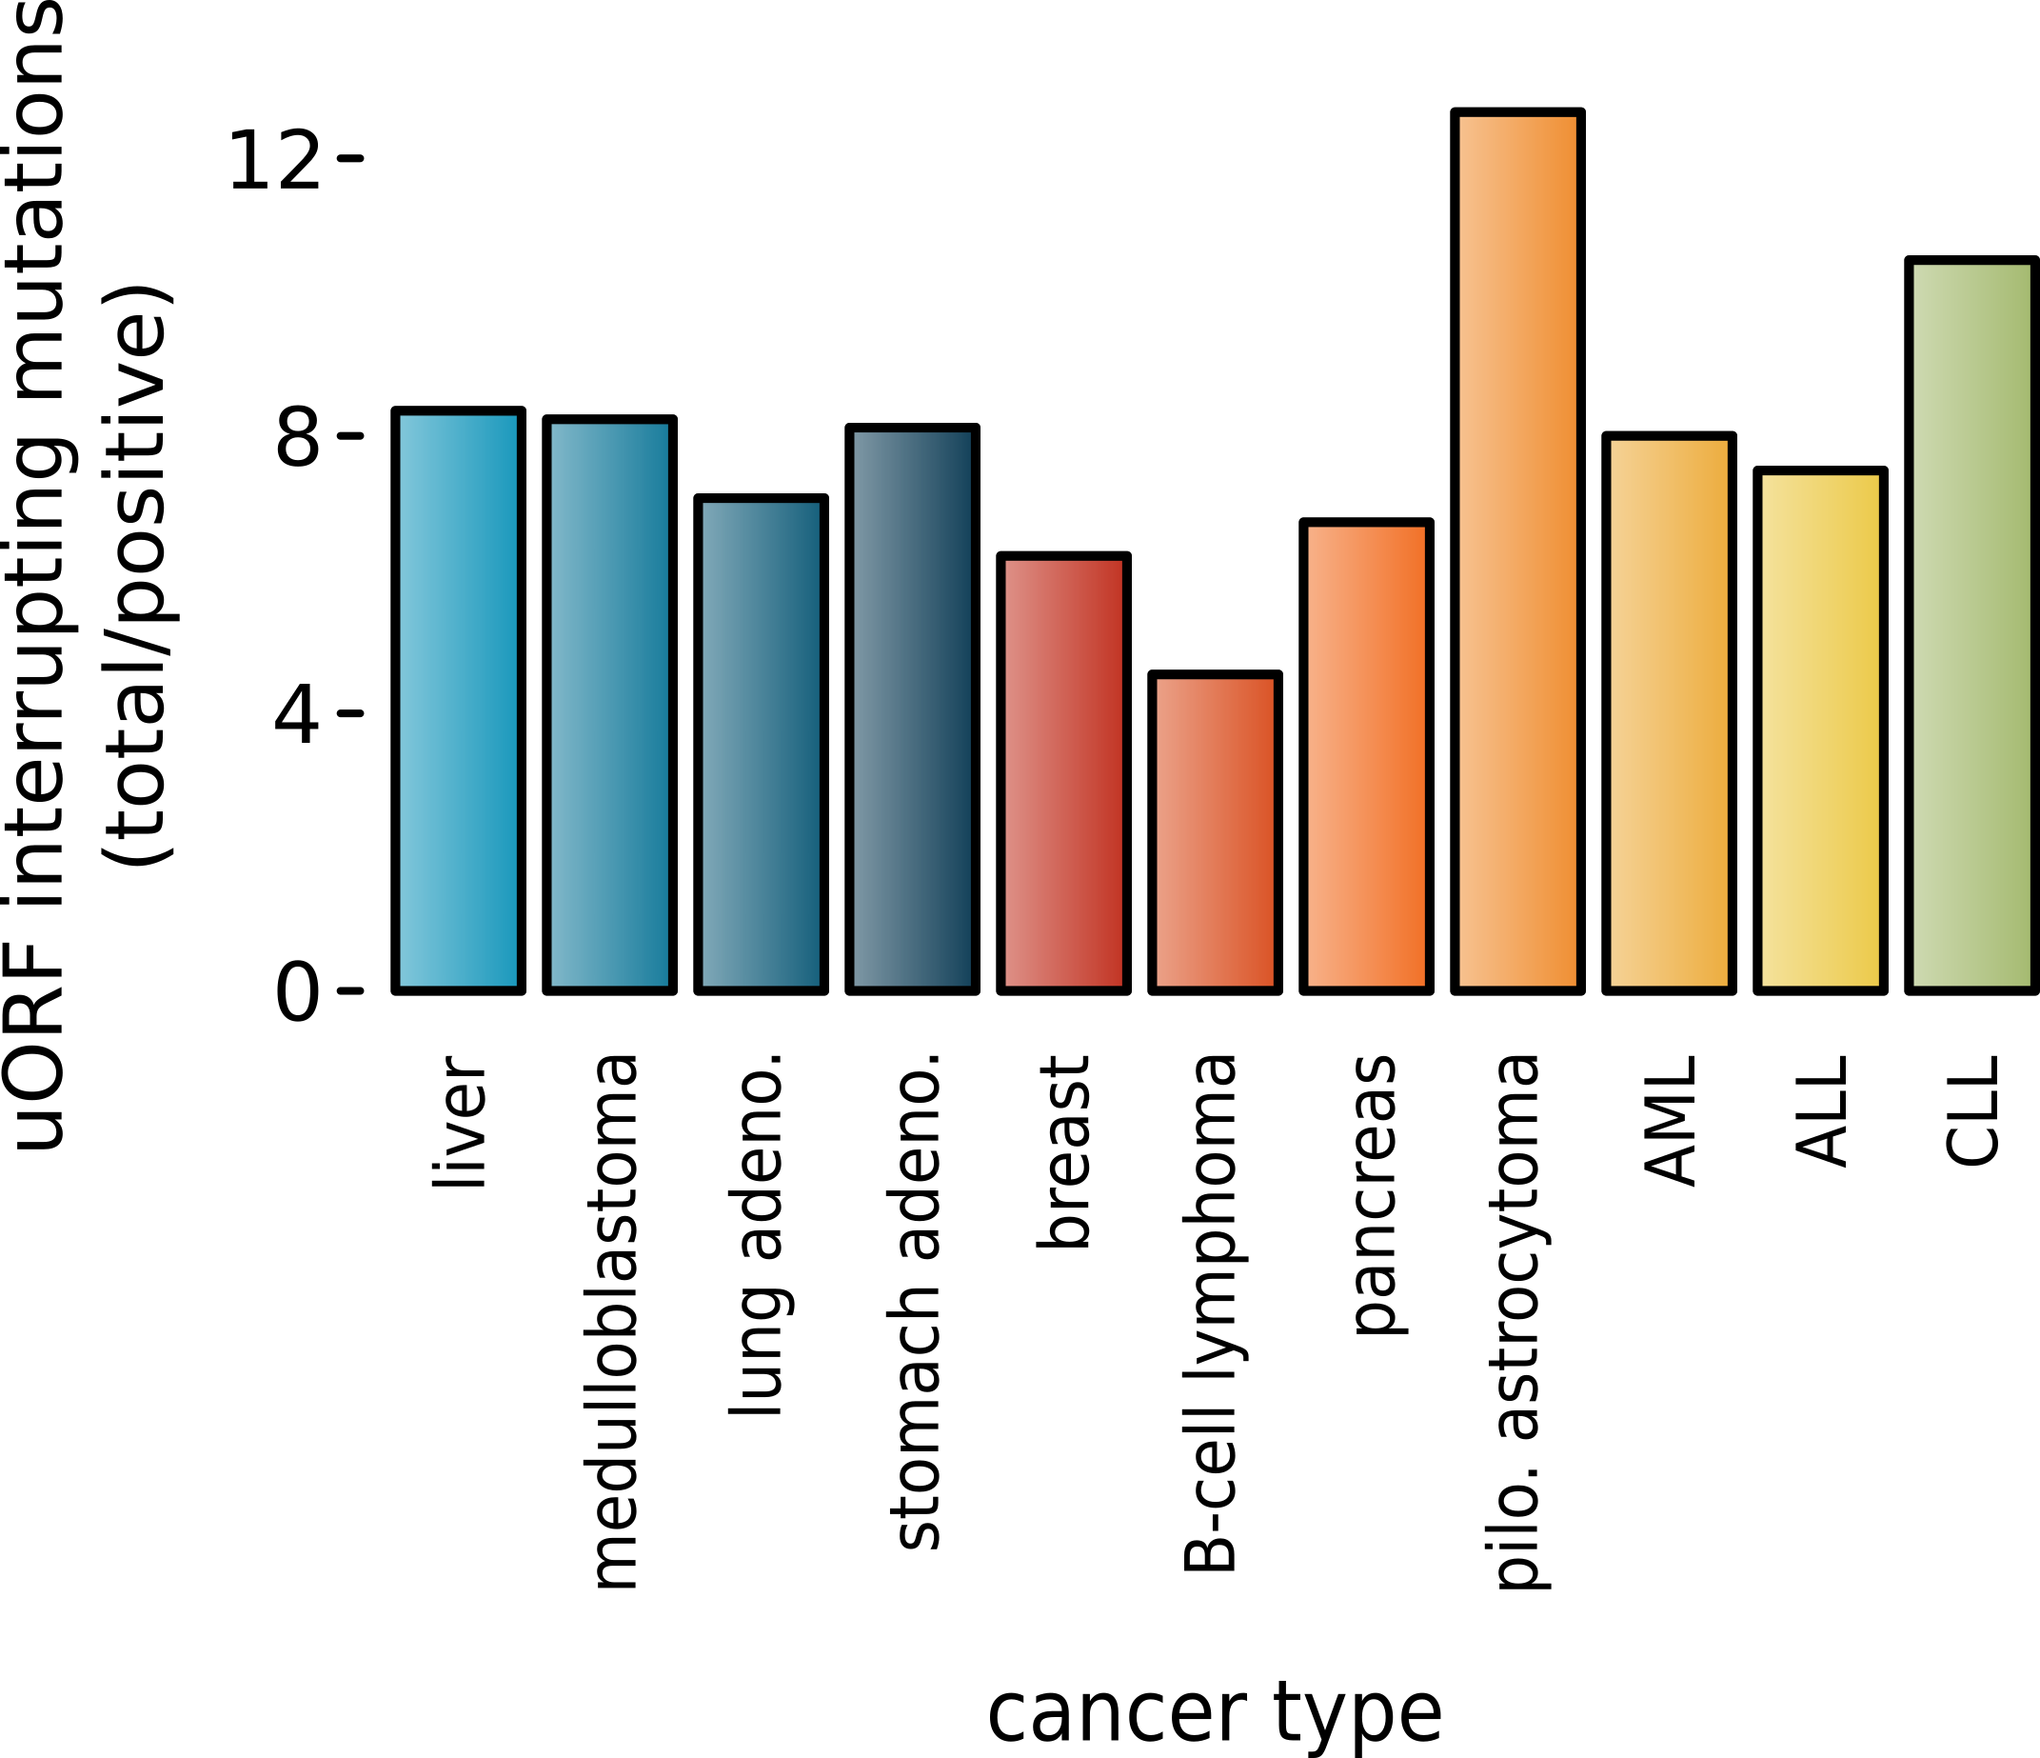
Somatic alteration of uORFs disproportionately affects certain cancers and molecular pathways
uORF gain and loss occurs in cancer (incl. in cancer associated genes, e.g., MYC, BCL2, etc.).
Alteration of translation may contribute to cancer.
These changes are concentrated in certain cancers and pathways.
Mutations leading to uORFs diff in somatic vs. germline.
[McGillivray et al., NAR (‘18)]

Slide 6
Prioritizing Variants in Personal Genomes: Using functional impact & recurrence, with particular application to cancer
Introduction
An individual's disease variants as the public's gateway into genomics & biology
The exponential scaling of data generation & processing
Mining big data to prioritize key variants as cancer drivers
Functional impact #1: Coding
ALoFT: Annotation of Loss-of-Function Transcripts.
Frustration as a localized metric of SNV impact. Differential profiles for oncogenes v. TSGs
Functional impact #2: Non-coding
uORFs: Altered translation of coding and non-coding regions by somatic mutation.
FunSeq integrates evidence, with a “surprisal” based weighting scheme
Prioritizing rare variants with “sensitive sites” (human conserved)
Recurrence: Statistics for driver identification
Background mutation rate significantly varies & is correlated with replication timing & TADs
Developed a variety of parametric & non-parametric methods taking this into account
LARVA uses parametric beta-binomial model, explicitly modeling covariates
MOAT does a variety of non-parm. shuffles (annotation, variants, &c). Useful when explicit covariates not available. Slower but speeded up w/ GPUs
Recurrence #2: (Low-power) application to pRCC
WGS finds additional facts on the canonical driver, MET. Other suggestive non-coding hotspots.
Analysis of signatures & tumor evolution helps identify key mutations in different ways

Slide 7
Coding and non-coding elements may synergistically contribute to cancer
[McGillivray et al., Ann. Rev. Biomedical Data Science (‘18), in press.]

Slide 8
Local molecular structure affects mutation consequence
[McGillivray et al., Ann. Rev. Biomedical Data Science (‘18), in press.]

Slide 9
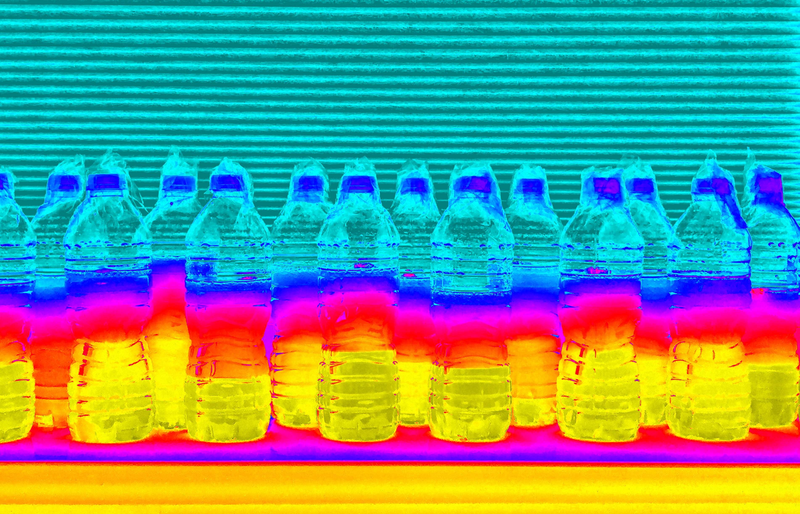
CostSeq2 - P Muir, S Li, S Lou, D Wang, DJ Spakowicz, L Salichos, J Zhang, GM Weinstock, F Isaacs, J Rozowsky
LARVA.gersteinlab.org
L Lochovsky, J Zhang, Y Fu, E Khurana
MOAT.gersteinlab.org - L Lochovsky, J Zhang
github.gersteinlab.org/uORFs
P McGillivray, R Ault, M Pawashe,
R Kitchen, S Balasubramanian
Biomednets - P McGillivray, D Clarke, W Meyerson, J Zhang, D Lee, M Gu, S Kumar, H Zhou
github.com/gersteinlab/Frustration
S Kumar, D Clarke
github.com/gersteinlab/MrTADfinder
KK Yan, S Lou
VAT.gersteinlab.org
L Habegger, S Balasubramanian, DZ Chen, E Khurana, A Sboner, A Harmanci, J Rozowsky, D Clarke, M Snyder
ALoFT.gersteinlab.org
S Balasubramanian, Y Fu, M Pawashe, P McGillivray, M Jin, J Liu, K Karczewski, D MacArthur
FunSeq.gersteinlab.org
Y Fu, E Khurana, Z Liu, S Lou, J Bedford, XJ Mu, KY Yip
pRCC - S Li, B Shuch
Acknowledgments! Also, Hiring: See Jobs.gersteinlab.org

