Slide 1
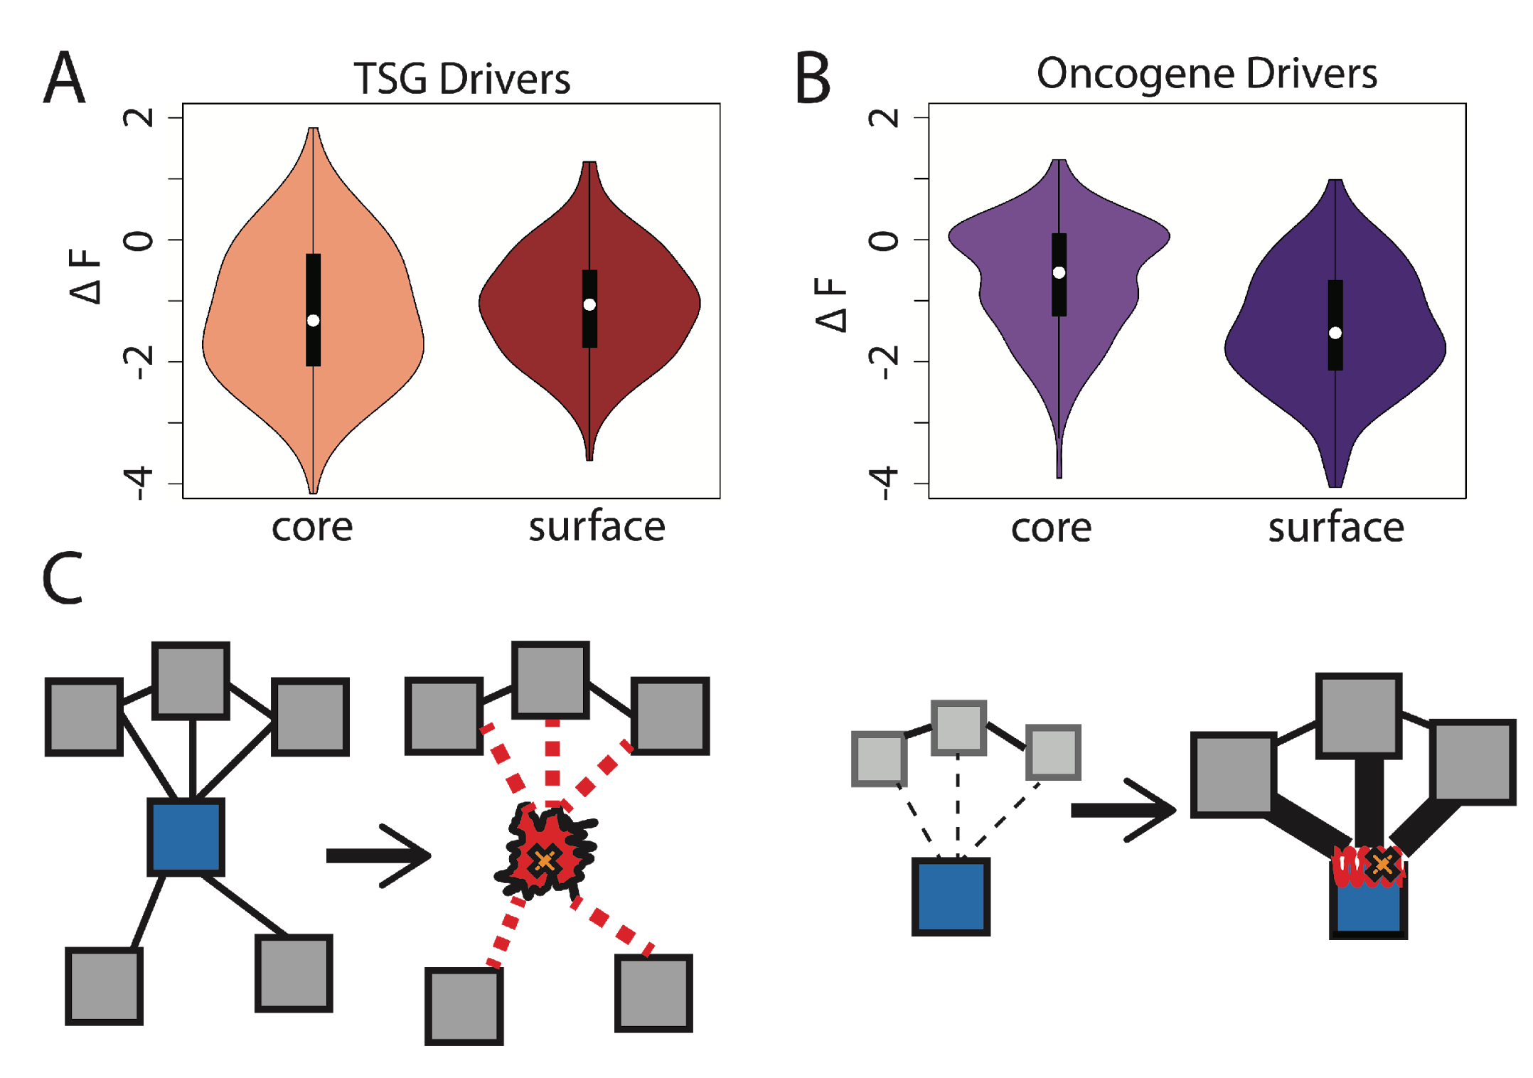
Comparison between ∆F distributions: TSGs v. oncogenes
[Kumar et al, NAR (2016)]
SNVs in TSGs change frustration more in core than the surface, whereas those associated with oncogenes manifest the opposite pattern. This is consistent with differences in LOF v GOF mechanisms.
Notes:
we observe that somatic SNVs associated with TSGs change the frustration more in core than the surface, whereas those associated with oncogenes manifest the opposite pattern. This is consistent with LOF and GOF mechanism proposed for TSG and oncogene driven cancer progression.

Slide 2
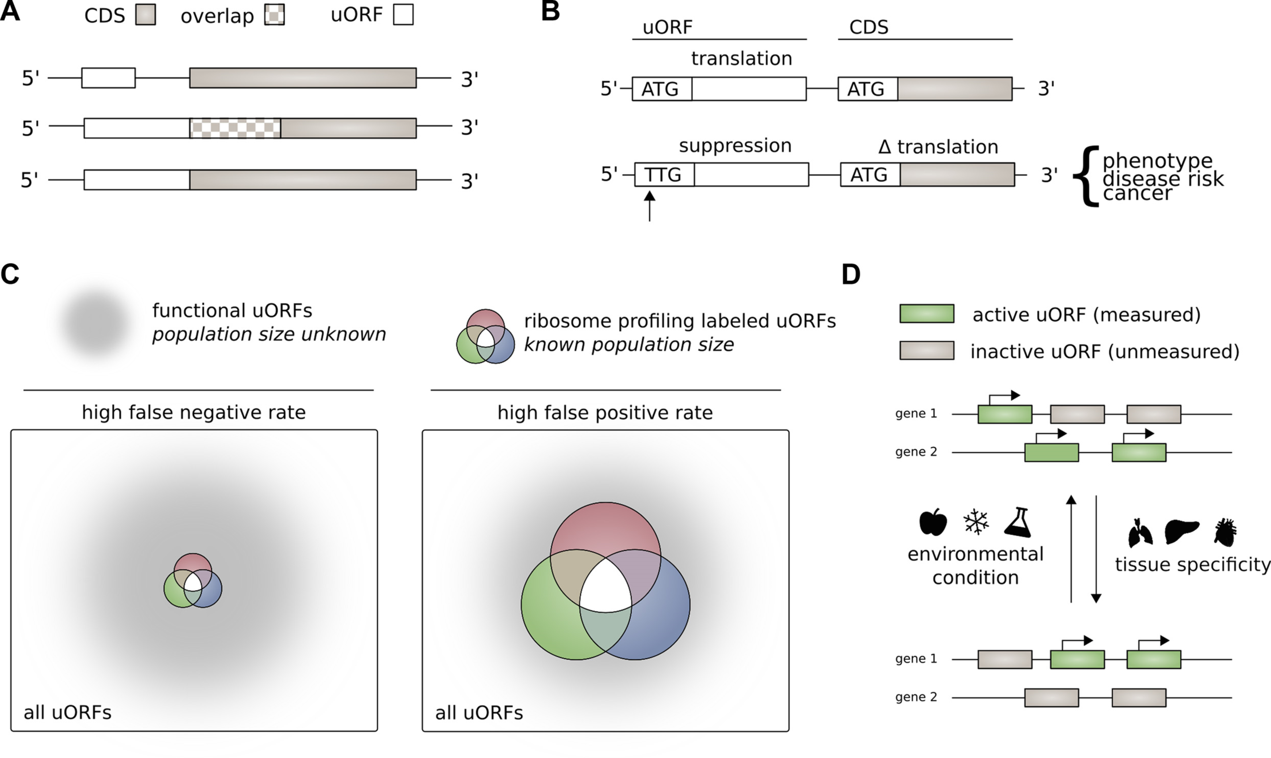
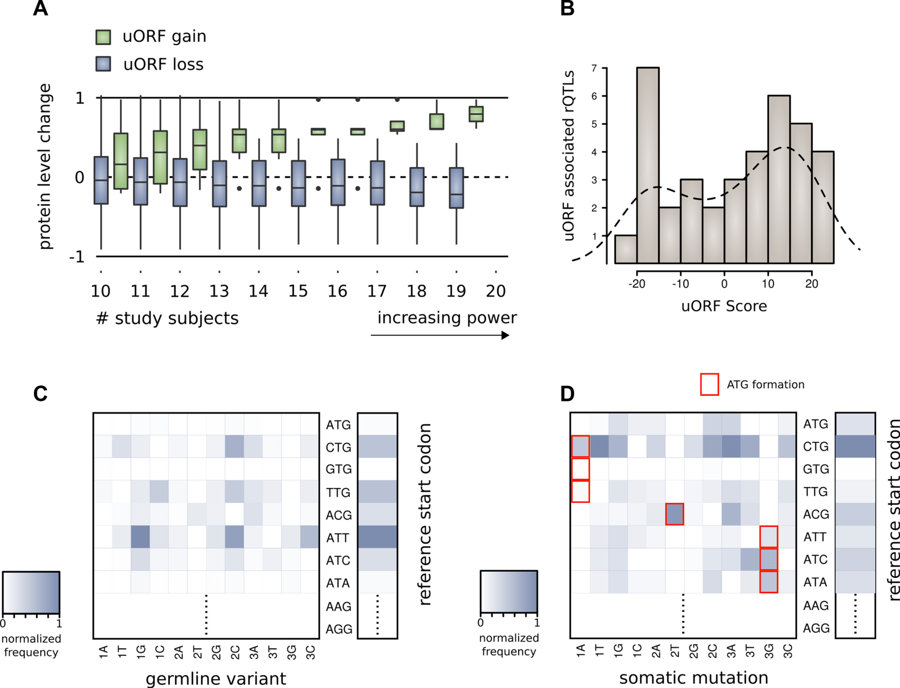
Upstream open reading frames (uORFs) regulate translation are affected by somatic mutation
uORFs regulate the translation of downstream coding regions.
This regulation may be altered by somatic mutation in cancer.
In B et al data uorf gain & loss assoc. protein level change
[McGillivray et al., NAR (‘18)]

Slide 3
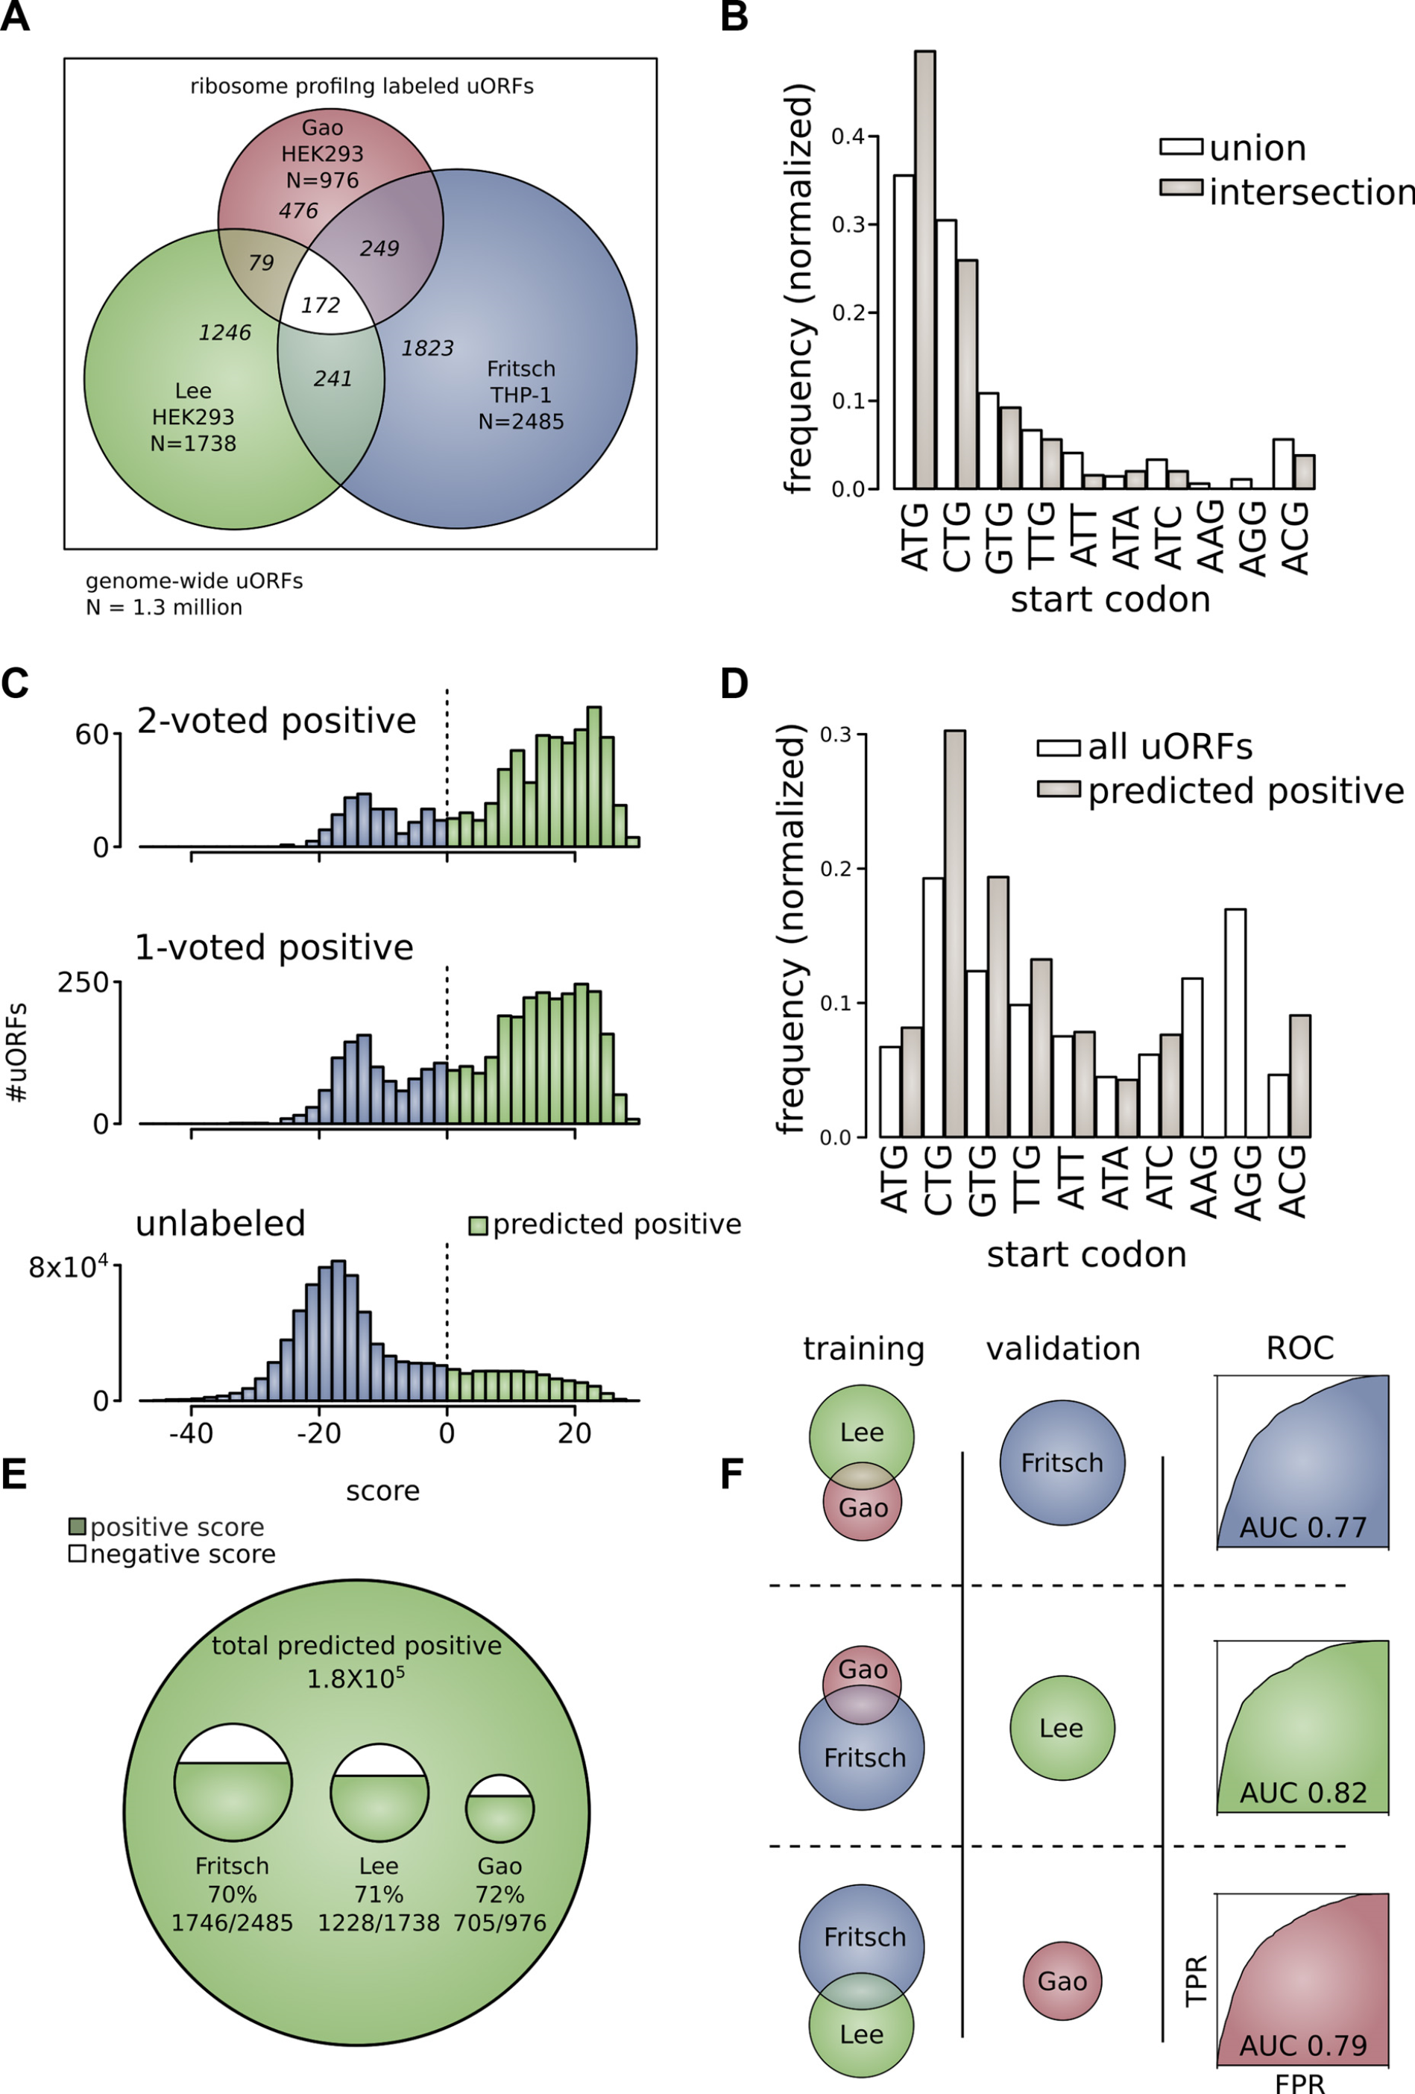
The population of functional upstream open reading frames may be significant
All 1.3 million uORFs scored by predicted functional impact.
[McGillivray et al., NAR (‘18)]
Ribosome profiling experiments have low overlap in identified uORFs.
This suggests high false-negative rate, and more functional uORFs than currently known.

Slide 4
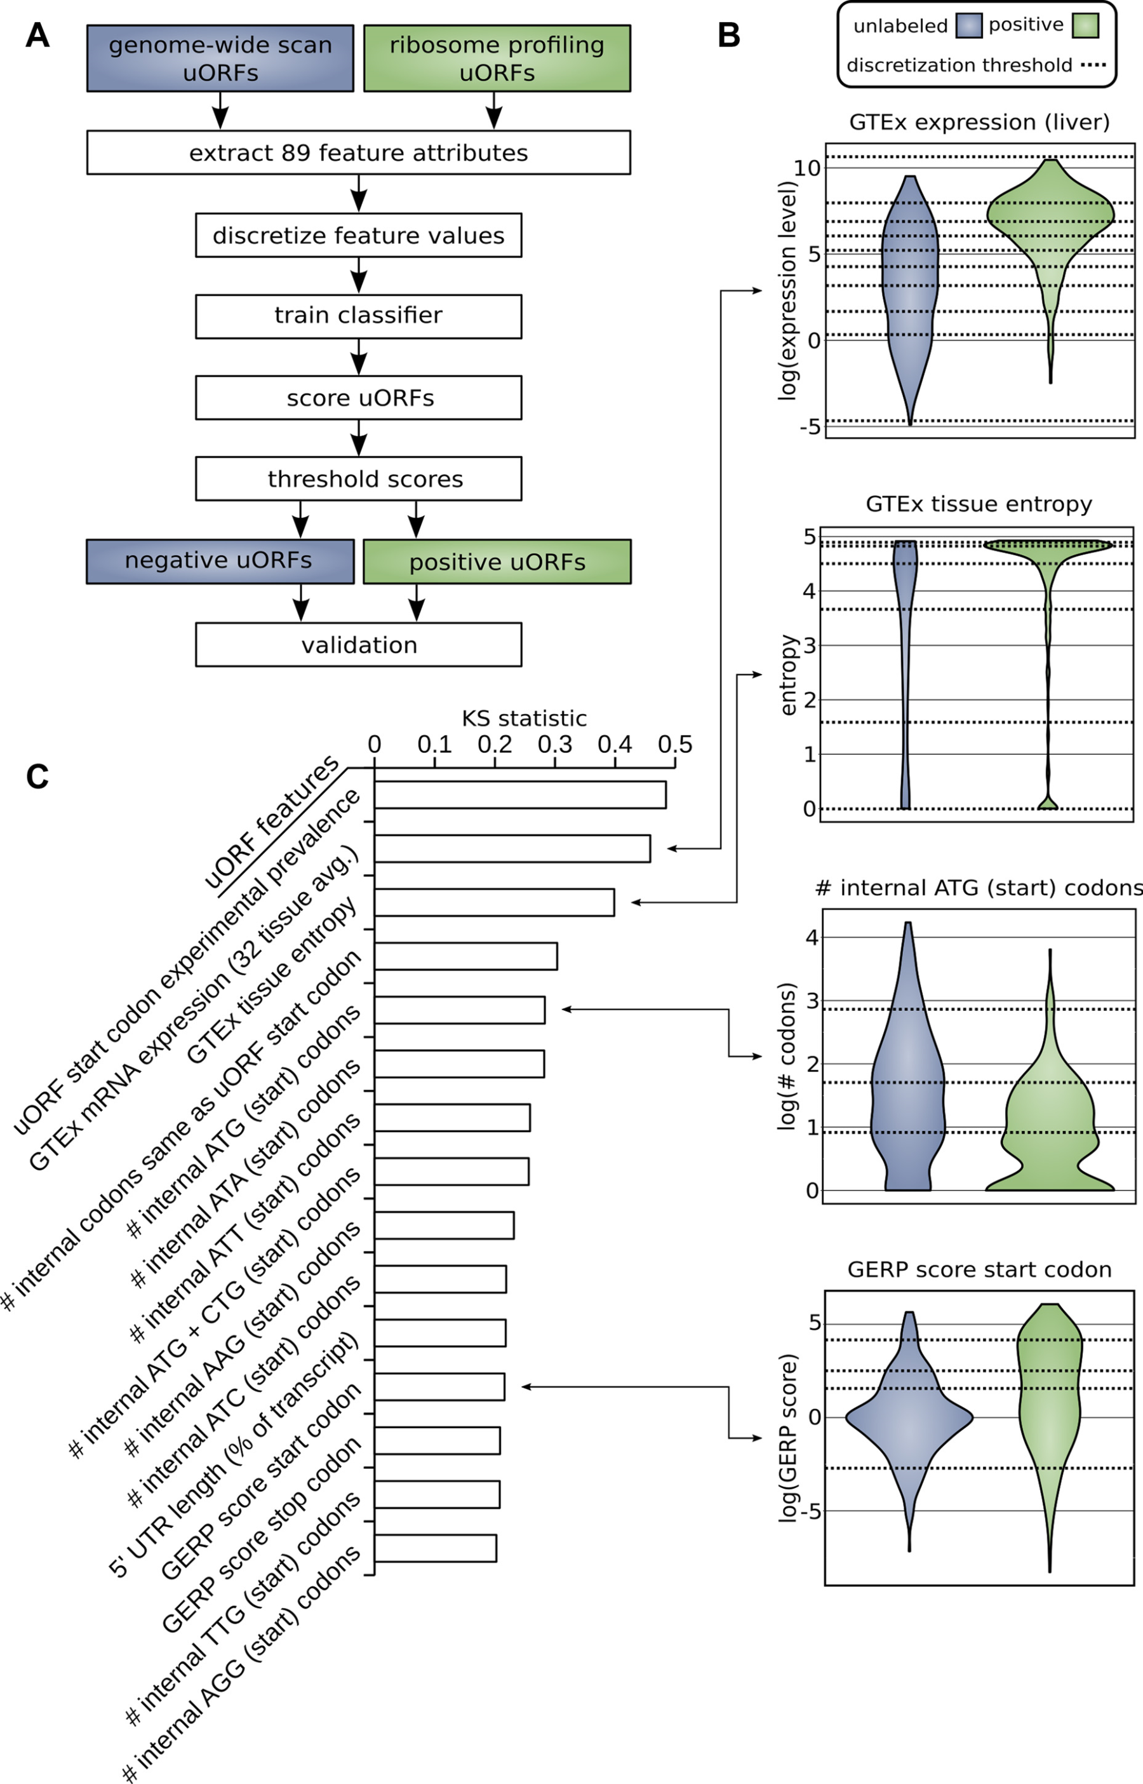
Prediction and validation of functional uORFs using 89 features
All 1.3 million uORFs scored by predicted functional impact.
All near-cognate start codons predicted.
Cross-validation on independent ribosome profiling datasets and validation using in vivo protein levels and ribosome occupancy in humans (Battle et al. 2014).
[McGillivray et al., NAR (‘18)]

Slide 5
From: A comprehensive catalog of predicted functional upstream open reading frames in humans
Nucleic Acids Res. Published online March 19, 2018. doi:10.1093/nar/gky188
Nucleic Acids Res | © The Author(s) 2018. Published by Oxford University Press on behalf of Nucleic Acids Research.This is an Open Access article distributed under the terms of the Creative Commons Attribution Non-Commercial License (http://creativecommons.org/licenses/by/4.0/), which permits unrestricted reuse, distribution, and reproduction in any medium, provided the original work is properly cited.
Notes:
Figure 2. (A) Methodology for distinguishing positive from unlabeled uORFs. uORFs identified through genome-wide scan and uORFs labeled in ribosome profiling experiments were used to train a machine learning algorithm to identify uORFs that are likely active (positive predictions). (B) Examples of differential distributions of attributes between positive and unlabeled uORFs. uORF attributes are used to distinguish positive from unlabeled uORFs. Continuous distributions were discretized and optimized for machine learning using the minimum description length principle (MDLP) binning algorithm. Horizontal lines on the plot correspond to these binning intervals. (C) Upstream open reading frame attribute ranking. Attributes are ranked according to the difference in distribution between positive and unlabeled uORFs using the KS statistic. The top 15 features according to this prioritization are shown.
5

Slide 6
A comprehensive catalog of functional uORFs for use
All 1.3 million scored uORFs available for download.
github.gersteinlab.org/uORFs
Large predicted positive set likely to affect translation (1.8x10⁵).
Predicted functional uORFs may be intersected with disease associated variants.
[McGillivray et al., NAR (‘18)]

Slide 7
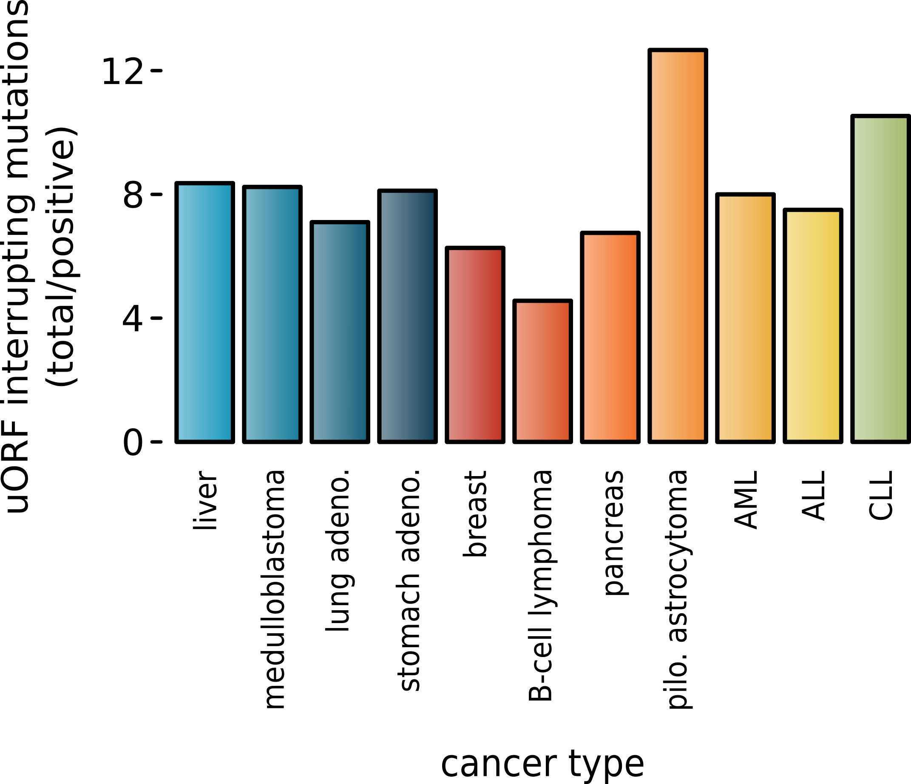
Somatic alteration of uORFs disproportionately affects certain cancers and molecular pathways
uORF gain and loss occurs in cancer (incl. in cancer associated genes, e.g., MYC, BCL2, etc.)
These changes are concentrated in certain cancers and pathways.
Alteration of translation may contribute to cancer.
Mutations leading to uorfs diff in som v germline
[McGillivray et al., NAR (‘18)]

Slide 8
Prioritizing Variants in Personal Genomes: Using functional impact & recurrence, with particular application to cancer
Introduction
  An individual's disease variants as the public's gateway into genomics & biology
  The exponential scaling of data generation & processing
  Mining big data to prioritize key variants
  as cancer drivers
  Functional impact #1: Coding
  ALoFT: Annotation of Loss-of-Function Transcripts.
  Frustration as a localized metric of SNV impact. Differential profiles for oncogenes v. TSGs
  uORFs: Altered translation of coding and non-coding regions by somatic mutation.
  Functional impact #2: Non-coding
  FunSeq integrates evidence,
  with a “surprisal” based weighting scheme
  Prioritizing rare variants with “sensitive sites”
  (human conserved)
Recurrence:
Statistics for driver identification
  Background mutation rate significantly varies & is correlated with replication timing & TADs
  Developed a variety of parametric & non-parametric methods taking this into account
  LARVA uses parametric beta-binomial model, explicitly modeling covariates
  MOAT does a variety of non-parm. shuffles (annotation, variants, &c). Useful when explicit covariates not available. Slower
  but speeded up w/ GPUs
Recurrence #2:
(Low-power) application to pRCC
  WGS finds additional facts on the canonical driver, MET. Other suggestive non-coding hotspots.
  Analysis of signatures & tumor evolution helps identify key mutations in different ways

Slide 9
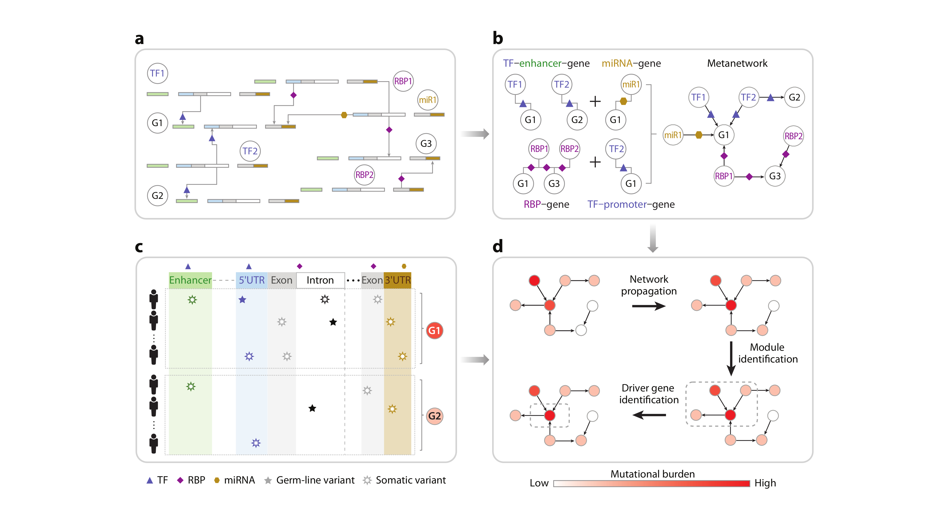
Coding and non-coding elements may synergistically contribute to cancer
[McGillivray et al., Ann. Rev. Biomedical Data Science (‘18), in press.]

Slide 10
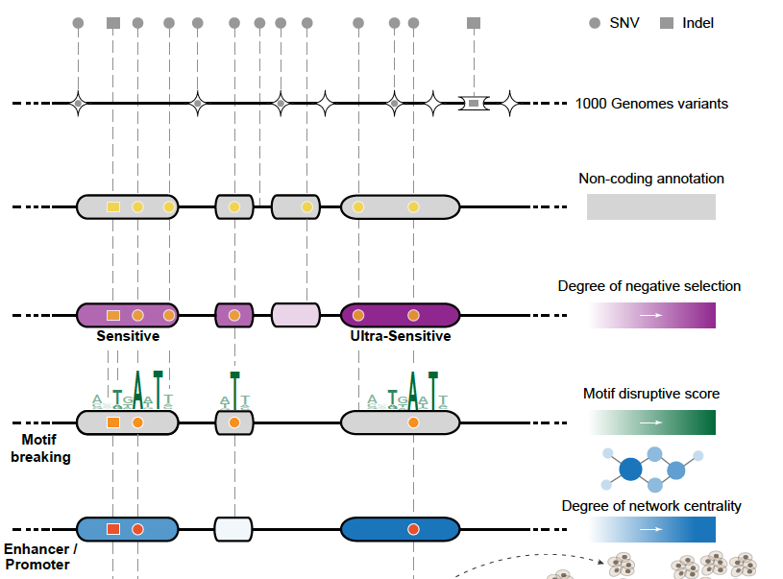
Funseq: a flexible framework to determine
functional impact & use this to prioritize variants
Annotation (tf binding sites open chromatin, ncRNAs) & Chromatin Dynamics
Conservation
(GERP, allele freq.)
Mutational impact (motif breaking, Lof)
Network (centrality position)
[Fu et al., GenomeBiology ('14), , Khurana et al., Science ('13)]

Slide 11
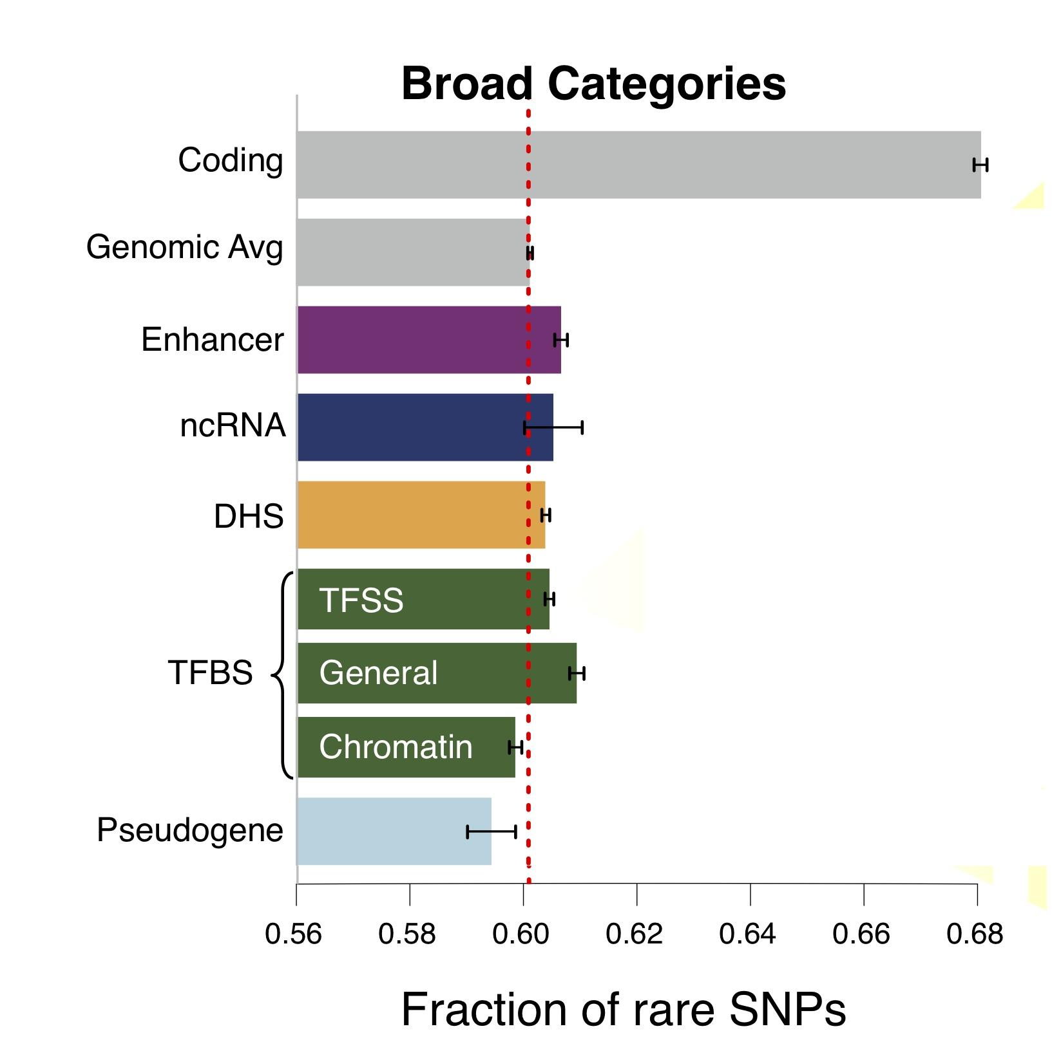
Finding "Conserved” Sites in the Human Population:
Negative selection in non-coding elements based on
Production ENCODE & 1000G Phase 1
Broad categories of regulatory regions under negative selection
Related to:
ENCODE, Nature, 2012
Ward & Kellis, Science, 2012
Mu et al, NAR, 2011
(Non-coding RNA)
(DNase I hypersensitive sites)
(TFSS: Sequence-specific TFs)
(Transcription factor binding sites)
Depletion of Common Variants
in the Human Population

Slide 12
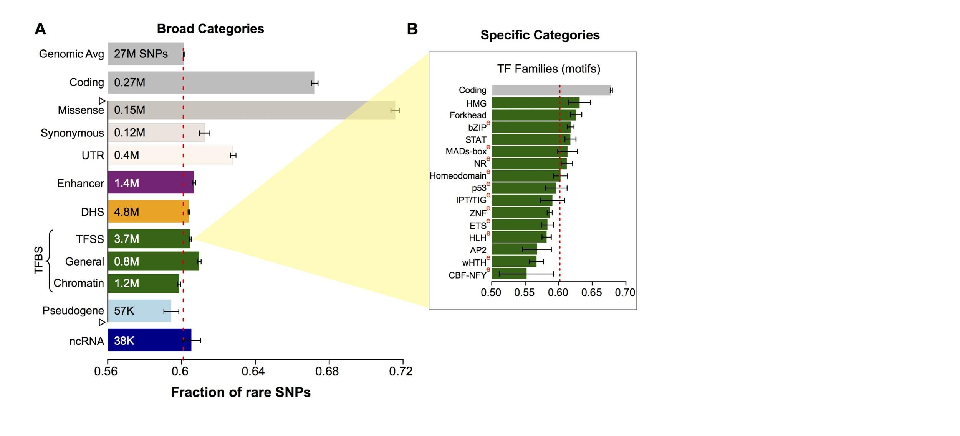
Differential selective constraints
among specific sub-categories
Sub-categorization possible because of better statistics from 1000G phase 1 v pilot
[Khurana et al., Science (‘13)]

Slide 13
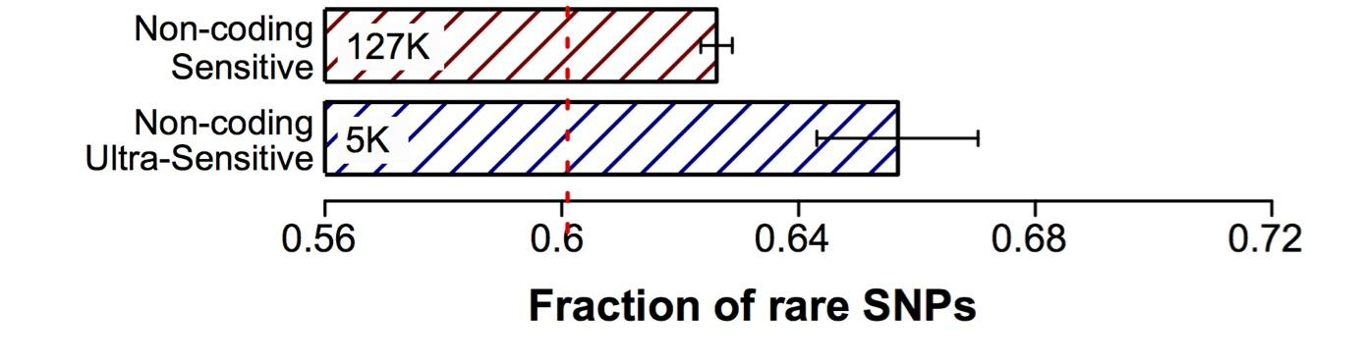
Defining Sensitive
non-coding Regions
~0.4% genomic coverage (~ top 25)
~0.02% genomic coverage (top 5)
Start 677 high-resolution non-coding categories; Rank & find those under strongest selection
Sub-categorization possible because of better statistics from 1000G phase 1 v pilot
[Khurana et al., Science (‘13)]

Slide 14
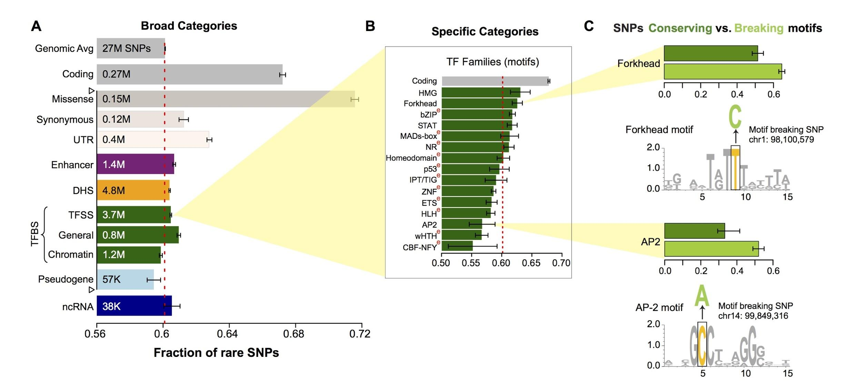
SNPs which break TF motifs are under stronger selection
[Khurana et al., Science (‘13)]

Slide 15
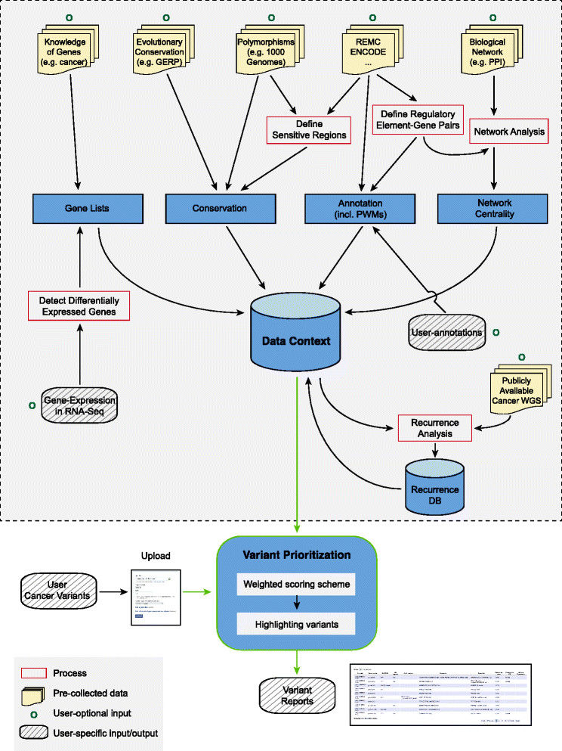
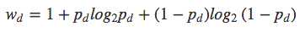
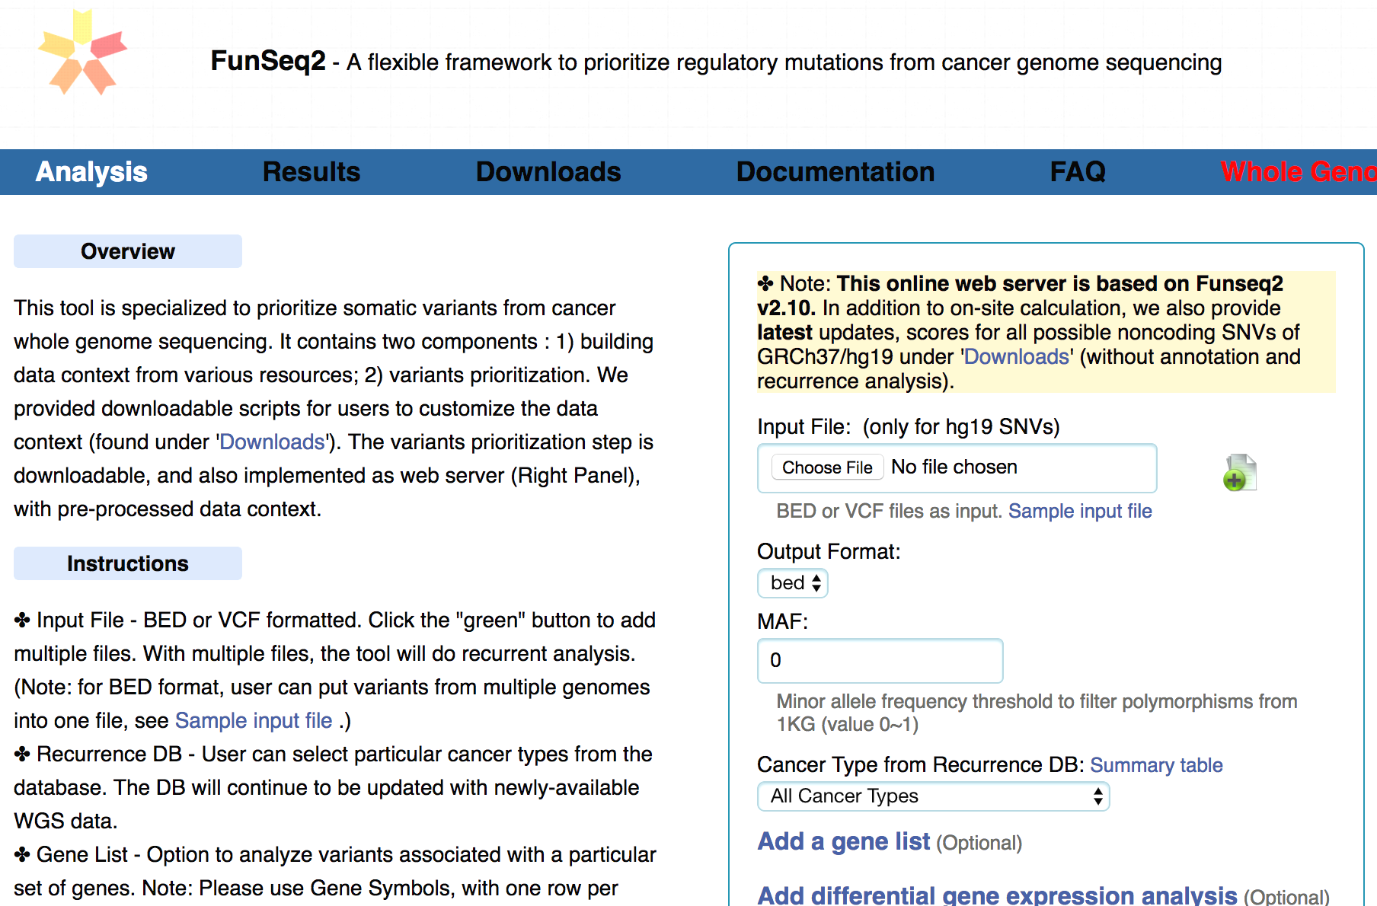
FunSeq.gersteinlab.org
HOT region
Sensitive region
Polymorphisms
Genome
Info. theory based method (ie annotation “surprisal”) for weighting consistently many genomic features
Practical web server
Submission of variants & pre-computed large data context from uniformly processing large-scale datasets
[Fu et al., GenomeBiology ('14)]

Slide 16
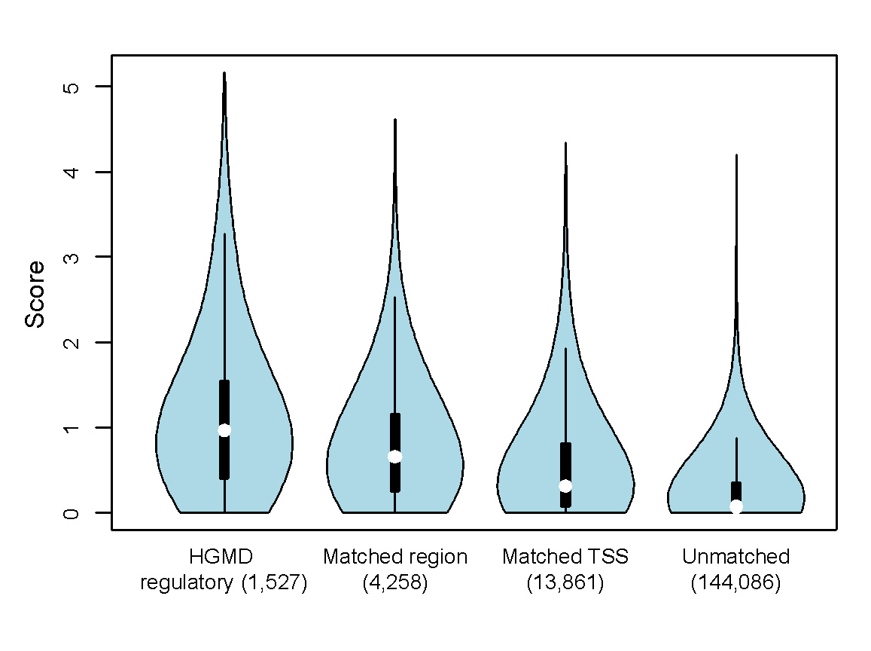
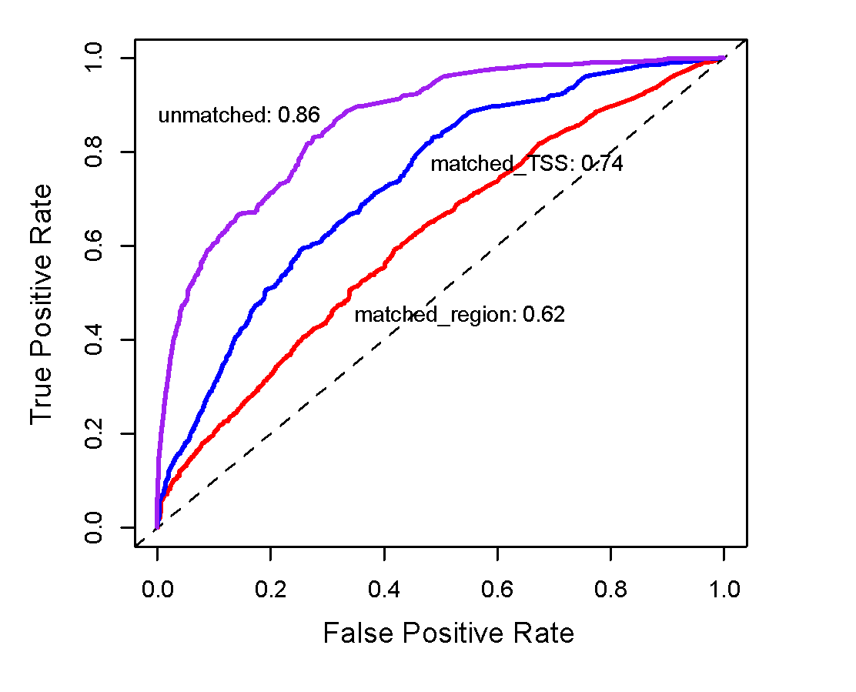
Germline pathogenic variants show higher core scores than controls
3 controls with natural polymorphisms (allele frequency >= 1% )
1. Matched region: 1kb around HGMD variants
2. Matched TSS: matched for distance to TSS
3. Unmatched: randomly selected
Ritchie et al., Nature Methods, 2014
[Fu et al., GenomeBiology ('14, in revision)]

Slide 17
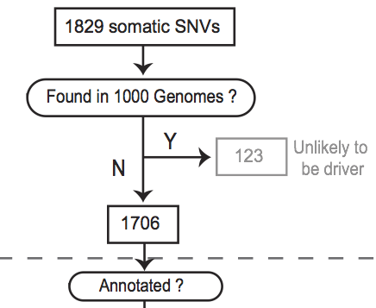
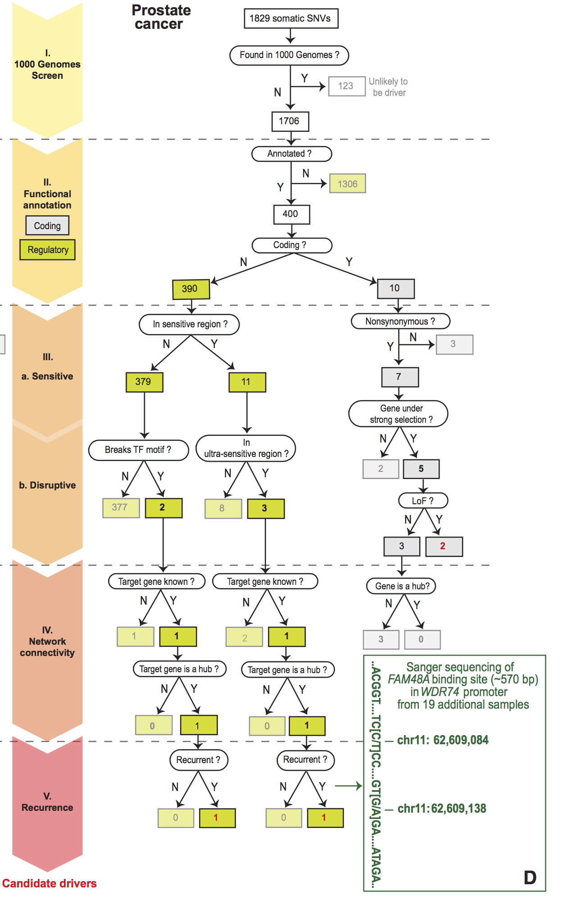
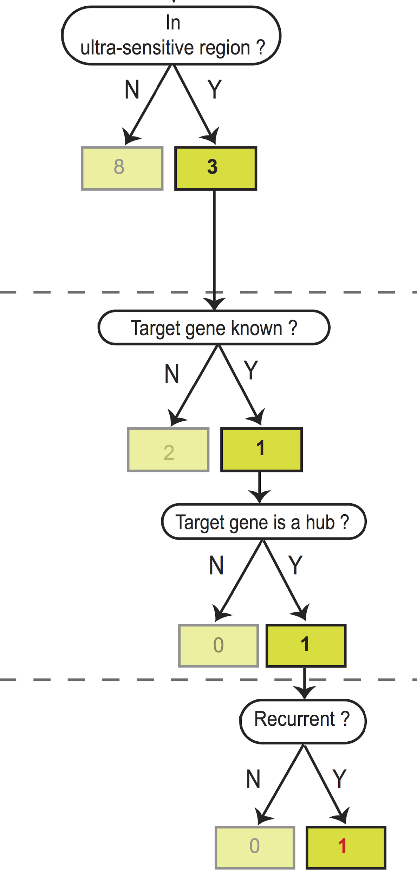
Flowchart for 1 Prostate Cancer
Genome (from Berger et al. '11)
[Khurana et al., Science (‘13)]

Slide 18
Prioritizing Variants in Personal Genomes: Using functional impact & recurrence, with particular application to cancer
Introduction
  An individual's disease variants as the public's gateway into genomics & biology
  The exponential scaling of data generation & processing
  Mining big data to prioritize key variants
  as cancer drivers
  Functional impact #1: Coding
  ALoFT: Annotation of Loss-of-Function Transcripts.
  Frustration as a localized metric of SNV impact. Differential profiles for oncogenes v. TSGs
  uORFs: Altered translation of coding and non-coding regions by somatic mutation.
  Functional impact #2: Non-coding
  FunSeq integrates evidence,
  with a “surprisal” based weighting scheme
  Prioritizing rare variants with “sensitive sites”
  (human conserved)
Recurrence:
Statistics for driver identification
  Background mutation rate significantly varies & is correlated with replication timing & TADs
  Developed a variety of parametric & non-parametric methods taking this into account
  LARVA uses parametric beta-binomial model, explicitly modeling covariates
  MOAT does a variety of non-parm. shuffles (annotation, variants, &c). Useful when explicit covariates not available. Slower
  but speeded up w/ GPUs
Recurrence #2:
(Low-power) application to pRCC
  WGS finds additional facts on the canonical driver, MET. Other suggestive non-coding hotspots.
  Analysis of signatures & tumor evolution helps identify key mutations in different ways

