Slide 1
Detecting Beneficial Mutations in Evolving Systems
As provided by the Gerstein team

Slide 2
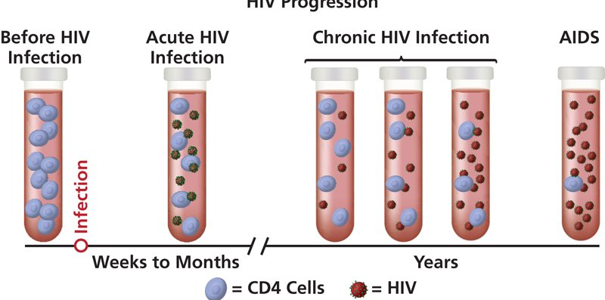
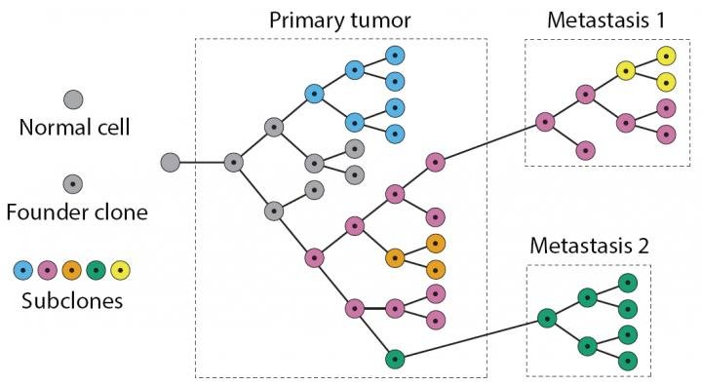
Evolving at different pace
Slow track
Fast track
A
5-10 years
~320 MYA
C
B
~100 MYA
Months to
a few years
~300 MYA

Slide 3
Why fitness mutations matter ?
?
?
?
?
?
?
?
?
?
?
?
?
?
?
?

Slide 4
Step 1: Conceptualize the problem

Slide 5
Step 2: Develop models that associate the mutational frequency with time

Slide 6
Step 3: Good luck; You are on your own..
We provide 1000 simulations with models that include single mutations from almost neutral to strong selection (one positive mutation per sample).
The simulations have been created using a “Birth and Death” algorithm with noise and stochasticity
You need to develop a method that classify the simulations into strong and weak selection
The methodology checks out if it can
Classify/predict correctly (We know the answers !!!)
Can be applied to thousand of genomes (e.g. no human assessment)

Slide 7
Questions?

