Slide 1
Phenome Risk Score Approaches to Improve Inference for CCDG and MSP Studies
Nancy J. Cox, PhD
Vanderbilt Genetics Institute
Vanderbilt University Medical Center

Slide 2
Hope to Motivate
Further collaborations with MSP
Unsolved cases
Characterization of the “rest” of the medical phenome for new Mendelian diseases
Building out the phenome for CCDG phenotypes
We don’t call it pleiotropy for Mendelian…

Slide 3
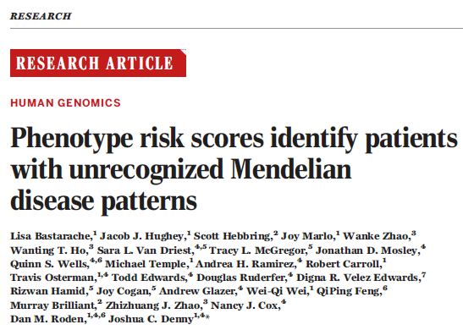
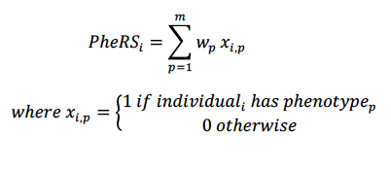
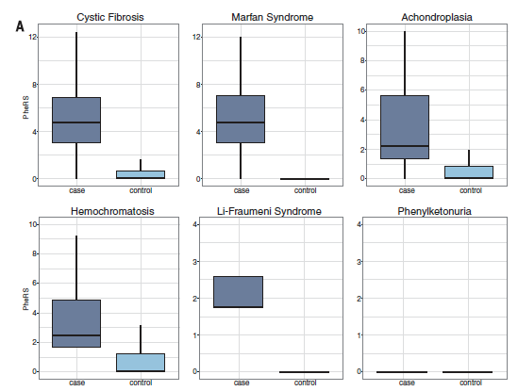
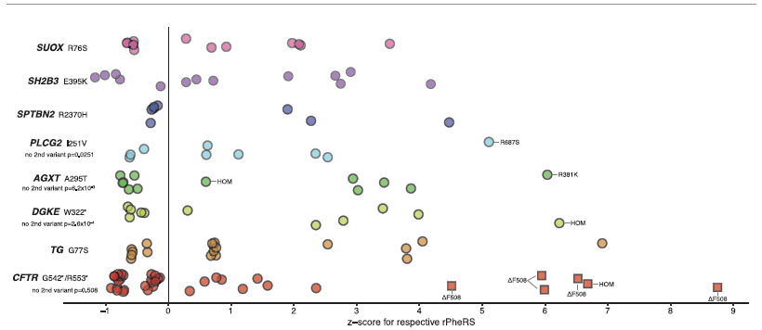
Population of N individuals, with n_{p} the number with phenotype p
AND

Slide 4
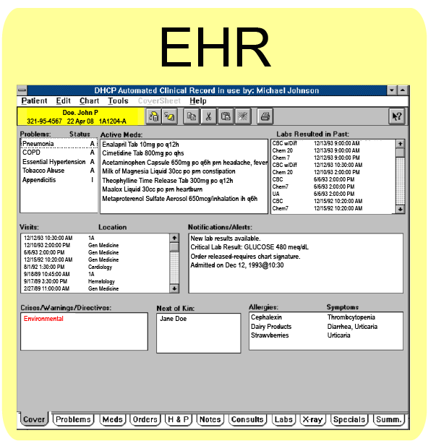
BioVU
~250,000
samples
-OMICS
~10-15 yrs of EHR
Genome variation
Transcriptomes
Metabolomes
120K
Imputed

Slide 5
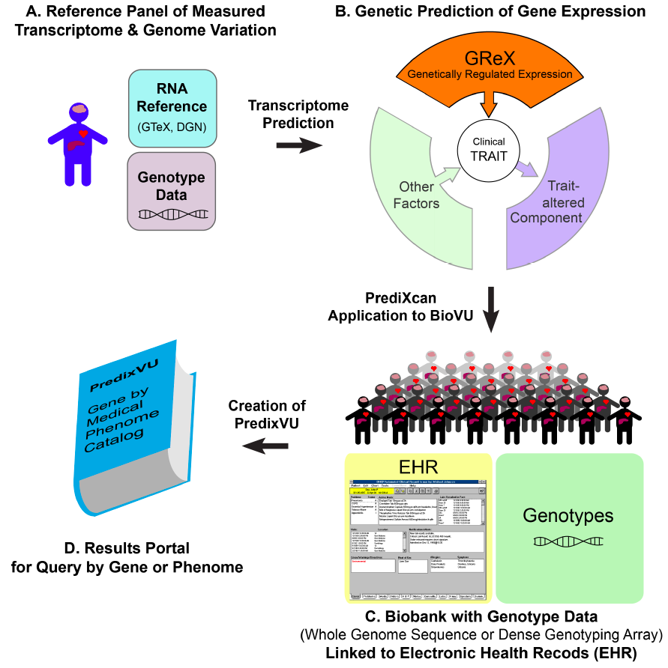
High quality prediction performance in 18,483 genes and lncRNAs
GTEx: WGS and RNA-Seq
in 44 tissues from ~450 (>950) subjects
BioVU: >250K subjects, linked to EHR going back on average 10-15 years; ~50K with genome interrogation, >120K by 2018
PredixVU catalog is a discovery engine for gene-phenotype relationships and iteration to primary mechanism of disease

Slide 6
Gene-based PheWAS
What does this gene do?
What does the natural variation in the expression of this gene associate with across the medical phenome?

Slide 7
Fishing with Phenome Risk Scores (PheRS)

Slide 8
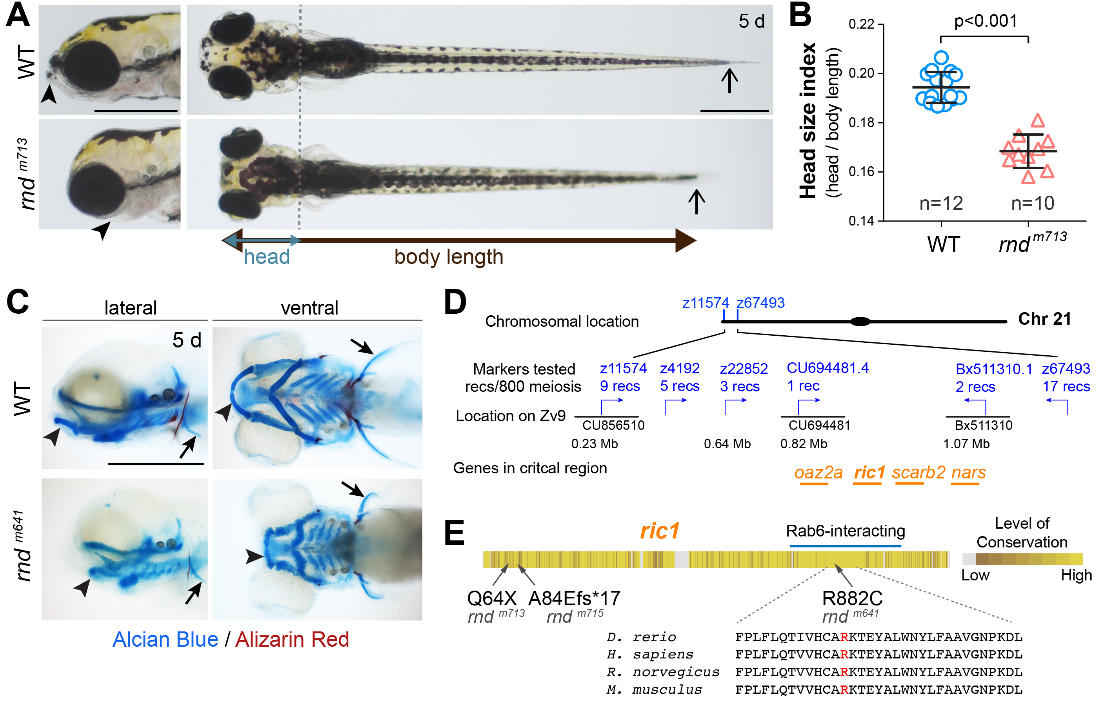

Slide 9
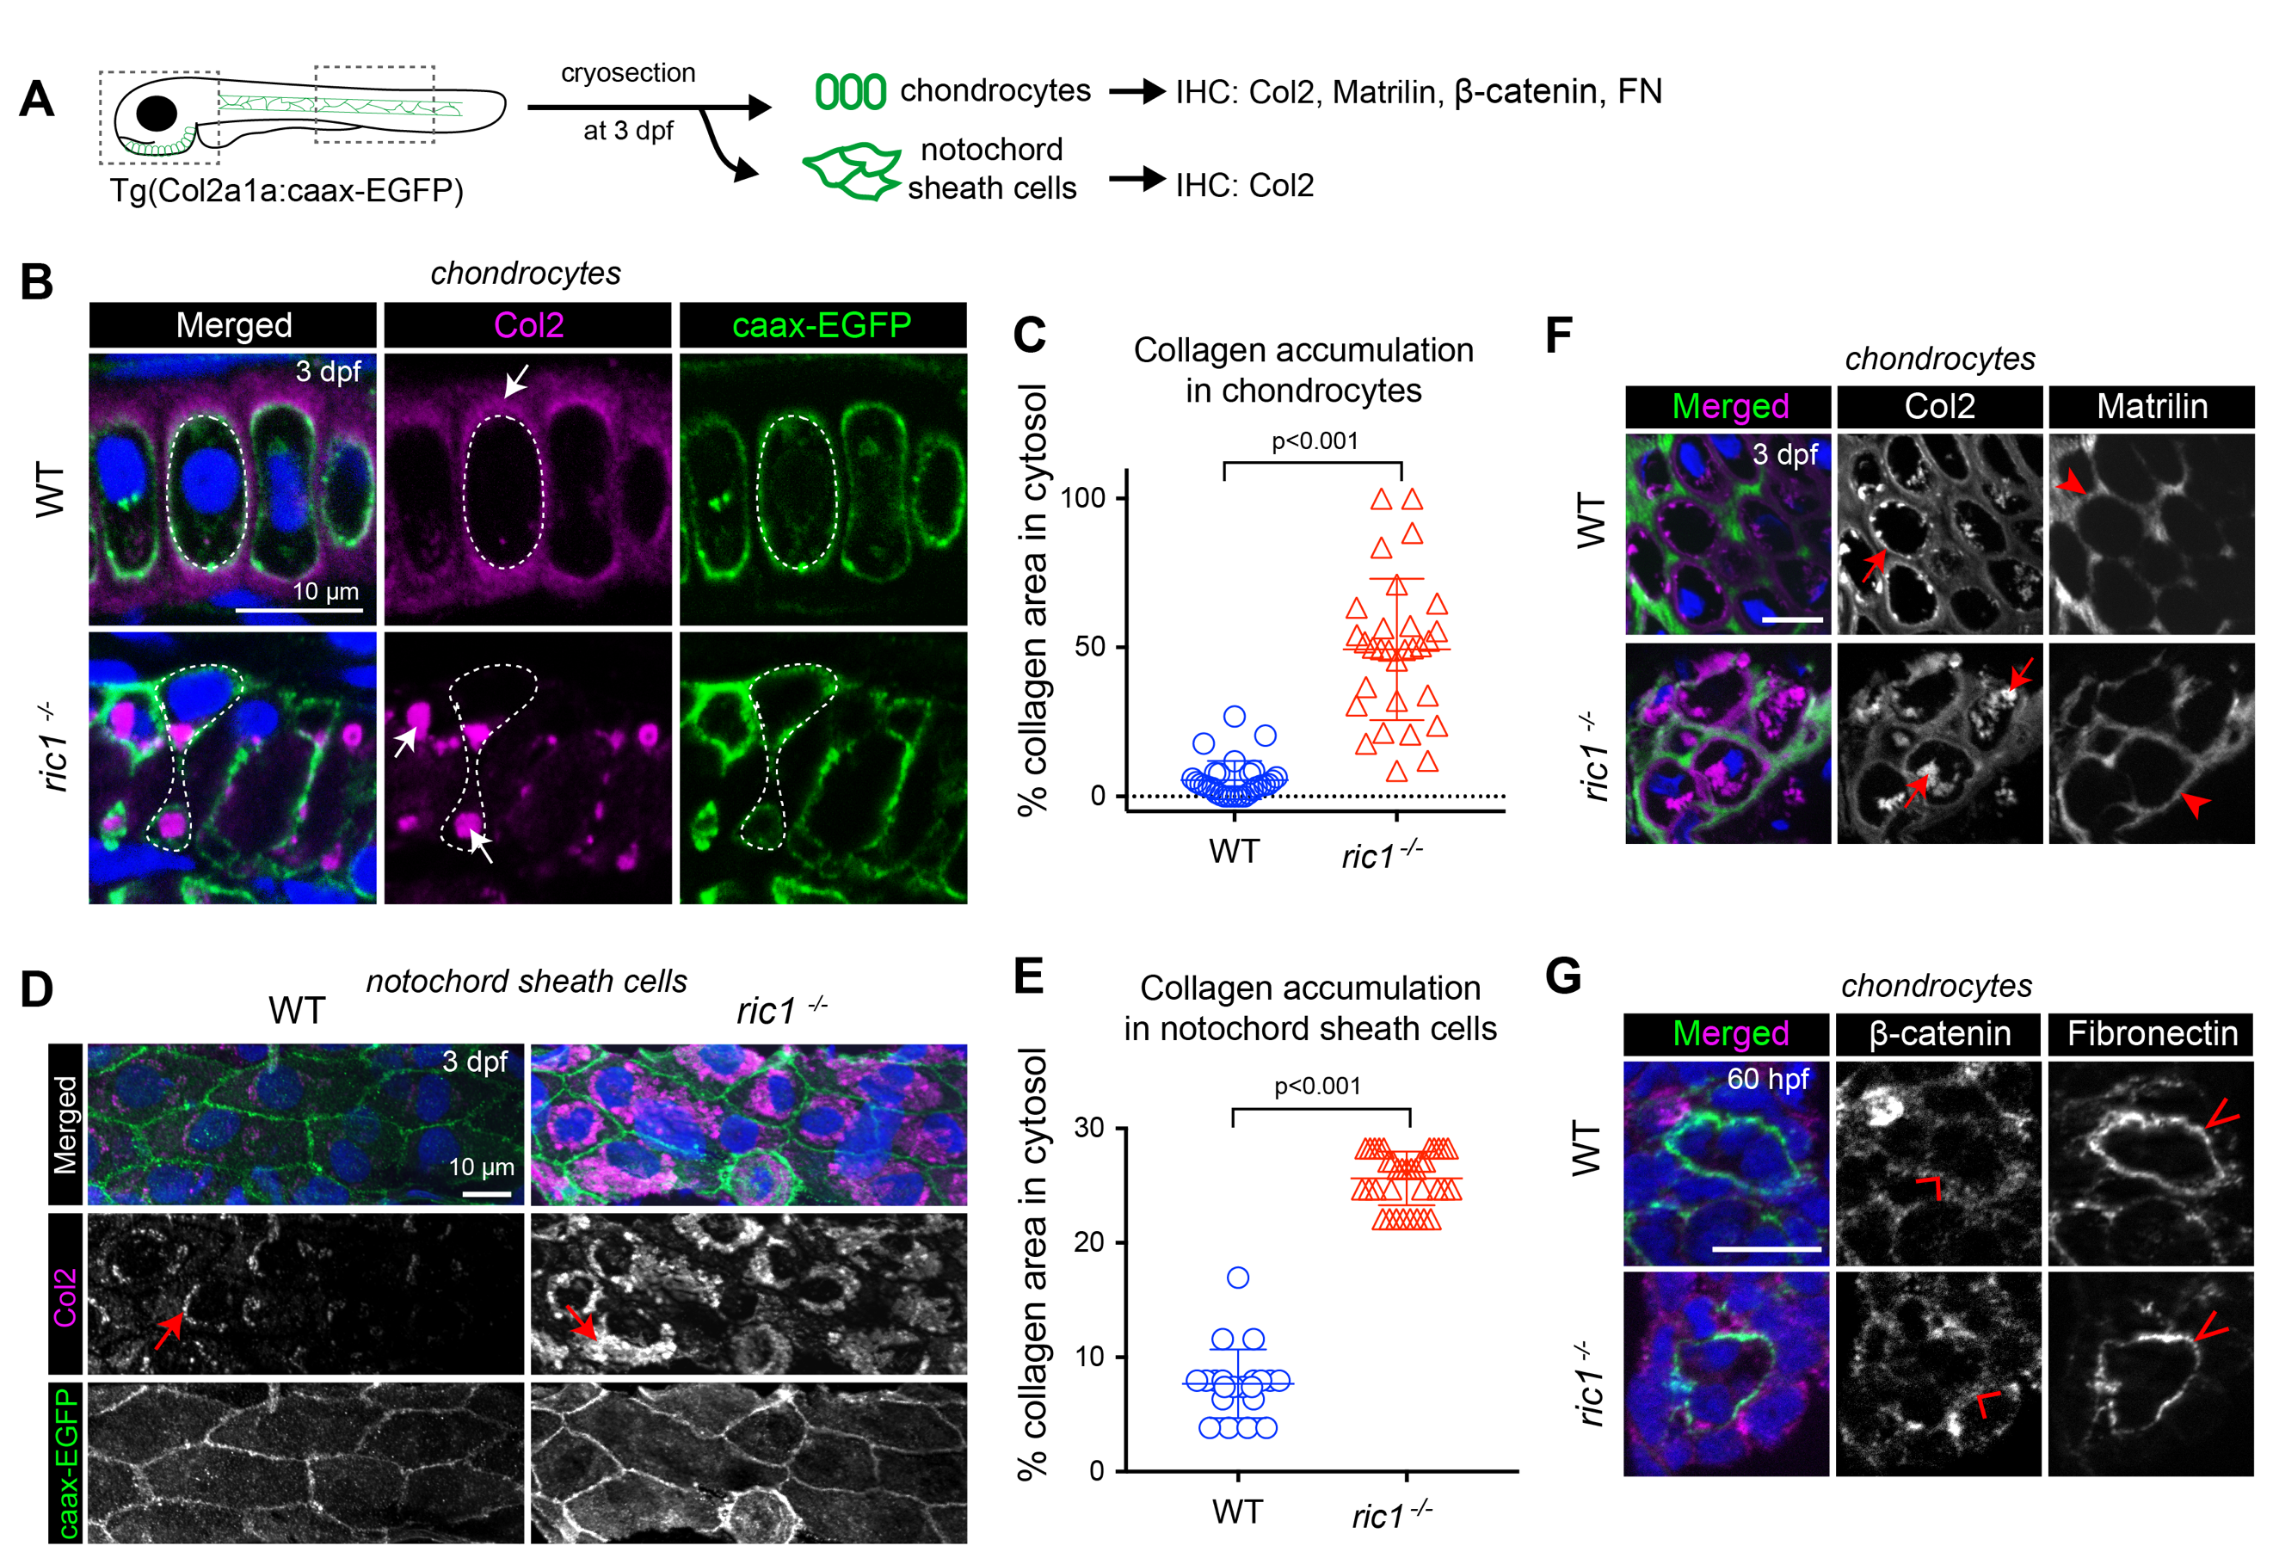

Slide 10
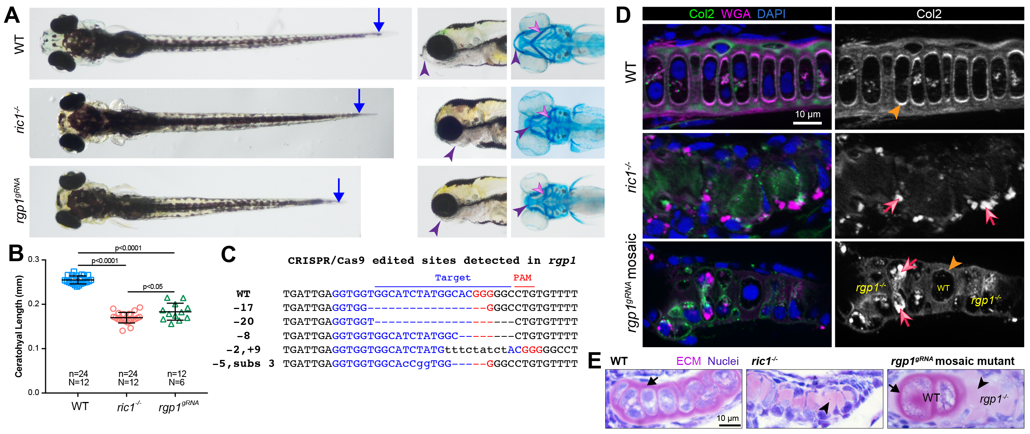

Slide 11
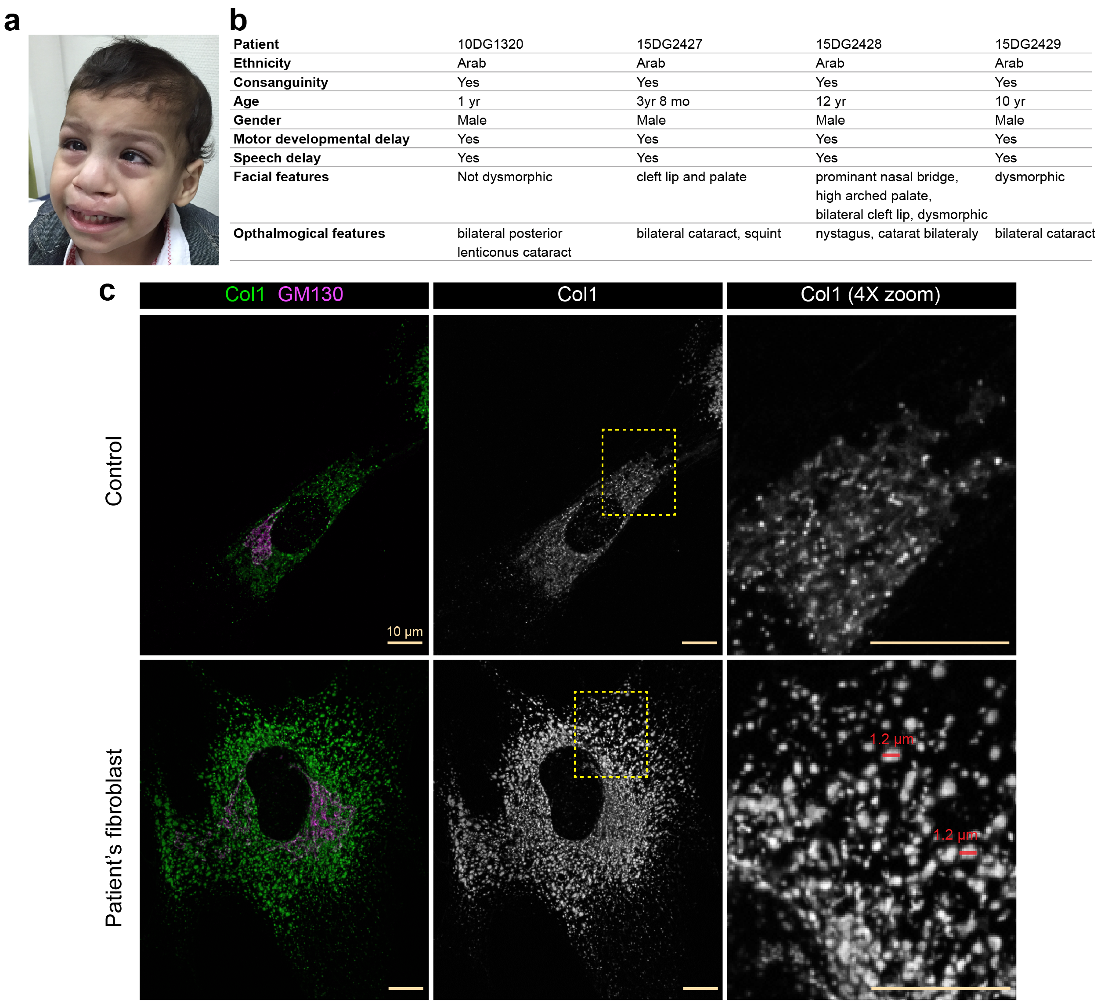
Fibroblasts from patient with RIC1 mutation shows the same cellular defect of collagen sequestered in cells, and patients have much of the phenome associated in BioVU.
Notes:
Fowzan Alkuraya

Slide 12
BioVU Phenome for RIC1/RGP1
Bone (fracture) and connective tissue disorders
Tooth development and eruption
Valve disorders
Skin disorders
Esophageal, gut and digestive disorders
Disorders of extracellular matrix
Neurological and neuropsychiatric disorders
Notes:
Bursitis, Kyphoscoliosis and scoliosis, Other disorders of synovium, tendon, and bursa, Symptoms involving nervous and musculoskeletal systems, Intervertebral disc disorder with myelopathy, Symptoms and disorders of the joints, sacroiliitis, many fractures, SHORT STATURE
disorders of tooth eruption, failure of tooth development, temporomandibular joint disorder
Heart valve disorders, heart valve replaced, non-rheumatic pulmonary valve disorders
Congenital anomalies of the skin, vitiligo, dyschromia
Ulcer of esophagus, Barret’s esophagus, disorders of esophageal motility, diverticulum of esophagus, stricture and stenosis of esophagus, intestinal malabsorption (non-celiac), vitamin and mineral deficiencies, diverticulosis and diverticulitis, peritoneal adhesions, chronic pancreatitis, cholelithisasis and cholecystitis, liver replaced by transplant
Trigeminal nerve disorders, nerve plexus lesions, generalized convulsive epilepsy, epilepsy, ADHD, pervasive developmental disorders, schizophrenia, mood disorders, major depressive disorder, depression, alcohol related diseases

Slide 13
Phenome Fishing to Find More Genes with RIC1/RGP1 Phenome
Use a Phenome Risk Score (PheRS) as the phenotype (rather than an individual disease code)
Weights reflecting significance of RIC1/RGP1 association in BioVU and whether observed for both

Slide 14
Genes with High PheRS
COL14A1, COL3A1, COL5A2, COL9A3 (Duh!)
Exchanges bound GDP for free GTP – a key part of the RIC1/RGP1 machine for collagen transport
FAM124A, FGD6, EPC2, EPPK1, ADAMTSL4, ATP5H, EDEM2, CPT1A
ER-associated degradation of misfolded glycoproteins
Attaches to fibrillin and fibrillar collagens to stabilize extracellular matrix

Slide 15
BioVU Phenome for KEOPS
Kidney disease and failure
Congenital anomalies of the nervous system
Gastrointestinal and liver disease
Cerebrovascular atherosclerosis and disease
Arrhythmias and heart failure
Neurological and neuropsychiatric disease
Eye disease
Notes:
Nephritis, nephrosis, renal sclerosis, glomerulonephrosis, nephritis and nephropathy without mention of glomerulonephritis, nephritis and nephropathy with pathological lesion, disorders resulting from impaired renal function, type 1 diabetes with renal manifestations, type 2 diabetes with renal manifestations
Microcephaly and hydrocephalus
Angiodysplasia of intestine, Gastrointestinal complications, chronic non-alcoholic liver disease, cirrhosis without mention of alcohol, cholelithiasis, diseases of pancreas, GI hemorrhage, blood in stool
Cerebral atherosclerosis, cerebrovascular disease, intracerebral hemorrhage, occlusion and stenosis of precerebral arteries, cerebral artery occlusions with cerbebral infarction
Tachycardia, cardiac arrest and ventricular fibrillation, heart failure with reduced EF, heart transplant / surgery
Dementia with cerebral degeneration, abnormal findings on study of brain or nervous system, encephalopathy, nerve root and plexus disorders, convulsions, nonspcific abnormal results of function study of brain and central nervous system, migraine, mood disorders, depression
Retinal disorders, degeneration of macula and posterior pole of retina, non-diabetic retinopathy, Chorioretinal scars, inflammations, corneal opacity, blindness and low vision, disorders of iris and ciliary body, type 1 diabetes with ophthalmic manifestations

Slide 16
BioVU Phenome for AD Genes
PSEN1: osteomyelitis, fracture of upper limb, acute osteomyelitis, fracture of humerus, bacterial enteritis, intestinal infection due to C. diff, heart failure with reduced EF, congenital anomalies of limbs, crystal arthropathies, heart failure NOS, long-term use of anticoagulants, disc disorders, intracranial hemorrhage, fracture of patella, subdural hemorrhage, non-rheumatic aortic valve disorders, cerebral aneurysm, muscular wasting and disuse atrophy, varicose veins, iron deficiency anemia secondary to blood loss, colles’ fracture, cardiomegaly, morbid obesity, acute laryngitis, atrial fibrillation, atrial flutter, hemorrhage of rectum and anus, cerebral degeneration, vascular dementia, hepatitis

Slide 17
BioVU Phenome for AD Genes
PSEN2: osteoarthrosis, jaw disease, paranoid disorders, cystic mastopathy, chronic pain syndromes, traumatic arthropathy, hyperhidrosis, internal derangement of knee, viral hepatitis A, disorders of liver, disease of pancreas, long-term use of anti-coagulants, coagulation defects, cancer of female genital organs, other conditions of brain, crystal arthropathies, arthropathy, coronary atherosclerosis, esophageal hemorrhage, intracranial hemorrhage, intracerebral hemorrhage, Parkinson’s

Slide 18
BioVU Phenome for AD Genes
APP: ASCVD, muscular wasting and disuse atrophy, pneumothorax, dependence on respirator or supplemental oxygen, liver replaced by transplant, tachycardia, aphasia, biliary tract disease, fracture of tibia and fibula, congestive heart failure, anticoagulants causing adverse effects, cerebral aneurysm, cardiac arrhythmia, hemorrhage NOS, congenital anomalies of limbs, bacterial enteritis

Slide 19
BioVU Phenome for AD Genes
APOE: deep vein thrombosis, peripheral angiopathy, valvular heart disease /heart chambers, coronary atherosclerosis, ischemic heart disease, orthopnea, acute and subacute thyroiditis, diseases of larynx, transient alteration of awareness, arthropathy, viral hepatitis, rupture of tendon, syncope and collapse, viral hepatitis C, essential tremor, pathologic fracture of femur, fracture of neck of femur, encephalitis, aortic aneurism, other aneurism, osteomyelitis, renal osteodystrophy, gouty arthropathy, osteoarthrosis, osteoarthritis, fracture of humerus, concussion, Alzheimers

Slide 20
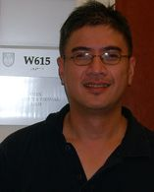
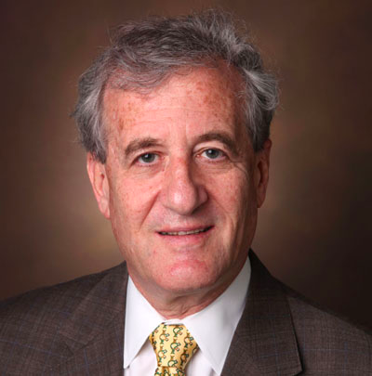
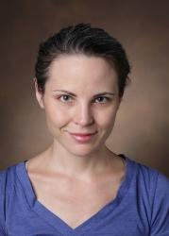
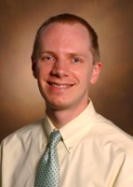
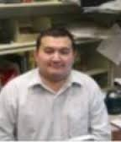
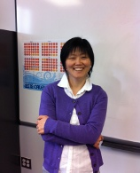
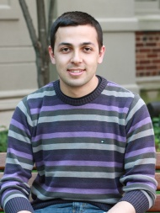
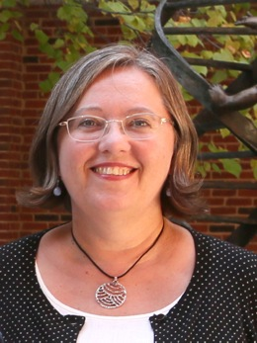
Eric Gamazon Dan Roden Lisa Bastarache Josh Denny Anuar Konkashbaev
Xue Zhong
Haky Im Gokhan Unlu Ela Knapik

