Slide 1
Population Genetics for Mendelian and Complex Diseases
Shamil Sunyaev and Eimear Kenny
GSP Analysis Centers:
Population Genetics

Slide 2
Population Genetics in GSP
  Large-scale sequencing data is a treasure trove for population genetics research
  In turn, population genetics informs sequencing studies:
  Analysis of genetic ancestry is key to rare variant studies, to leveraging common controls and to polygenic models
  Inference of natural selection highlights functionally significant variation and informs rare variant studies of Mendelian and Complex traits
  Understanding patterns of genetic variation assists in development of new statistical approaches and guides study design

Slide 3
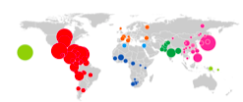
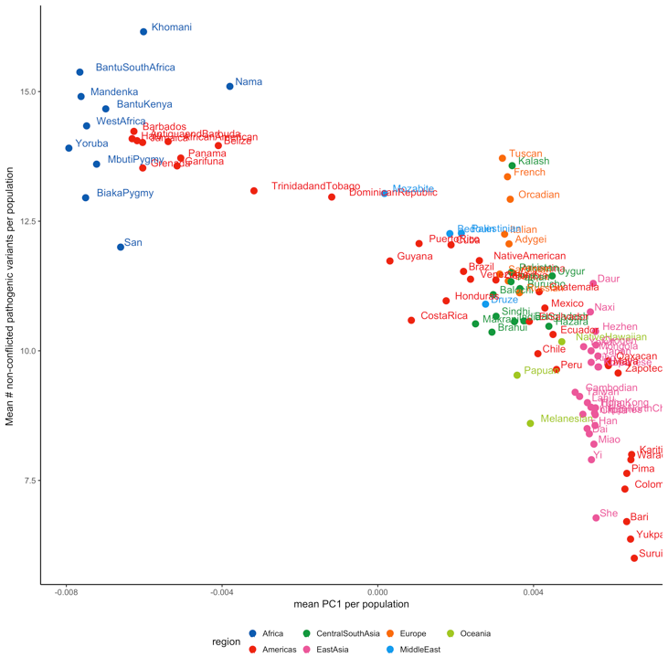
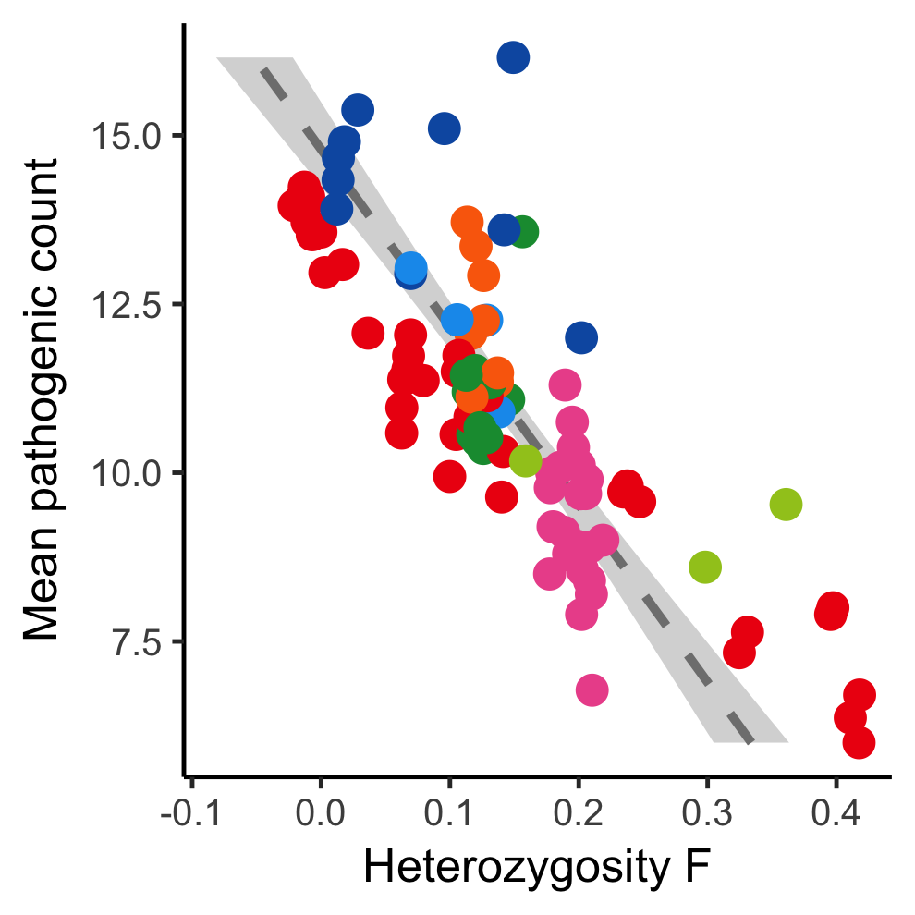
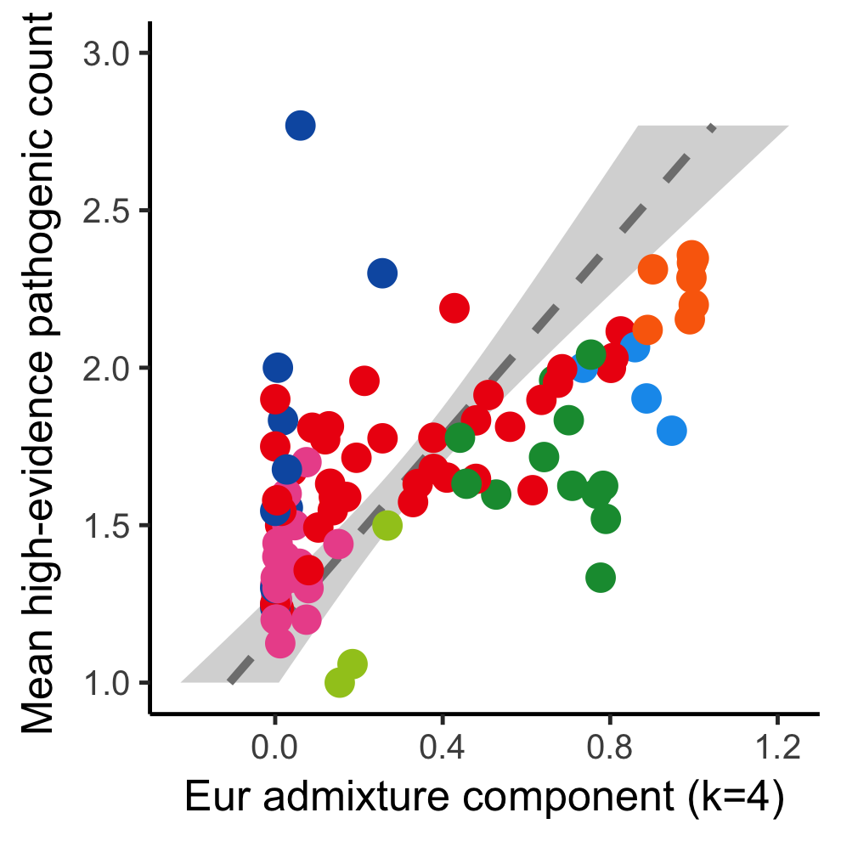
Recent demography expected to play a considerable role in rare variant mapping
7 continental region-level and 99 population-level in the PAGE Study
Mean pathogenic count
Mean PC1 per population

Slide 4
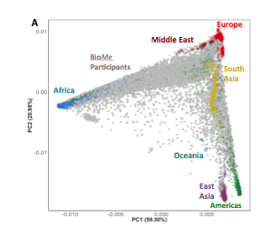
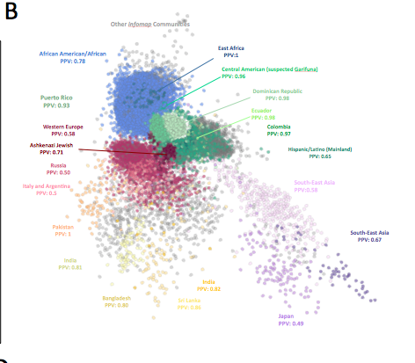
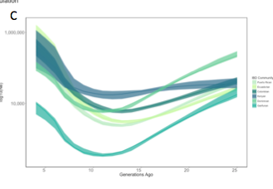
Recent demography expected to play a considerable role in rare variant mapping
40K New Yorkers (BioMe Biobank)
PCA (common SNPs)
IBD-network
(rare haplotypes)
IBD-demography

Slide 5
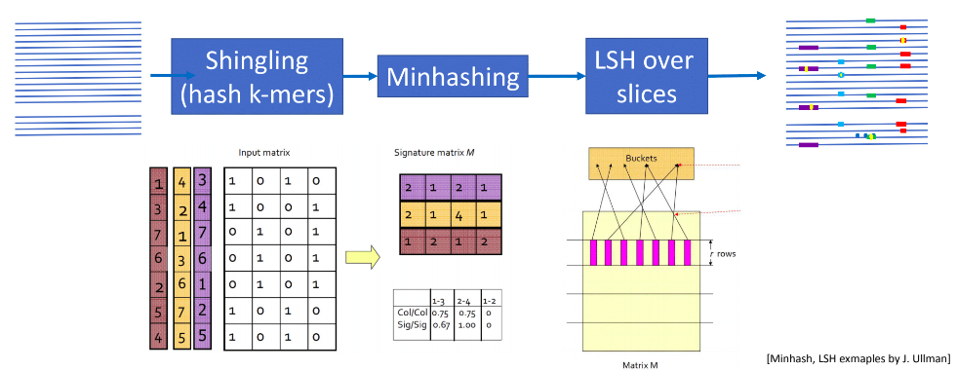


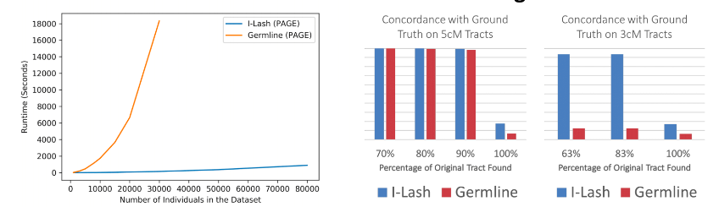

Recent demography expected to play a considerable role in rare variant mapping
iLASH – IBD using local sensitive hashing
LSH: estimates Jaccard similarity of strings, quickly get similar pairs and eliminate most disimilar pairs

Slide 6
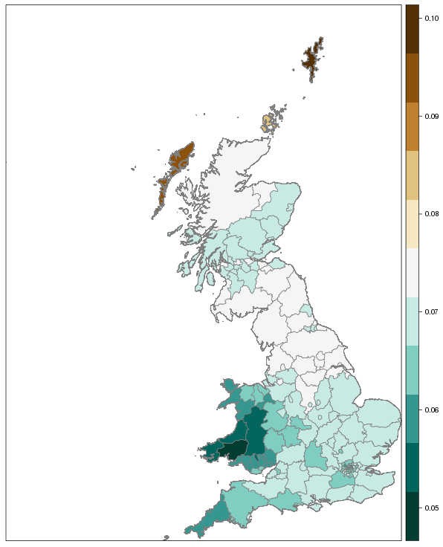
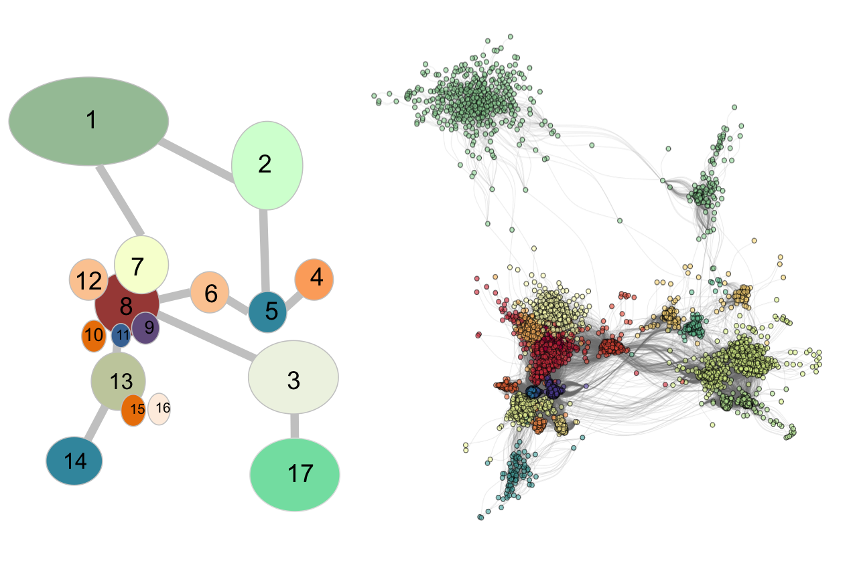
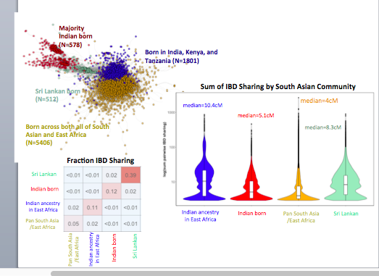
Recent demography expected to play a considerable role in rare variant mapping
Norway versus UK Region
14,181,681,196 IBD tracts present in 487,409 UK Biobank participants!
Norway versus UK Region
Shetland Isles (0.1)
Orkney (0.085)
Outer Hebrides (0.09)
Median Degree of Sharing
Median Degree of Sharing

Slide 7
About 2% of human mutations appear
in clusters

Slide 8
Enrichment of C>G changes in clusters
Clustered mutations differ from the rest

Slide 9
Genomic regions enriched in C>G clusters

Slide 10
Modeling natural selection
  Estimating selective constraint to guide rare variant association studies
  Reconciling models of natural selection and data on heritability partitioning

Slide 11
Population Genetics in GSP
  Population genetics metrics will be incorporated into the annotation tracks
  Annotations at multiple levels: variant level, locus level, individual level and population level

