Slide 1
Developing methods and models
Methods and software development – variant prioritization and pleiotropy
Population genetics – understanding and modeling mutation and selection based on sequencing data
Allelic architecture – partitioning heritability by allele frequency and functional annotation

Slide 2
Two faces of pleiotropy
Using pleiotropy to power gene discovery - MTAG
Testing whether two traits share the same causal variant(s) – JLIM
Towards causal chains
G
E₁
E₂
P
Chun et al., Nature Genetics 2017; Turley et al, Nature Genetics 2018

Slide 3
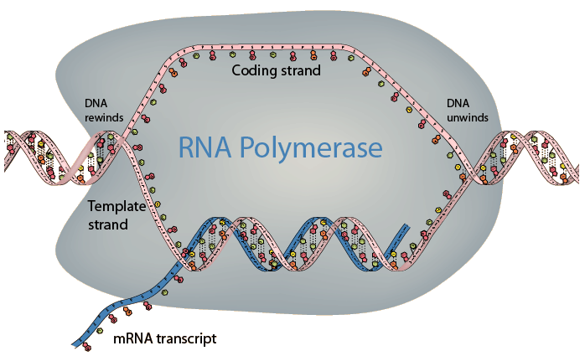
Asymmetry with respect to transcription
Studying mutagenesis – understanding biology and informing statistical genetics

Slide 4
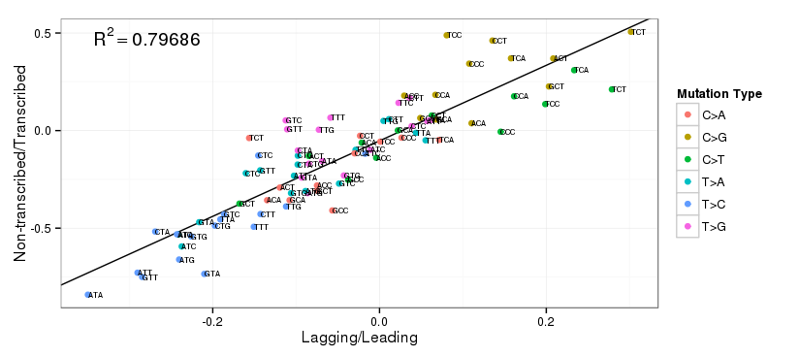
Asymmetry with respect to transcription and asymmetry with respect to replication
Seplyarskiy et al., bioRxiv, in revision at Nature Genetics

Slide 5
Potential reasons for the asymmetry with respect to replication
Differential damage bypass
Yeels et al. CSH Perspect Biol 2013

Slide 6
Natural selection increases rare variant effects and determines their importance for complex diseases
Analysis across 25 UK Biobank traits and diseases:
α = – 0.4 indicates increased rare variant effects (var. [p(1−p)]^{α})
implies < 10% of heritability due to rare variants (MAF < 1%)
Schoech et al. bioRxiv 2017 (in revision at Nature Genetics)

Slide 7
Low-frequency (0.5% ≤ MAF < 5%) functional architectures reveal strength of selection across genomic annotations
Implications
1) critical impact of non-synonymous variants
(17±1% of low-freq. variant heritability vs. 2.1±0.2% of common variant heritability)
2) low-frequency architecture can inform rare variant prioritization in whole-genome sequencing studies
(LFVE/CVE ratio tags strength of selection)
Stratified LD score regression (Finucane et al. 2015, Gazal et al. 2017) extended to low-freq. variants
Results meta-analyzed across 27 independent UK Biobank traits (N = 355K)
Gazal et al. in preparation (biorxiv est. 04/09/18)

