Slide 1
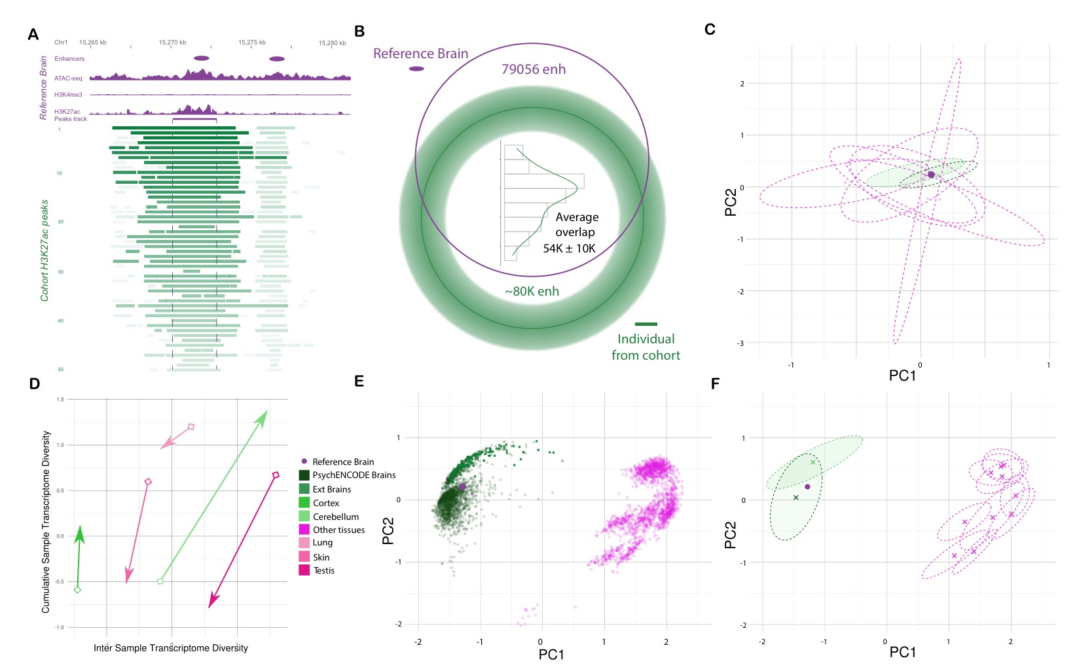

Slide 3
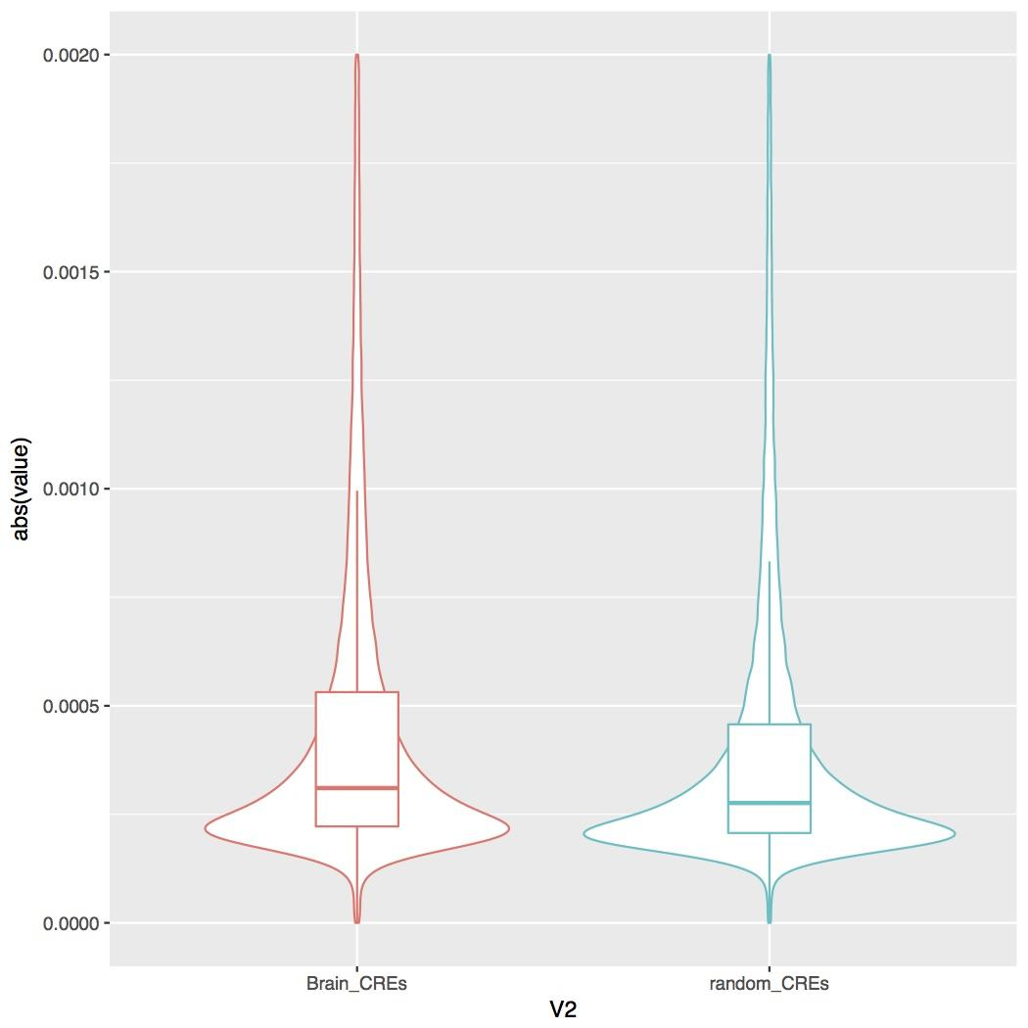
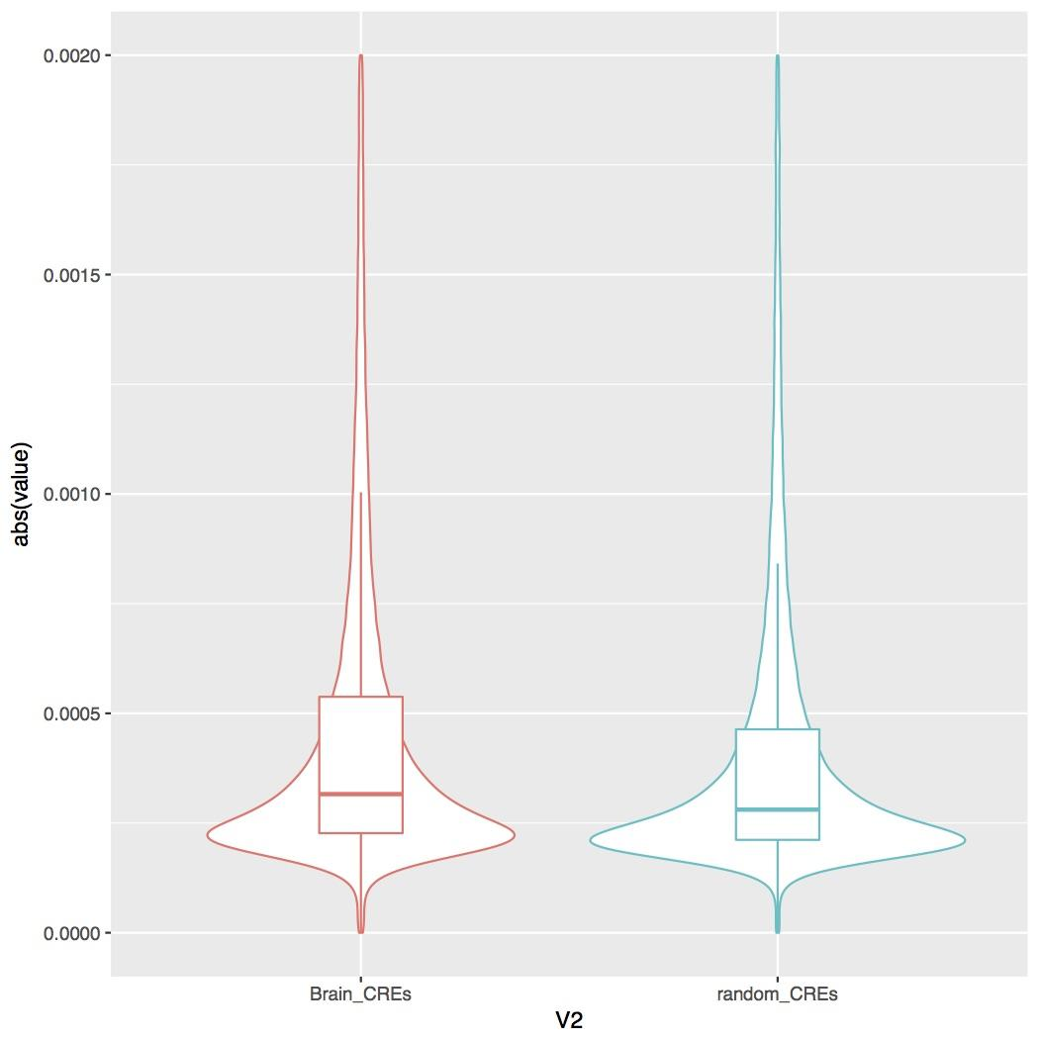
CRE values
Removing all promoters vs removing only brain promoters doesn't seem to affect the distribution of the random_CREs.
Removing brain promoters
Removing all promoters (gencode)

