Slide 1
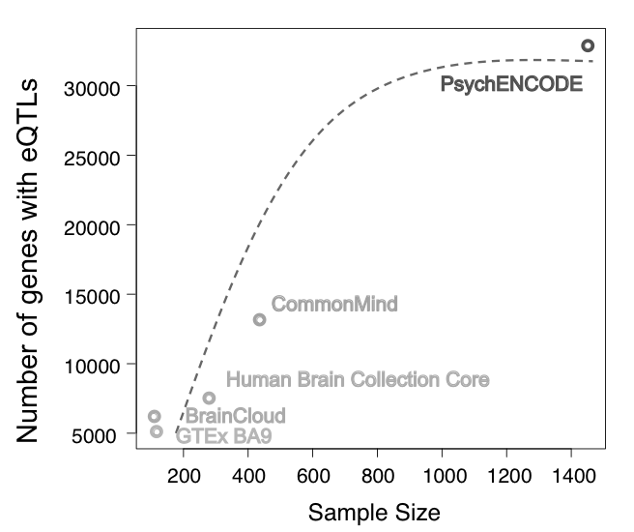
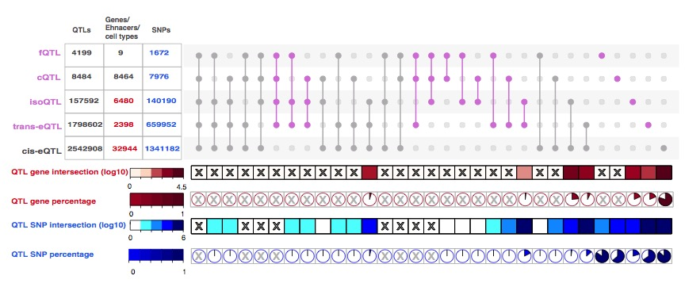
B
E
A
Enrichment -log10(P)
CAD
Schizophrenia
Asthma
Parkinsons
Bipolar
Type 2 diabetes
D
C
Notes:
Figure 4. QTLs of human adult brain DLPFC. (A) Example of H3K27ac signal of individual brains in a representative genomic region showing largely congruent identification of regions of open chromatin. Region in dashed frame represents a chromatin QTL, the signal magnitudes of individuals with G/G or G/T genotype are lower than the ones with T/T genotype. (B) Numbers of genes with at least one eQTL (eGenes) vs. sample size in different studies. Numbers of eGenes increase as the sample size increases. The eGene of PsychENCODE is close to saturation. (C) Overlap of eQTL, sQTL, fQTL and cQTL snps. cQTL snps overlap with other QTL snps is the smallest and eQTL & sQTL overlap is the largest among all overlaps. among all overlap. 30% of sQTL snps overlap with eQTL snps. fQTL overlap more with sQTL(17%) than eQTL(9%) (p < e⁻¹⁵, odds ratio:2.07). (D) Enrichment of genomic regions annotations of QTLs. (E) Enrichment of GWAS snps on cis-eQTL snps. Enrichment for GWAS SNPs of brain disorders on cis-eQTLs SNPs are more significant than the ones of non-brain disorder GWAS SNPs. Schizophrenia GWAS SNPs have the highest enrichment on cis-eQTLs SNPs among those three brain disorders.
grey in D

