Slide 1
Brain ncRNA annotation
Evolutionary conservation
- phastCons
- phyloP
- calculate for exon region & whole gene
Human purifying selection
- SNP density (number/Kb) [ref: 22956687]
- common SNPs from 1000 Genomes Project (MAF>0.05)
- calculate for exon region & promoter region
Primate-specific or not?

Slide 2
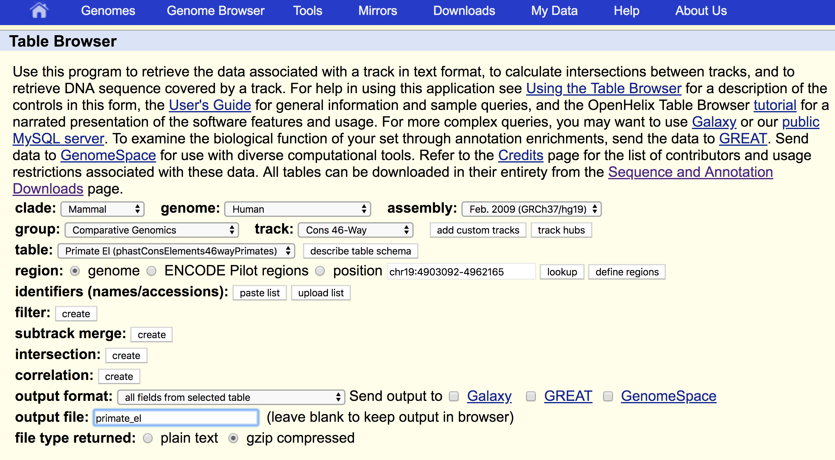
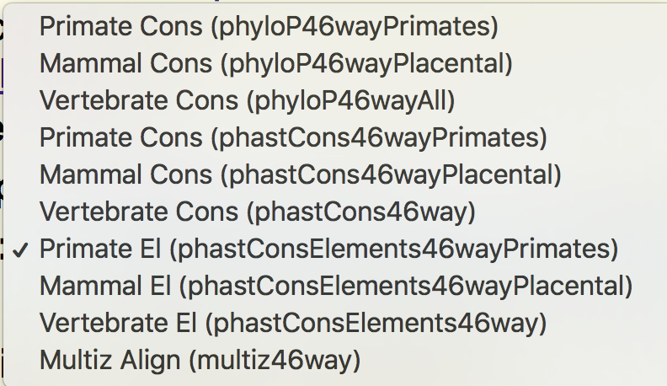
IncRNA: primate-specific or not?
The predicted elements are segments of the alignment that are likely to have been "generated" by the conserved state of the phylo-HMM using phastCons.

Slide 3
Multiple conserved segments overlapping with the IncRNA segment
Mammal conserved
Primate conserved

Slide 4
Different overlapping cutoffs
Primate conserved
20%: 80
50%: 16
80%: 9
Primate specific
20%: 10
50%: 2
80%: 2

