Slide 1
Total: 312 unique
TF KD experiments
K562 | HepG2 | MCF-7 | C4-2B
182 | 132 | 1 | 1
K562
HepG2
We merge replicates in a single experiment, and consider all kinds of KD data
shRNA
siRNA
Crispri
Crispr
MCF-7
C4-2B
110
22
72
1

Slide 2
Checking the quality of KD data
K562
HepG2
FC = $\log{\frac{KD+1}{C+1}},$
Where KD is the expression of a gene after knockdown,
And C is the expression of a gene in the control.
TF expression FC after knockdown

Slide 3
# of signif. genes with PositiveFC after KD of TF
*Significance is FC > log(2.5)
USF2 – Tumor-suppression function of transcription factor USF2 in prostate carcinogenesis (Chen et al 2006)
# of signif. genes with Negative FC after KD of TF
*Significance is FC < -log(2.5)
G3BP2– functions breast tumor initatior, knockdown results in reduced tumor growth, potential oncogene (Gupta 2017, Ashikari 2017)

Slide 4
Positive FC
Negative FC
# of genes with significant
FC after KD
hierarchy
hierarchy
**Next step, compare FC of direct and indirect target of TF

Slide 5
Expression changes in mutated/non-mutated samples
Define mutated/non-mutated for different annotations
CDS
eCLIP
Enhancer
TF
UTR
Ext gene
SRSF2
Group 0 is non-mutated in extended gene
Group 1 is mutated in extended gene
Can take –log(wilcox-test p-value)
expression

Slide 6
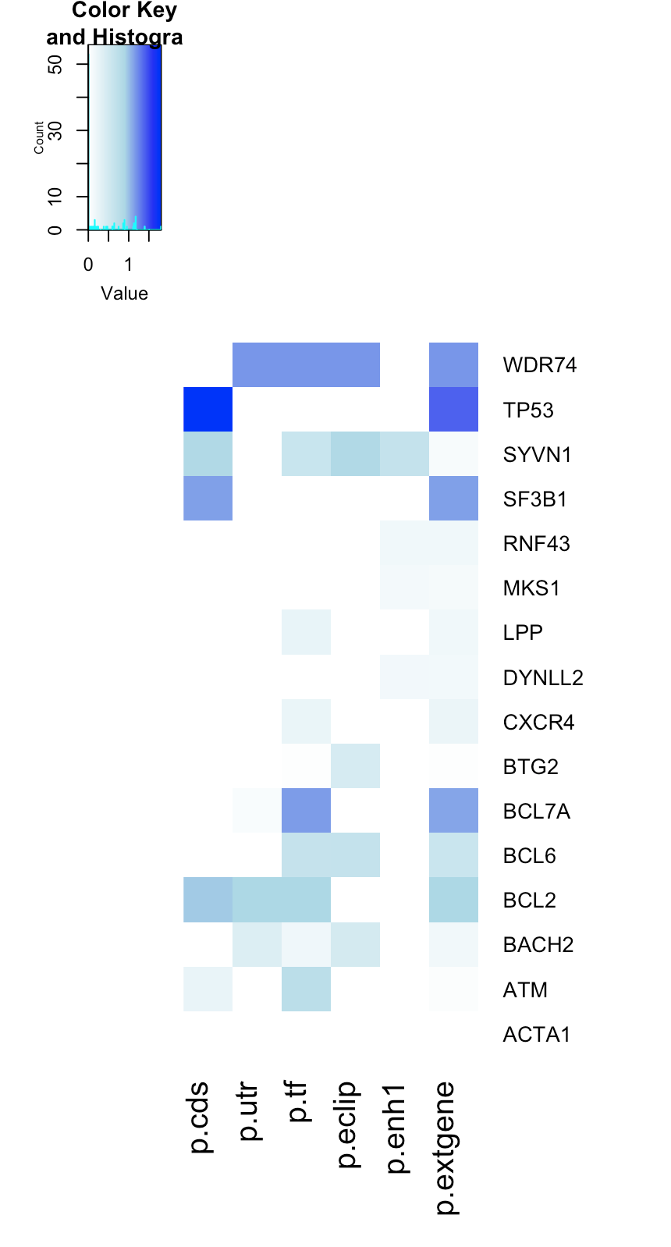
Lymph-CLL
expression significance
Subset of genes

Slide 7
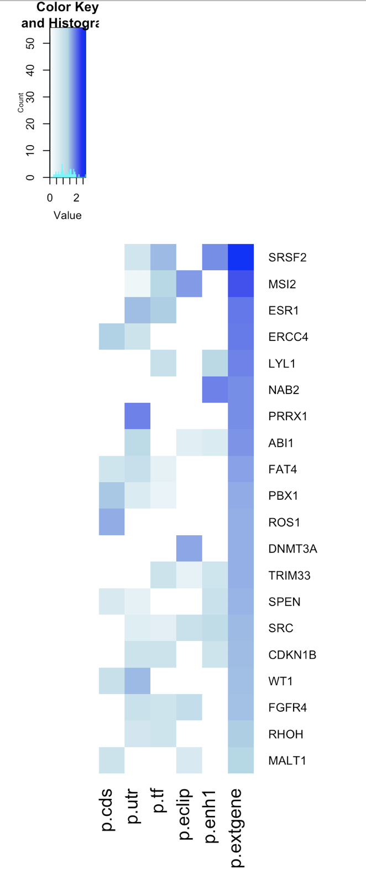
Liver-HCC
expression significance
Top performers (CGC)
*Top 20 out of 500 CGC

Slide 8
K562, Lymph-CLL
HepG2, Liver-HCC
Ext gene more signif.
Ext gene less signif.
# of occurences
**Potential limitation, is this doesn’t consider if there is significance already

