Slide 1
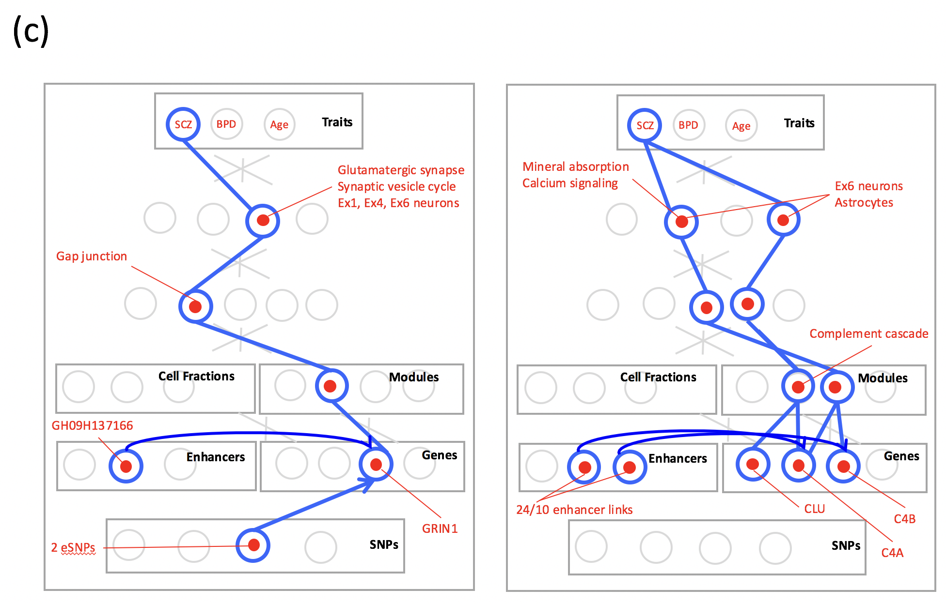

Slide 2
DPSN module prioritization scheme
Links:
+
-
-
+
-
-
+
-
+
+
-

Slide 3
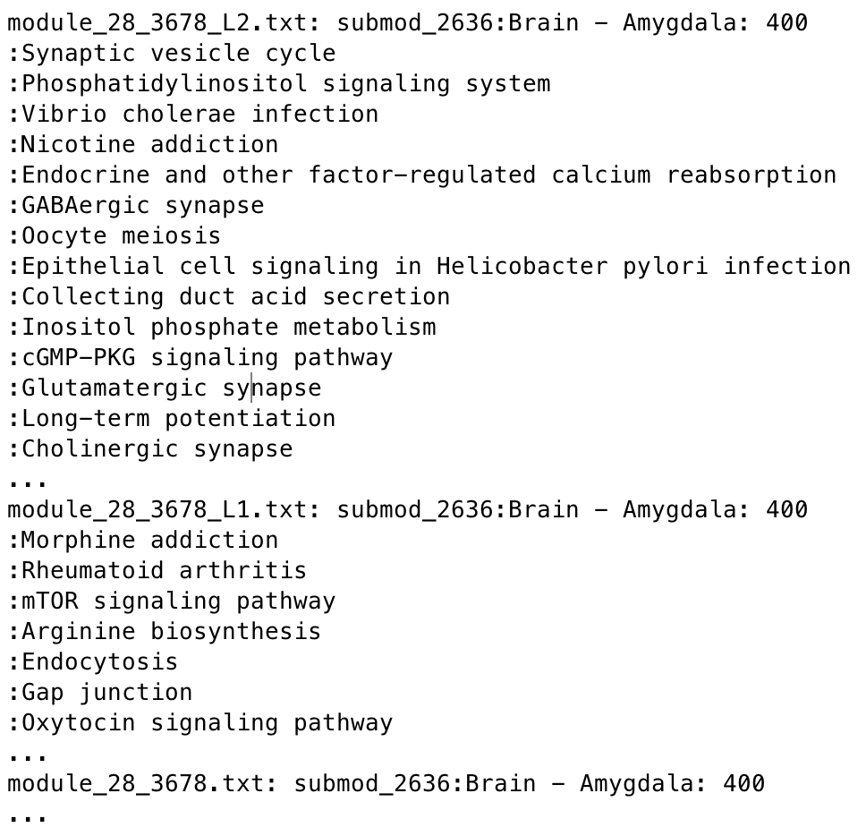
Example trace enrichment terms (SCZ):

Slide 4
Further enrichment results
From Hyejung’s gene lists:
  BAF complex genes found in SCZ model (SMARCC1, SMARCC2, BCL11A, BCL11B )
From AGE model:
  NRGN found in prioritized module
  Module functionally enriched for Alzheimer’s, Parkinson’s, Synaptic functions, and Longevity regulating pathway, Spliceosome
  Spliceosome function enriched in many top modules
  Enriched cell types include Ex4 and Ex6 and Astrocytes

Slide 5
GWAS SNPs
SCZ
BIP
x-axis:
1: non-prioritized modules
2: prioritized modules
SCZ
Model
*p=0.038
***p=1.6e-5
y-axis: GWAS SNPs per gene
BIP
p=0.068
**p=6.6e-3

Slide 6
