Slide 1
Brain meeting
03/08 - Figure update

Slide 2
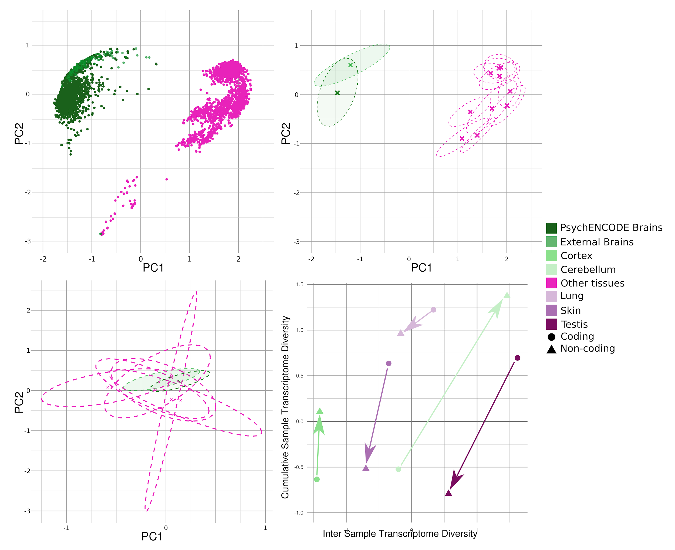

Slide 3
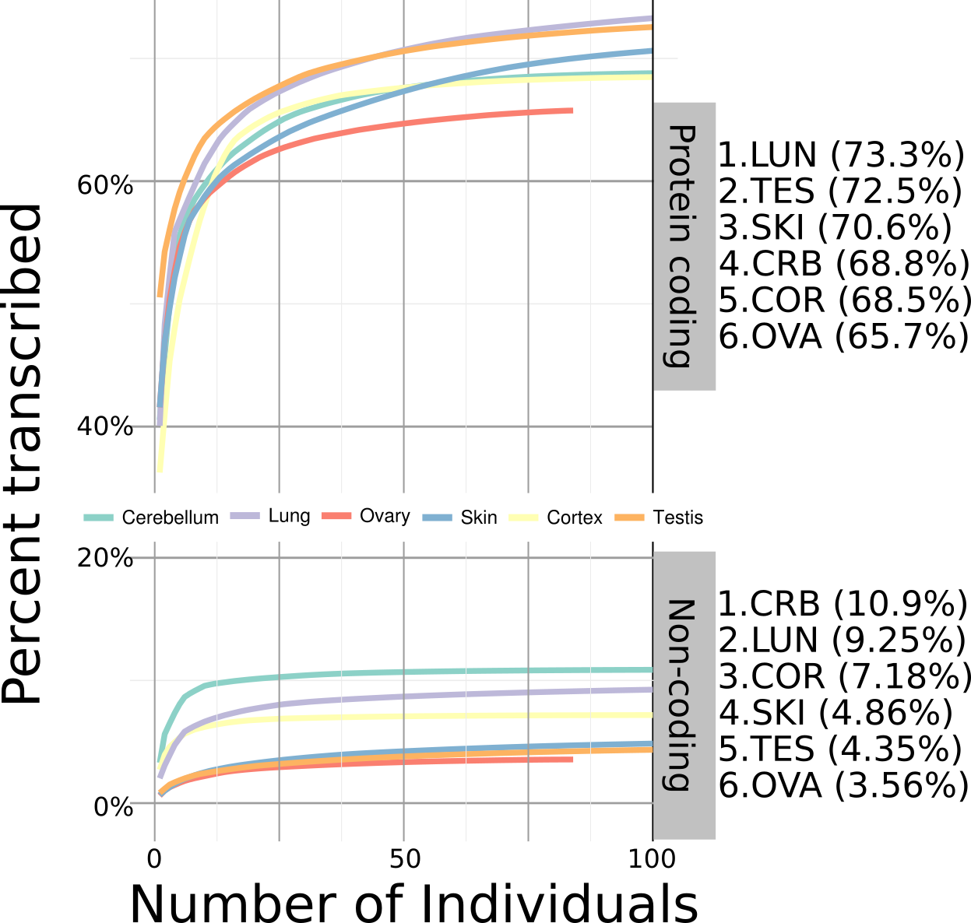
Cumulative diversity coding vs non-coding
SUPP

Slide 4
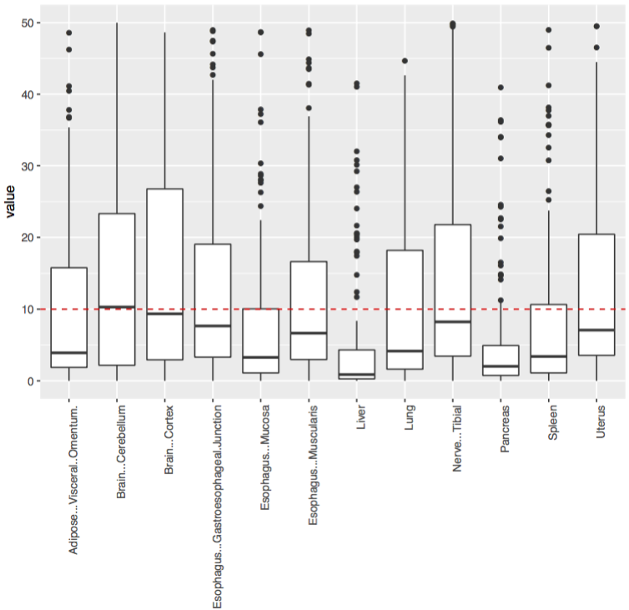
PC1 drivers
SUPP
Partial result:
200 genes driving the separation between samples in PC1
Reactome pathways | # | # | expected | Fold Enrichment | +/- | P value
Serotonin Neurotransmitter Release Cycle | 17 | 4 | .16 | 25.01 | + | 4.14E-02
Neurotransmitter Release Cycle | 50 | 6 | .47 | 12.75 | + | 1.68E-02
Neuronal System | 337 | 14 | 3.17 | 4.41 | + | 8.43E-03
Dopamine Neurotransmitter Release Cycle | 22 | 5 | .21 | 24.15 | + | 4.52E-03
http://pantherdb.org/tools/compareToRefList.jsp
http://homes.gersteinlab.org/people/fn64/PC1_drivers.txt

Slide 5
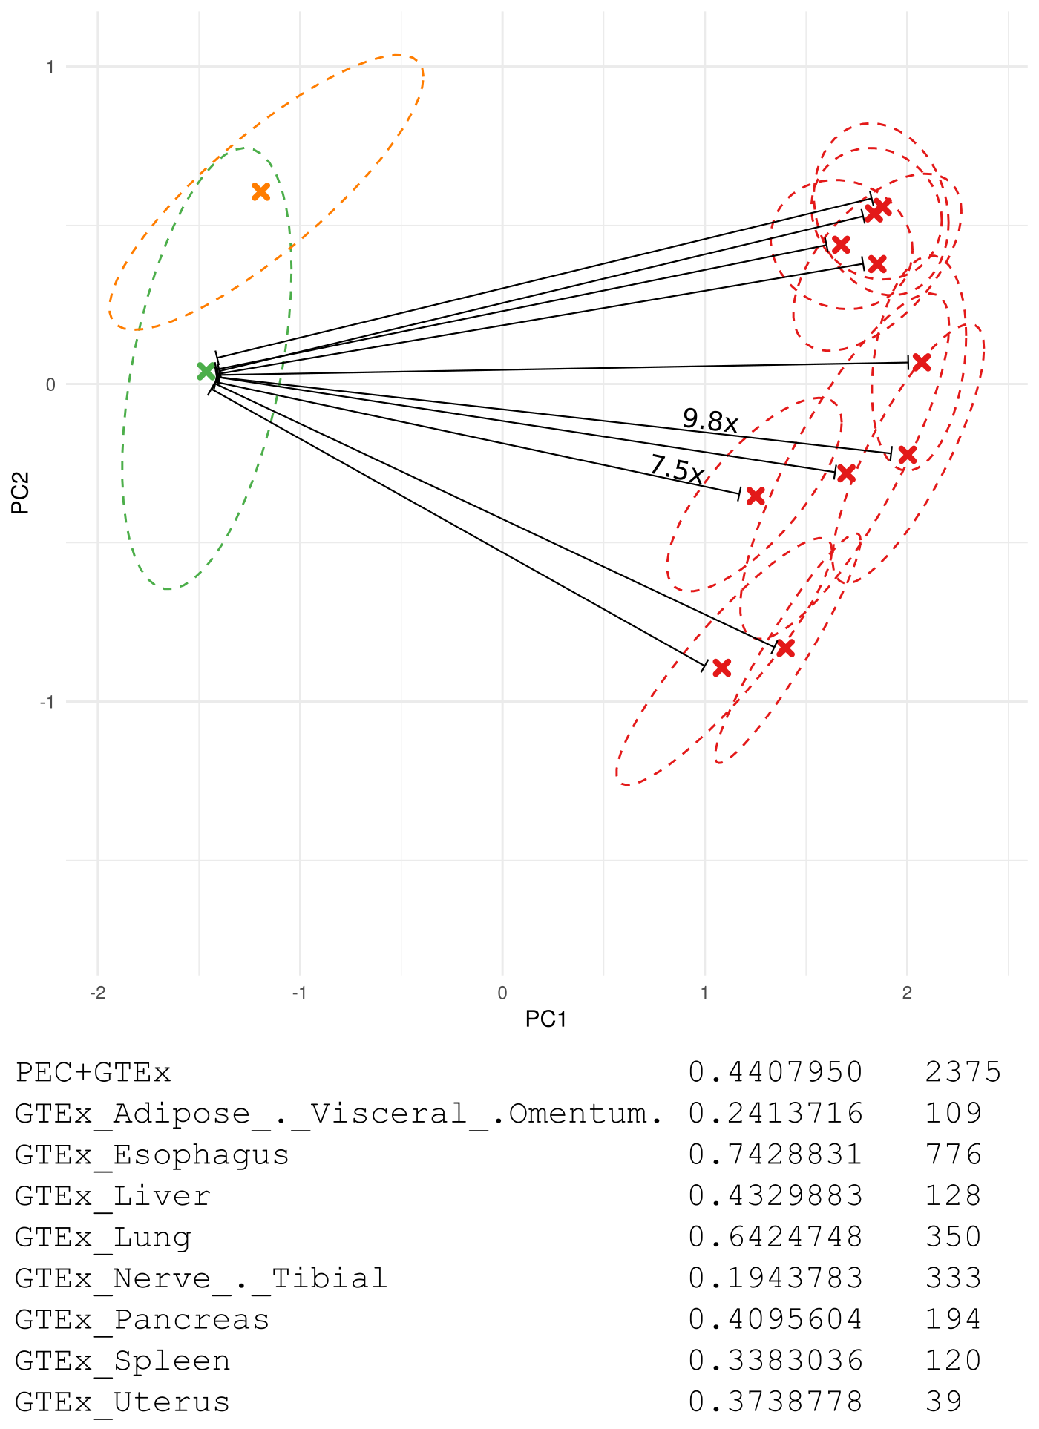
Tissue distances (normalized by brain dist)
SUPP

