Slide 1
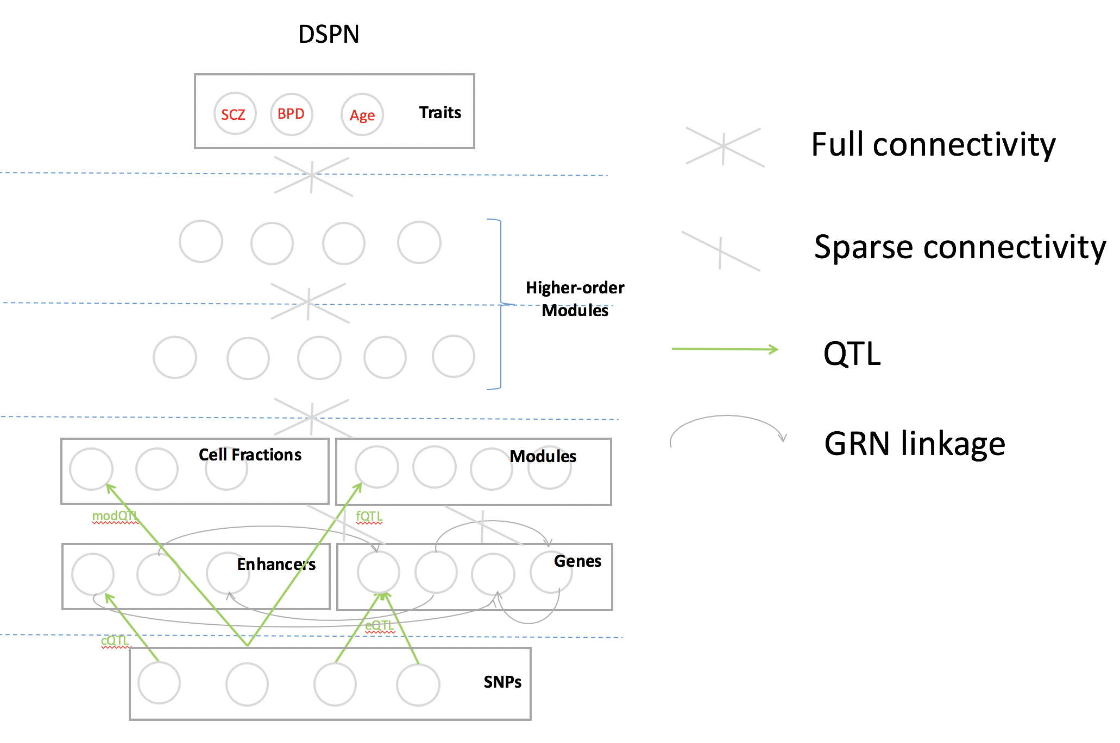
Model schematic

Slide 2
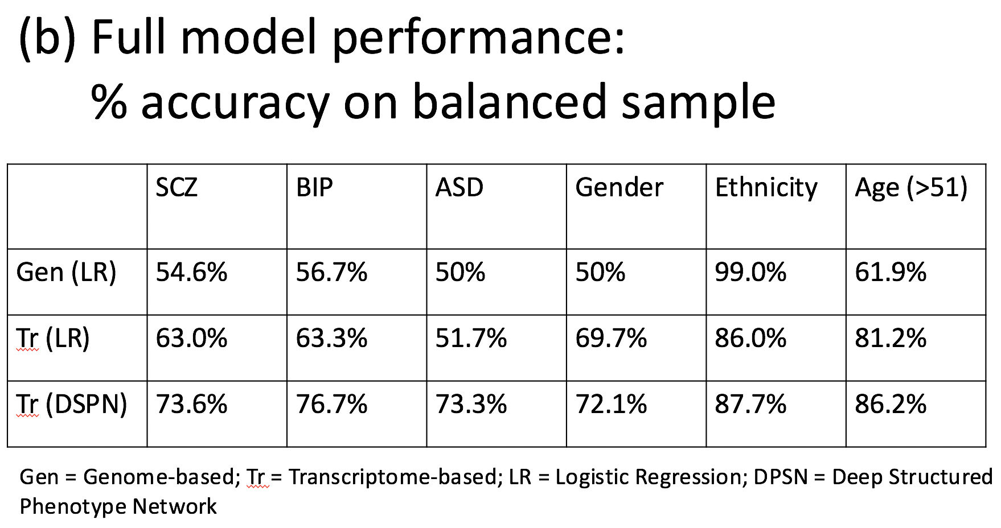
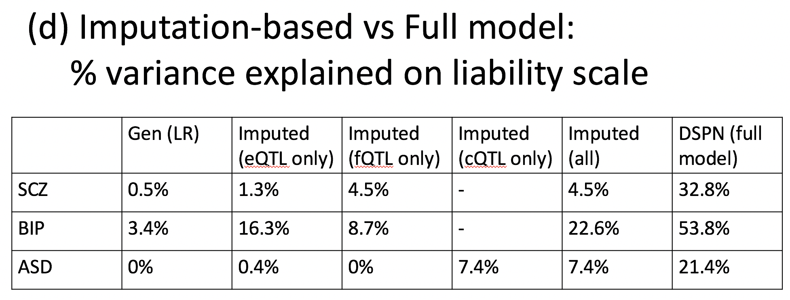
Updated results

Slide 3
DPSN module prioritization scheme
Links:
+
-
-
+
-
-
+
-
+
+
-

Slide 4
Enrichment: SCZ Pathways
module_1685:
Synaptic vesicle cycle:
Dopaminergic synapse:
Calcium signaling pathway:
Glutamatergic synapse:
cGMP-PKG signaling pathway
module_1741:
Spliceosome:
Cytosolic DNA-sensing pathway
module_3040:
Synaptic vesicle cycle:
Epithelial cell signaling in Helicobacter pylori infection:
Endocrine and other factor-regulated calcium reabsorption:
Dopaminergic synapse:
Vibrio cholerae infection
module_3107:
Mineral absorption:
Complement and coagulation cascades
module_3698:
Oxidative phosphorylation:
Parkinson's disease:
Huntington's disease:
Alzheimer's disease:
Non-alcoholic fatty liver disease (NAFLD)
module_3711:
postsynapse:
neuromuscular junction:
synapse part
module_3029:
mitochondrial ribosome:
mitochondrial inner membrane:
mitochondrial matrix

Slide 5
Enrichment: SCZ Cell types
SCZ
Age
ASD
module_3038:
Microglia
OPC
module_3729:
Oligodendrocytes
module_725:
In8
module_2743:
Ex2:
Ex3:
Ex5:
Ex7
module_734:
Microglia:
OPC

Slide 6
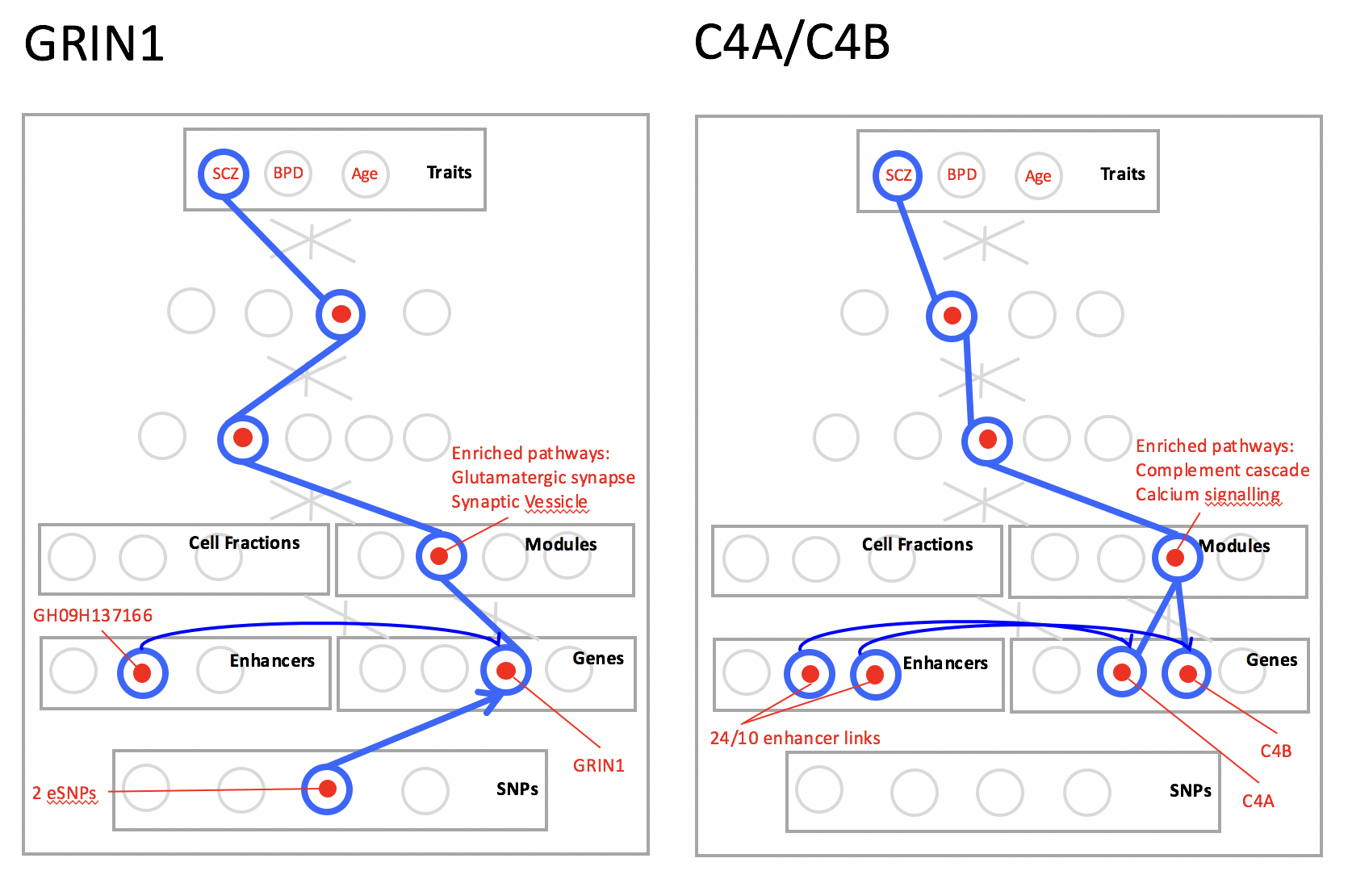
Trace schematics

