Slide 1
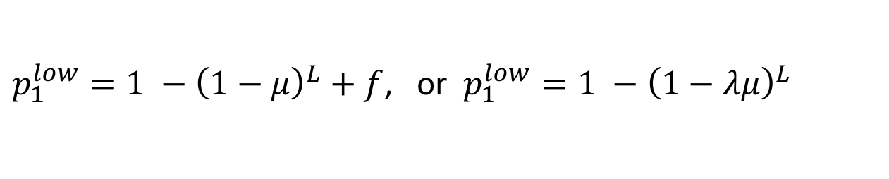
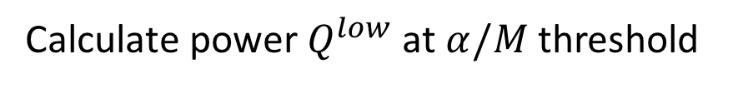
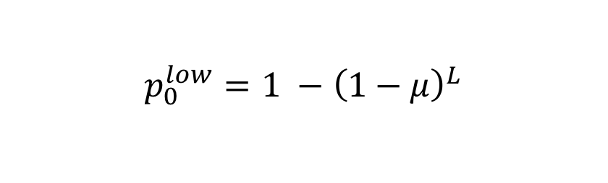
Merging hypotheses I
1
0
1
1
1
1
$$p_{0}^{low}=1 −{\left(1−μ\right)}^{L}$$
$p_{1}^{low}=1 −{\left(1−μ\right)}^{L}+f$, or $p_{1}^{low}=1 −{\left(1−λμ\right)}^{L}$
Calculate power $Q^{low}$ at $α/M$ threshold

Slide 2




Merging hypotheses II
1
0
1
$$p_{0}^{high}=1 −{\left(1−μ\right)}^{2L}$$
$$p_{1}^{high}=2p_{1}^{low}−{\left(p_{1}^{low}\right)}^{2}$$
$$=1−{\left(1−μ\right)}^{2L}+f(2{\left(1−μ\right)}^{L}−f)$$
Calculate power $Q^{high}$ at $α/(\frac{M}{2})$ threshold

Slide 3


Merging hypotheses III
1
0
1
1
1
0
0
1
0
$$Q^{proj}=2Q^{low}−{\left(Q^{low}\right)}^{2}$$
Benificial when $Q^{high}>Q^{proj}$

Slide 4
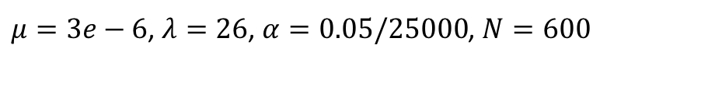
Varying length and driver density
Q=.9
Q=.7
Q=.5
d (driver density)
Q=.3
Q=.1
L (region length)
$μ=3e−6$, $λ=26$, $α=0.05/25000$, $N=600$

Slide 5
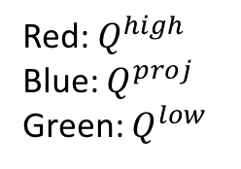






Comparing power
$K=2$
$K=3$
$K=5$
Red: $Q^{high}$
Blue: $Q^{proj}$
Green: $Q^{low}$
$$Q$$
$$Q$$
$$Q$$
$$μ$$
$$μ$$
$$μ$$
$$L=50, N=500, M=500, λ=10$$

Slide 6



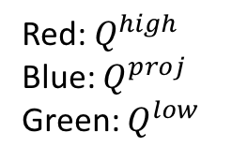
Comparing power
$f=0.0107$
$f=0.0022$
Red: $Q^{high}$
Blue: $Q^{proj}$
Green: $Q^{low}$
$$Q$$
$$Q$$
$$μ$$
$$μ$$
$$L=300, N=600, M=25000, K=2$$

Slide 7
Non-constant driver density
Q=.9
Q=.7
Q=.5
d (driver density)
Q=.3
Q=.1
L (region length)
$μ=3e−6$, $λ=26$, $α=0.05/25000$, $N=600$

Slide 8



ROC analysis
$$TPR$$
$$TPR$$
Red: high
Blue: projected
Green:low
$$FPR$$
$$FPR$$

