Slide 1
Xu Shi 02/22/2018

Slide 2
Single cell RNA-seq workflow

Slide 3
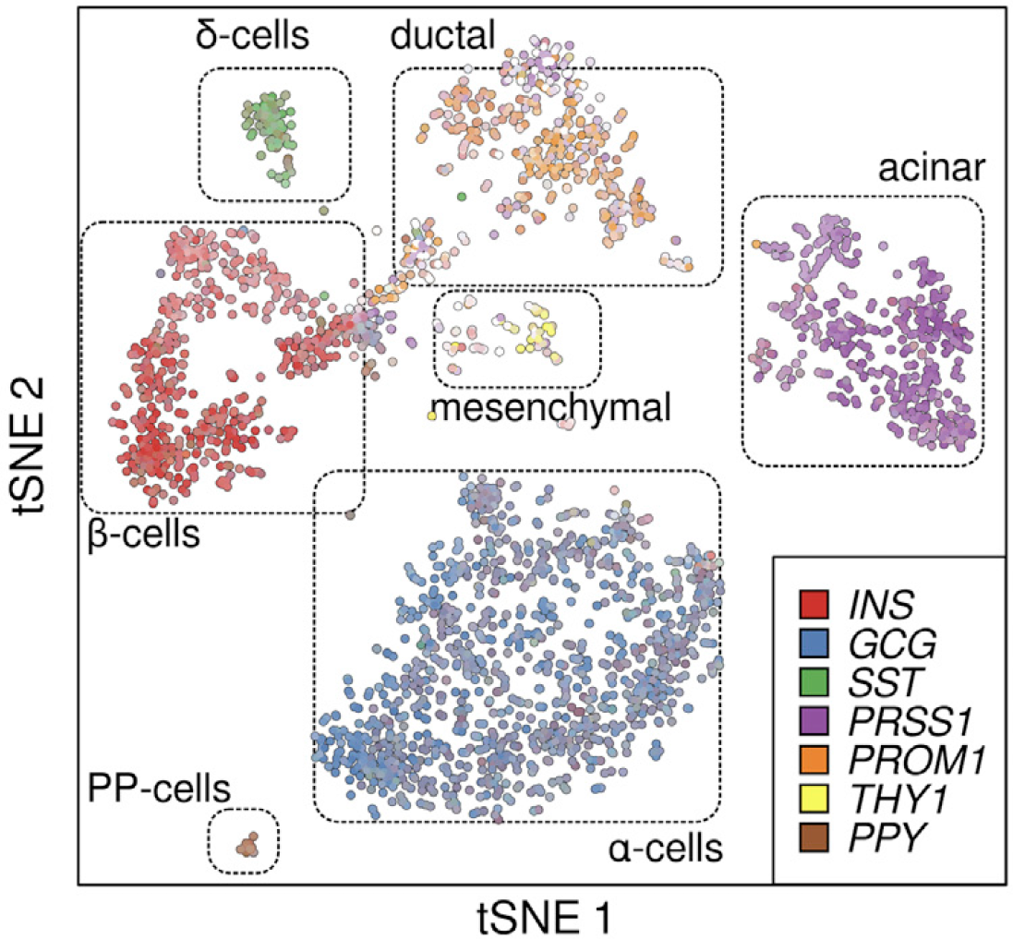
Pancreas single cell data
8 donors with large span of ages (~ 6 decades)
3 juvenile (1 month, 5 years and 6 years)
2 young adults (21 years and 22 years)
3 adults middle aged (38 years, 44 years and 54 years)
2,544 single cell sequenced
Absence of donor or sequencing batch effect

Slide 4
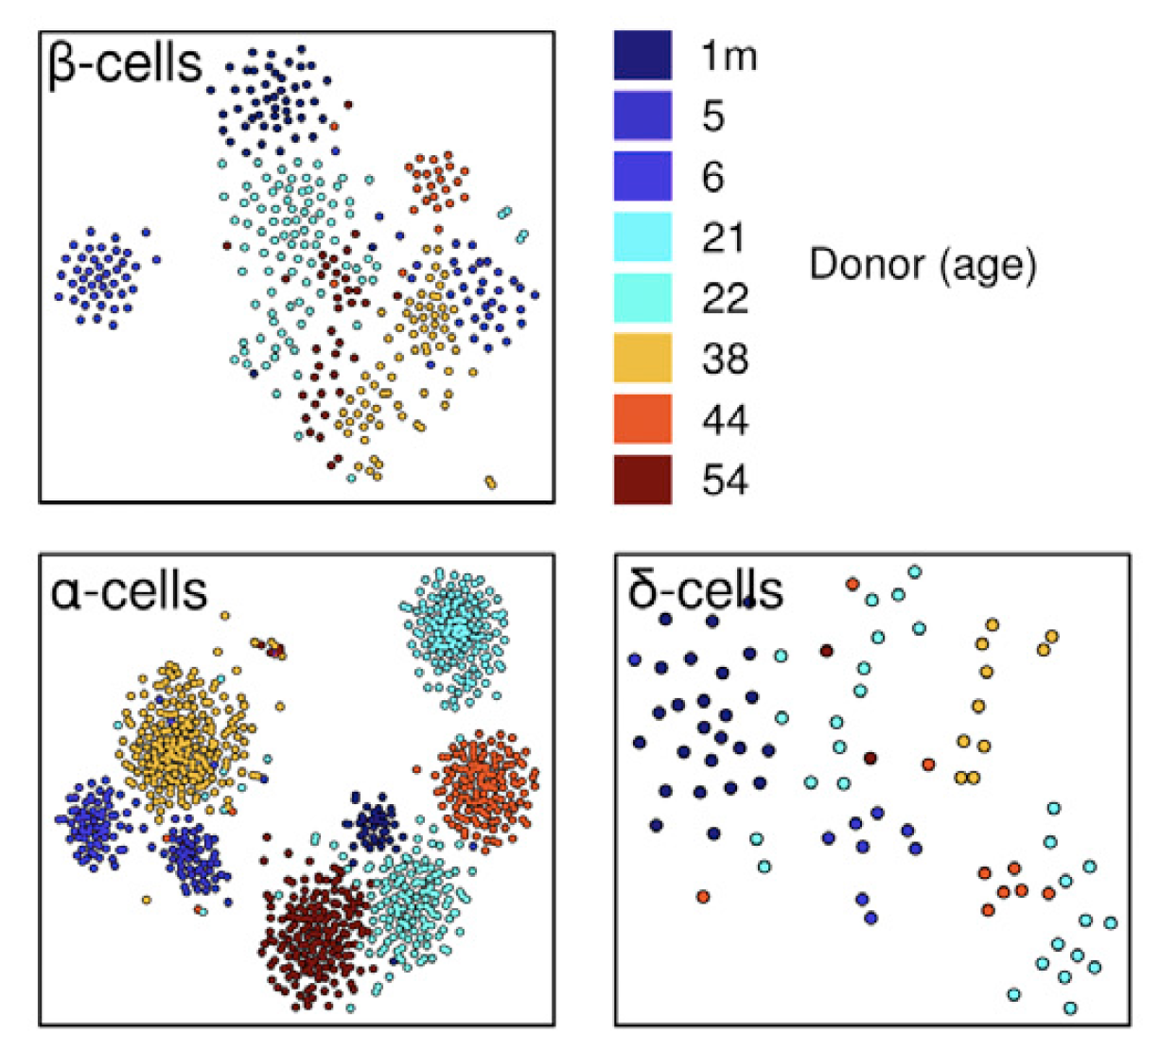
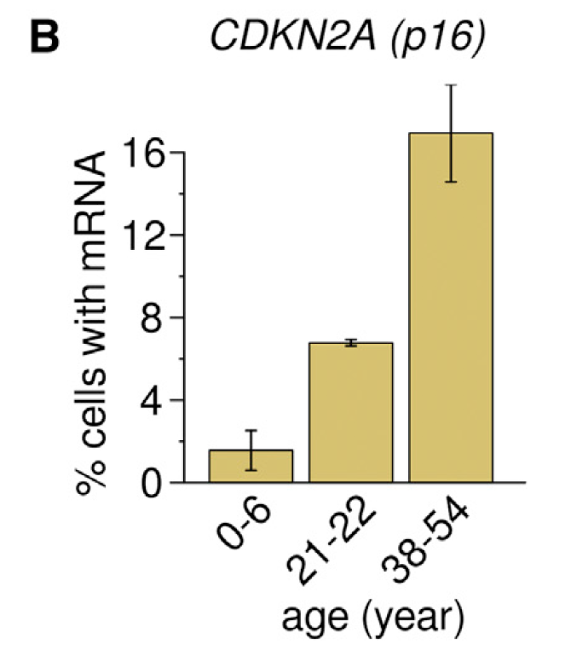
Age related genes
B
A
Consistent with other bulk RNA-seq study
t-sne by age-specific genes
Cells clustered by donor rather than ages
Many of the age-specific genes do not show strong association with age

Slide 5
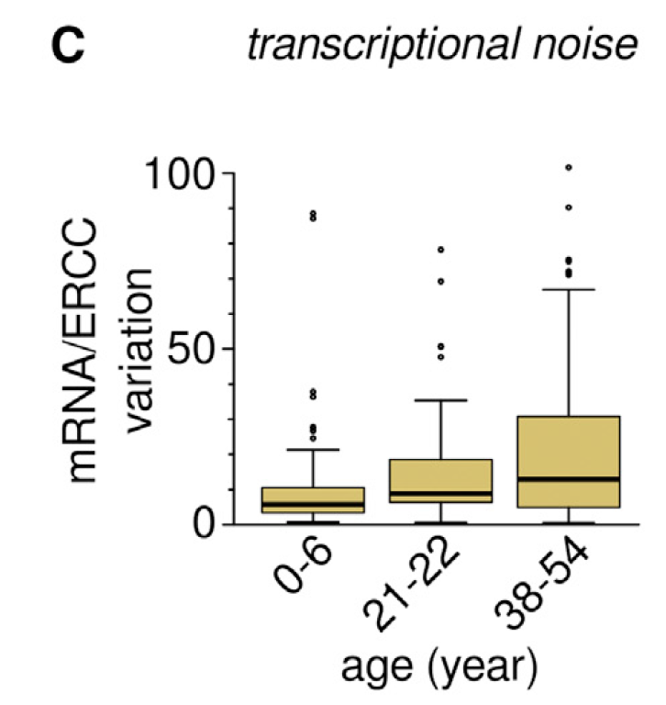
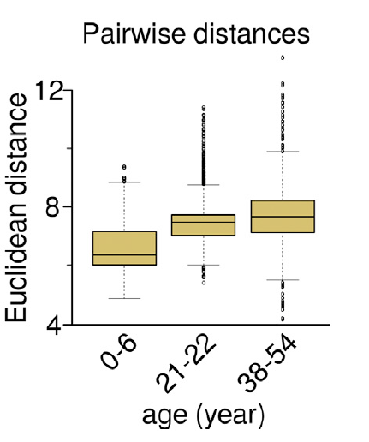
Transcriptional instability
A
Transcriptional noise
Given a cell $k$ of cell type $i$, patient $j$
Biological variation: $b_{ijk}=1−corr(x_{ijk},u_{ij})$
$x_{ijk}$ is single cell gene expression
$u_{ij}$ is the mean expression of cell type $i$in patient $j$
Technical variation: $t_{ijk}=1−corr(x_{ijk}^{contr},u_{ij}^{contr})$
$x_{ijk}^{contr}$ is single cell ERCC spike-in expression
$u_{ij}^{contr}$is the mean ERCC expression of cell type $i$in patient $j$
Transcriptional noise = $\frac{b_{ijk}}{t_{ijk}}$
Pairwise distance
Calculate Euclidean distance between each cell expression and the mean cell expression of given cell type
linear regression
p=3.01E-11
B
linear regression
p<1E-16

Slide 6
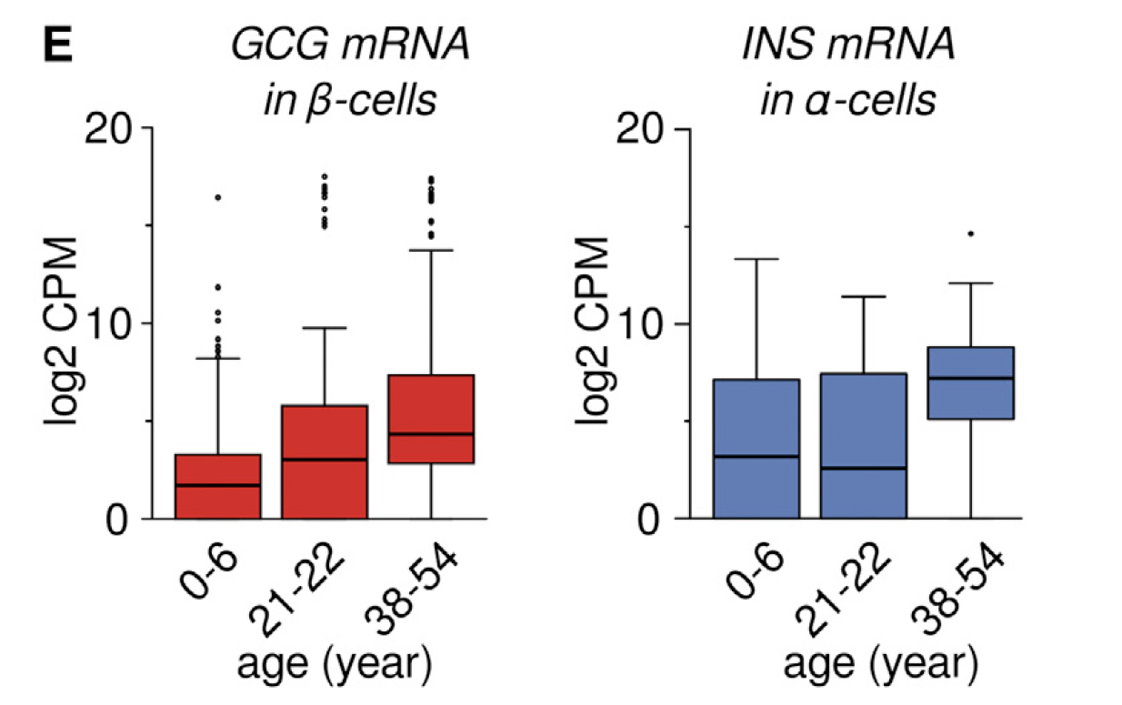
Insulin (INS) and Glucagon (GCG) mRNA
In biology, $α$-cells secrete GCG and $β$-cells secrete INS by definition
A subset of $α$-cells and $β$-cells simultaneously express both INS and GCG
A
B
Linear regression p=1.74E-27
Linear regression p=5.3E-10

Slide 7
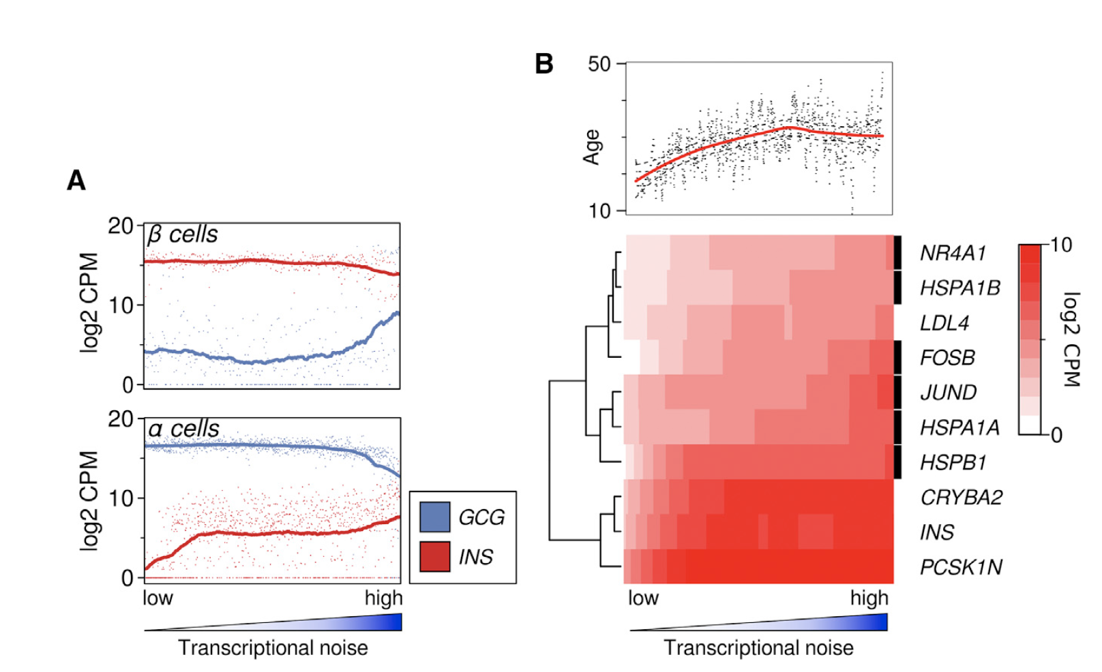
Transcriptional noise and hormone (INS and GCG)
Transcriptional noise is associated with age
Linear regression analysis to find genes related to transcriptional noise and age
Stress response genes

Slide 8
Mutational signature
40 distinct human cancer types

Slide 9
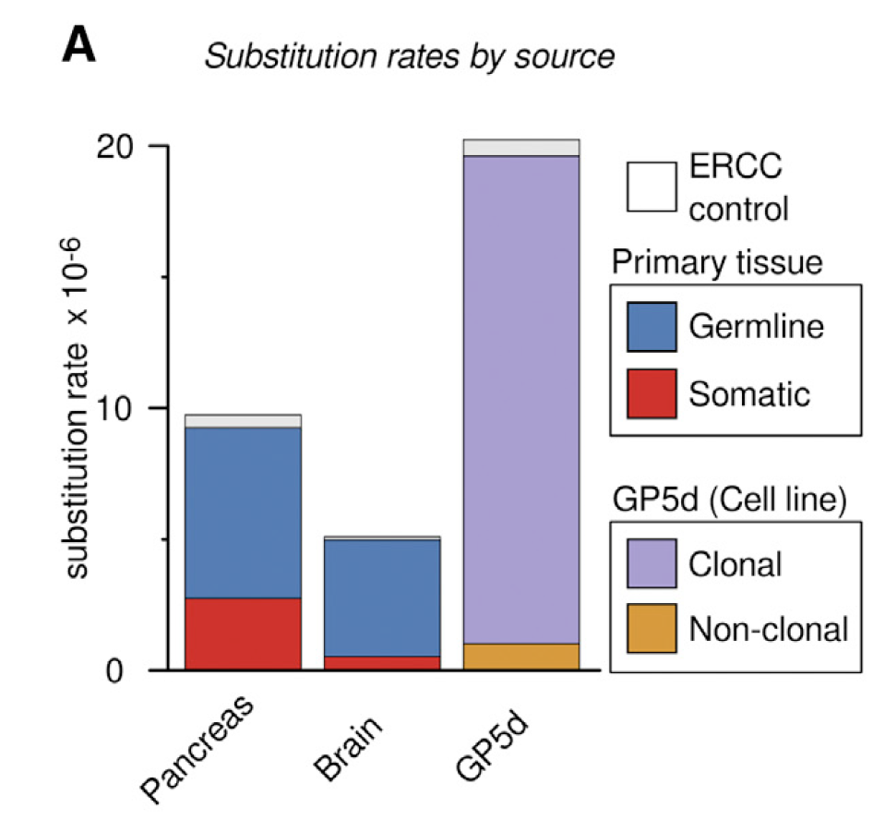
Mutation calling
2,544 pancreas cells + 398 adult brain cells + 73 GP5d colon cancer cells (in vitro)
Pancreas cells have much higher somatic substitution rate than Brain cells (>5-fold), but similar germline rate

Slide 10
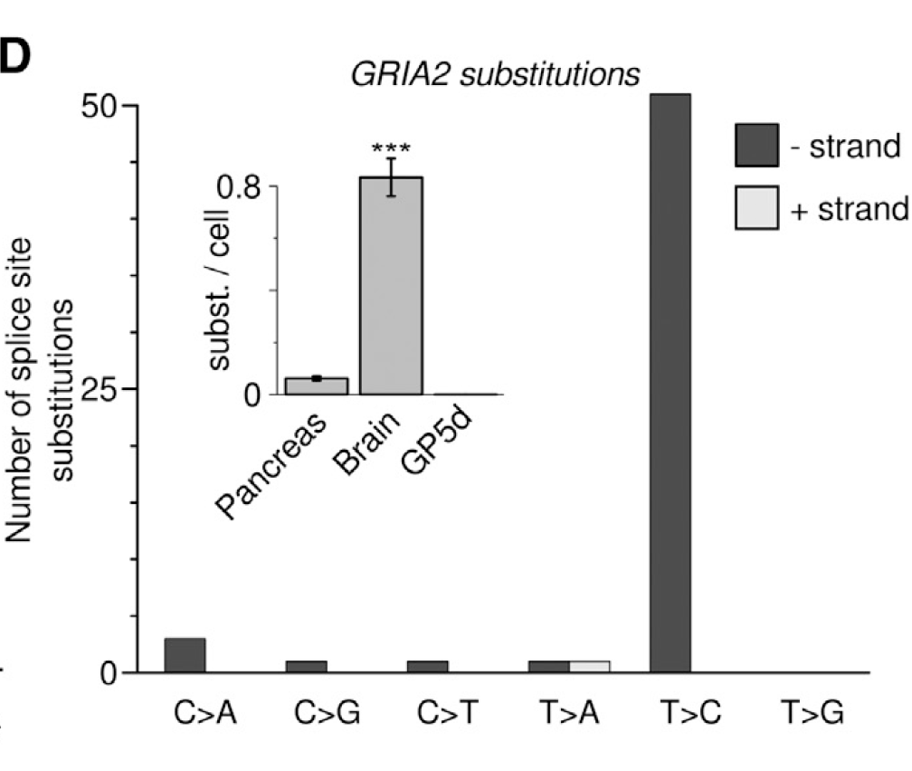
Mutation in different regions
A
B
Splice site substitutions
Somatic mutations are enriched in untranslated regions
mRNA editing rather than DNA level mutation
GRIA2: well-known target for mRNA editing on splice sites
Neuron specific

Slide 11
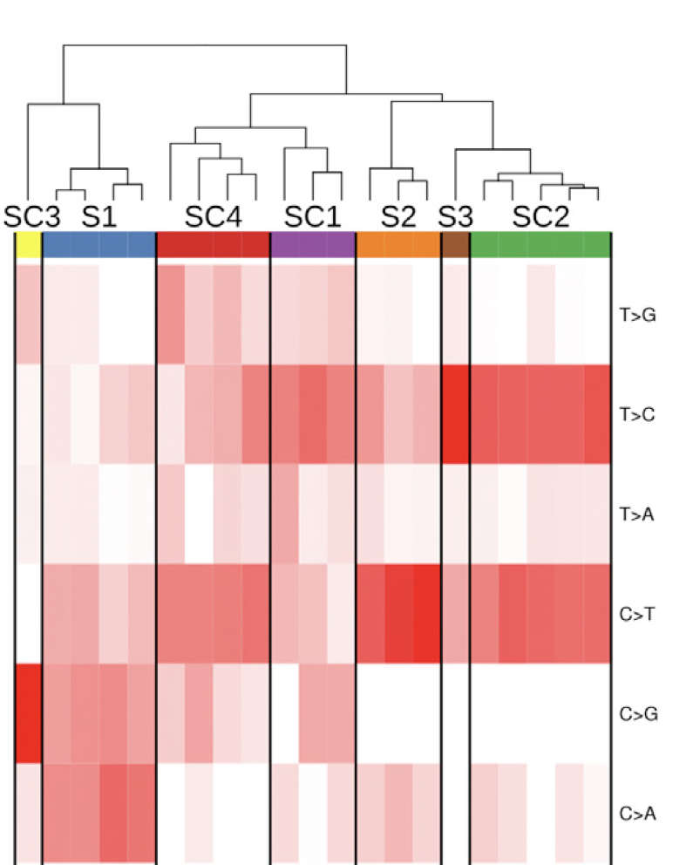
Mutational signatures identification
Single cells
NMF decomposition
Single cells
Base substitution rates
Mutational signatures
Merge 21 components to 7 signatures

Slide 12
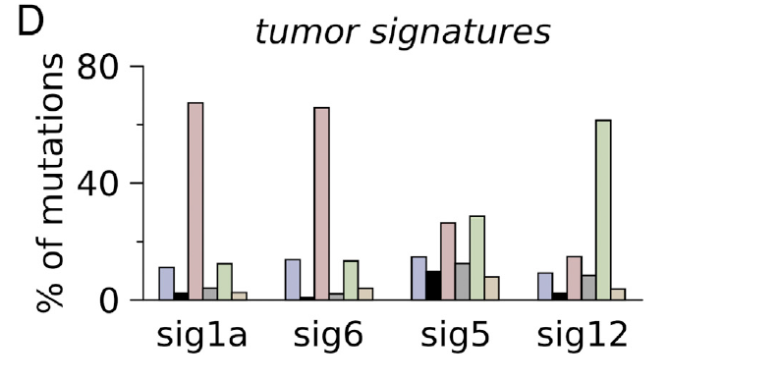
Mutational signatures
Excluding signatures:
Pattern similar to ERCC spike-in RNA
No cell-type specificity
Very low signal
COSMIC signatures from WGS and WES cancer data

Slide 13
Cell-specific mutational signatures
A
B
Mutational signature S1
Pancreas specific
Novel signature not discovered by COSMIC
Mutational signature S3
Brain specific
Match to one signature in COSMIC (including brain data)

Slide 14
Mutation load with age
Linear rank regression p=5.95E-23
Rank correlation analysis to identify genes associated with mutation load
Correlation analysis between mutation load and age

Slide 15
GO analysis of genes associated with S1 mutation load
B
Functions related to protein production
A

Slide 16
Discussion
Pros
Measure transcriptional instability by transcriptional noise and demonstrate the strong association with age
Develop a pipeline to identify base substitutions using single cell RNA-seq
Identify mutational signatures (one novel pancreas specific signature) for different cell types
Cons
Need more careful design of mutation calling pipeline for single cell data
Single cell data has high dropout rate and coverage is low
High error rate introduced in the reverse transcription and PCR amplification

