Slide 1
Single cell-level analysis of SCZ candidate genes
Hyejung Wo
02/02/2018

Slide 2
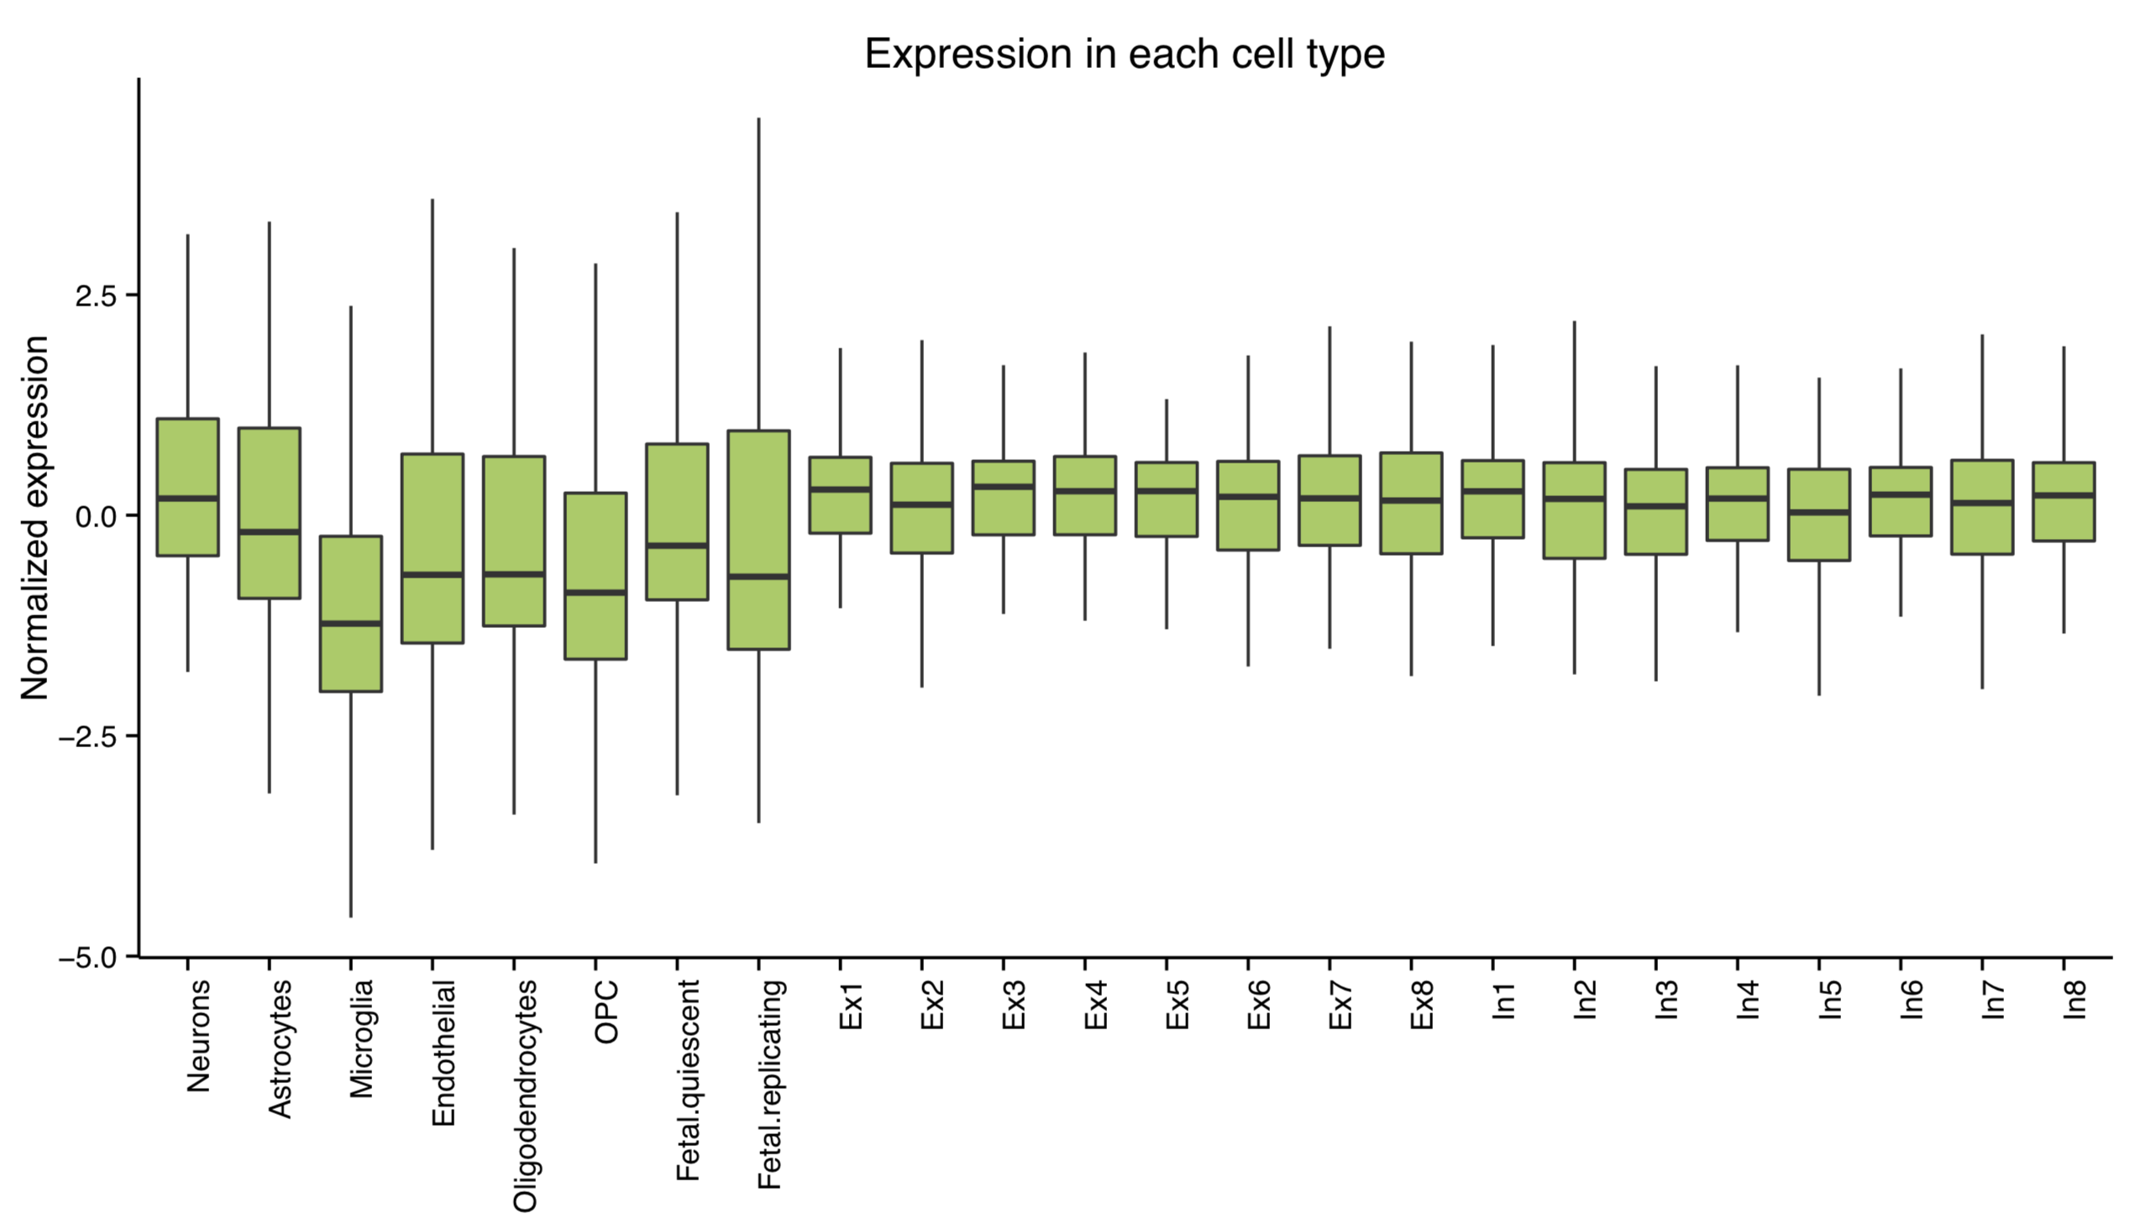
Overrepresentation test using marker genes
Expression level in each cell type
eQTL/sQTL/Hi-C

