Slide 1
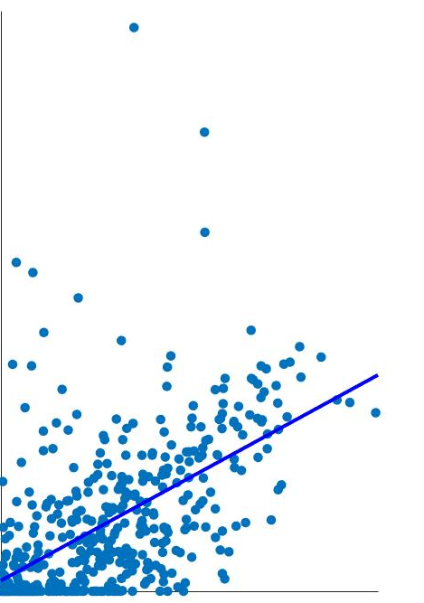
NMF component fractions (H)
25 unsupervised components
(neuron, non-neuron, fetal related)
NMF components (V)
20K genes
NMF-5
$$=$$
1931 individuals
25 unsupervised components
Tissue decomposition (NMF)
Bulk expression (B)
$$×$$
20K genes
corr(V,X)
1931 individuals
Cell fractions (W)
NMF-5
24 defined cell types
(17 neuron,5 non-neuron,2 fetal)
Single cell expression (C)
20K genes
Ex3
Ex3
fQTL
$$=$$
24 defined cell types
Tissue deconvolution
1931 individuals
$$×$$
Ex3

