Slide 1
Basic outline
What kind of distribution fits to chemical probing data?
What causes the variation?
How do different p-value based metrics perform for identifying reactive nucleotides?
How does statistical power affect the relative performance of p-value based metrics and reactivity based metrics?
Bridging distribution fitting and reactivity based metrics to visualize reactivity profiles with confidence estimates.
Application to RNA structure prediction?

Slide 2
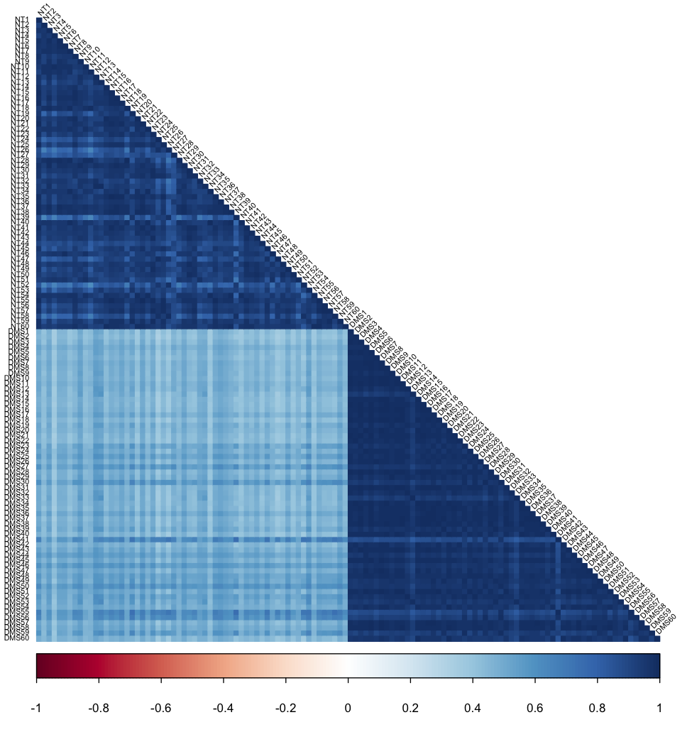
Fig 1a: Correlations of 60 replicate datasets
7SK DMS probing
Correlations of probability of RT stopping at each nucleotide
Other datasets:
genome-wide (no rRNA depletion)
GapDH mRNA
(show these in supp. figure)
NT
DMS
MEF cells; experiment by Alec Sexton

Slide 3
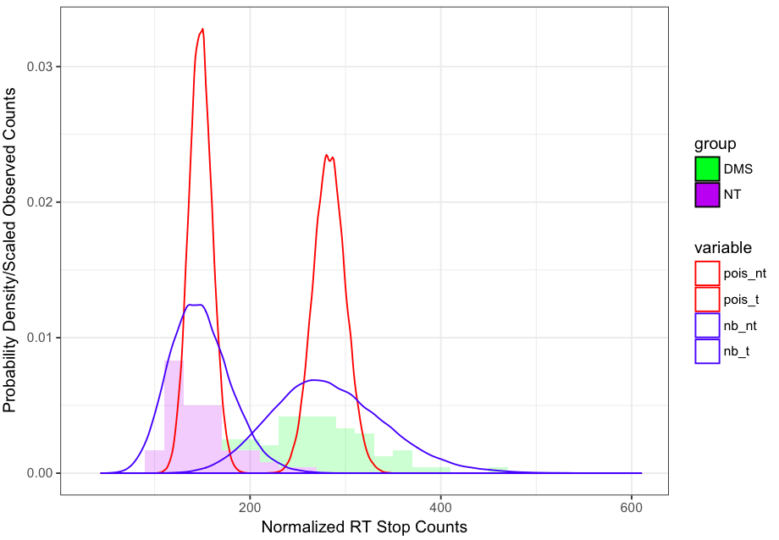
Fig 1b: Observed data and distribution fits for m7SK nucleotide 129
Need to improve legends. Red = Poisson; Blue = Negative Binomial
Stagger histograms?

Slide 4
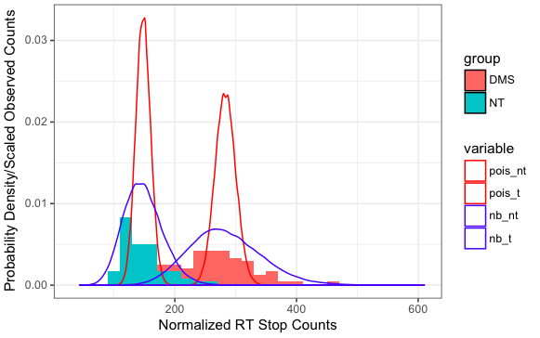
Fig 1b: Observed data and distribution fits for m7SK nucleotide 129
Need to improve legends. Red = Poisson; Blue = Negative Binomial
Stagger histograms?

Slide 5
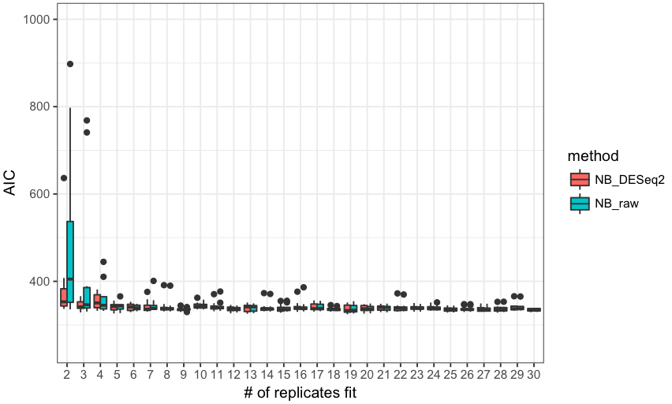
m7SK nucleotide 152 (switch nucleotide to match 1a)
Show Poisson & Binomial on this figure; Show Negative Binomial raw only in supplement.

Slide 6
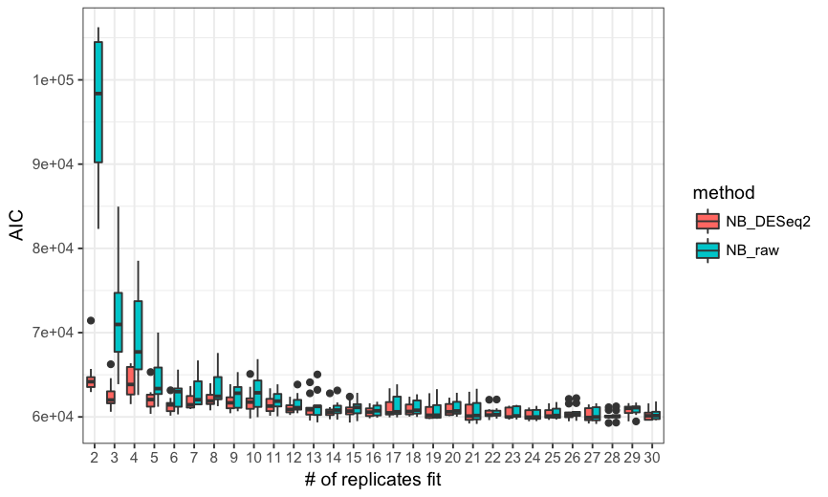
Fig 1c. Comparison of DESeq2 vs. NB raw fits (m7SK full)
Show Poisson & Binomial on this figure; Show Negative Binomial raw only in supplement.

Slide 7
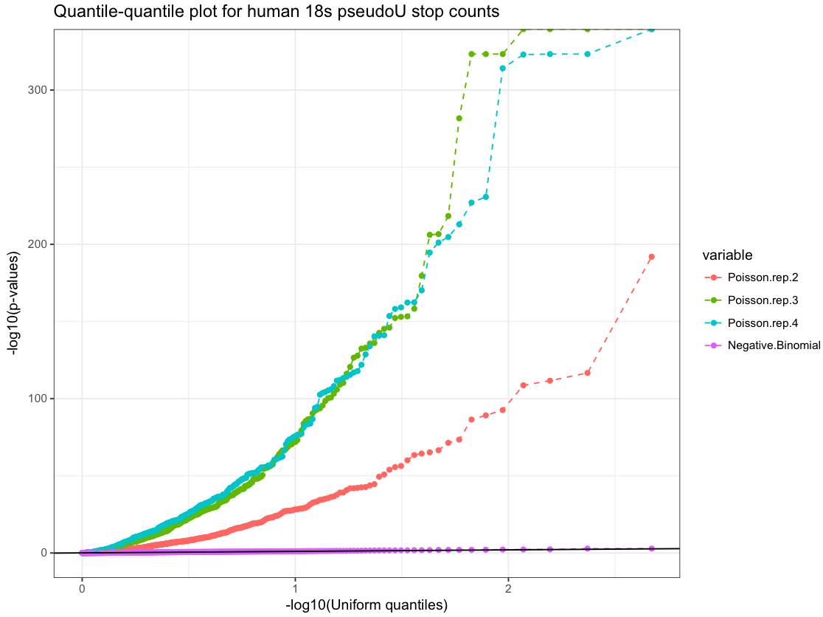
Fig 1d: Quantile-qunatile plot (remake with matching data)

Slide 8
Fig 1e: Compare Poisson & NB fits with likelihood metrics and a fixed # of replicates for many datasets
Datasets will be colored by reagent, texture by target RNA and/or lab

Slide 9
Basic outline
What kind of distribution fits to chemical probing data?
What causes the variation?
How do different p-value based metrics perform for identifying reactive nucleotides?
How does statistical power affect the relative performance of p-value based metrics and reactivity based metrics?
Bridging distribution fitting and reactivity based metrics to visualize reactivity profiles with confidence estimates.
Application to RNA structure prediction?

Slide 10
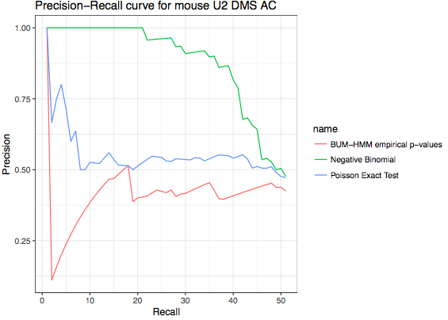
Precision-Recall Curve for mouse U2 snRNA DMS-Seq
Negative binomial p-values improve distinction of AC vs. GU nucleotides.
Data: Alec Sexton

Slide 11
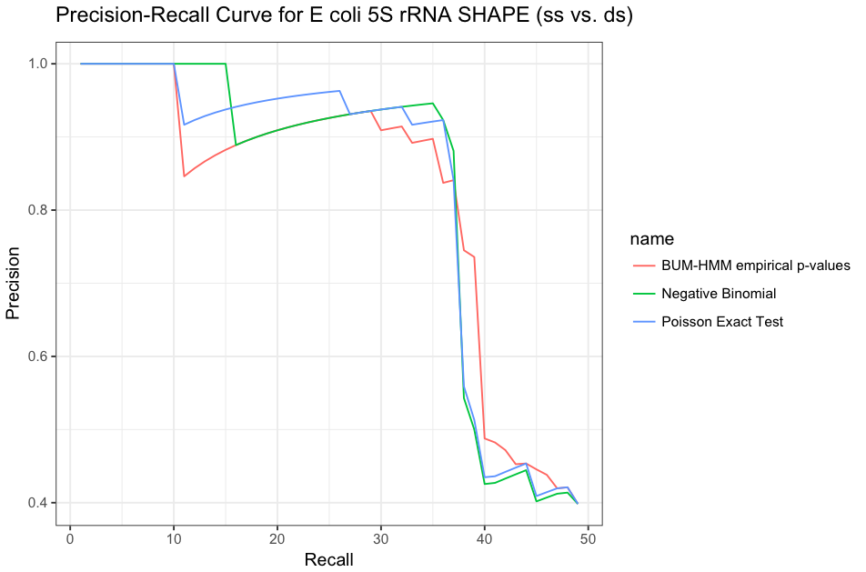
Precision-Recall Curve for E. coli 5S rRNA SHAPE-Seq
Data: Loughrey et al. NAR 2014

Slide 12
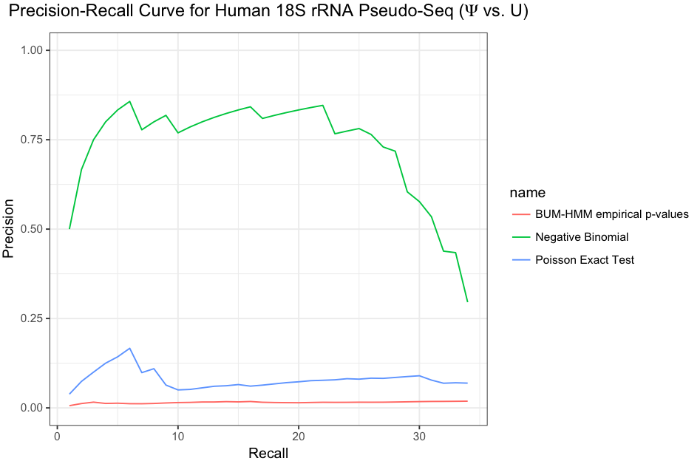
Precision-Recall Curve for Human 18S rRNA Pseudo-Seq
Data: Carlile et al. Nature 2014

Slide 13
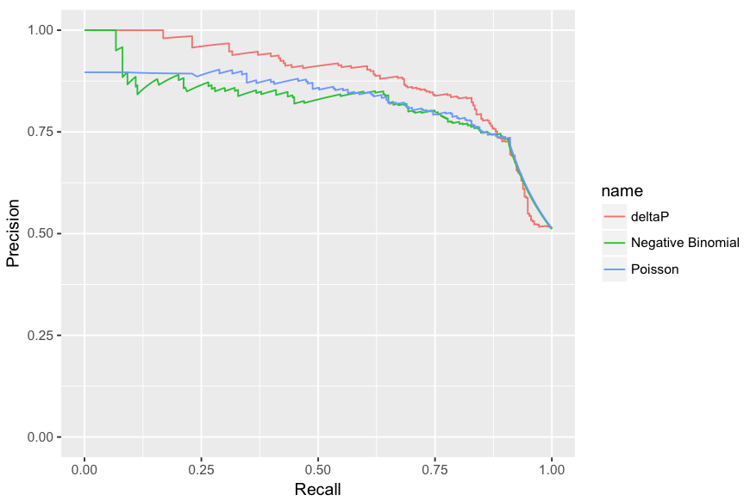
Comparing negative binomial p-values to chemical induced stop rate
Negative binomial p-values do not always outperform a simpler metric

Slide 14
Are p-values for treated vs. control comparison the best way to think about probing data?
What if the probe is selective, but with some nonspecific reactivity?
Property of interest
Treatment
Reactivity
0
Control
Reactivity
0

Slide 15
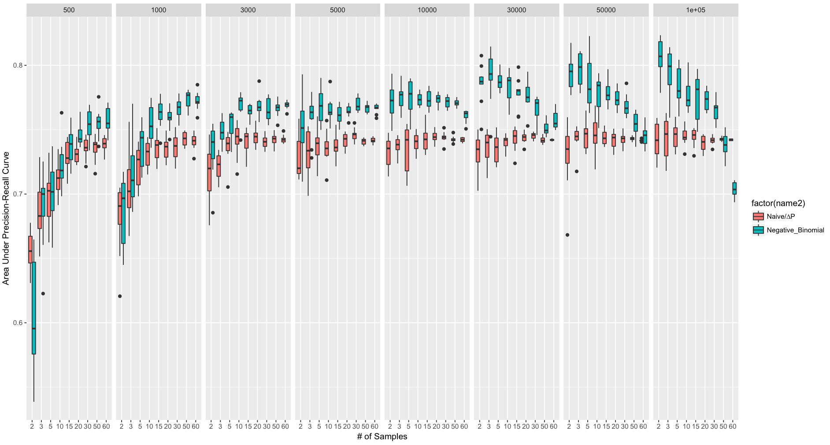
Fig ***: Mouse 7SK AC vs. GU AUPR as a function of # of reads and # of samples

Slide 16
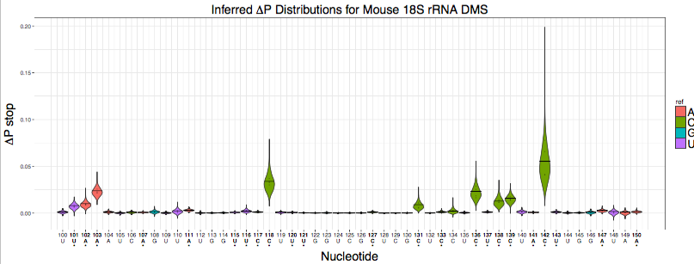

Slide 17
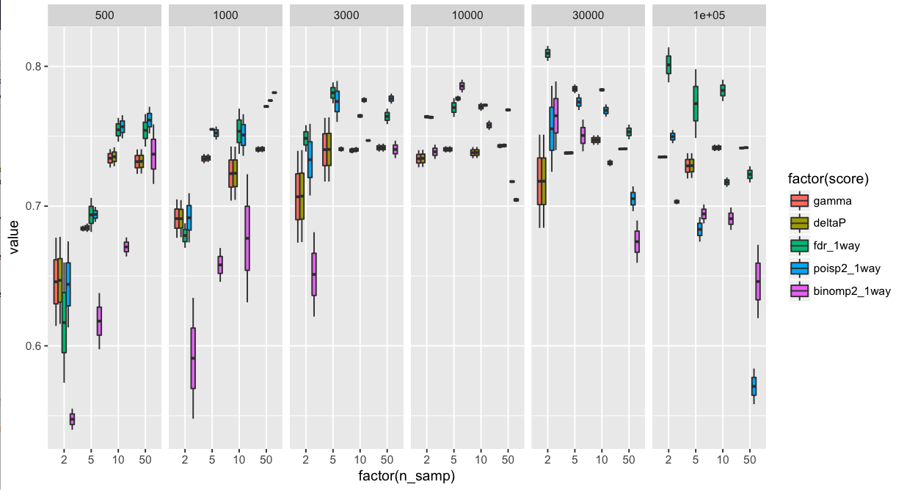
How does statistical power affect the relative performance of p-value based metrics and reactivity based metrics?

Slide 18
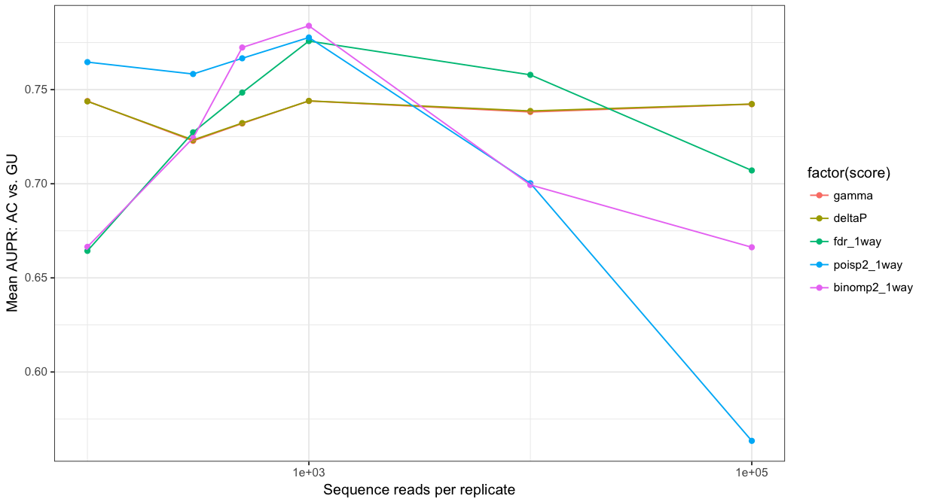
60 replicates: AC vs. GU AUPR
Goal: show the “peakiness” of p-value based metrics and the approach to maximum performance of reactivity-based metrics in one simple figure

Slide 19
Fig ***: Mouse 7SK AC vs. GU AUPR as a function of # of reads and # of samples

Slide 20
Fig S1: Correlations of 60 replicate datasets
7SK DMS probing
Correlations of probability of RT stopping at each nucleotide
Other datasets:
genome-wide (no rRNA depletion)
GapDH mRNA
(show these in supp. figure)
NT
DMS
MEF cells; experiment by Alec Sexton

Slide 21
Alternative Fig 1b: Observed data and distribution fits for m7SK nucleotide 129
Need to improve legends. Red = Poisson; Blue = Negative Binomial
Stagger histograms?

Slide 22
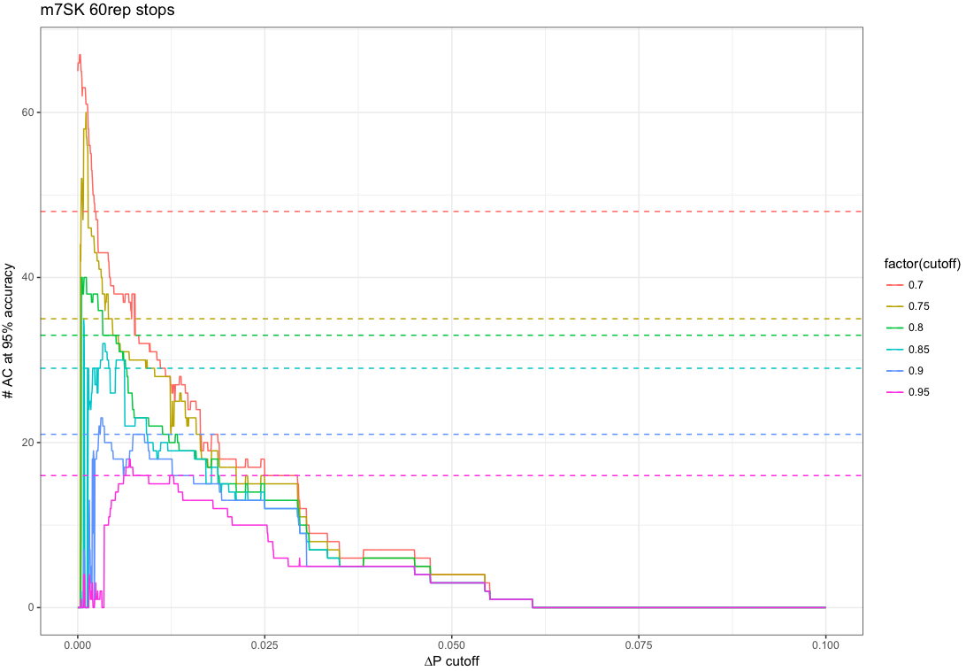

Slide 23
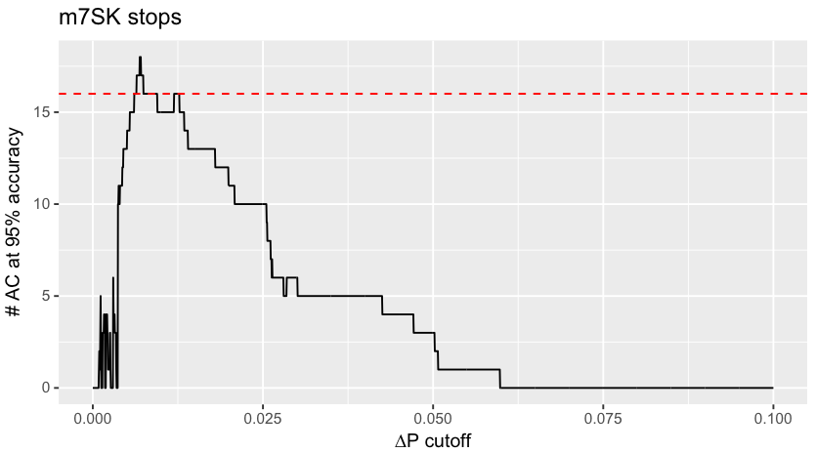
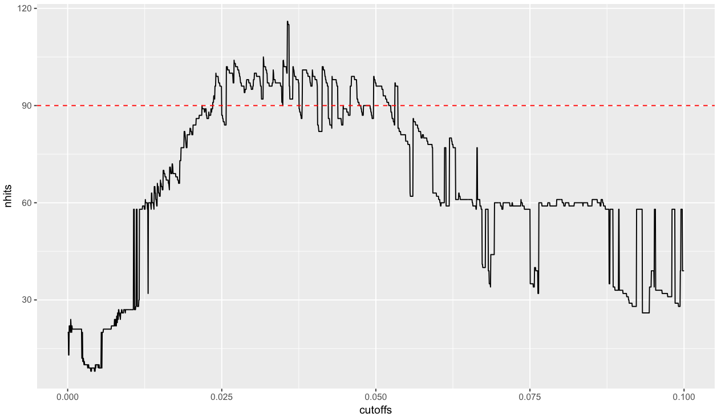
m7SK and mGapDH achieve best recall at 95% accuracy at very different cutoffs
mGapDH stops

Slide 24
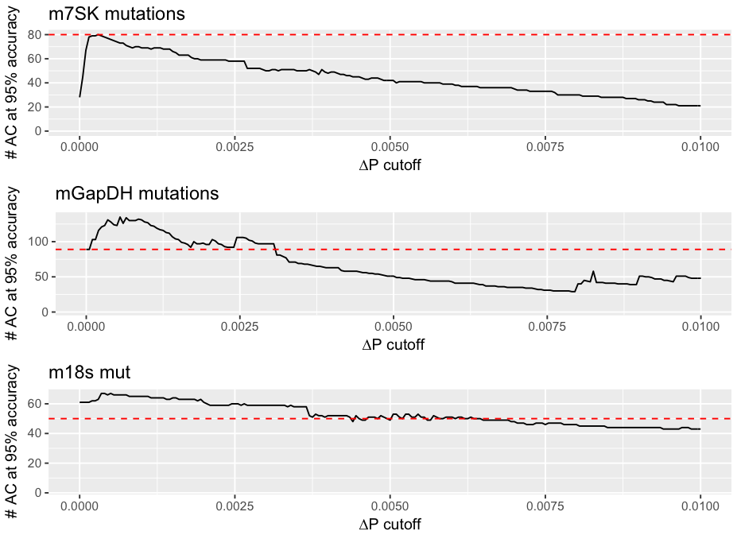
Fig ***: ∆P cutoffs can improve inference of top reactive bases

