Slide 1
Group Meeting
02/06/2018

Slide 2
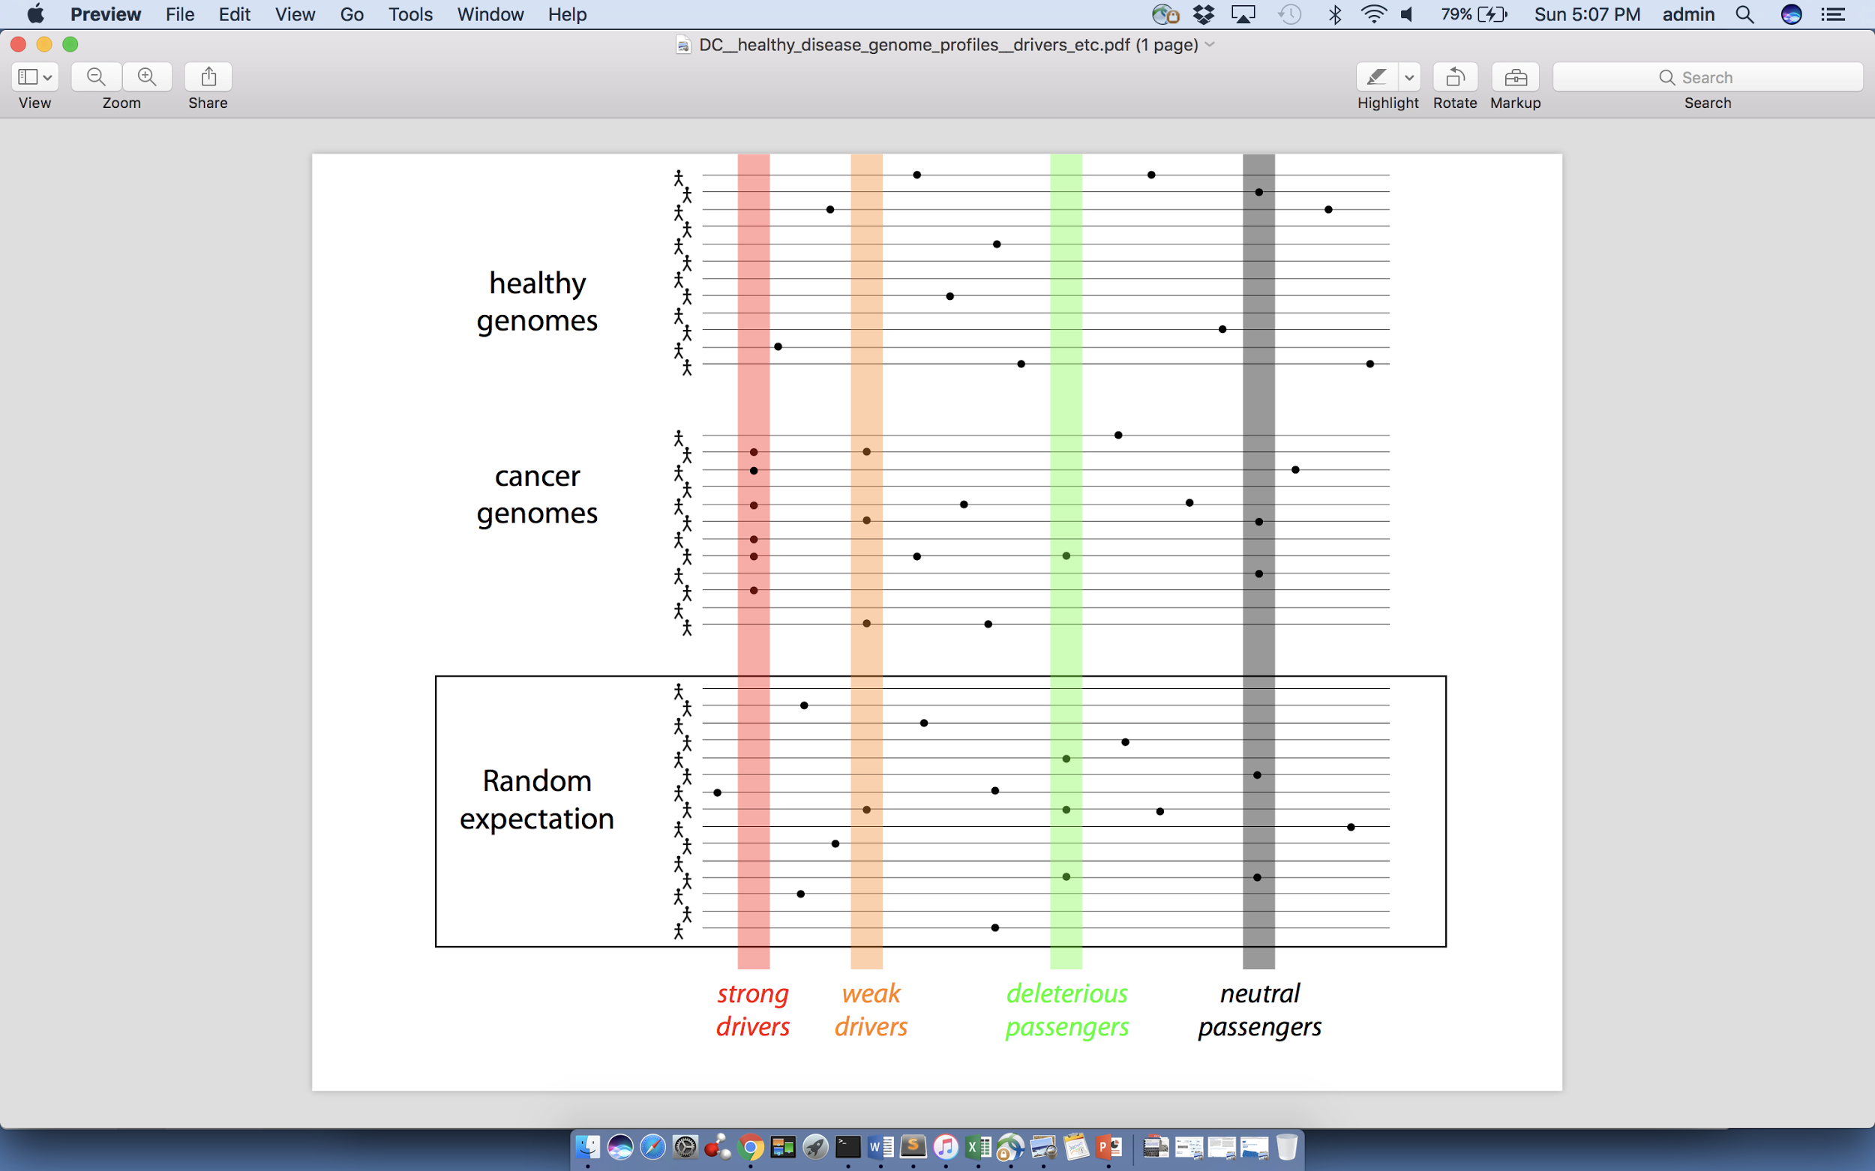
Canonical model of drivers and passengers in cancer
Drivers
  Driver mutations directly confer a selective growth advantage to the tumor cell.
  A typical tumor contains 2-5 drivers.
  Drivers are identified through signals of positive selection.
Passengers
  Conceptually, a passenger mutation has no direct or indirect effect on tumor progression.
  There are thousands of passengers in a typical cancer genome.

Slide 3
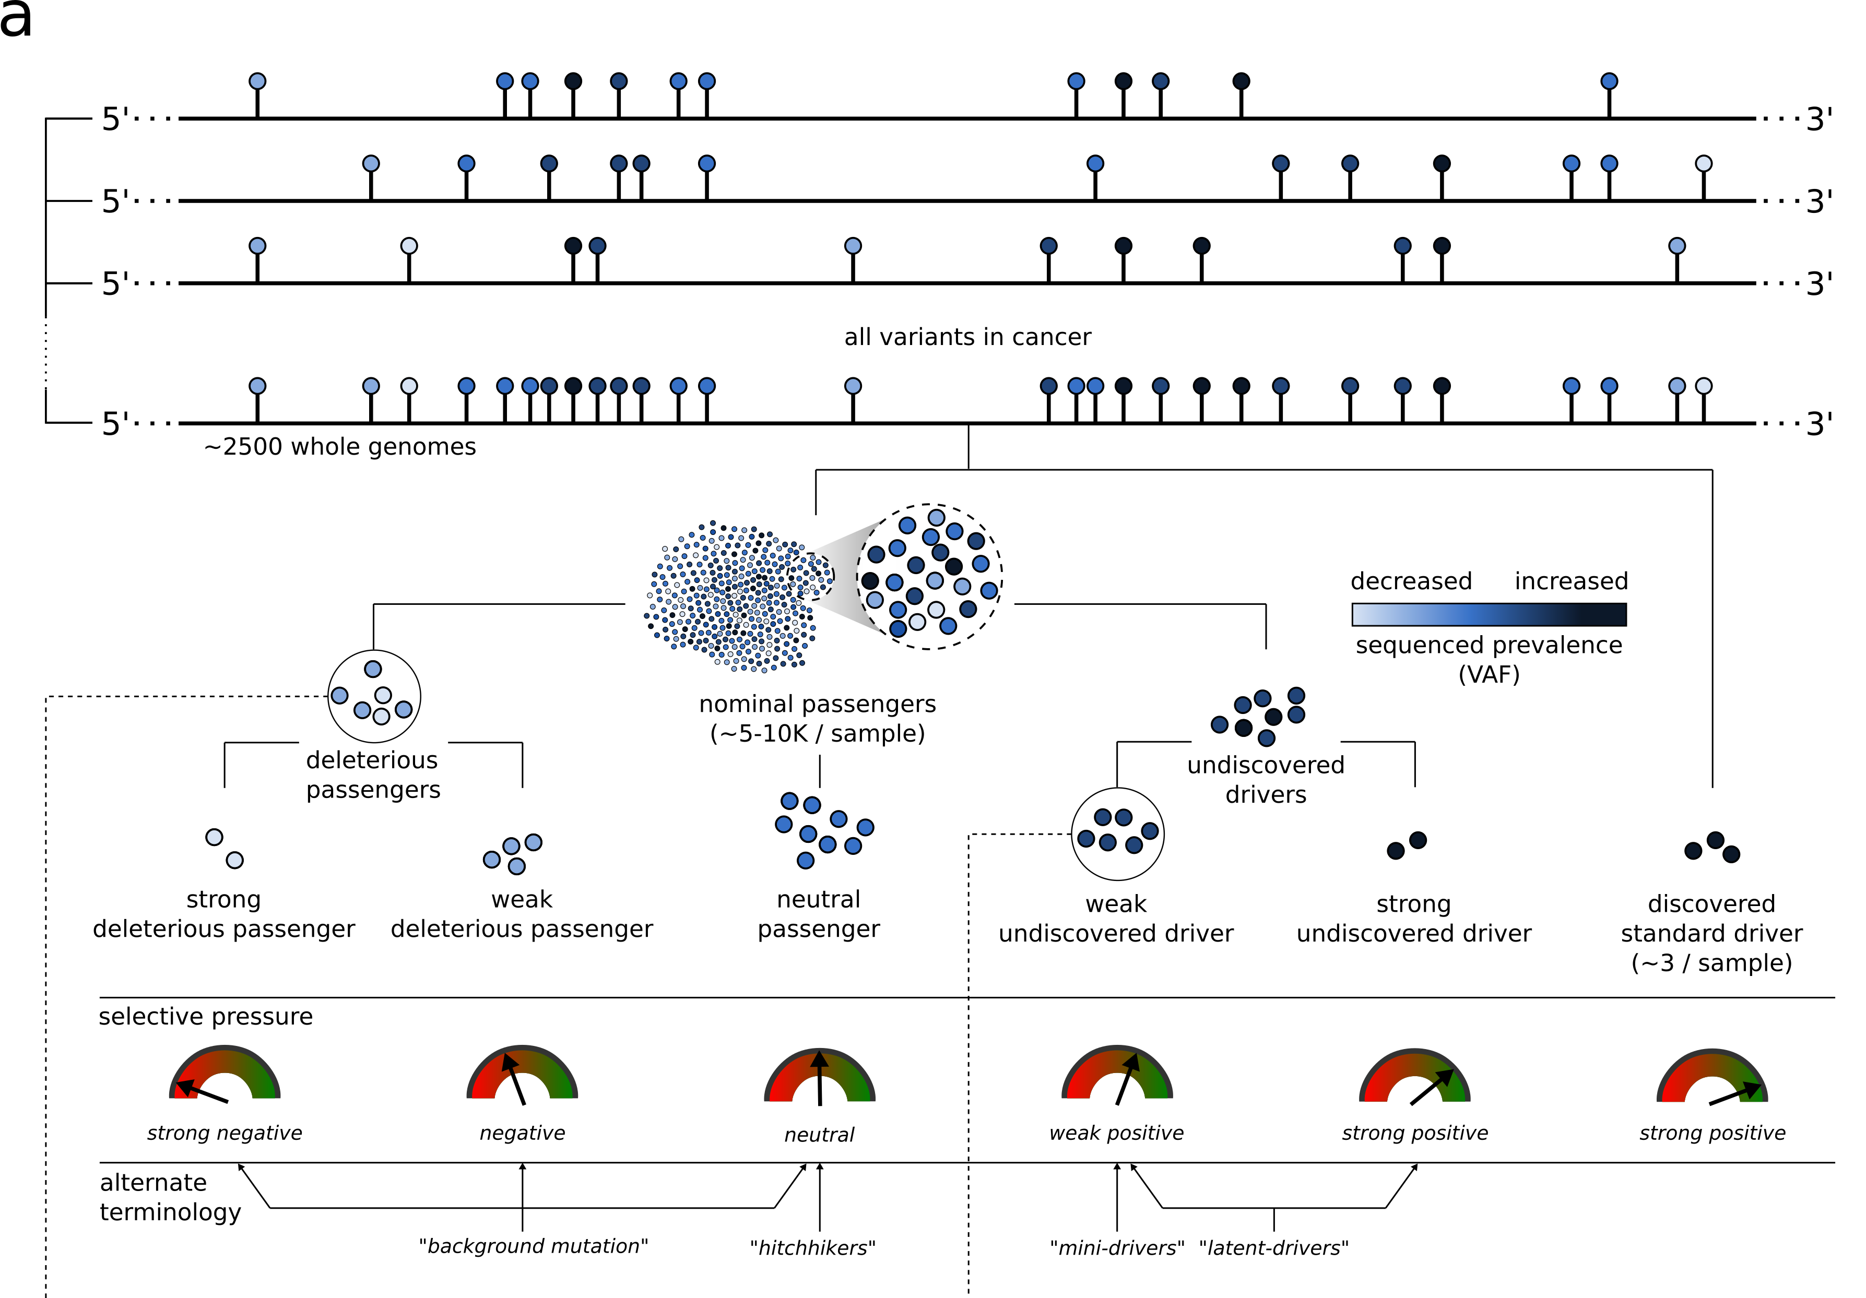
Conceptual extension of the canonical model of drivers and passengers

Slide 4
Additive variance model to quantify aggregated effect of mutations
Additive variance model (with random effects) detects aggregate effects of many variants on a phenotype, whose individual effect sizes may be too weak to achieve significance individually
Model can only detect that an aggregate effect exists: does not identify particular variants as significant
We adapt this model from GWAS analysis to detect non-neutral weak effects in cancer

Slide 5
Additive variance model setup
$$y_{j}=μ+\sum_{i}{z_{ij}u_{i}+e_{j}}$$
$y_{j}$ = phenotype of patient $j$
$μ$ = mean phenotype
$z_{ij}$ = normalized (z-scored) burden of element $i$ in sample $j$
$u_{i}$ = effect of SNV $i$
$e_{j}$ = residual for patient $j$
Random effects model:
Gaussian prior distributions:
Restricted maximum likelihood (REML) used to estimate $σ_{u}^{2}$ and $σ_{e}^{2}$ (Yang et al. Nat Genet. 2010)
We use the additive effects model to discriminate true cancer genotypes ($y=1$) from simulated cancer genotypes ($y=0$) using our own null model incorporating trinucleotide context and covariates (replication timing, chromatin accessibility, GC content)
$$u_{i}∼N\left(0,σ_{\text{u}}^{2}\right)$$
$$e_{j}∼N(0,σ_{\text{e}}^{2})$$

Slide 6
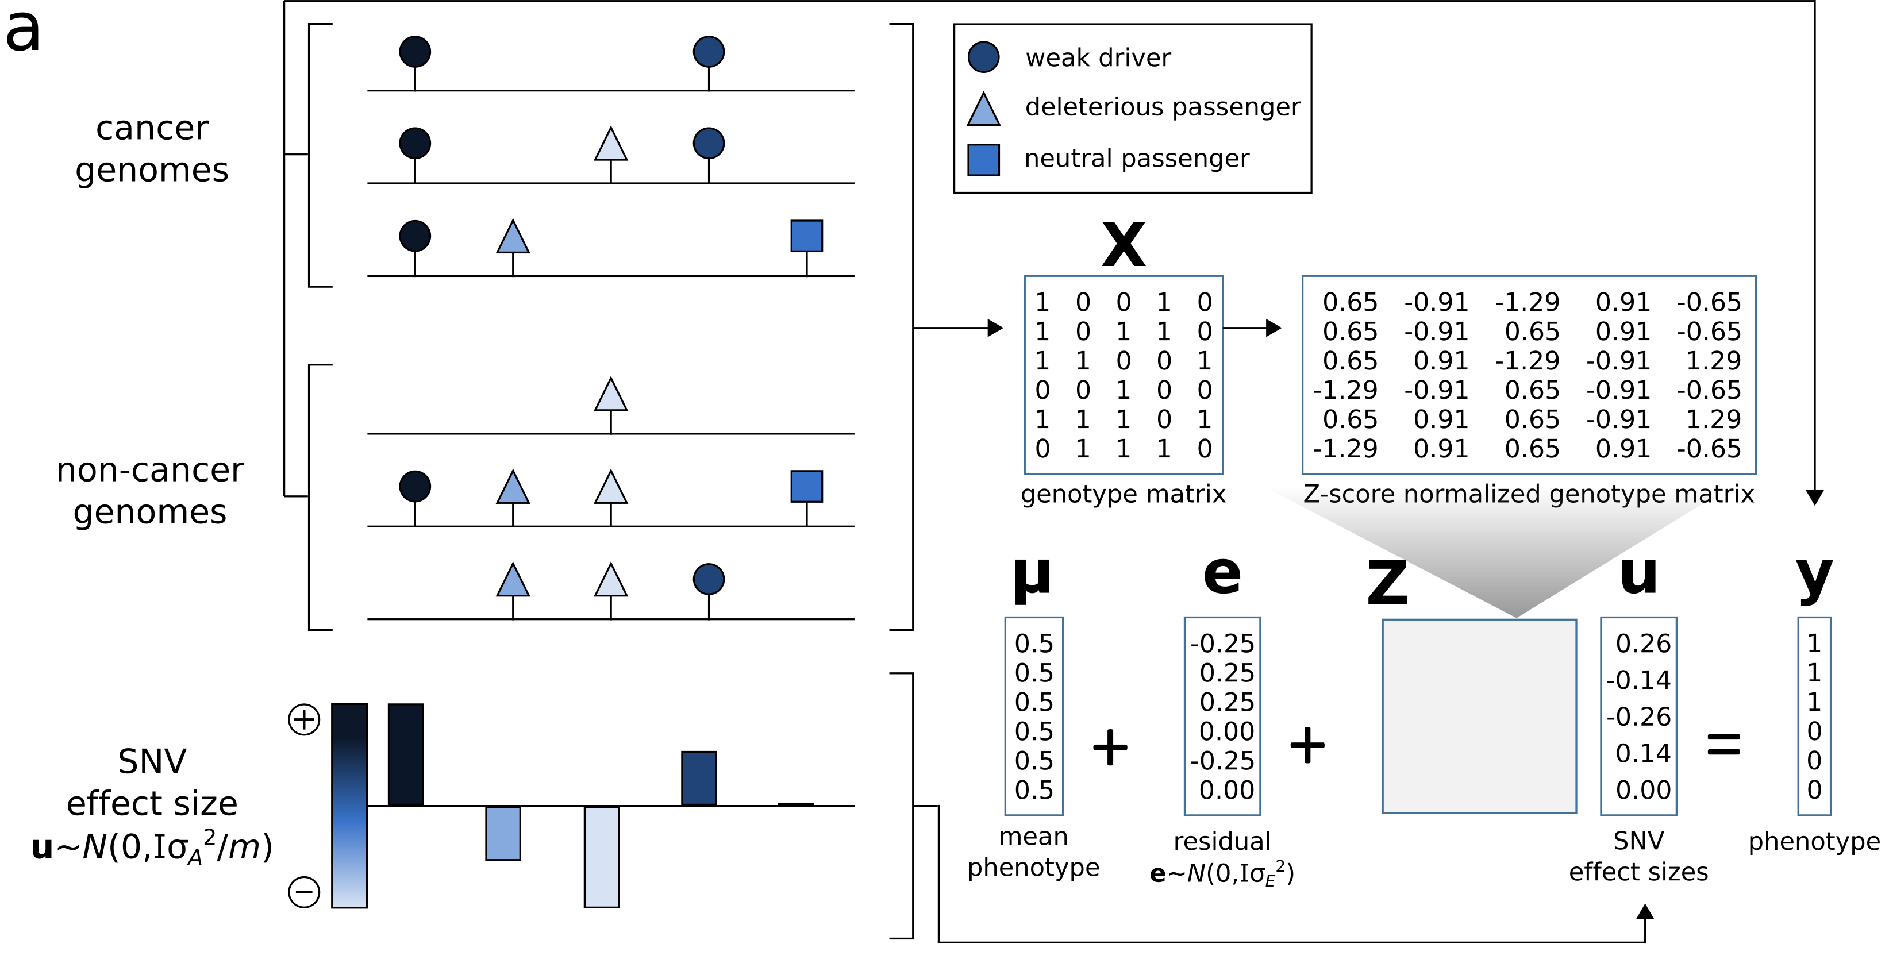
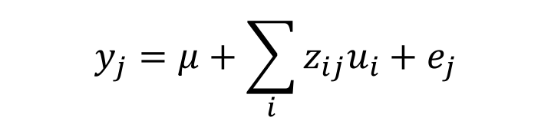
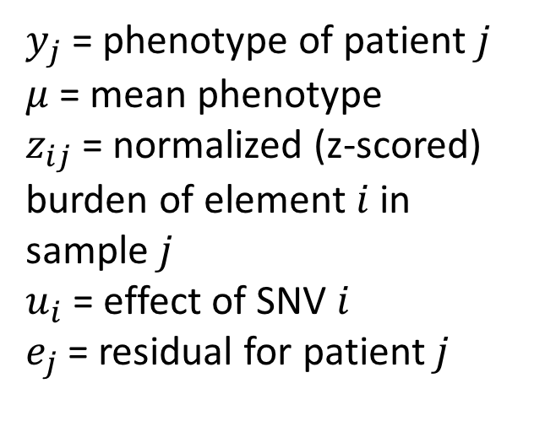

Additive variance model on PCAWG samples
$$y_{j}=μ+\sum_{i}{z_{ij}u_{i}+e_{j}}$$
$$u_{i}∼N\left(0,σ_{\text{u}}^{2}\right)$$
$$e_{j}∼N(0,σ_{\text{e}}^{2})$$
$y_{j}$ = phenotype of patient $j$
$μ$ = mean phenotype
$z_{ij}$ = normalized (z-scored) burden of element $i$ in sample $j$
$u_{i}$ = effect of SNV $i$
$e_{j}$ = residual for patient $j$

Slide 7
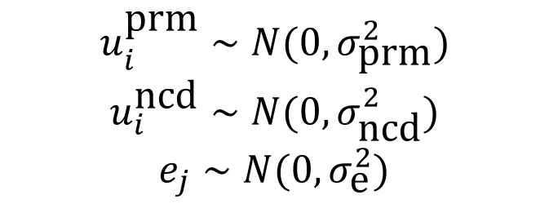
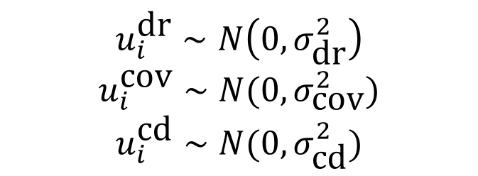
Different Flavors of additive variance model
Nested model:
$$y_{j}=μ+z_{j}^{\text{dr}}u^{\text{dr}}+\sum_{i}{z_{ij}^{\text{cd}}u_{i}^{\text{cd}}+}\sum_{i}{z_{ij}^{\text{prm}}u_{i}^{\text{prm}}+}\sum_{i}{z_{ij}^{\text{n}\text{cd}}u_{i}^{\text{n}\text{cd}}+e_{j}}$$
$$u_{i}^{\text{dr}}∼N\left(0,σ_{\text{dr}}^{2}\right)$$
$$u_{i}^{\text{cov}}∼N(0,σ_{\text{cov}}^{2})$$
$$u_{i}^{\text{cd}}∼N(0,σ_{\text{cd}}^{2})$$
$$u_{i}^{\text{prm}}∼N(0,σ_{\text{prm}}^{2})$$
$$u_{i}^{\text{ncd}}∼N(0,σ_{\text{n}\text{cd}}^{2})$$
$$e_{j}∼N(0,σ_{\text{e}}^{2})$$

Slide 8
Broad simulations as control group
Divided the genome into 50kb regions.
For each region, computed the mutation rate. Mutation rate was defined as the ratio between number of mutation in the region across all PCAWG patients to the total number of mutations in PCAWG.
Every base was assigned a coverage count based on in how many samples that particular base was sufficiently covered in 1111 PCAWG samples.
Mutation were permuted under following constraints
  Tri-nucleotide context of permuted location was same as original mutation
  Permutated mutations were assigned to regions based on mutation rate
  Fraction of patients with enough coverage at a given site was used as position’s probability for being mutated

Slide 9
Custom randomization to generate covariate corrected randomized dataset
Following conditions were applied to generate new randomized dataset
  Tri-nucleotide context of permuted location was same as original mutation
  Permuted mutation lie on the same chromosome as original mutation
  genome was divided into 10kb non-overlapping bins. Average of multiple covariates were computed for each bin.
  Clustering approach was applied to identify relevant bins, where a given mutation can be permuted satisfying condition1 and condition2.
  Following co-variate corrections were considered for generating the background mutations:
    Replication timing
    Chromatin accessibility
    GC content
    Penta-nucleotide context for Liver and Melanoma cohorts

Slide 10
Sanger simulations as control group

Slide 11
Sensitivity analysis – Double randomization

Slide 12
Sensitivity analysis – Varying window length

Slide 13
Predictive power of known drivers and nominal passengers using the additive effects model
Compares the maximum possible variance which can be explained using known drivers with the performance of the model containing driver and putative passenger.
An increase in the additive variance from ~49.9% using drivers alone to ~59.4% with putative passengers when averaged across all cohorts

Slide 14
Predictive power of known drivers and nominal passengers using the additive effects model
Split mutations into coding, promoter and other non-coding categories, where the coding mutations are a superset of the PCAWG drivers.
Coding mutations (~50.7% averaged across cohorts) accounted for the largest overall proportion of the variance.
Promoters and other non-coding also contributed much lesser, but still significant amounts of extra variance (~1.9% and 6.9% respectively)

Slide 15
Predictive power of known drivers and nominal passengers using the additive effects model
Additive variance per SNV by normalizing by the number of SNVs in each category.
Normalized variance is substantially higher in promoters than other non-coding, although lower than coding mutations.

Slide 16
Additive variance estimates, samples with SNV drivers removed
Total Additive Variance
Variance per SNV
 | Coding | Promoters | Other non-cod. | Total
Breast (52)# | 0.0015 | 0.0087 | 0.1381 | 0.1483
CNS (84) | 0.0118 | 0.0147 | 0.0737 | 0.1002
Kidney (46) | 0.0166 | 0.0104 | 0.12 | 0.147
Liver (67) | 0.0012 | 0.0024 | 0.2795 | 0.2831
Ovary (18) | 0.0017 | 0.004 | 0.0072 | 0.0129
Pancreas (5) | 0.0051 | 0 | 0 | 0.0051
Prostate (111) | 0.0051 | 0.0045 | 0.1689 | 0.1784
Skin Mel (11) | 0.0083 | 0.1104 | 0.0074 | 0.1261
Average | 0.0064 | 0.0194 | 0.0994 | 0.1251
 | Coding | Promoters | Other non-cod.
Breast | 0.0015 | 0.0004 | 0.0012
CNS | 0.0118 | 0.0024 | 0.0035
Kidney | 0.0166 | 0.0026 | 0.0018
Liver | 0.0012 | 0 | 0.0006
Ovary | 0.0017 | 0.0013 | 0.0005
Pancreas | 0.0051 | 0 | 0
Prostate | 0.0051 | 0 | 0.0003
Skin Mel. | 0.0017 | 0.0008 | 0.0004
Average | 0.0056 | 0.001 | 0.001
# Number of samples after removing those with SNV drivers

Slide 17
Additive variance estimates, samples with SNV + SV + CNV drivers removed, Only cohorts with at least 15 samples remaining are included
 | Nuria’s drivers removed | All drivers removed
CNS (84 / 53) # | 0.1002 | 0.0747
Kidney-RCC (46 / 15) | 0.147 | 0.1190
Liver (67 / 18) | 0.2831 | 0.1274
Prostate (111 / 18) | 0.1784 | 0.0426
Pan-cancer (243) | NA | 0.0606
#(a / b): number of samples after removing those with SNV drivers (a); and those with SNV+SV+CNV drivers (b)
 | All drivers removed
Kidney-ChRCC (- / 27) | 0
Panc-Endocrine (- / 24) | 0.0274
Lymph-CLL (- / 20) | 0.4001
Thy-AdenoCA (- / 15) | 0.0383

Slide 18
Additive variance analysis for samples with missing drivers
Samples lacking driver SNVs (Nuria’s approach) show a significant amount of remaining additive variance (slightly higher than the increase in variance from the whole cohort analysis)
As expected, when samples with SV and CNV drivers are also excluded (in addition to driver SNVs), the additive variance decreases slightly
The variance on the pan-cancer cohort (SNV, SV, CNVs excluded) is lower than that on the individual cohorts, suggesting tissue specific effects

Slide 19
Extending the current additive variance analysis framework
Insufficient power due to lack of large sample size can influence additive variance analysis
  Pooling mutations on gene/element level
  Including additional samples for the current analysis
Generating sensitive background models
  Incorporating tissue specificity
  Incorporating epigenomics covariates in the current simulation
Incorporating clonal status of mutations
  Population specific additive variance analysis

Slide 20
Tissue specific randomization to generate covariate corrected updated background
Following additional conditions were applied to generate updated randomized dataset
  Following co-variate corrections were considered for generating the background mutations:
    Replication timing
    Chromatin accessibility
    Tissue specific Histone marks
    Mutation rate for each window
    Coverage sufficiency
    Gene expression (tissue specific)
    GC content
    Penta-nucleotide context for Liver and Melanoma cohorts

Slide 21
Comparing additive effects of coding mutations in PCAWG and Pancancer Atlas
Pan-cancer Atlas has over 10K exome plus (CDS+UTRs) samples for 32 cancer types.
Gene level additive variance analysis for coding mutations in 8 cancer cohorts
BRCA, SKCM, LUAD, LIHC, KIRP, Ovary, Pancreatic and Medulloblastoma
Additional samples in 8 pancan atlas cancer cohorts increases the observed additive variance compared to PCAWG.

Slide 22
Incorporating tissue specific background models for PCAWG samples
PCAWG drivers
Noncoding passengers
All passengers
Tissue specific neutral model based additive variance (SNV-level) estimate contribution improves for noncoding passengers.

Slide 23
Summary and Future Directions
Additive variance based approach to extend the canonical driver-passenger model.
a) Power is an issue for current driver detection approaches
b) Looking at aggregated effect can help identify mini drivers and deleterious passengers
c) generating sensitive background model remains challenging
d) additional samples and subclonal information can help in detecting accurate additive effects of passenger mutations in cancer
e) Estimate frequency of mini drivers and deleterious passengers in different cancer cohorts
f) Using multivariate information theoretic approach to identify gene level interactions(somatic-somatic & somatic-germine) in different cancers.

Slide 24
Identifying cancer drivers at subgene resolution
Signal of nonrandom distribution of mutations at various level of biological resolution.
Methods vary in approach to identify nonrandom distributions.
Protein sequence based approach: linear cluster of mutations.
3D protein structure: spatial cluster of mutation
Position of mutation : de novo cluster identification

Slide 25
Identifying cancer drivers at subgene resolution
Type I method looks for mutation cluster along the gene sequence.
Differs in specific background model.
Can be applied for any gene sequence
Type II finds novel mutation cluster using 3D structure of the protein
Differs in utilizing structural data to identify cluster
Can be applied for only proteins with 3D structure
Type III analyze linear protein regions to identify those enriched in cancer mutations
Protein domain, post-translational modification sites
Can be applied for proteins with external domain info
Type IV analyze 3D protein regions
looking at interaction interface with Protein/DNA/RNA/ligand
Very limited in scope

Slide 26
Sensitive detection of hotspot communities in cancers ( HOTCommics)
Current approaches to identify mutation clusters does not take protein dynamics into account.
  Dynamics of protein essential for protein function
  Cluster or communities identified by weighing in protein motion more accurate
Current approaches to identify mutation clusters assumes all residues in cluster important
  Mechanistic insight by evaluating perturbation effects in cluster due to individual mutations
Current approaches to identify mutation clusters limited to somatic mutations
  Enrichment of rare germline variants in protein communities can potentially identify predisposing cancer genes?

Slide 27
c
sampld1
sampld1
sampld1
Sampld N-1
Sampld N
d

Slide 28
Q-Q plot highlighting hotspot communities in PDBs
Total of 164 hotspot communities identified across 102 unique genes.
24 among 102 unique genes are COSMIC genes.
-log P(observed)
ABL2 | KIT
CCND1 | MSH6
CTNNB1 | MYH9
DAXX | NONO
DDX3X | PIK3CA
EGFR | PIK3R1
ERBB3 | POT1
FAS | PPP2R1A
GMPS | RNF43
HRAS | SMAD4
IDH1 | TP53
IDH2 | USP8
-log P(expected)

Slide 29
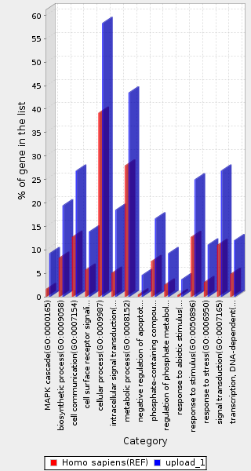
Molecular function of genes with hotspot communities

Slide 30
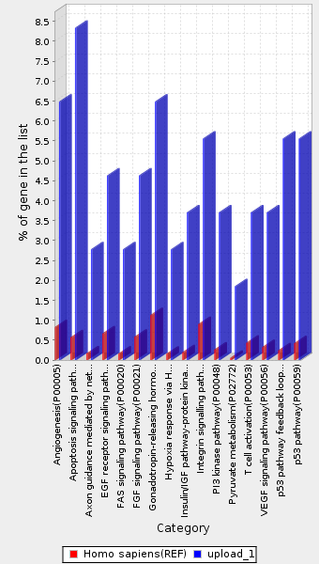
Genes with hotspot communities enriched among signaling and metabolism related pathways

Slide 31
Mutations in hotspot communities have higher functional impact
Functional impact (Polyphen2 Score)
Functional impact (CADD Score)

Slide 32
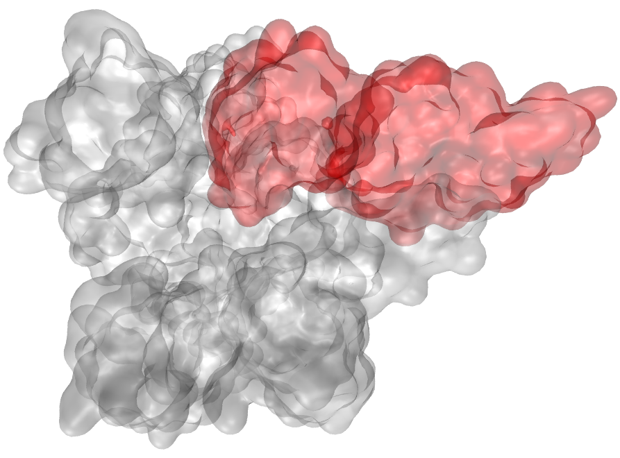
Oncogene with hotspot communities
Four hotspot communities were identified in the PIK3CA gene.
PIK3CA 3HHM 1 chr3:178917634:A:G 0.003
PIK3CA 3HHM 1 chr3:178917669:T:C 0.004
PIK3CA 3HHM 1 chr3:178919311:C:A 0.996
PIK3CA 3HHM 1 chr3:178921339:G:A 0.951
PIK3CA 3HHM 1 chr3:178921353:C:A 0.01
PIK3CA 3HHM 1 chr3:178921362:A:G 0.007
PIK3CA 3HHM 1 chr3:178921393:G:T 0.859
PIK3CA 3HHM 1 chr3:178921404:C:G 0.013
PIK3CA 3HHM 10 chr3:178916639:A:G 0.999
PIK3CA 3HHM 10 chr3:178916725:C:T 1
PIK3CA 3HHM 10 chr3:178916728:G:A 0.562

Slide 33
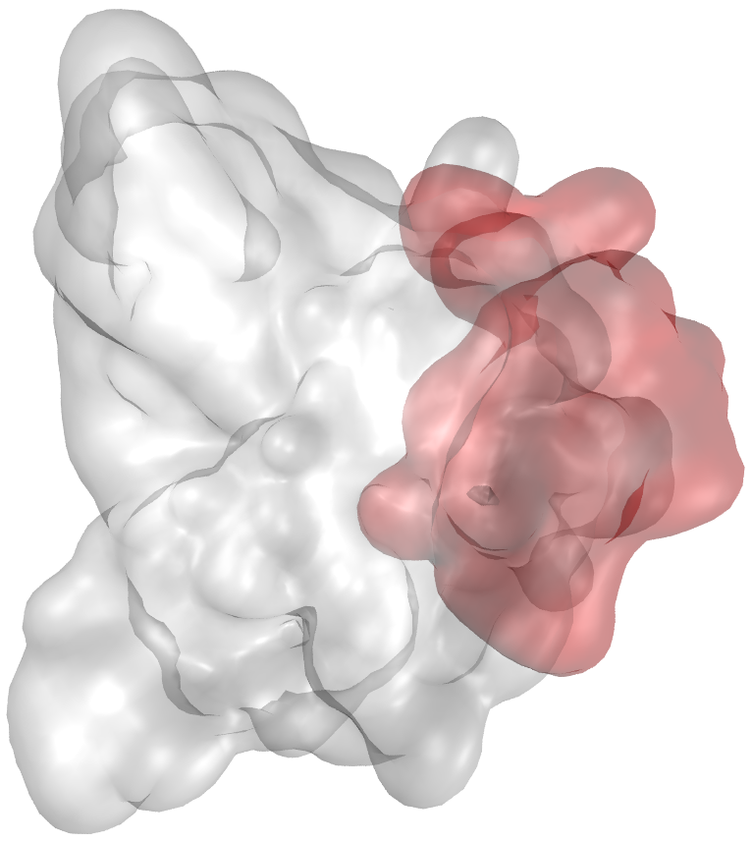
Tumor suppressor with hotspot community
Identified one hotspot community in the TP53 gene after multiple hypothesis correction.
TP53 2PCX 8 chr17:7577570:C:A 0.997
TP53 2PCX 8 chr17:7577570:C:T 0.997
TP53 2PCX 8 chr17:7577571:A:T 0.998
TP53 2PCX 8 chr17:7577572:T:C 0.995
TP53 2PCX 8 chr17:7578262:C:G 0.999
TP53 2PCX 8 chr17:7578271:T:A 1
TP53 2PCX 8 chr17:7578271:T:C 1
TP53 2PCX 8 chr17:7578271:T:G 1
TP53 2PCX 8 chr17:7578272:G:A 1
TP53 2PCX 8 chr17:7578272:G:T 1
TP53 2PCX 8 chr17:7578277:G:A 1
TP53 2PCX 8 chr17:7578371:C:T 0.528
TP53 2PCX 8 chr17:7578388:C:T 0.977
TP53 2PCX 8 chr17:7578389:G:A 0.381
TP53 2PCX 8 chr17:7578392:C:T 1TP53

Slide 34
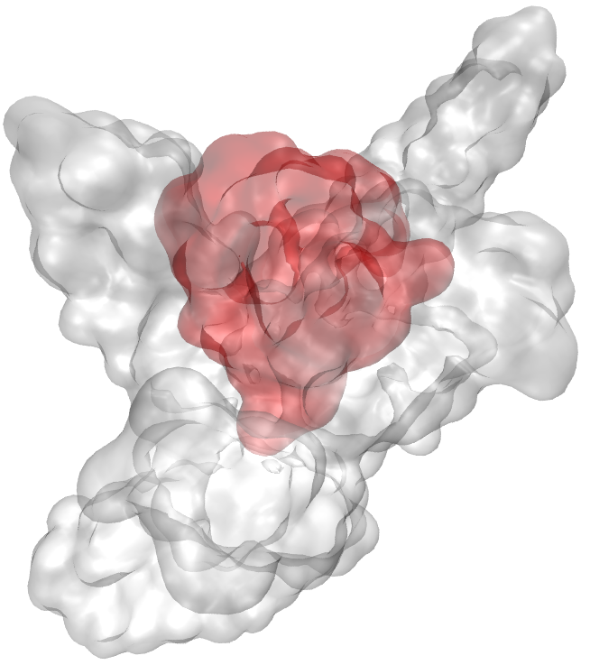
Example beyond cosmic genes with hotspot community
Identified hotspot community in the RAB8A gene.
protein encoded by this gene is a member of the RAS superfamily which are small GTP/GDP-binding proteins.
RAB8A 3TNF 7 chr19:16222763:G:A 0.99
RAB8A 3TNF 7 chr19:16222769:G:T 1
RAB8A 3TNF 7 chr19:16222778:T:C 0.994
RAB8A 3TNF 7 chr19:16222790:C:T 0.995
RAB8A 3TNF 7 chr19:16222810:C:G 0.137
RAB8A 3TNF 7 chr19:16236325:A:G 0.993
RAB8A 3TNF 7 chr19:16236343:C:T 0.998
RAB8A 3TNF 7 chr19:16238325:C:G 0.014
RAB8A 3TNF 7 chr19:16238326:G:T 0.189
RAB8A 3TNF 7 chr19:16238849:A:G 0.945
RAB8A 3TNF 7 chr19:16238875:G:A 1
RAB8A 3TNF 7 chr19:16238876:C:T 1
RAB8A 3TNF 7 chr19:16238893:G:T 0.455

Slide 35
Summary and Future Directions
Framework to identify mutation clusters by integrating protein motions.
Various novel genes (beyond cosmic genes) harbor hotspot communities in their corresponding protein structure
These genes are enriched among signaling and metabolic pathways.
Cancer specific hotspot communities and correlating with gene expression and protein expression data.
Looking at communities enriched among rare germline mutations.

Slide 36
Acknowledgment
Mark Gerstein
Jonathan Warrell
Lucas Lochovsky
Declan Clarke
William Meyerson
Patrick McGillivray
Leonidas Salichos
Shantao Li
Timur Galeev
Hussein Mohsen

