Slide 1
Cell fractions (W)
24 cell types
(17 neuron,5 non-neuron,2 fetal)
Single cell expression (X)
457 biomarker genes
Bulk expression (Y)
1931 tissue samples
24 cell types
Tissue deconvolution
$$=$$
$$×$$
457 biomarker genes
1931 tissue samples
NMF component fractions (H)
25 components
NMF components (V)
457 biomarker genes
$$=$$
Tissue decomposition (NMF)
1931 tissue samples
25 components
$$×$$

Slide 2
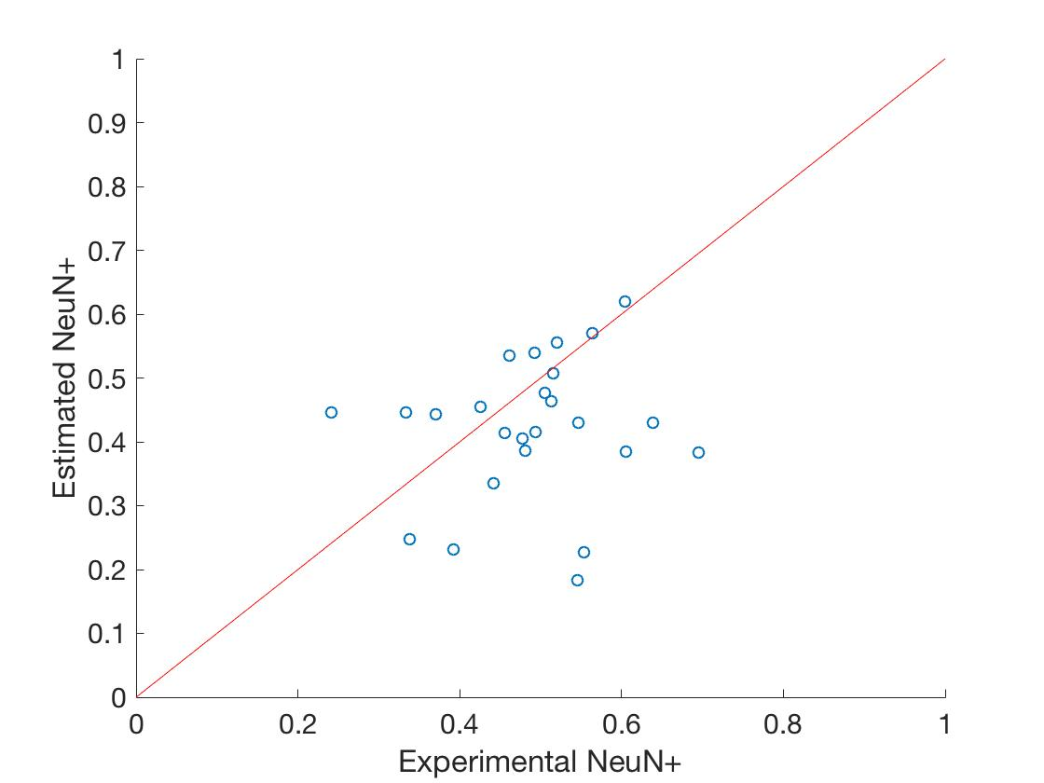
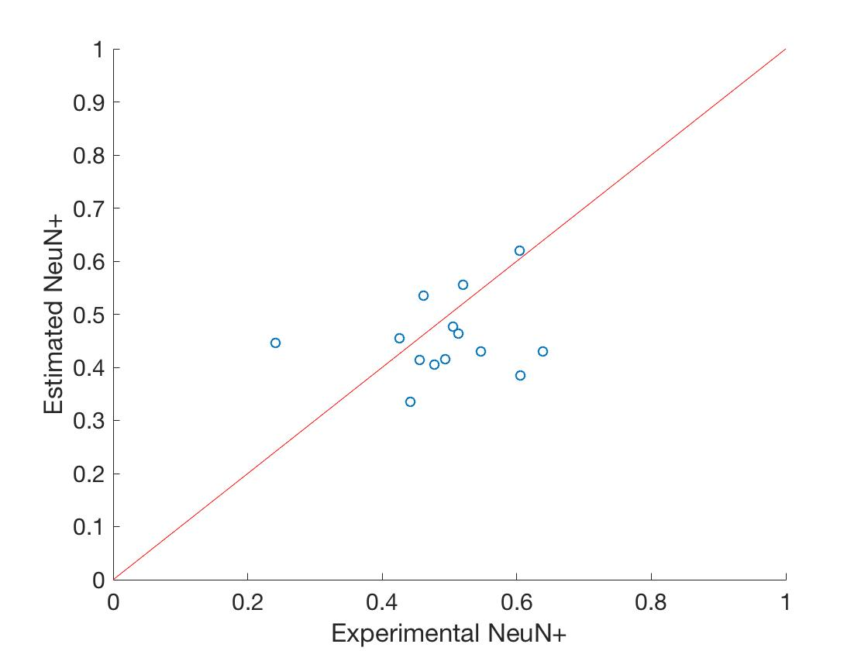
Filter 11 samples with RIN < 7.2
Before filtering (25 samples)
After filtering (14 samples)

