Slide 1
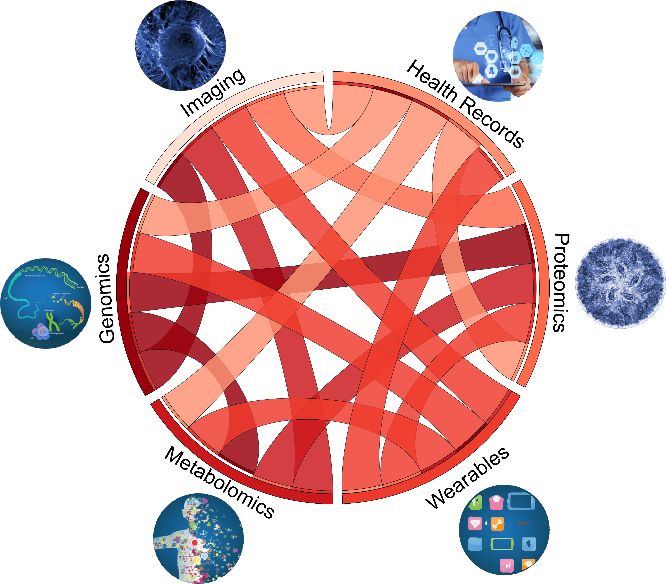
Biomedical data science
---- Integration is the key

