Slide 1
A framework for supervised enhancer prediction
Encode Consortium Meeting
Mengting Gu
Gerstein lab

Slide 2
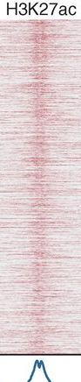
Unique shape associated histone signals flanking active enhancers identified through STARR-seq
Arnold, et al., Science, 2013
Shlyueva, et al., Nat Rev Genet, 2014
Nie, et al., PloS one2013
Notes:
ENCODE has been a huge effort to understand the functional genomics and annotate the human genome, mouse genome and other mod organism. One of the challenge is to predict the enhancers and a lot of methods have been developed for this. And there has been an challenge to develop good methods for this, and today I’m going to talk about the our work in this effort. We have developed a framework which takes advantage of the signal-processing techniques to identify enhancers using histone marks.

Slide 3
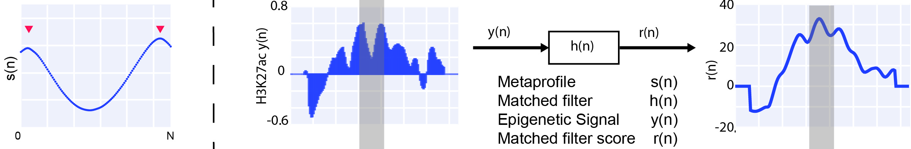
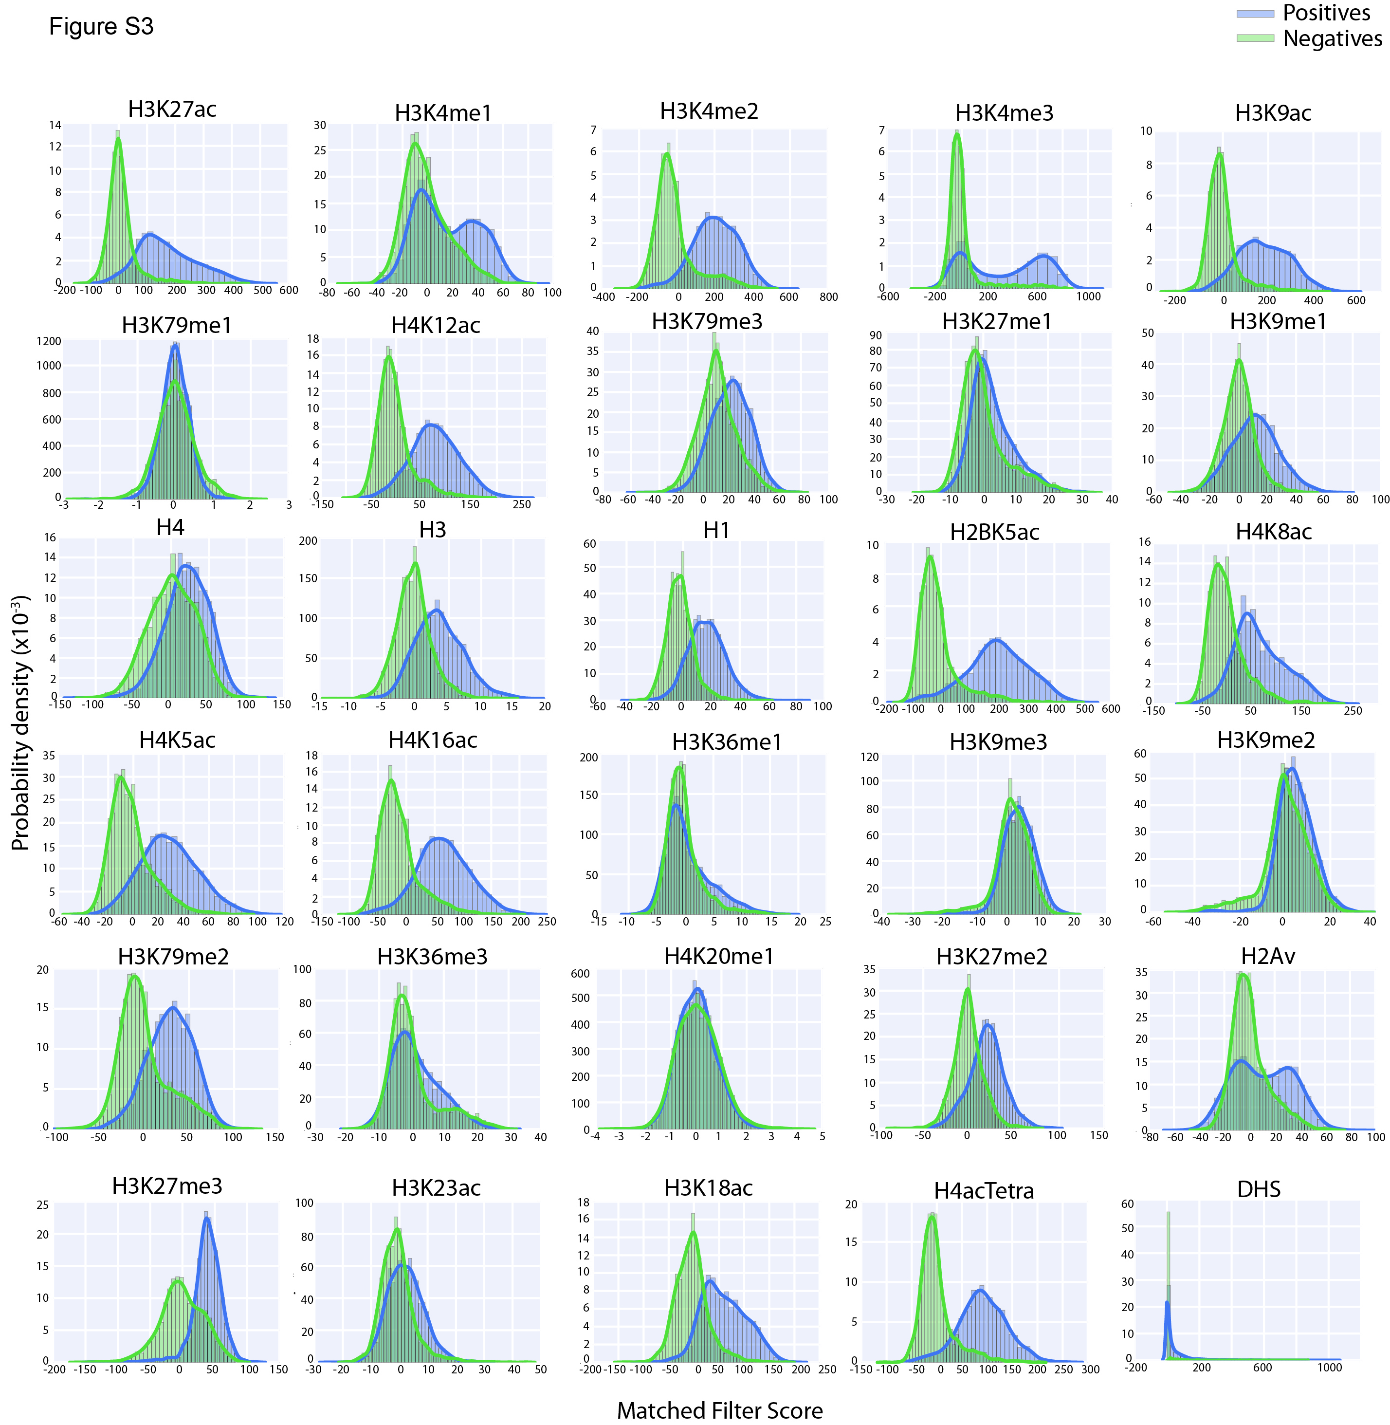
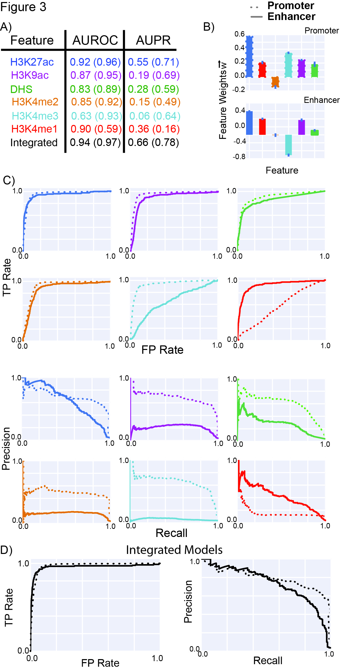
Matched Filter recognize shape patterns
Matched Filter
Score STARR-seq regulatory regions VS random negatives
10-fold cross-validation
Seth A*, Gu M*, et al, under review

Slide 4
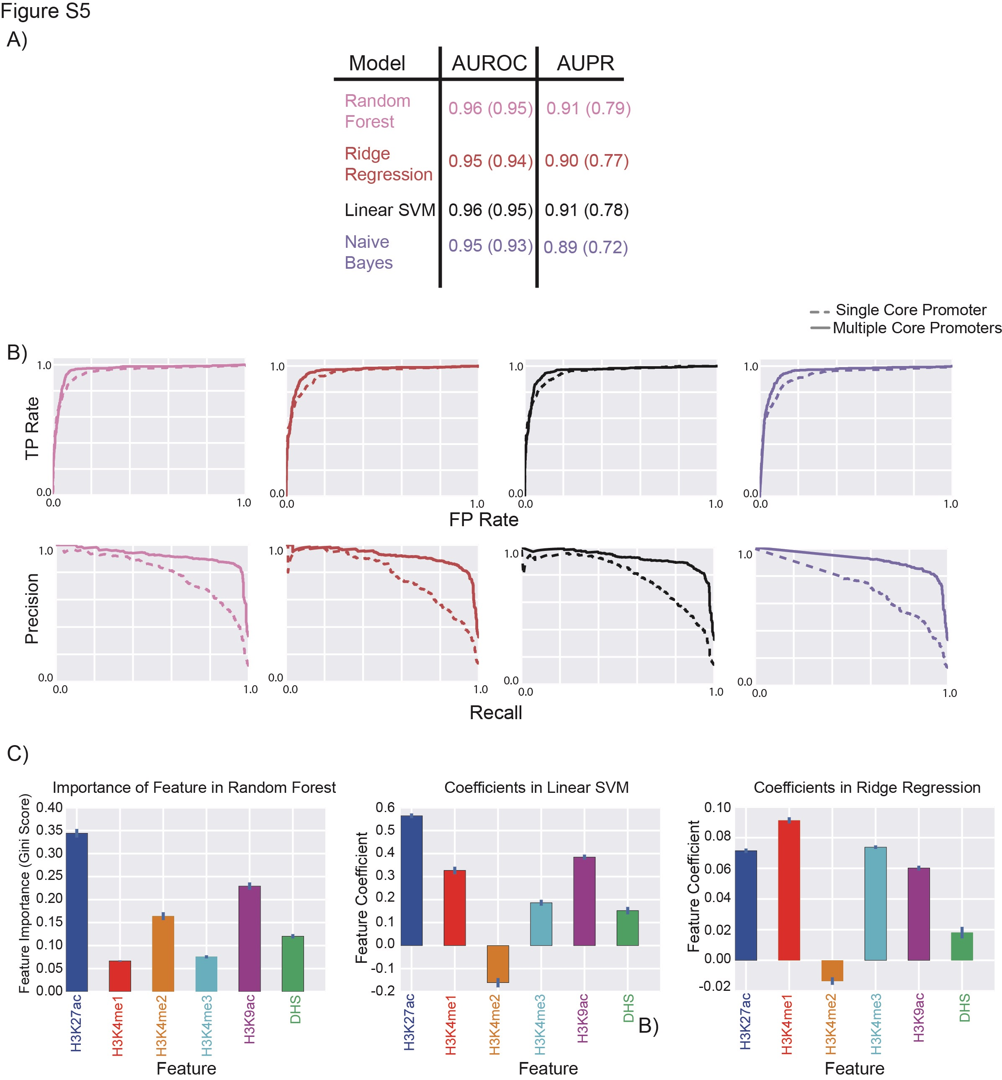
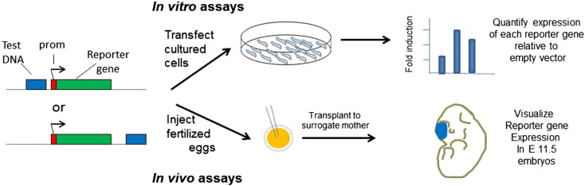
Integrate matched filter scores of multiple features
Validation with transgenic mouse enhancer assay
Cross validation
Inject fertilized eggs
Seth A*, Gu M*, et al, under review

Slide 5
Summary
A framework for supervised enhancer prediction using matched filter based on STARR-seq enhancer essay
The model can be applied across organisms and in different developmental stages.
Easy to use and retrain with new experimental data

Slide 6
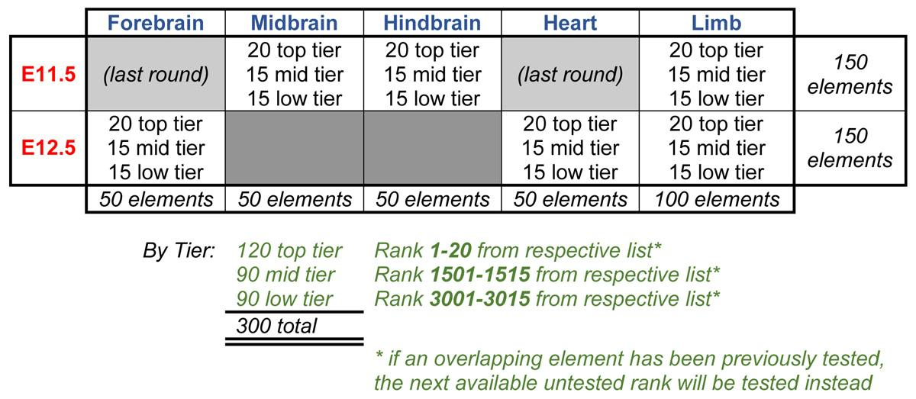
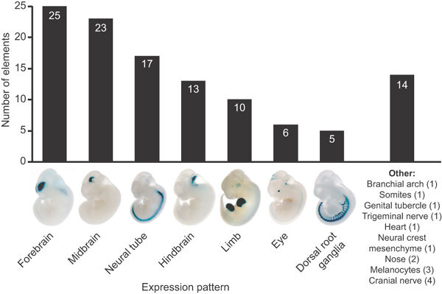
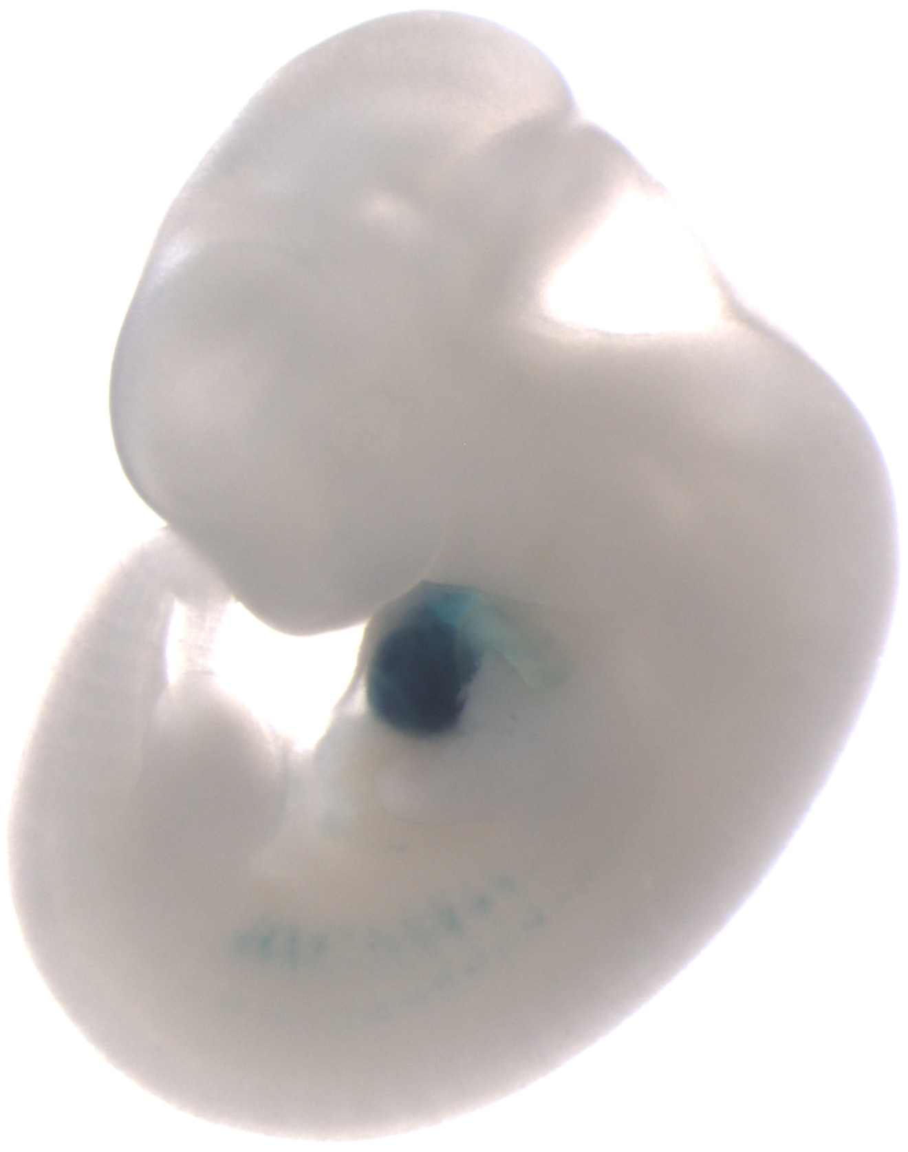
Encode enhancer challenge
Forebrain
Midbrain
Neural tube
Hindbrain
Limb
Heart
*Figure adapted from VISTA Enhancer Browser

Slide 7


Acknowledgement
Mark Gerstein
Anurag Sethi
Joel Rozowsky
Landon Chan
Koon-Kiu Yan
Kevin Yip
Chengfei Yan
Jing Zhang
Donghoon Lee
Prashant Emani
Len A. Pennacchio
Axel Visel
Diane E. Dickel
Iros Barozzi
Veena Afzal
Jennifer Akiyama
Ingrid Plajzer-Frick
Catherine Pickle
Momoe Kato
Tyler Garvin
Quan Pham
Anne Harrington Brandon Mannion Elizabeth Lee
Yoko Fukuda-Yuzawa
Richard Sutton
Emrah Gumusgoz

