Slide 1
Proposals for projects to be implemented in Quantum Computing Platforms
Gerstein Lab
Yale University

Slide 2
Possible areas for QC intervention
Network Analyses:
WGCNA
MrTADfinder: a Hi-C map-based TAD region discovery analysis)
Genomic Security
Non-negative Matrix factorization (NMF)

Slide 3
Weighted Gene Co-Expression Network Analysis (WGCNA)
Commonly used workhorse for gene cluster identification across samples
Can be broadly expanded for use across other types of networks as well (genotypes, epigenomic data sets, etc.)
The time cost is $𝒪\left(n^{3}\right)$ for hierarchical clustering, in addition to time cost of generating dissimilarity matrices – potential for improvement with QC? Major cost from topological overlap calculation:
But an outstanding issue maybe memory cost of $𝒪\left(n^{2}\right)$

Slide 4
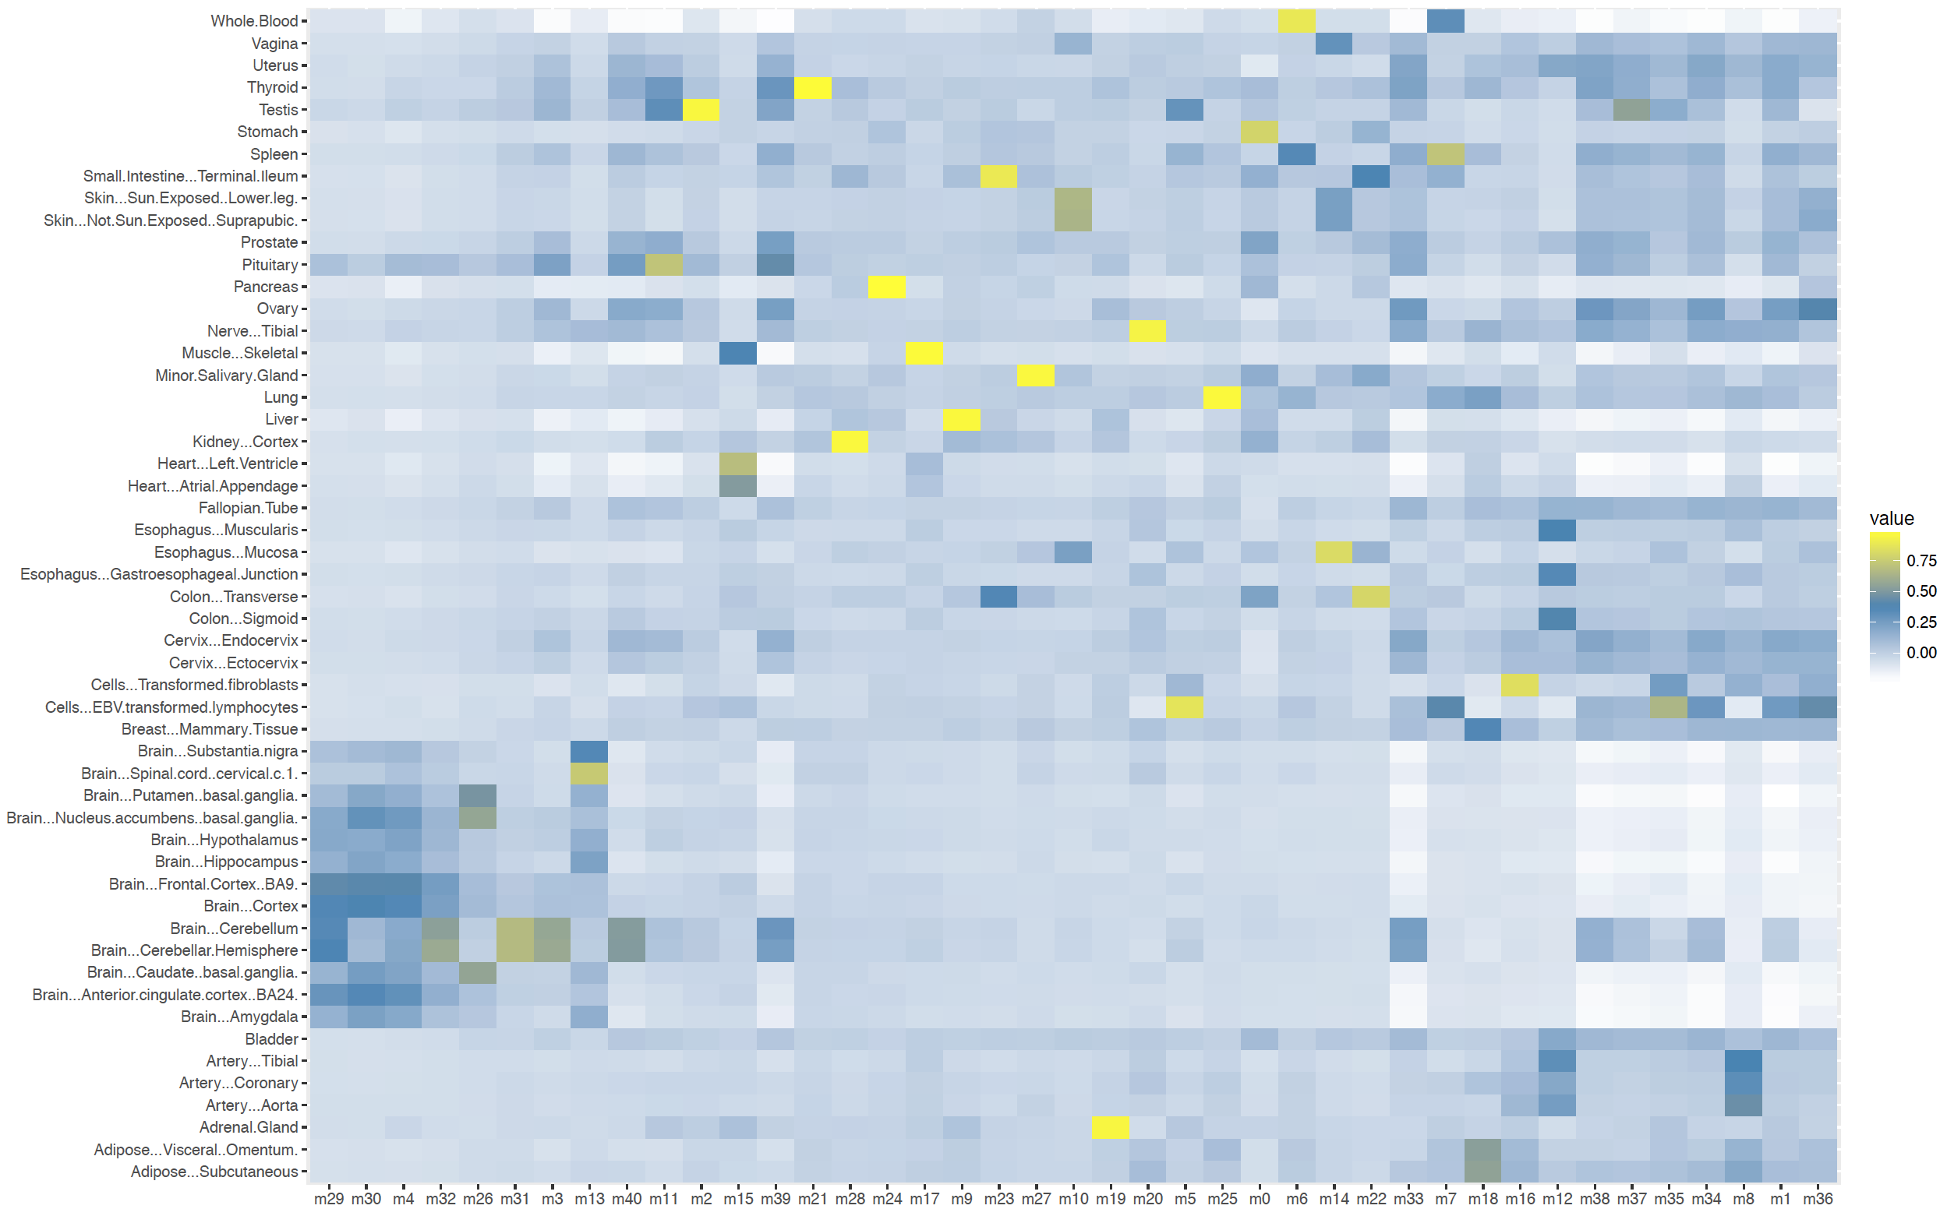
Identifying brain co-expression modules
Tissues
Brain regions
+/-ve corr:
p<0.001:
Modules (ordered by brain-specificity)

Slide 5
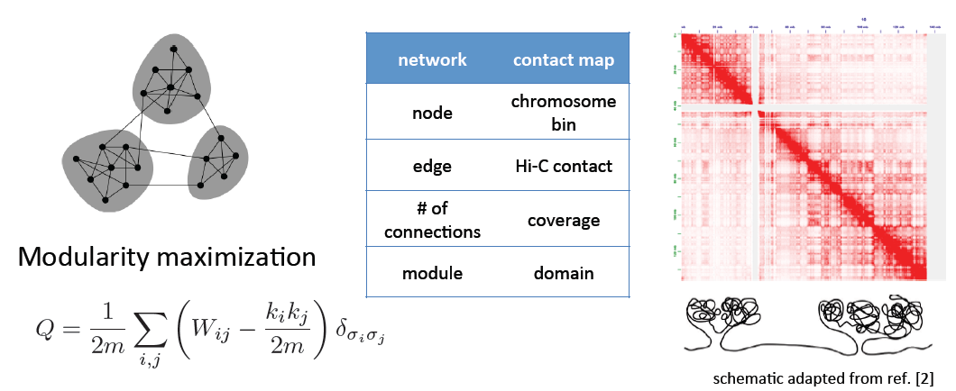
MrTADFinder*
Identifying topologically associating domains in multiple resolutions
Graph
HiC
Modularity detection
TAD detection
*Yan K-K, Lou S, Gerstein M (2017), PLoS Comput Biol 13(7): e1005647

Slide 6
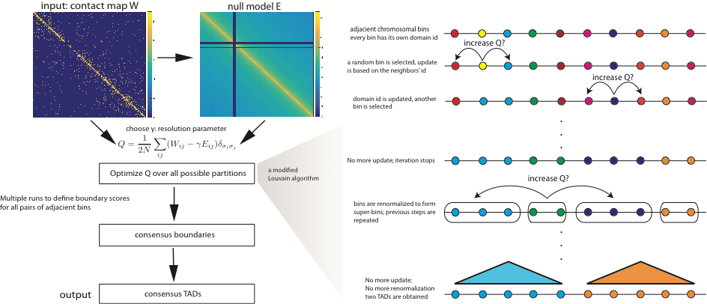

Slide 7
Genomic privacy:* Information leakage from functional genomics data
Quantifying the information leakage risk from functional genomics datasets, such as eQTLs
Define the problem in terms of potential method of identity “hacking”
Use publicly available phenotypes (such as gene expression) to predict genotypes, using eQTL information
Measure proximity to stolen genotype information
Use this to link further metadata to the linked individual (such as disease risk, etc.)
Calculates risk in terms of Individual Characterizing Information (ICI) and genotype predictability ($π$):
*Harmanci, A. and Gerstein, M. (2016) Nat. Methods 13(3): 251-256

Slide 8
Could use computational speed-ups when calculating overall risk associated with given data set

Slide 9
Non-negative matrix factorization (NMF) for decomposition and clustering
Solving $\overset{⃡}{Y}≈\overset{⃡}{W}∙\overset{⃡}{X}$ using $\min_{\overset{⃡}{W},\overset{⃡}{X}}{{⟦\overset{⃡}{Y}−\overset{⃡}{W}∙\overset{⃡}{X}⟧}_{F} s.t. W_{ij}≥0, }X_{ij}≥0$
Need to search for a solution when uniqueness is not always guaranteed (for non-convex solution spaces)
Multiple applications with matrix dimensions ranging from number of protein-coding genes (~20k) to number of Single Nucleotide Variants (~millions)

