Slide 1
DNA seen through the eyes of a coder
If you are a hammer, everything looks like a nail
Min Xu @jclub
Originally from Bert Hubert

Slide 2
Basics: DNA
4 nucleotides:
A C G T
DNA ‘byte’:
codon: 3 nucleotides, 64 possible values
Binary encoding:
00 01 10 11
Digital byte:
8 bits, 256 values
Notes:
DNA is like the source code for all the creatures.
The language of DNA is digital, but not binary.

Slide 3
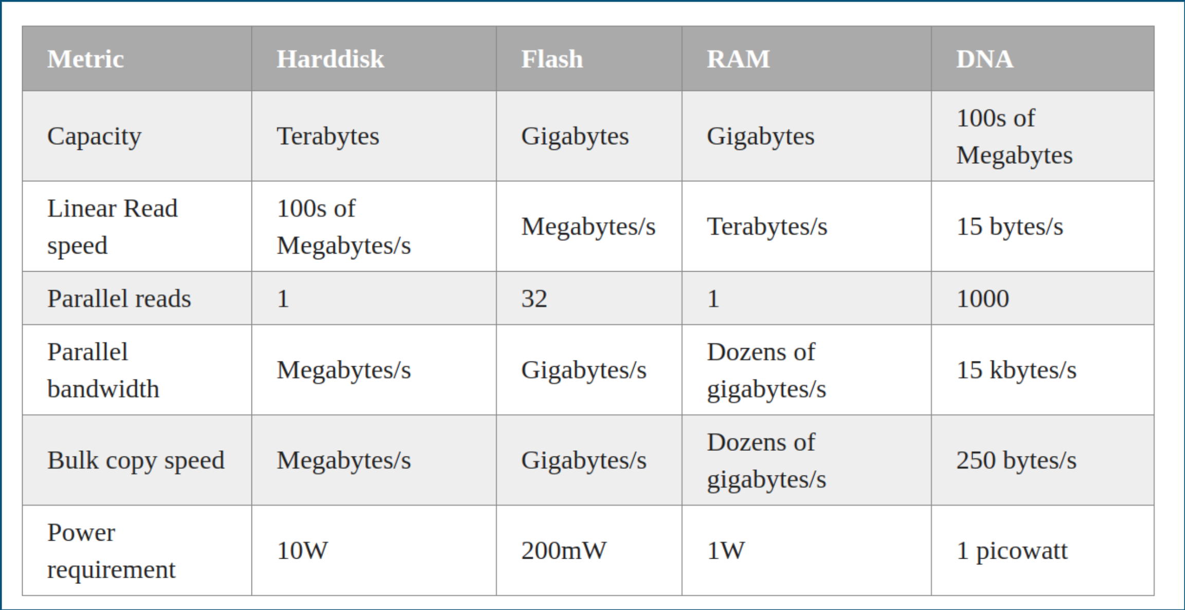
Human genome: ~3 gigabases ≈ 750 Mb
Notes:
Copying dna in a whole bacteria takes like 20 min
Energy consumption here is for bacteria, human takes way more, but still impressive

Slide 4
Mirroring & failover
Each DNA helix is redundant in itself: A – T / G – C
Humans have two copies of each chromosome (except the Y chromosome).
RAID 1 consists of an exact copy (or mirror) of a set of data on two or more disks
Notes:
In case one is broken or unusefully mutated, the other independent copy is still there.
This is what we would normally call 'failover'.

Slide 5
The Central Dogma
C compilation
Souce code .c file
Object file .o file
Executable a.out/exe

Slide 6
Conditional compliation
Notes:
as almost all cells carry around a full copy ('distribution') of the genome
a system is needed to #ifdef out stuff not needed. And that is just how it works. The genetic code is full of #if/#endif statements.

Slide 7
Introns & comments
ACTUAL CODE<!-- blah blah blah blah ---- blah -->ACTUAL CODE
| | | | |
exon 1 donor intron 1 acceptor exon 2
(start of comment) (end of comment)
RLL or MFM coding
On a hard disk, a bit is encoded by a polarity transition (1) or the lack (0) thereof.
Encoding 000000 is easy - just keep the magnetic phase unchanged for a few micrometers. However, when decoding, uncertainty creaps in.
So we need to insert spacers so as to prevent too little transitions. This is called 'Run Length Limiting' on magnetic media.
Introns may do much the same thing by making sure that the resulting code can be coiled properly.
Notes:
The start of a comment is almost always indicated by the letters 'GT', the end is signalled by AG
how many micrometers did we read? Does this correspond to 6 zeroes or 5? To prevent this problem, data is treated such that these long stretches of no transitions do not occur.

Slide 8
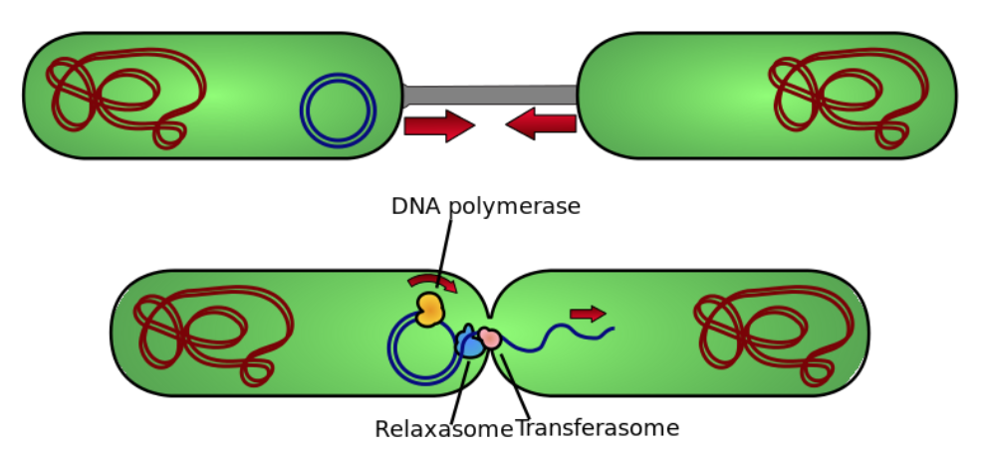
Other analogies
Protein-protein interaction
Gene therapy
A lot of African Americans are immune to malaria but instead suffer from sickle cell anemia
Plasmid
Dependency hell
Binary patching
Bug regression
Open source code & plugins
Notes:
medical science has tried to patch people with SCID, or 'Severe Combined Immunodefeciency', which is a very nasty disease which in effect disables the immune system - leading to very ill patients. It has been clear for quite a while now which letters in the DNA need to be fixed in order to cure these people.
Obstacle to using crispr in humans
While inheriting one copy of the mutation confers a benefit, inheriting two copies is a tragedy. Children born with two copies of the genetic mutation have sickle cell anemia, a painful disease that affects the red blood cells.

Slide 9
Boolean logic & how it hangs together
E. coli
Needs power to run: 0.5 pW, 0.03 fW/gene
Loves glucose
Can run on lactose if it must
Through conversion
Less efficient
Algorithm required:
if (glucosePresent)
useGlucose()
else if (lactosePresent)
enableLactoseCircuits()
else
sitTight()

Slide 10
Lack of glucose causes cAMP protein buildup (‘hunger signal’)
cAMP binds to CAP and make it bind to the promoter
Lacl protein binds to 1) lactose or 2) a specific DNA sequence (the repressor)

Slide 11
A typical “nature” solution: finding food

Slide 12
Random walk

Slide 14
Stochastic gradient descent

Slide 15
Bioinformatics
Reverse Engineering a 4 billion year old software project

