Slide 1
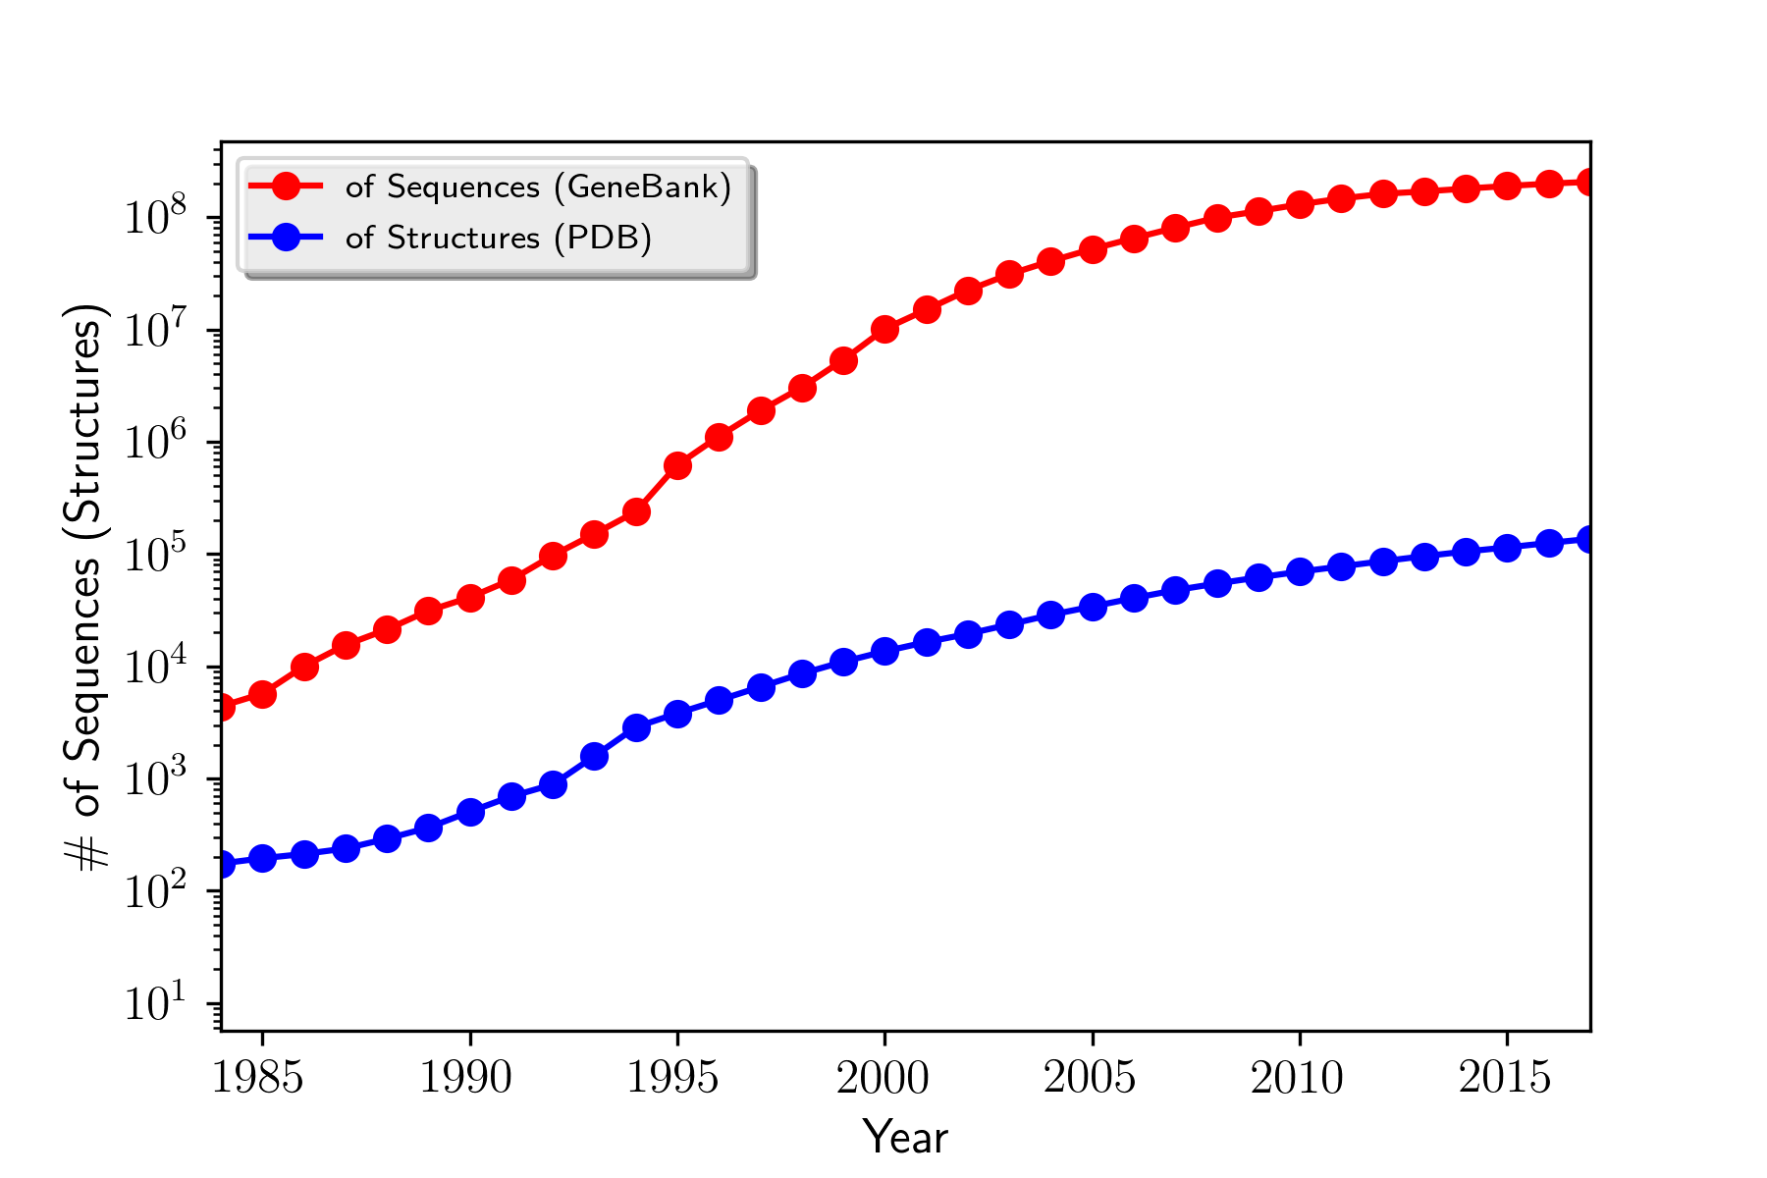
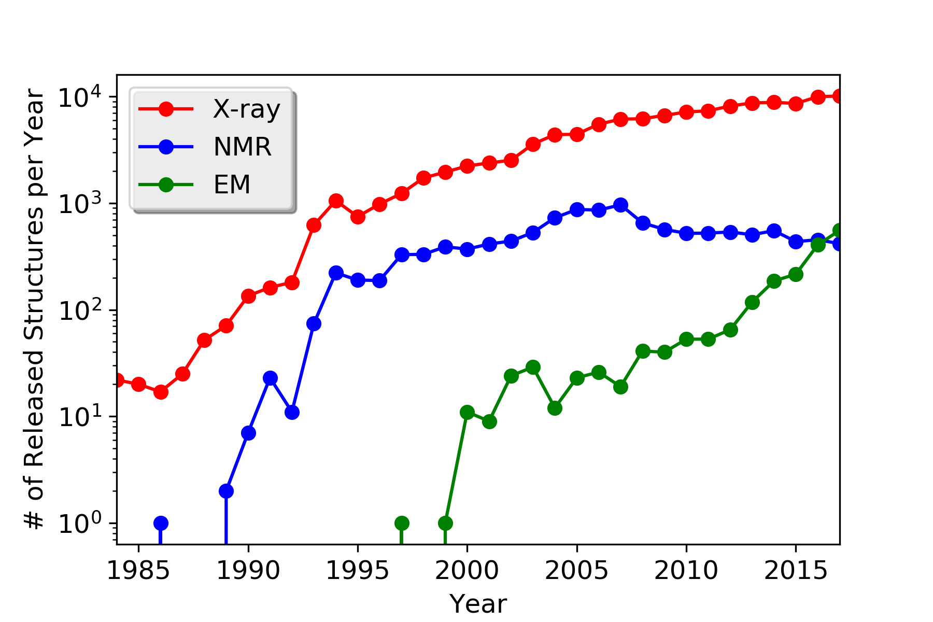
Experimental determination of 3D structures can not keep up with the explosive growth of sequence information
The Electron Microscopy (EM) has emerged as a powerful tool in determining 3D structures

