Slide 1
Trends in data generation point to growing opportunities for leveraging sequence variants to study structure (and vice versa) The volume of sequenced exomes is outpacing that of structures
Without WGS

Slide 2
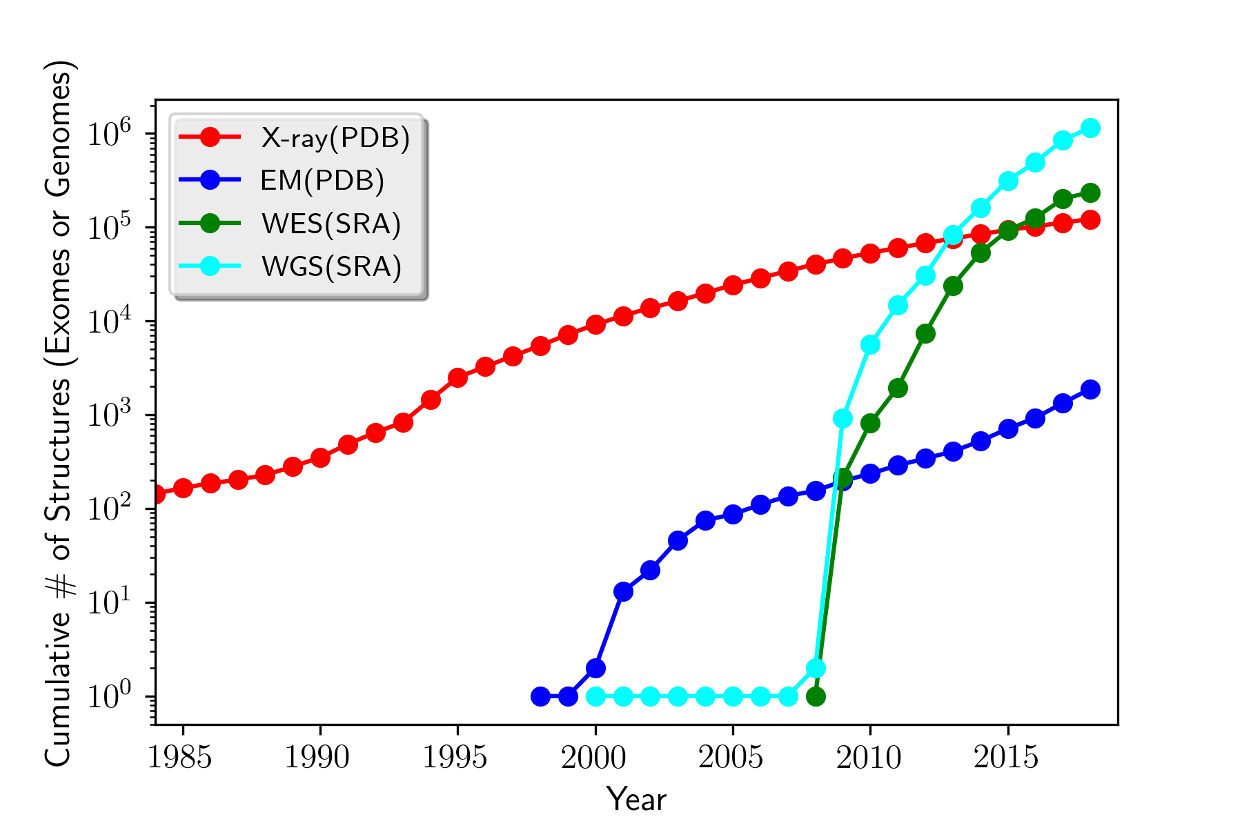
Trends in data generation point to growing opportunities for leveraging sequence variants to study structure (and vice versa) The volume of sequenced exomes is outpacing that of structures
With WGS

