Slide 1
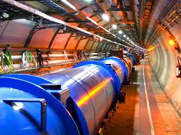
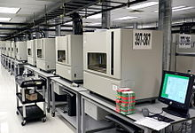
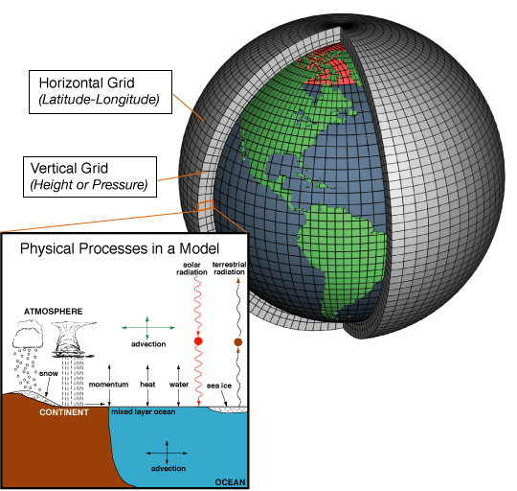
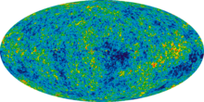
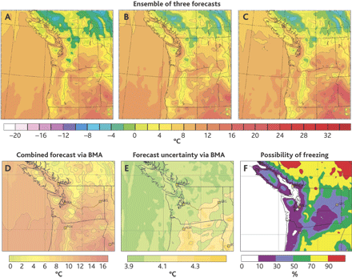

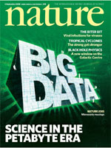
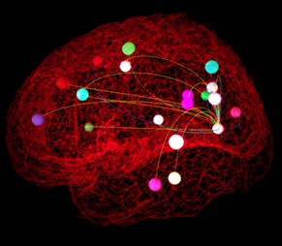
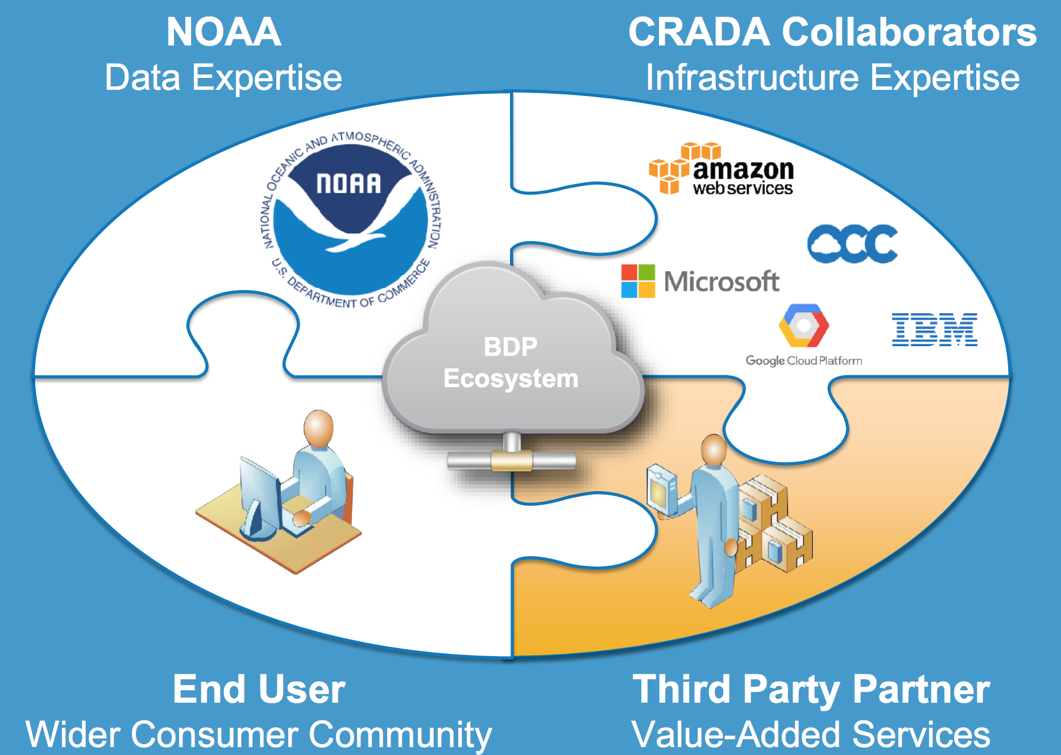
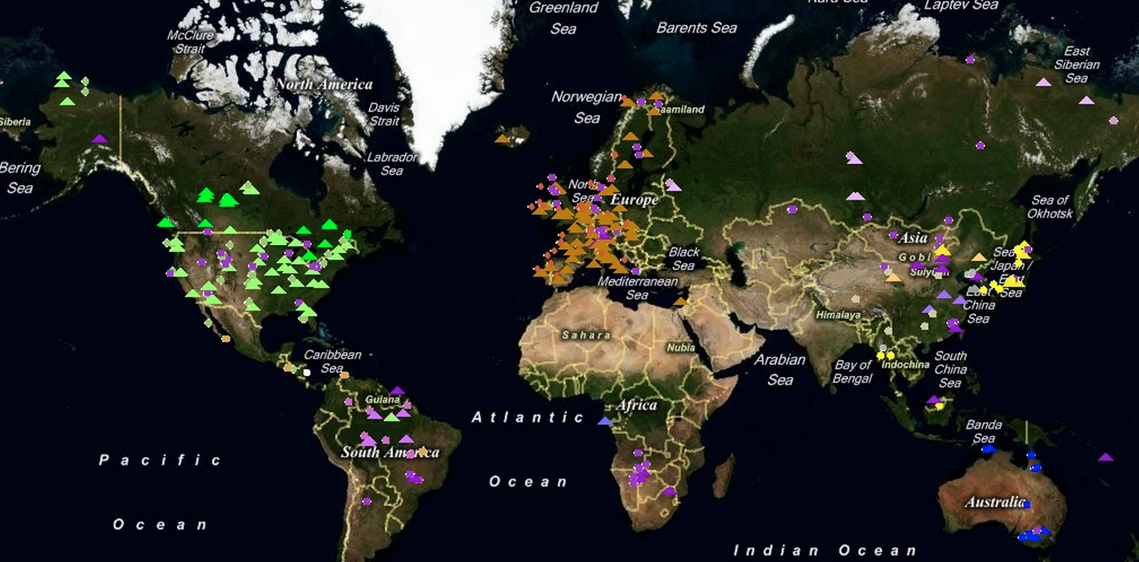
Data Science in Traditional Science
Pre-dated commercial mining
Instrument generated
Large data sets often created by large teams not to answer one Q but to be mined broadly
Often coupled to a physical/biological model
Interplay w/ experiments
High energy physics -
Large Hadron Collider
Genomics - DNA sequencer
Astronomy -
Sloan Digital Sky survey
Weather & climate
Physical models & massive
sim. Useful but not sufficient –
think “butterfly” effect.)
Large-scale data collection
via sensors
Neuroscience -
The Human Connectome Project
Ecology & Earth Sci. - Fluxnet
NOAA

Slide 2
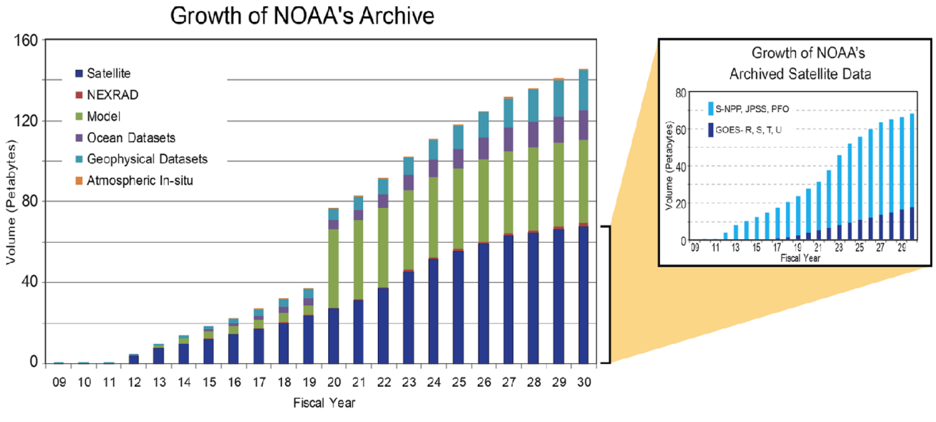
Weather forecasting
Lampooned but actually very successful
  No ability to predict a century ago;
  now forecasts checked by billions every day
  Interpretable & useful statistical predictions,
  informing everything from clothing choices to commerce
How do they do it?
  Physical models & massive sim. useful
  (but not sufficient - think “butterfly” effect.)
  Large-scale data collection via sensors
1964, first climate model
90s, ensemble methods
2010s, big data project
NOAA

Slide 3





Genomics export/import & buzzwords w/ icons
Export: population genetics (Pritchard et al., 2000)…Mixed-membership model/LDA

