Slide 1
EN-TEx Working Group
ENCODE Consortium Meeting
6 February 2018

Slide 2
Assembling and Analyzing Personal Genomes
Sequence Genomes using
Multiple Technologies
Goals
What are the most effective biotechnologies for sequencing?
What do we learn from a personalized genome instead of the reference?
Can we use the genomic variants as natural perturbations of the encyclopedia elements?
De novo
Assembly
Map to
Reference
Identify SNP, INDEL, SV
Phase Variants &
Construct Diploid Chromosomes
Functional Analysis

Slide 3
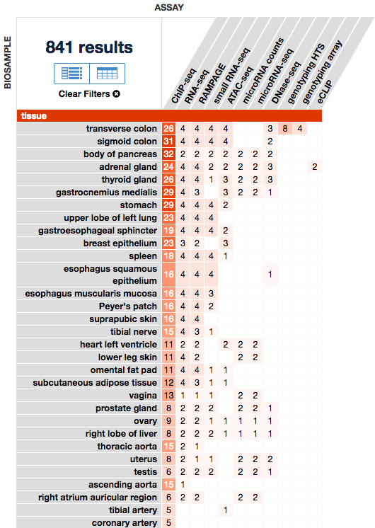
EN-TEx: Expression & Regulation Analysis of Personalized Genomes
 | ENC-001 | ENC-002 | ENC-003 | ENC-004
Age | 37 | 54 | 53 | 51
Sex | Male | Male | Female | Female
Cause of Death | Anoxia | Anoxia | Cerebral Vascular Accident | Cerebral Vascular Accident
Total Libraries | 319 | 299 | 488 | 299
Sequenced the genomes for 2 male and 2 female samples using transverse colon tissue
Large number of ChIP-seq, RNA-seq, ATAC-seq, DNase-seq, and other functional datasets available in dozens of tissues
http://encodeproject.org

Slide 4
Sequencing and Assembly

Slide 5
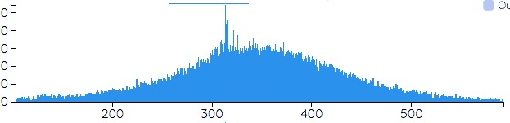
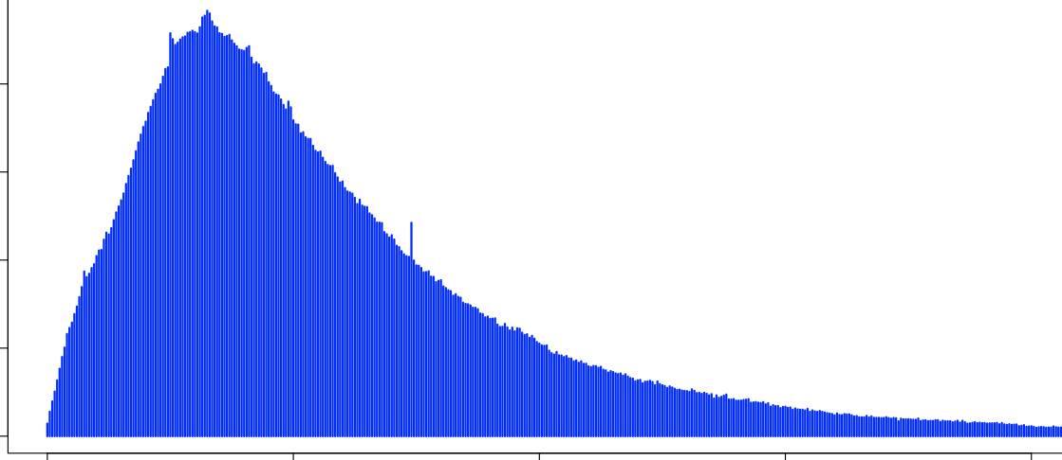
Genomic Sequencing Data
Illumina
10X Genomics
PacBio
μ=350bp
μ=117kbp
μ=7.5kbp
0.2
0.3
0.4
0.5
0
100
200
300
400
0
10
20
30
40
Fragment Length (kbp)
Molecule Length (kbp)
Read Length (kbp)
60x Paired End
All 4 samples
35x Linked Reads
All 4 samples
55x Long Reads
*Only ENC-002 & ENC-003
Michael Schatz

Slide 6
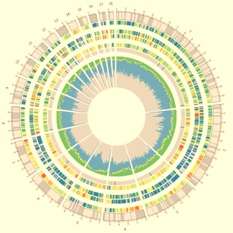
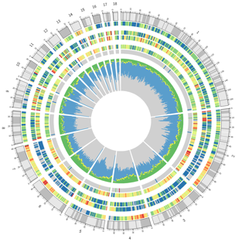
CrossStitch
https://github.com/schatzlab/crossstitch
A -> C
A/C -> A|C
Call SNPs
+ Indels
Phase SNPs
+ Indels
my.mat.fa
Phased
SNPs,
Indels &
SVs.vcf
Assemble
Diploid
Sequence
GAT
-> XXX
GAT/XXX
-> GAT|XXX
HQ Reference
Call SVs
Phase SVs
& Local Assembly
my.pat.fa
In collaboration with Sedlazeck, Gingeras, Guigo, Ren, & Gerstein Labs
Michael Schatz

Slide 7
SVs using Short, Long and Linked Reads
17,139
PacBio
Main Diagonal
Calls per tool
Outer triplets
Concordance by Technology
Inner triplets
Concordance by Assembly
Concordance by Mappers
Overall:
Lonnnnnnng reads give the most variants with the best concordance ☺
Sniffles
7,857
12,241
Falcon
LongRanger
2,823
1,946
3,785
10X Genomics
3,394
2,837
1,486
18,862
SuperNova
3,291
2,163
2,274
1,646
6,631
Illumina
SURVIVOR2
1,858
1,529
569
1,378
687
3,855
MegaHit
Sniffles
Falcon
MegaHit
LongRanger
SuperNova
SURVIVOR2
Michael Schatz

Slide 8
Assembling a “Perfect” Personalized Diploid Genome
Carefully “stitch” the phased variants into the reference genome at the right position to create a pair of phased chromosome fasta files
G | A | T | T | A | C | A
Phased
SNPs,
Indels &
SVs.vcf
G | A | T | T | A | C | A
Michael Schatz

Slide 9
Assembling a “Perfect” Personalized Diploid Genome
Carefully “stitch” the phased variants into the reference genome at the right position to create a pair of phased chromosome fasta files
sub
inversion
G | C | T
G | T | A
A
Phased
SNPs,
Indels &
SVs.vcf
G | C | T | T
A | C | A
A | - | A
sub
insertion
del
Stitching based on AlleleSeq pipeline enhanced for SVs (Rozowsky et al, 2011)
Maintains a mapping from reference to personal genome coordinates to make lift over of annotation straightforward to compute
Using 10X + HiC + PacBio, assemble essentially perfect diploid human genomes with haplotypes spanning entire chromosomes
Phased diploid genome can be aligned or aligned against just like a de novo genome assembly
Michael Schatz

Slide 10
Pipeline of haplotype phasing using Hi-C
HiC
1
Raw Reads
Alignment (BWA)
Filter chimeric reads
Deduplication (Picard)
High Quality Heterozygous variants
Mapped Reads
WGS (ENCODE DCC)
10X (Mike Schatz)
Haplotype Assembly (HapCUT2)
Imputation
(Beagle v4.1)
Optional
Phased SNPs
Bing Ren

Slide 11
Application of Hi-C phasing on ENTEX samples
Using Hi-C data from 4 individuals, 2 tissues each (skeletal muscle, colon)
Results
  All chromosomes of each individual donor’s genome were phased as a single block
  On average 84.64% heterozygous SNPs were phased in four individuals ranging from 73.52% to 92.11%
Library ID | Sample ID | Participant | Tissue | Sequenced Reads | Intra-chromosome Reads
SRC573 | ENC-1LVAN-307-SM-A9VP4 | PT-1LVAN | Colon - Transverse | 1,437,649,049 | 666,264,440
SRC578 | ENC-1LVAN-055-SM-C1PWV | PT-1LVAN | Muscle - Skeletal | 1,532,019,865 | 622,994,954
SRC574 | ENC-1JKYN-206-SM-ACCQ1 | PT-1JKYN | Colon - Transverse | 1,495,241,571 | 730,866,362
SRC579 | ENC-1JKYN-130-SM-C1PX4 | PT-1JKYN | Muscle - Skeletal | 1,604,645,109 | 669,051,844
SRC575 | ENC-1LGRB-198-SM-BZ2ZS | PT-1LGRB | Colon - Transverse | 1,511,877,041 | 708,736,834
SRC576 | ENC-1LGRB-326-SM-ADA6L | PT-1LGRB | Muscle - Skeletal | 1,407,821,522 | 614,195,333
SRC724 | ENC-1K2DA-283-SM-C1MKW | PT-1K2DA | Colon - Transverse | 2,060,484,878 | 938,343,803
TL219 | ENC-1K2DA-264-SM-CSSDA | PT-1K2DA | Muscle - Skeletal | 1,379,367,523 | 616,653,386
Bing Ren

Slide 12
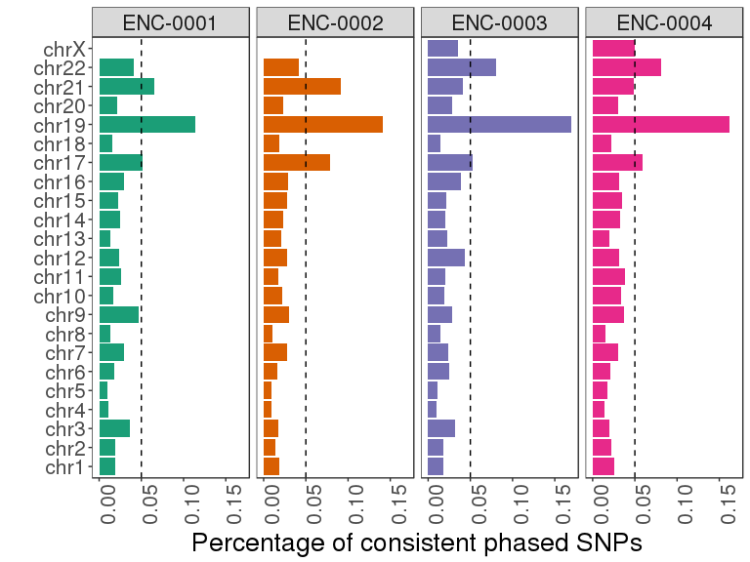
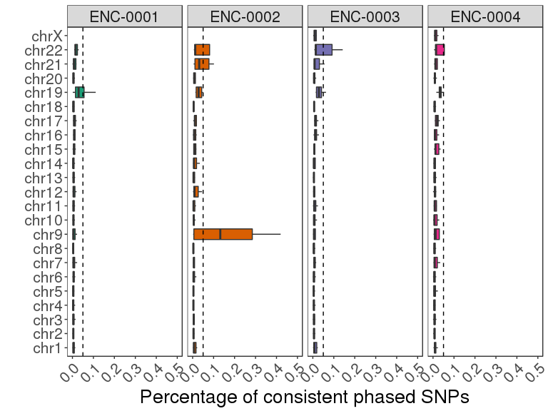
Validation of phasing accuracy
Perform phasing using two tissues separately, and compare the consistency of phasing results
Compare phasing results with 10X data
Bing Ren

Slide 13
EN-TEx RNA-Seq Data
Anna Vlasova (Guigo Lab)

Slide 14
Analysis of Functional *-Seq Data

Slide 15
EN-TEx RNA-Seq Data
Anna Vlasova (Guigo Lab)

Slide 16
Analysis of Allele-Specific Expression and Binding
Timur Galeev (Gerstein Lab)

Slide 19
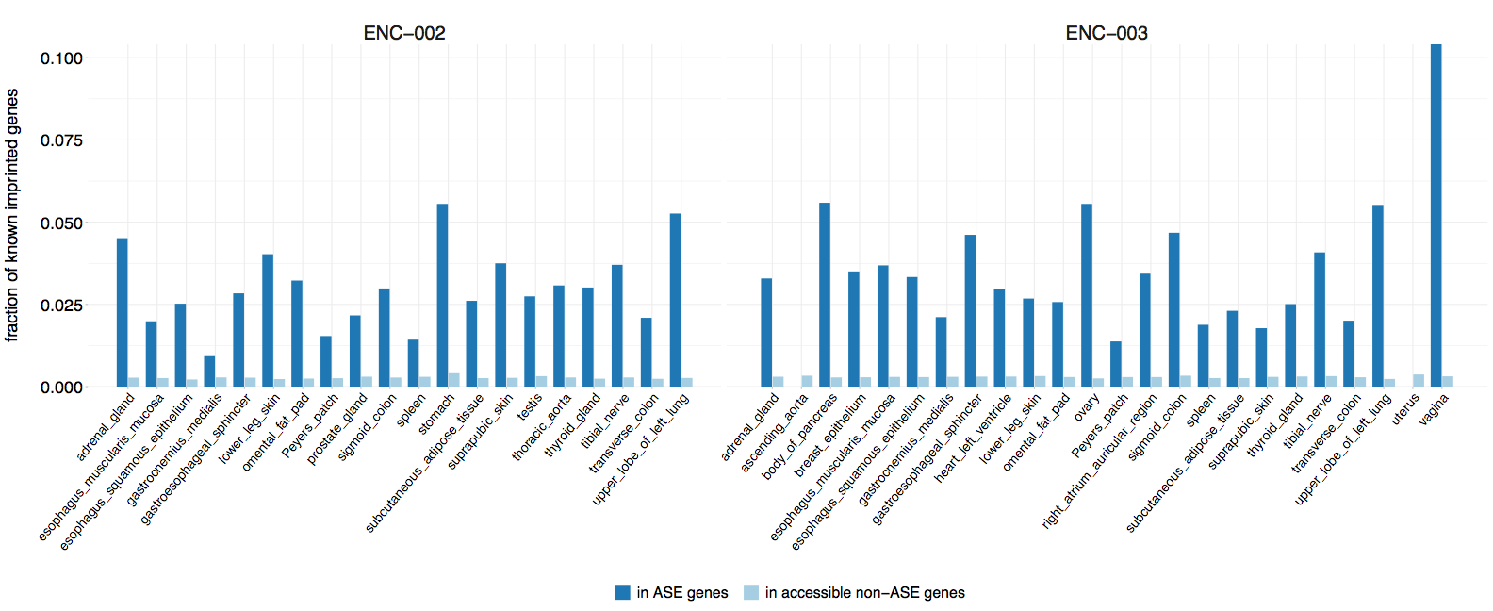
Fraction of Known Imprinted Genes detected as ASE
Timur Galeev (Gerstein Lab)

Slide 20
Anna Vlasova (Guigo Lab)

Slide 21
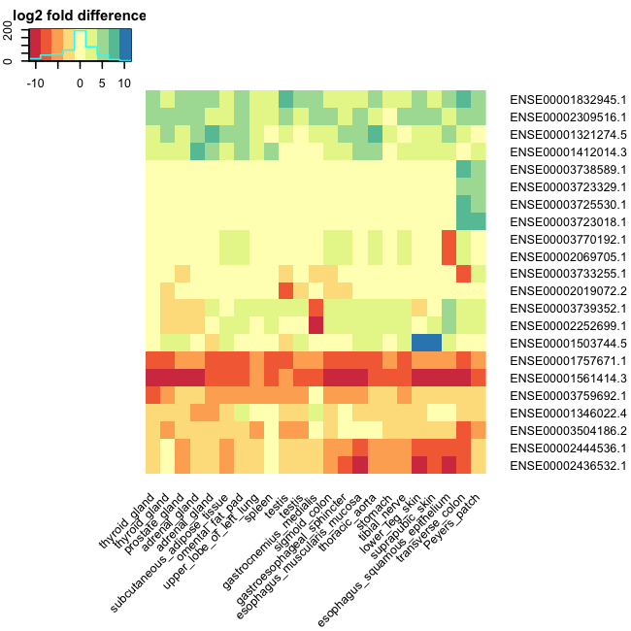
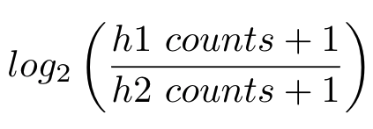
Exons affected by SVs with fold change >6
Total SVs: 21672
Total affected exons: 926, Found in Personal
Genome: 906
Only reads uniquely mapped to one haplotype
Fold =
>2 fold change in at least one tissue: 266 exons
>2 fold change difference between at least two
tissues: 283
Xiangmeng Kong (Gerstein Lab)

Slide 22
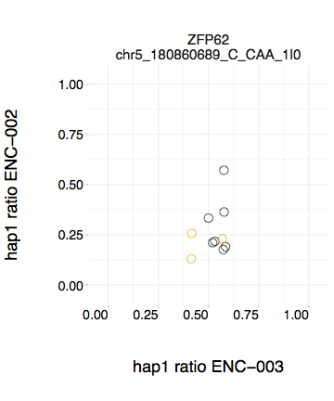
Any het-indel that in a promoter region and might be causing ASE?
Protein-coding genes (one for ENC-002) that
has one ENC-002 het-indel/SV in the promoter region,
do not have ENC-003 het-indels/SVs in the promoter region,
do not overlap other expressed genes,
do not have other ENC-002 het-indels/SVs;
were called ASE in at least three ENC-002 tissues
and the call was made using at least two het-SNVs,
are accessible in at least 3 tissues in both ENC-002 and ENC-003
were not called ASE in any ENC-003 tissue.
Tissues in which the gene is accessible to ASE calling for both individuals (orange if called ASE for ENC-002)
Timur Galeev (Gerstein Lab)

Slide 23
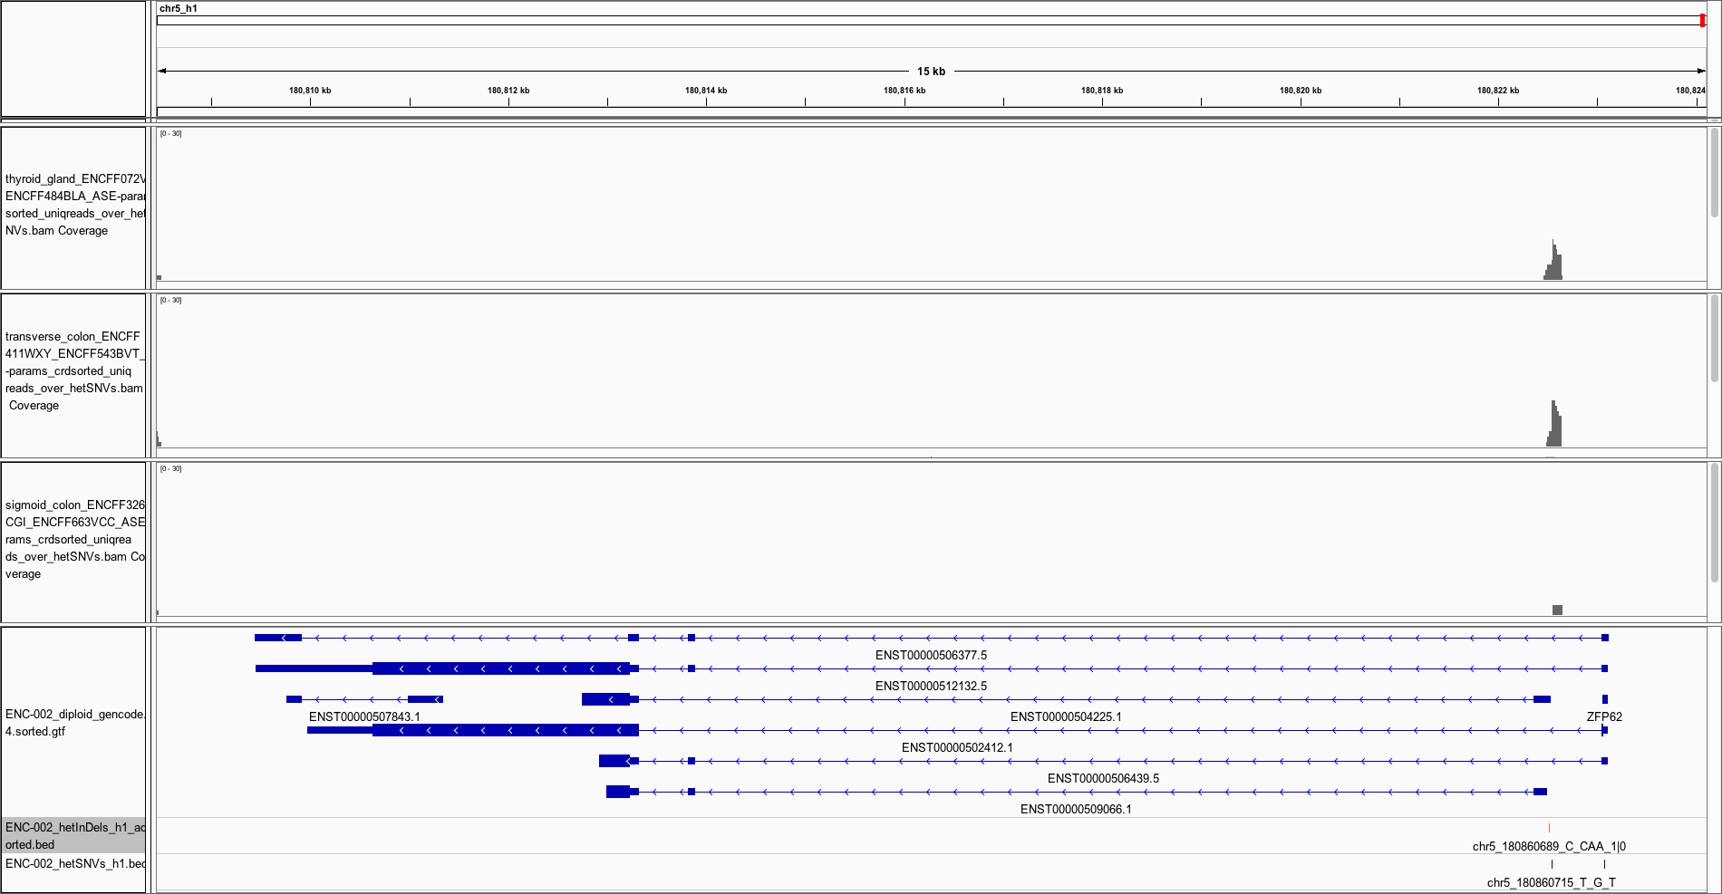
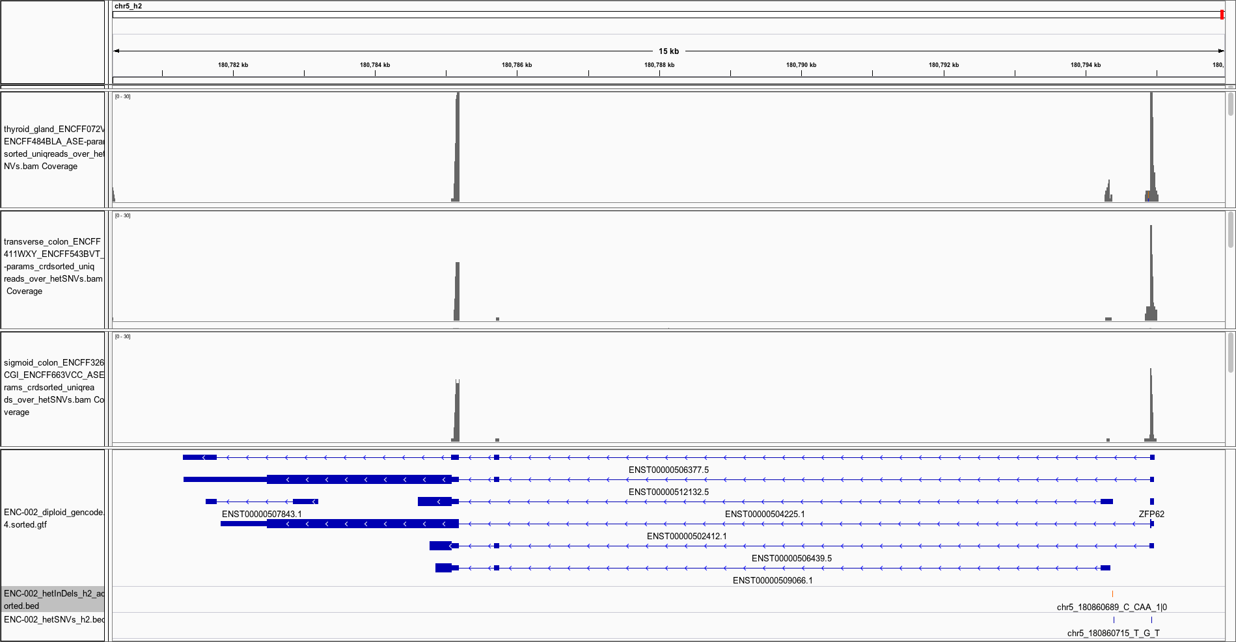
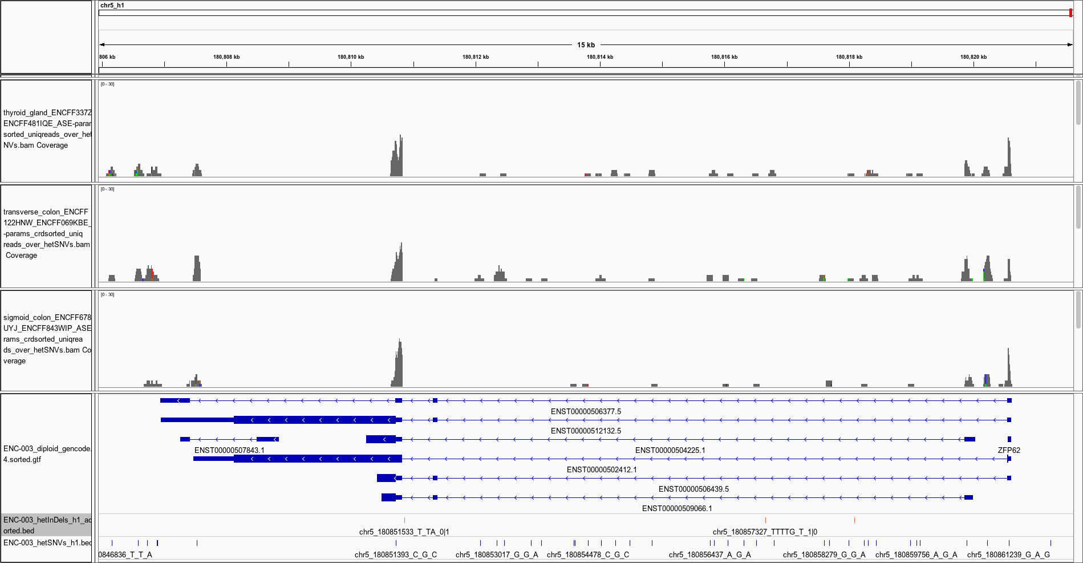
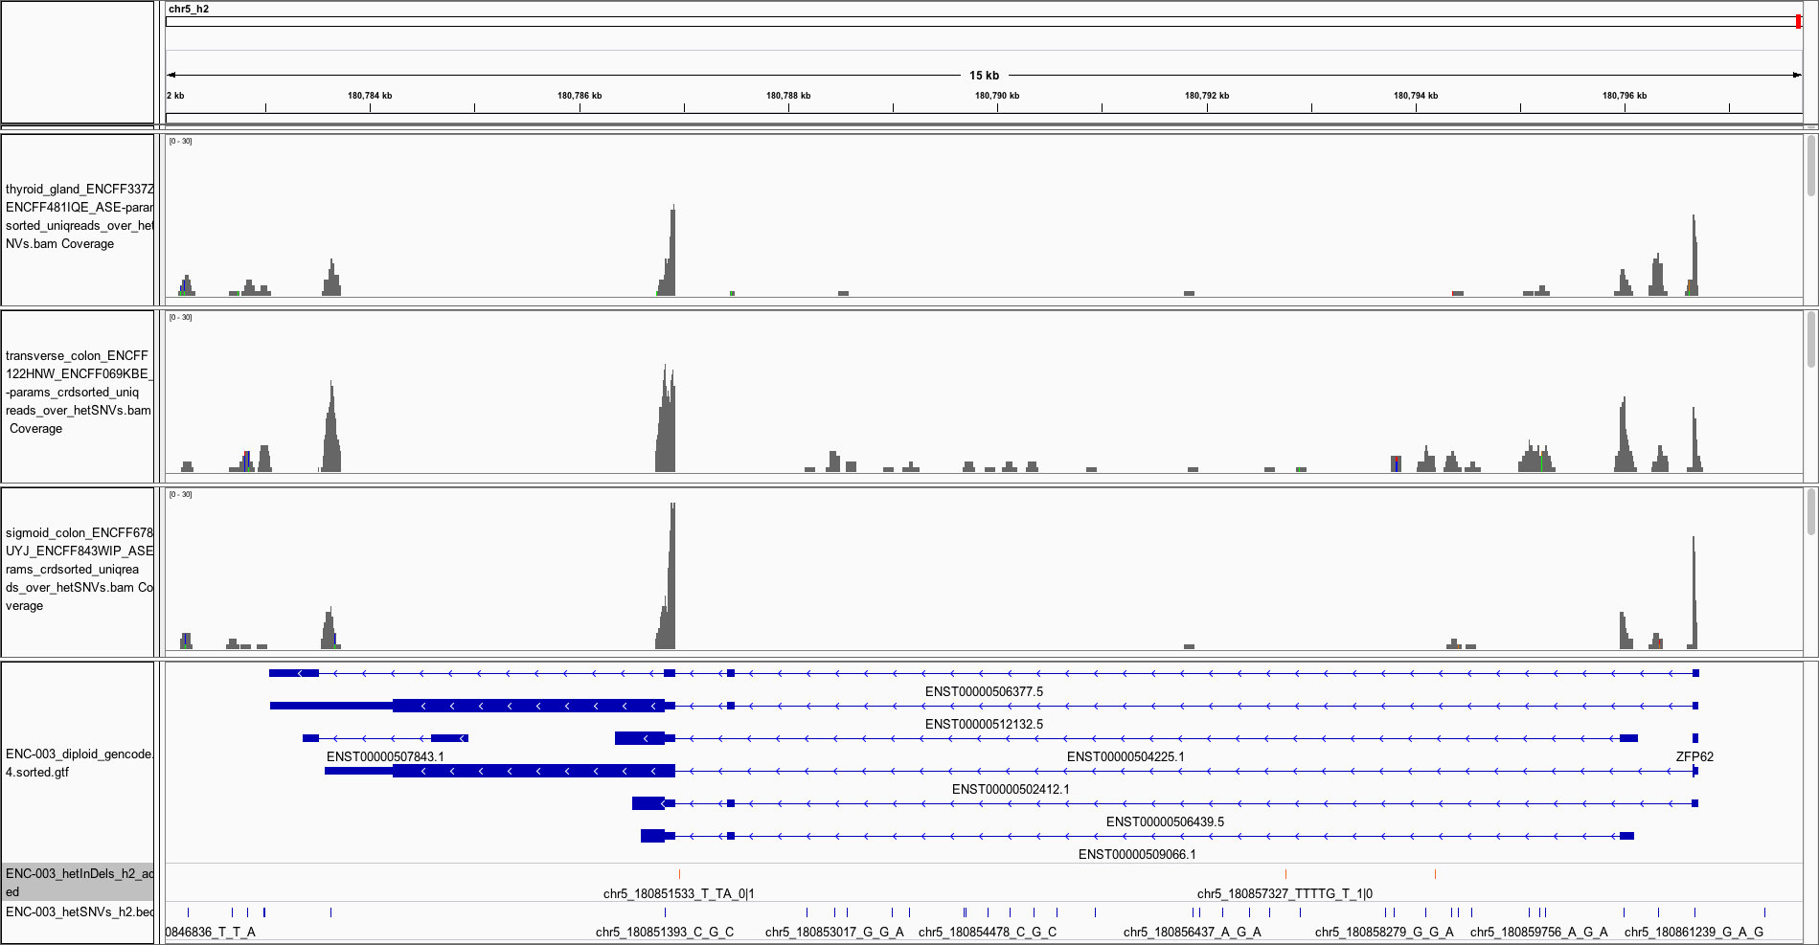
Haplotype 1
ZFP62
Haplotype 2
2bp INS in hap1
ENC-002
ENC-003
Timur Galeev (Gerstein Lab)
23￼

Slide 24
Chromatin segmentation
Chromatin segmentation with ChromHMM {Ernst, Kellis 2012}
ENC003 donor, 10 tissues X 6 chromatin marks (full matrix), 20 states
emission probability %
median overlap enrichment
H3 K4 me3 | H3 K4 me1 | H3 K27 ac | H3 K36 me3 | H3 K27 me3 | H3 K9 me3 | Chromatin State Label | Genome coverage % | CpG islands | Exons | Genes | TTS | TSS | TSS +/- 2kb
98 | 7 | 98 | 0 | 1 | 0 | Active Promoter | 0.64 | 61.9 | 9.2 | 1.7 | 2.7 | 64.6 | 23.7
97 | 91 | 100 | 0 | 1 | 0 | Active Flanking Promoter | 0.27 | 16.6 | 4.1 | 1.6 | 3.9 | 10.9 | 17.0
91 | 37 | 80 | 79 | 1 | 0 | Active Flanking Promoter, Exonic | 0.03 | 10.2 | 12.6 | 2.3 | 12.3 | 6.4 | 10.0
65 | 48 | 1 | 0 | 84 | 1 | Bivalent Promoter | 0.13 | 85.7 | 8.5 | 1.4 | 4.2 | 29.5 | 17.1
87 | 37 | 90 | 0 | 75 | 1 | Bivalent Promoter + H3K27ac | 0.04 | 79.4 | 8.9 | 1.6 | 3.8 | 38.2 | 20.5
77 | 10 | 9 | 0 | 2 | 0 | Inactive Promoter | 0.23 | 31.5 | 5.1 | 1.5 | 1.9 | 26.5 | 15.8
87 | 85 | 9 | 1 | 2 | 0 | Inactive Flanking Promoter | 0.14 | 17.2 | 4.2 | 1.9 | 2.6 | 10.2 | 20.0
3 | 80 | 92 | 1 | 0 | 0 | Active Enhancer | 1.06 | 0.2 | 1.4 | 1.6 | 1.9 | 1.3 | 2.5
5 | 78 | 90 | 62 | 0 | 0 | Active Enhnacer, Exonic | 0.04 | 1.1 | 7.6 | 2.3 | 7.5 | 1.4 | 2.0
0 | 52 | 6 | 0 | 0 | 0 | Inactive Enhancer | 1.42 | 0.4 | 1.1 | 1.8 | 1.3 | 0.8 | 2.8
2 | 49 | 7 | 62 | 0 | 0 | Inactive Enhancer, Exonic | 0.08 | 1.1 | 7.1 | 2.3 | 6.6 | 1.7 | 3.1
0 | 0 | 0 | 77 | 0 | 0 | Strong Transcription | 2.94 | 0.8 | 5.9 | 2.3 | 4.1 | 0.5 | 0.6
1 | 3 | 59 | 77 | 0 | 0 | Strong Transcription + H3K27ac | 0.17 | 1.3 | 7.9 | 2.3 | 6.7 | 0.9 | 1.1
0 | 1 | 0 | 4 | 0 | 0 | Weak Transcription | 11.60 | 0.3 | 2.0 | 1.9 | 2.1 | 0.4 | 0.9
4 | 0 | 0 | 71 | 0 | 79 | ZNF Genes | 0.16 | 0.2 | 6.6 | 2.0 | 4.1 | 0.6 | 0.7
0 | 0 | 0 | 0 | 34 | 0 | Polycomb Repression | 0.75 | 8.3 | 2.5 | 1.0 | 3.0 | 3.3 | 6.5
0 | 0 | 0 | 1 | 0 | 48 | Heterochromatin | 1.55 | 0.3 | 0.6 | 0.8 | 0.8 | 0.3 | 0.4
0 | 0 | 0 | 0 | 0 | 0 | Quiescent | 75.84 | 0.2 | 0.5 | 0.8 | 0.6 | 0.4 | 0.5
1 | 7 | 64 | 1 | 0 | 0 | H3K27ac | 2.13 | 0.4 | 1.3 | 1.4 | 1.8 | 1.4 | 2.3
37 | 30 | 17 | 29 | 51 | 84 | A bit of Everything | 0.02 | 4.6 | 2.7 | 0.6 | 1.6 | 4.2 | 3.7
Alex Dobin (Gingeras Lab)

Slide 25
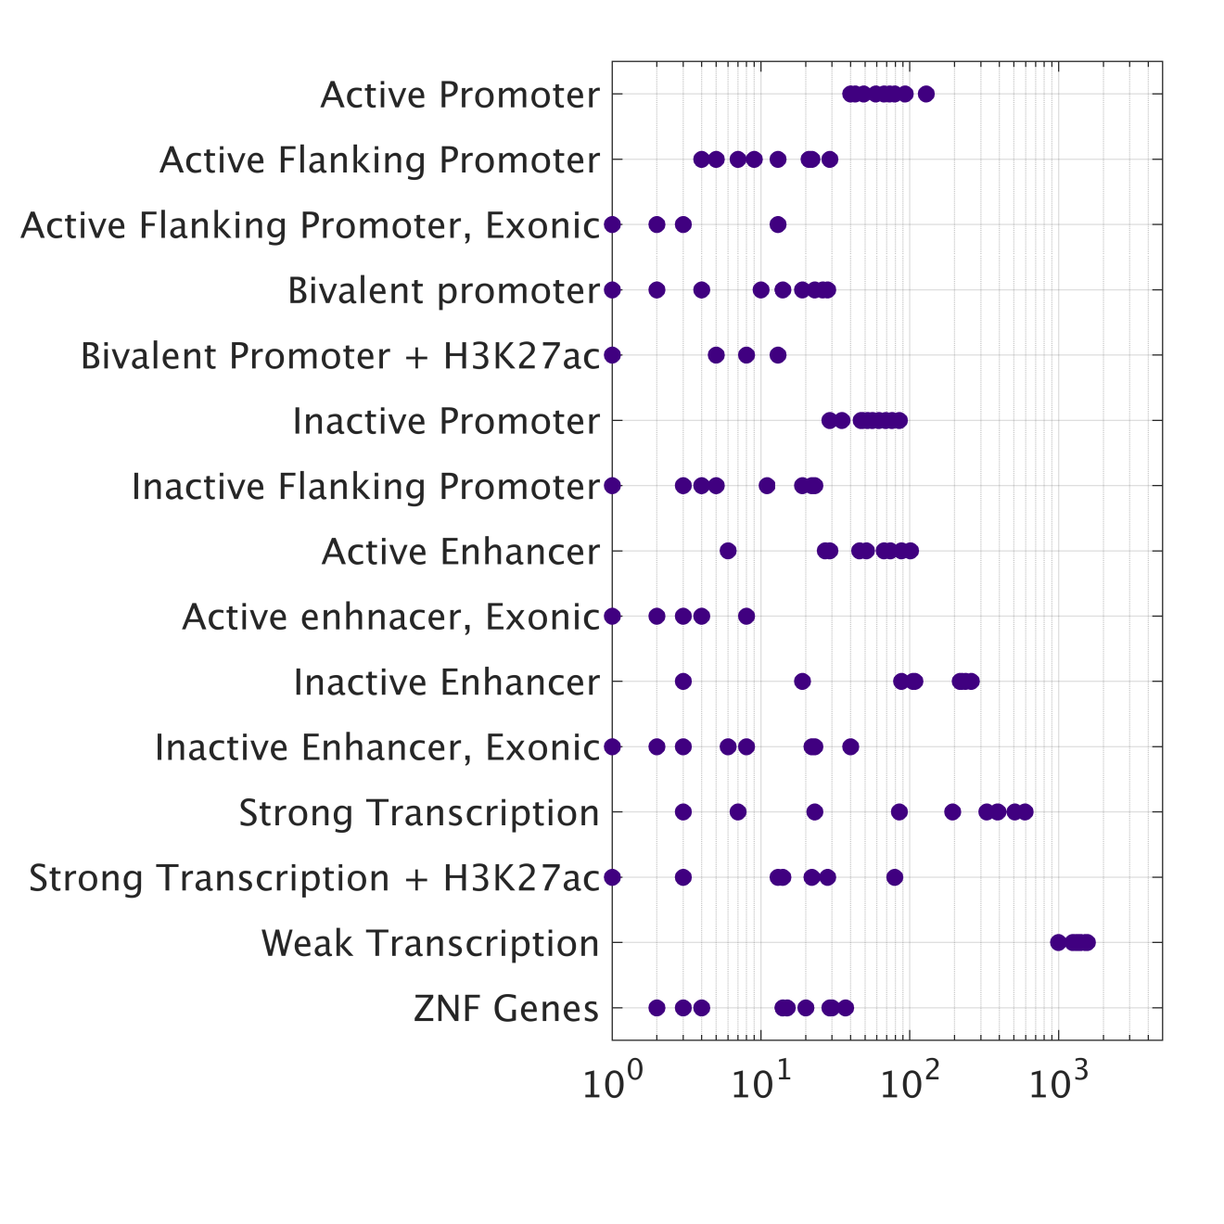
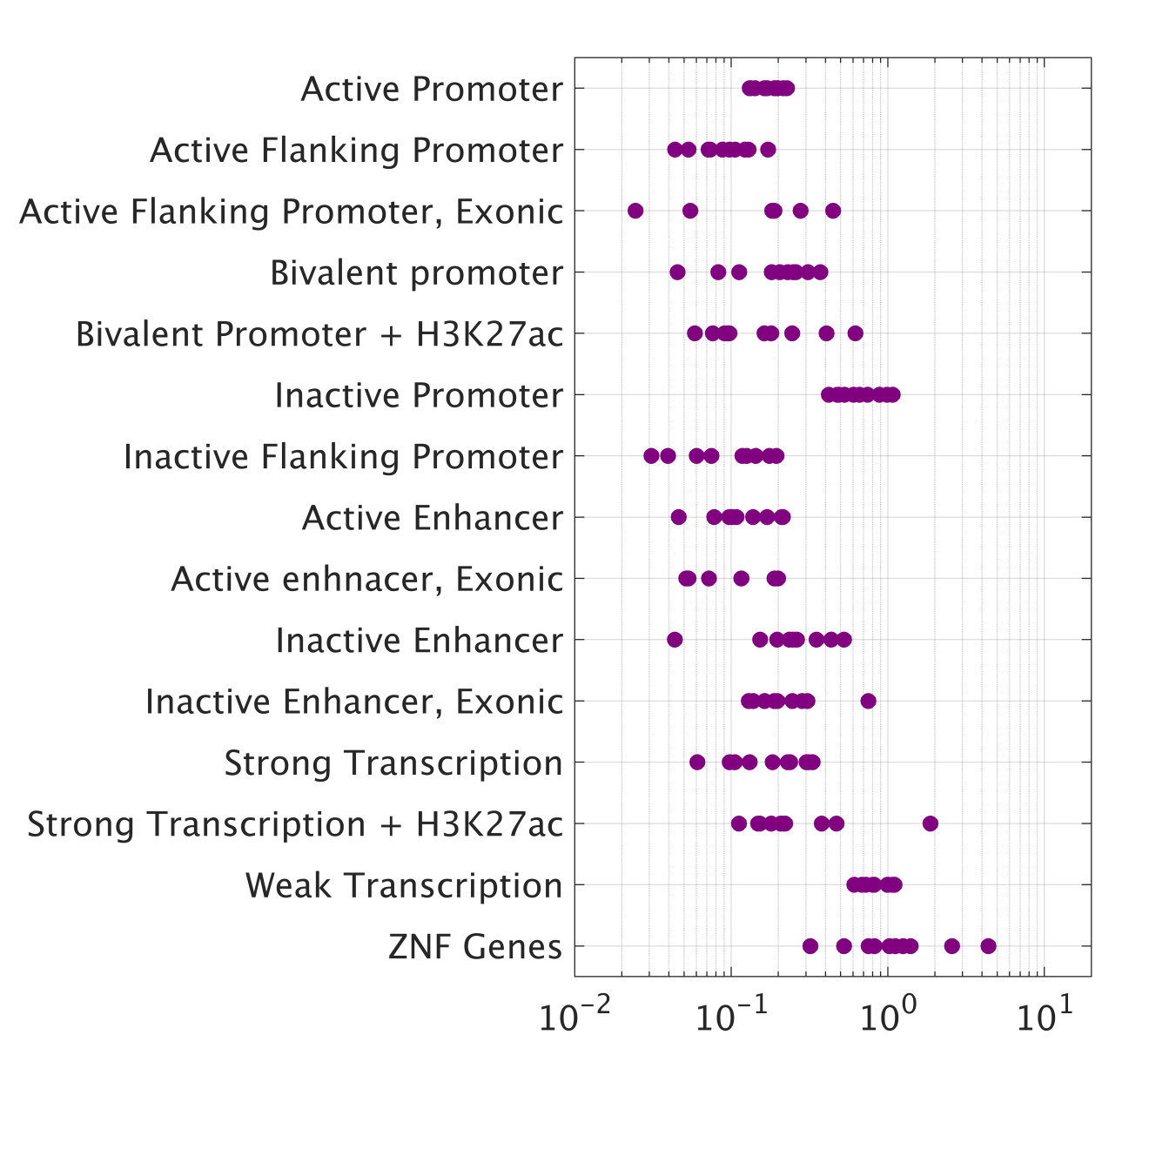
Chromatin segments vs deletions
Chromatin segments overlapped by large (>30b) deletions in 10 tissues:
Number Enrichment
~10-100 segments of each type per tissue are overlapped by large deletions
As expected, most chromatin segments are depleted of deletions
Alex Dobin (Gingeras Lab)

Slide 26
GENCODE EN-TEx Proteomics
James Wright (GENCODE)

Slide 27
GENCODE EN-TEx Proteomics
(preliminary results)
James Wright (GENCODE)

Slide 28
Summary
We have assembled high quality phased diploid genomes including SVs for ENC-002 and ENC-003 (preliminary assemblies for the other two).
Can phase and accurately assemble diploid genomes using Hi-C data
Ongoing analysis of functional genome data comparing personal genome vs reference genome
Analysis of allele-specific behavior in EN-TEx individuals
Analysis of impacts of SVs on expression and binding
Preliminary GENCODE EN-TEx proteomic data

Slide 29
Acknowledgements
Members of the EN-TEx working group
Tom Gingeras
Mark Gerstein
Roderic Guigo
Barbara Wold
Mike Schatz
Bing Ren
Alex Dobin
Timur Galeev
Anna Vlasova
Xiangmeng Kong
Erez Lieberman-Aiden
James Wright
NHGRI

