Slide 1
Brain
2017/12/13

Slide 2
UCLA_ASD PFC | ASD | Control
Sample # | 43 | 50
UCLA_ASD DFC | ATP | Oxford | NICHD | London Brain
Sample # | 44 | 21 | 22 | 6

Slide 3
Merged H3K27ac peaks (1589bp)
cREs
(419bp)

Slide 4
Filter peaks to require they are from at least three sources
97967 peaks
90963 peaks overlap cREs
362428 Brain_cREs are involved

Slide 5
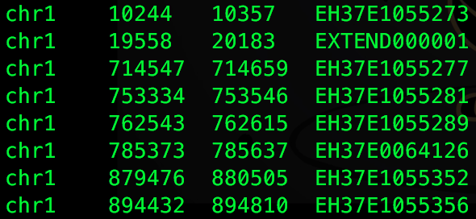
Tissue | Study | Sample size | Enhancer
Prefrontal cortex | UCLA_ASD | 50 | 88.8K
Cerebellum | UCLA_ASD | 50 | 50K
Temporal cortex | UCLA_ASD | XXX | XXX

Slide 6
600 bp
1665 bp
1663 bp
746 bp
261 bp

Slide 7
Tissue | Study | Sample size | Peaks from all files | Merged | Filtered (more than 3 replicates) | Enhancer
Prefrontal cortex | UCLA_ASD | 50 | 3.6M | 209K | 97.6K | 88K
Cerebellum | UCLA_ASD | 50 | 2.2M | 196K | 56K (85K >1) | 50K (69K)
Temporal cortex | UCLA_ASD | 50 | 3.8M | 225K | 101K | 90K
600 bp
1665 bp
1663 bp
746 bp
261 bp

Slide 8
PFC enhancer | Hi-C filter | JEME Elastic Net | JEME Elastic Net interactions | JEME lasso | JEME lasso interactions
88370 | 37857 | 1243 | 3065 | 1231 | 3010
Hi-C
JEME (ElasticNet/Lasso)

Slide 9
PFC enhancer | Enhancers in JEME Elastic Net | JEME Elastic Net interaction | JEME Elastic Net interaction in Hi-C
88370 | 2585 | 5824 | 160
Enhancers in JEME Lasso | JEME Lasso interaction | JEME Lasso in Hi-C
2545 | 5675 | 155
…...
JEME (ElasticNet/Lasso)
Hi-C

Slide 10
T/T
G/G

Slide 11
reference

