Slide 1
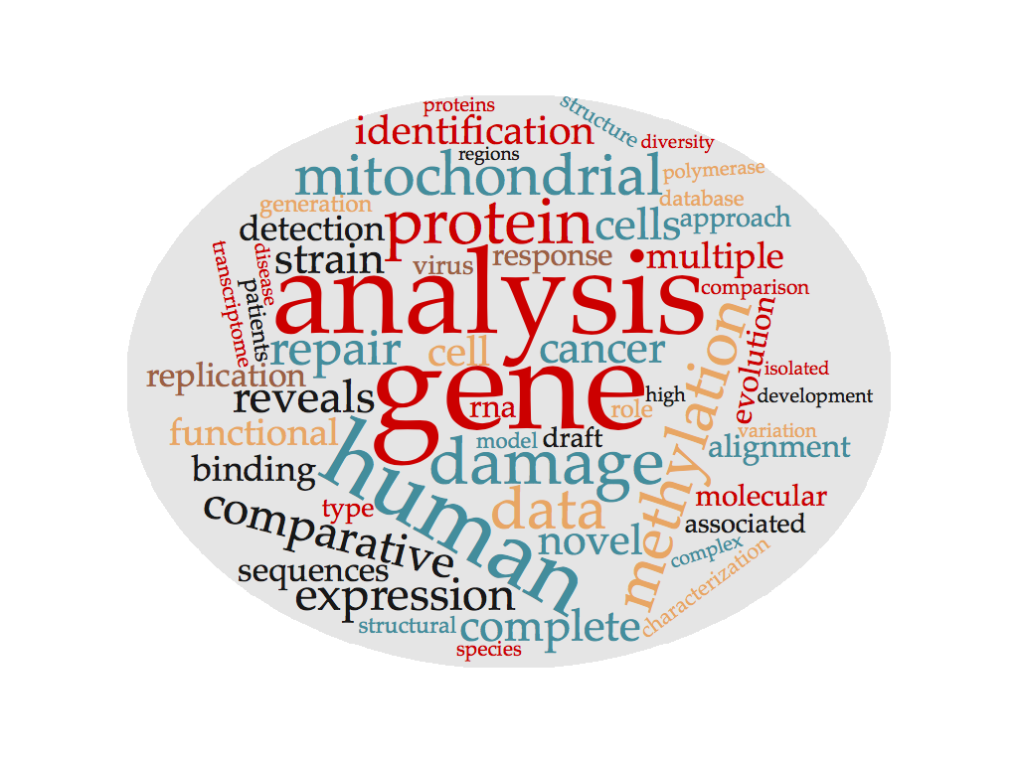
Wordcloud for genomics publications

Slide 2
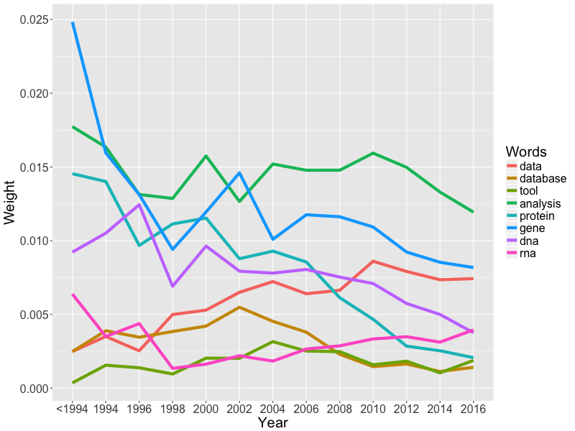
Trend of the key words

Slide 3
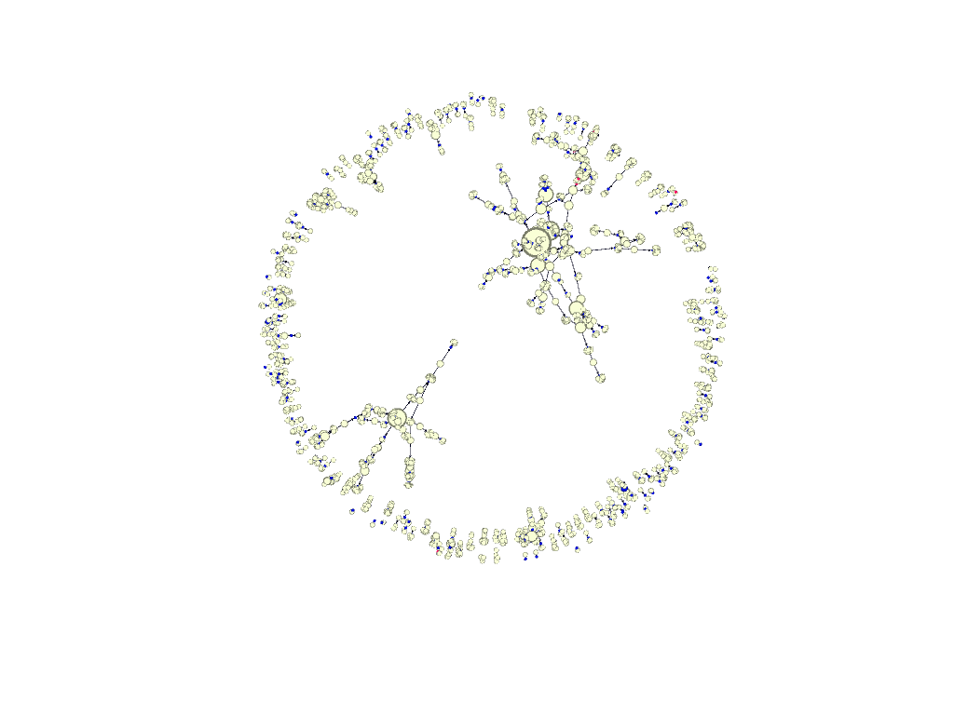
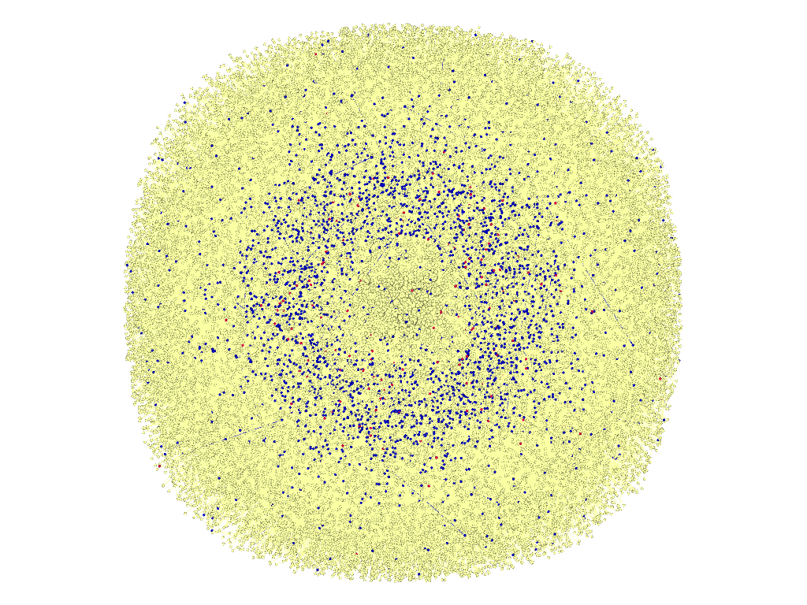
Citation network evolution
By 2000
By 2016
:Regarding data, database and data analysis tools and algorithms
:Genomics
:Non-genomics

