Slide 1
modERN Call
Jinrui Xu
Jan 18th 2018
Gerstein lab

Slide 2
We suspect that many spurious binding sites predicted using DNA input as control

Slide 3
Binding sites ranked by DNA input
Binding sites ranked by hotness
Many spurious binding sites are ranked top by DNA input
  Using the top rank binding sites helps functional analysis a little

Slide 4
Binding sites ranked by mock IP
Binding sites ranked by DNA input
Binding sites ranked by hotness
Mock IP remove many spurious binding sites, especially for top ranked ones

Slide 5
The correlation is not due to local GC-content bias
---- ----
Shuffled genome (50bp window)

Slide 6
Ratio of average mean motifs per binding site (Mock IP vs DNA Input)
Total binding sites
Same # of top binding sites
71%
67%
Mock IP improves binding site quality substantially

Slide 7
Target genes of predicted binding sites
  1kb up and 1kb down of TSS
Target gene expression change upon TF knock down
  mt expression / wt expression
Target genes of binding sites by mock IP reduce expression
Notes:
P = 0.008237

Slide 8
Cor. btw ranks of predicted binding sites and their target gene expression changes (mt/wt)
  If a gene have multiple binding sites, it uses the best rank of the binding sites
High quality binding site prediction renders “good” correlation:
  Activating TFs => more negative correlation
  Repressing TFs => more positive correlation
  TFs do both => more negative correlation, more positive correlation => large absolute correlation

Slide 9
Absolute cor.
  Mock IP generates better correlations than DNA input
Notes:
Correlation could be high control confounding factors
P = 0.0199

Slide 10
Number of predicted binding sites
500 binding sites
SPP-signal (std pipeline) is very sensitive to noise, thus predict less than 100 binding sites for 23% TFs using mock IP
Add SPP a function to calculate p-value, SPP-pvalue predicts 0% TFs (<100 binding sites)

Slide 11
Use both DNA input and mock IP to predict binding sites
  a peak is due to both specific and non-specific antibody-antigen binding
  Mock IP can control for the non-specific, but has high technical noise
New peak calling strategy
  Use DNA input to identify candidate peaks
    Remove extremely noisy genomic regions
    These candidates are due to both specific and non-spcific ab-antigen bindings
  Use both DNA input and mock IP to score the peaks for IDR to predict binding sites
    scoring function: a bona fide binding site enriches more reads than DNA input and mock IP
Notes:
Peaks due to non-specific ab-ag binding are controlled

Slide 12
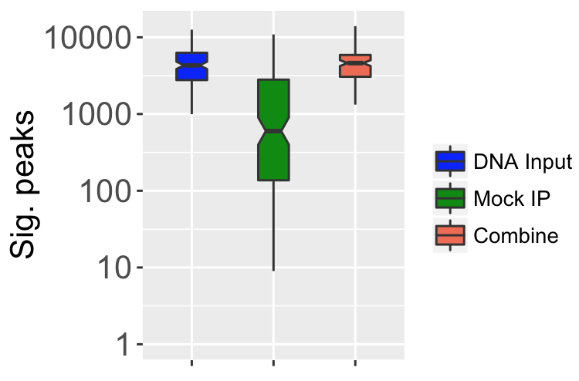
Number of binding sites predicted by IDR
Fly TFs

Slide 13
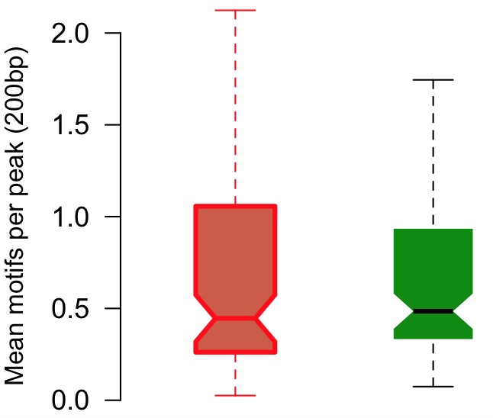
Similar motif enrichment as using mock IP (for same number of top binding sites)
P = 0.27
Combo
Mock IP

Slide 14
Pros of mock IP
  Generate high quality binding sites
    Absolute improvement is small but relative is large
  Lead to more reasonable biological conclusions
    TF knock down reduce expression rather than increase, in general
  Together with DNA input, a new peak calling method
    High quality and more binding sites
  Binding site ranking is more reasonable
    More stringent IDR, higher quality binding sites

Slide 15
Developmental robustness to regulation perturbation
Data
  ChIP-seq & RNA-seq data => gene networks
  TF knock down as perturbation
  Developmental robustness is mutant type transcriptome deviation away from wild-type

Slide 16
If various TF KDs impact development differently, and why?
  TF expression profiles (spatial-tempo)
    Is influential TF highly expressed in many cells/tissues, during the whole developmental process or in a key developmental stage?
  TF paralogs
    Does influential TF have less paralogs?
    Epistasis of TF paralogs?
  TF’s network properties (regulation and PPI)

Slide 17
Thanks to Ben and Jaeda

Slide 18
Technique
  Using large and comparable datasets to identify and alleviate defects in techniques
Biological analysis
  DNA input may give puzzling conclusions
  Mock IP and hot region?
    TF knock down increases target gene expression in general?
    Spurious binding sites are a confounder?

Slide 19
One TF but close to two genes, influence both genes?

